Slide 1
VLANs
Via Cheru Haile (MSc)

Slide 2
VLAN Definitions (cont.)
VLANs allow an administrator to segment networks based on factors such as function, project team, or application, without regard for the physical location of the user or device.
VLANs enable the implementation of access and security policies according to specific groupings of users.
A VLAN is a logical partition of a Layer 2 network.
Multiple partitions can be created, allowing for multiple VLANs to co-exist.
Each VLAN is a broadcast domain, usually with its own IP network.
VLANs are mutually isolated, and packets can only pass between them via a router.
The partitioning of the Layer 2 network takes place inside a Layer 2 device, usually via a switch.
The hosts grouped within a VLAN are unaware of the VLAN’s existence.

Slide 3
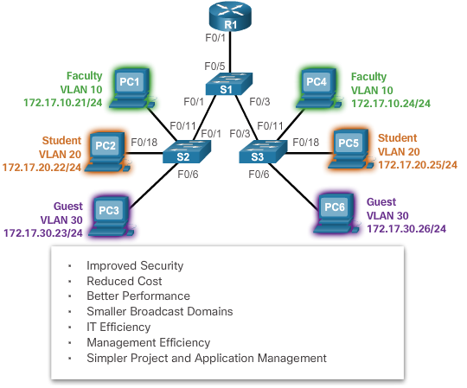
Benefits of VLANs

Slide 4
Types of VLANs
Data VLAN – user generated traffic
Default VLAN – all switch ports become part of this VLAN until switch is configured, show vlan brief
Native VLAN – used for untagged traffic
Management VLAN – used to access management capabilities

Slide 5
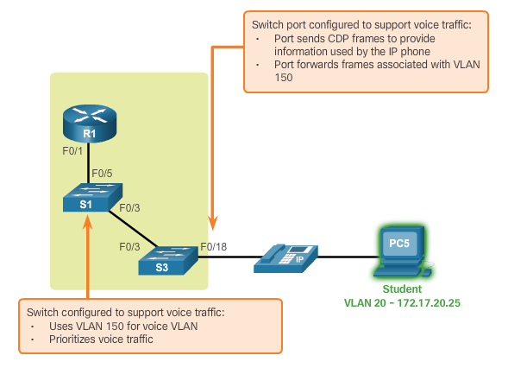
Voice VLANs

Slide 6
Cont’d…
VoIP traffic is time-sensitive and requires:
Assured bandwidth to ensure voice quality.
Transmission priority over other types of network traffic.
Ability to be routed around congested areas on the network.
Delay of less than 150 ms across the network.
The voice VLAN feature enables access ports to carry IP voice traffic from an IP phone.

Slide 7
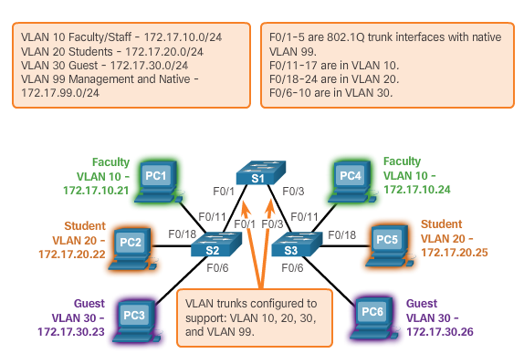
VLAN Trunks

Slide 8
Cont’d…
A VLAN trunk is a point-to-point link that carries more than one VLAN.
A VLAN trunk is usually established between switches so same-VLAN devices can communicate, even if physically connected to different switches.
A VLAN trunk is not associated to any VLANs; neither is the trunk ports used to establish the trunk link.
Cisco IOS supports IEEE802.1q, a popular VLAN trunk protocol.

Slide 9
Controlling Broadcast Domains with VLANs
VLANs can be used to limit the reach of broadcast frames.
A VLAN is a broadcast domain of its own.
A broadcast frame sent by a device in a specific VLAN is forwarded within that VLAN only.
VLANs help control the reach of broadcast frames and their impact in the network.
Unicast and multicast frames are forwarded within the originating VLAN.

Slide 10
Tagging Ethernet Frames for VLAN Identification
Frame tagging is the process of adding a VLAN identification header to the frame.
It is used to properly transmit multiple VLAN frames through a trunk link.
Switches tag frames to identify the VLAN to which they belong.
Different tagging protocols exist; IEEE 802.1Q is a vey popular example.
The protocol defines the structure of the tagging header added to the frame.
Switches add VLAN tags to the frames before placing them into trunk links and remove the tags before forwarding frames through non-trunk ports.
When properly tagged, the frames can transverse any number of switches via trunk links and still be forwarded within the correct VLAN at the destination.

Slide 11
Native VLANs and 802.1Q Tagging
Control traffic sent on the native VLAN should not be tagged.
Frames received untagged, remain untagged and are placed in the native VLAN when forwarded.
If there are no ports associated to the native VLAN and no other trunk links, an untagged frame is dropped.
When configuring a switch port on a Cisco switch, configure devices so that they do not send tagged frames on the native VLAN.
In Cisco switches, the native VLAN is VLAN 1, by default.

Slide 12
VLAN Ranges on Catalyst Switches
Cisco Catalyst 2960 and 3560 Series switches support over 4,000 VLANs.
VLANs are split into two categories:
Normal range VLANs
VLAN numbers from 1 to 1,005
Configurations stored in the vlan.dat (in the flash memory)
IDs 1002 through 1005 are reserved for Token Ring and Fiber Distributed Data Interface (FDDI) VLANs, automatically created and cannot be removed
Extended Range VLANs
VLAN numbers from 1,006 to 4,096
Configurations stored in the running configuration (NVRAM)
VLAN Trunking Protocol (VTP) does not learn extended VLANs

Slide 13
Inter-VLAN Routing Using Routers
What is Inter-VLAN Routing?
Layer 2 switches cannot forward traffic between VLANs without the assistance of a router.
Inter-VLAN routing is a process for forwarding network traffic from one VLAN to another, using a router.

Slide 14
Legacy Inter-VLAN Routing
Actual routers were used to route between VLANs.
Each VLAN was connected to a different physical router interface.
Packets would arrive on the router through one interface, be routed and leave through another.
Because the router interfaces were connected to VLANs and had IP addresses from that specific VLAN, routing between VLANs was achieved.
Large networks with large number of VLANs required many router interfaces.

Slide 15
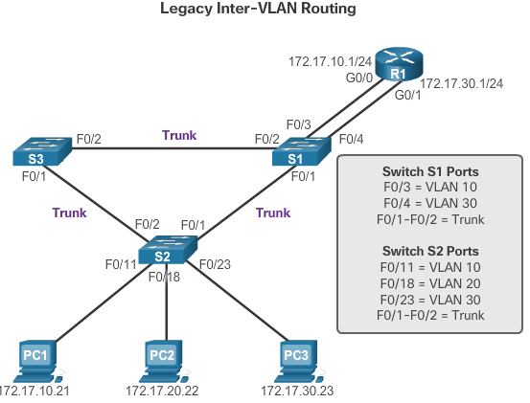

Slide 16
Router-on-a-Stick Inter-VLAN Routing
The router-on-a-stick approach uses only one of the router’s physical interface.
One of the router’s physical interfaces is configured as a 802.1Q trunk port so it can understand VLAN tags.
Logical subinterfaces are created; one subinterface per VLAN.
Each subinterface is configured with an IP address from the VLAN it represents.
VLAN members (hosts) are configured to use the subinterface address as a default gateway.

Slide 17
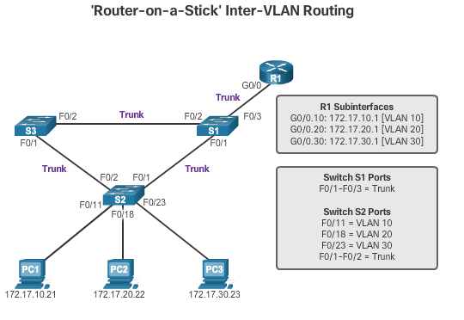

Slide 18
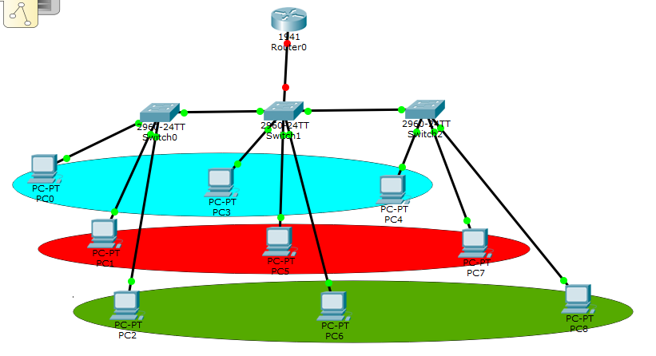
Implementation of VLAN
Valn 10 student
Valn 20 student
Valn 30 student

Slide 19
Create vlan
Switch>enable
Switch#config t
Switch(config)#vlan 10
Switch(config-vlan)#name
Switch(config-vlan)#name student
Switch(config-vlan)#exit
Switch(config)#vlan 20
Switch(config-vlan)#name staff
Switch(config-vlan)#exit
Switch(config)#vlan 30
Switch(config-vlan)#name registrar
Switch(config-vlan)#exit

Slide 20
Trunking
Switch(config)#int f0/1
Switch(config-if)#switchport mode trunk
Switch(config-if)#switchport trunk allowed vlan 10,20,30

Slide 21
Access
Switch(config)#int f0/2
Switch(config-if)#switchport mode access
Switch(config-if)#switchport access vlan 10
Switch(config-if)#exit
Switch(config)#int f0/3
Switch(config-if)#switchport mode access
Switch(config-if)#switchport access vlan 20
Switch(config-if)#exit
Switch(config)#int f0/4
Switch(config-if)#switchport mode access
Switch(config-if)#switchport access vlan 30
Switch(config-if)#do wr

Slide 22
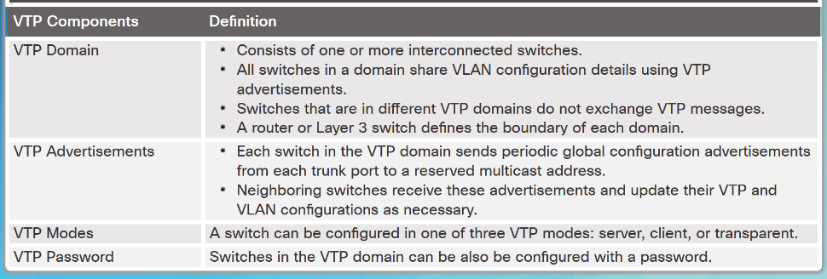
VTP Overview
VLAN trunking protocol (VTP) allows a network administrator to manage VLANs on a switch configured as a VTP server.
The VTP server distributes and synchronizes VLAN information over trunk links to VTP-enabled switches throughout the switched network.

Slide 23
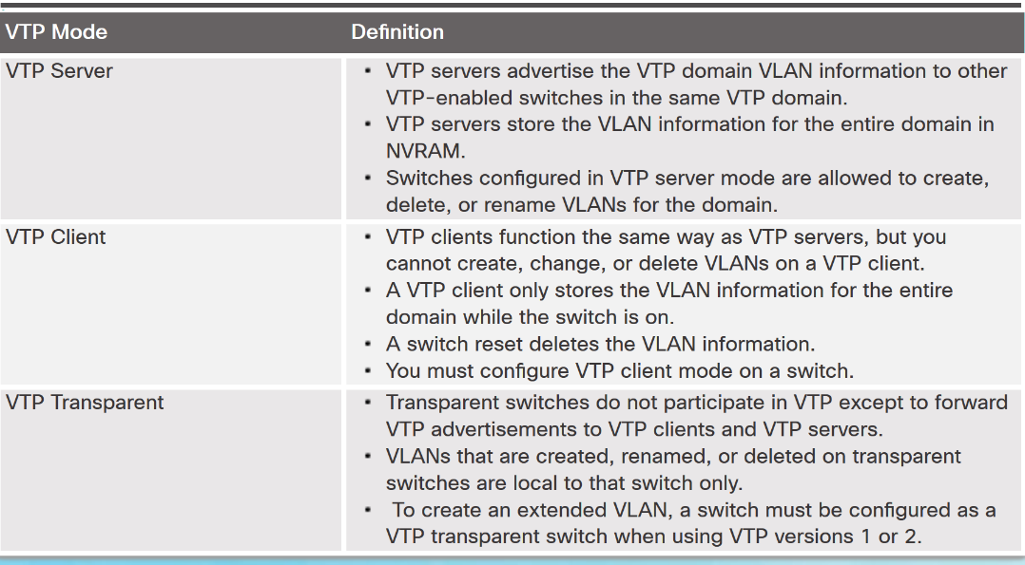
VTP Modes

Slide 24
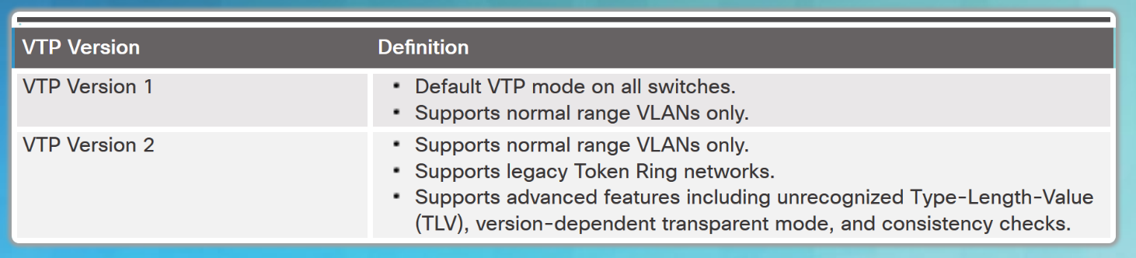
VTP Versions
Switches in the same VTP domain must use the same VTP version.

Slide 25
VTP Configuration Overview
Steps to Configure VTP:
Step 1 - Configure the VTP Server
Step 2 - Configure the VTP Domain Name and Password
Step 3 - Configure the VTP Clients
Step 4 - Configure VLANs on the VTP Server.
Step 5 - Verify the VTP clients have received the new VLAN information.

Slide 26
Switch>enable
Switch#config t
Switch(config)#hostname server
server(config)#vtp mode serve
server(config)#vtp mode server
server(config)#vtp domain cheru.com
server(config)#vtp pass
server(config)#vtp password ?
server(config)#vtp password cheru
server(config)#vlan 10
server(config-vlan)#name student
server(config-vlan)#exit
server(config)#vlan 20
server(config-vlan)#name
server(config-vlan)#name staff
server(config-vlan)#exi
server(config)#interface f0/1
server(config-if)#switchport mode trunk
server(config-if)#switchport trunk allowed vlan 10,20

Slide 27
Verifying VLAN Information
Commands to verify VLANs:
show vlan
show interfaces
show vlan name vlan-name
show vlan brief
show vlan summary
show interfaces vlan vlan-id

Slide 28
Question

Slide 29
How to Configure DHCP?
DHCPv4:
assigns IPv4 addresses and other network configuration information dynamically
useful and timesaving tool for network administrators
dynamically assigns, or leases, an IPv4 address from a pool of addresses
Administrators configure DHCPv4 servers so that leases expire. Then the client must ask for another address, although the client is typically reassigned the same address.

Slide 30
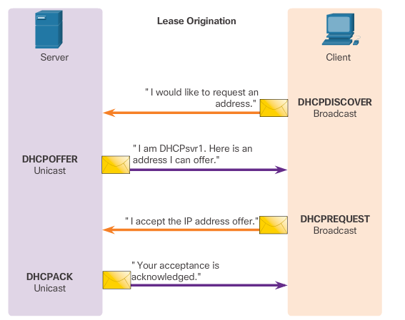
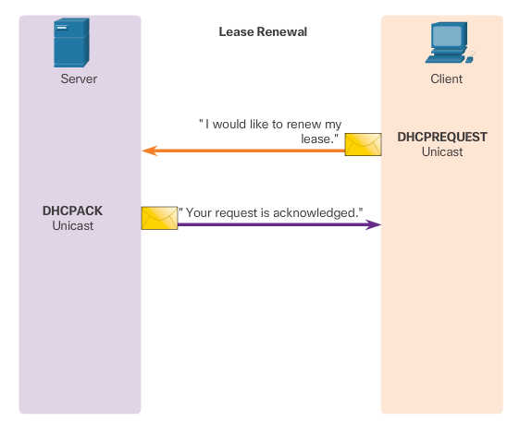
DHCPv4 operation

Slide 31
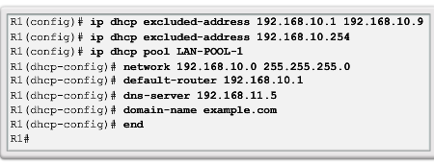
Configure a Basic DHCPv4 Server
Exclude addresses from the pool.
Set up the DHCP pool name.
Define the range of addresses and subnet mask. Use the default-router command for the default gateway. Optional parameters that can be included in the pool – dns server, domain-name.
To disable DHCP, use the no service dhcp command.

Slide 32
Verifying DHCPv4
Commands to verify DHCP:
show running-config | section dhcp
show ip dhcp binding
show ip dhcp server statistics
On the PC, issue the ipconfig /all command.

Slide 33
Any Question

