Slide 1
SUPPLY CHAIN FRAUD
DETECTION SYSTEM
Team 2
Ahaz Bhatti
Deep Arvind Bambharoliya
Gianni Deguzman
Shrey Bishnoi
Sruthi Gatta

Slide 2
Project Background
Background and Summary
A Supply Chain is a sequence of processes involved in the production and distribution of a commodity.
Global Enterprises have a plethora of customers, suppliers spanning across Nations connected to their supply chain
Fraudsters seep into company’s Complex supply chain network to perform fraudulent activities in various ways
Enterprises are now leveraging capabilities of Big Data technologies to identify and mitigate fraudulent activities
Project Goal
Create a supervised machine learning model to learn from fraudulent transaction patterns and flag Fraud or Non Fraud transactions
Reduce the probability of misclassification by increasing predictive performance of the model

Slide 3
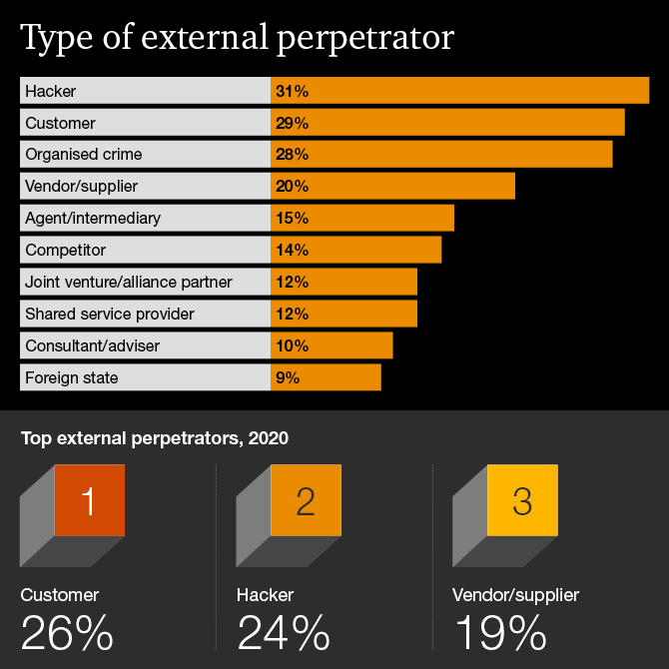
Project Motivation
Global Fraud valued at $20.98B
Compound Annual Growth Rate
15.4 % from 2021 to 2028
Digital Frauds, Financial Crimes, Cyber Attacks challenging the growth of several businesses worldwide
With improved data procurement technologies, enterprises are investing in Data Mining and Machine Learning Technologies to mitigate financial and other frauds
https://www.pwc.com/gx/en/services/forensics/economic-crime-survey.html

Slide 4
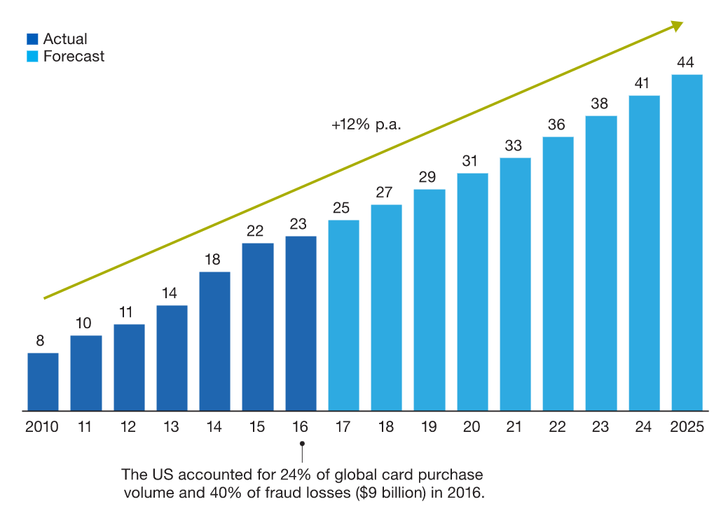
Project Motivation
44.7 % Frauds
Discovered By Accident
39.2 % Frauds
Discovered By Internal Audit, Management Review
ML can be used to monitor real-time data and discover transaction irregularities in the order and shipping process.
https://www.mckinsey.com/industries/financial-services/our-insights/fraud-management-recovering-value-through-next-generation-solutions

Slide 5

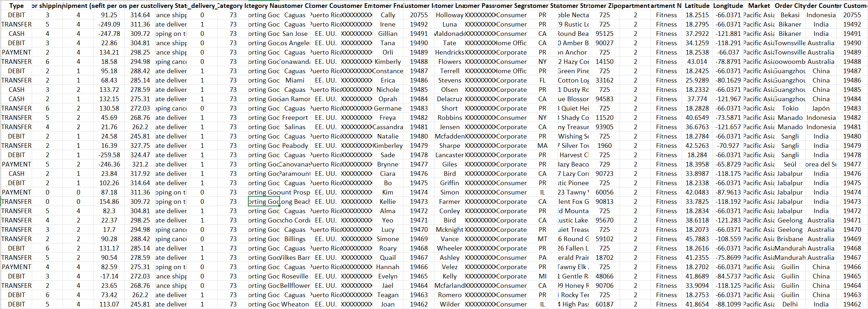
Data Collection
53 columns, 180k data points
Notes:
This dataset contains data of supply chains for DataCo Global company. This dataset spans to 91MB which includes 180520 customer records in 53 columns which has different types of products namely clothing, sports, and electronic supplies. It includes the data of the path of provisioning, production, sales, and commercial distribution methods for these products.
which includes a collection of their products sold, financial details(profit, loss, total sales etc.), Shipping details, and customer details such as sales, demographics, and transaction details.

Slide 6
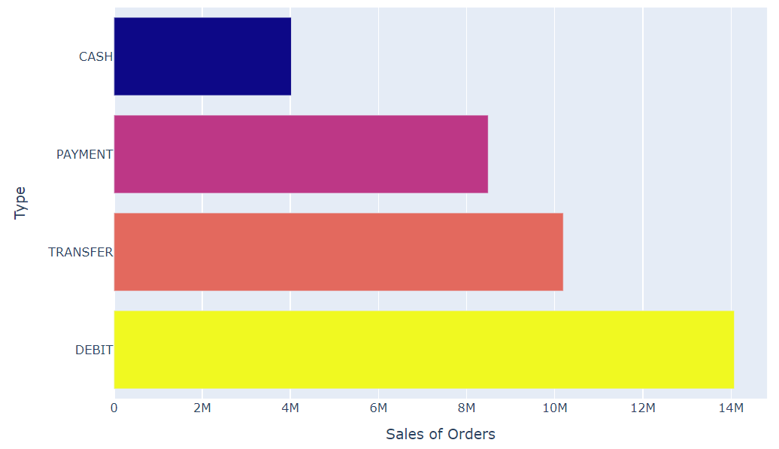
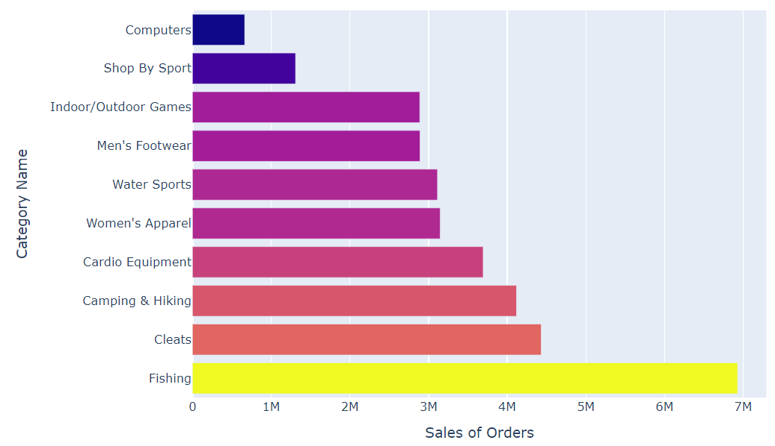
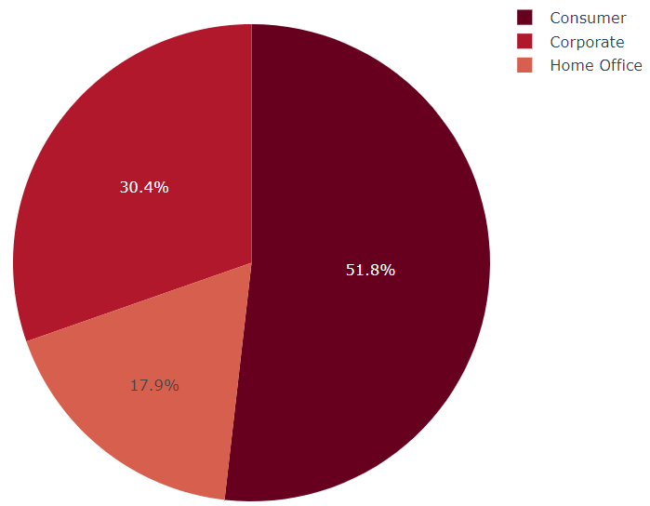
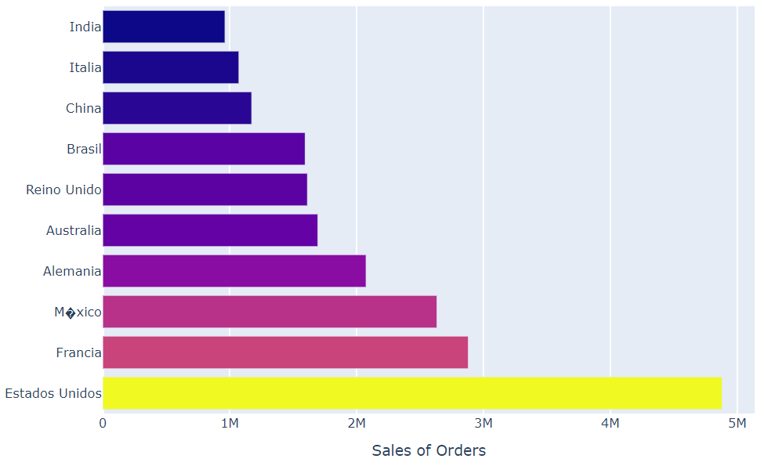
Exploratory Data Analysis

Slide 7
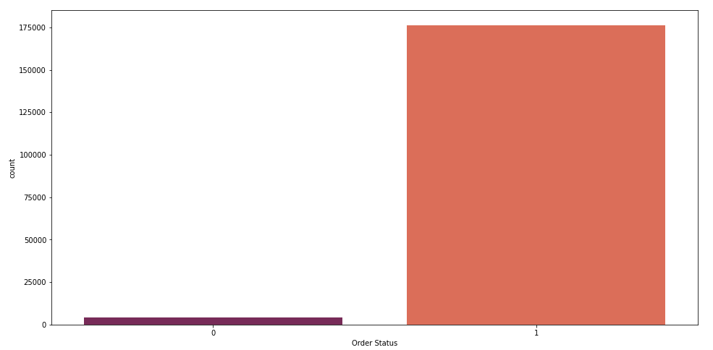
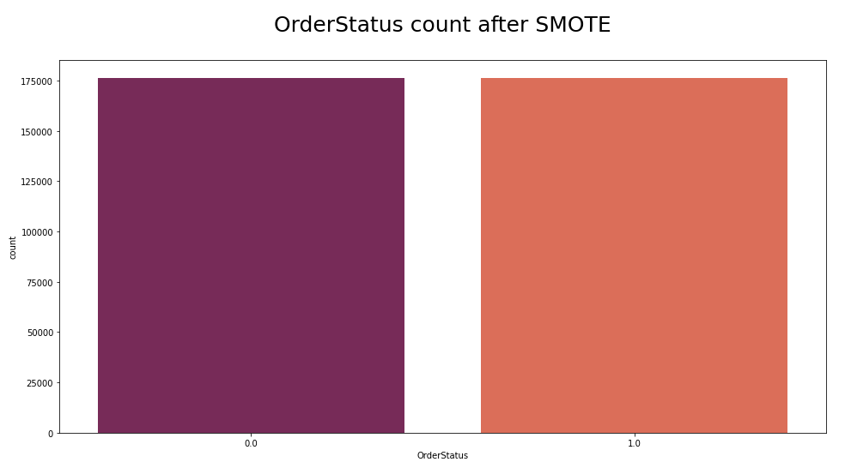
Exploratory Data Analysis
Order Status Data Imbalance
Order Status after Data Balance (SMOTE)

Slide 8
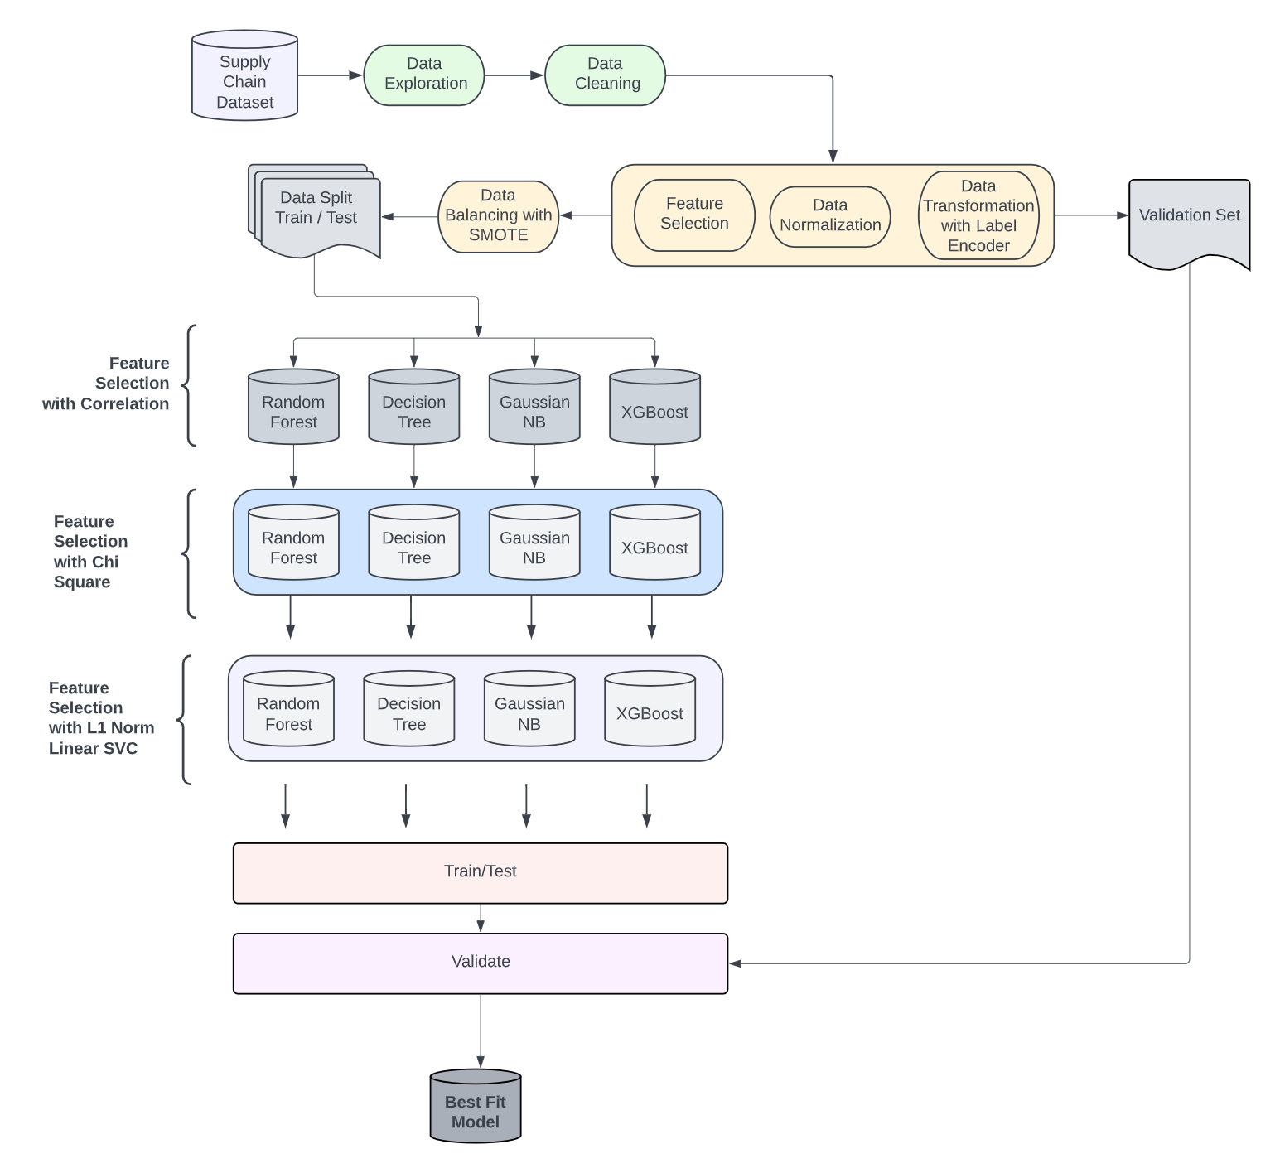
Project Dataflow

Slide 9
Feature Selection Methods
Feature selection is primarily focused on removing non-informative or redundant predictors from the model
No Feature Selection
Baseline
Correlation HeatMap
Chose features with |corr| > .015
Kbest Features
Chi – Square
Identifies Independency / Dependency between Variables and the Target
L1- Based
LinearSVC
Linear models penalized with the L1 norm have sparse solutions: many of their estimated coefficients are zero and are removed

Slide 10
Machine Learning Models
Pros
Assumes conditional independence in features
Low computation use
Eliminates Insignificant specifications
Cons
High training time for
large amount of data
Pros
Does not require normalization of data
Missing values in the data does not affect performance
Feature Selection is automatic
Cons
Prone to overfitting
Has weak accuracy because of high variance
Gaussian NB
Decision Tree
XGBoost
Pros
Works well with both categorical and numerical data
High dimensional data
Imbalance, noisy, and sparse data
Cons
Requires high computation
Takes longer to train
Pros
Efficient for data with missing values
Possible to fit existing model with new data
Cons
Requires high computation
Takes longer to train
Random
Forest
Notes:
A RF classifier is an ensemble model that consists of a group of decision trees that are trained in parallel using random subset of features. The prediction is obtained by calculating the majority voting from predictions of the all the trees in the forest

Slide 11
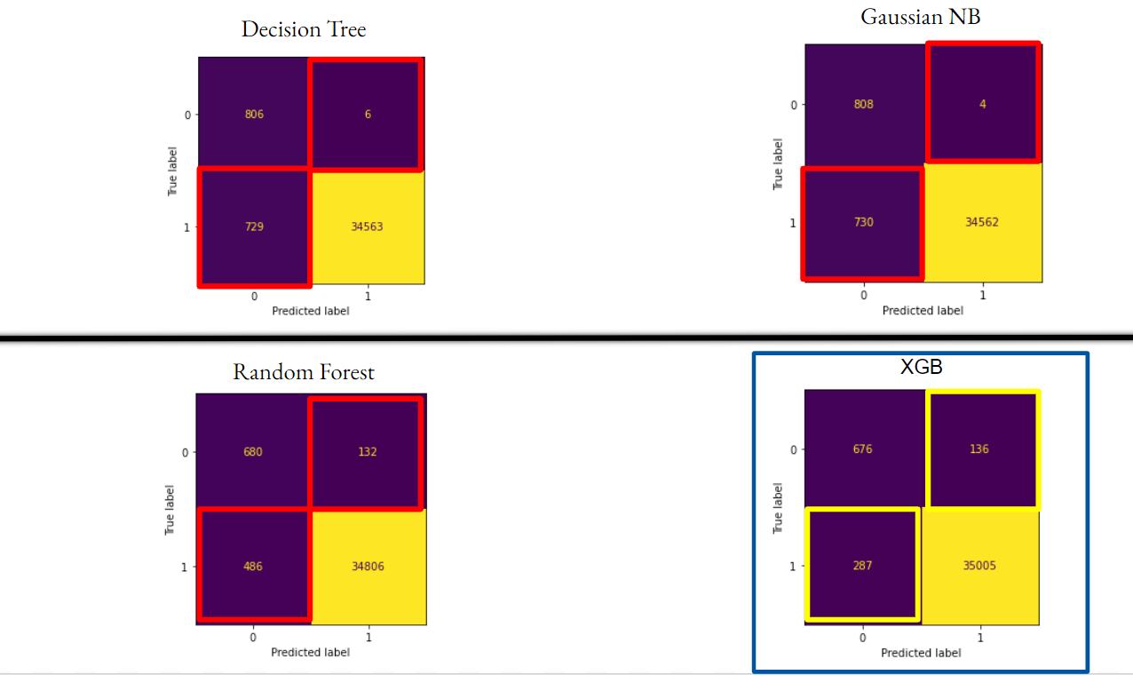
Confusion Matrices - No Feature Selection

Slide 12
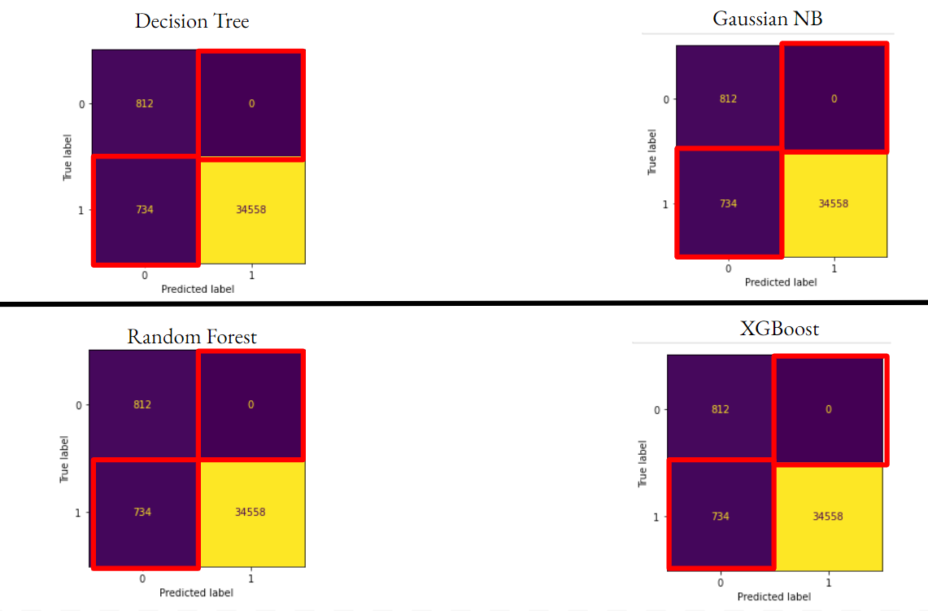
Confusion Matrices - Correlation

Slide 13
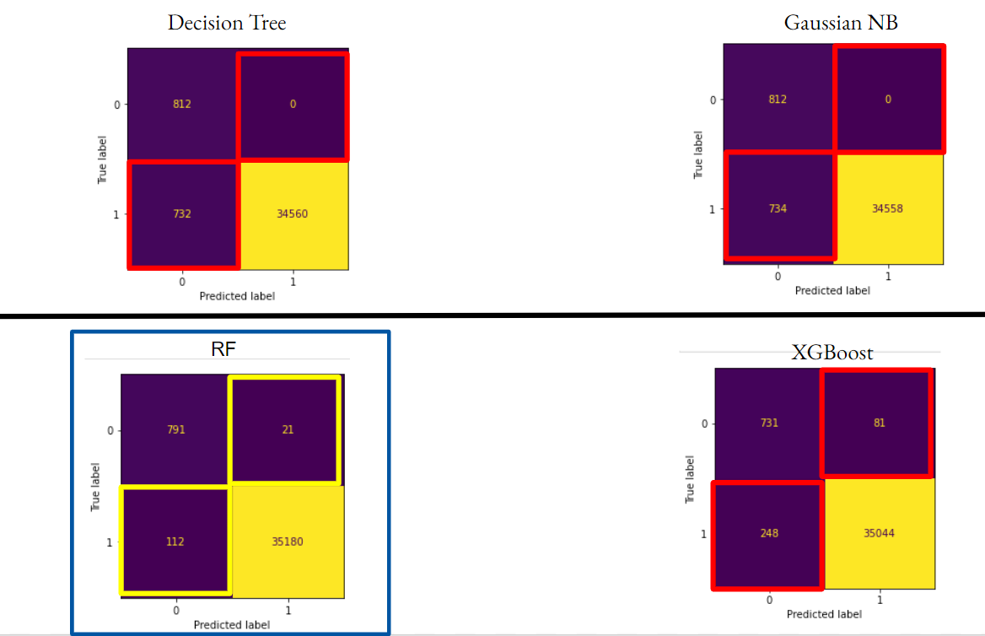
Confusion Matrices - KBest Features

Slide 14
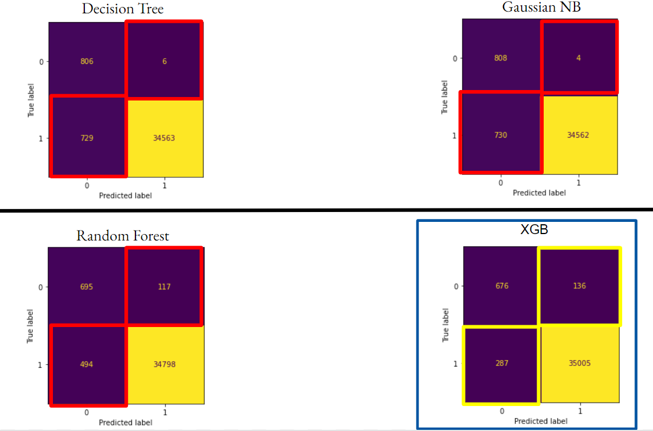
Confusion Matrices - L1 Based

Slide 15
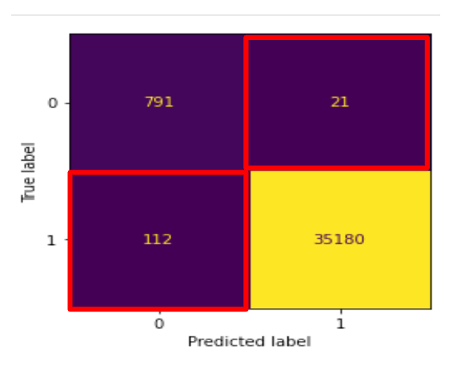
Best Confusion Matrix
RANDOM FOREST with KBest Features Method
False Positive == Angry Honest Customer
False Negative == Missed Fraudulent Transaction
Other models had lower False Negatives but much higher False Positives

Slide 16
Strong Performers - Selected Features
Model | Feature Selection Method | N Features | Features
Random Forest | KBest | 10 | Type, Delivery Status, Late_delivery_risk, Customer Country, Customer Id, Customer Segment, Customer Zipcode, Order Customer Id, order date (DateOrders), Order Region
XGBoost | L1 | 15 | Type, Days for shipping (real), Benefit per order, Delivery Status, Late_delivery_risk, Customer Segment, Customer Zipcode, Order City, Order Country, order date (DateOrders), Order Item Id, Order Profit Per Order, Order State, shipping date (DateOrders), Shipping Mode

Slide 17
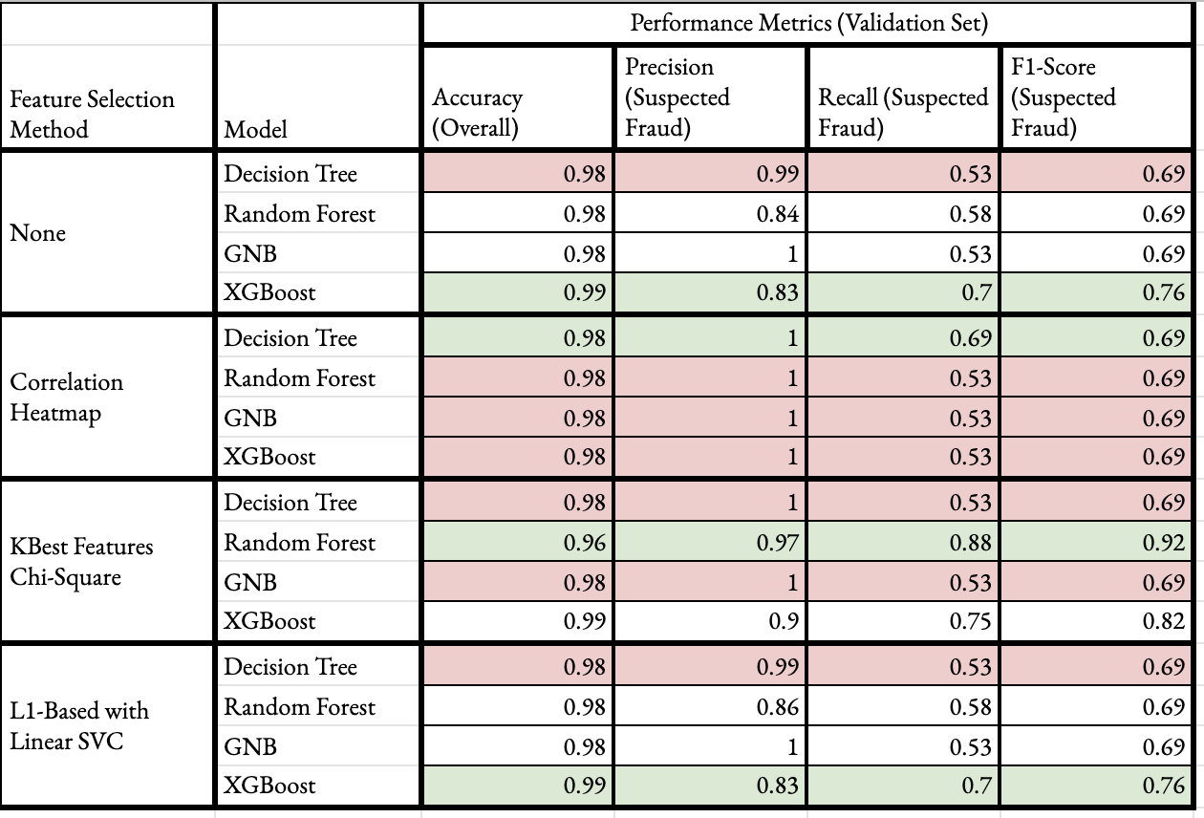

Result Comparison

Slide 18
Observations
Regional effects
Orders from Western Europe and Central America accounted for over 30% of suspected fraudulent orders
Concentration of fraudulent customers in area code 725
Repeat offenders
Roughly 4000 instances of suspected fraud, ~1300 unique customer id’s
All potentially fraudulent transactions use Transfer payment type
Limitations
Dataset only included suspected fraud, so model includes non-fraudulent transactions
Types of fraud
Identity theft vs actual fraudster
Conclusion
Future Scope
Expand customer region
Point of Sale detection/Verification

Slide 19
Ahaz Bhatti
Technology & Solution Survey
Data Management Plan
Project Organization Plan
Data Process
Data Analytics
Model Proposal
Model Support
Final Report-APA formatting
Deep Bambharoliya
Data Management Plan
Project Requirement Plan
Data Collection
Data Preparation & Statistics
Model Proposal
Model Evaluation
Final Report- APA formatting
Team Organisation
Syama Ravi Teja
Project Deliverables
Literature Survey
Project Development Methodology
Project Schedule: Gantt & Pert Chart
Data Transformation
Model Proposal
Final Report- APA formatting
Shrey Bishnoi
Project Background & Executive Summary
Project Requirements
Project Development Methodology
Data Preprocessing
Model Proposal
Model Comparison
Final Report -APA formatting

Slide 20
References
Constante-Nicolalde, FV., Guerra-Terán, P., Pérez-Medina, JL. (2020). Fraud Prediction in Smart Supply Chains Using Machine Learning Techniques. In: Botto-Tobar, M., Zambrano Vizuete, M., Torres-Carrión, P., Montes León, S., Pizarro Vásquez, G., Durakovic, B. (eds) Applied Technologies. ICAT 2019. Communications in Computer and Information Science, vol 1194. Springer, Cham. https://doi.org/10.1007/978-3-030-42520-3_12
F. Wan, "XGBoost Based Supply Chain Fraud Detection Model," 2021 IEEE 2nd International Conference on Big Data, Artificial Intelligence and Internet of Things Engineering (ICBAIE), 2021, pp. 355-358, doi: 10.1109/ICBAIE52039.2021.9390041.
Mark Lokanan, Vikas Maddhesia. (2022). Supply Chain Fraud Prediction with Machine Learning and Artificial intelligence.
P. Porouhan and W. Premchaiswadi, "Big Data Analytics of Supply Chains with Process Mining," 2021 19th International Conference on ICT and Knowledge Engineering (ICT&KE), 2021.
Ensemble Technique on Predictive Analysis and Fraud Orders Detection using Supervised Machine Learning Algorithms in Supply Chain Management https://www.tojqi.net/index.php/journal/article/view/6308/4494

Slide 21
Thank You
Q and A

