Slide 1
Huge Pages and
Swap Avoidance
Ahbaid Gaffoor
DBA / A9.com

Slide 2
Overview
Section 1: Paging
Section 2: Huge Pages
Section 3: Configuration
Section 4: Verification
Section 5: MySQL Configuration
Section 6: Performance Graphs
Huge Pages, A9.com Feb 19th 2010

Slide 3
Section 1
Paging
Huge Pages, A9.com Feb 19th 2010

Slide 4
Paging
Segment Sizes
Page Table Entries (PTEs)
Kernel / System CPU
Page size of 4Kb on RHEL4/5 64-bit
Swap
Kernel Image Pages – 4Mb
Huge Pages, A9.com Feb 19th 2010

Slide 5
Section 2
Huge Pages
Huge Pages, A9.com Feb 19th 2010

Slide 6
Huge Pages
Contiguous Memory
2Mb Page Size RHEL4/5 64-bit
Less PTEs
Guaranteed no swap
Huge Pages, A9.com Feb 19th 2010

Slide 7
Section 3
Configuration
Huge Pages, A9.com Feb 19th 2010

Slide 8
Configuration 1/2
Shared Mem segment sizes:
  ipcs –m
cat /proc/meminfo | grep -i ^Hugepages
  HugePages_Total (H)
  Hugepagesize (2048 Kb) (P)
H = Segment Size / Hugepagesize
/etc/sysctl.conf
  vm.nr_hugepages = <H>
  vm.hugetlb_shm_group = <group id>
Huge Pages, A9.com Feb 19th 2010

Slide 9
Configuration 2/2
/etc/security/limits.conf
  <domain> <type> <item> <value>
    domain : username
    type : soft & hard
    item : memlock
    value : number or “unlimited”
      oracle soft memlock unlimited
      oracle hard memlock unlimited
Contiguous
Allocate largest segments first
Huge Pages, A9.com Feb 19th 2010

Slide 10
Section 4
Verification
Huge Pages, A9.com Feb 19th 2010

Slide 11
Verification
cat /proc/meminfo | grep -i ^Hugepages
  RHEL 4
    HugePages_Total
    HugePages_Free
  RHEL 5
    HugePages_Total
    HugePages_Free
    HugePages_Rsvd
    Actual free = HugePages_Free – HugePages_Rsvd
Indicators
  Swap & System CPU
Huge Pages, A9.com Feb 19th 2010

Slide 12
Section 5
Application Configuration
Huge Pages, A9.com Feb 19th 2010

Slide 13
Application System Calls
Kernel Build Requirements
  CONFIG_HUGETLB_PAGE
  CONFIG_HUGETLBFS
Shared Memory Segment Allocation (C)
  int shmget(key_t key, size_t size, int shmflg);
  shmflg : SHM_HUGETLB
Huge Pages, A9.com Feb 19th 2010

Slide 14
Oracle Configuration
Kernel
  /etc/sysctl.conf
  /etc/security/limits.conf
Oracle
  No Automatic Memory Management
HugePages automatically detected and used on RHEL4 and RHEL5
Huge Pages, A9.com Feb 19th 2010

Slide 15
MySQL Configuration
Kernel
  /etc/sysctl.conf
  /etc/security/limits.conf
MySQL
  Command line “mysqld –large-pages”
  Config file:
    [mysqld]
    large-pages
HugePages are invoked via. specific calls from MySQL
Huge Pages, A9.com Feb 19th 2010

Slide 16
Section 6
Performance Graphs
Huge Pages, A9.com Feb 19th 2010

Slide 17
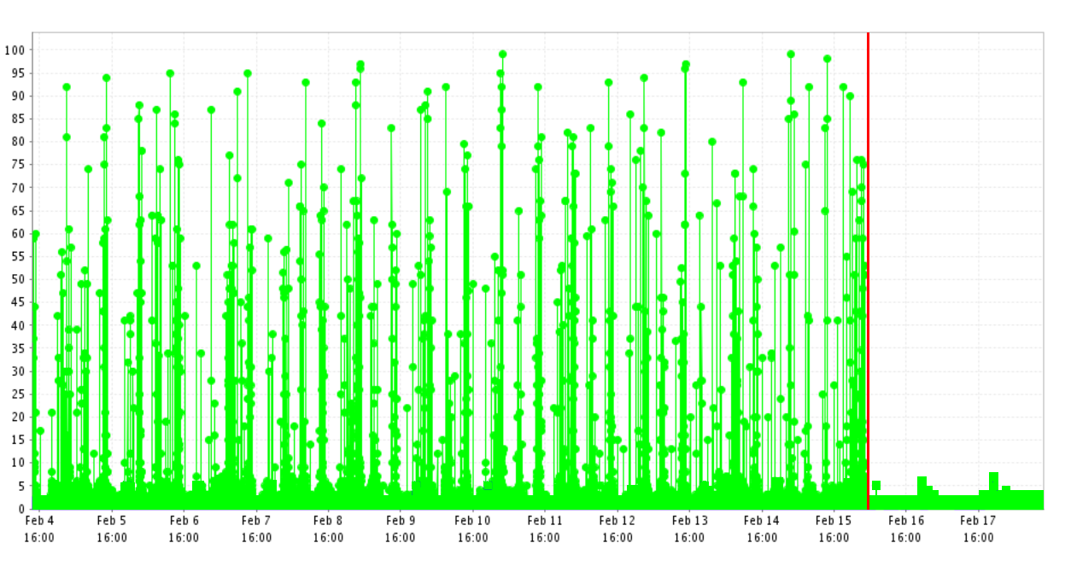
System CPU
Huge Pages, A9.com Feb 19th 2010

Slide 18
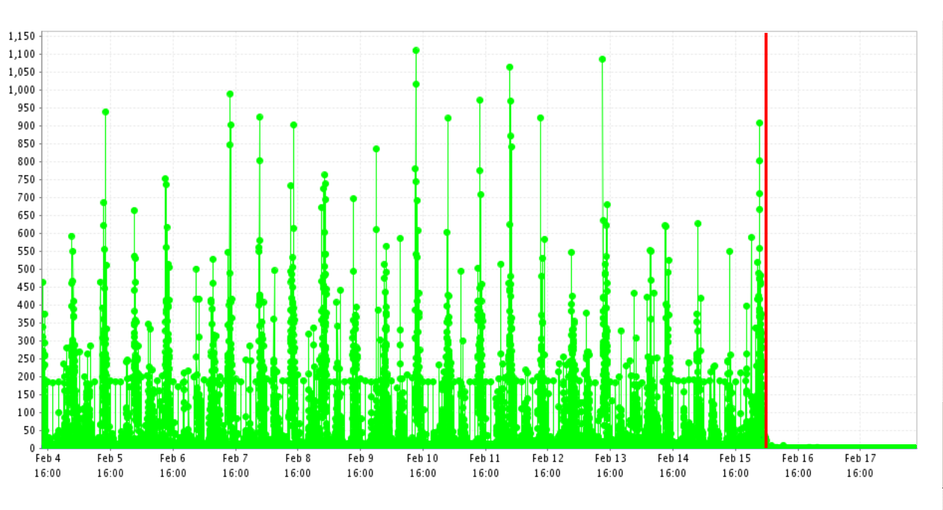
Swap (Pages In)
Huge Pages, A9.com Feb 19th 2010

Slide 19
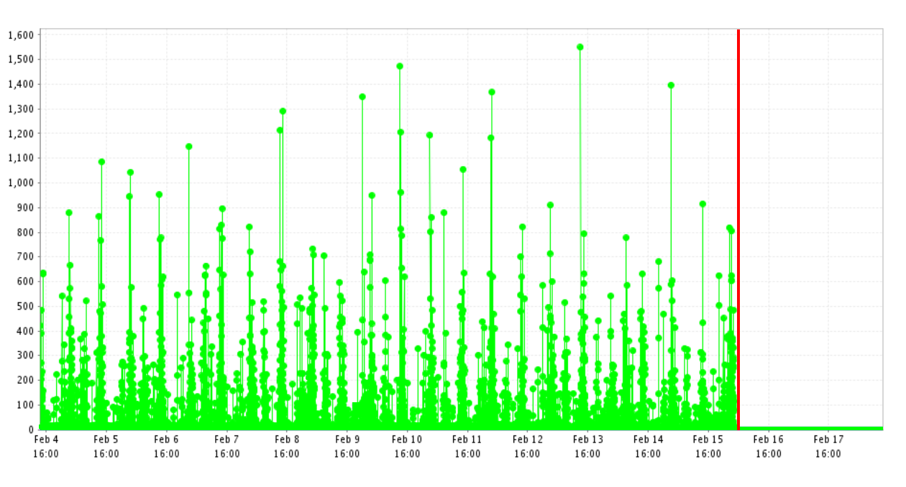
Swap (Pages Out)
Huge Pages, A9.com Feb 19th 2010

Slide 20
Thank You ahbaid@{amazon.com|a9.com}

Slide 21
References
Understanding the Linux Virtual Memory Manager (Mel Gorman)
Understanding the Linux Kernel (Daniel P. Bovet & Marco Cesati)
http://dev.mysql.com/doc/refman/5.0/en/large-page-support.html
http://www.mjmwired.net/kernel/Documentation/vm/hugetlbpage.txt
http://linux.die.net/man/2/shmget
Huge Pages, A9.com Feb 19th 2010

