Slide 1
Semi-Dynamic Session Types for ABS

Slide 2
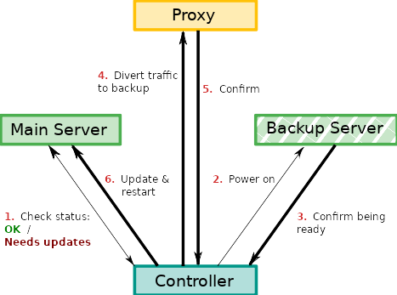
Motivation - Protocols
Interactions within a distributed system may require a certain order
Example: Swapping out a web server for maintenance must adhere to this protocol

Slide 3
Motivation - Protocols
Manually ensuring compliance with protocol is…
susceptible to human error
Labor-intensive
Impossible for large systems
Formal specification
+ automatic verification / enforcement can help

Slide 4
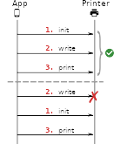
Motivation – Enforcing Scheduling
Messages sent in the right order must also processed in that order
Issue if messages can arrive disordered or endpoints may process them in any order
Static verification can not prevent this
⇒ processing order must be enforced / corrected at runtime

Slide 5
Solution: Combine static & dynamic approaches
We need a specification language
→ Session Types
We to verify implementations against a protocol
→ Static verification of call orders etc.
We need to enforce message processing orders at runtime
→ Schedulers

Slide 6
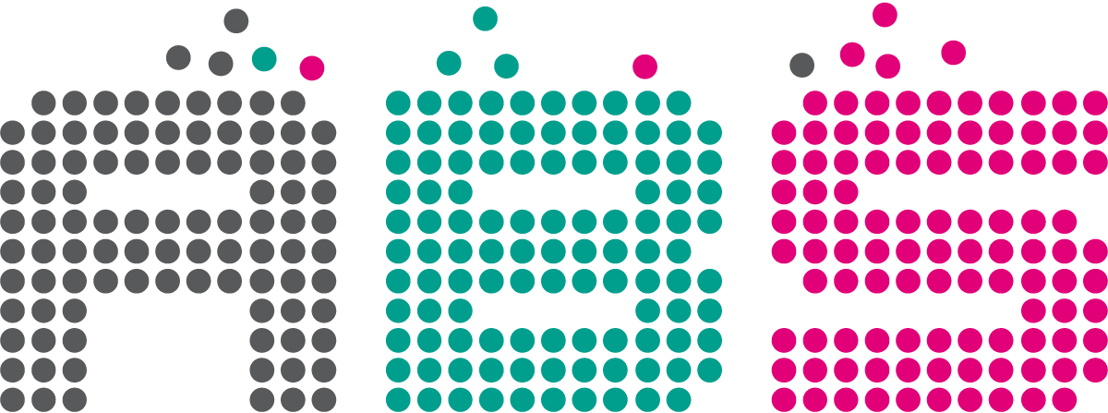
Implementation Environment: ABS Language
ABS is intended for modeling „distributed, object-oriented“ software
designed to facilitate its verification

Slide 7
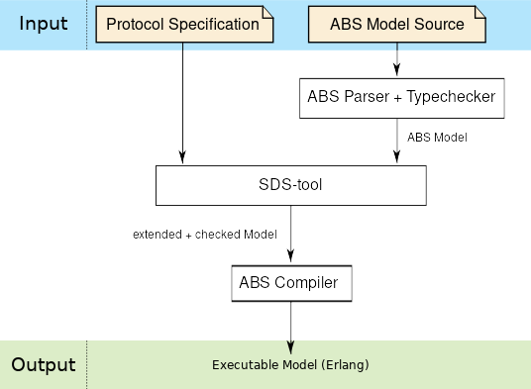
Workflow Overview

Slide 8
Structure
Specification Language
Static Verification
Dynamic Enforcement
Evaluation

Slide 9
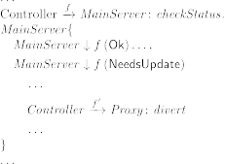

Specification Language: Session Types
Session Type Capabilities
express interaction (calls, retrieving values)
Branchings & loops
ABS cooperative scheduling (suspension, reactivation)

Slide 10
Specification Sanity Checks
Specification language allows expressing impossible protocols
Releasing control on non-active participants
Fetching results from unresolved futures
…
⇒ Some basic sanity checks are necessary

Slide 11

Specification Sanity Checks –
Analysis by Execution
„A calls m on B and fetches result (before B computes it!)“
abstract state
(captures used
futures etc.)
type components used
as instructions of a program
analysis by transition
relation

Slide 12
Structure
Specification Language
Static Verification
Dynamic Enforcement
Evaluation

Slide 13

Static Verification – Compositional Approach

Slide 14
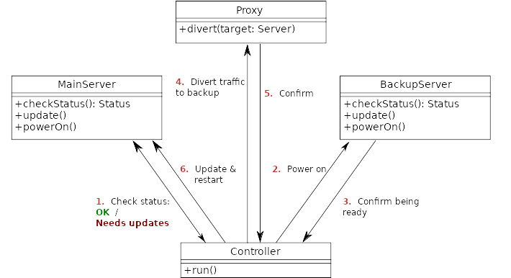
Static Verification – Compositional Approach
every method is verified individually against the session type
a specification of a method‘s behavior is extracted from a global protocol
Verification of method AST against local type
⇒ Projection
⇒ Type System

Slide 15
Projection - Implementation
Function
Extracts parts of behavior relevant to the participant
Using a set of rules and information from abstract state of validity analysis

Slide 16

Projection: Extraction of a localized specification
Global Session Type

Slide 17
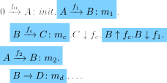

Projection: Extraction of a localized specification
Global Session Type
Projection on
object B
Object Local Type for B

Slide 18

Projection: Extraction of a localized specification
Global Session Type
Projection on
object B
Object Local Type for B
Projection on
method B::m1
for future f1
Method Local Type for B::m1

Slide 19
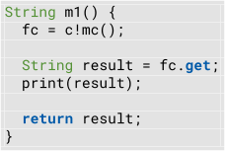



Verification using a Type System
. . .
Now, method bodies can be verified against local type using a type system
Specified actions must each be implemented by a corresponding statement
Control structures must match type branchings / loops
Correct usage of variables, futures etc. is checked
Data type checking is left to the ABS compiler
...

Slide 20
Verification using a Type System
. . .
Design Goals
Soundness
Support current implementation of ABS
Usability: Leave developers as much freedom as possible
i. e. allow all additional code that does not influence session

Slide 21

Demo

Slide 22
Structure
Specification Language
Static Verification
Dynamic Enforcement
Evaluation

Slide 23
Dynamic enforcement of protocols
What does it take to enforce a protocol?
At every point of execution, we need to know…
How far we have progressed in the protocol
Which method activations are allowed next
For every participant

Slide 24
From Specification to Scheduler

Slide 25
Session Automata – Example
„Receive call on m as future f, then suspend, then reactivate f“
⇒
automaton allows reactivation only, if future to be reactivated belongs to original invocation
Automaton state contains registers for storing futures

Slide 26
From Specification to Scheduler

Slide 27
Scheduling Functions
Input
  possible (re-)activations
  automaton state
Ouput
  selected (re-)activation
  Or nothing → pauses
Called upon
  invocations, reactivations, ...

Slide 28
Demo

Slide 29
Runtime Verification of Method Side Effects
Specification so far does not reason about object heap
→ extend session types with postconditions for interactions, e. g.
Easy to check at runtime
Unit m() {
…
if (automatonState == 2)
assert(attrib == 42);
}

Slide 30
Structure
Specification Language
Static Verification
Dynamic Enforcement
Evaluation

Slide 31
Evaluation – Main Questions
Static Verification
Does the type system meet design goals?
Modeling freedom / usability?
Soundness
Dynamic Enforcement
Is method activation order reliably ensured?
How do schedulers affect execution
performance?

Slide 32
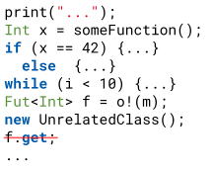

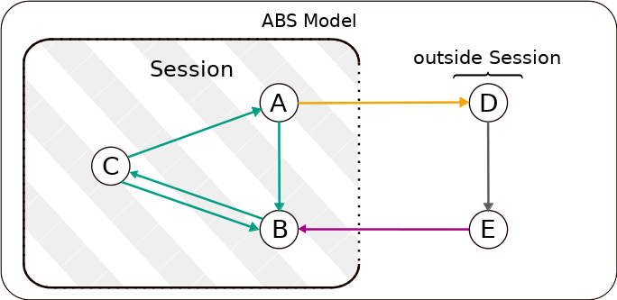
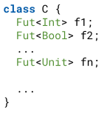
Evaluation – Type System
Usability – Some Examples
Pro
Contra
Actions not influencing
session always permitted
Even calls
  →Half-open systems
Futures can not be communicated
between objects
Session actors must be
instantiated in main block
Session actors are bound to classes
Futures must be stored in fields

Slide 33
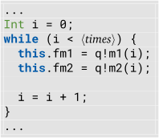
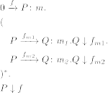
Evaluation – Dynamic Enforcement
Minimal Scenario: Consecutive Calls

Slide 34
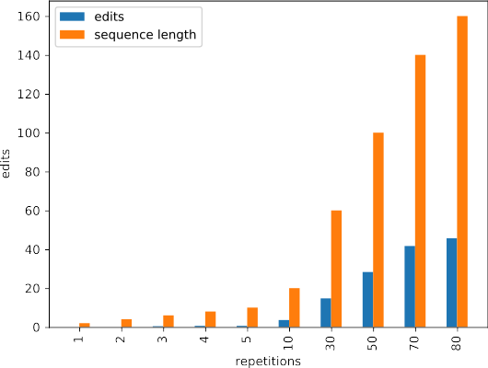
Evaluation – Dynamic Enforcement
Is invocation order enforced?
Measure: Levenshtein distance between observed invocation
order and intended, alternating order
Model without schedulers increasingly violates order with
higher number of calls
Model with schedulers never violated the order
Intended order: m1, m2, m1, m2, m1, m2, …
Recorded, wrong order: m2, m1, m1, m2, m2, m1

Slide 35
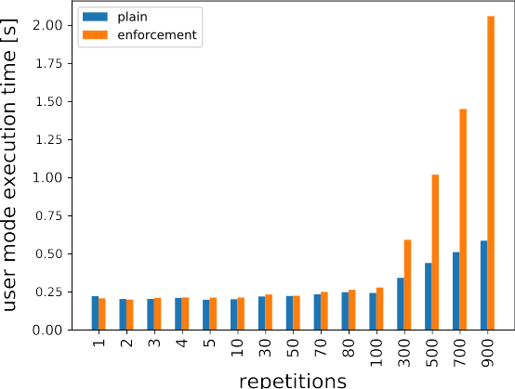
Evaluation – Dynamic Enforcement
How is model execution time affected? (user mode)
Constant, slight overhead until certain number of calls (200)
Fast growing overhead at 600+ calls
  Multiples of original execution time

Slide 36
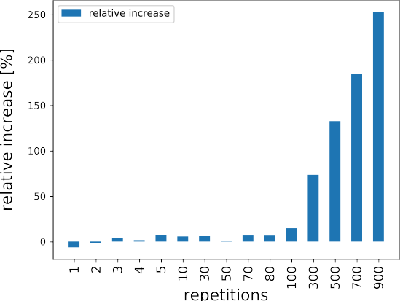
Evaluation – Dynamic Enforcement
How is model execution time affected? (user mode)
Constant, slight overhead until certain number of calls (200)
Fast growing overhead at 600+ calls
  Multiples of original execution time

Slide 37
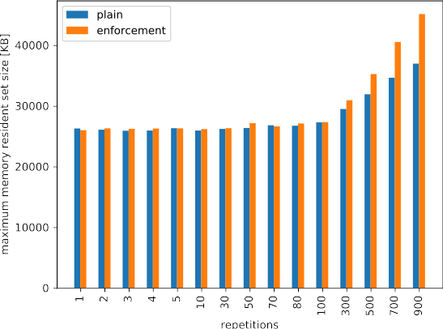
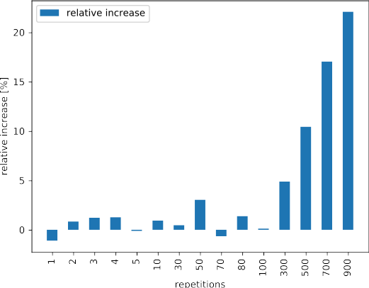
Evaluation – Dynamic Enforcement
Similar observations are made for maximum memory resident set size, though overhead is not as severe

Slide 38

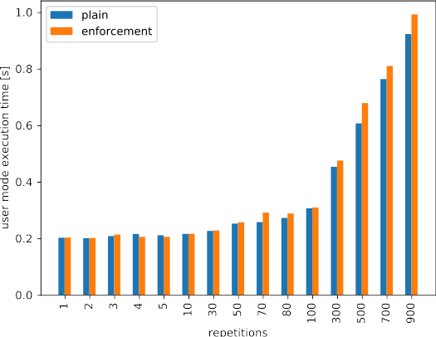
Evaluation – Dynamic Enforcement
How do schedulers compare to manual synchronization?
we insert await-statements between the calls
Now, reduced execution time overhead for plain and enforcment models
  (schedulers do not have to reorder)
Counterintuitive, since both, caller and callee are being stalled
Notes:
Should I give percentages of reduction?

Slide 39
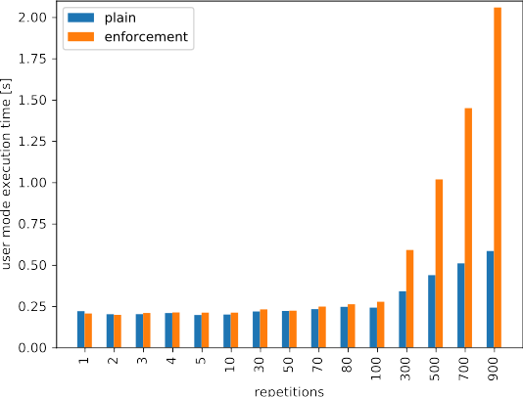
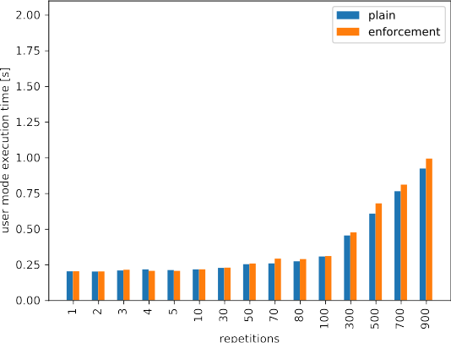
Evaluation – Dynamic Enforcement
Manual synchronization takes less time than schedulers
without „await“
with „await“
Notes:
Should I talk about the experiment, which introduced delays?

Slide 40
Future Work
Lifting modeling restrictions
Allow to store futures in non-fields, share futures between objects, …
Will require more sophisticated analyses
  points-to analyses to identify references etc.
Improving liveness properties
Introduce deadlock checks
Improvements on session automata (data-determinism)
...

Slide 41
Evaluation – Type System
Soundness
It has been informally argued that our type validation, projection
and type system rules...
  ...take the same precautions to ensure soundness as the
  theoretical work the SDS-tool is based on
  ...also ensures soundness where we diverge from the original
  work
Tests and examples support this claim
Formal proof remains (time constraints)

Slide 42
Future Work
Expand condition checking
Use KeY-ABS to try proving conditions statically first
Use runtime verification only when necessary
Comprehensive Case Study
Apply session types to an extensive ABS model
How do usability issues affect the modeling process?
How do schedulers impact performance of complex models?

Slide 43
Conclusion
A tool has been developed which...
allows to statically verify an ABS model against a session type specification
extends models to dynamically enforce behavior which can not be statically guaranteed
The evaluation has shown…
the tool can be applied to develop small models in the current ABS implementation
order is reliably enforced at runtime
at the cost of severe execution time overhead at a high number of calls
  can be mitigated by manual synchronization

Slide 44
Thank you for listening
projection
session automata
global
dynamic enforcement
...
protocols
local
schedulers
Semi-Dynamic Session Types for ABS
specification validation
static verification
type system
based on
„Session-based compositional analysis for actor-based languages using futures."
„Stateful Behavioral Types for ABS“
by Kamburjan, E., Din, C. C., Chen, T.

Slide 45
Image sources
Google Material Design Icons have been used in this presentation
Source: https://github.com/google/material-design-icons
License: Apache 2.0

Slide 46
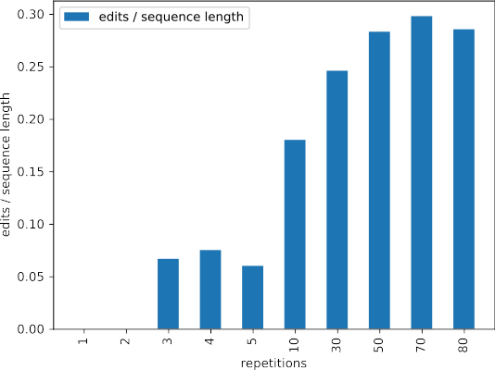
Evaluation – Dynamic Enforcement
Is invocation order enforced?
Measure: Levenshtein distance between observed invocation
order and intended, alternating order
Model without schedulers increasingly violates order with
higher number of calls
Model with schedulers never violated the order

