Slide 1
Multi-Agent Formation Control
For Implementation of Group Tasks
Aubrey Hormel
Mentor: Dr. Jingjin Yu

Slide 2
Distance-Optimal Formation Control
Algorithm Overview
Group Tasks
Demo
Goals
Acknowledgements

Slide 3

Distance-Optimal Formation Control
Runtime Complexity: $O(n{\left|V\right|}^{2})$

Slide 4

Problem Model
$$G=\left(V, E\right)$$
$$V={\left\{v_{i}\right\}}_{i=1}^{k}$$
$$E={\left\{\left(v_{i}, v_{j}\right) :edge exists\right\}}_{i, j=1}^{k}$$

Slide 5









Problem Model
Agent Initial Positions
$$A_{I}={\left\{a_{i}\right\}}_{i=1}^{n}$$
Goal Positions
$$A_{G}={\left\{g_{i}\right\}}_{i=1}^{n}$$
$$a_{1}$$
$$a_{2}$$
$$g_{1}$$
$$a_{3}$$
$$a_{4}$$
$$g_{2}$$
$$g_{3}$$
$$g_{4}$$

Slide 6
Problem Model
Constraints:
Choose shortest set of paths between initial and goal nodes
Bound convergence time
But, a given agent is allowed to be mapped to any goal node
$$a_{1}$$
$$a_{2}$$
$$g_{1}$$
$$a_{3}$$
$$a_{4}$$
$$g_{2}$$
$$g_{3}$$
$$g_{4}$$

Slide 7
Algorithm Overview

Slide 8
Constructing a Directed Acyclic Graph (DAG)

Slide 9
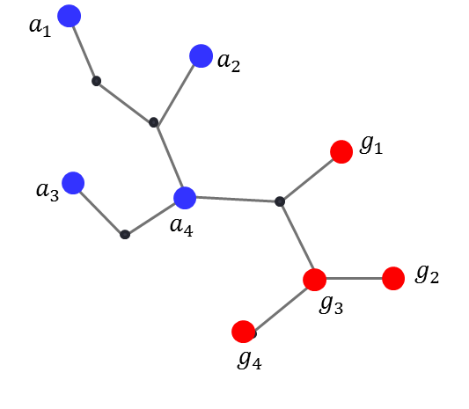
Distance-Optimal Pairing
Perform a Breadth-First Search (BFS) to construct a distance matrix between each initial/goal node pair.

Slide 10
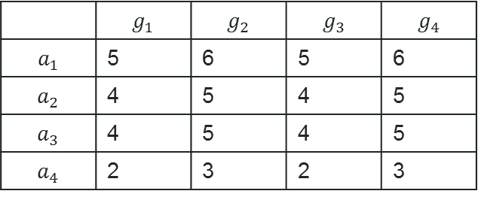
Distance-Optimal Pairing
Perform a Breadth-First Search (BFS) to construct a distance matrix between each initial/goal node pair.
Linear Sum Assignment Problem:
Hungarian/Munkres Algorithm
 | $$g_{1}$$ | $$g_{2}$$ | $$g_{3}$$ | $$g_{4}$$
$$a_{1}$$ | 5 | 6 | 5 | 6
$$a_{2}$$ | 4 | 5 | 4 | 5
$$a_{3}$$ | 4 | 5 | 4 | 5
$$a_{4}$$ | 2 | 3 | 2 | 3

Slide 11
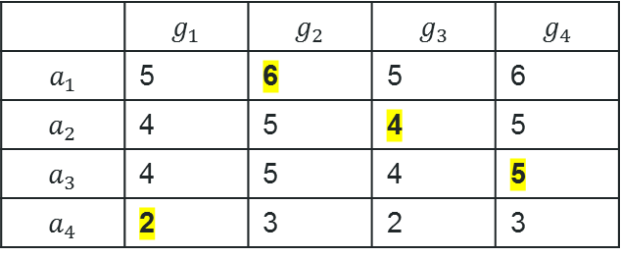
Distance-Optimal Pairing
Perform a Breadth-First Search (BFS) to construct a distance matrix between each initial/goal node pair.
Linear Sum Assignment Problem:
Hungarian/Munkres Algorithm
 | $$g_{1}$$ | $$g_{2}$$ | $$g_{3}$$ | $$g_{4}$$
$$a_{1}$$ | 5 | 6 | 5 | 6
$$a_{2}$$ | 4 | 5 | 4 | 5
$$a_{3}$$ | 4 | 5 | 4 | 5
$$a_{4}$$ | 2 | 3 | 2 | 3

Slide 12
DAG Construction
Creates a shortest- yet unscheduled- path set

Slide 13
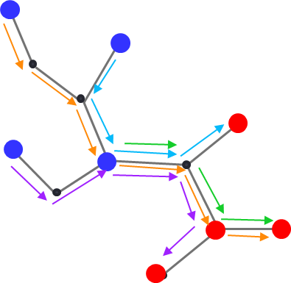
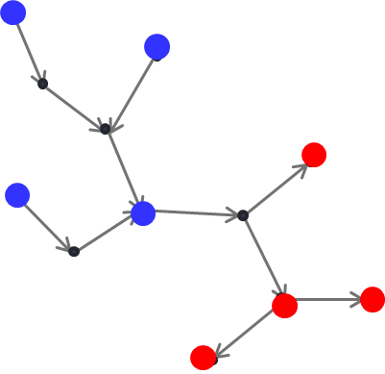
DAG Construction
Creates a shortest- yet unscheduled- path set
Path set induces a directed acyclic graph

Slide 14
Agent Path Scheduling Process

Slide 15







Sink Nodes
Identify Sink Nodes:
Nodes that have no outward-directed edges
Lie in only one path
$$a_{1}$$
$$a_{2}$$
$$g_{1}$$
$$a_{3}$$
$$a_{4}$$
$$g_{2}$$
$$g_{3}$$
$$g_{4}$$

Slide 16
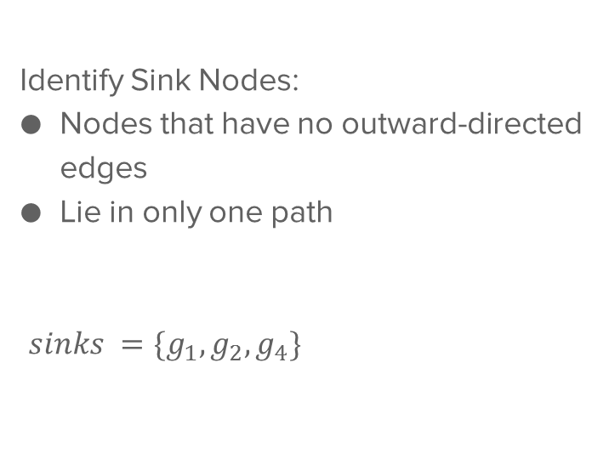
Sink Nodes
Identify Sink Nodes:
Nodes that have no outward-directed edges
Lie in only one path
$sinks =\{g_{1},g_{2},g_{4}\}$
$$a_{1}$$
$$a_{2}$$
$$g_{1}$$
$$a_{3}$$
$$a_{4}$$
$$g_{2}$$
$$g_{3}$$
$$g_{4}$$

Slide 17
Path Assignment
WLOG, choose a standalone goal node to schedule an agent to.
$$a_{1}$$
$$a_{2}$$
$$g_{1}$$
$$a_{3}$$
$$a_{4}$$
$$g_{2}$$
$$g_{3}$$
$$g_{4}$$

Slide 18

Path Assignment
Perform “reverse” BFS on directed edges until first initial node is found.
$$a_{1}$$
$$a_{2}$$
$$g_{1}$$
$$a_{3}$$
$$a_{4}$$
$$g_{2}$$
$$g_{3}$$
$$g_{4}$$

Slide 19
Path Assignment
Perform “reverse” BFS on directed edges until first initial node is found.
$$a_{1}$$
$$a_{2}$$
$$g_{1}$$
$$a_{3}$$
$$a_{4}$$
$$g_{2}$$
$$g_{3}$$
$$g_{4}$$

Slide 20
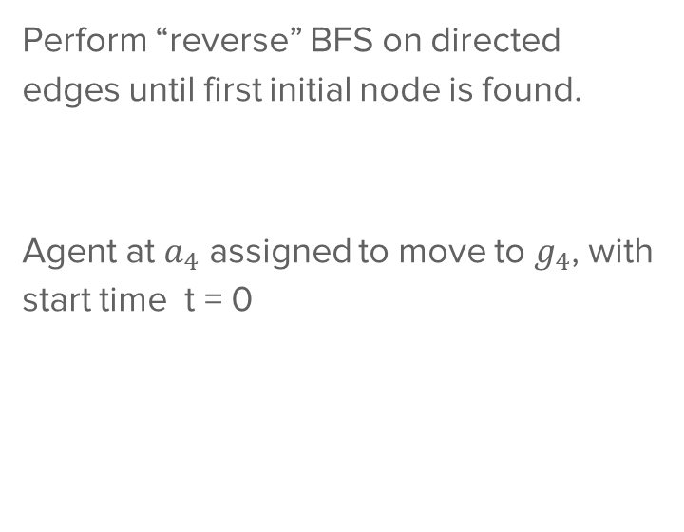
Path Assignment
Perform “reverse” BFS on directed edges until first initial node is found.
Agent at $a_{4}$ assigned to move to $g_{4}$, with start time t = 0
$$a_{1}$$
$$a_{2}$$
$$g_{1}$$
$$a_{3}$$
$$a_{4}$$
$$g_{2}$$
$$g_{3}$$
$$g_{4}$$

Slide 21
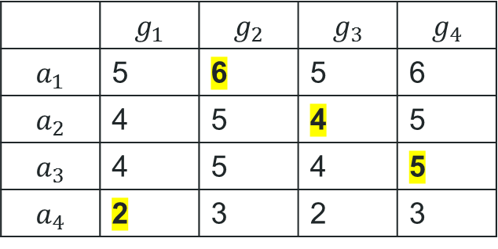
Path Assignment
Recall: Cost Matrix
$$a_{1}$$
$$a_{2}$$
$$g_{1}$$
$$a_{3}$$
$$a_{4}$$
$$g_{2}$$
$$g_{3}$$
$$g_{4}$$

Slide 22
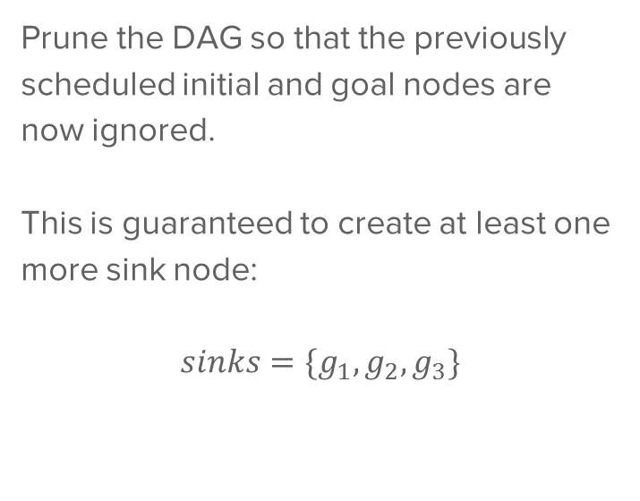

DAG Maintenance
Prune the DAG so that the previously scheduled initial and goal nodes are now ignored.
This is guaranteed to create at least one more sink node:
$$sinks=\{g_{1},g_{2},g_{3}\}$$
$$a_{1}$$
$$a_{2}$$
$$g_{1}$$
$$a_{3}$$
$$g_{3}$$
$$g_{2}$$

Slide 23
Path Scheduling
Repeat:
$$a_{1}$$
$$a_{2}$$
$$g_{1}$$
$$a_{3}$$
$$g_{3}$$
$$g_{2}$$

Slide 24
Path Scheduling
Repeat:
$$a_{1}$$
$$a_{2}$$
$$g_{1}$$
$$a_{3}$$
$$g_{3}$$
$$g_{2}$$

Slide 25
Path Scheduling
Repeat:
$$a_{1}$$
$$a_{2}$$
$$g_{1}$$
$$a_{3}$$
$$g_{3}$$
$$g_{2}$$

Slide 26
Path Scheduling
Repeat:
$$a_{1}$$
$$a_{2}$$
$$g_{1}$$
$$a_{3}$$
$$g_{3}$$
$$g_{2}$$

Slide 27
Path Scheduling
Repeat:
$$a_{1}$$
$$a_{2}$$
$$g_{1}$$
$$a_{3}$$
$$g_{3}$$
$$g_{2}$$

Slide 28

Path Scheduling
Repeat:
Agent at $a_{4}$ assigned to move to $g_{4}$
Start Time?
$$a_{1}$$
$$a_{2}$$
$$g_{1}$$
$$a_{3}$$
$$g_{3}$$
$$g_{2}$$

Slide 29
Path Scheduling
When assigned a path, agents check for the possibility of collision with agents who have already been processed.

Slide 30
Path Scheduling
When assigned a path, agents check for the possibility of collision with agents who have already been processed.
If same node, same timestep:
Agent’s start time incremented from that of the last agent.

Slide 31
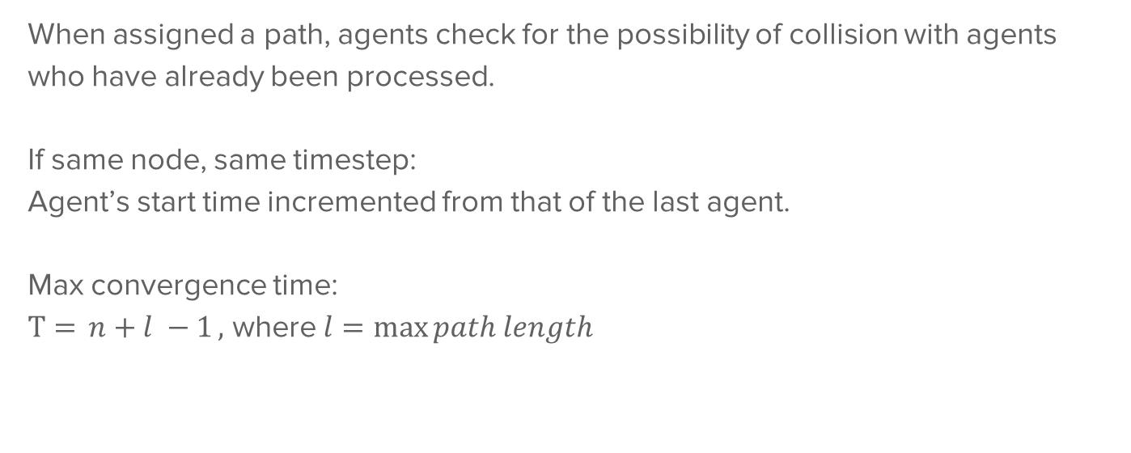
Path Scheduling
When assigned a path, agents check for the possibility of collision with agents who have already been processed.
If same node, same timestep:
Agent’s start time incremented from that of the last agent.
Max convergence time:
$T={n+l −1},$ where $l=\max{path length}$

Slide 32
Group Tasks

Slide 33
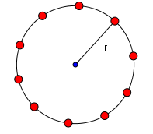
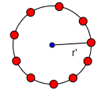
Group Strategies
Surround and close-in on a target

Slide 34
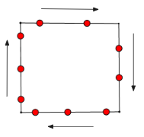
Next Step: Group Strategies
Surround and close-in on a target
Patrol a perimeter

Slide 35
Next Step: Group Strategies
Surround and close-in on a target
Patrol a perimeter
(still working)

Slide 36
Demo

Slide 37
Goals

Slide 38
Goals
Perimeter Patrol
Surround & Capture:
Automate “closing in”
Several targets
Combinations of group tasks

Slide 39
Goals
A little buggy – shows when surrounding a target

Slide 40
Acknowledgements

Slide 41

References & Acknowledgements
Special thanks to:
Dr. Jingjin Yu, Mentor National Science Foundation, funding provided through grant ISS-1734419
Reference: Yu, J., & LaValle, S.M. (2012). Distance Optimal Formation Control on Graphs with a Tight Convergence Time Guarantee, presented at 51st IEEE Conference on Decision and Control, Maui, HA, December 10-13.

