Slide 1
Application of regional survival curves to enhance modeling of used vehicle market and stock in TEMPO
Arthur Yip
Originally scheduled milestone: Jun 30, 2025
Proposed revised deadline: Sep 30, 2025 (end of FY25)

Slide 2
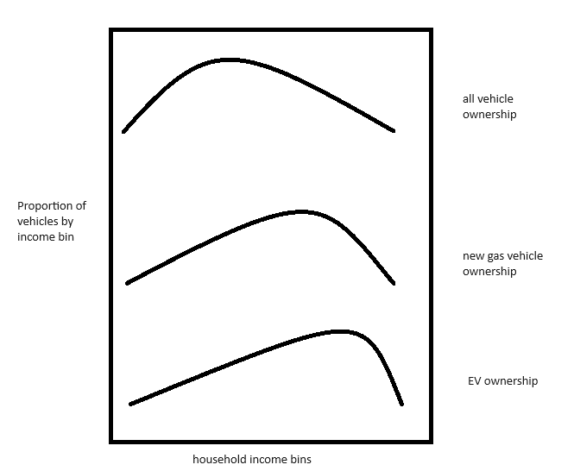
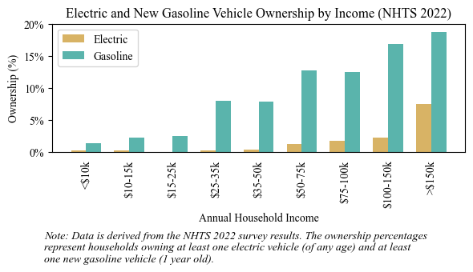
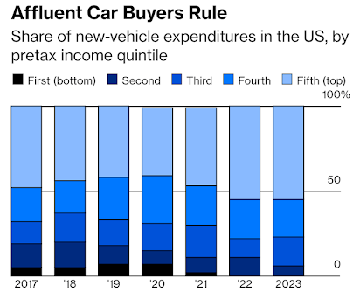
Disproportionate ownership of new vehicles and EVs by high-income households
Skew is growing, and may change in the future

Slide 3
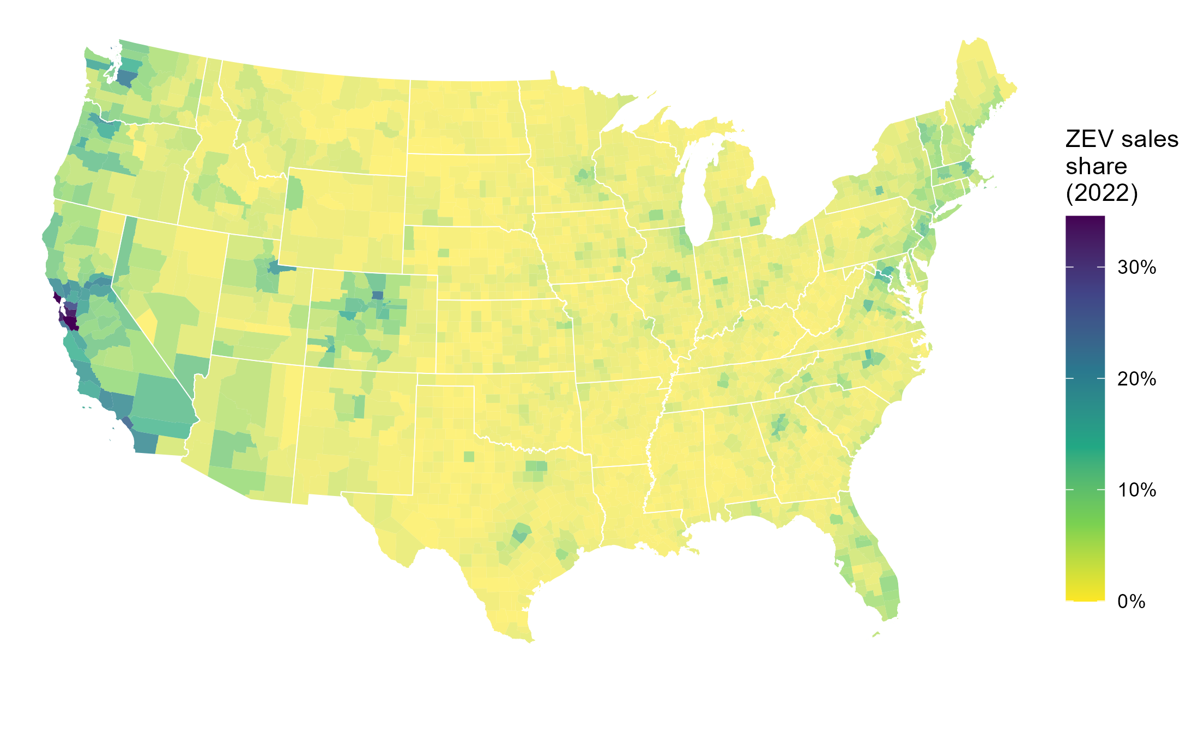
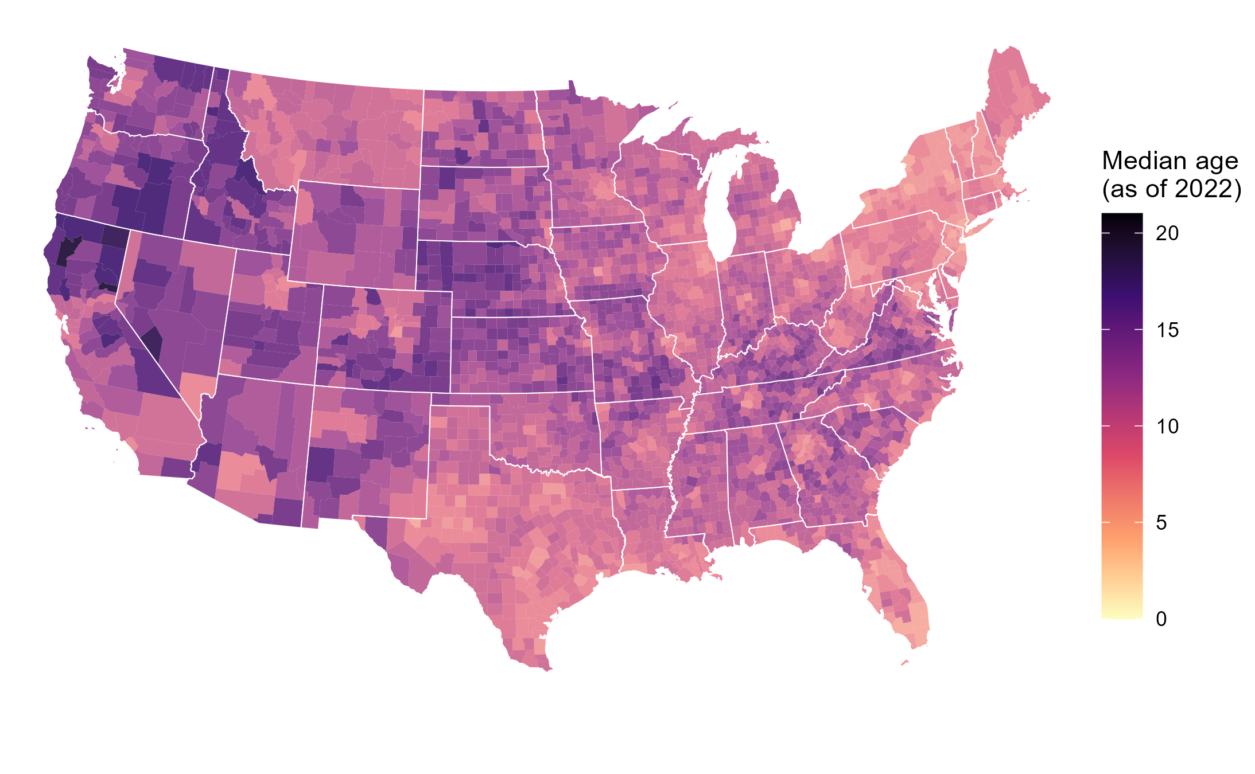
EV diffusion depends on both sales share and new sales
“The future is already here; it’s just not very evenly distributed.” – William Gibson
Projected EVs in a county = a function of both:
1) Trajectory of EVs as share of new vehicle sales
2) Projected vehicle sales, driven by vehicle survival/ scrappage/turnover
“Preference” for “age” (i.e. used vehicles) is an understudied factor affecting EV adoption
Higher median age in a county is indicative of slower vehicle stock turnover, fewer new sales, fewer EVs
Notes:
Higher median vehicle age in a county can arise from
-transfers of used vehicles from other counties
-households holding onto vehicles longer - quality of vehicles lasting longer, or “preference” for cheaper/used vehicles
-VMT impacts on survival/repairability
Ownership / backup vehicles
Incentives, new/used car subsidies, programs e.g. cash for clunkers
Winter road salt corrosion (correlated with temperature/climate)
Summer heat impact on EV battery degradation, range, and longevity
- not necessarily spatially different, but over the years, vehicle age has gone up, quite possibly partially due to improved vehicle lifetimes. - not visible/I don’t have the evidence, but some make/models/types probably last longer than others...
I’d delete
Higher average vehicle age in a local jurisdiction can arise from many phenomena, including lower new vehicle sales, imports of older used vehicles from other counties, exports of newer used vehicles to other counties, or households holding onto and using vehicles longer before scrapping them
, which could be from either the higher quality of owned vehicles or the higher acceptance of or reliance on used/older vehicles
Is this a common reason? Do we have examples of this
- Lack of corrosion due to winter salt - EV-specific: lack of battery degradation due to summer heat - not necessarily spatially different, but over the years, vehicle age has gone up, quite possibly partially due to improved vehicle lifetimes. - not visible/I don’t have the evidence, but some make/models/types probably last longer than others...

Slide 4
Objectives and Status
Supporting contributions of survival data/analysis/paper complete
UTK Research Report published, journal manuscript about to be submitted
Team has proposed research extensions (unfunded)
Some additional analyses and preliminary results on vehicle ages and sales also available
Remaining objective:
Implement new theory and data on regional LDV survival curves to better represent the used vehicle market and overall stock at a granular level in TEMPO
Milestone:
Explain implications of modeling enhancements on national and subnational stock modeling, result consistency, and future applicable analyses e.g. new technology adoption.

Slide 5
Objectives and Status

Slide 6
Advancing the state of the art
Current state of the art:
Survival is exclusively modeled nationally in peer-reviewed literature and energy-economy models*
* In the latest EIA NEMS model and AEO 2025, EIA derived and implemented regional survival curves, but without documentation and without vetting of theory and data
Anticipated & desired improvements in modeling results:
Represent & maintain existing vehicle age distributions within subnational regions
Predict regional vehicle survival and sales, with implications on technology adoption
Anticipated issues & risks:
Potential inconsistencies in national & subnational vehicle stock totals
In the case of negative survival, vehicles start appearing into the stock (rather than disappear from fixed tracked quantities)
Scarce data on EV-specific survival/movement; risk of inappropriate application
Inability to distinguish vehicle movements vs. true scrappage variation between areas, which could lead to inappropriate extrapolation of temporary trends
No data and theory available to model vehicle movements/transfers between regions

Slide 7
With remaining budget, plan is to…
First-cut application of regional survival curves
Run TEMPO for 50 states or ~3000 counties, with regional initial stocks and with national and regional survival curves
Reduce or increase vehicle stocks by age according to regional survival curve (including negative net survival)
Naïvely reduce/increase uniformly across powertrain types
Assume BEVs follow same survival rates
Observe regional and aggregate sales and stock-age distributions; compare with TEMPO national run results
Compare with EIA NEMS implementation
Describe results, assess progress, explain limitations & future applicability
Propose alternative data structures, parameterization, and assumptions to address limitations
Notes:
First pass is uniform assumption (possible expected eventuality)
+ assumption that BEVs follow same survival
Plan is to assess results and revisit parameterization

