Slide 1
Application of regional survival curves to enhance modeling of used vehicle market and stock in TEMPO
Arthur Yip
Status update milestone for Q4 FY25

Slide 2
Regional differences in vehicle age, survival, and stock modeling have been underlooked
Sales generally assumed to translate into stock, according to standard survival theory and modeling
But this ignores distributional impacts and heterogeneity across consumers and regions
Furthermore, regional policies such as ZEV could amplify differences and impacts across regions
Many studies suggest accelerated retirement as a necessity in certain scenarios, without detail on how

Slide 3
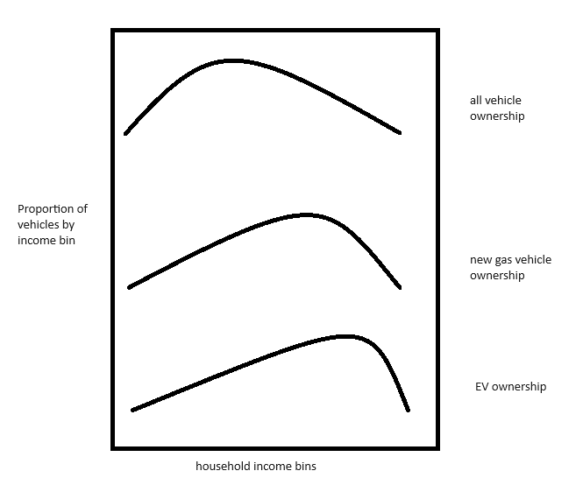
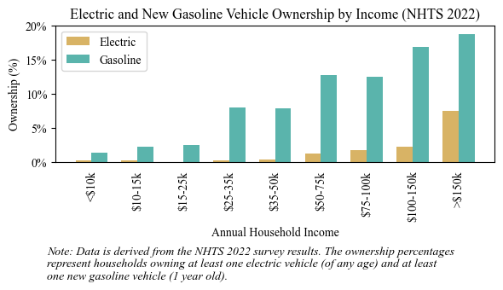
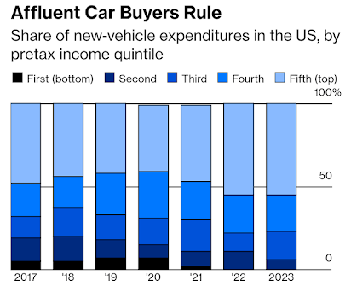
Disproportionate ownership of new vehicles and EVs by high-income households
Skew is growing, and may change in the future

Slide 4
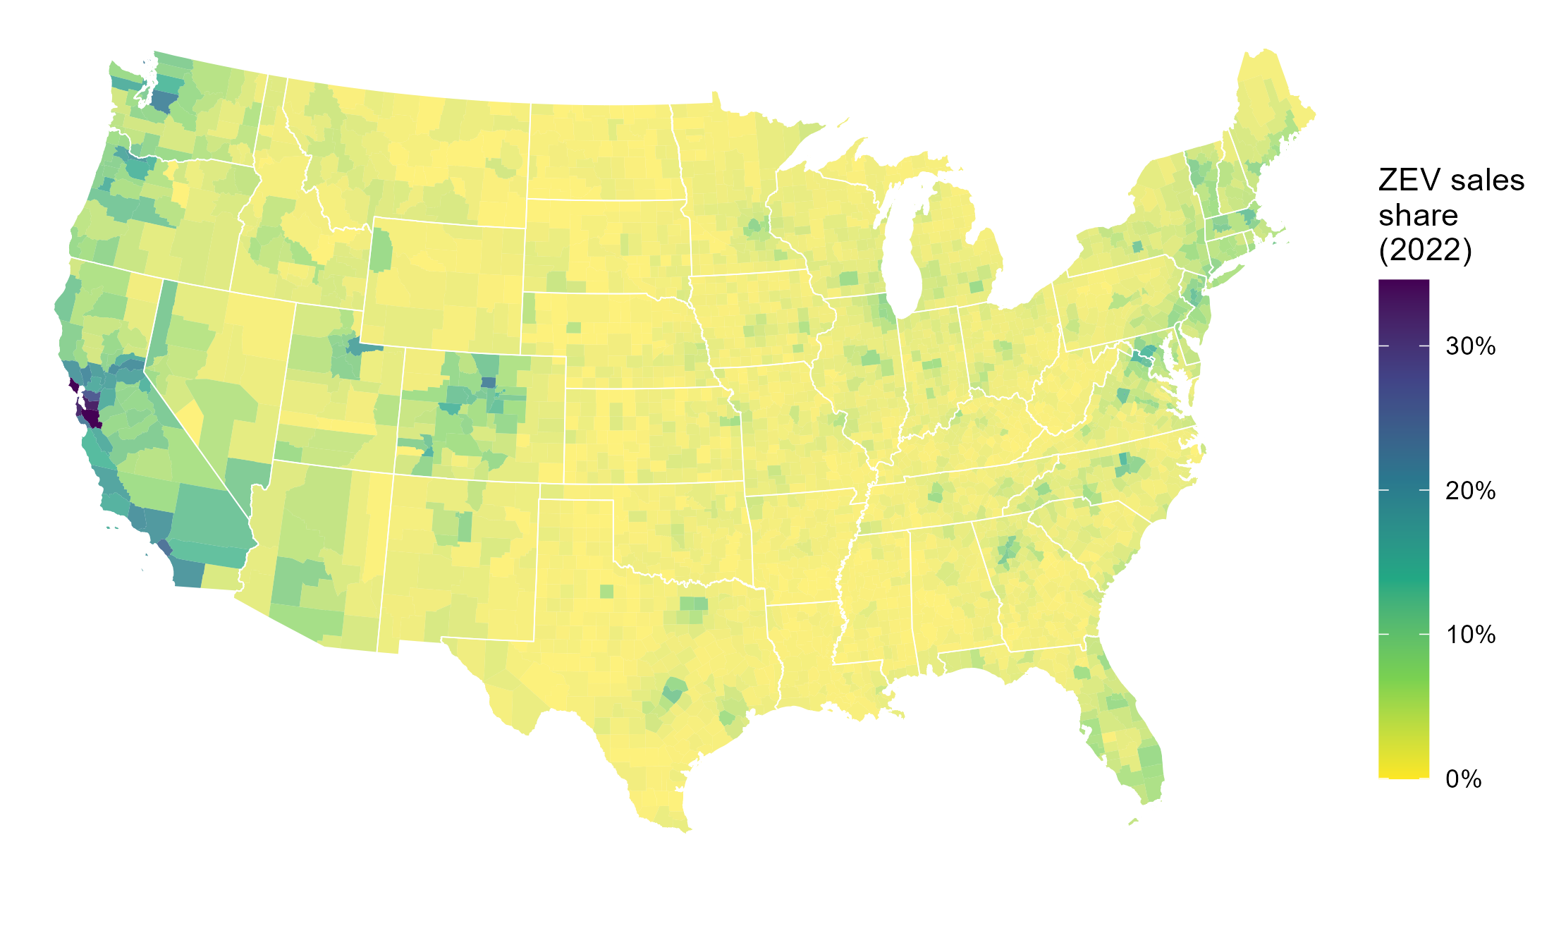
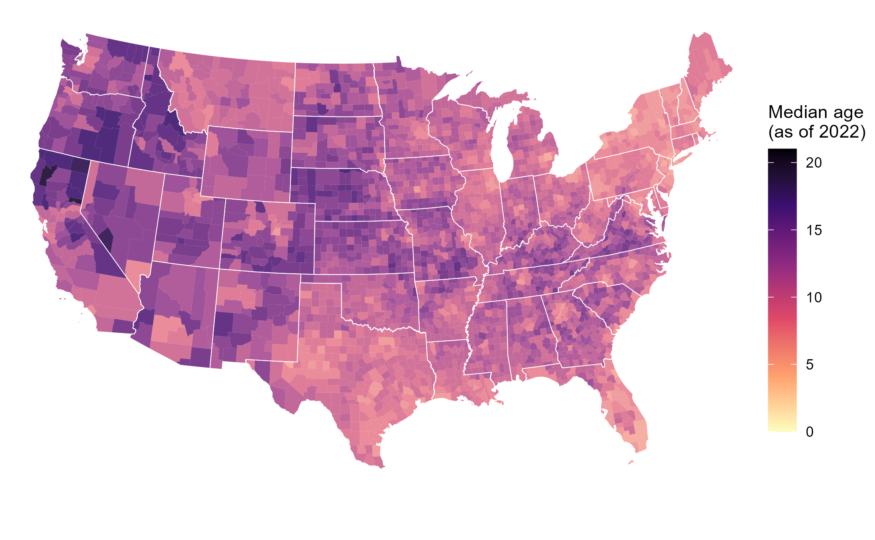
EV diffusion depends on both sales share and new sales
“The future is already here; it’s just not very evenly distributed.” – William Gibson
Projected EVs in a county = a function of both:
1) Trajectory of EVs as share of new vehicle sales
2) Projected vehicle sales, driven by vehicle survival/ scrappage/turnover
“Preference” for “age” (i.e. used vehicles) is an understudied factor affecting EV adoption
Higher median age in a county is indicative of slower vehicle stock turnover, fewer new sales, fewer EVs
Notes:
Higher median vehicle age in a county can arise from
-transfers of used vehicles from other counties
-households holding onto vehicles longer - quality of vehicles lasting longer, or “preference” for cheaper/used vehicles
-VMT impacts on survival/repairability
Ownership / backup vehicles
Incentives, new/used car subsidies, programs e.g. cash for clunkers
Winter road salt corrosion (correlated with temperature/climate)
Summer heat impact on EV battery degradation, range, and longevity
- not necessarily spatially different, but over the years, vehicle age has gone up, quite possibly partially due to improved vehicle lifetimes. - not visible/I don’t have the evidence, but some make/models/types probably last longer than others...
I’d delete
Higher average vehicle age in a local jurisdiction can arise from many phenomena, including lower new vehicle sales, imports of older used vehicles from other counties, exports of newer used vehicles to other counties, or households holding onto and using vehicles longer before scrapping them
, which could be from either the higher quality of owned vehicles or the higher acceptance of or reliance on used/older vehicles
Is this a common reason? Do we have examples of this
- Lack of corrosion due to winter salt - EV-specific: lack of battery degradation due to summer heat - not necessarily spatially different, but over the years, vehicle age has gone up, quite possibly partially due to improved vehicle lifetimes. - not visible/I don’t have the evidence, but some make/models/types probably last longer than others...

Slide 5
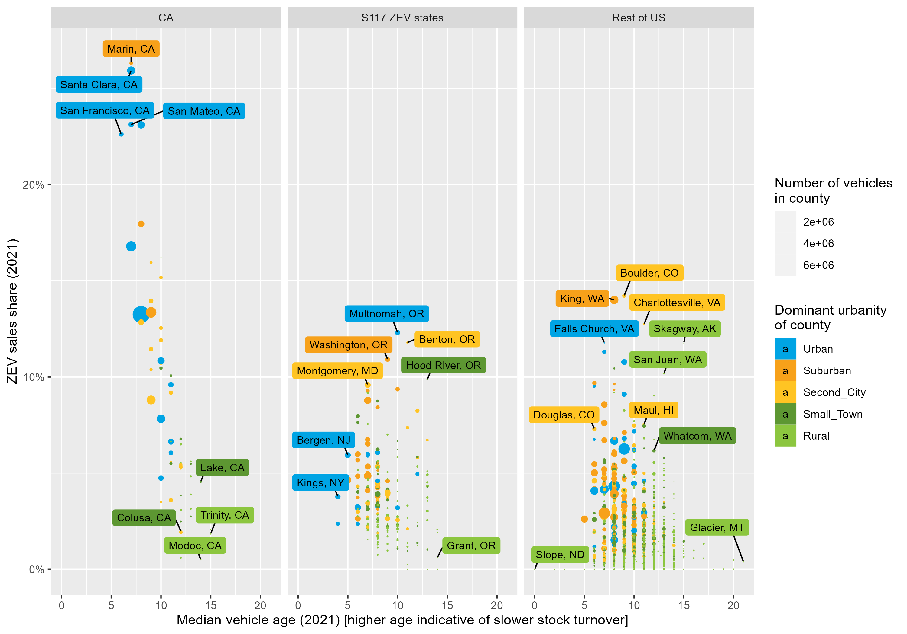
EV sales share and age have been somewhat anti-correlated so far
Counties typically have had higher EV sales share AND newer vehicles / faster turnover so far, mostly in CA
However, this may not be the case in the future
To make better EV adoption projections, both ZEV sales share and age need to be considered in modeling
Notes:
The correlation between regional stock turnover rates and EV sales is also of near-term importance. To date, US counties that have had higher EV shares have also been typically the ones that sell more new vehicles and have faster vehicle stock turnover (such as urban/suburban locations in California with populations with higher income and early adopters of technology). This can be observed in Figure 13, which shows EV sales shares and average vehicle age being anti-correlated (especially in California), where regions with the highest EV sales also tend to have lowest vehicle age, meaning EV stock will turnover faster in these regions. However, this is concurrent and correlated with many other factors – such as both lower EV sales share and higher vehicle age in more rural and lower-income counties – and therefore, the EV sales-to-stock transition may evolve differently in other regions and in the future.

Slide 6
Not just important for EVs/environment
Because vehicle regulations are typically imposed on new Model Years, any new technologies and their benefits must flow through sales to stock
Changes in new vehicle market technologies or prices affect used vehicle ownership/market responses, with feedback to the new vehicle market and stock turnover
The sales volume of the new car market has implications on automotive industry profitability/health/competitiveness

Slide 7
This work seeks to enhance modeling of regional vehicle stocks, sales, and turnover
Goal: Produce theory, methodology, and data to support long-term forecasting of regionally specific vehicle stock, sales, and turnover, without modeling underlying movements/transfers
Goal: Verify soundness of EIA’s approach of using regional survival in NEMS
Premise: Data on sales at a detailed regional resolution are typically unavailable
Premise: Data of used vehicle market movements are not available and modeling them would be too complex
Premise: Retiring vehicles requiring replacement drives most of the quantity of new vehicle sales and turnover
Premise: True differences in regional survival vs. vehicle transfers and movements would be too difficult to disentangle
Premise: National survival is well studied and utilized in models such as TEMPO, VISION, NEMS, MOVES, and can be assumed to approximate scrappage
Notes:
(as opposed to additional new sales from population/economic/vehicle ownership growth)
Salt, miles, traffic, behavior, vehicle composition, repairability, condition

Slide 8
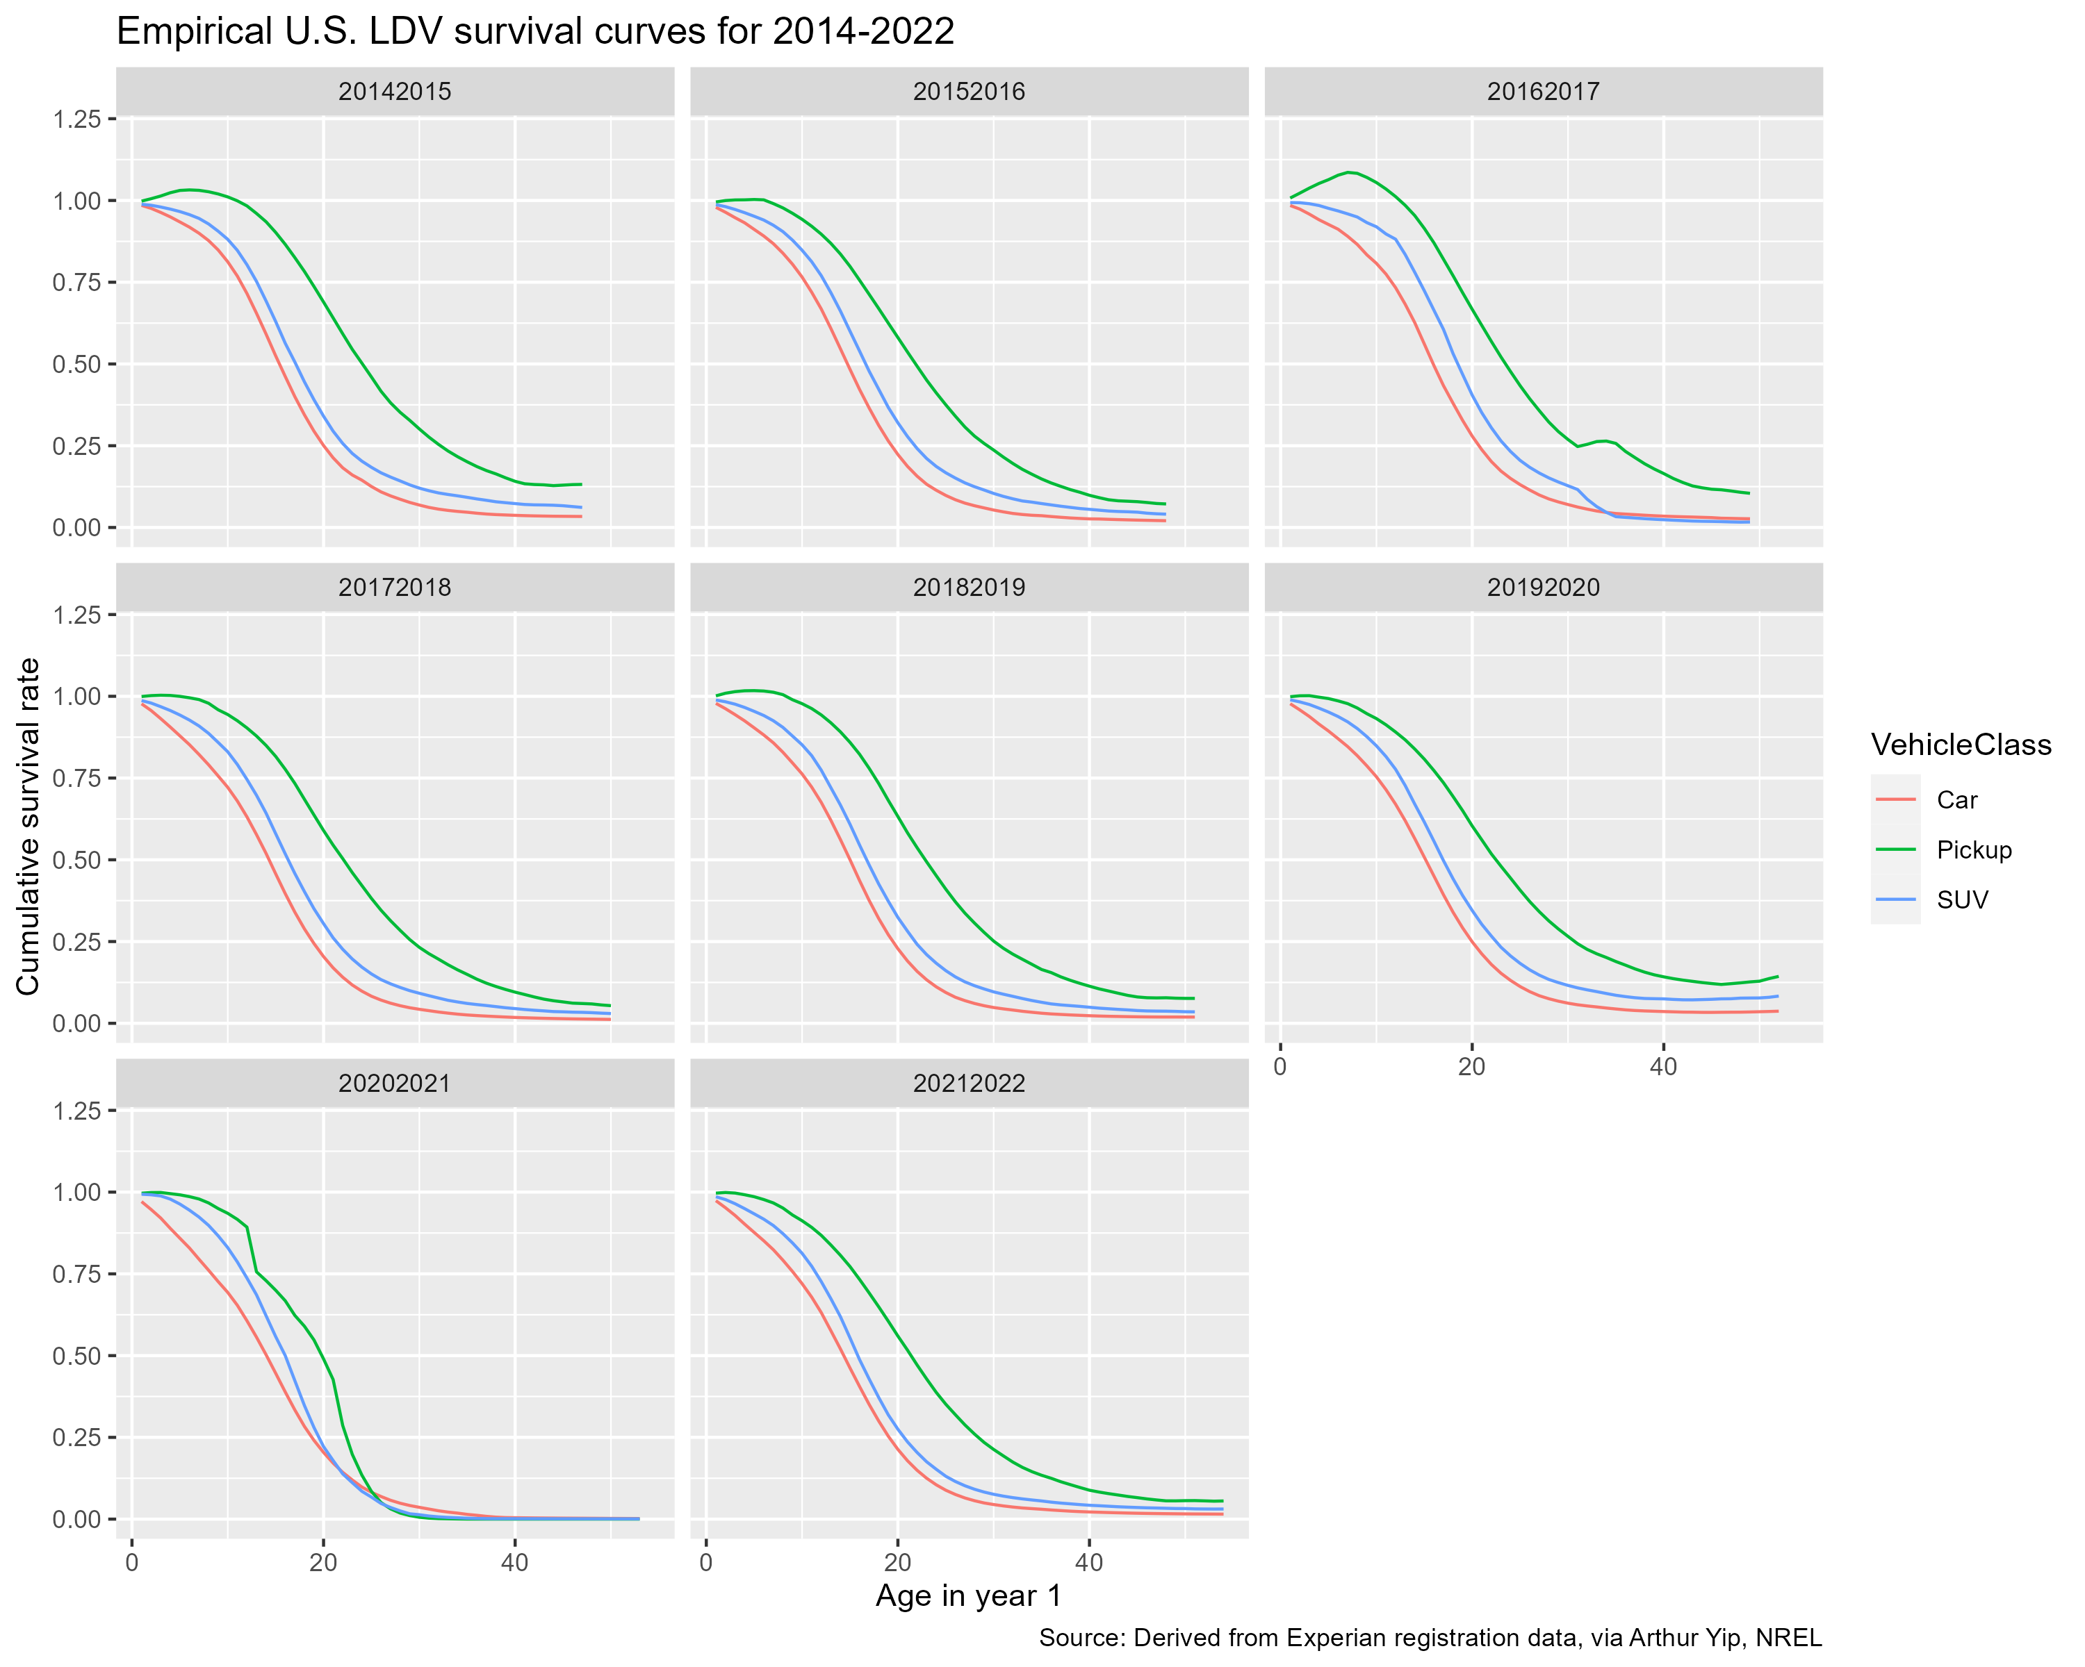
National-level vehicle fleet survival curve
Describes how the vehicle fleet “turns over” over time (i.e. as vehicles age)
Proportion of new vehicles in the U.S. surviving to
age x
100%
~50% of new pickup trucks are still on the road at age 21
50%
0%
Vehicle Age
~70% of new cars survive to age 10
30% have retired/scrapped by this age
(or been exported out of the U.S.)
Notes:
EARLY net survival = import/export
LATE net survival = scrappage
Global/national conservation of vehicle stocks and flows
State neighbors, spatial interaction, gravity modeling

Slide 9
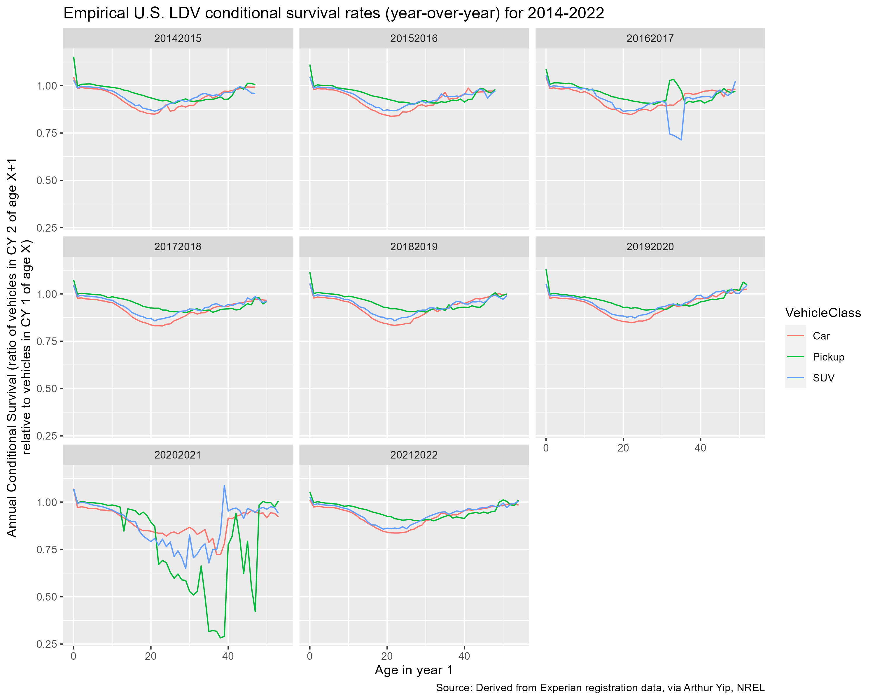
National survival curves 2014-2022
Noteworthy differences between states
Various patterns observed:
>1 and above avg survival in early ages
Below natl avg in early ages
Above natl avg in late ages
Notes:
Automotive industry
Recession – year-specific
Policy years

Slide 10
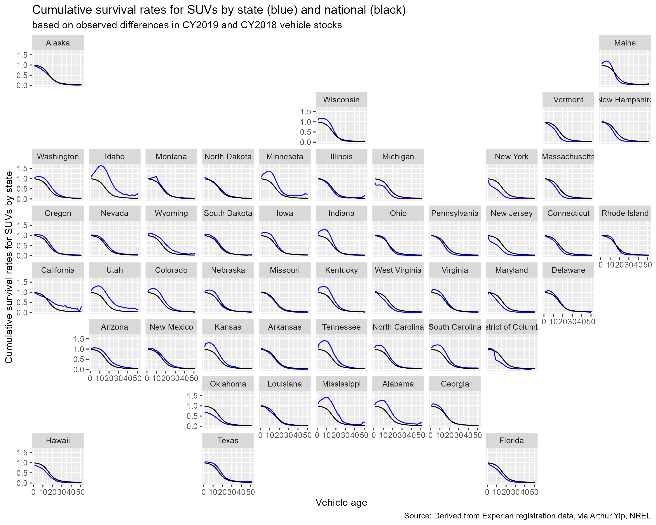
State-level survival curves, 2019
Noteworthy differences between states
Various patterns observed:
>1 and above avg survival in early ages e.g. Idaho
Below natl avg in early ages e.g. New York
Above natl avg in late ages e.g. California

Slide 11
Variables explaining state-level differences in survival
Paper in progress: Greene et al. (2025) submitted
Regression analysis to uncover what drives regionally-specific survival rates
Blue = higher than national = more vehicles surviving or net imported
Red = lower than national = more vehicles scrapped or net exported

Slide 12
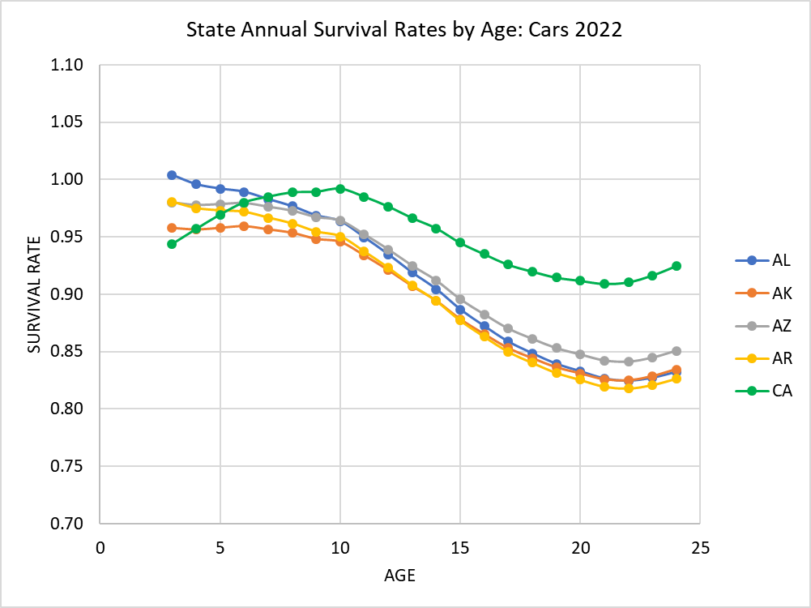
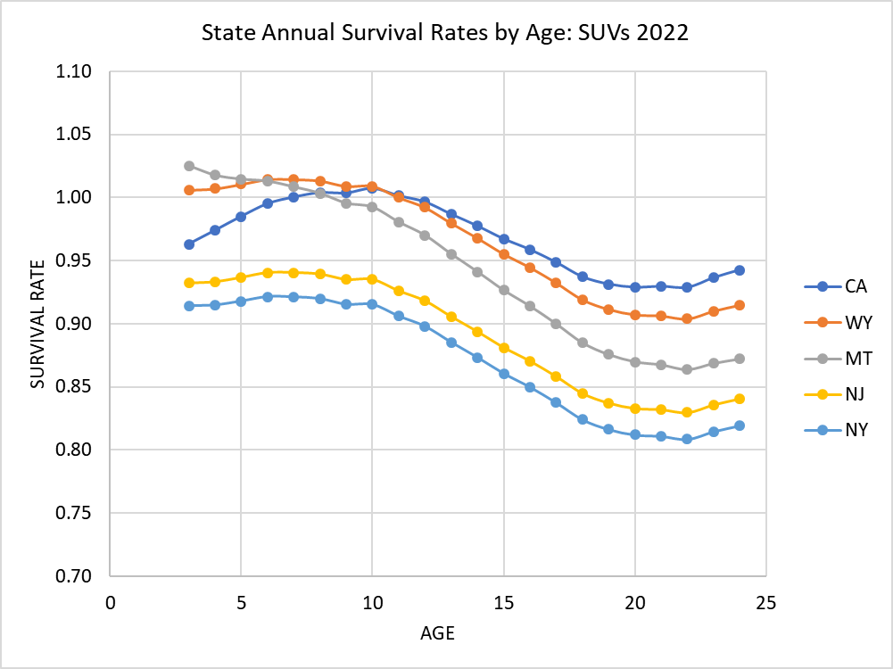
Generalized state-level survival curves, predicted for 2022, based on 2014-2022 data
Greene et al. 2025 (submitted)

Slide 13
Journal peer review - reject
Paper released as UTK Research Report and on SSRN
Submitted to and returned from Transportation Research Part A: Policy and Practice with reviewer comments
Reviewers noted a disconnect between stated motivation and goals (informing EV transition) vs. actual results
Reviewers were confused about “net survival”, which combines scrappage and migration, and disputed its usefulness
Reviewers requested more rigorous theory and further attempts to distinguish scrappage and migration
Reviewers requested validation of model forecasts e.g. via out-of-sample prediction or backcasting/backtesting
Responses and resubmission to another journal in progress
In particular, validation via out-of-sample prediction/backcasting via this subtask

Slide 14
How can accurate regional vehicle turnover/sales be estimated?
Regional stocks paired with… | Pros | Cons
National survival | Simple, well-studied, validated | Regional stock age converge to national stock age. Only approximate scrappage is captured; no representation of used market/internal transfers.
Regional sales fixed at historical turnover, assuming FIFO | Simple, preserves regional average ages | Regional average ages are only approximated; regional age distributions are lost. No representation of transfers.
Regional “net survival” | Potentially better representation of regional dynamics | Potential discrepancies with national turnover Negative net survival (imports) may not draw from available stock General net survival rates may under/overestimate changes to technology-specific vehicle stock
Full model of used market and transfers between regions |  | Lack of data/model/theory Complex – regions can’t be run independently Embeds current patterns
Notes:
Assume known/fixed population/demographic, economic, and vehicle ownership levels

Slide 15
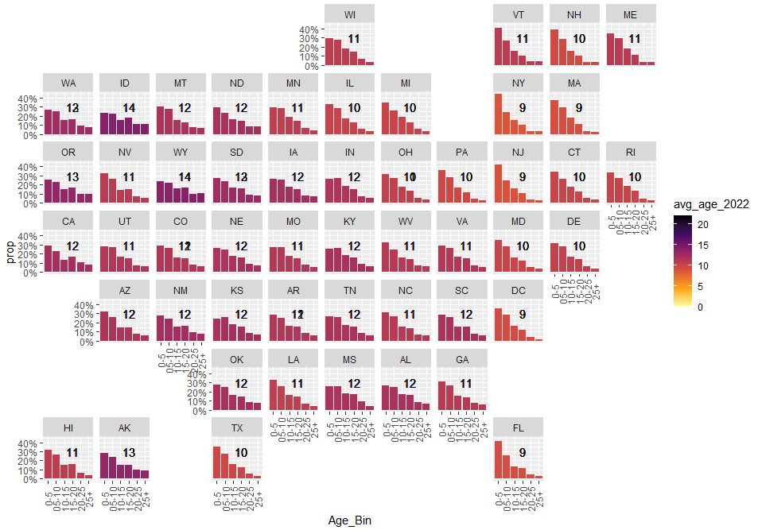
The age distribution of vehicle stock differs varies across the US

Slide 16
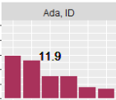
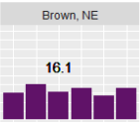
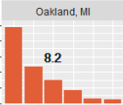
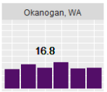
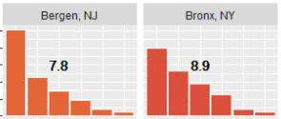
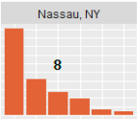
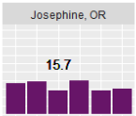
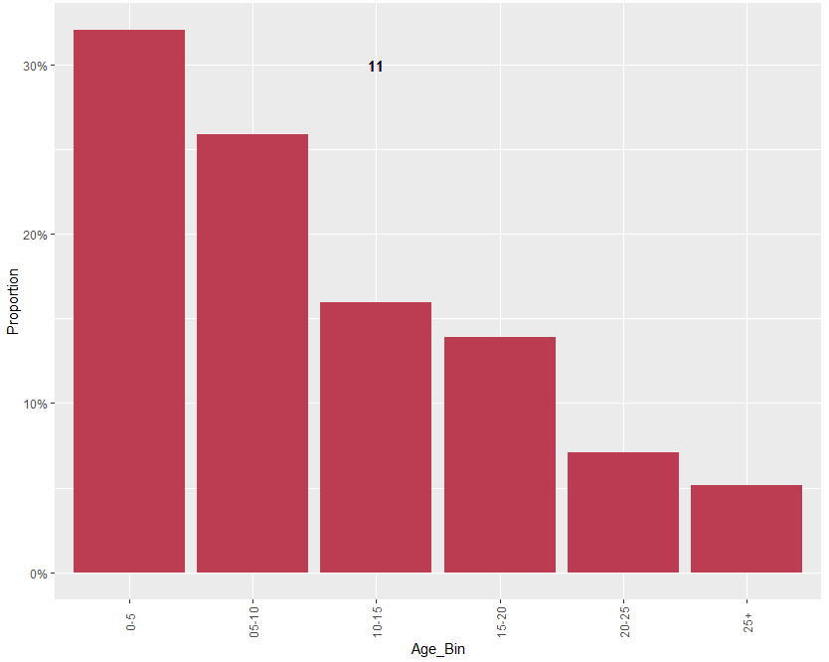
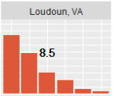
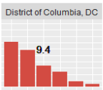
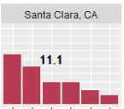
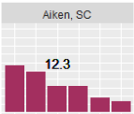
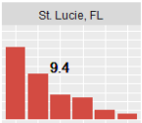
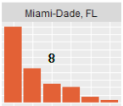
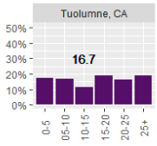
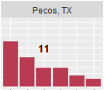
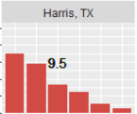
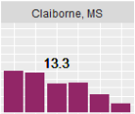
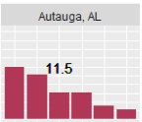
Differences in age distribution are starker at the county level

Slide 17
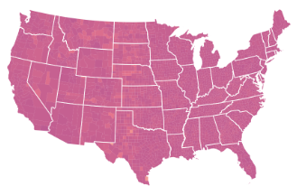
Applying the national survival to 2050 produces the expected steady-state stock, same in every county

Slide 18

How would regional stocks evolve if we used our newly derived state-level net survival curves?
Current age distribution of regional vehicle stocks
+
State-level net survival curves
(Greene et al. 2025, submitted)
25 simulation years in TEMPO
?

Slide 19
Next steps (with limited remaining budget)
Complete resubmission of peer-reviewed paper
Complete interpretation of simulation results (which could be part of additional validation for above)
Document with choropleths and highlighted regional results
Assess and discuss alignment with national results, specifically with stock of new technologies

