Slide 1
Application of regional survival curves to enhance modeling of used vehicle market and stock in TEMPO
Arthur Yip
Status update milestone for Q4 FY25

Slide 2
Regional differences in vehicle age, survival, and stock modeling have been underlooked
Sales generally assumed to translate into stock, according to standard survival theory and modeling
But this ignores distributional impacts and heterogeneity across consumers and regions
Furthermore, regional policies such as ZEV could amplify differences and impacts across regions
Many studies suggest accelerated retirement as a necessity in certain scenarios, without detail on how

Slide 3
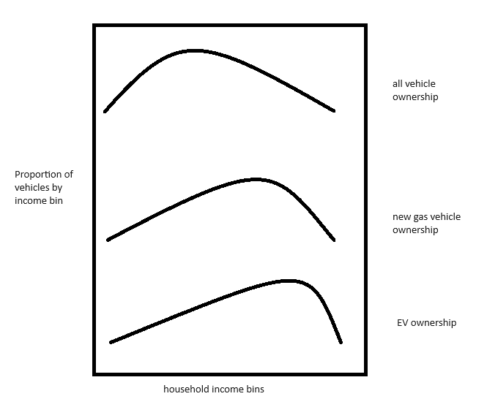
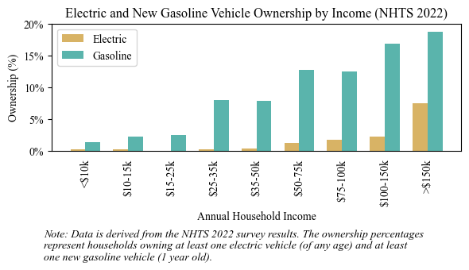
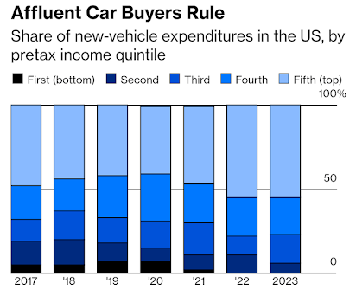
Disproportionate ownership of new vehicles and EVs by high-income households
Skew is growing, and may change in the future

Slide 4
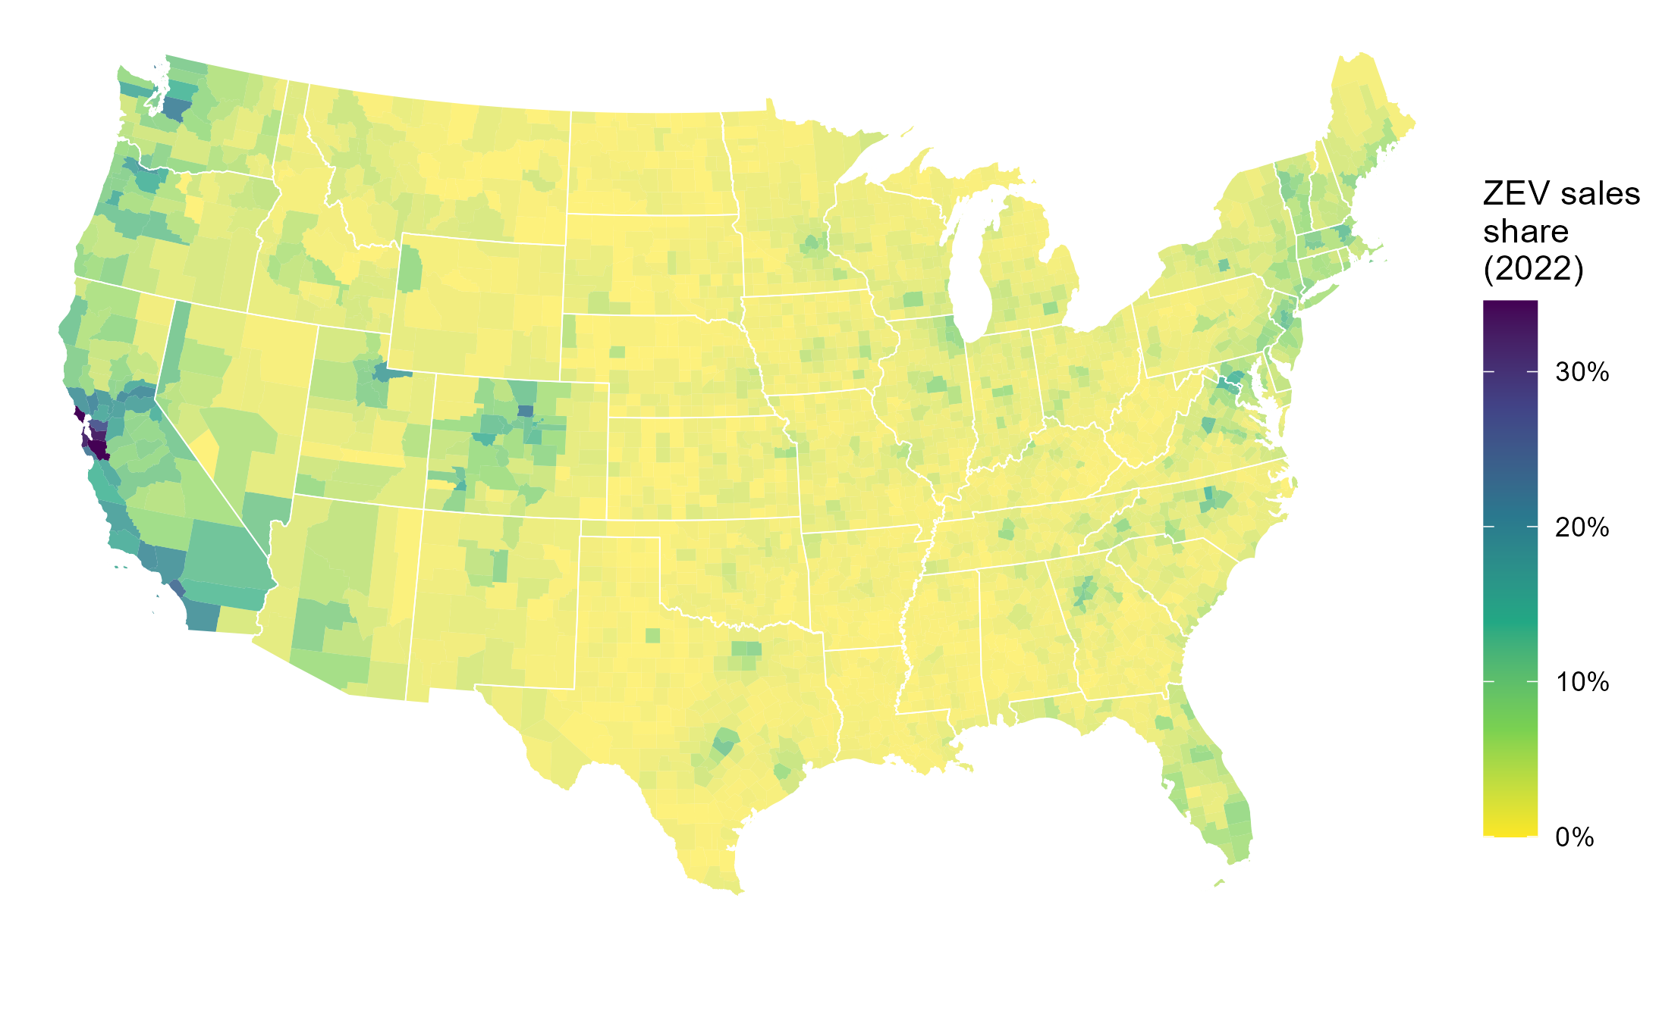
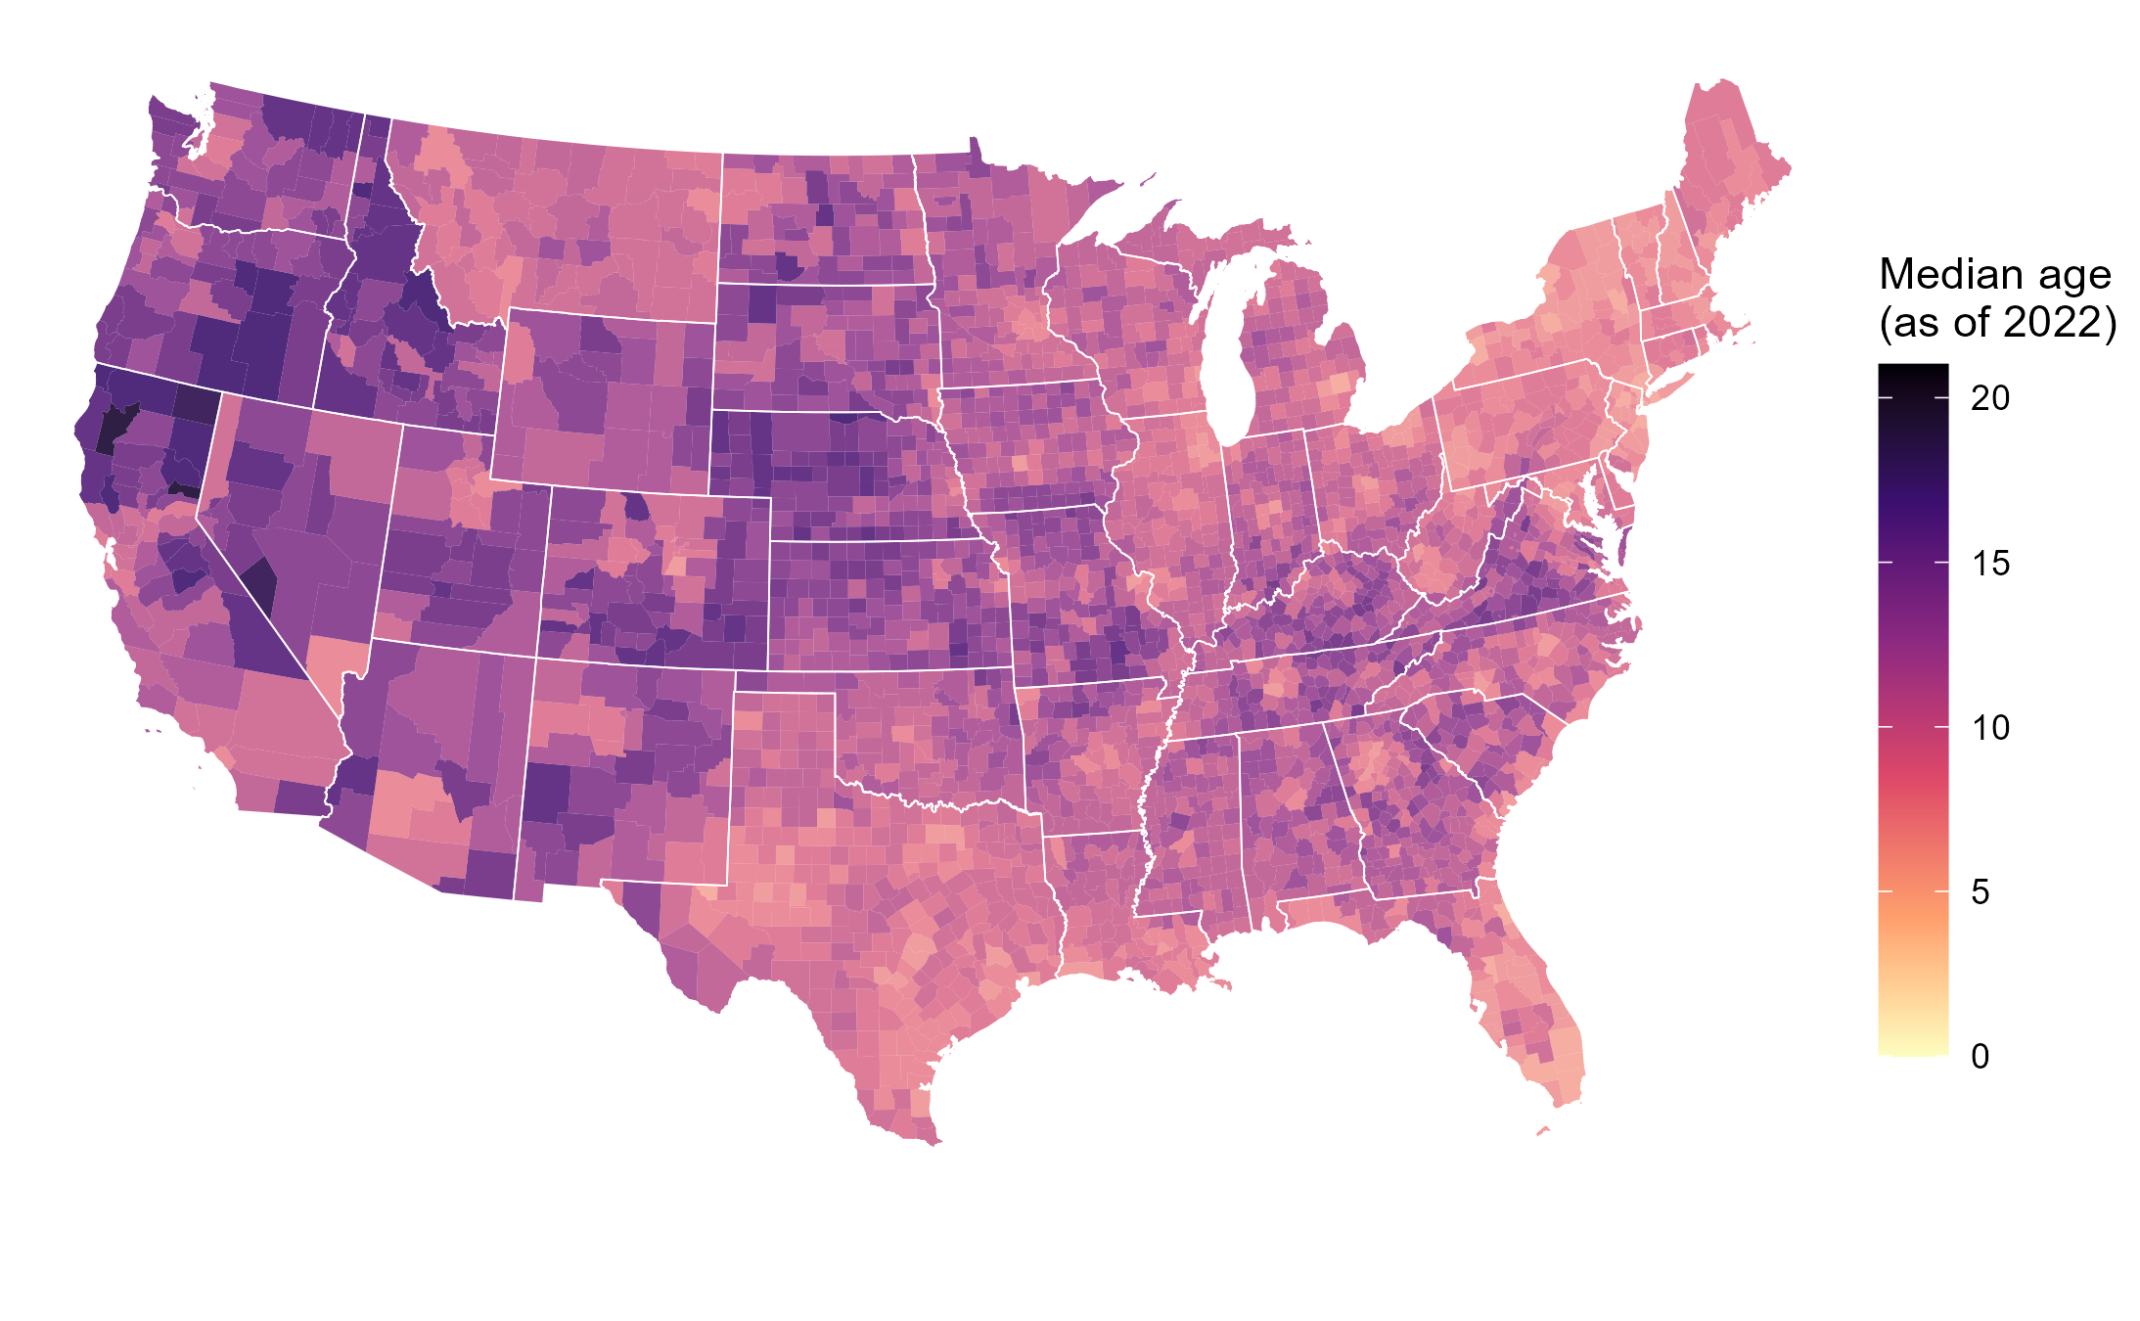
EV diffusion depends on both sales share and new sales
“The future is already here; it’s just not very evenly distributed.” – William Gibson
Projected EVs in a county = a function of both:
1) Trajectory of EVs as share of new vehicle sales
2) Projected vehicle sales, driven by vehicle survival/ scrappage/turnover
“Preference” for “age” (i.e. used vehicles) is an understudied factor affecting EV adoption
Higher median age in a county is indicative of slower vehicle stock turnover, fewer new sales, fewer EVs
Notes:
Higher median vehicle age in a county can arise from
-transfers of used vehicles from other counties
-households holding onto vehicles longer - quality of vehicles lasting longer, or “preference” for cheaper/used vehicles
-VMT impacts on survival/repairability
Ownership / backup vehicles
Incentives, new/used car subsidies, programs e.g. cash for clunkers
Winter road salt corrosion (correlated with temperature/climate)
Summer heat impact on EV battery degradation, range, and longevity
- not necessarily spatially different, but over the years, vehicle age has gone up, quite possibly partially due to improved vehicle lifetimes. - not visible/I don’t have the evidence, but some make/models/types probably last longer than others...
I’d delete
Higher average vehicle age in a local jurisdiction can arise from many phenomena, including lower new vehicle sales, imports of older used vehicles from other counties, exports of newer used vehicles to other counties, or households holding onto and using vehicles longer before scrapping them
, which could be from either the higher quality of owned vehicles or the higher acceptance of or reliance on used/older vehicles
Is this a common reason? Do we have examples of this
- Lack of corrosion due to winter salt - EV-specific: lack of battery degradation due to summer heat - not necessarily spatially different, but over the years, vehicle age has gone up, quite possibly partially due to improved vehicle lifetimes. - not visible/I don’t have the evidence, but some make/models/types probably last longer than others...

Slide 5
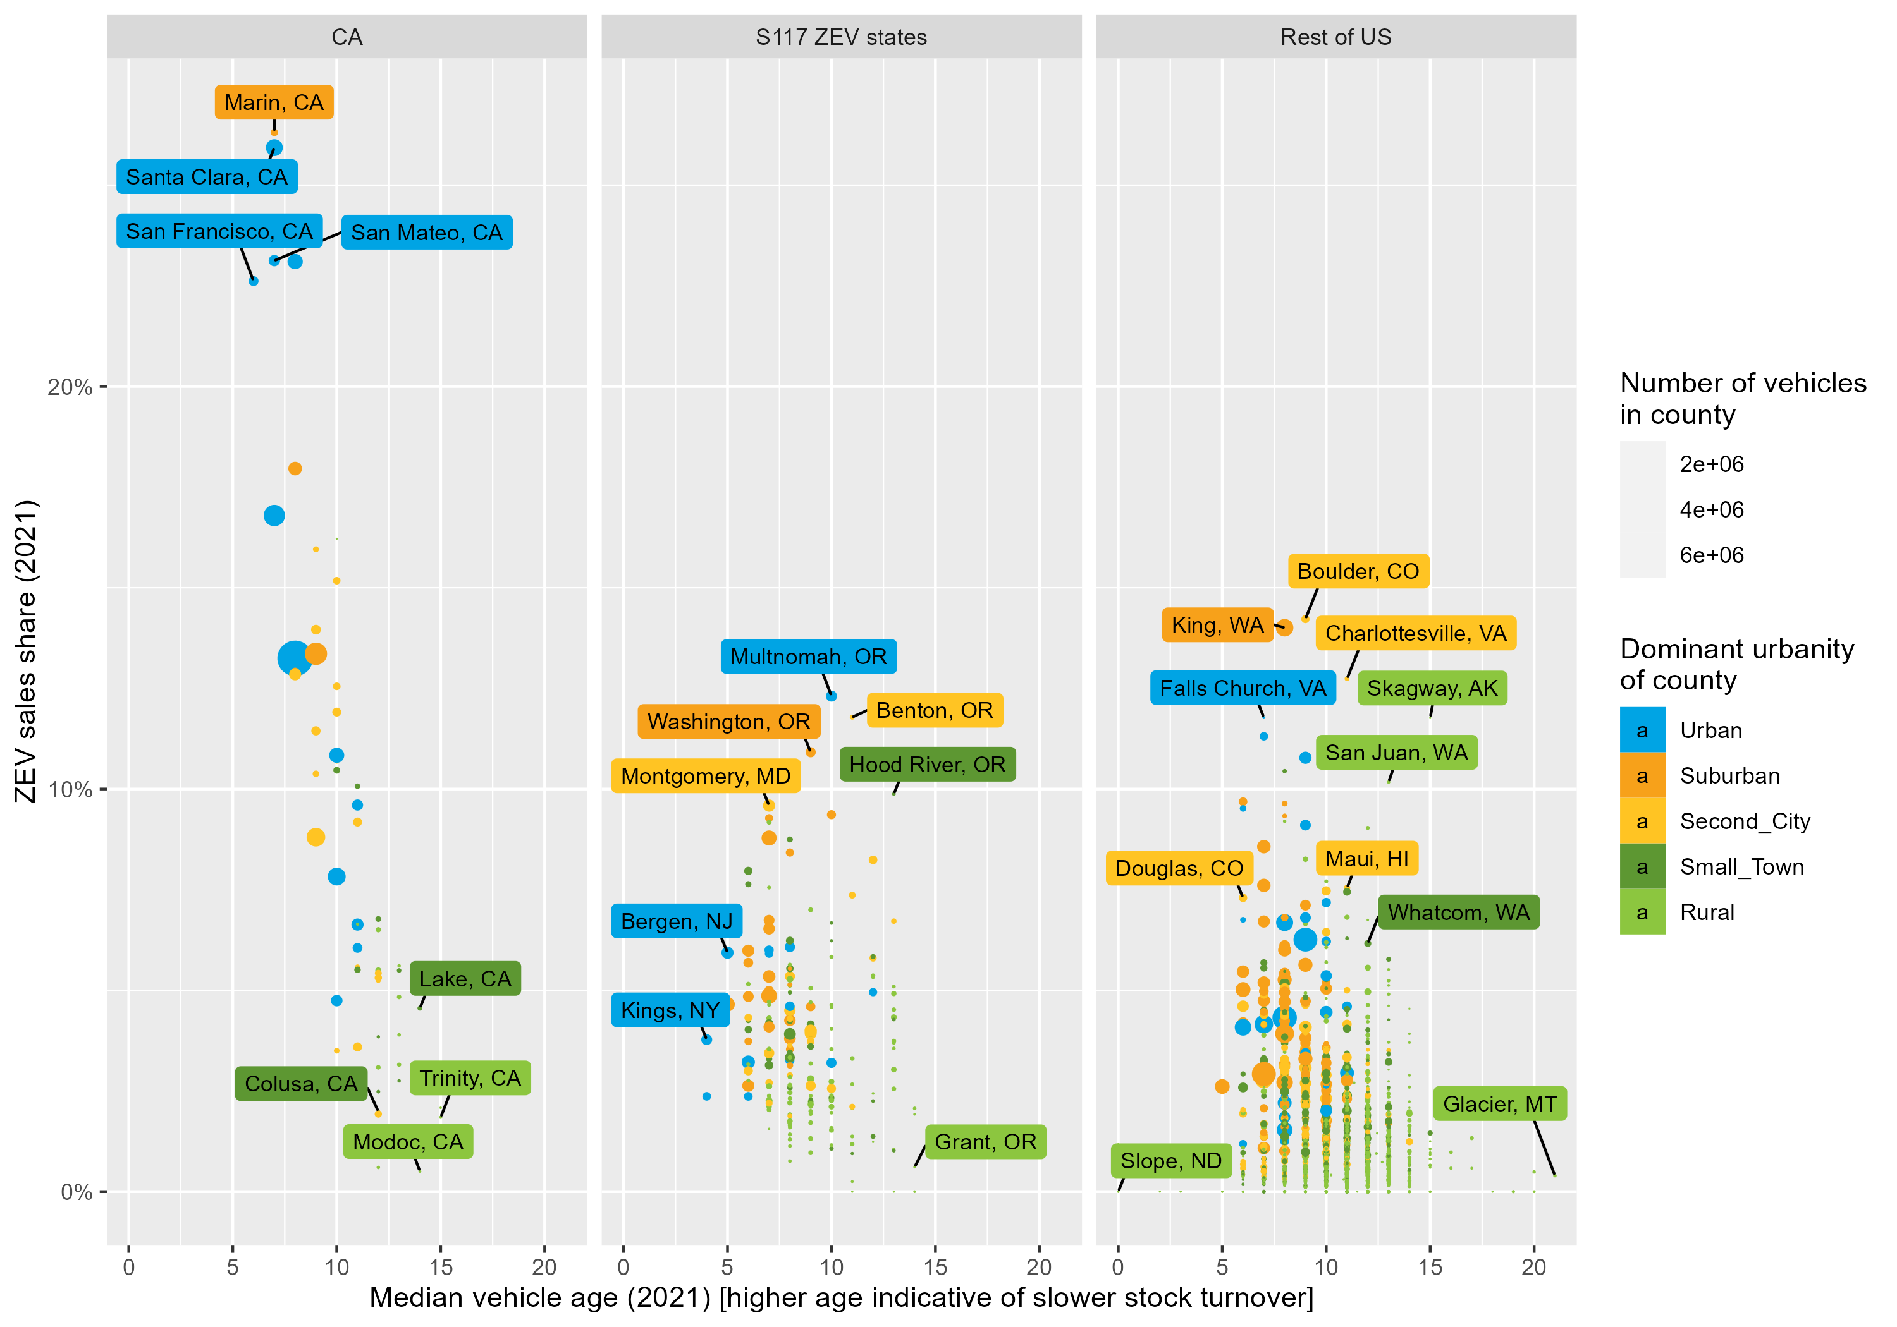
EV sales share and age have been somewhat anti-correlated so far
Counties typically have had higher EV sales share AND newer vehicles / faster turnover so far, mostly in CA
However, this may not be the case in the future
To make better EV adoption projections, both ZEV sales share and age need to be considered in modeling
Notes:
The correlation between regional stock turnover rates and EV sales is also of near-term importance. To date, US counties that have had higher EV shares have also been typically the ones that sell more new vehicles and have faster vehicle stock turnover (such as urban/suburban locations in California with populations with higher income and early adopters of technology). This can be observed in Figure 13, which shows EV sales shares and average vehicle age being anti-correlated (especially in California), where regions with the highest EV sales also tend to have lowest vehicle age, meaning EV stock will turnover faster in these regions. However, this is concurrent and correlated with many other factors – such as both lower EV sales share and higher vehicle age in more rural and lower-income counties – and therefore, the EV sales-to-stock transition may evolve differently in other regions and in the future.

Slide 6
Not just important for EVs/environment
Because vehicle regulations are typically imposed on new Model Years, any new technologies and their benefits must flow through sales to stock
Changes in new vehicle market technologies or prices affect used vehicle ownership/market responses, with feedback to the new vehicle market and stock turnover
The sales volume of the new car market has implications on automotive industry profitability/health/competitiveness

Slide 7
This work seeks to enhance modeling of regional vehicle stocks, sales, and turnover
Goal: Produce theory, methodology, and data to support long-term forecasting of regionally specific vehicle stock, sales, and turnover, without modeling underlying movements/transfers
Goal: Verify soundness of EIA’s approach of using regional survival in NEMS
Premise: Data on sales at a detailed regional resolution are typically unavailable
Premise: Data of used vehicle market movements are not available and modeling them would be too complex
Premise: Retiring vehicles requiring replacement drives most of the quantity of new vehicle sales and turnover
Premise: True differences in regional survival vs. vehicle transfers and movements would be too difficult to disentangle
Premise: National survival is well studied and utilized in models such as TEMPO, VISION, NEMS, MOVES, and can be assumed to approximate scrappage
Notes:
(as opposed to additional new sales from population/economic/vehicle ownership growth)
Salt, miles, traffic, behavior, vehicle composition, repairability, condition

Slide 8
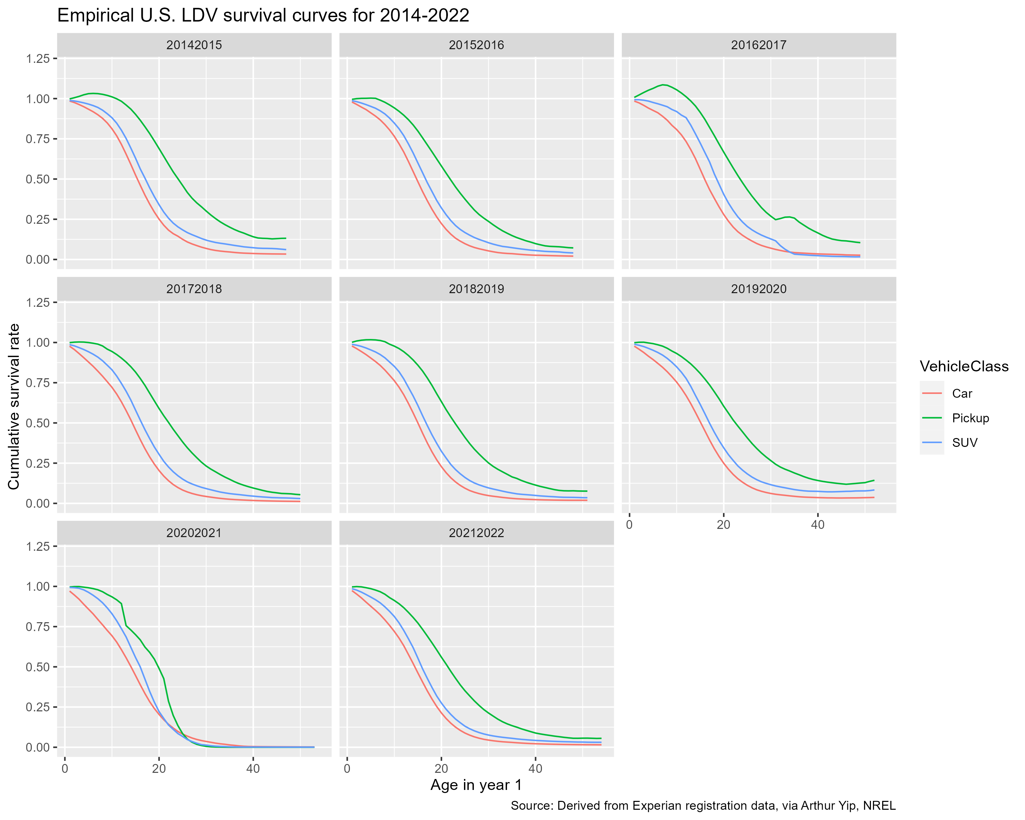
National-level vehicle fleet survival curve
Describes how the vehicle fleet “turns over” over time (i.e. as vehicles age)
Proportion of new vehicles in the U.S. surviving to
age x
100%
~50% of new pickup trucks are still on the road at age 21
50%
0%
Vehicle Age
~70% of new cars survive to age 10
30% have retired/scrapped by this age
(or been exported out of the U.S.)
Notes:
EARLY net survival = import/export
LATE net survival = scrappage
Global/national conservation of vehicle stocks and flows
State neighbors, spatial interaction, gravity modeling

Slide 9
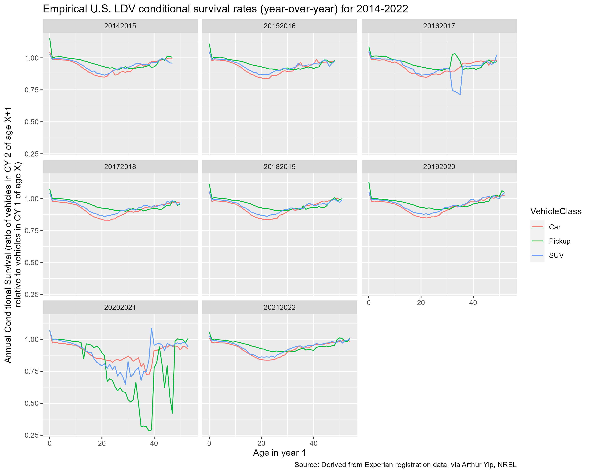
National survival curves 2014-2022
Noteworthy differences between states
Various patterns observed:
>1 and above avg survival in early ages
Below natl avg in early ages
Above natl avg in late ages
Notes:
Automotive industry
Recession – year-specific
Policy years

Slide 10
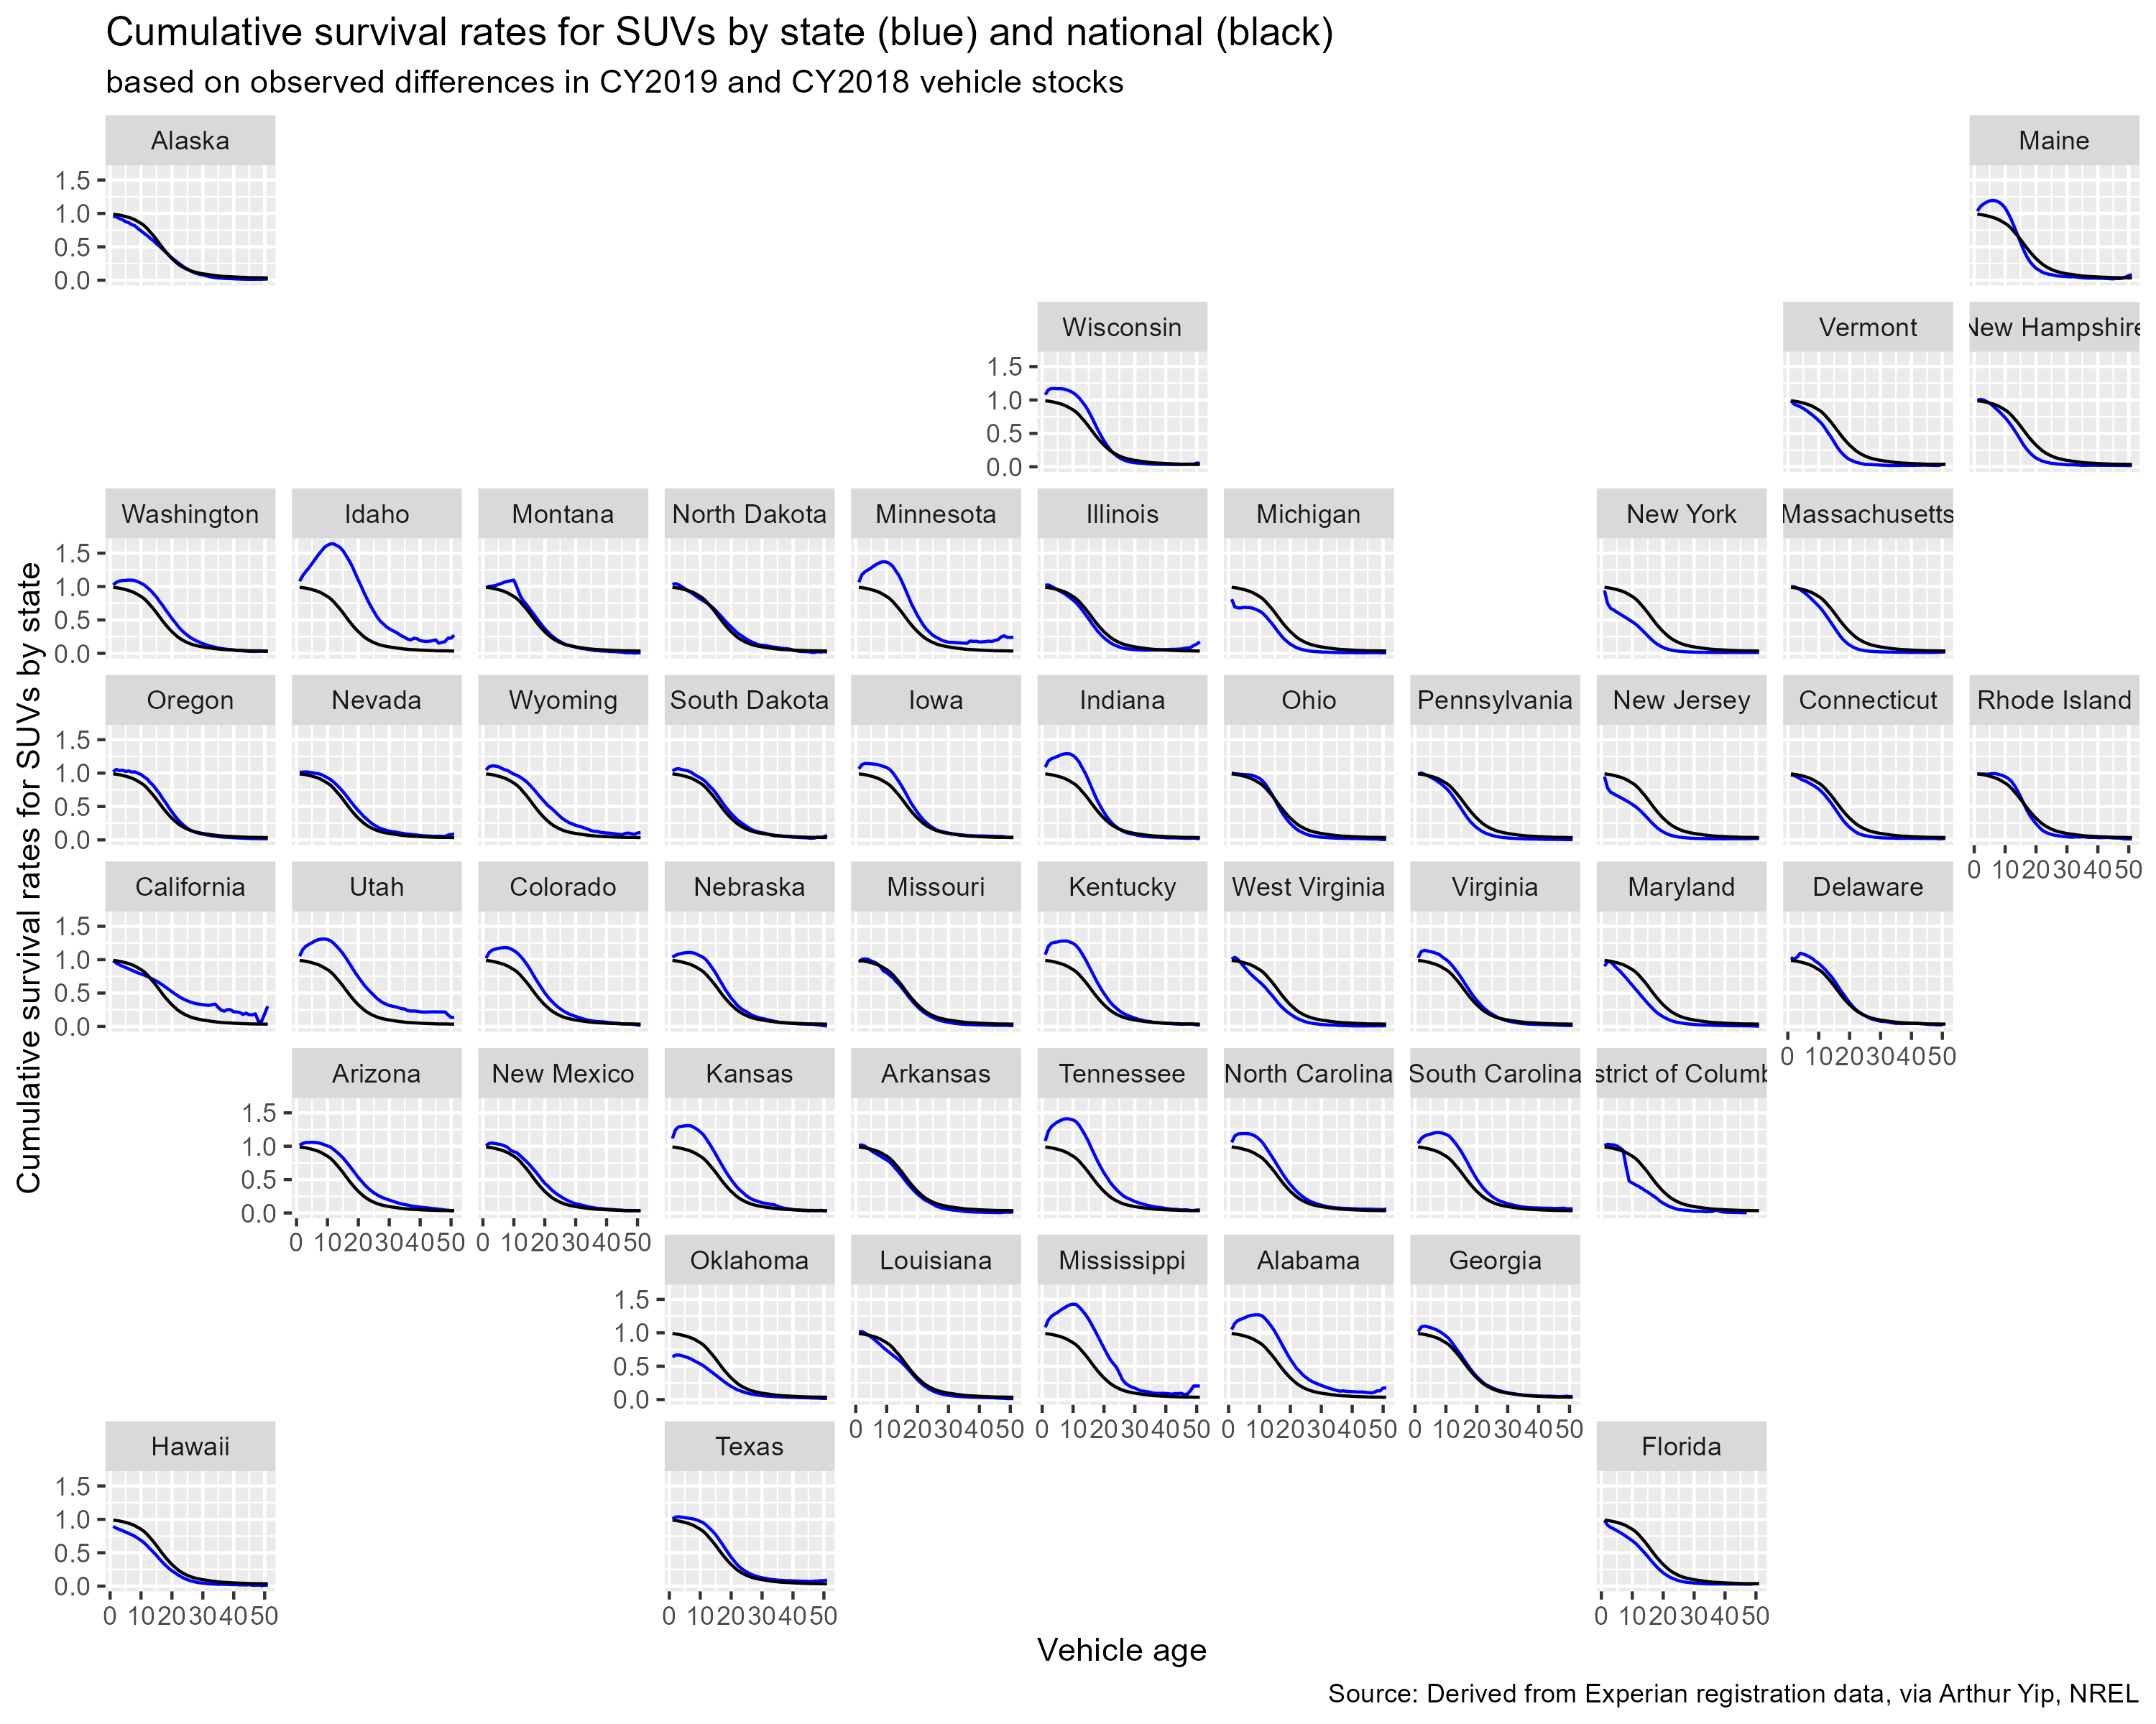
State-level survival curves, 2019
Noteworthy differences between states
Various patterns observed:
>1 and above avg survival in early ages e.g. Idaho
Below natl avg in early ages e.g. New York
Above natl avg in late ages e.g. California

Slide 11
Variables explaining state-level differences in survival
Paper in progress: Greene et al. (2025) submitted
Regression analysis to uncover what drives regionally-specific survival rates
Blue = higher than national = more vehicles surviving or net imported
Red = lower than national = more vehicles scrapped or net exported

Slide 12
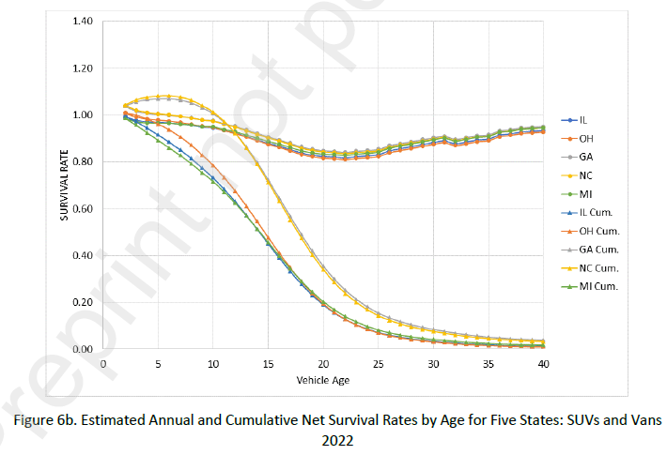
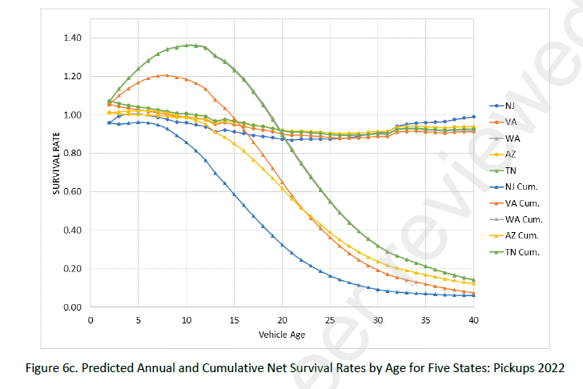
Generalized state-level survival curves, predicted for 2022, based on 2014-2022 data
Greene et al. 2025 (submitted)

Slide 13
Journal peer review - reject
Paper released as UTK Research Report and on SSRN
Submitted to and returned from Transportation Research Part A: Policy and Practice with reviewer comments
Reviewers noted a disconnect between stated motivation and goals (informing EV transition) vs. actual results
Reviewers were confused about “net survival”, which combines scrappage and migration, and disputed its usefulness
Reviewers requested more rigorous theory and further attempts to distinguish scrappage and migration
Reviewers requested validation of model forecasts e.g. via out-of-sample prediction or backcasting/backtesting
Responses and resubmission to another journal in progress
In particular, validation via out-of-sample prediction/backcasting via this subtask

Slide 14
How can accurate regional vehicle turnover/sales be estimated?
Regional stocks paired with… | Pros | Cons
National survival | Simple, well-studied, validated | Regional stock age converge to national stock age. Only approximate scrappage is captured; no representation of used market/internal transfers.
Regional sales fixed at historical turnover, assuming FIFO | Simple, preserves regional average ages | Regional average ages are only approximated; regional age distributions are lost. No representation of transfers.
Regional “net survival” | Potentially better representation of regional dynamics | Potential discrepancies with national turnover Negative net survival (imports) may not draw from available stock General net survival rates may under/overestimate changes to technology-specific vehicle stock
Full model of used market and transfers between regions |  | Lack of data/model/theory Complex – regions can’t be run independently Embeds current patterns
Notes:
Assume known/fixed population/demographic, economic, and vehicle ownership levels

Slide 15
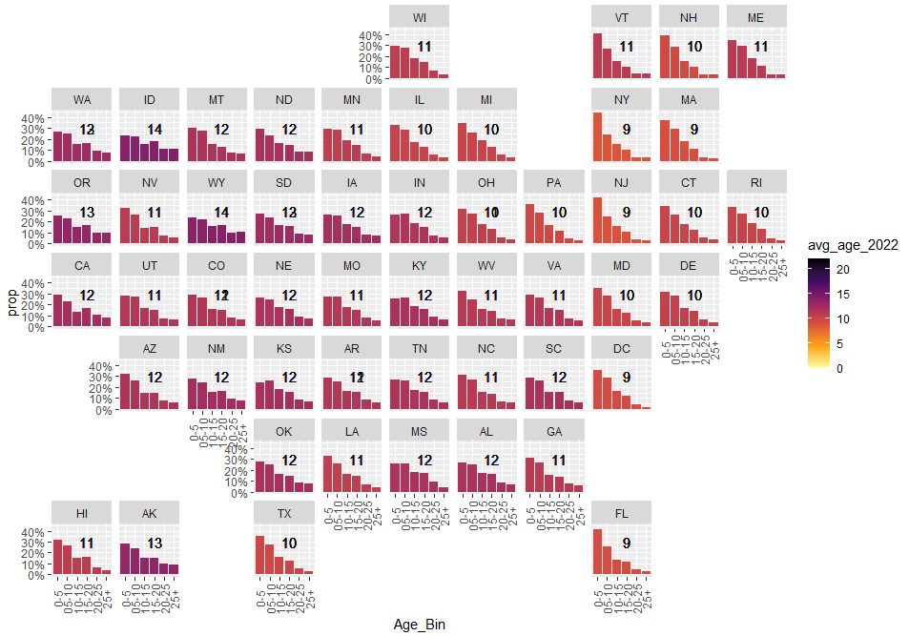
The age distribution of vehicle stock differs varies across the US

Slide 16
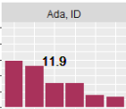
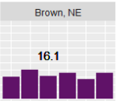
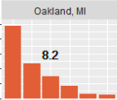
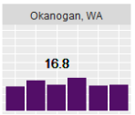
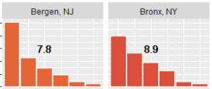
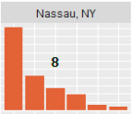
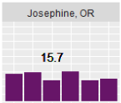
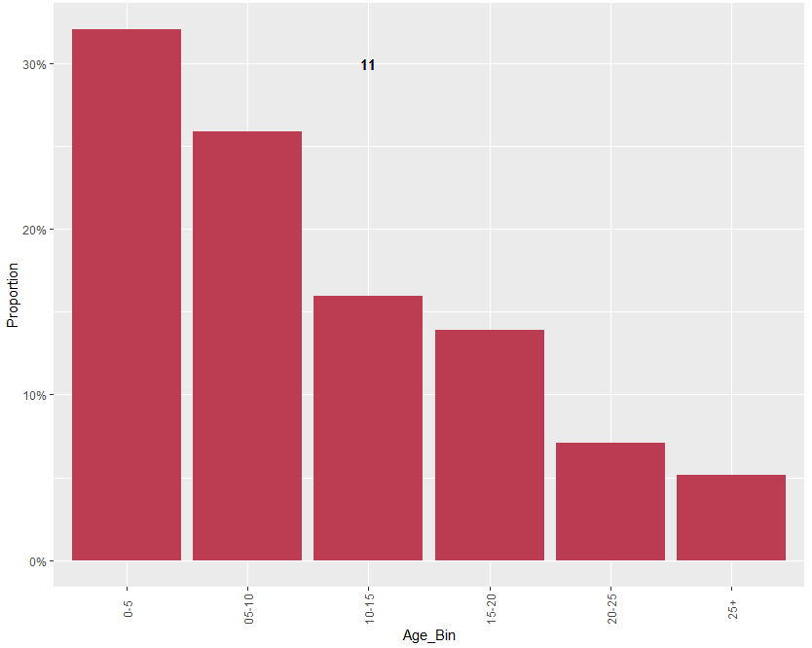
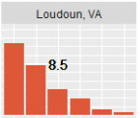
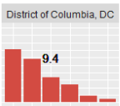
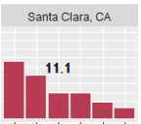
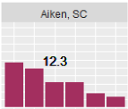
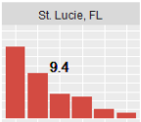
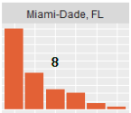
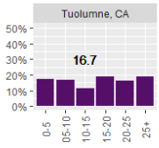
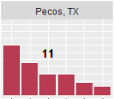
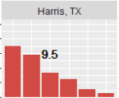
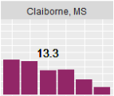
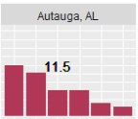
Differences in age distribution are starker at the county level

Slide 17
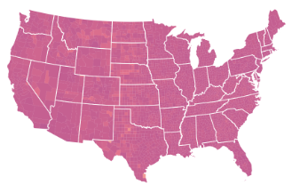
Applying the national survival to 2050 produces the expected steady-state stock, same in every county

Slide 18
Applying fixed regional turnover to 2050 helps maintain average age in every county, but veers away from original distributions
Results in progress

Slide 19

How would regional stocks evolve if we used our newly derived state-level net survival curves?
Current age distribution of regional vehicle stocks
+
State-level net survival curves
(Greene et al. 2025, submitted)
25 simulation years in TEMPO
?

Slide 20
Applying regional net survival to 2050 helps maintain age distribution shapes in every county, but sums may not match national, especially technology-specific sums
Results in progress

Slide 21
Next steps (with limited remaining budget)
Complete resubmission of peer-reviewed paper
Complete interpretation of simulation results (which could be part of additional validation for above)
Document with choropleths and highlighted regional results
Assess and discuss alignment with national results, specifically with stock of new technologies

Slide 22
Future steps
Connect survival curves to the age distribution and average age of stock
Does simulating any stock on a certain survival curve end up at a predictable age distribution at steady-state?
Does the age at which 50% of vehicles are expected to have cumulatively survived equal the expected median age at steady-state? What about expected age vs. life?
Would this be applicable to net survival curves, and would ages with negative net survival be able to be accounted?
Is census region, state, or county the appropriate level of analysis? County clusters?
Notes:
-National as true scrappage - yes
-Theoretical connection with stock age profile/distribution and the steady-state result of running through a survival curve and/or a net survival curve -- problems: fluctuating sales. You could say expected life etc. ?
-- problems: exports from the US

Slide 24
Objectives and Status
Supporting contributions of survival data/analysis/paper complete
UTK Research Report published, journal manuscript about to be submitted
Team has proposed research extensions (unfunded)
Some additional analyses and preliminary results on vehicle ages and sales also available
Remaining objective:
Implement new theory and data on regional LDV survival curves to better represent the used vehicle market and overall stock at a granular level in TEMPO
Milestone:
Explain implications of modeling enhancements on national and subnational stock modeling, result consistency, and future applicable analyses e.g. new technology adoption.

Slide 25
Advancing the state of the art
Current state of the art:
Survival is exclusively modeled nationally in peer-reviewed literature and energy-economy models*
* In the latest EIA NEMS model and AEO 2025, EIA derived and implemented regional survival curves, but without documentation and without vetting of theory and data
Anticipated & desired improvements in modeling results:
Represent & maintain existing vehicle age distributions within subnational regions
Predict regional vehicle survival and sales, with implications on technology adoption
Anticipated issues & risks:
Potential inconsistencies in national & subnational vehicle stock totals
In the case of negative survival, vehicles start appearing into the stock (rather than disappear from fixed tracked quantities)
Scarce data on EV-specific survival/movement; risk of inappropriate application
Inability to distinguish vehicle movements vs. true scrappage variation between areas, which could lead to inappropriate extrapolation of temporary trends
No data and theory available to model vehicle movements/transfers between regions

Slide 26
With remaining budget, plan is to…
First-cut application of regional survival curves
Run TEMPO for 50 states or ~3000 counties, with regional initial stocks and with national and regional survival curves
Reduce or increase vehicle stocks by age according to regional survival curve (including negative net survival)
Naïvely reduce/increase uniformly across powertrain types
Assume BEVs follow same survival rates
Observe regional and aggregate sales and stock-age distributions; compare with TEMPO national run results
Compare with EIA NEMS implementation
Describe results, assess progress, explain limitations & future applicability
Propose alternative data structures, parameterization, and assumptions to address limitations
Notes:
First pass is uniform assumption (possible expected eventuality)
+ assumption that BEVs follow same survival
Plan is to assess results and revisit parameterization

Slide 27
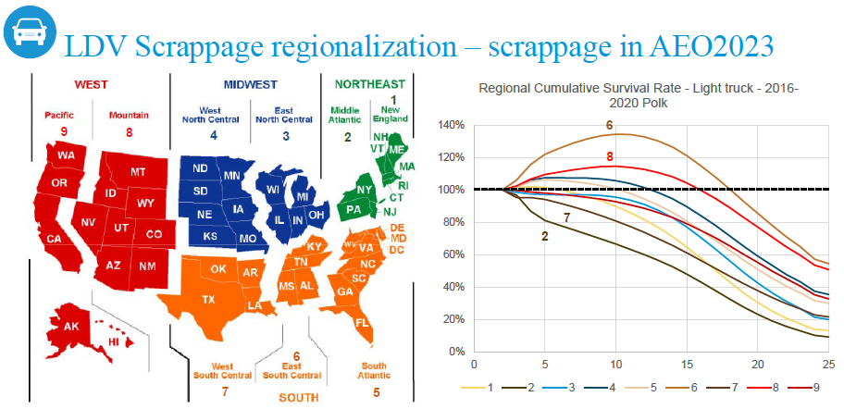
Regional survival curves to help TEMPO reflect vehicle age heterogeneity and impact on EV roll-out
In lieu of explicitly modeling used vehicle sales and transfers, we will apply regionalized “survival” curves to TEMPO that can approximate used vehicle transfers and slower turnover.
In addition to regional survival either from EIA or from analysis of Experian vehicle registration data, we will make assumptions about the EV share of transferred vehicles and true scrappage from national survival data.
Overall, this will enable TEMPO to more accurately reflect the nature of new vs. used sales by county and improve its projections of EV roll-out.
New to AEO 2023, EIA started using regionalized survival curves. Note region 6 where light trucks of age 10 have 140% survival i.e. more age 10 vehicles appear in this region than the previous year’s age 9 vehicles.
This can be attributable to used vehicle transfers, likely from regions such as 2 and 7 where these vehicles are disproportionately disappearing.
Notes:
Use national as actual scrap
Total stock of a vintage = previous vintage + net used transfers in - actual scrap (note new sales in vintage 0)
Exogenous national scenario could inform EV share of net used transfers in
Total net transfers out
Total net transfers in
Idea: run counties with net transfers out first. This would provide details (fuel type, vintage, class) of the transferred vehicle market.
Determine tech shares for remaining counties.
Run counties with net transfer in, pulling from the transferred vehicle market. Uniform/average.

Slide 28
Remaining uncertainty
When a region retires and exports vehicles, we assume it retires/exports a mix of ages and powertrains of the composition of the region’s stock
When a region imports vehicles, we do not have visibility into the mix of powertrains. This may be particularly relevant if a region has low or no new sales or EVs, but does begin to import used EVs.
We will need to establish assumptions and a calibration procedure such that the sum of regional vehicle stocks do not fall out of alignment of nationwide stock and survival.

