Slide 1

Light-Duty Vehicle Survival and Longevity in the US: Analysis of National Vehicles in Operation Statistics David Greene Civil & Environmental Engineering Ben Leard Baker School November 20, 2025

Slide 2

_{We}
WHY?
Important determinant of Replacement Demand for new vehicles.
Key factor in the time required to accomplish an Energy Transition.
Essential for modeling Vehicle Stock Turnover and future energy use, emissions, safety and vehicle automation.
This work was supported by Oak Ridge National Laboratory and in done collaboration with the National Renewable Energy Laboratory.
The views expressed are those of the authors and not necessarily those of ORNL, NREL, the USDOE or UT.

Slide 3
Motor vehicles and especially light-duty vehicles (LDV) dominate U.S. Transportation
Highway vehicles produce 87% of passenger miles, 40% of ton miles.
87% of >280 million highway vehicles in operation (VIO) are light-duty vehicles (LDV): Cars, SUVs, Pickups.
Used vehicles are approximately 95% of vehicles in use.
USDOT, Bureau of Transportation Statistics, National Transportation Statistics, 2025.

Slide 4
Here are the topics I plan to cover.
Please feel free to raise questions at any time.
Economics of vehicle scrappage.
Historical evidence of increasing vehicle longevity.
Scrappage/survival analysis of 2002-2020 passenger cars, SUVs and minivans, and pickup trucks in operation (supported by ORNL).
Implications for electrification and LDV CO₂ emissions.
Preliminary analysis of 2014-2022 state-level used vehicle scrappage and migration (collaboration with ORNL and NREL).

Slide 5
Econometric analyses of vehicle scrappage go back to the 1950s but the literature is relatively sparse.
Cramer (1958): vehicles scrapped at zero value due to wear and tear or accidents.
Walker (1968): scrappage when cost of repair > market value, influenced by used vehicle prices.
Parks (1977): scrappage when cost of random repair + scrap value > market price.
Several more (including Greenspan & Cohen, 1999; Jacobsen and Bentham, 2015) but basic economic theory essentially the same.
Useful international studies, especially for scrappage functional forms.
VIO data used in early studies contained about 10 vintages + >10 yrs. Today, 50 or more vintages are available.

Slide 6
Review of the literature revealed a trend of increasing longevity at rates of 0.5% to 1.0% per year in studies dating to 1999 using data as early as 1958. During this period, the designs and uses of light trucks changed markedly.
Source | Vehicle Type | Model or Calendar Year | Start Year | End Year | Expected Lifetime |  | Annual % Change
 |  |  |  |  | Start Year | End Year
Hamilton & McCauley, 1999 | Cars | Model | 1958 | 1977 | 9.0 | 11.0 | 1.06%
Greenspan & Cohen, 1999 | Cars & Trucks | Model | 1960 | 1980 | 9.8 | 12.5 | 1.22%
Davis & McFarlin, 1996 | Cars | Model | 1970 | 1985 | 10.7 | 12.1 | 0.83%
 | Trucks | Calendar | 1969 | 1975 | 14.0 | 14.6 | 0.77%
 | Trucks | Calendar | 1975 | 1983 | 14.6 | 15.8 | 0.98%
Davis & Diegel, 2013 | Cars | Model | 1970 | 1980 | 11.6 | 12.5 | 0.81%
 | Light Trucks | Model | 1970 | 1980 | 16.2 | 15.2 | -0.58%
Bento et al., 2018 | Cars | Calendar | 1974 | 1983 | 12.5 | 14.1 | 1.29%
 | Light Trucks | Calendar | 1974 | 1983 | 16.3 | 15.1 | -0.80%
NHTSA, 2006. | Cars | Calendar | 1984 | 1989 | 12.4 | 13.2 | 1.10%
 | Light Trucks | Calendar | 1984 | 1989 | 15.6 | 14.1 | -1.89%
Greene & Leard, 2022 | Cars | Calendar | 2003 | 2020 | 14.9 | 16.1 | 0.46%
 | SUV & Van | Calendar | 2003 | 2020 | 16.6 | 18.2 | 0.54%
 | Pickup | Calendar | 2003 | 2020 | 18.7 | 24.0 | 1.48%
Zhu et al., 2021 | Cars | Calendar | 1975 | 2018 | 12.2 | 16.9 | 0.76%
 | SUVs* | Calendar | 1975 | 2018 | 14.2 | 17.8 | 0.53%
 | Pickups | Calendar | 1975 | 2018 | 16.3 | 18.6 | 0.31%
 |  |  | Mean including light trucks |  |  |  | 0.52%
 |  |  | Mean excluding light trucks |  |  |  | 0.96%
 |  |  | Mean trucks weighted 1/3 |  |  |  | 0.67%

Slide 7
We modeled the probability of surviving to age a+1, conditional on surviving to age a.
IHS Markit® National Vehicles In Operation (VIO) counts, 2002-2020 (ORNL).
US used passenger vehicle exports exceed used imports by an order of magnitude. Net exports averaged 6.8% (stdev 1.2%) of LDV scrappage from 2003 to 2020 (USDOC, 2025).
We define vehicle age (imprecisely) as (calendar year) – (model year).
Model year ≠ Calendar year, carryover of unsold inventory can be substantial.
Survival rate of (a-1)-year-old vehicle, type v from year t-1 to t is S_{vat} = (N_{vat}/N_{v(a-1)(t-1)}) .
v = passenger car, SUV+vans, pickups.
Scrappage rate is r_{vat} = 1- S_{vat .}
U.S. Department of Commerce (USDOC), International Trade Administration, 2025b. “Used Vehicle Trade Data Visualization”,
U.S. Exports of Used Passenger Vehicles TOTAL Exports HTS Units and U.S. Imports of Used Passenger Vehicles TOTAL Imports HTS Units.
https://www.trade.gov/data-visualization/used-vehicle-trade-data-visualization .

Slide 8
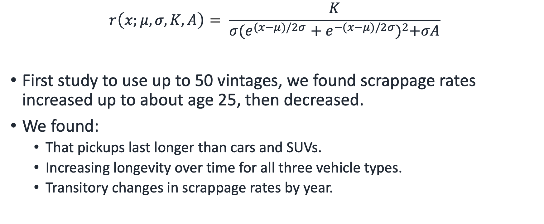
After testing several functional forms, we found a modified logistic distribution fit the data best.
$$r\left(x;μ,σ,K,A\right)= \frac{K}{σ{(e^{(x−μ)/2σ}+e^{−(x−μ)/2σ})}^{2}+σA}$$
First study to use up to 50 vintages, we found scrappage rates increased up to about age 25, then decreased.
We found:
That pickups last longer than cars and SUVs.
Increasing longevity over time for all three vehicle types.
Transitory changes in scrappage rates by year.

Slide 9
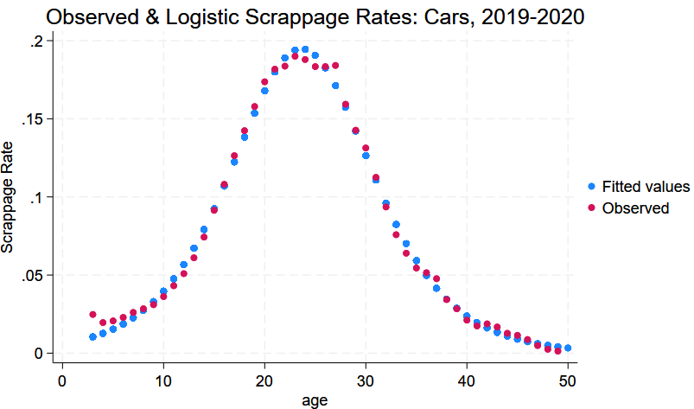
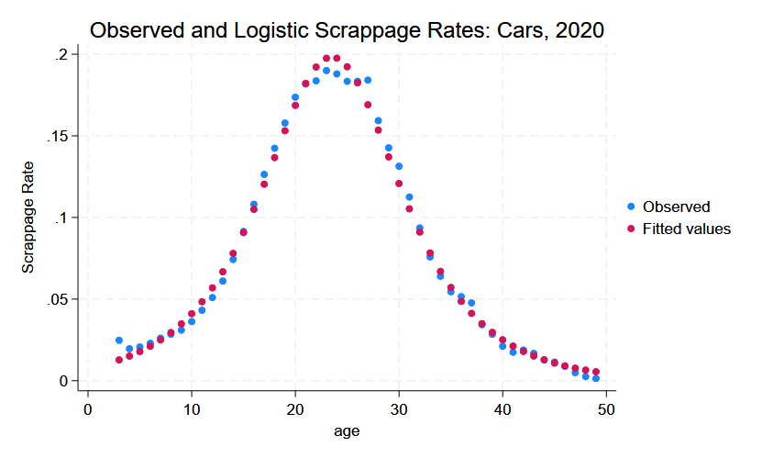
Weighting the data by the VIO for each age and vehicle type fits newer vehicles slightly better, older vehicles slightly worse. (Apologies for switching colors!)
Weighted

Slide 10
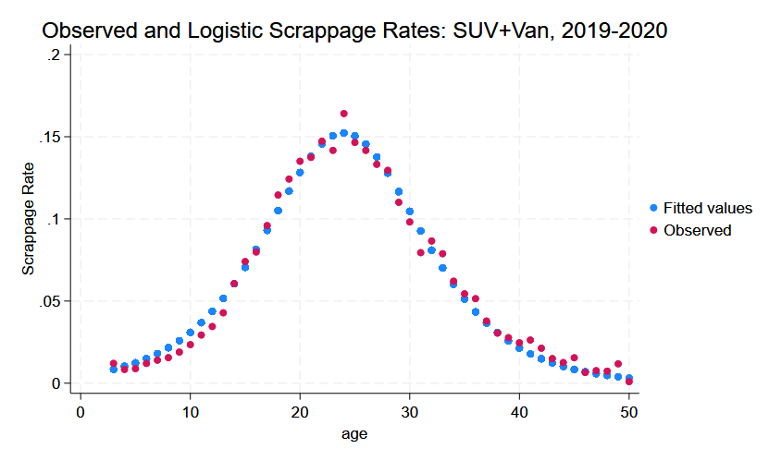
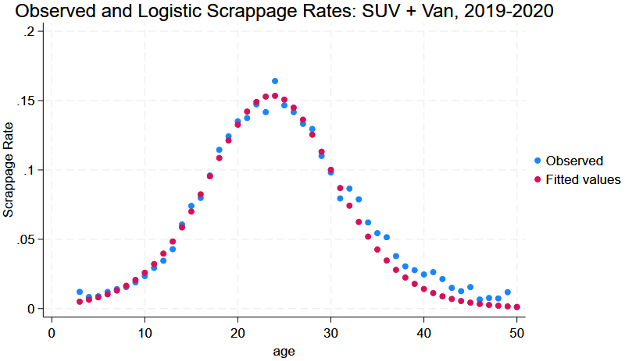
For SUVs the balance between the fit to newer and older vehicles is more evident.
Weighted
Weighted

Slide 11
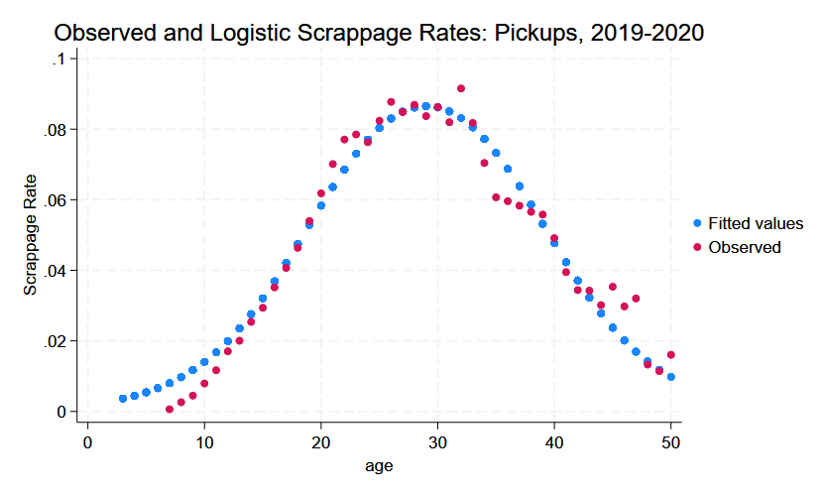
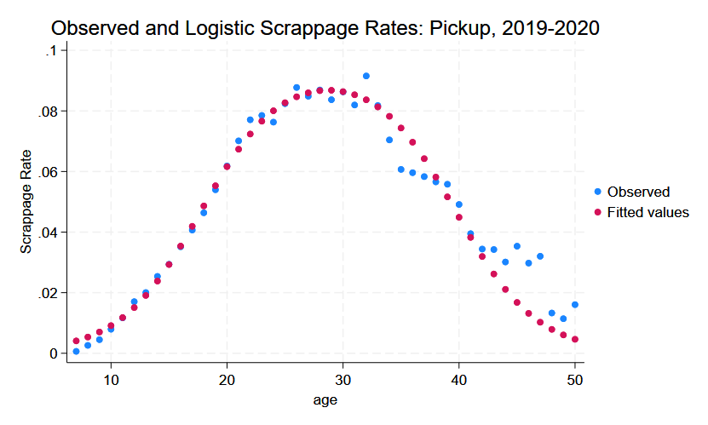
The pickup curves are platykurtic (first chance ever to use that word) with a maximum at 28-29 years. (Also, negative scrappage rates for <7 years in 2019).
Weighted
Weighted

Slide 12
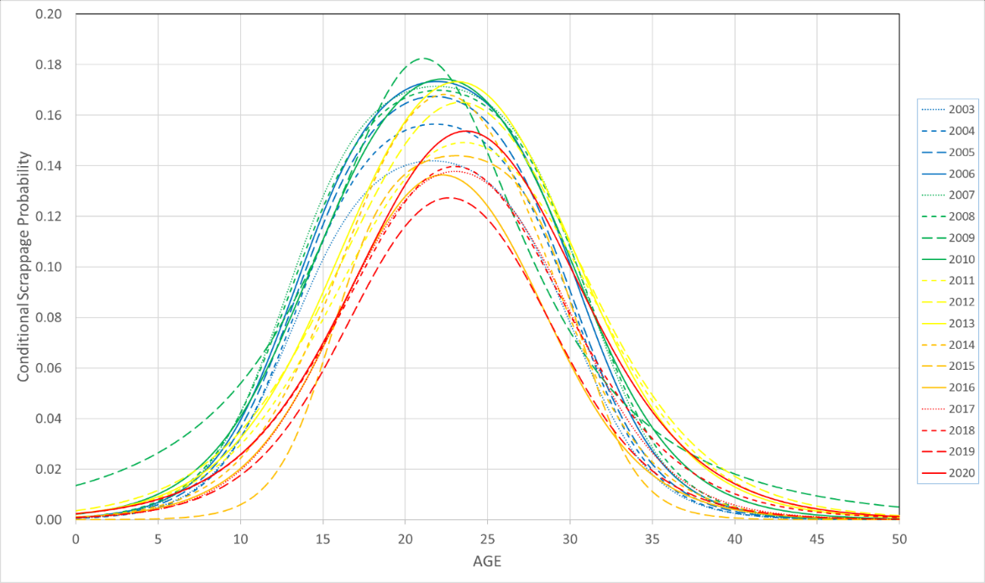
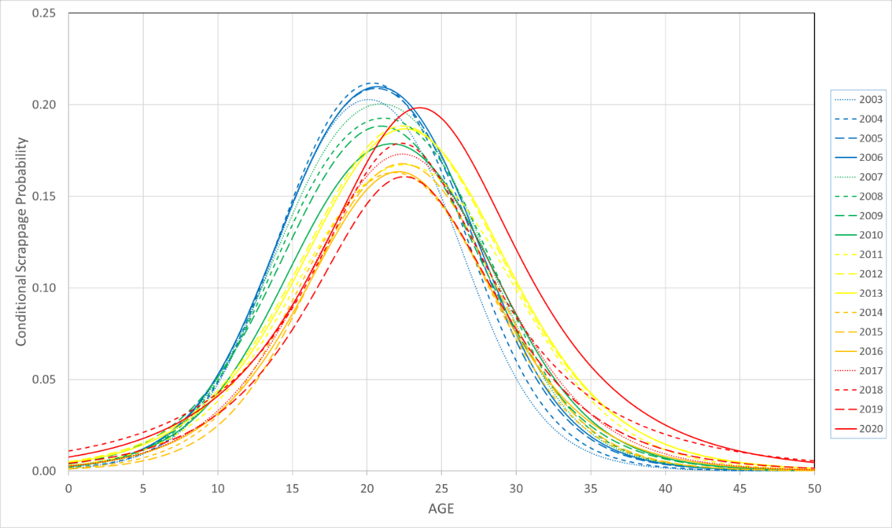
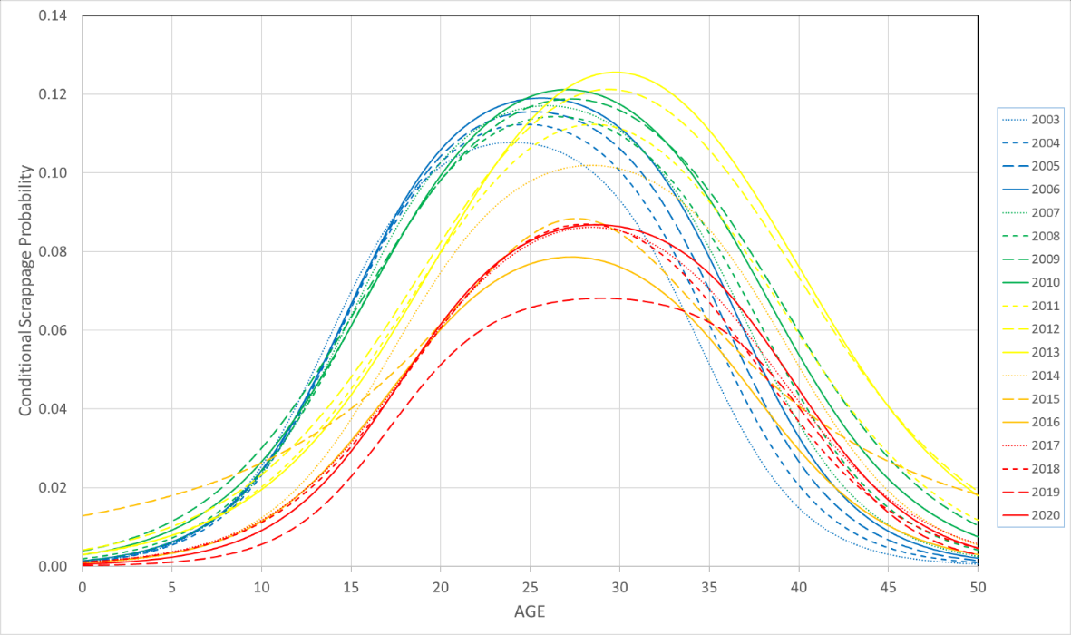
All three vehicle types show increasing longevity from 2002-2020. The time sequence is blue to green to yellow to red, with increasing solidity of the lines.
SUVs + Vans
Cars
Pickups
Scrappage Rate
AGE 0 to 50 Years

Slide 13
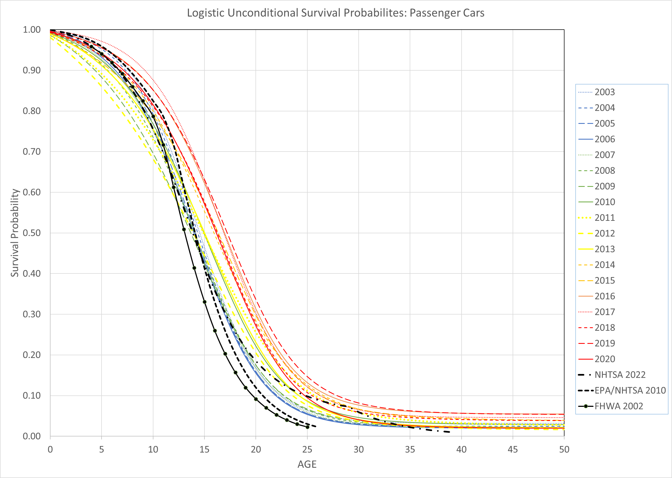
Median expected lifetime is where the survival function crosses 0.5. Time sequence is blue to green to yellow to red, with increasing solidity of the lines.
Cars

Slide 14
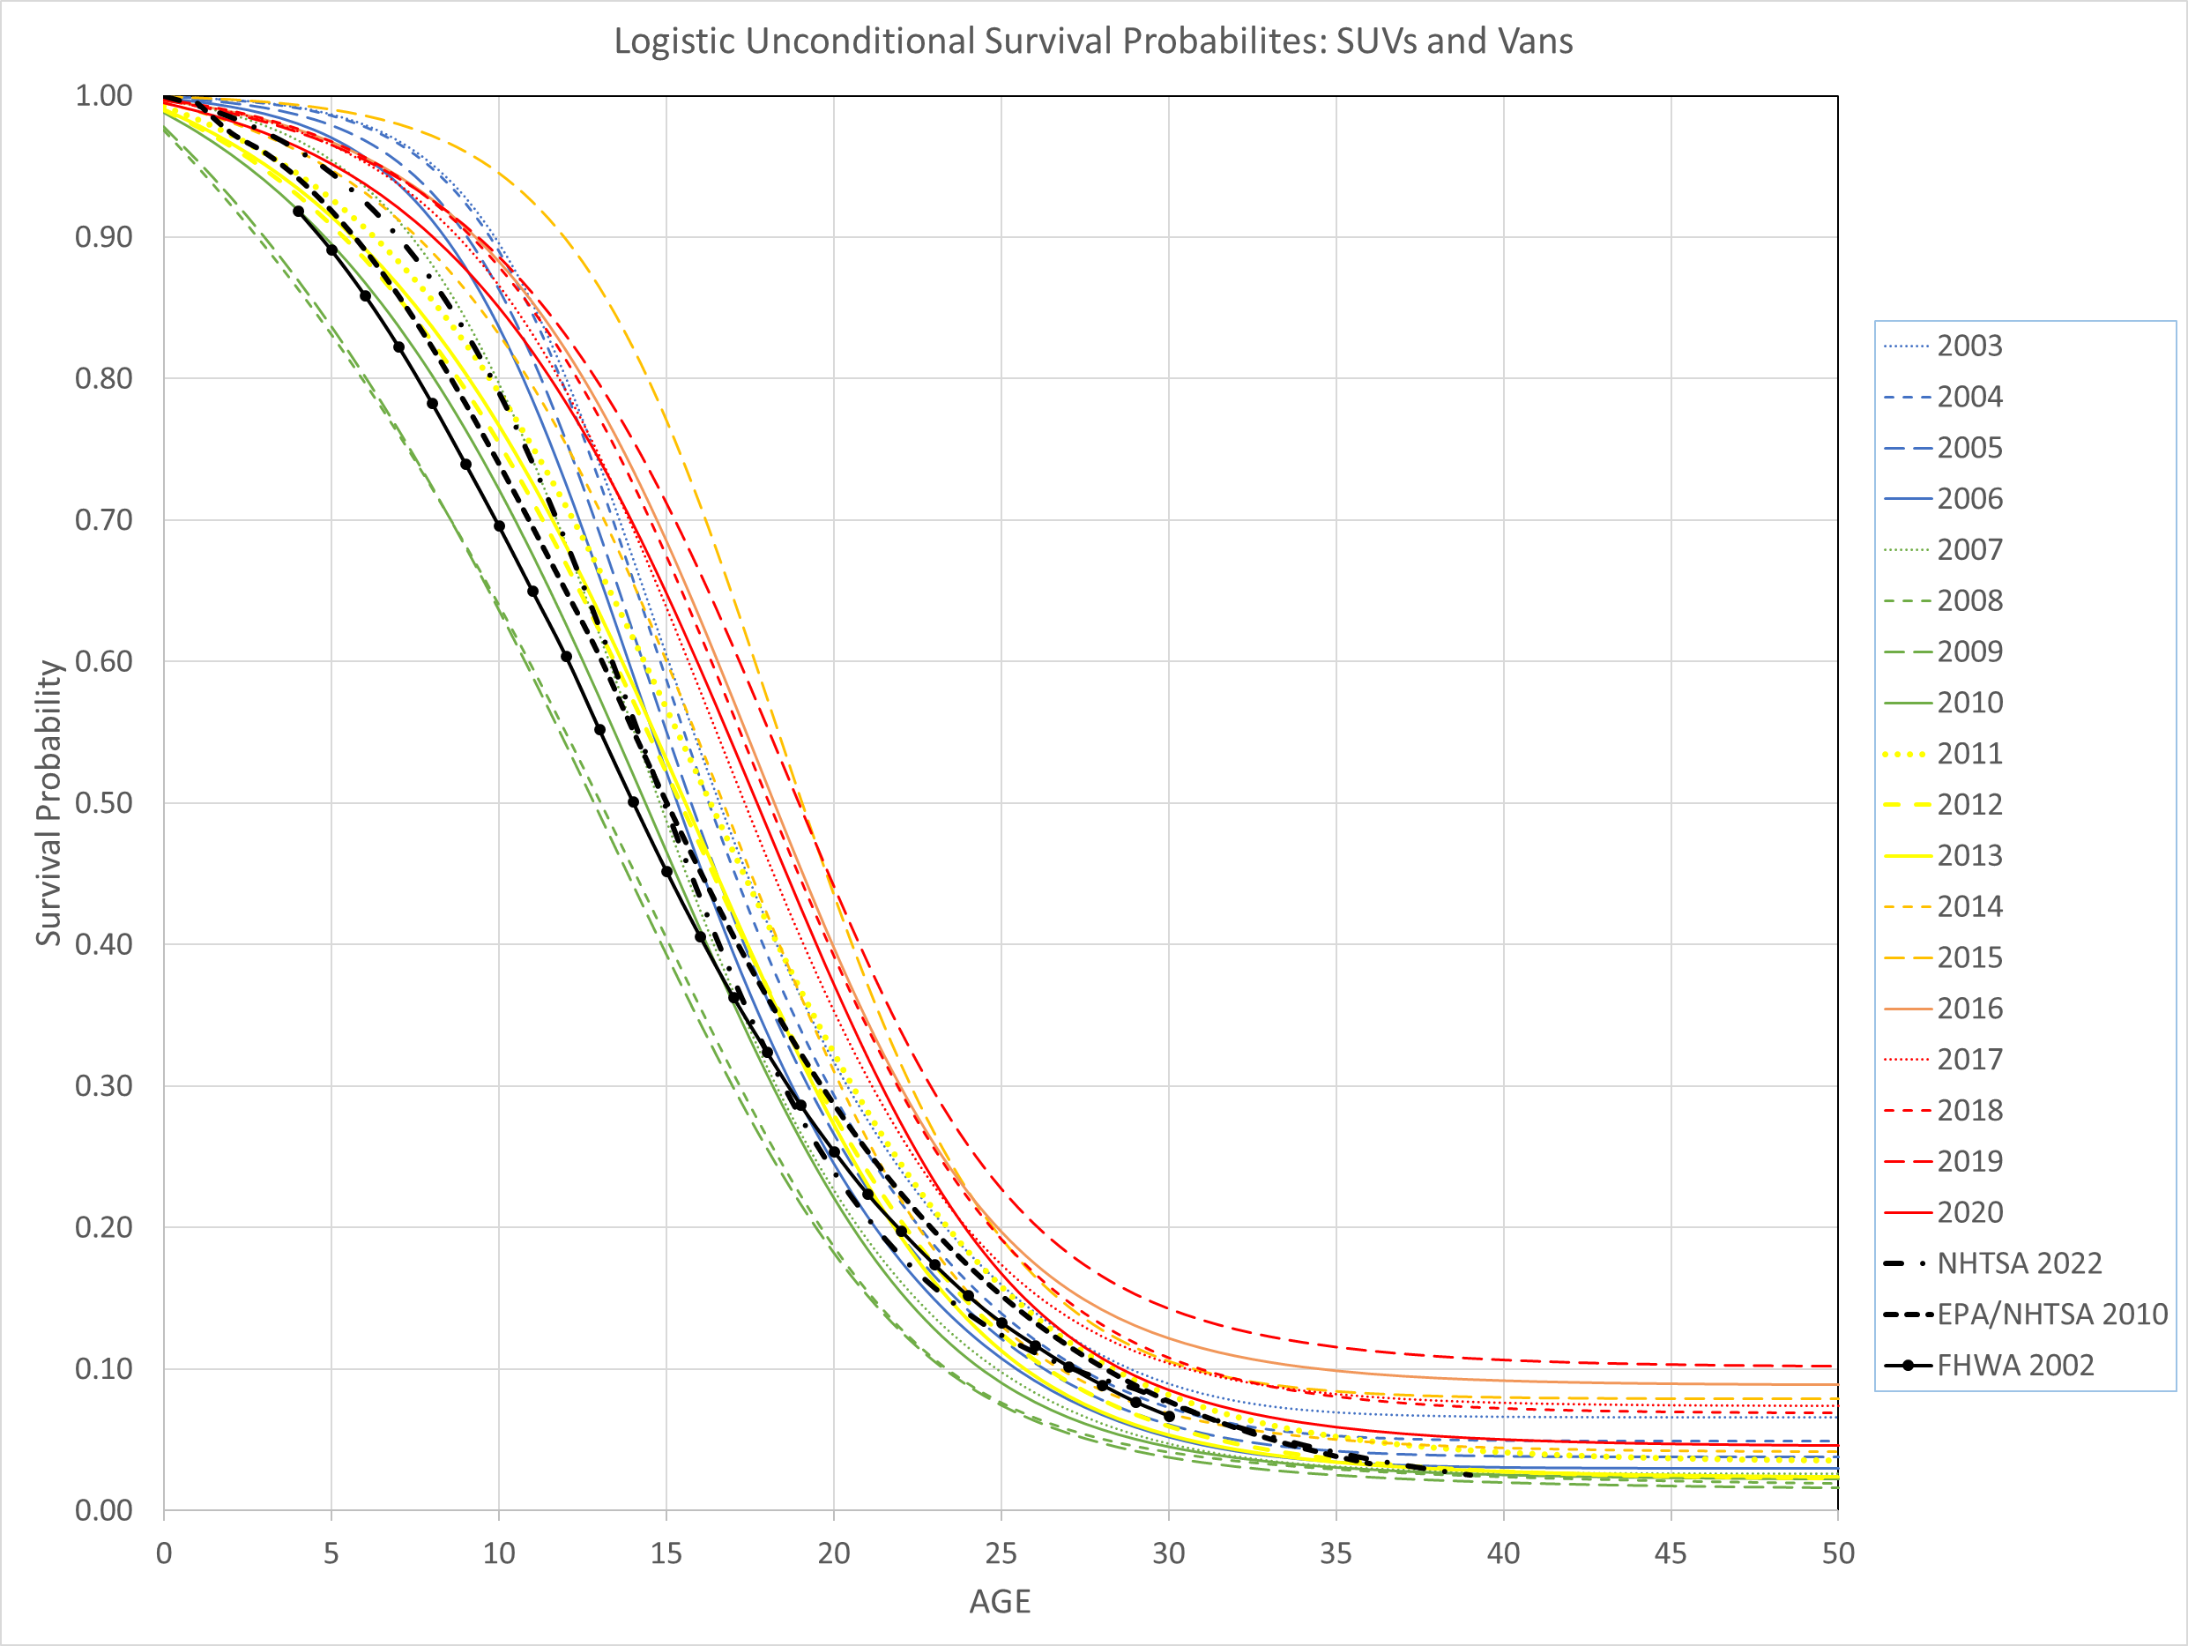
The FHWA and EPA/NHTSA curves are for all light trucks. Time sequence is blue to green to yellow to red, with increasing solidity of the lines.
SUVs + Vans

Slide 15
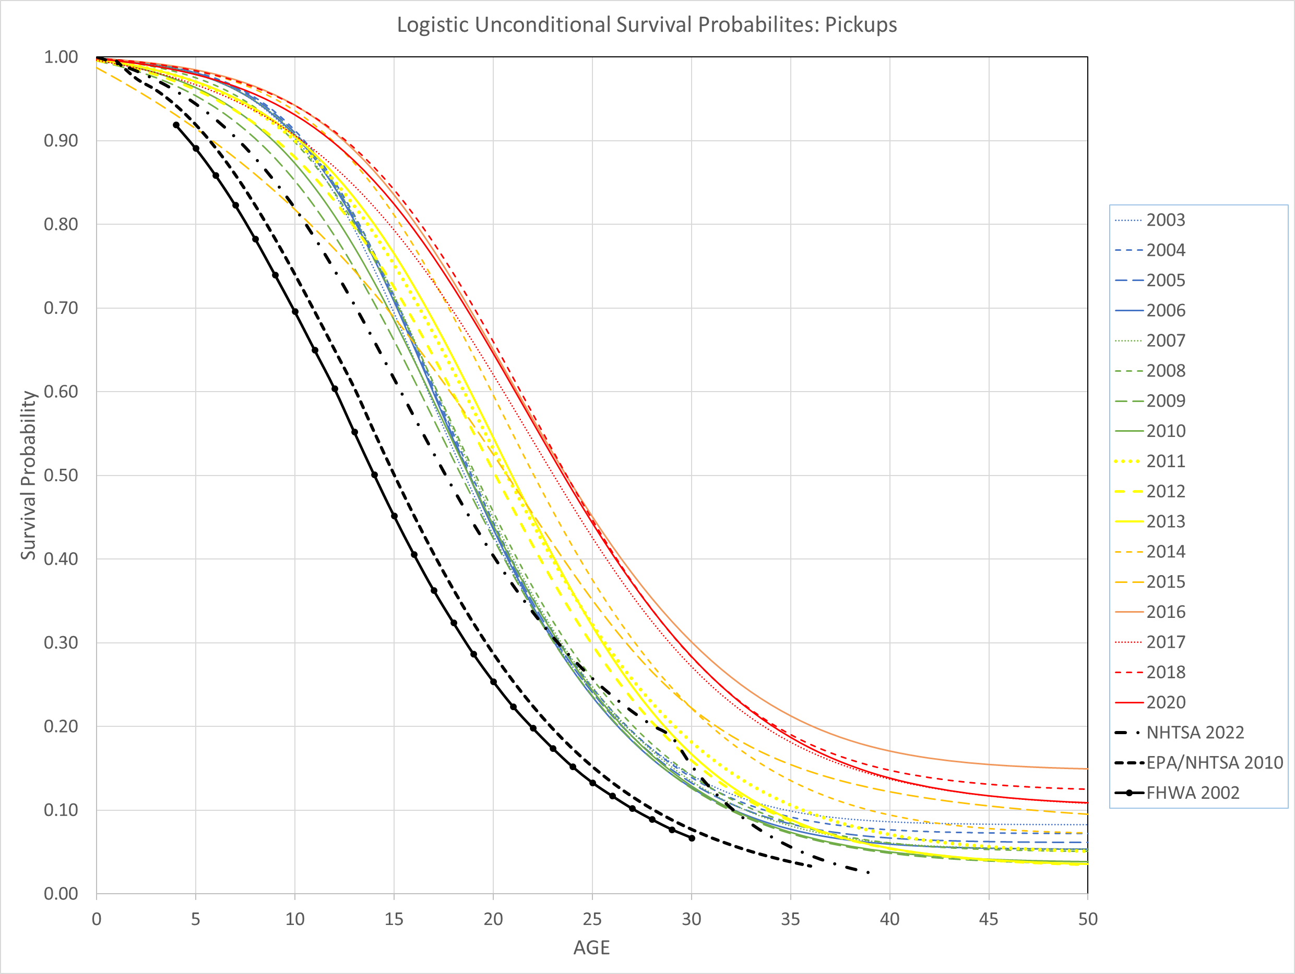
Increasing longevity is easier to see in the survival curves. Time sequence is blue to green to yellow to red, with increasing solidity of the lines.
Pickups

Slide 16
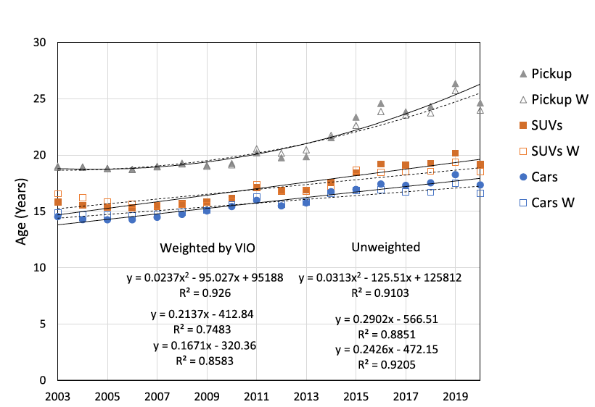
We also estimated logistic models whose parameters were linear functions of time (x = years since 2002). They supported increasing longevity with some year-to-year variation.
W = weighted data

Slide 17
Although we did not try to estimate causes of increased longevity, it seems clear that…
The content ($) of LDVs has increased (faster than repair costs?)
Amenities
Safety equipment
Fuel economy technology
Technology has improved
Materials and coatings that resist rust
Computer controls and monitoring
More precision manufacturing
Lower friction lubricants
Regulations have had additional impacts
100,000-mile durability of emissions controls
Reduced drivetrain friction to increase fuel economy
Crash avoidance

Slide 18
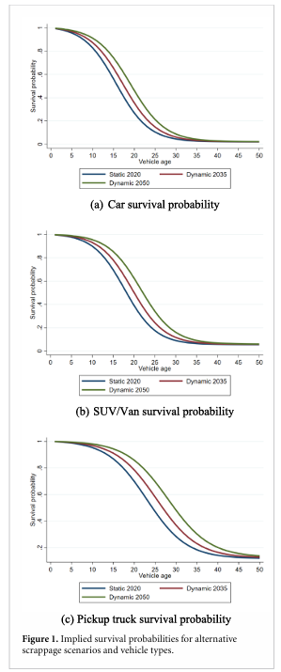
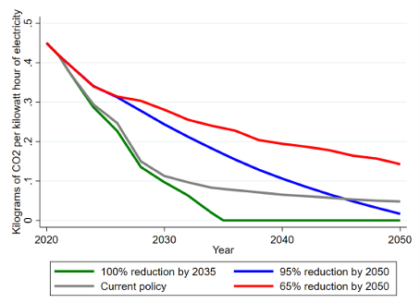
Using a simple stock model, we explored the implications of increasing vehicle longevity in a paper published in Environmental Research Letters in 2023.
Extrapolated survival probability functions to 2050.
We constructed 2 scenarios of new EV sales:
100% by 2035 vs. 50% by 2035 & 100% by 2045
70% BEV, 30% PHEV
Increasing then decreasing
HEV market share.
We adopted 4 scenarios
of decarbonization based on
Gagnon P, Brown M, Steinberg D and Brown P, 2022.
“2022 standard scenarios report: a U.S. electricity
sector outlook”.
Technical Report NREL/TP-6A40-84327
(National Renewable Energy Laboratory)
(available at: www.nrel.gov/docs/fy23osti/84327.pdf).
B. Leard and D. Greene, 2023. “Coordinating the electric vehicle transition and electricity grid decarbonization in the U.S. is not
essential to achieving substantial long-term carbon dioxide emissions reductions”, Environmental Research Letters, 18 074035.

Slide 19
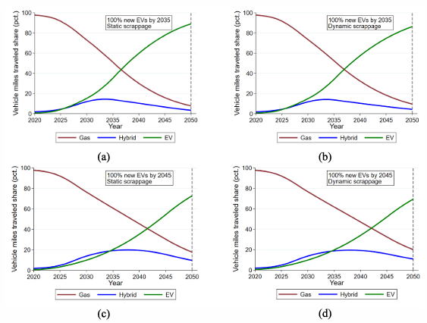
We found that gradually increasing vehicle longevity had relatively small effects on: 1. The transition of the vehicle stock to EVs. 2. The transition of vehicle miles to EVs.

Slide 20
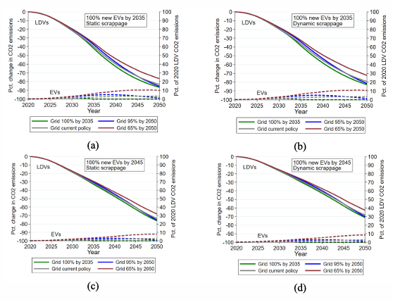
Of course, the timing of EV sales growth, grid decarbonization and vehicle longevity mattered, but not as much as we thought they would.
The slowest grid decarbonization scenario reduced CO₂ emissions by over 60% by 2050, with 100% PEVs by 2045 and increasing longevity.
No scenario reduced CO₂ emissions by more than 90% by 2050.
Emissions by PEVs in the early years of the transition were almost negligible in all scenarios.

Slide 21
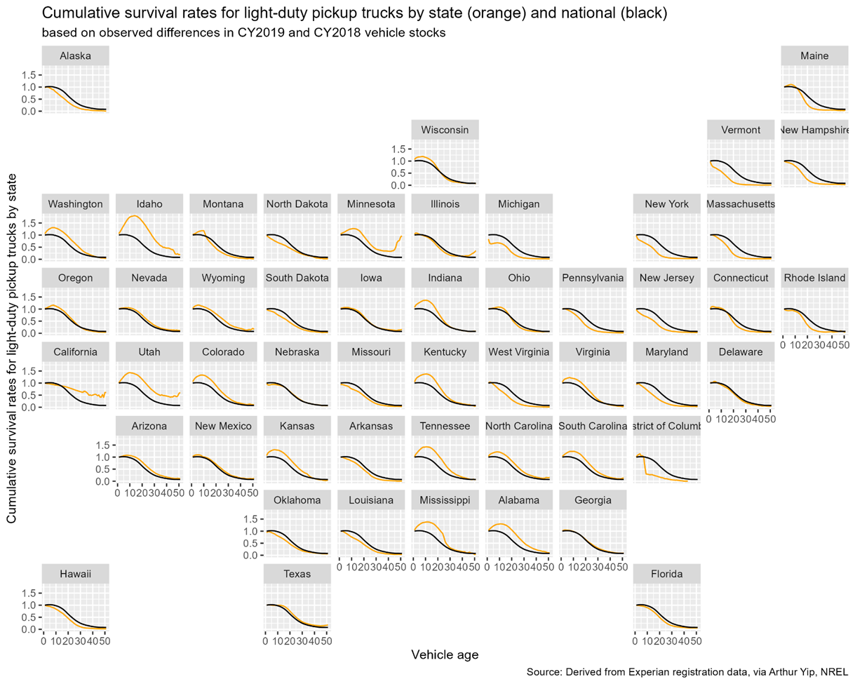

Interested in how EVs might migrate across states and affect the grid, in 2024 NREL shared 2015-2022 state survival rates by the 3 vehicle types.
The state survival rates (S)
are “net” survival rates
because they include
both scrappage (R) as well as imports (I) and exports (E), i.e., net migrations of vehicles.
$$S_{iva+1t+1}=\frac{N_{ivat}−R_{ivat}+I_{ivat}−E_{ivat}}{N_{ivat}}$$
Permission to share the calculated rates
was from obtained by NREL from
Experian®, the source of the data.

Slide 22
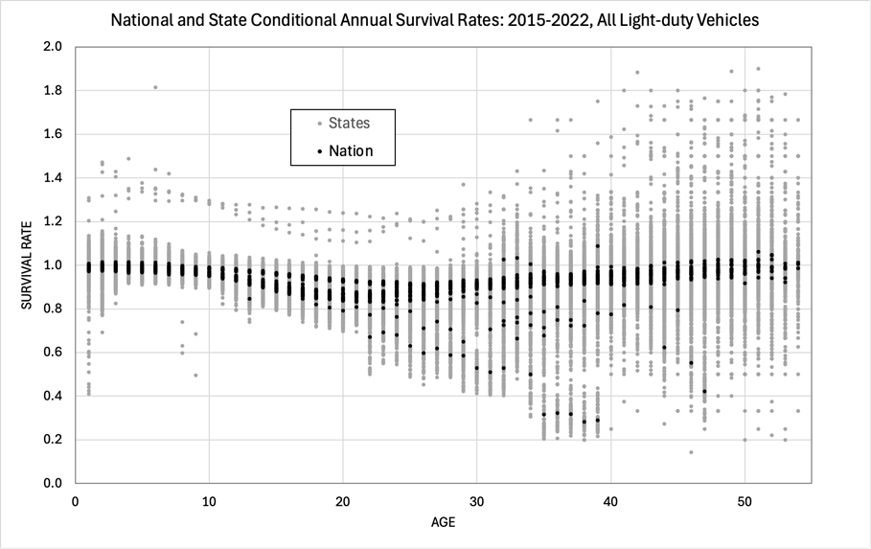
State survival rates are more variable. And there are anomalies.
These are
TN 2015
Lots of noise
very few
vehicles
Age =1 is
always unusual
COVID-19

Slide 23
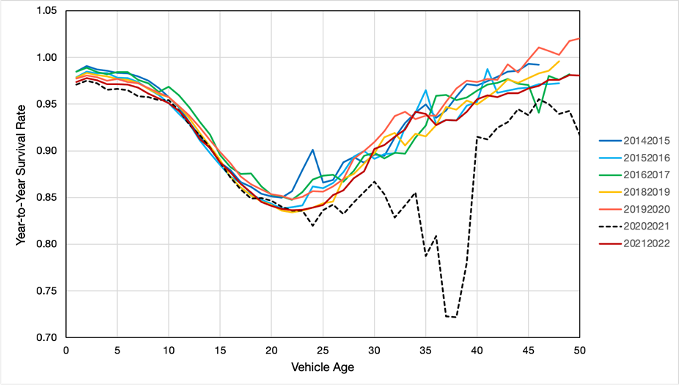
The NREL data included 2020 and 2021. How weird was the effect of COVID-19? Very. An estimated 385,676 US deaths due to COVID-19 in 2020, the first year of the pandemic. Why such a large impact on passenger cars over 20 years old? (Is this an artifact?) What effect did this have on used car prices after 2020?
Passenger Cars

Slide 24
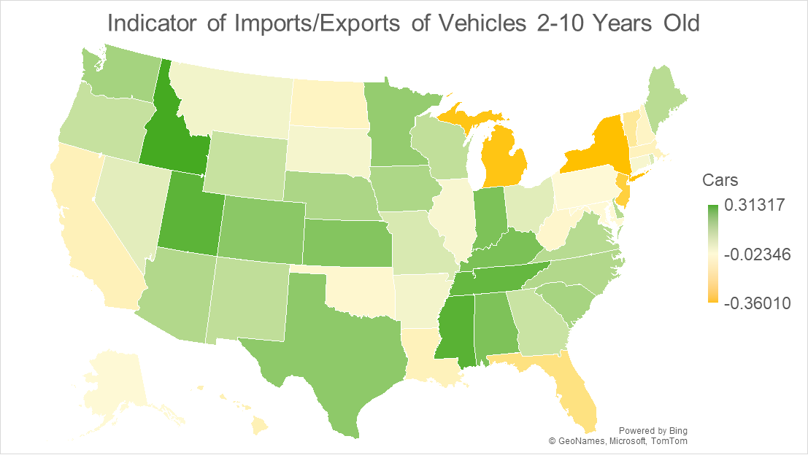
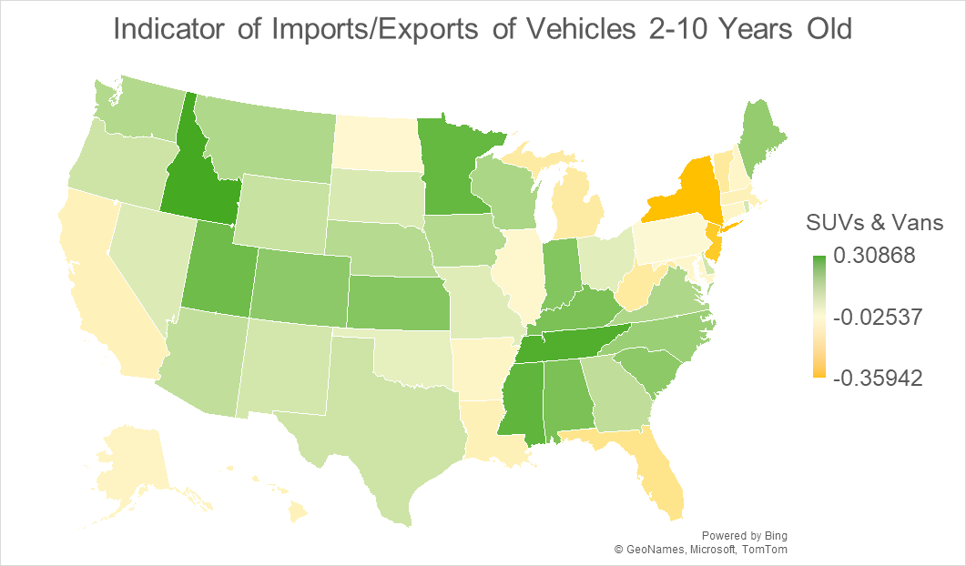
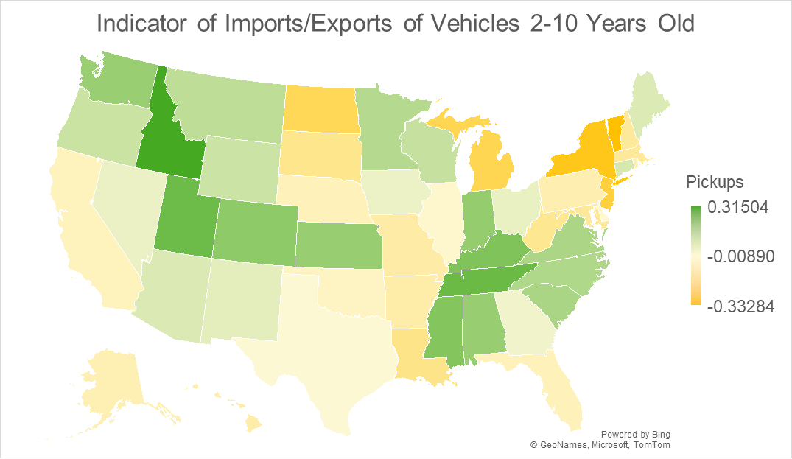
The maps display an indicator of the fraction of vehicles 2 to 10 years old in the state imported (green) or exported (yellow) for the year Jan 1, 2018 to Jan 1, 2019. The patterns are relatively consistent from 2014-2021.
PRELIMINARY PLEASE DO NOT CITE

Slide 25
So…
Vehicle longevity has been increasing for decades.
At about 0.5% to 1% per year.
Estimated increases for 2002-2020: 2-3 years for cars, 3-4 years SUVs, 5-6 years for pickups.
Seems likely to continue.
A relatively simple modified logistic function fits scrappage rates well.
2020 expected lifetimes for cars (16.1), SUVs and vans (18.2) are similar, but pickups last longer (24.0).
How might that affect a transition to EVs? (Leard & Greene, Envir. Res. Ltrs. 18(7) 2023)
Effect of continued increases in longevity on a transition to EVs seem modest.
CO₂ emissions caused by EVs in the early years of transition are relatively minor.
From 2015 to 2022 some states appear to be consistent importers of newer used vehicles, some are exporters.
Will this be true for EVs, as well?
How will differences in new EV sales and used EV migrations affect the grid?
COVID-19 lowered newer used vehicle survival rates a bit but seems to have had a very large impact on vehicles over 25 years old.
How did this influence used and new vehicle prices?

Slide 26
Thank you.

