Slide 1
Used Vehicle Market Modeling for TEMPO
Arthur Yip

Slide 2
county analysis of sales/age/turnover
Motivations:
-Bonnie and Caley want sales numbers (EV sales) (also talk to Ranjit)
-also need to show Paige and Bo (and Chris) that county sales/age/survival/turnover are all linked.
-validate methods used for IEF/EVBPS county disaggregation
There's a paper here...
TITLE
Predicting US light-duty vehicle sales and turnover at the county level ... TR Part B?
Vehicle markets and populations and sales vary greatly across the US. New vehicle sales is typically how EVs are modeled to enter the vehicle stock.
While vehicle sales depend on the economy, automotive industry, and new and used market supply, demand, and prices, long-term projections do not seek to model economic or industry fluctuations.
Without explicitly modeling population and economic growth, and holding vehicle ownership levels fixed (fixed vehicles per household ratio), TEMPO models new vehicle sales arising from vehicle retirements according to survival curves.
national survival: greene, jacobsen van benthem, ...
national / state sales: e.g. aai , county level data not readily available
systems dynamics models also rely on turnover rates.
Implications:
vehicle turnover affects what vintage of vehicles are on the road - safety, emissions...
granular modeling matters for understanding local impacts of changes in vehicle powertrains, equity impacts of areas much more dependent on used vehicles than new vehicles...
Potential methods of predicting county-level new vehicle sales (or sales/stock ratio):
apply national survival to county stock (assuming fixed ownership rates) => fail. (ages will converge to national)
assume fixed sales rate
- assume based on latest year, approximating from MY
- assume average of past years, approximating from MY
assume fixed age
- assume sales based on turnover rate based on 1/(med age * 2)
- assume sales based on turnover rate based on 1/(avg age * 2)
EIA: regional survival. assume fuel type independence.
These methods help maintain county-level ages, but don't reflect imports/exports affecting fuel type.
Maintain ages with fuel type specificity? not appropriate for fast-changing EV market?
goal of this paper is to produce summary statistics and distributions that can allow for granular modeling of vehicle sales and turnover, and identify methods for projecting at the county level, without needing raw registration data.

Slide 3
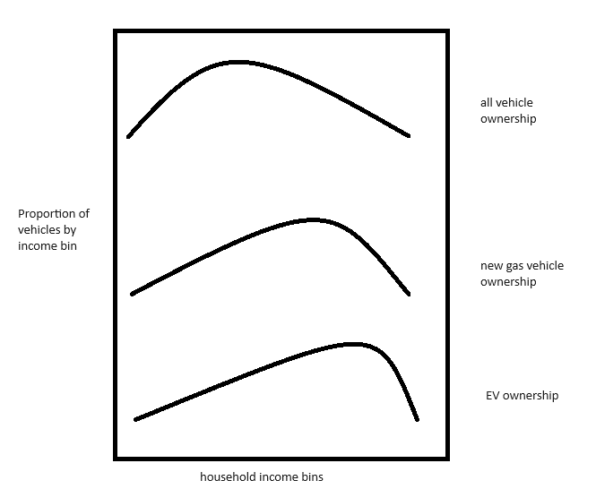
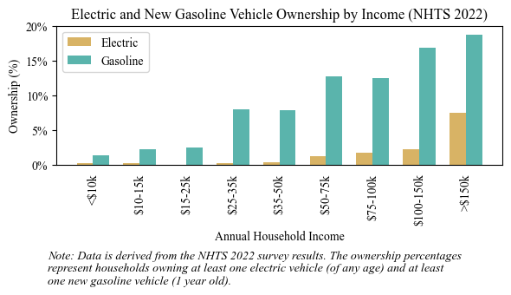
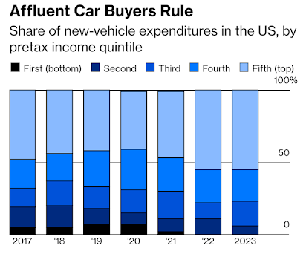
Disproportionate ownership of new vehicles and EVs by high-income households
Skew is growing, and may change in the future

Slide 4
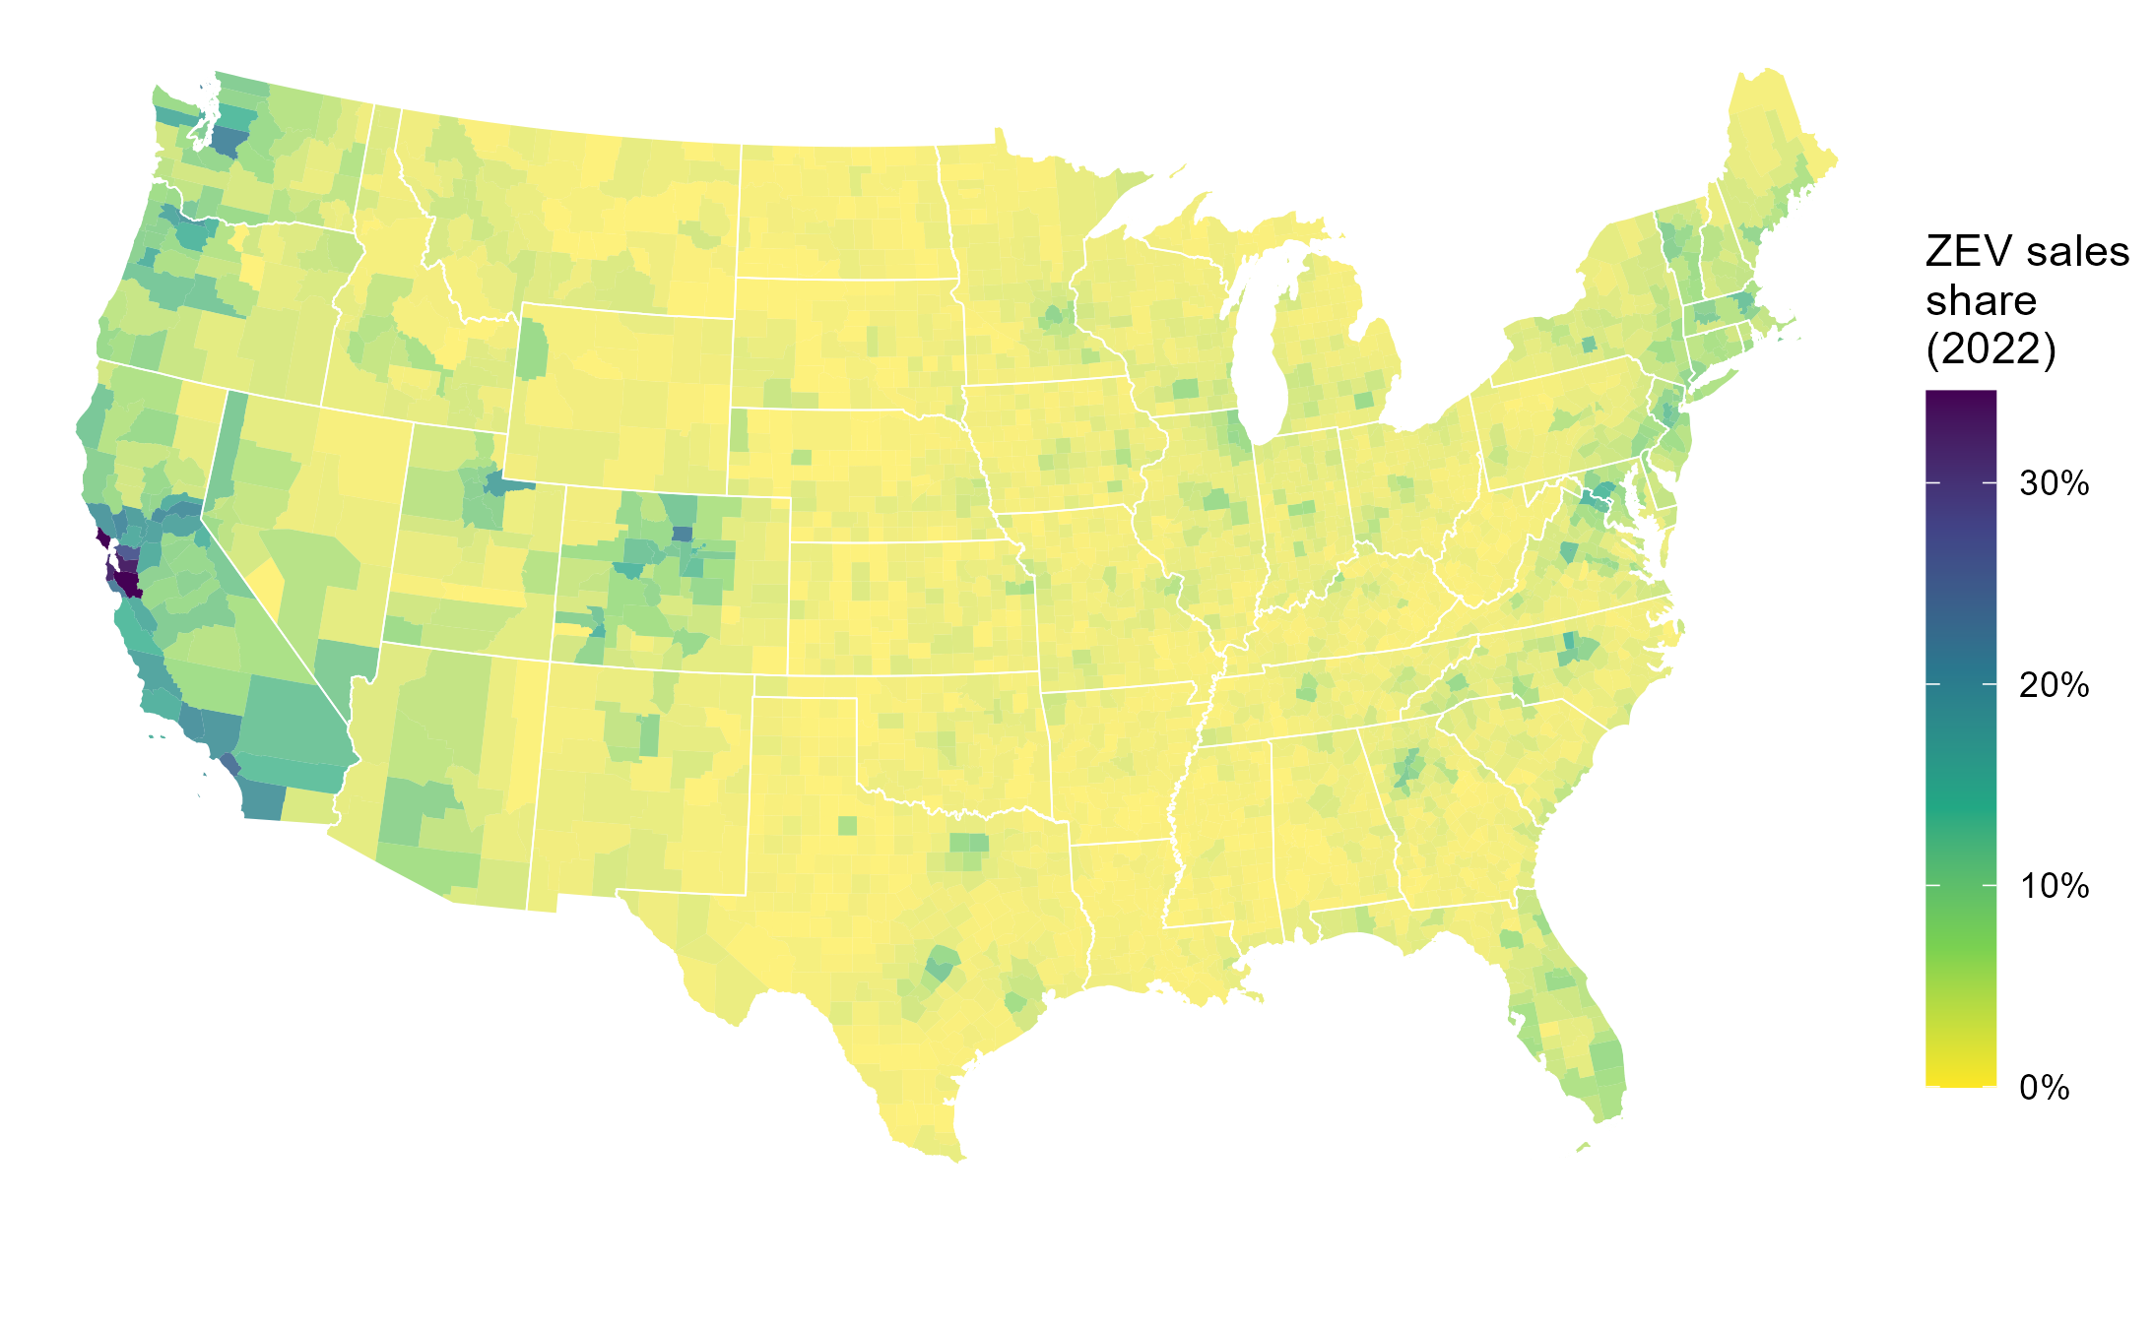
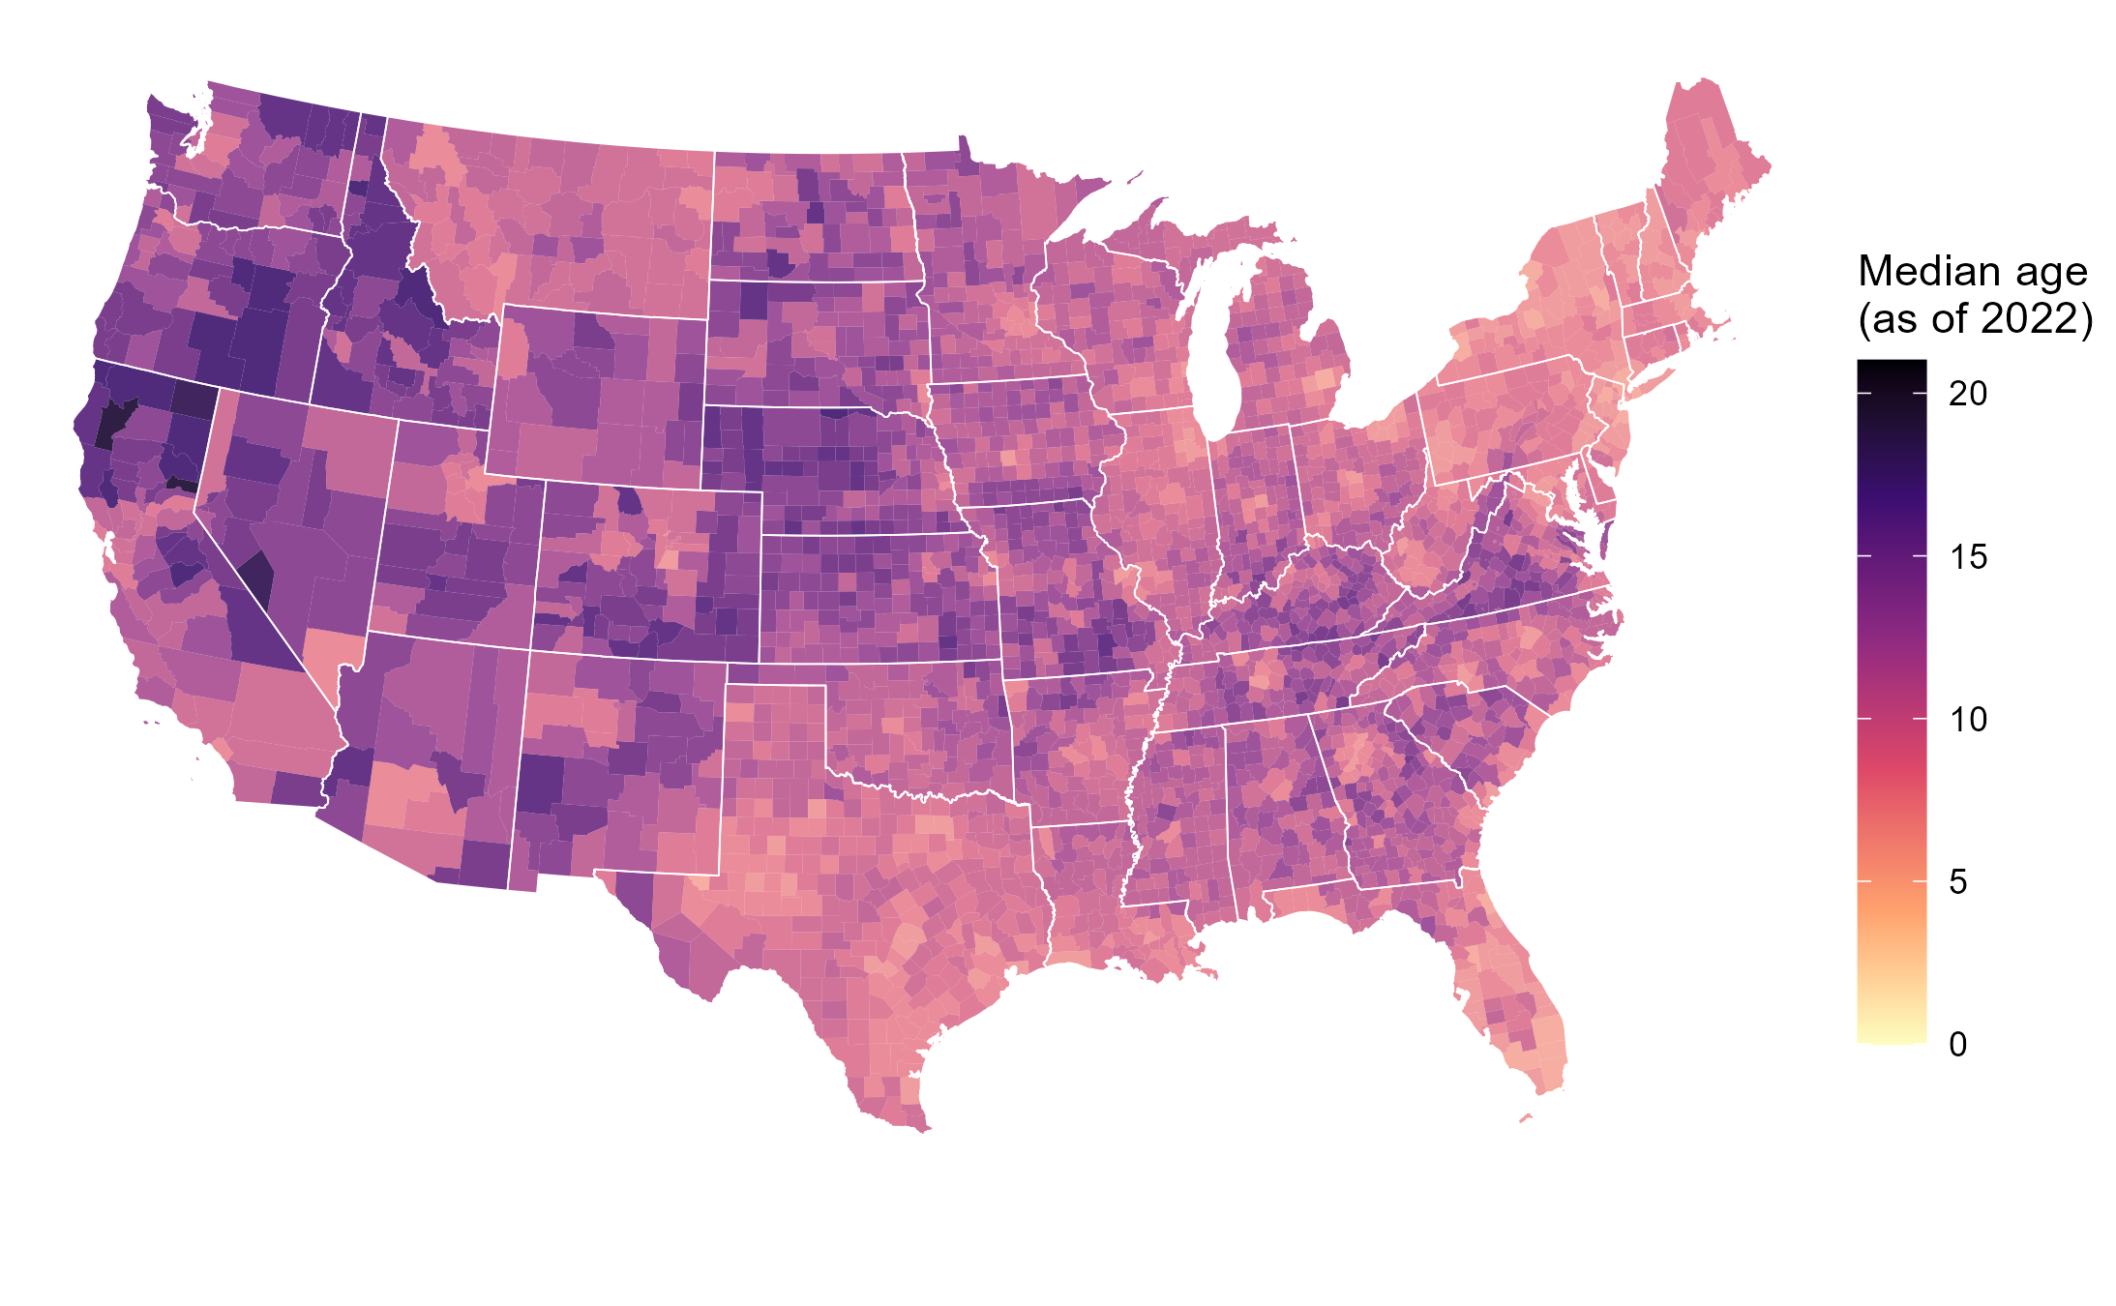
EV diffusion depends on both sales share and new sales
“The future is already here; it’s just not very evenly distributed.” – William Gibson
Projected EVs in a county = a function of both:
1) Trajectory of EVs as share of new vehicle sales
2) Projected vehicle sales, driven by vehicle survival/ scrappage/turnover
“Preference” for “age” (i.e. used vehicles) is an understudied factor affecting EV adoption
Higher median age in a county is indicative of slower vehicle stock turnover, fewer new sales, fewer EVs
Notes:
Higher median vehicle age in a county can arise from
-transfers of used vehicles from other counties
-households holding onto vehicles longer - quality of vehicles lasting longer, or “preference” for cheaper/used vehicles
-VMT impacts on survival/repairability
Ownership / backup vehicles
Incentives, new/used car subsidies, programs e.g. cash for clunkers
Winter road salt corrosion (correlated with temperature/climate)
Summer heat impact on EV battery degradation, range, and longevity
- not necessarily spatially different, but over the years, vehicle age has gone up, quite possibly partially due to improved vehicle lifetimes. - not visible/I don’t have the evidence, but some make/models/types probably last longer than others...
I’d delete
Higher average vehicle age in a local jurisdiction can arise from many phenomena, including lower new vehicle sales, imports of older used vehicles from other counties, exports of newer used vehicles to other counties, or households holding onto and using vehicles longer before scrapping them
, which could be from either the higher quality of owned vehicles or the higher acceptance of or reliance on used/older vehicles
Is this a common reason? Do we have examples of this
- Lack of corrosion due to winter salt - EV-specific: lack of battery degradation due to summer heat - not necessarily spatially different, but over the years, vehicle age has gone up, quite possibly partially due to improved vehicle lifetimes. - not visible/I don’t have the evidence, but some make/models/types probably last longer than others...

Slide 5
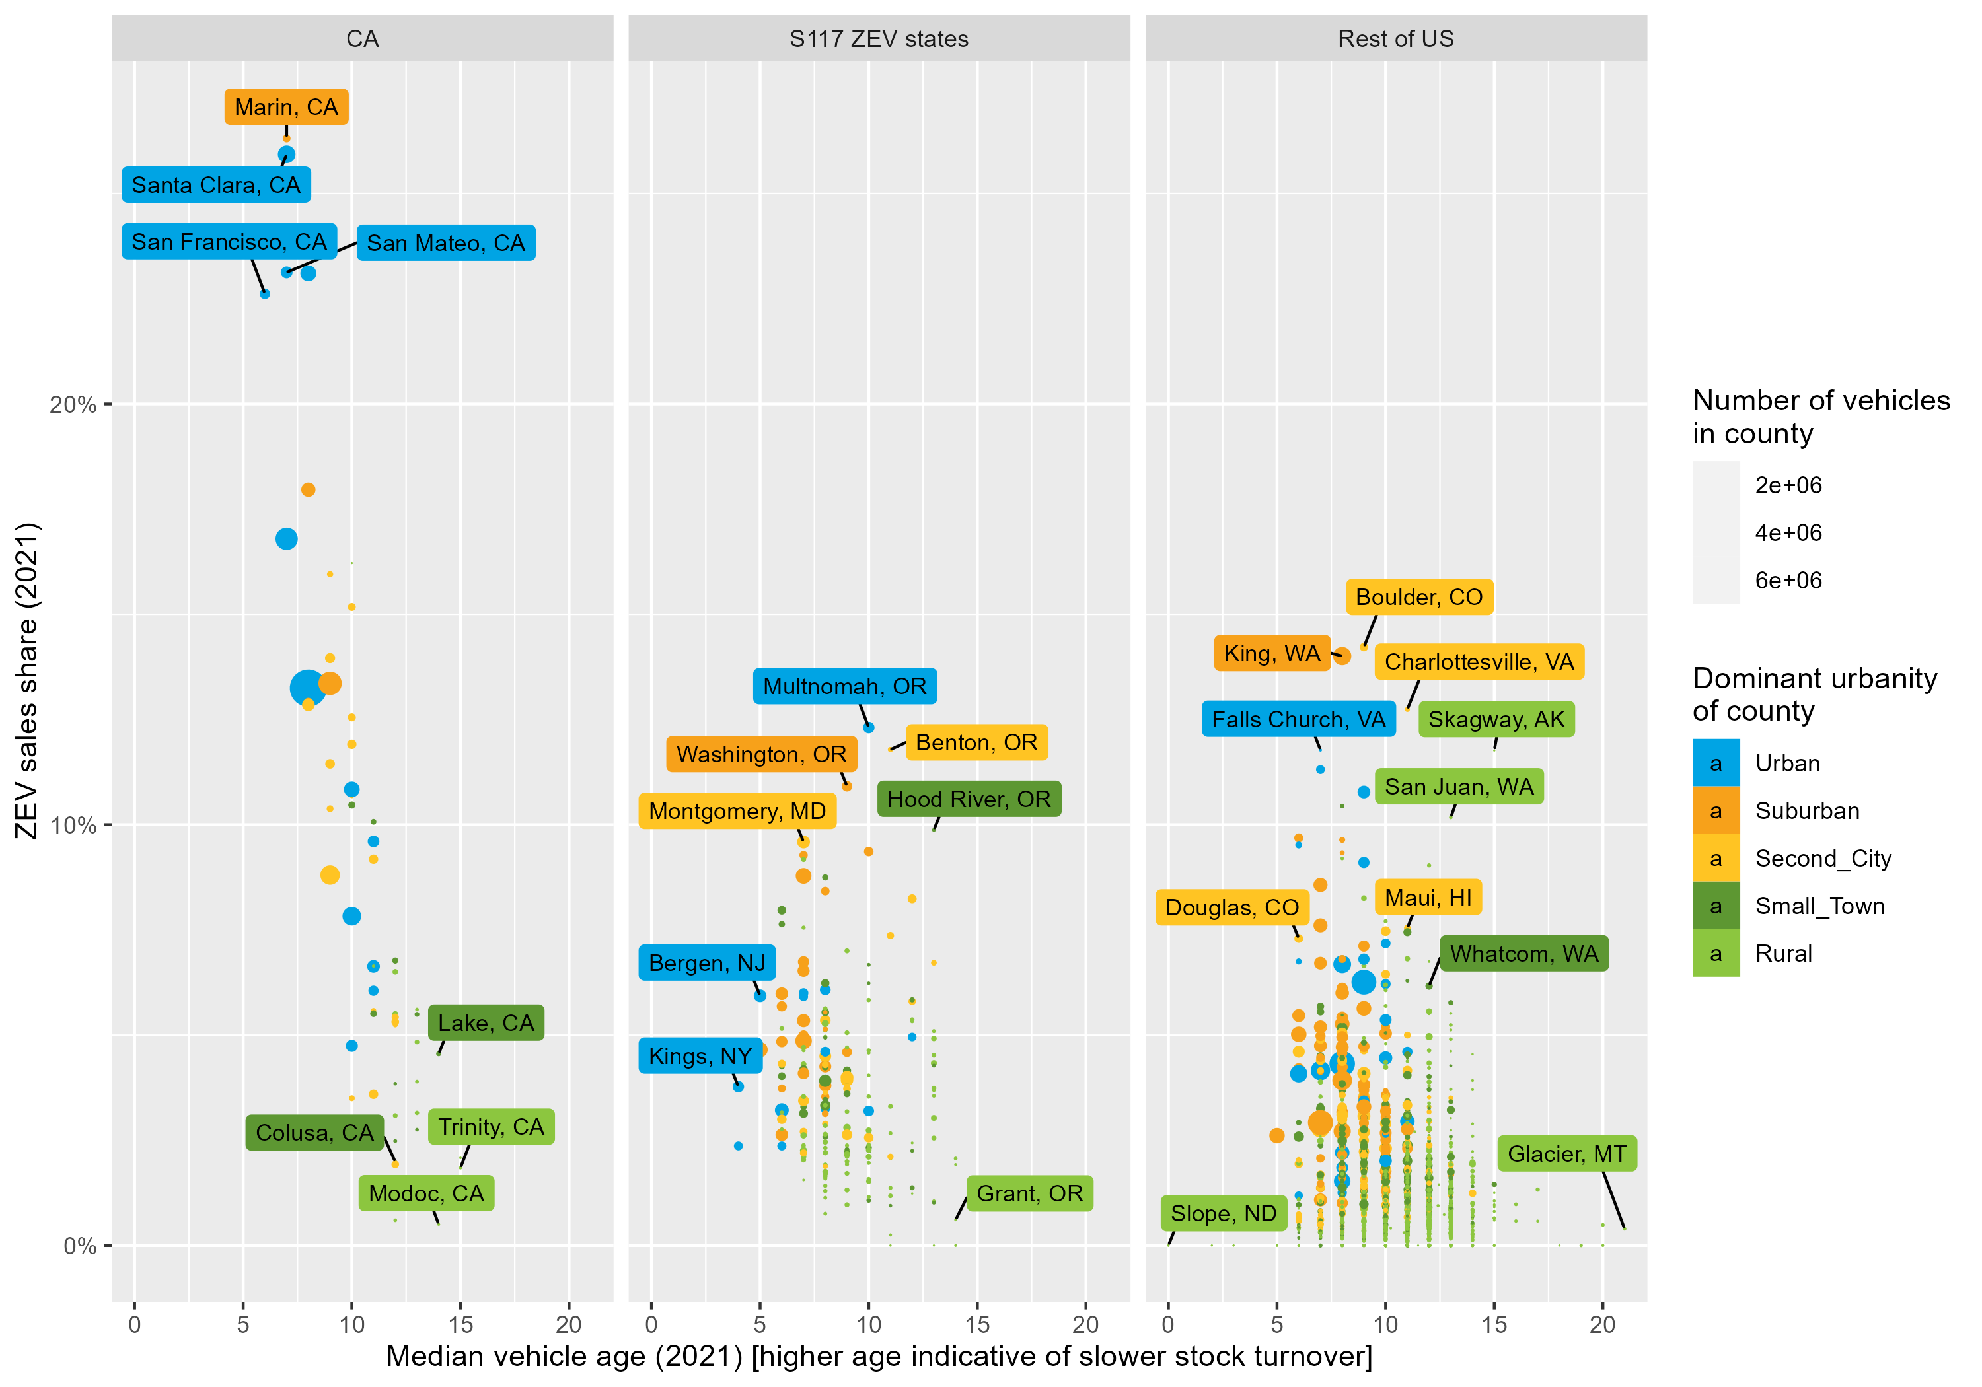
EV sales share and age have been somewhat anti-correlated so far
Counties typically have had higher EV sales share AND newer vehicles / faster turnover so far, mostly in CA
However, this may not be the case in the future
To make better EV adoption projections, both ZEV sales share and age need to be considered in modeling
Notes:
The correlation between regional stock turnover rates and EV sales is also of near-term importance. To date, US counties that have had higher EV shares have also been typically the ones that sell more new vehicles and have faster vehicle stock turnover (such as urban/suburban locations in California with populations with higher income and early adopters of technology). This can be observed in Figure 13, which shows EV sales shares and average vehicle age being anti-correlated (especially in California), where regions with the highest EV sales also tend to have lowest vehicle age, meaning EV stock will turnover faster in these regions. However, this is concurrent and correlated with many other factors – such as both lower EV sales share and higher vehicle age in more rural and lower-income counties – and therefore, the EV sales-to-stock transition may evolve differently in other regions and in the future.

Slide 6
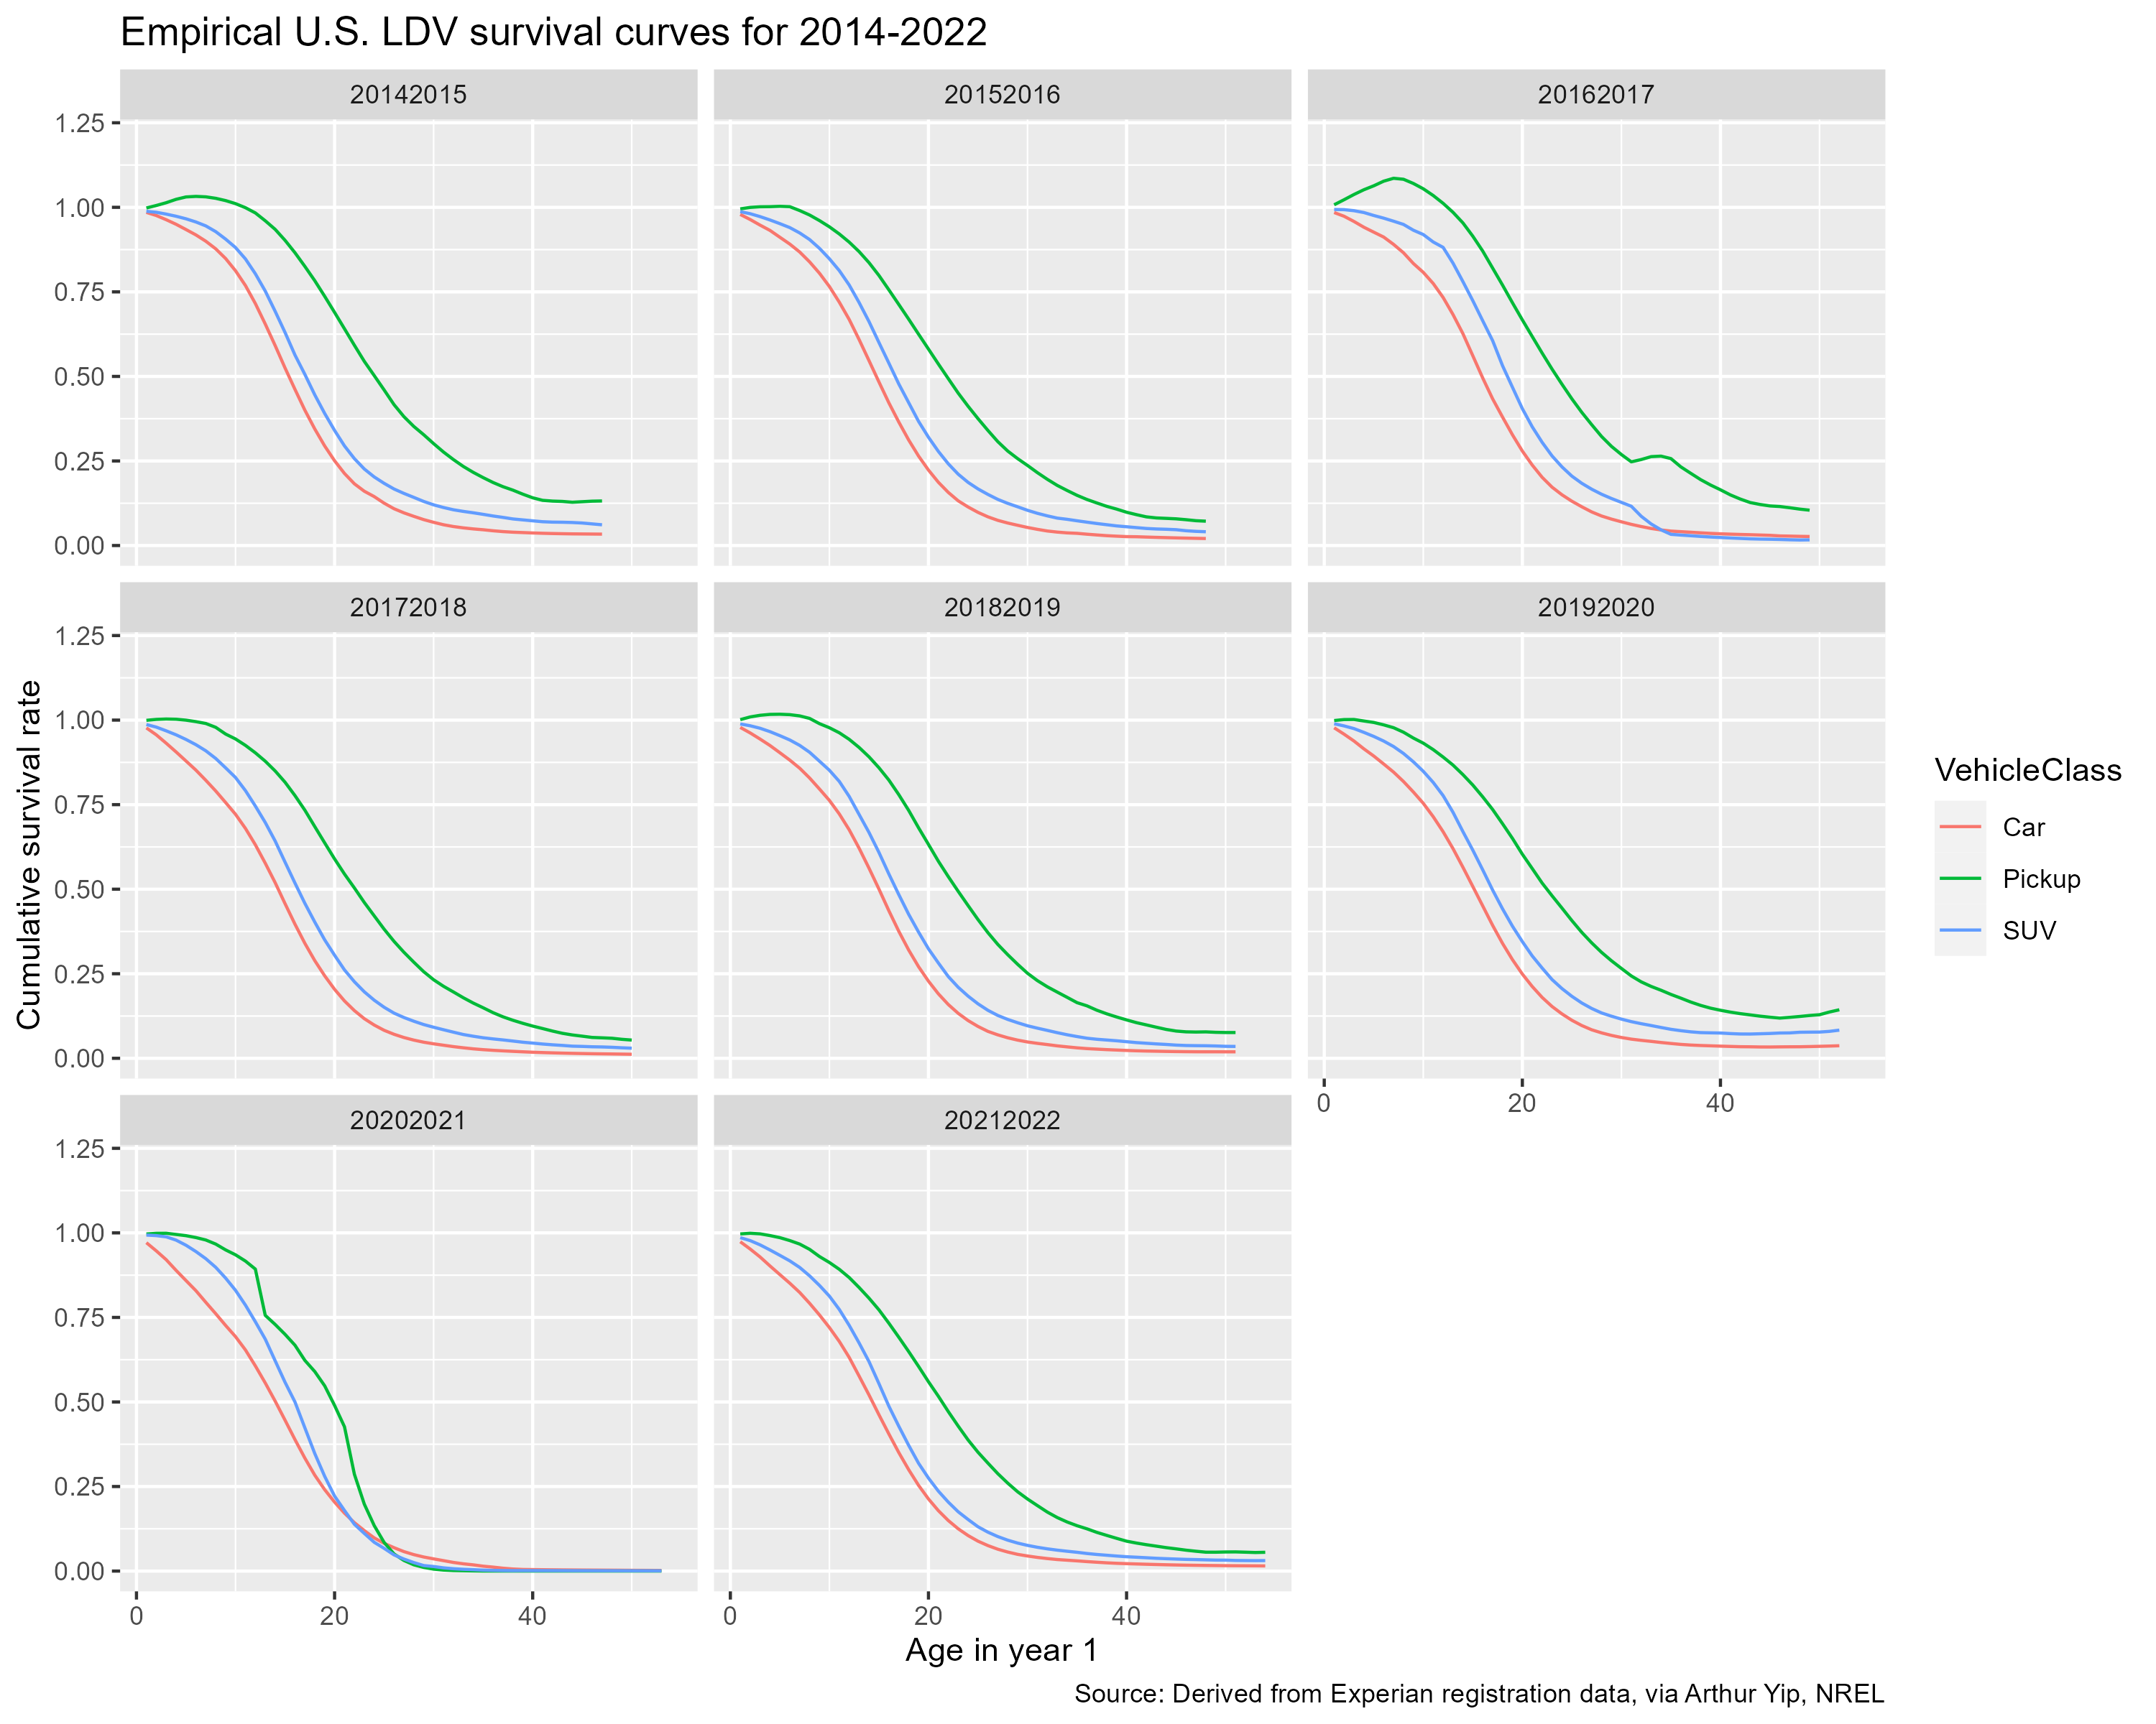
National-level vehicle fleet survival curve
- Describes how the vehicle fleet “turns over” over time (i.e. as vehicles age)
Proportion of new vehicles in the U.S. surviving to
age x
100%
~50% of new pickup trucks are still on the road at age 21
50%
0%
Vehicle Age
~70% of new cars survive to age 10
30% have retired/scrapped by this age
(or been exported out of the U.S.)
Notes:
EARLY net survival = import/export
LATE net survival = scrappage
Global/national conservation of vehicle stocks and flows
State neighbors, spatial interaction, gravity modeling

Slide 7
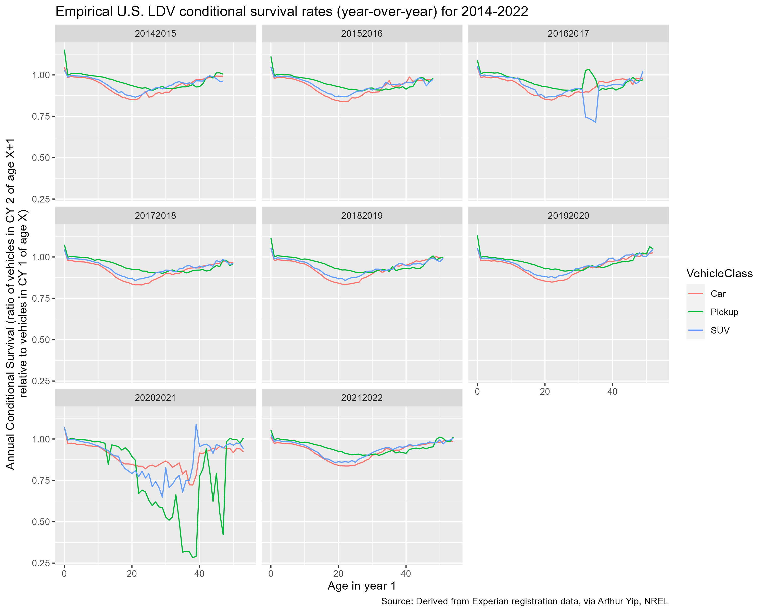
National survival curves 2014-2022
Noteworthy differences between states
Various patterns observed:
>1 and above avg survival in early ages
Below natl avg in early ages
Above natl avg in late ages
Notes:
Automotive industry
Recession – year-specific
Policy years

Slide 8
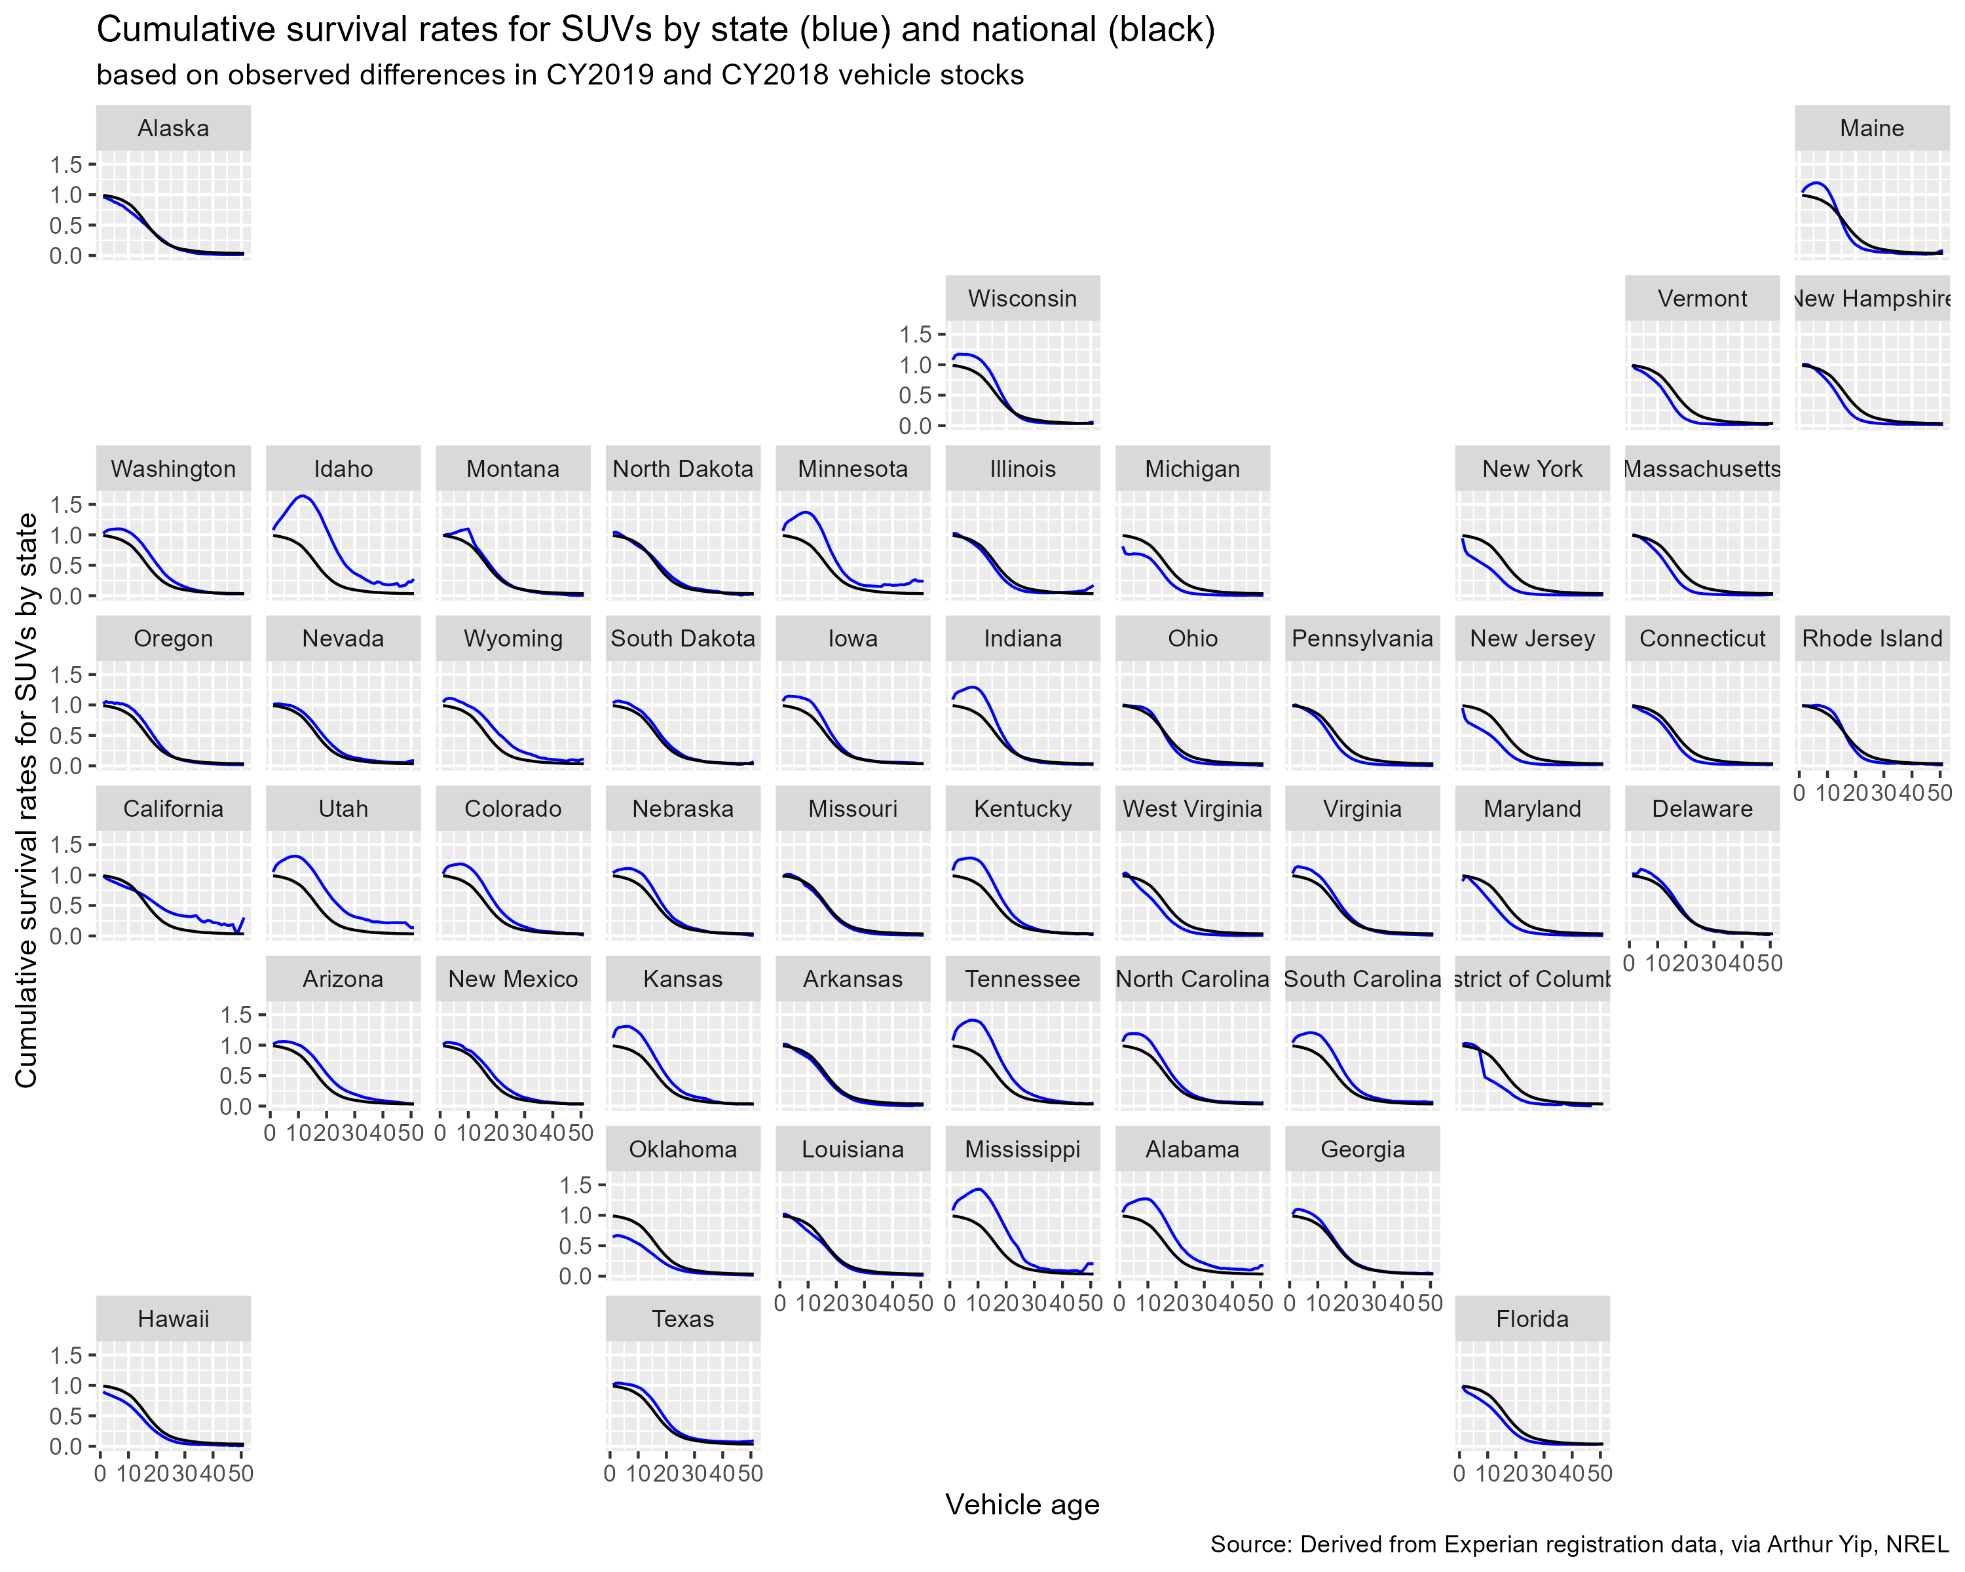
State-level survival curves, 2019
Noteworthy differences between states
Various patterns observed:
>1 and above avg survival in early ages e.g. Idaho
Below natl avg in early ages e.g. New York
Above natl avg in late ages e.g. California

Slide 9
Variables explaining state-level differences in survival
Paper in progress: Greene et al. 2024
Regression analysis to uncover what drives regionally-specific survival rates
Blue = higher than national = more vehicles surviving or net imported
Red = lower than national = more vehicles scrapped or net exported

Slide 10
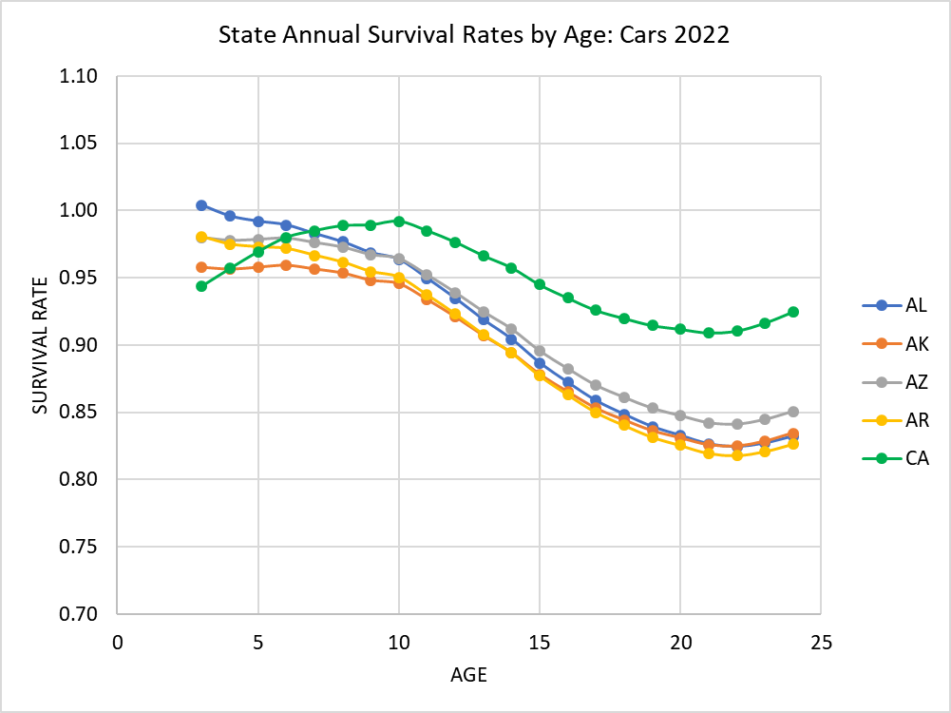
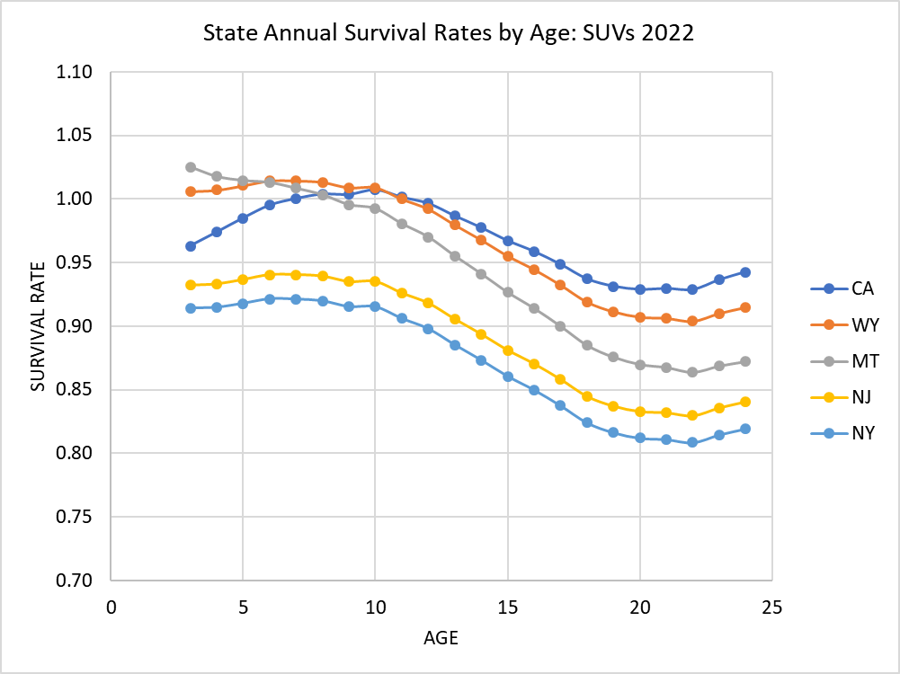
Generalized state-level survival curves, predicted for 2022, based on 2014-2022 data
Greene et al. 2024

Slide 11
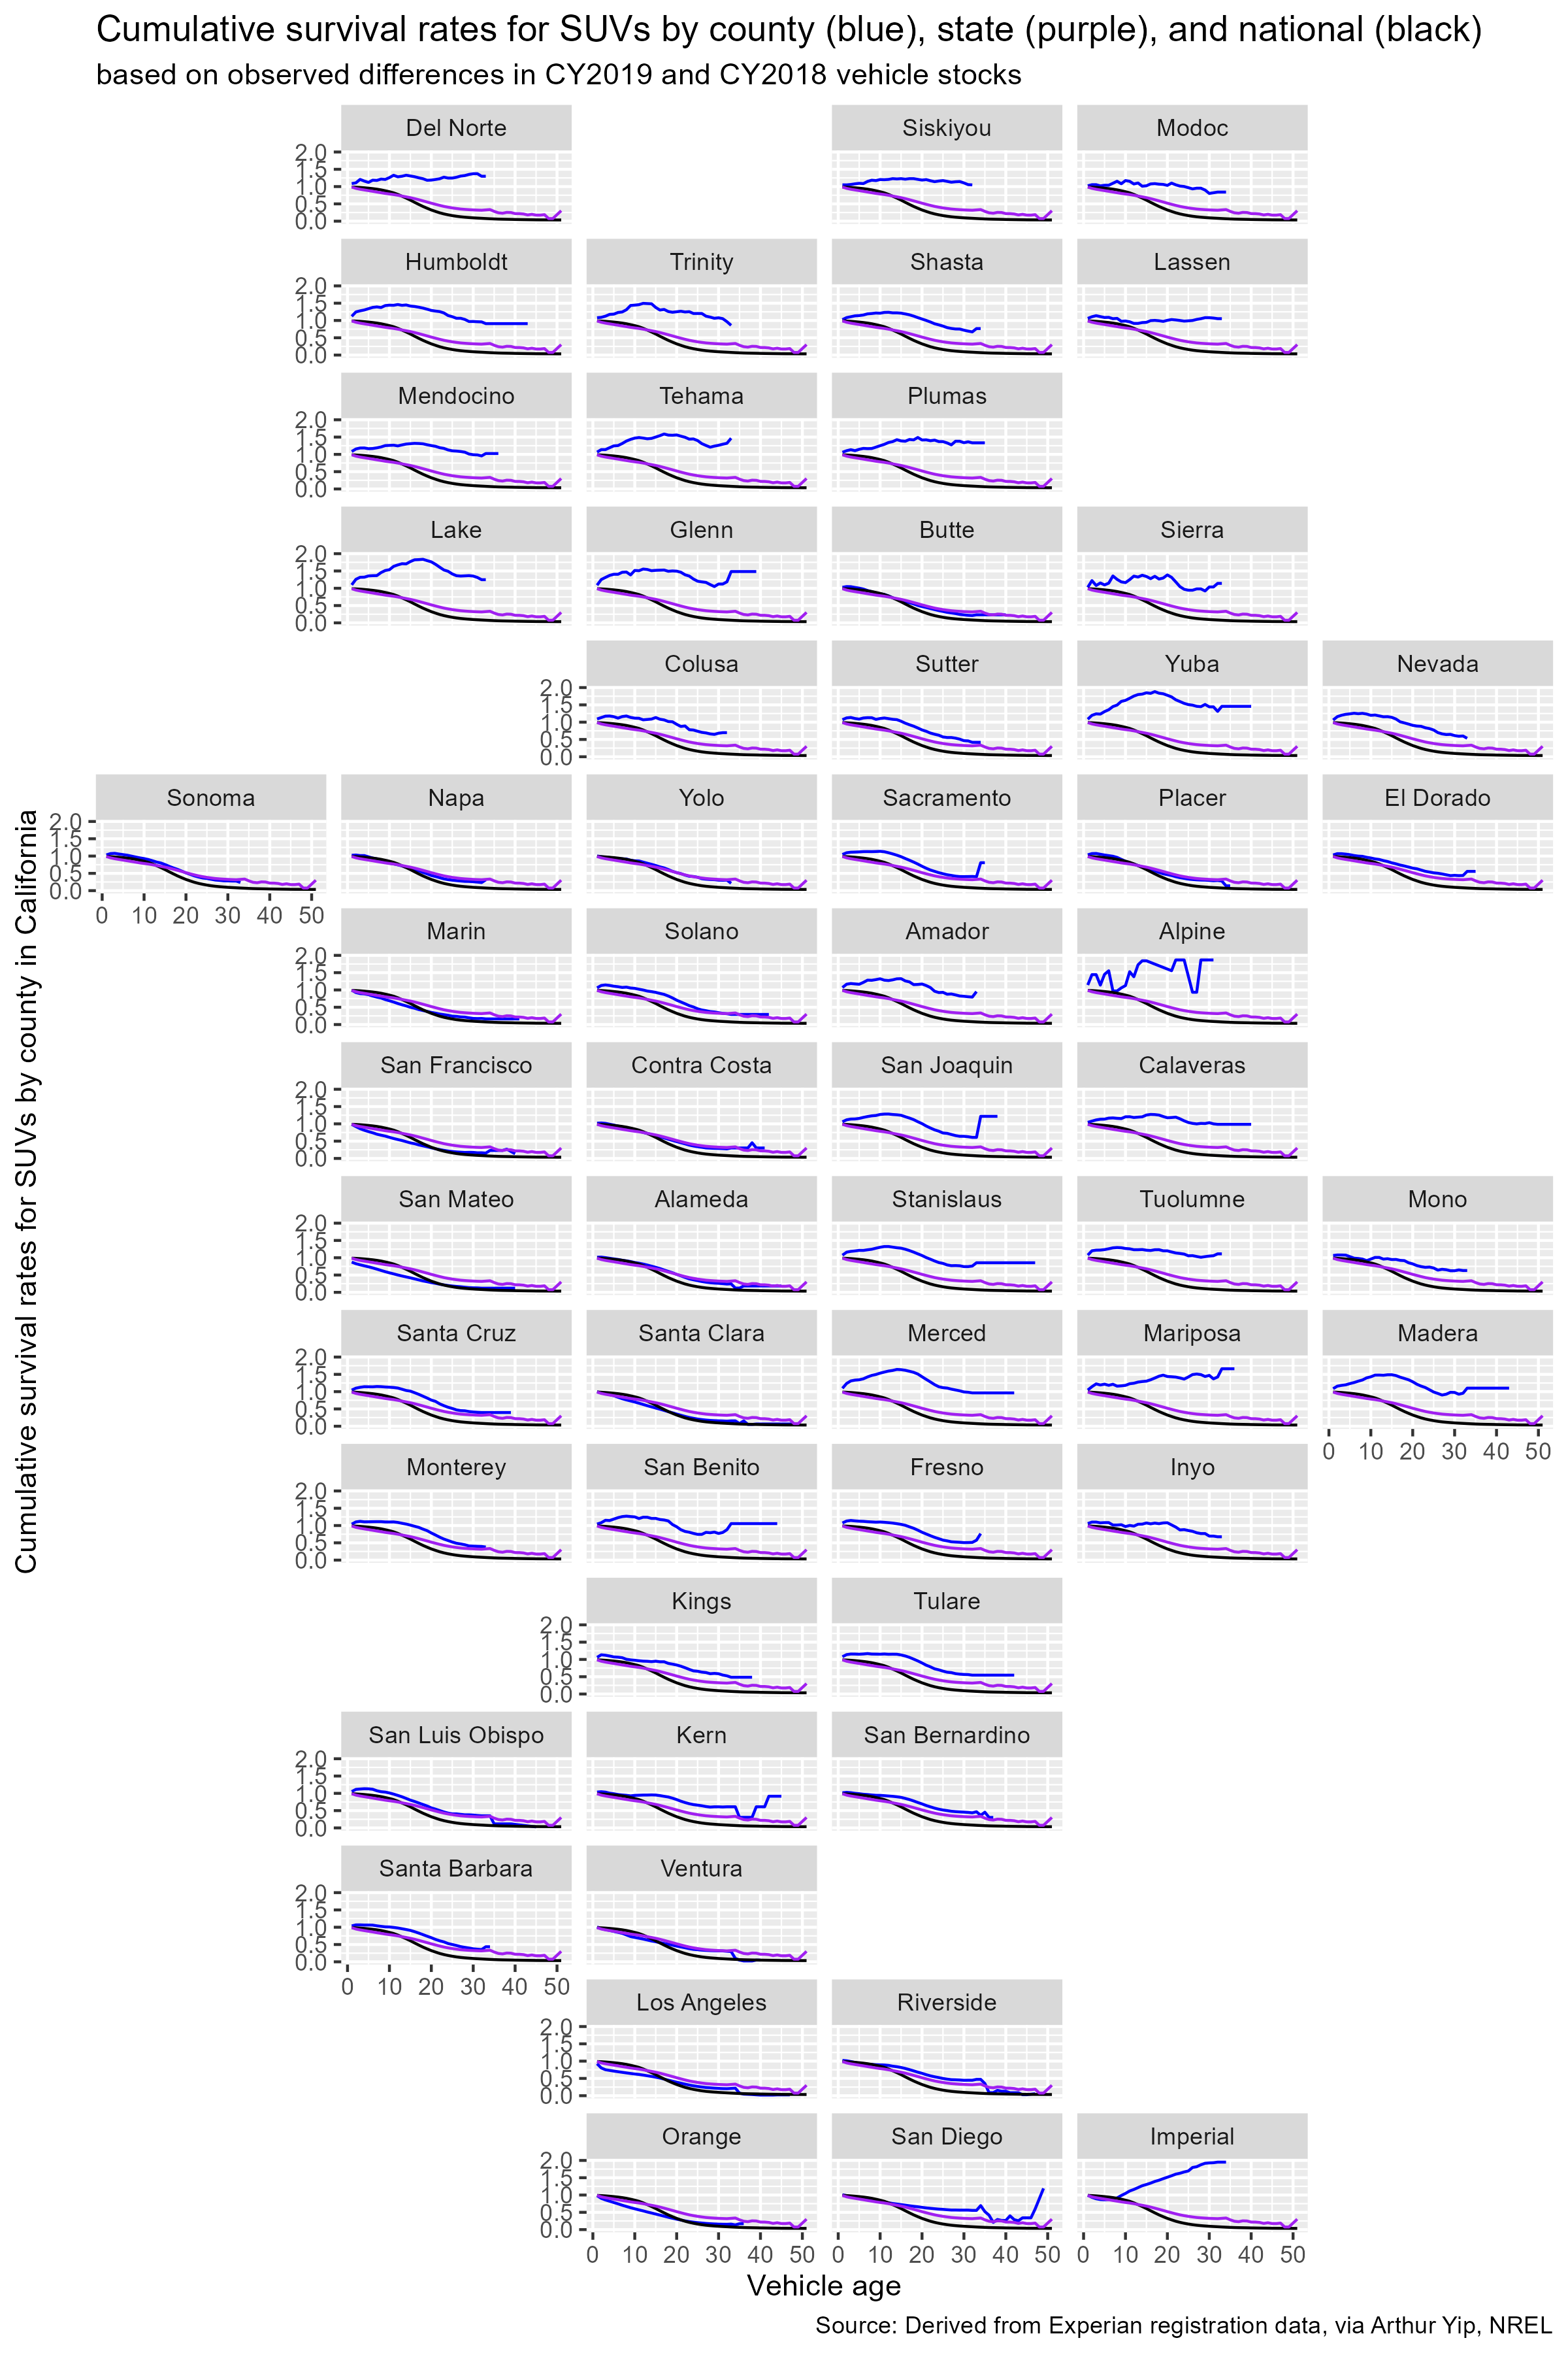
County-level survival?

Slide 12
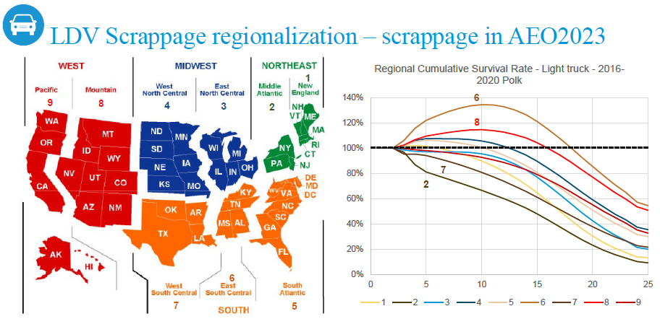
Regional survival curves to help TEMPO reflect vehicle age heterogeneity and impact on EV roll-out
In lieu of explicitly modeling used vehicle sales and transfers, we will apply regionalized “survival” curves to TEMPO that can approximate used vehicle transfers and slower turnover.
In addition to regional survival either from EIA or from analysis of Experian vehicle registration data, we will make assumptions about the EV share of transferred vehicles and true scrappage from national survival data.
Overall, this will enable TEMPO to more accurately reflect the nature of new vs. used sales by county and improve its projections of EV roll-out.
New to AEO 2023, EIA started using regionalized survival curves. Note region 6 where light trucks of age 10 have 140% survival i.e. more age 10 vehicles appear in this region than the previous year’s age 9 vehicles.
This can be attributable to used vehicle transfers, likely from regions such as 2 and 7 where these vehicles are disproportionately disappearing.
Notes:
Use national as actual scrap
Total stock of a vintage = previous vintage + net used transfers in - actual scrap (note new sales in vintage 0)
Exogenous national scenario could inform EV share of net used transfers in
Total net transfers out
Total net transfers in
Idea: run counties with net transfers out first. This would provide details (fuel type, vintage, class) of the transferred vehicle market.
Determine tech shares for remaining counties.
Run counties with net transfer in, pulling from the transferred vehicle market. Uniform/average.

Slide 13
Remaining uncertainty
When a region retires and exports vehicles, we assume it retires/exports a mix of ages and powertrains of the composition of the region’s stock
When a region imports vehicles, we do not have visibility into the mix of powertrains. This may be particularly relevant if a region has low or no new sales or EVs, but does begin to import used EVs.
We will need to establish assumptions and a calibration procedure such that the sum of regional vehicle stocks do not fall out of alignment of nationwide stock and survival.

Slide 14
MA3T used vehicle modeling
Based on scenarios of new vehicle sales, MA3T can model variations in stock evolution and survival
Economic conditions, scrappage, VMT
Price elasticity of used vehicles
Mark Jacobsen for EPA
IRA for new and used EVs, future potential subsidies e.g. cash for clunkers

Slide 15
Future ideas
2014-2022 full - done
Look at specific make-models
MHDV – use gap between VIUS vs. Experian? Did EIA purchase multiple years of Experian?

Slide 16
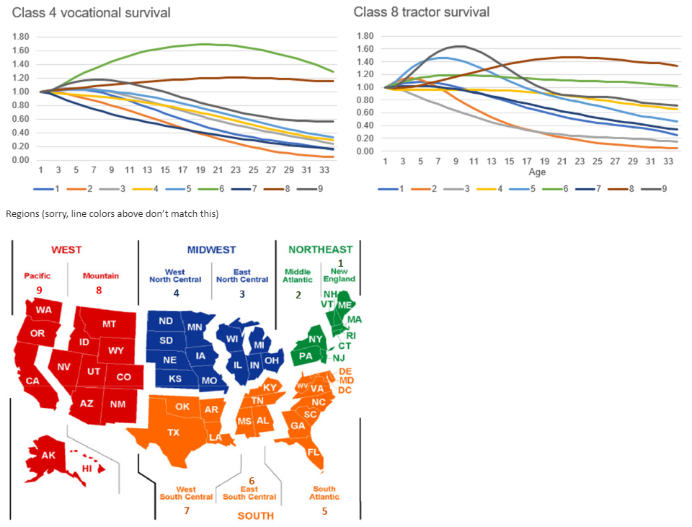

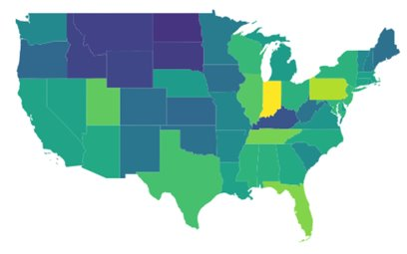
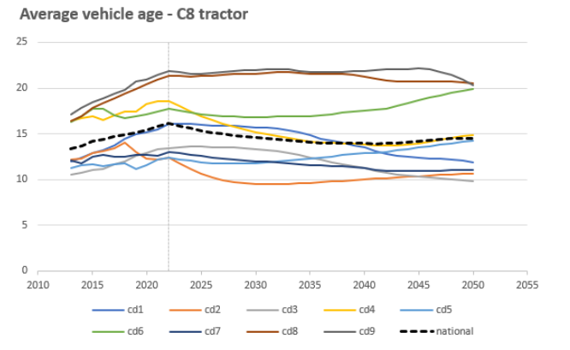
MHDV regional survival
Average tractor age (Experian)
New for EIA AEO 2025

Slide 17
Possible data sources
Two paths:
Derive county-level survival from Experian
Method 1: EIA
From 2014-2022 stock, derive age from each year’s data
Then add up all the age 1, age 2
Normalize to age 1 = 1.00
Method 2: Compare constant MY
Look over time how different MY decline
Method 3 / more detail:
Look at certain cars: Toyota Corolla, Ford 150, SUVs, …, Evs
Implement EIA regions

Slide 18
EIA Jun meeting notes
meeting with EIA about survival/age/fleet turnover
heroic assumptions needed
national stock, household assignment
county stock, household assignment
so with survival, you will have to assume EV flows the same as ICEV ??
polk: number of veh/hh, carfax odometers
polk EV input
experian EV stocks by state (AFDC?)
oklahoma rental cars
fleet flag
natl fleet transfer to hh
transfer rates
AEO projected sales
Polk - explicitly say rental, govt, commercial
check EIA input files
NEMS sales - comes from global insight macro model
- some macro feedback on VMT
TEMPO: scrapped to replace and meet total VMT
odometer
huge distribution
mi/yr + scrappage
old vehicles
annual inspection - vehicles leaving the state
inspection of used vehicle registration - used vehicles entering the state
<18 licensing requirements
next step: EIA to comment on more concrete plan
MHDV
11 size classes
9 regions
99 scrappage curves
regulatory influence
+ truck registrations =/= travel
FAF county OD
truck locations: better to use imaging/AI / businesses
idea: plot MHDV registrations by county
Polk has agreement with body-upfitters and VINs to get body info
Polk: bought new or used, transaction year
determine first owner payback
size of fleet
business information
rich stuckey
- invite David Greene to meet with EIA

Slide 19
https://github.nrel.gov/mmurator/TMM/issues/307

Slide 20
June status
Updating and regionalizing survival curves helps with used vehicle market representation (more accurate and granularly resolved stock projections).
There is more to the used market, some of which we are working on via the ResStock project: which households own which used vehicles? how are they used: annual VMT by age, intra-household choice, interactions with trip-level technology and mode choice
We still won't be modeling actual used market choices/transactions explicitly (so, we still won't have a direct implementation of the IRA used vehicle credit)
We still won't be implementing the ORNL approach of estimating new sales based on economic variables/scenarios (rather than simply replacing all retired stock 1:1, according to current stock and vehicles per household)
much of the past ORNL-David Greene work has been based on this - how sales and survival affect each other, mediated by used vehicle prices, and are affected by economic conditions.
In fact, we are already seeing that county-level differences in survival have a lot to do with county-level differences in both household and economic growth. The data seems to show household and economic growth is likely an important factor in people bring their vehicles, resulting in more cars entering than leaving that state or county.
And finally, updating MHDV survival and considering MHDV business models (vehicles used differently over lifetimes, some fleets/users only buying and using used trucks) is out of scope, but something else we should start considering.
I'm also learning that AEO/NEMS 2025 will use regionalized (AEO regions) survival for both LDV and MHDV. (they already did it for LDV in AEO 2023)
However, we should internally discuss if/how TEMPO should do the same (follow/keep up/ or do it better / more transparently?) and how we should frame this to VTO/Raphael,
and so I'll wait until we talk/finalize this before we present such "plans" to VTO/Raphael.

Slide 21
Emails btwn Arthur and Michael Dwyer
If Evs get added/removed from regions proportional to existing stock (% of previous age of that powertrain, according to survival), then Evs will be under-added if that region actually imports used Evs from other regions

Slide 22
Thread as of July 1

Slide 23
Age analysis scripts:
TMM/dsgrid\dsgrid-tempo-summary.Rmd
TEMPO.jl/Calibration/exogenous…/latest sales shares and age/
Onedrive – eia, survival, …
“age and zev.html” are plotly widgets from dsgrid-tempo-summary.Rmd
Hhdata-county-summary.R

Slide 24
Also see onenote – copy notes to over here

Slide 25
References
Cash for clunkers analyses, systems dynamics analyses
Madalsa Singh
Milovanoff (used TEDB and VISION)
Al-Arfaj (TEDB)
Muratori/Ledna (JVB, VISION, MOVES) (see SI of npj paper)
Bento et al. 2018
Gohlke, D., Cribioli, M., 2021. Distributions of Real-World Vehicle Travel: Variations in vehicle scrappage by powertrain and size class, unpublished manuscript, Argonne National Laboratory, Argonne, IL, September.
NHTSA 2022 TSD update https://www.nhtsa.gov/sites/nhtsa.gov/files/2022-04/Final-TSD_CAFE-MY-2024-2026.pdf
Dwyer email chain
Greene et al. 2024 https://www.sciencedirect.com/science/article/pii/S0965856424000302
Greene et al. 2025a,b

Slide 26
County stock vintage profiles
Run state or county survival, add new vehicles
End up at ?

