Slide 1
Project on click

Slide 2
Background
Our Project presents a visual Data of Amdocs Projects.
Our Users are the stakeholders .
Our clients are Big companies both local and international such as at@t and pelephone.

Slide 3
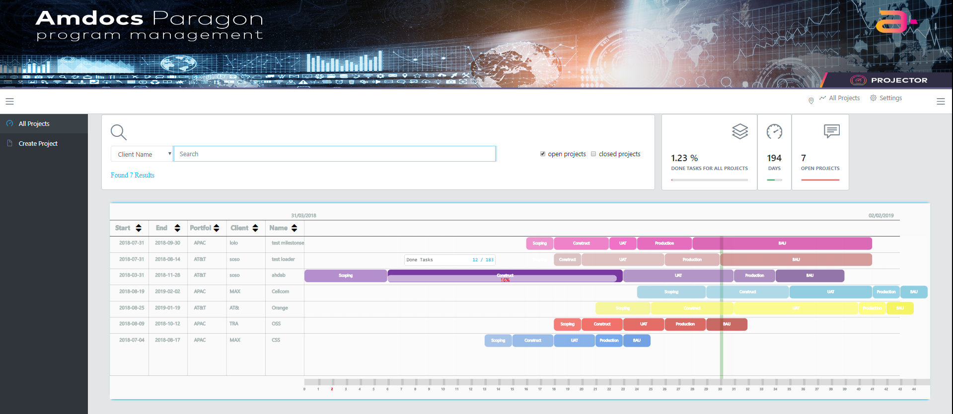
Screens 1 - All Project Screen

Slide 4
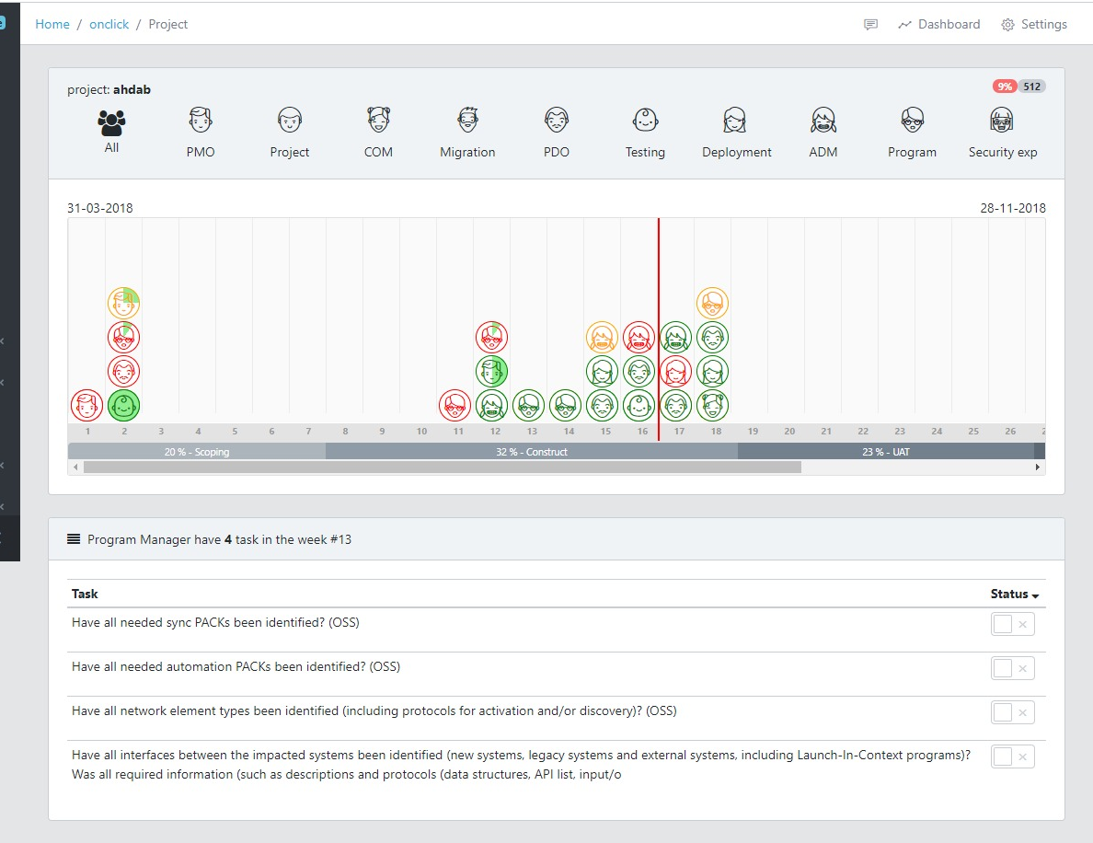
2-Project Time Line Screen

Slide 5
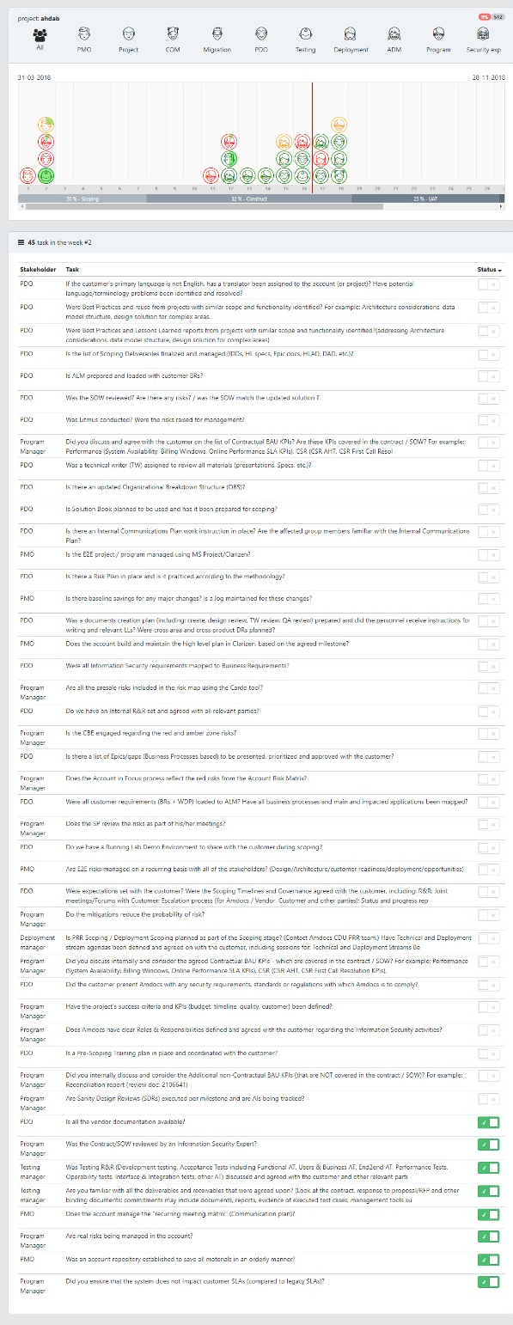
2-Project Time Line Screen

Slide 6
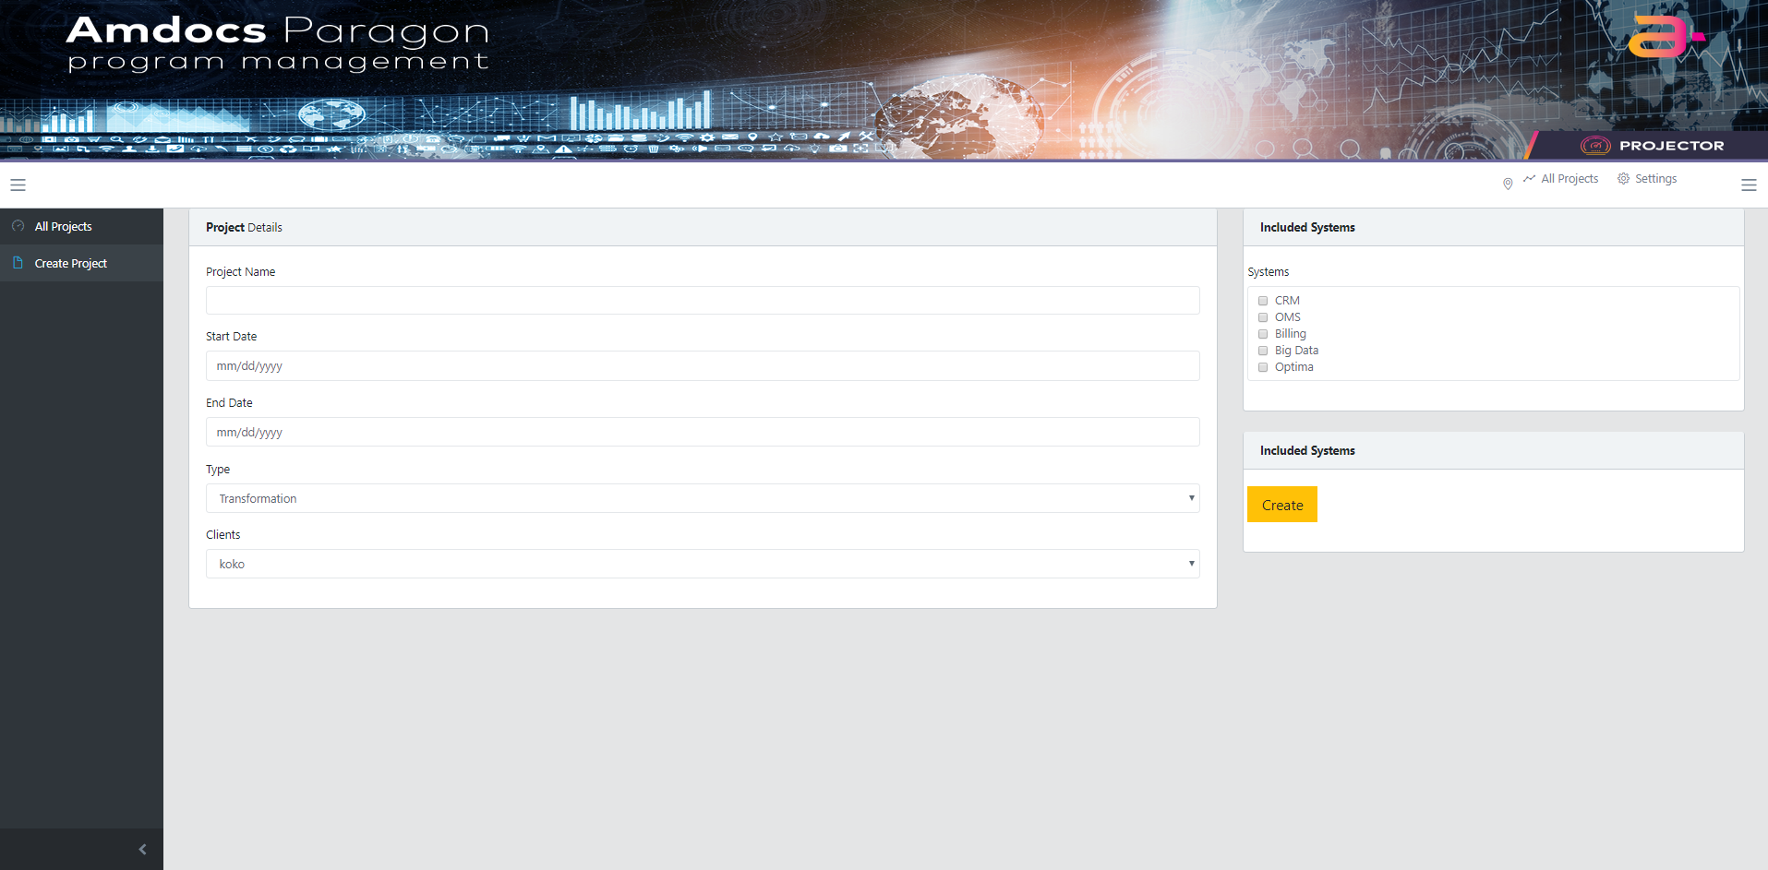
3 - Create Project screen

Slide 7
Project Purpose & Goals
To Visualize the State of all projects in Amdocs
Distinguishing the possible bottle necks in every project.
To present the status of every mission .

Slide 8
Functional REQUIREMENTS :
Real Time Projects View​
Creating Projects ​
Update tasks for Projects

Slide 9
Non-Functional Requirements
User friendly interface.
Easy to use.
High performance.

Slide 10
Methodologies & Techniques:
Back End :
Java
Mysql database
Front End :
Angular 5
Jquery
JSON

Slide 11
Class diagram
https://drive.google.com/drive/u/0/folders/1jMn6JNpDkEEWfqoxUuVCdu03NmVEv0lr

Slide 12
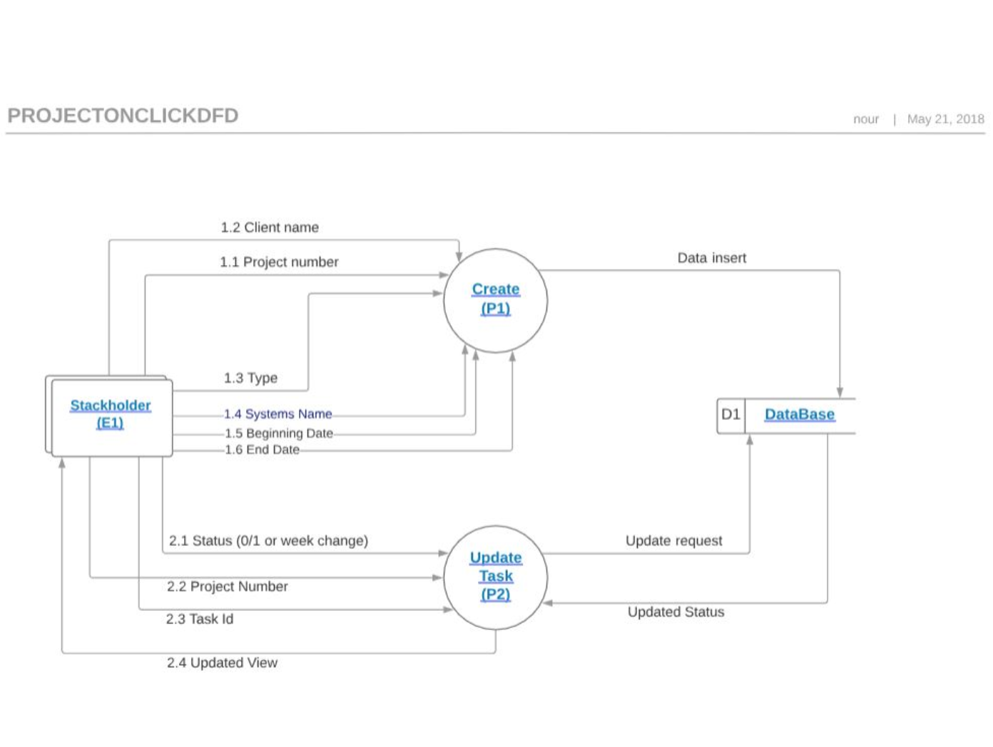
DFD

Slide 13
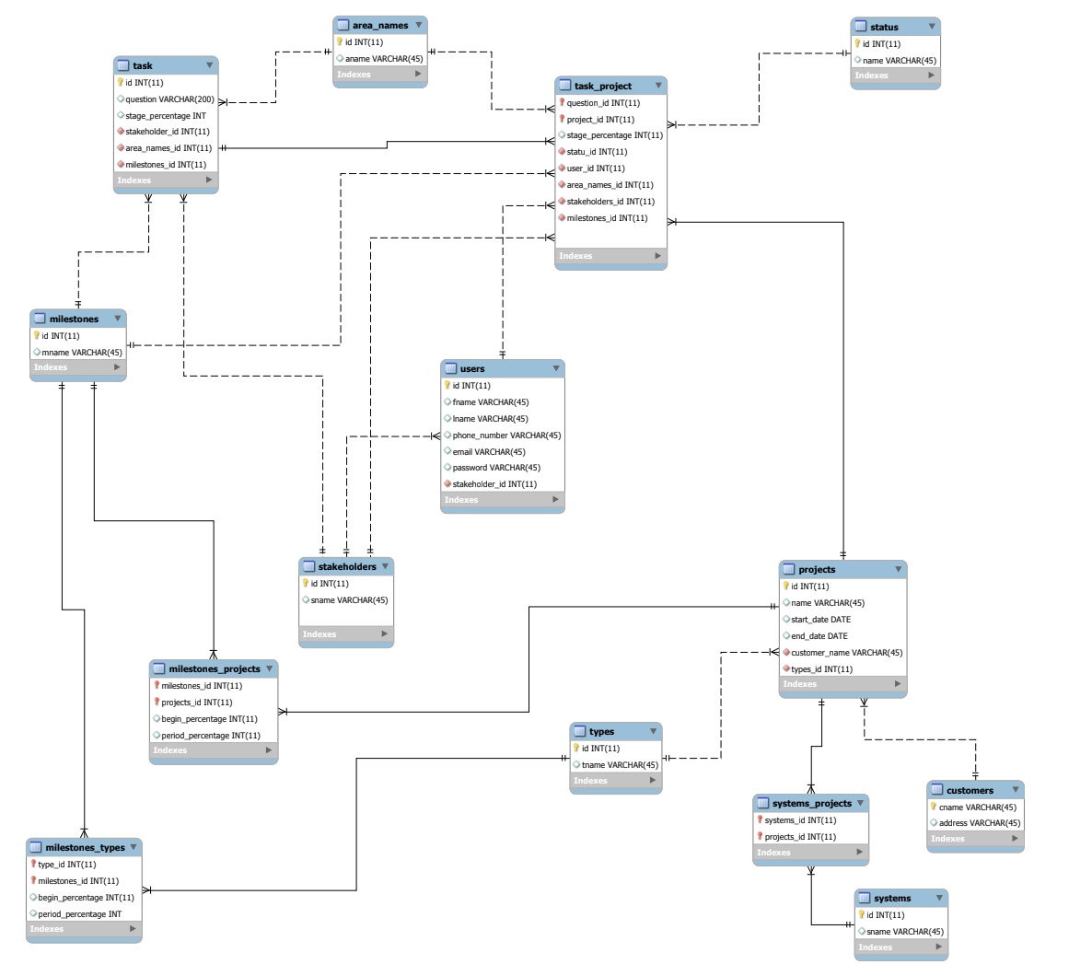
ERD

Slide 14
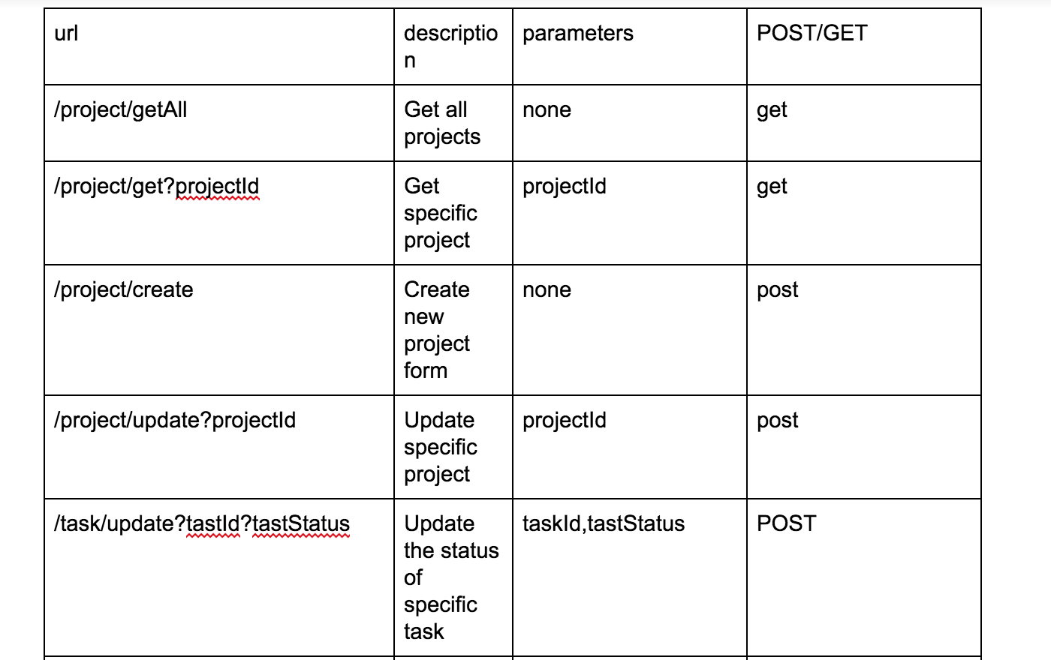
API

