Slide 1

Workshop on Data Analysis
Professor Ahmad Daryanto
Lancaster University
Presented at Fakultas Ilmu Administrasi
Universitas Brawijaya, Malang
September 2026

Slide 2
Chapter 17: Endogeneity
Textbook: Ahmad Daryanto, Introduction to Quantitative Research Methods for Marketing With SPSS and R: Tools and Techniques, Routledge. 2024

Slide 3
To start
Click
Download SPSS macros, datasets, these slides, pdf articles.
https://github.com/ahdar1/FIA

Slide 4
Learning Objectives
Understand the concept of endogeneity
Able to use EndoS macro to address an endogeneity problem

Slide 5
What Is Endogeneity?
Consider this modelling situation:
I want to examine the influence of the background music in a barbershop on customers’ revisit intentions to their first-time visit barbershop.
Item to measure revisit intention: Will you visit the same barbershop in the future? (1 = very unlikely, 5 = highly likely).
Item to measure customers’ attitude toward the background music: How do you like the background music played in the barbershop? (1 = extremely dislike; 7 = like it very much).

Slide 6

I come up with the following simple linear model
However, the true model is:
Where BARBER = How do you like the barber
(1 = extremely dislike, 7= like very much
Because BARBER and MUSIC may be correlated,
omitting BARBER from the first model will lead to a biased in the coefficient estimate for MUSIC (endogeneity problem)

Slide 7
Formal Definition
The modelling situation where a predictor is correlated to an error term is termed as an endogeneity problem.
Omitting an important variable from a model is not the only cause of an endogeneity problem. Endogeneity can also arise when (1) variables are measured with errors, (2) the causal effects run both from X → Y and from Y → X, known in the regression literature as simultaneity.

Slide 8
Two-Stage Least Square (TSLS)
One of the techniques to deal with an endogeneity problem is the two-stage least squares (TSLS).
TSLS requires us to find a variable known as an instrumental variable or instrument, for short, often denoted by Z.

Slide 9
Instrumental Variable (Z)
Any variable that acts as a Z must satisfy the following assumptions:
It must be correlated with MUSIC. This is referred to as a relevance assumption. Cor(Z, MUSIC) is not zero.
It should not be correlated with the error term O. This is referred to as an exogeneity assumption.
It affects REVISIT only via MUSIC. This is referred to as an exclusion restriction assumption.

Slide 10

The relationship between the instrument Z, the endogenous variable X, and the dependent variable Y.
O
$$ε$$
Z
MUSIC
REVISIT

Slide 11
The Role of Z
In an endogeneity situation, the variation in MUSIC comprises of parts that are correlated and uncorrelated with to the error term O. The role of Z is to capture the uncorrelated part and used it to replace MUSIC.
Z is challenging to find.

Slide 12
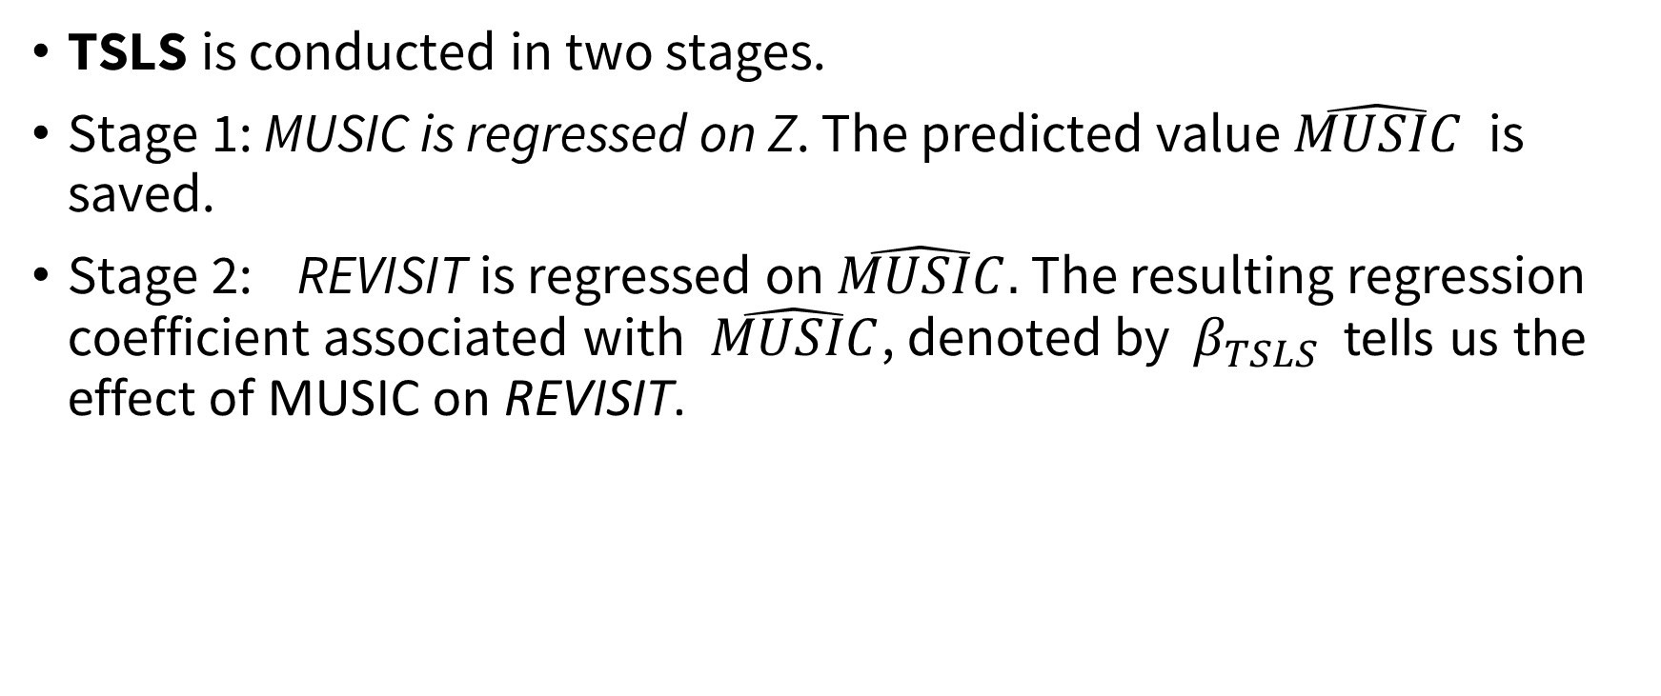
TSLS PROCEDURE
TSLS is conducted in two stages.
Stage 1: MUSIC is regressed on Z. The predicted value $\hat{MUSIC}$ is saved.
Stage 2: REVISIT is regressed on $\hat{MUSIC}.$ The resulting regression coefficient associated with $\hat{MUSIC}$, denoted by $β_{TSLS}$ tells us the effect of MUSIC on REVISIT.

Slide 13
What is our Z?
The number of CDs owned by an individual
Does it satisfy the relevance and exclusion restriction assumption?

Slide 14
Arguments
Relevance: Individuals who own more CDs are more involved with music and therefore likely to have stronger attitudes toward the barbershop's background music.
Exclusion restriction: CD ownership influences revisit intentions only through customers' evaluations of the background music and has no independent effect on barbershop choice.
Caveat: CD may be a weak instrument, which does not fully support the exclusion restriction. This is because CD ownership may be a proxy for broader music-related lifestyles and atmosphere preferences that directly affect revisit intentions. Consequently, CD is a plausible but not a strong instrument.

Slide 15

Illustration
CDS is the instrument.
CDS = the number of music CDs a customer has
CDs is assumed to satisfy the relevance, and the exogeneity assumptions.
WAIT is a control variable (“I waited very long before being served).
O
$$ε$$
WAIT
CDs
MUSIC
REVISIT

Slide 16
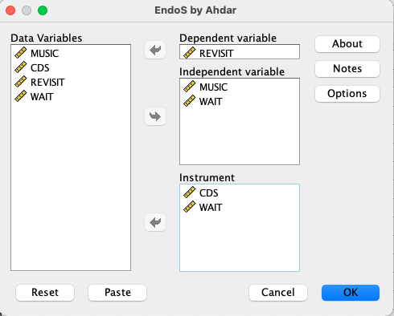
ENDOS
Developed by Ahmad Daryanto
Install ENDOS.SPD

Slide 17
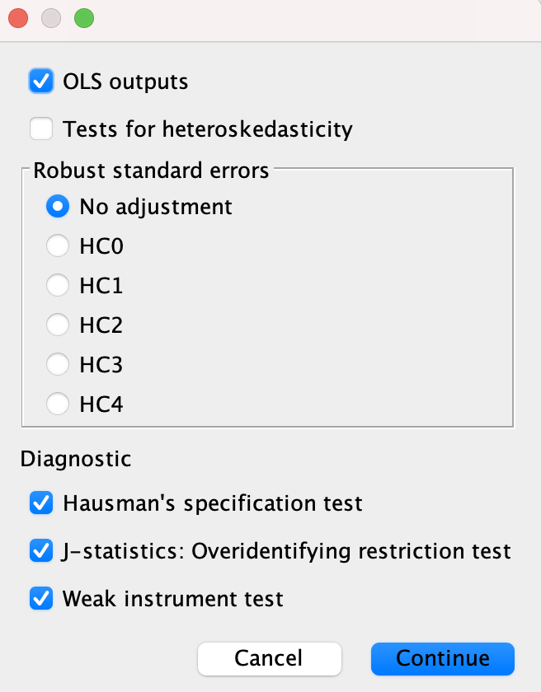
Product outputs Of OLS regression
Test whether a predictor is truly endogenous (or is 2SLS better than OLS?)
For multiple instruments.
Are the extra instruments necessary?
Test whether instruments are weak

Slide 18
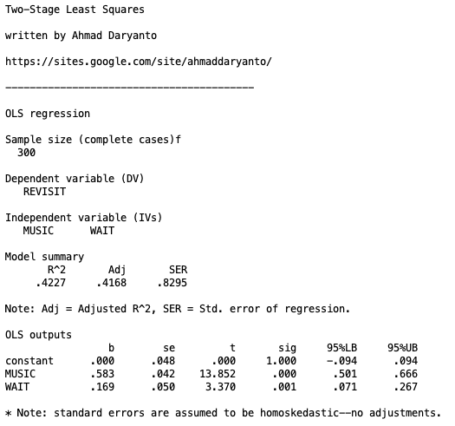
With OLS, MUSIC is significant

Slide 19
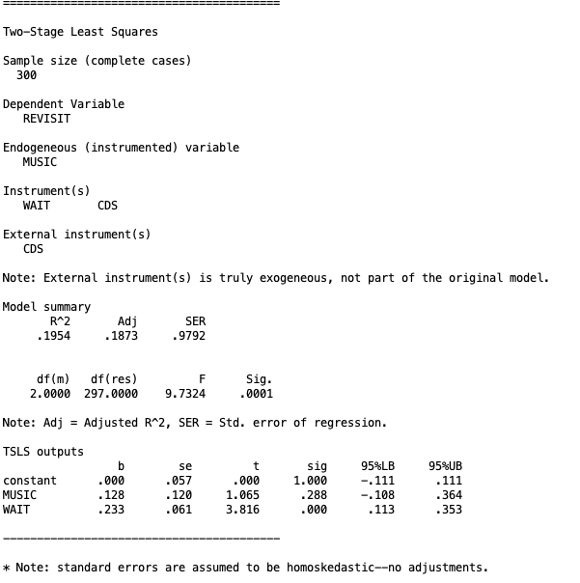
With TSLS, MUSIC is no longer significant

Slide 20
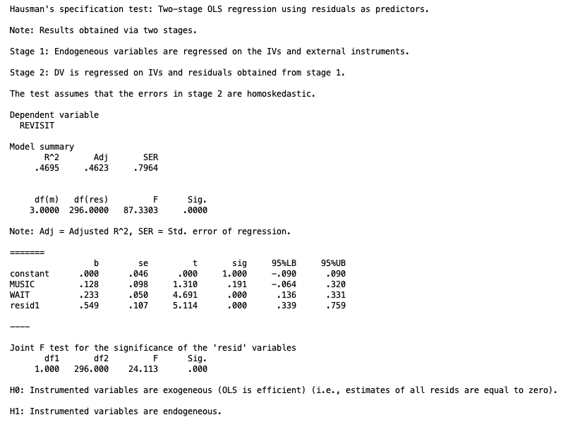
Hausman’s specification test
H0: MUSIC is an exogenous variable (OLS is better)
H1: MUSIC is an endogenous variable
(TSLS is better than OLS)
To assess the significance of H1. You need to look at the significance of the ‘resid’ variable (i.e., resid1).
H0 is rejected because resid1 is significant.
Thus, MUSIC is endogenous, and TSLS is justified

Slide 21
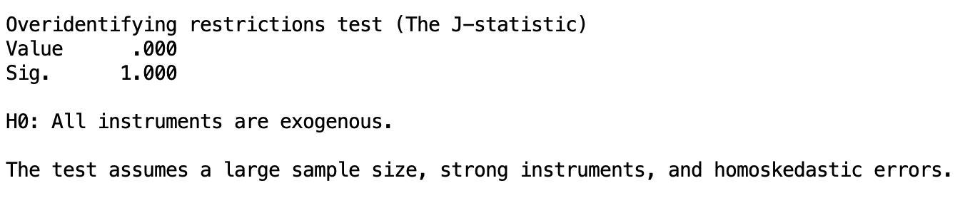
Overidentifying restriction test
H0: All instruments are exogenous H1. One of the instrument is endogenous (i.e., related to the error term)
As we have only one instrument, therefore, this test is not applicable. For one instrument, the value of the J statistic is printed as zero with p-value is equal to 1. For multiple instruments, if the test is not significant (p-value < 0.05), then all instruments are likely to be exogenous.

Slide 22
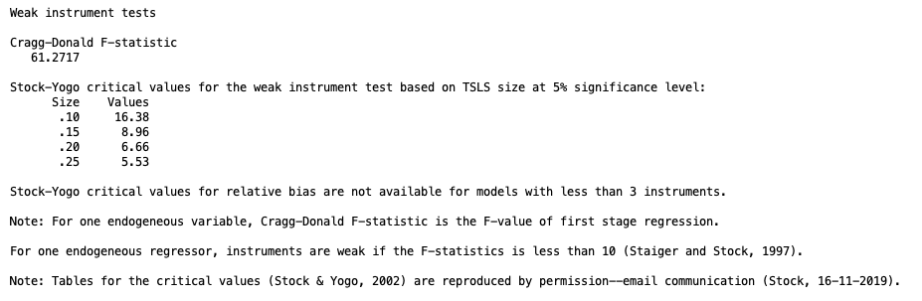
Weak instrument test
An instrument is considered as weak if it weakly correlates with the instrumental variable Z. To know whether CDs is a weak instrument, we look at the F statistic related to first-stage regression of the TSLS procedure. If the F-statistic is less than 10 (Staiger & Stock, 1994), the instrument is weak. In the output, the F-statistic is larger than 10, therefore CDs is not a weak instrument

Slide 23
Instrument as a Part of a Mediation Model
c
CDs
REVISIT
a
b
CDs
MUSIC
REVISIT

Slide 24

Use OLS
Regress REVISIT on CDs
Regress MUSIC on CDs
$β_{TSLS}$ = 0.054/0.424 = 0.128
0.054
CDs
REVISIT
The same value is reported by Endos
0.423
0.128
CDs
MUSIC
REVISIT

Slide 25
Exercise
Use Mroz.sav
Predict Lwage from Educ.
Use Fatheduc as an instrument
Draw the relationship in a diagram
Inspect your result

Slide 26
Research question: Do current political institutions cause higher GDP per capita?
Acemoglu et al. (2001)

Slide 27
The Endogeneity Problem
Model: log(GDP)=β0+β1Risk+u
• Risk measures institutional quality
• OLS coefficient = 0.522
• Omitted factors affect both institutions and GDP

Slide 28
Instrument: Settler Mortality
• Settler mortality influenced colonial strategy
• High mortality → extractive institutions
• Low mortality → settlement institutions
• Historical mortality should not directly affect current GDP
Mortality → Institutions → GDP

Slide 29
Why the Instrument is Valid
Relevance:
Mortality affected institution building.
Exclusion Restriction:
Mortality affects GDP only through institutions.

Slide 30
Results: OLS vs TSLS
OLS β = 0.522
TSLS β = 0.944
OLS understates the causal impact of institutions on GDP.

Slide 31
Diagnostic Tests
• Hausman F = 17.621 (endogeneity present)
• Cragg-Donald F = 22.95 (strong instrument)
• Overidentification test not applicable: just-identified model
Conclusion: Settler mortality is a strong IV and institutions have a larger causal effect than OLS suggests.

Slide 32
Further Readings
Antonakis, J., Bendahan, S., Jacquart, P., & Lalive, R. (2014). Causality and endogeneity: Problems and solutions. The Oxford Handbook of Leadership and Organizations, 1, 93-117.
Busenbark, J. R., Yoon, H., Gamache, D. L., & Withers, M. C. (2022). Omitted variable bias: Examining management research with the impact threshold of a confounding variable (ITCV). Journal of Management, 48(1), 17-48.
Daryanto, A. (2020). EndoS: An SPSS macro to assess endogeneity. The Quantitative Methods for Psychology, 16(1), 56-70.
Sande, J. B., & Ghosh, M. (2018). Endogeneity in survey research. International Journal of Research in Marketing, 35(2), 185-204.

