Slide 1

Workshop on Data Analysis
Professor Ahmad Daryanto
Lancaster University
Presented at Fakultas Ilmu Administrasi
Universitas Brawijaya, Malang
September 2026

Slide 2
Chapter 14: Diagnostic
Textbook: Ahmad Daryanto, Introduction to Quantitative Research Methods for Marketing With SPSS and R: Tools and Techniques, Routledge. 2024

Slide 3
To start
Click
Download SPSS macros, datasets, these slides, pdf articles.
https://github.com/ahdar1/FIA

Slide 4
Learning Objectives
Understand the concept of heteroskedasticity and multicollinearity.
Know how to use the HeteroskedasticityV3 macro and interpret its outputs to detect heteroskedasticity.
Know how to detect a multicollinearity problem and remedy it.
Regression diagnostics are set of activities or procedures to evaluate whether a regression model satisfied regression assumptions. This chapter focuses on two assumptions that can be violated when working with data collected at a fixed point in time (i.e., cross-sectional data), namely, constant residuals (homoskedasticity) and no multicollinearity

Slide 5
On YouTube
https://www.youtube.com/watch?v=dJFAkPLrbx4&t=28s

Slide 6
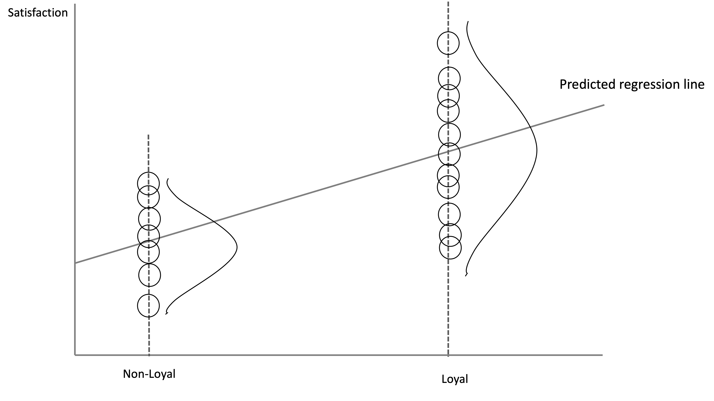
Homoskedasticity and Heteroskedasticity
Homoskedasticity = regression residuals should have the same spreads across any values of independent variables.
Heteroskedasticity = non-constant spread.
Heteroskedasticity exists. Satisfaction scores of loyal customers are more spread out than that of non-loyal customers

Slide 7
Consequences of Heteroskedasticity
If regression errors are heteroskedastic and we run a regression as usual in SPSS, the standard errors reported by SPSS are wrong. As a consequence, the t-value, p-value, and confidence intervals for b0 and b1 are wrong. If they are all wrong, our research conclusion are wrong. For example, non-significant relationship in a population can be significant in a sample when heteroskedasticity is present.

Slide 8
How to Detect Heteroskedasticity?
Inspecting the plot of residuals against the independent variable or against the predicted values of the dependent variable.
By conducting statistical tests, among which are the popular Breusch-Pagan and Koenker test.
The null hypothesis of the tests is that error terms are homoskedastic.
Because we want to satisfy the homoskedasticity assumption, we want to have a large p-value. This means we do not want to reject the null hypothesis.
If the null hypothesis is not rejected, we can conduct a regression analysis as usual without having to adjust the standard errors of the regression coefficients.

Slide 9
Homoskedastic or heteroskedastic residuals?
In practice, it is more common to have heteroskedastic than homoskedastic residuals. Modern views regards homoskedastic residuals as an exception (Stock & Watson, 2015).

Slide 10
Remedy
Adjust the standard errors of the regression coefficients using the heteroskedasticity-adjusted standard errors (Stock & Watson, 2015), or HC standard error, for short.
There are several types of these HC standard errors, namely HC0 (or Eicker-Huber-White standard errors), HC1, HC2, HC3, and HC4. When we open the HeteroskedasticityV3 macro, we can select one of these HC standard errors
HC4 is widely recommended, which is the latest version of the types (Daryanto, 2020). My recommendation is that we report your regression results with and without adjusted standard errors.

Slide 11
SPSS Action: HeteroskedasticityV3 Macro
Download the HeteroskedasticityV3 macro from this website https://www.tqmp.org/Vignettes/vol16-5/v008/index.html. To download the file, on the website, click Appendix. A folder containing the macro will be downloaded automatically. Please check your download folder in your computer.

Slide 12

For an illustration, let estimate this model again.
Data: satisfaction.sav
Steps:
Analyze → Regression → HeteroskedasticityV3 by Ahmad Daryanto.
Insert Sales to the Outcome variable box.
Insert Loyal to the Explanatory variable box.
Leave the default HC4 as it is.
Click OK and inspect the outputs. Do not click ‘Paste’ because long list of syntax will be output to a new syntax file.

Slide 13
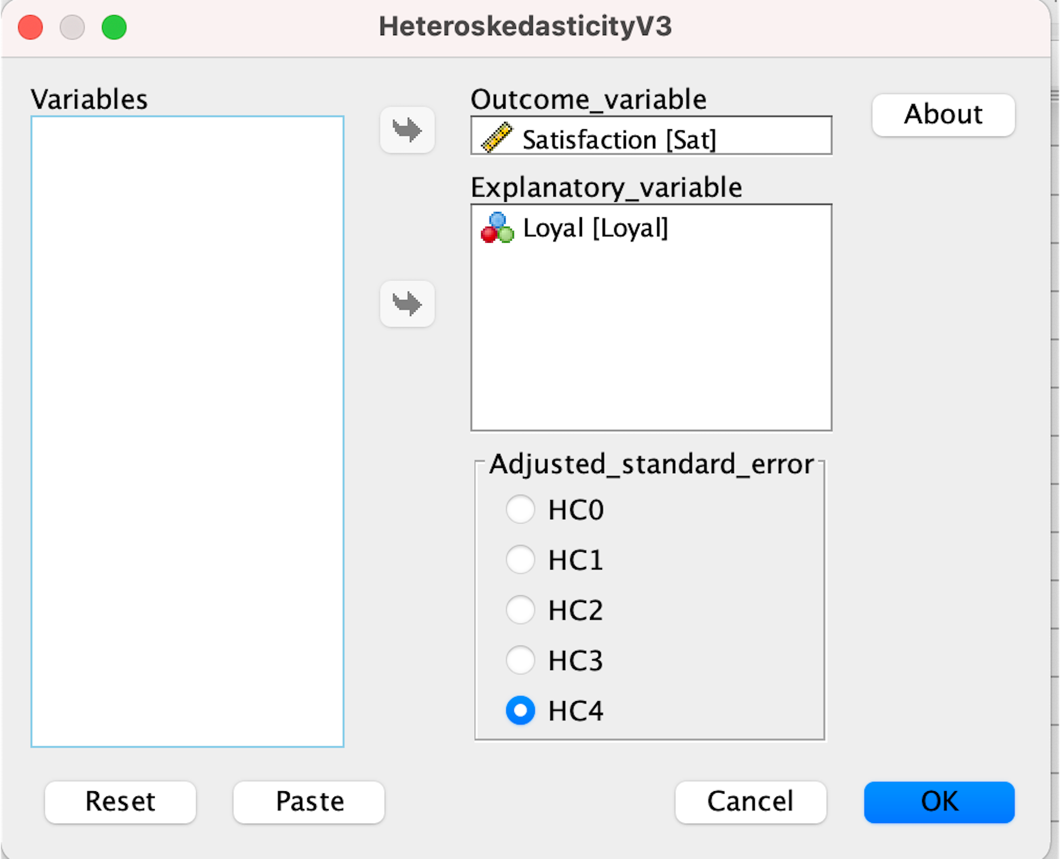

Slide 14
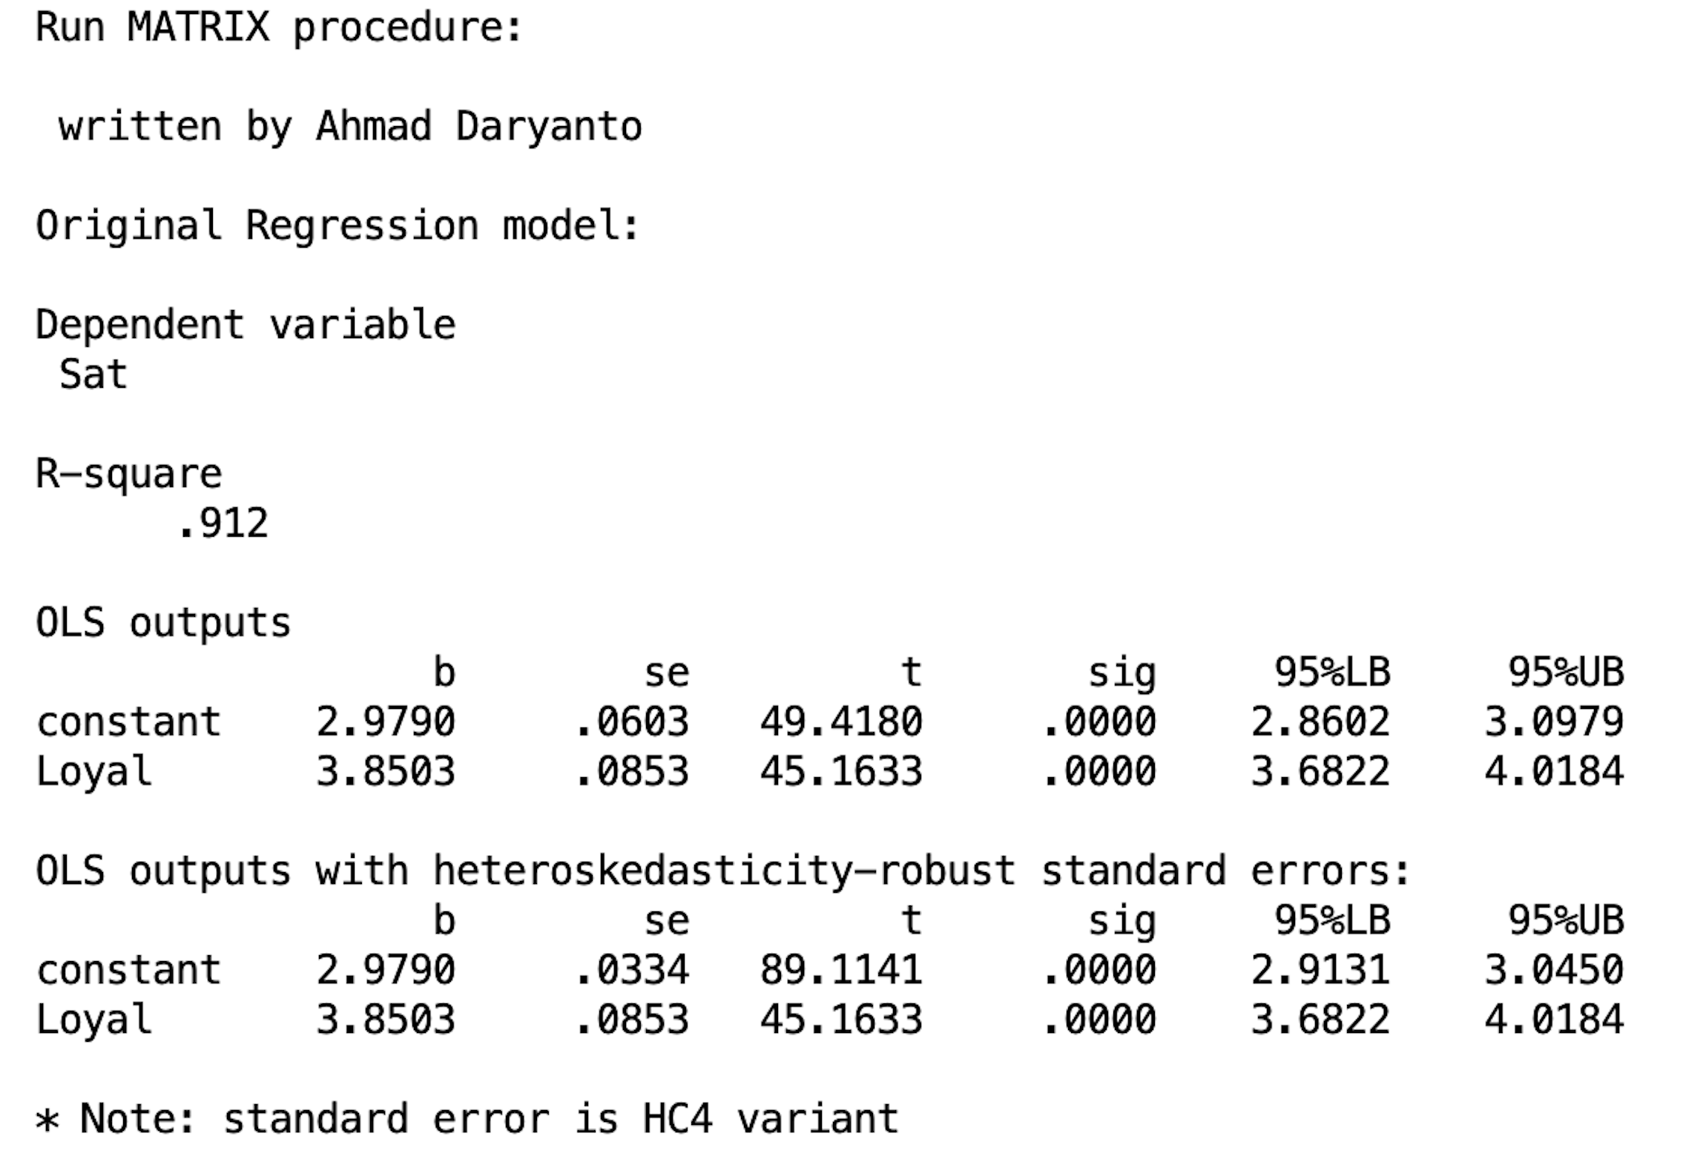
The Macro’s Outputs
As we can see from the Figure, the first part presents the standard regression outputs. The second part presents the regression results with adjusted standard errors. In both part, the regression coefficients are the same. As expected, the standard errors are slightly different for the intercept, which is smaller in the adjusted standard error (se = 0.0603 vs. se(HC4) = 0.0334). In this particular example, Loyal is significant with and without adjusted standard errors. Despite minimal differences, we still need to decide which part of the outputs will be used, with or without adjusted standard errors? We have to look at the next outputs.

Slide 15
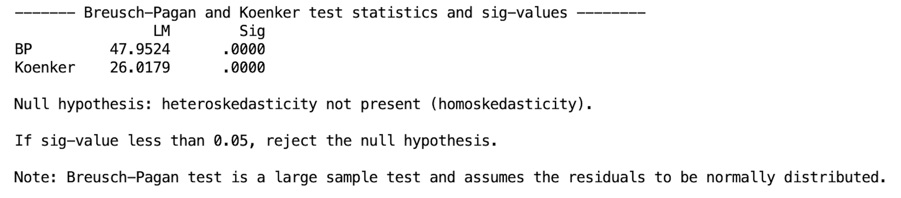
Statistical tests
In this example, the LM statistics of both tests are significant as both p-values are smaller than 0.05. Therefore, the null hypothesis of homoskedasticity is rejected.
This means that heteroskedasticity is likely to be present in the data.
Based on this result, we have to use the results with the adjusted standard errors.
The BP test is more stringent than the Koenker test, which assumes that the residuals are normally distributed. When two results are different, Koenker’s test is more preferable as it is robust against the departure from normality, especially if sample is large.

Slide 16
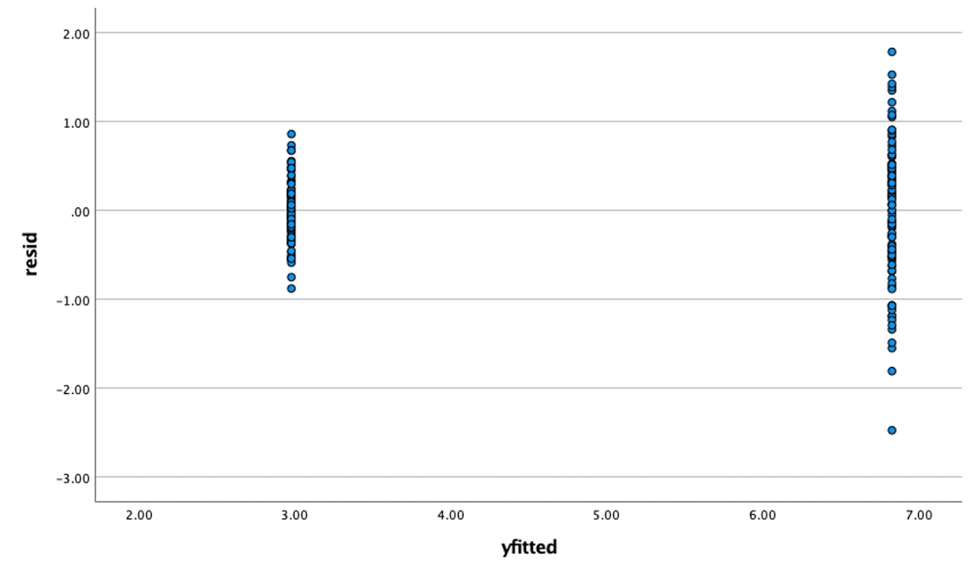
Residual plot
The plot of residuals against the fitted values is displayed in the last output of the macro. From the output, it is very obvious that the distribution of the residuals are not constant. The residuals of the loyal customer group is more spread out than that of the non-loyal customer group, which confirmed the results of the BP and Koenker tests above.

Slide 17
Exercise
Use Slotegraaf.sav
Inspect the relationship between Team Stability, Team Size, and Team-level Debate. Draw your model in a diagram.
Would you correct for the standard errors?

Slide 18
R Action
library(haven)
library(lmtest)
library(sandwich)
rm(list=ls()) # start from a clean slate.
dat <- read_spss("/Users/ahmaddaryanto/Documents/Data1/satisfaction.sav")
lm_model <- lm(Sat ~ Loyal, data = dat)
summary(lm_model)
plot(lm_model, which=c(1,1))
# BP test
bp <- bptest(Sat ~ Loyal, varformula = NULL, studentize = FALSE
, data = dat)
bp
# Koenker test
kt <- bptest(Sat ~ Loyal, varformula = NULL, studentize = TRUE,
data = dat)
kt

Slide 19
Calculate robust standard errors and compute their 95% confidence interval:
coeftest(lm_model,vcov = vcovHC(lm_model,type="HC4"))
#compute 95%CI for robust se
covariance <- vcovHC(lm_model, type = "HC4")
t.critical <-qt(c(0.025,0.975),summary(lm_model)$df[2])
se <- sqrt(diag(covariance))
robust.ci <-coef(lm_model) + se %o% t.critical
robust.ci

Slide 20
Further Reading
Daryanto, A. (2020). Tutorial on heteroskedasticity using heteroskedasticityV3 SPSS macro. The Quantitative Methods forPsychology, 16(5), 8-20.

