Slide 1
Chapter 14: Diagnostic
Textbook: Ahmad Daryanto, Introduction to Quantitative Research Methods for Marketing With SPSS and R: Tools and Techniques, Routledge. 2024

Slide 2
Learning Objectives
Understand the concept of heteroskedasticity and multicollinearity.
Know how to use the HeteroskedasticityV3 macro and interpret its outputs to detect heteroskedasticity.
Know how to detect a multicollinearity problem and remedy it.
Regression diagnostics are set of activities or procedures to evaluate whether a regression model satisfied regression assumptions. This chapter focuses on two assumptions that can be violated when working with data collected at a fixed point in time (i.e., cross-sectional data), namely, constant residuals (homoskedasticity) and no multicollinearity

Slide 3
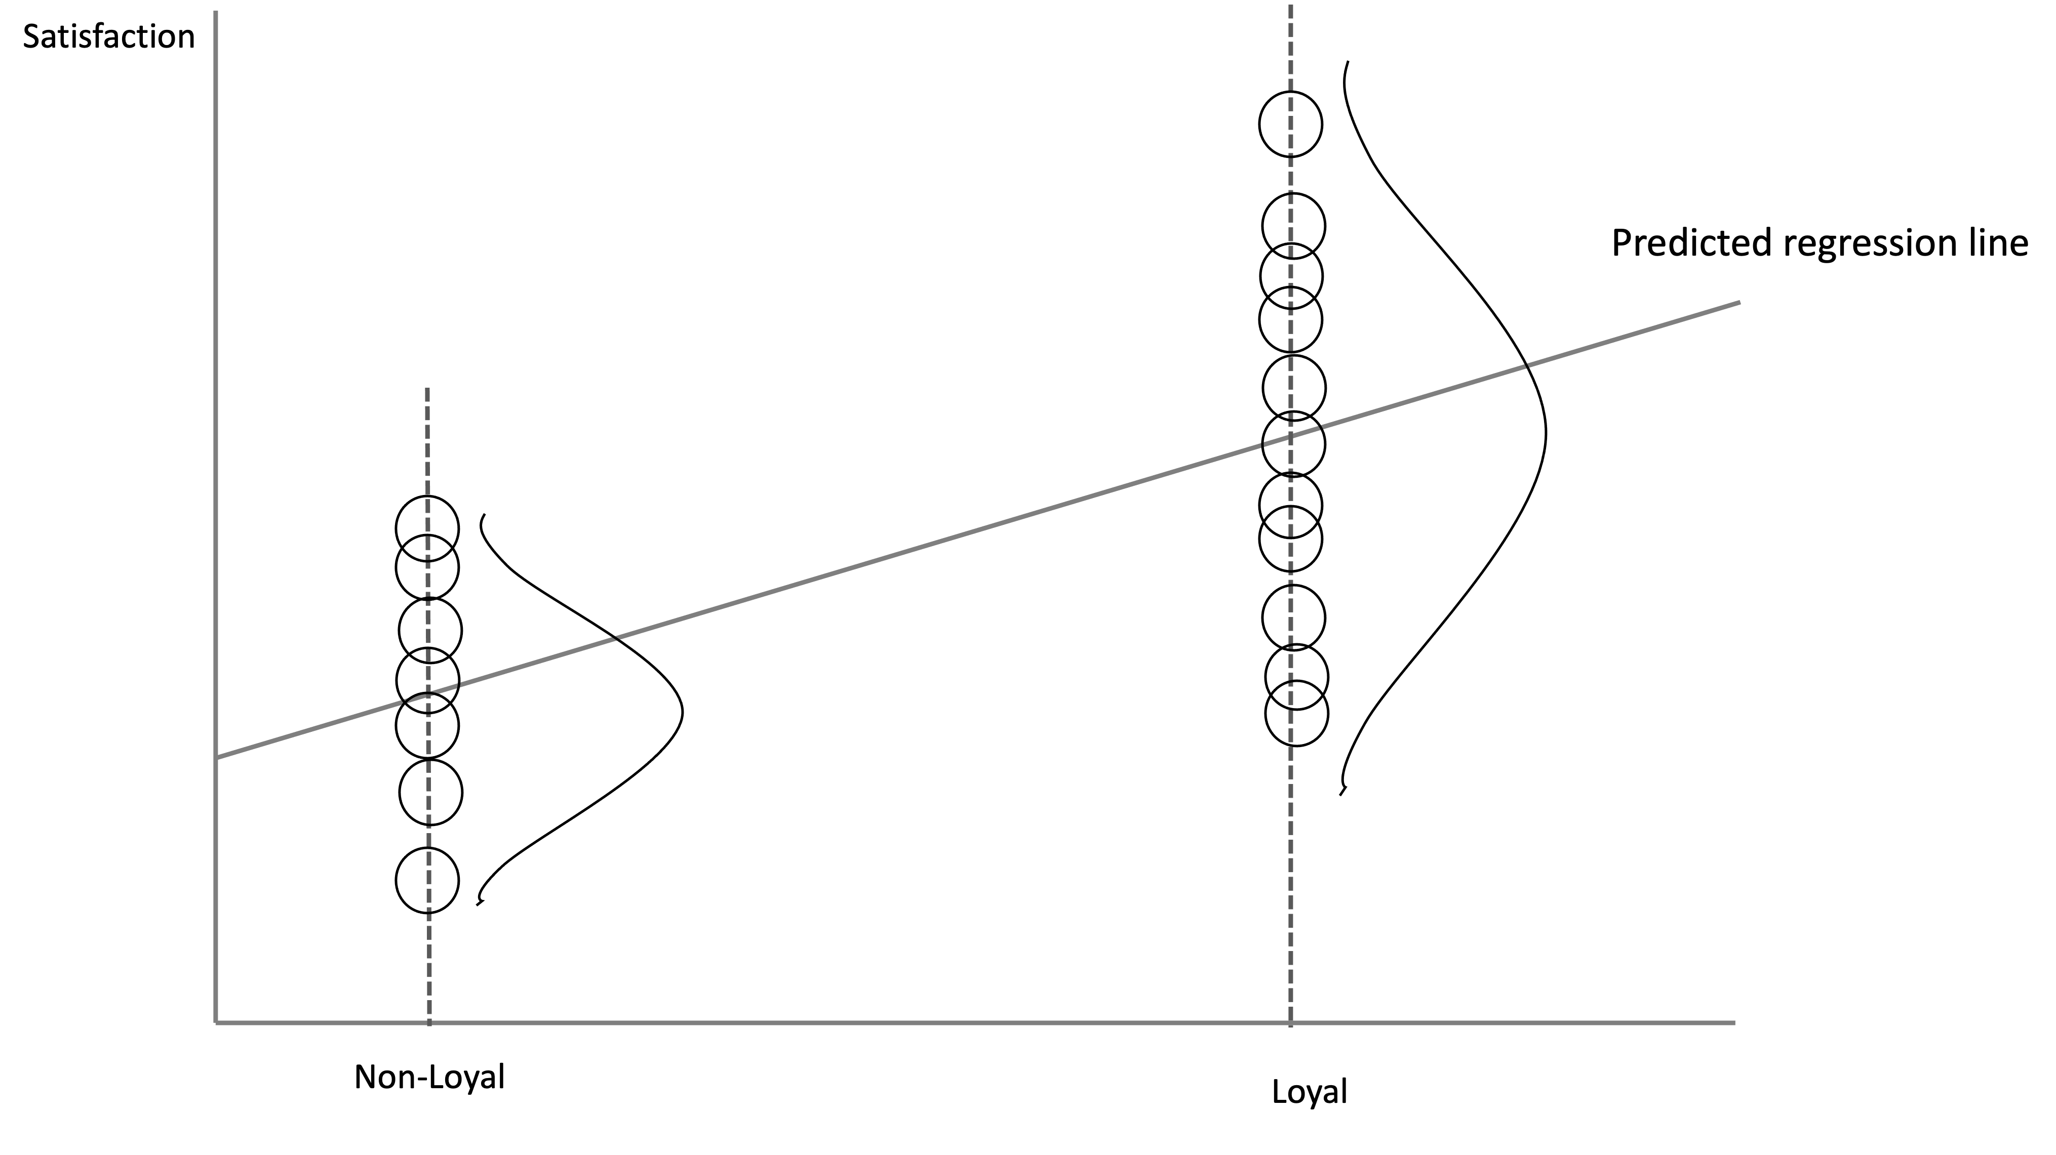
Homoskedasticity and Heteroskedasticity
Homoskedasticity = regression residuals should have the same spreads across any values of independent variables.
Heteroskedasticity = non-constant spread.
Heteroskedasticity exists. Satisfaction scores of loyal customers are more spread out than that of non-loyal customers

Slide 4
Consequences of Heteroskedasticity
If regression errors are heteroskedastic and we run a regression as usual in SPSS, the standard errors reported by SPSS are wrong. As a consequence, the t-value, p-value, and confidence intervals for b0 and b1 are wrong. If they are all wrong, our research conclusion are wrong. For example, non-significant relationship in a population can be significant in a sample when heteroskedasticity is present.

Slide 5
How to Detect Heteroskedasticity?
Inspecting the plot of residuals against the independent variable or against the predicted values of the dependent variable.
By conducting statistical tests, among which are the popular Breusch-Pagan and Koenker test.
The null hypothesis of the tests is that error terms are homoskedastic.
Because we want to satisfy the homoskedasticity assumption, we want to have a large p-value. This means we do not want to reject the null hypothesis.
If the null hypothesis is not rejected, we can conduct a regression analysis as usual without having to adjust the standard errors of the regression coefficients.

Slide 6
Homoskedastic or heteroskedastic residuals?
In practice, it is more common to have heteroskedastic than homoskedastic residuals. Modern views regards homoskedastic residuals as an exception (Stock & Watson, 2015).

Slide 7
Remedy
Adjust the standard errors of the regression coefficients using the heteroskedasticity-adjusted standard errors (Stock & Watson, 2015), or HC standard error, for short.
There are several types of these HC standard errors, namely HC0 (or Eicker-Huber-White standard errors), HC1, HC2, HC3, and HC4. When we open the HeteroskedasticityV3 macro, we can select one of these HC standard errors
HC4 is widely recommended, which is the latest version of the types (Daryanto, 2020). My recommendation is that we report your regression results with and without adjusted standard errors.

Slide 8
SPSS Action: HeteroskedasticityV3 Macro
Download the HeteroskedasticityV3 macro from this website https://www.tqmp.org/Vignettes/vol16-5/v008/index.html. To download the file, on the website, click Appendix. A folder containing the macro will be downloaded automatically. Please check your download folder in your computer.

Slide 9

For an illustration, let estimate this model again.
Data: satisfaction.sav
Steps:
Analyze → Regression → HeteroskedasticityV3 by Ahmad Daryanto.
Insert Sales to the Outcome variable box.
Insert Loyal to the Explanatory variable box.
Leave the default HC4 as it is.
Click OK and inspect the outputs. Do not click ‘Paste’ because long list of syntax will be output to a new syntax file.

Slide 10
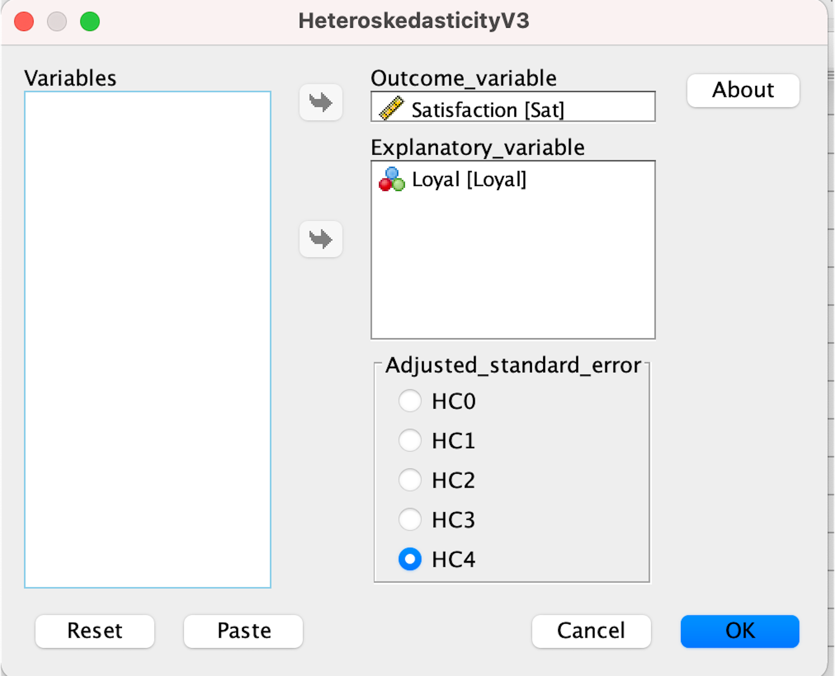

Slide 11
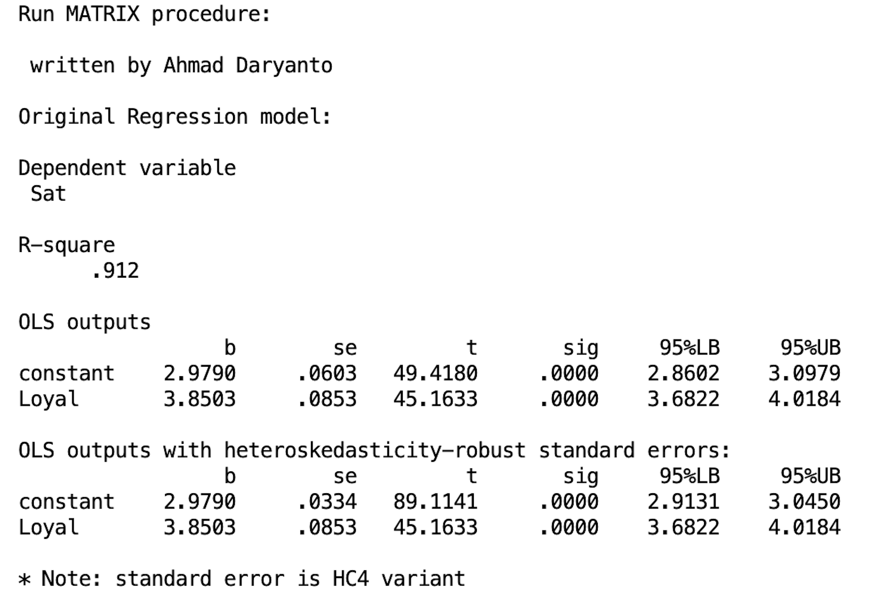
The Macro’s Outputs
As we can see from the Figure, the first part presents the standard regression outputs. The second part presents the regression results with adjusted standard errors. In both part, the regression coefficients are the same. As expected, the standard errors are slightly different for the intercept, which is smaller in the adjusted standard error (se = 0.0603 vs. se(HC4) = 0.0334). In this particular example, Loyal is significant with and without adjusted standard errors. Despite minimal differences, we still need to decide which part of the outputs will be used, with or without adjusted standard errors? We have to look at the next outputs.

Slide 12
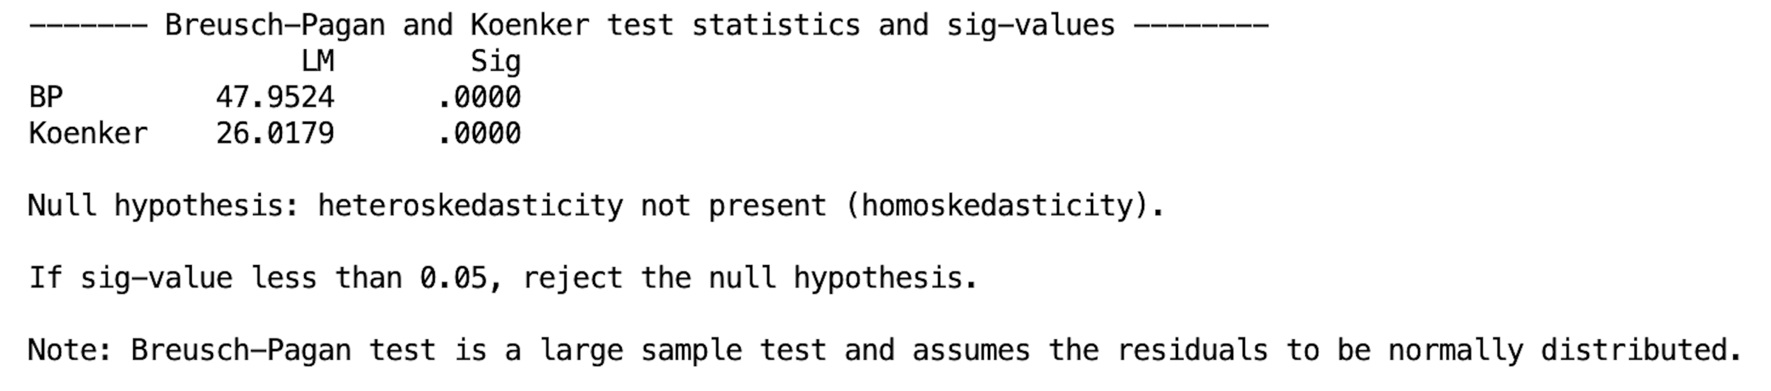
Statistical tests
In this example, the LM statistics of both tests are significant as both p-values are smaller than 0.05. Therefore, the null hypothesis of homoskedasticity is rejected.
This means that heteroskedasticity is likely to be present in the data.
Based on this result, we have to use the results with the adjusted standard errors.
The BP test is more stringent than the Koenker test, which assumes that the residuals are normally distributed. When two results are different, Koenker’s test is more preferable as it is robust against the departure from normality, especially if sample is large.

Slide 13
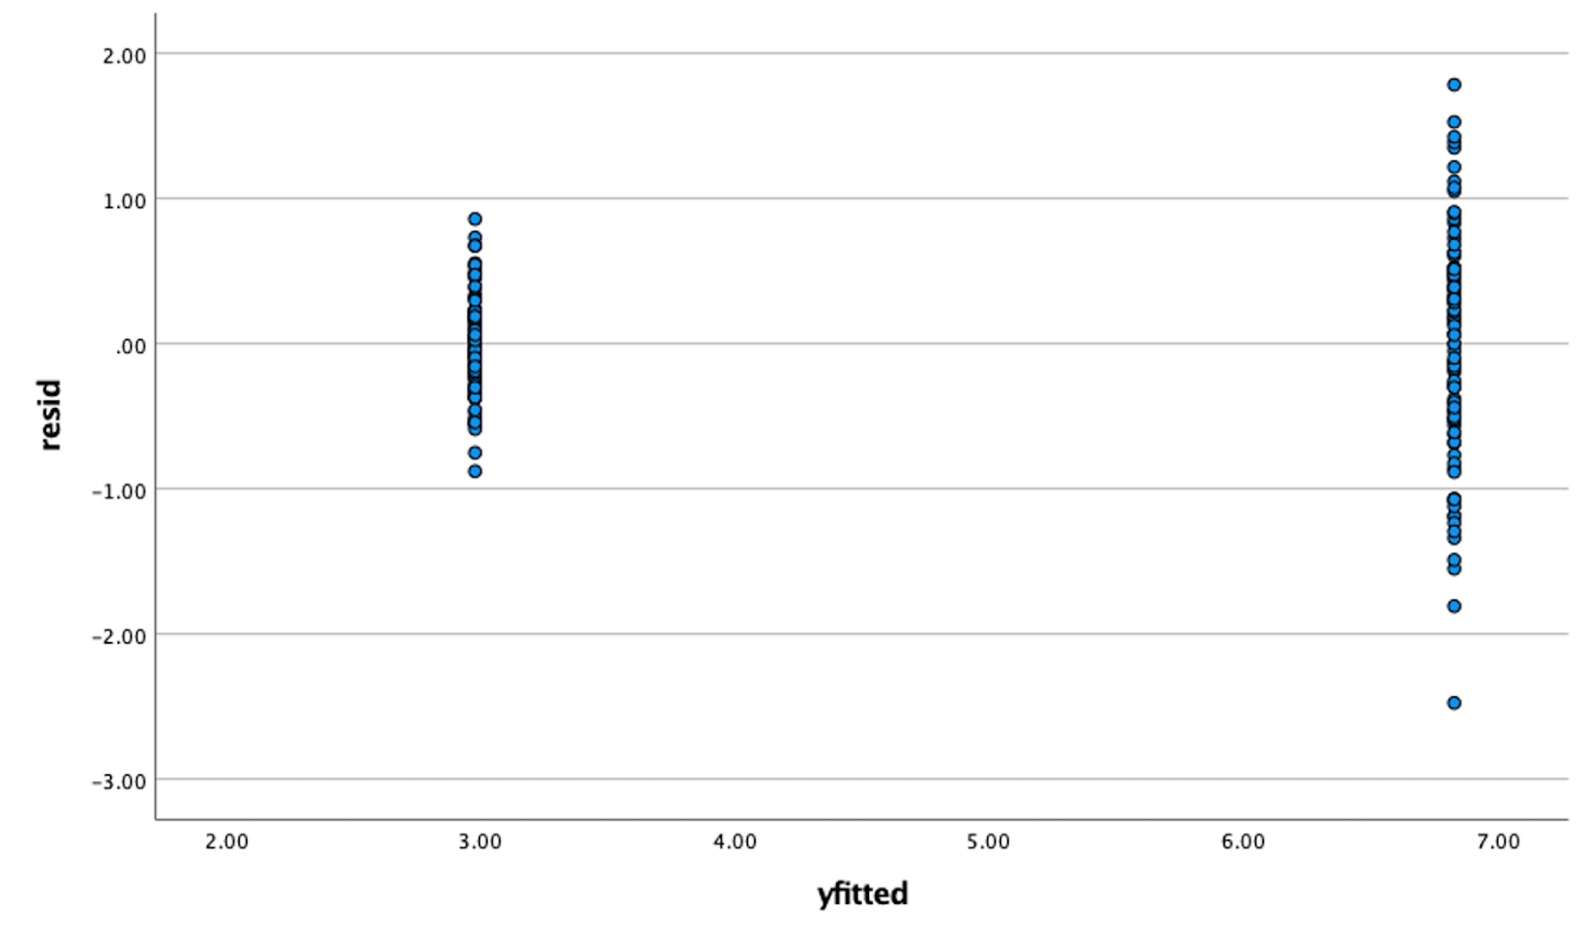
Residual plot
The plot of residuals against the fitted values is displayed in the last output of the macro. From the output, it is very obvious that the distribution of the residuals are not constant. The residuals of the loyal customer group is more spread out than that of the non-loyal customer group, which confirmed the results of the BP and Koenker tests above.

Slide 14
R Action
library(haven)
library(lmtest)
library(sandwich)
rm(list=ls()) # start from a clean slate.
dat <- read_spss("/Users/ahmaddaryanto/Documents/Data1/satisfaction.sav")
lm_model <- lm(Sat ~ Loyal, data = dat)
summary(lm_model)
plot(lm_model, which=c(1,1))
# BP test
bp <- bptest(Sat ~ Loyal, varformula = NULL, studentize = FALSE
, data = dat)
bp
# Koenker test
kt <- bptest(Sat ~ Loyal, varformula = NULL, studentize = TRUE,
data = dat)
kt

Slide 15
Calculate robust standard errors and compute their 95% confidence interval:
coeftest(lm_model,vcov = vcovHC(lm_model,type="HC4"))
#compute 95%CI for robust se
covariance <- vcovHC(lm_model, type = "HC4")
t.critical <-qt(c(0.025,0.975),summary(lm_model)$df[2])
se <- sqrt(diag(covariance))
robust.ci <-coef(lm_model) + se %o% t.critical
robust.ci

Slide 16
Multicollinearity
Multicollinearity refers to a high correlation among independent variables in a regression model. A correlation coefficient greater than 0.9 is generally considered high, however, r>0.7 can be an indicative of a multicollinearity problem. Multicollinearity causes the standard errors of the regression coefficients to be inflated, which makes the research conclusion to be misleading.
When multicollinearity exists, it is difficult to assess the relative importance of a variable while keeping another variable constant because it is difficult to assess the effect of one variable while isolating the effect of another variables as they are highly correlated.

Slide 17

VIF
One of the frequently used diagnostic tools to assess multicollinearity is the variance inflation factor (VIF), which can be calculated for each predictor in a regression model. VIF measures how much the variance of the regression estimate associated with a predictor is inflated as compared to when the predictor is not correlated with other predictors in the model.
To understand the calculation of VIF, we have to know the concept of Tolerance because VIF is the inverse of Tolerance (VIF=1/Tolerance). Tolerance is the percentage of variation in an independent variable that cannot be explained by other independent variables.

Slide 18
VIF threshold
The largest VIF value exceeding 10 is often considered as a serious sign of a mullticollinearity problem (Kutner, Nachtsheim, Neter, Li, et al., 2005).
Others impose a more stringent value such as 5 (Studenmund, 2014) or even 3 (Hair, Black, Babin, Anderson, & Tatham, 2009).
The thresholds for the VIF values are rule of thumbs. They need to be interpreted “in the context of other factors that influence the stability of the estimates of the ith regression coefficient” (O’brien, 2007, p. 685).

Slide 19
SPSS Action
Data: store.sav
Click Analyze → Regression → Linear.
Insert satstore to the Dependent box.
Insert satemp,wt,age to the Independent(s) box.
Click Statistics and tick ‘Collinearity diagnostics’.
Click OK and inspect the coefficient table in the output

Slide 20
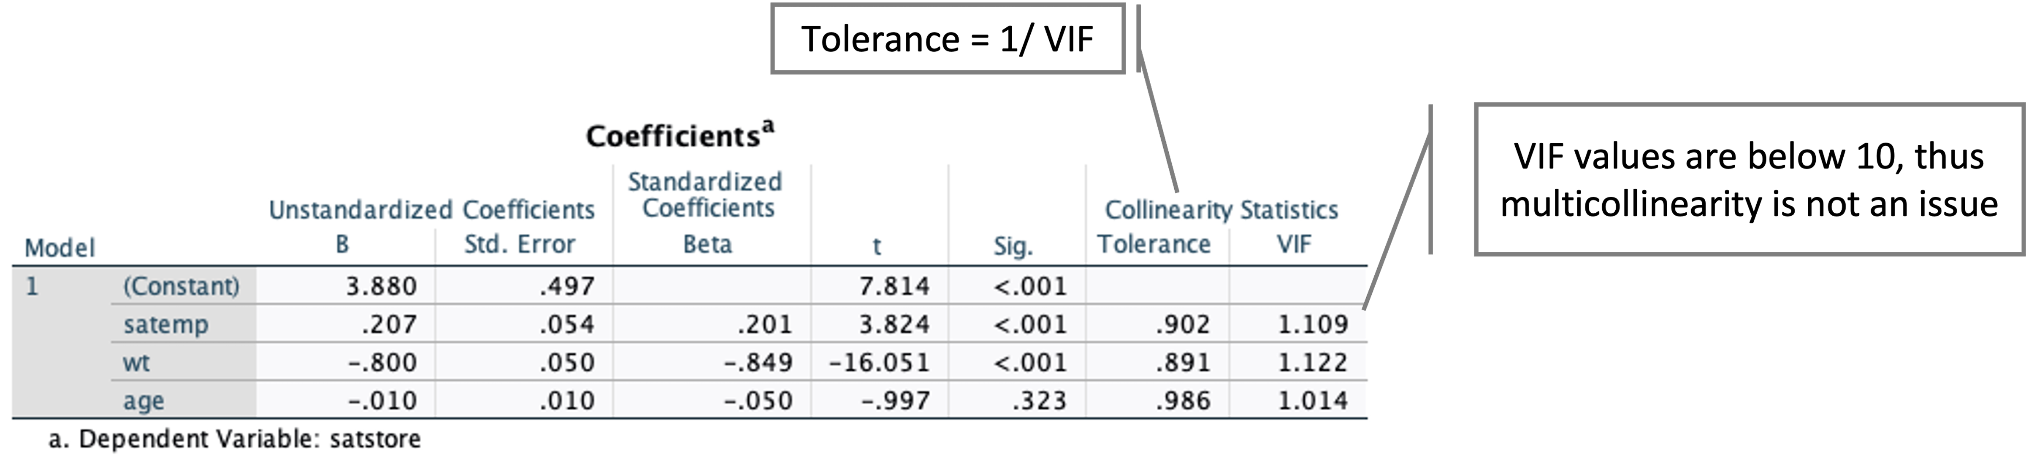
SPSS printed two additional columns as a result of ticking ‘Collinearity diagnostic’, one of which is the VIF column that contains the VIF values associated with each independent variable. As we can see from Figure 2.9, the VIF values are very small, thus multicollinearity is not a concern.

Slide 21
R Action
library(haven)
library(stargazer)
rm(list=ls()) # start from a clean slate.
dat <- read_spss("/Users/ahmaddaryanto/Documents/Data1/store.sav")
lm_model <- lm(satstore ~ satemp + wt + age, data = dat)
stargazer(lm_model, type = "text", single.row=TRUE)

Slide 22
To calculate VIF values, we have to rely on another package: car() library, that has a vif() function. Now, let us use the function to calculate the VIF values associated with each of the independent variable:
# Load the car library
library(car)
# Calculate the VIF
round(vif(lm_model), 3) # round to 3 dp

Slide 23
Remedy
Three common ways to deal with multicollinearity:
Omit one or more highly correlated independent variables. For example, suppose that perceived product quality is explained by both brand image (BI) and product image (PI). However, if BI and PI are highly correlated, we drop one of them (either BI or PI) from the model.
Create a composite variable by averaging variables that are highly correlated. The new variable is the one that is used as an independent variable in a regression model. The drawback of averaging is that some information is lost, and the meaning of the single variable is unclear. In this case, the interpretation of the meaning of the regression coefficient associated with the single variable is also unclear.

Slide 24
Model that suffers with multicollinearity can be used for prediction purposes only – predicting an individual’s satisfaction score. Model that suffers from multicollinearity, however, can not be used for theory testing – e.g., it can not be used to answer this question: to what extent does subjective waiting time affect satisfaction?

