Slide 1
Chapter 18: Endogeneity
Textbook: Ahmad Daryanto, Introduction to Quantitative Research Methods for Marketing With SPSS and R: Tools and Techniques, Routledge. 2024

Slide 2
Learning Objectives
Understand the concept of endogeneity
Able to use EndoS macro to address an endogeneity problem

Slide 3
What Is Endogeneity?
Consider this modelling situation:
I want to examine the influence of the background music in a barbershop on customers’ revisit intentions to their first-time visit barbershop.
Item to measure revisit intention: Will you visit the same barbershop in the future? (1 = very unlikely, 5 = highly likely).
Item to measure customers’ attitude toward the background music: How do you like the background music played in the barbershop? (1 = extremely dislike; 7 = like it very much).

Slide 4

I come up with the following simple linear model
However, the true model is:
Where BARBER = How do you like the barber
(1 = extremely dislike, 7= like very much
Because BARBER and MUSIC may be correlated,
omitting BARBER from the first model will lead to a biased in the coefficient estimate for MUSIC (endogeneity problem)

Slide 5
Formal Definition
The modelling situation where a predictor is correlated to an error term is termed as an endogeneity problem.
Omitting an important variable from a model is not the only cause of an endogeneity problem. Endogeneity can also arise when (1) variables are measured with errors, (2) the causal effects run both from X → Y and from Y → X, known in the regression literature as simultaneity.

Slide 6
Two-Stage Least Square (TSLS)
One of the techniques to deal with an endogeneity problem is the two-stage least squares (TSLS).
TSLS requires us to find a variable known as an instrumental variable or instrument, for short, often denoted by Z.

Slide 7
Instrumental Variable (Z)
Any variable that acts as a Z must satisfy the following assumptions:
It must be correlated with MUSIC. This is referred to as a relevance assumption.
It should not be correlated with the error term O. This is referred to as an exogeneity assumption.
It affects REVISIT only via MUSIC. This is referred to as an exclusion restriction assumption.

Slide 8

The relationship between the instrument Z, the endogenous variable X, and the dependent variable Y.
O
$$ε$$
Z
MUSIC
REVISIT

Slide 9
The Role of Z
In an endogeneity situation, the variation in MUSIC comprises of parts that are correlated and uncorrelated with to the error term O. The role of Z is to capture the uncorrelated part and used it to replace MUSIC.
Z is the hard to find in practice.

Slide 10
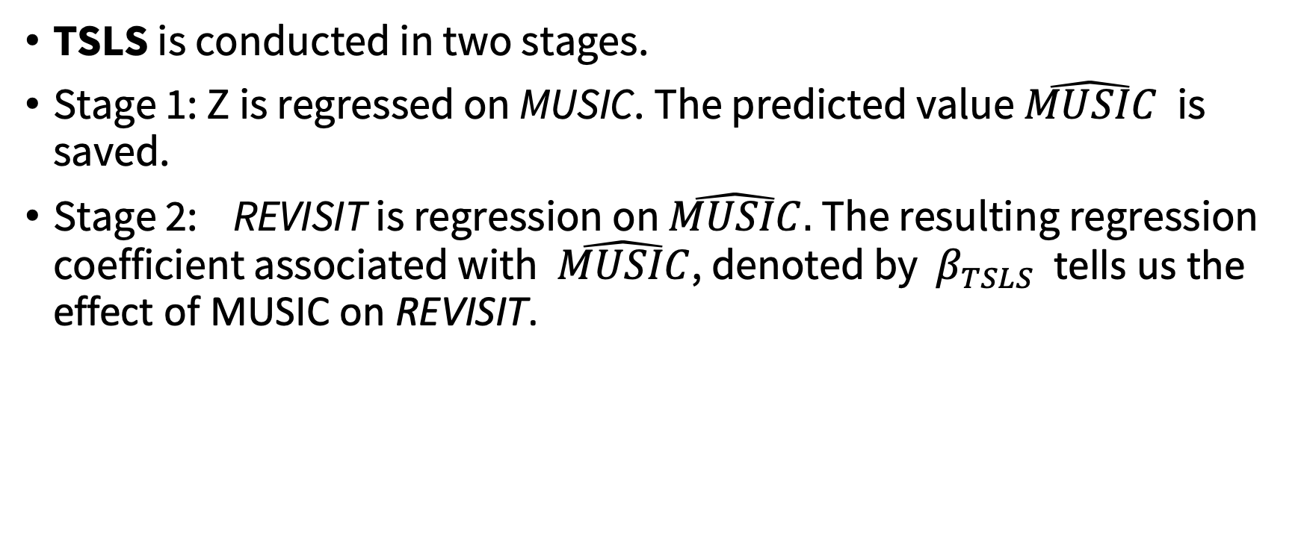
TSLS PROCEDURE
TSLS is conducted in two stages.
Stage 1: Z is regressed on MUSIC. The predicted value $\hat{MUSIC}$ is saved.
Stage 2: REVISIT is regression on $\hat{MUSIC}.$ The resulting regression coefficient associated with $\hat{MUSIC}$, denoted by $β_{TSLS}$ tells us the effect of MUSIC on REVISIT.

Slide 11

Illustration
CDS is the instrument.
CDS = the number of music CDs a customer has
CDs is assumed to satisfy the relevance, and the exogeneity assumptions.
WAIT is a control variable (“I waited very long before being served).
O
$$ε$$
WAIT
CDs
MUSIC
REVISIT

Slide 12
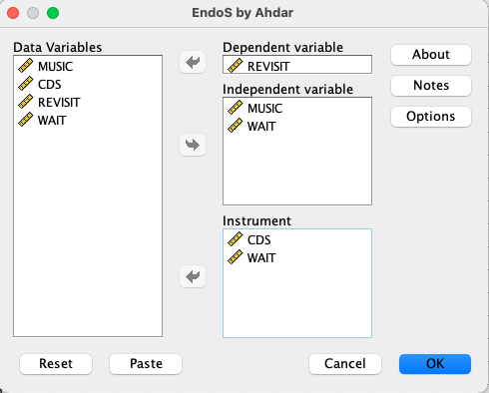
ENDOS
Developed by Ahmad Daryanto
Install ENDOS.SPD

Slide 13
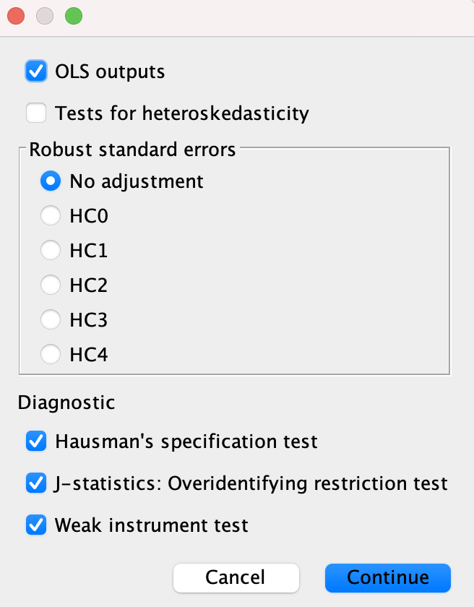
Product outputs Of OLS regression
Test whether a predictor is truly endogenous (or is 2SLS better than OLS?)
For multiple instruments.
Are the extra instruments necessary?
Test whether instruments are weak

Slide 14
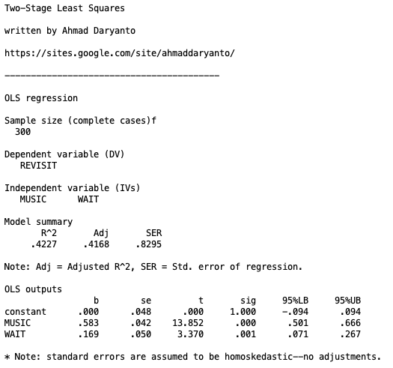
With OLS, MUSIC is significant

Slide 15
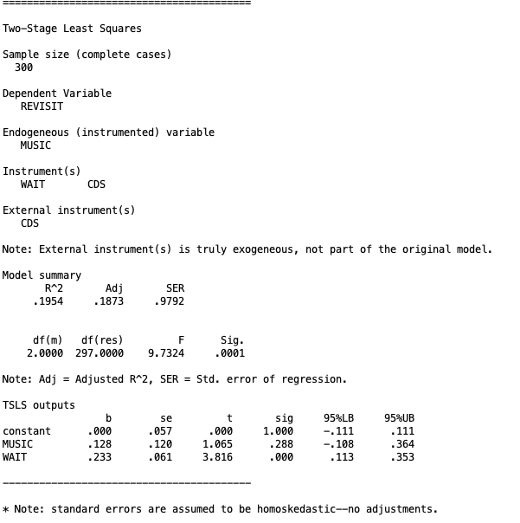
With TSLS, MUSIC is no longer significant

Slide 16
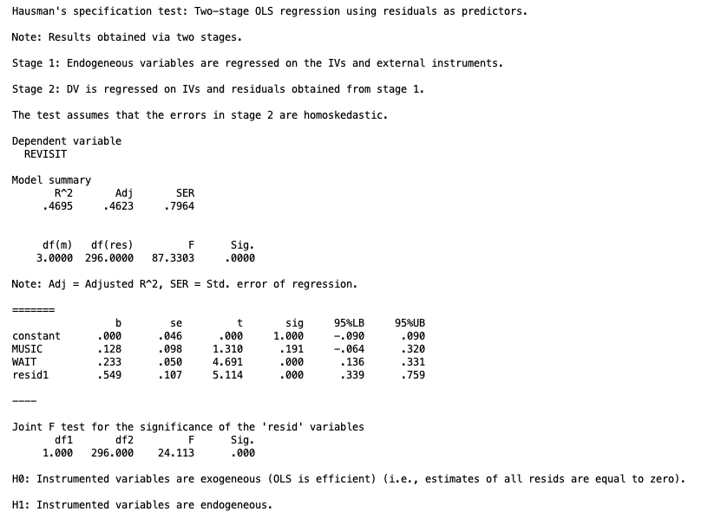
Hausman’s specification test
H0: MUSIC is an exogenous variable (OLS is better)
H1: MUSIC is an endogenous variable
(TSLS is better than OLS)
To assess the significance of H1. You need to look at the significance of the ‘resid’ variable (i.e., resid1).
H0 is rejected because resid1 is significant.
Thus, MUSIC is endogenous, and TSLS is justified

Slide 17
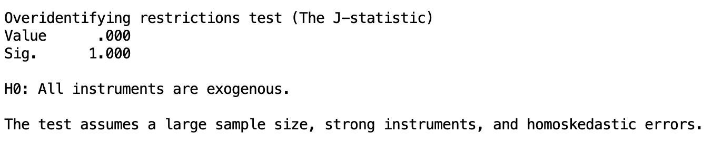
Overidentifying restriction test
H0: All instruments are exogenous H1. One of the instrument is endogenous (i.e., related to the error term)
As we have only one instrument, therefore, this test is not applicable. For one instrument, the value of the J statistic is printed as zero with p-value is equal to 1. For multiple instruments, if the test is not significant (p-value < 0.05), then all instruments are likely to be exogenous.

Slide 18
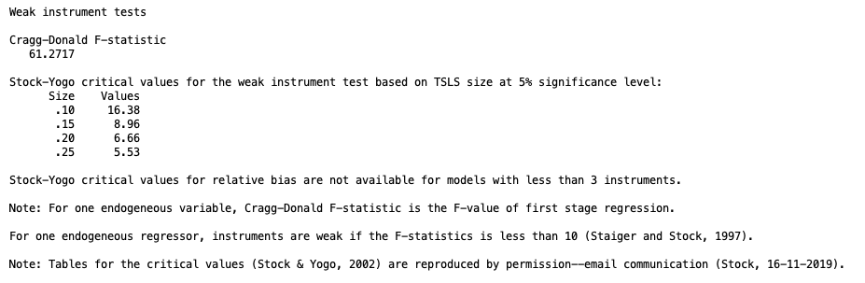
Weak instrument test
An instrument is considered as weak if it weakly correlates with the instrumental variable Z. To know whether CDs is a weak instrument, we look at the F statistic related to first-stage regression of the TSLS procedure. If the F-statistic is less than 10 (Staiger & Stock, 1994), the instrument is weak. In the output, the F-statistic is larger than 10, therefore CDs is not a weak instrument

Slide 19
Instrument as a Part of a Mediation Model
c
CDs
REVISIT
a
b
CDs
MUSIC
REVISIT

Slide 20

Use OLS
Regress REVISIT on CDs
Regress MUSIC on CDs
$β_{TSLS}$ = 0.054/0.424 = 0.128
0.054
CDs
REVISIT
The same value is reported by Endos
0.423
0.128
CDs
MUSIC
REVISIT

Slide 21
Further Readings
Antonakis, J., Bendahan, S., Jacquart, P., & Lalive, R. (2014). Causality and endogeneity: Problems and solutions. The Oxford Handbook of Leadership and Organizations, 1, 93-117.
Busenbark, J. R., Yoon, H., Gamache, D. L., & Withers, M. C. (2022). Omitted variable bias: Examining management research with the impact threshold of a confounding variable (ITCV). Journal of Management, 48(1), 17-48.
Daryanto, A. (2020). EndoS: An SPSS macro to assess endogeneity. The Quantitative Methods for Psychology, 16(1), 56-70.
Sande, J. B., & Ghosh, M. (2018). Endogeneity in survey research. International Journal of Research in Marketing, 35(2), 185-204.

