Slide 1
Chapter 9: Hypothesis And Significance
Textbook: Ahmad Daryanto, Introduction to Quantitative Research Methods for Marketing With SPSS and R: Tools and Techniques, Routledge. 2024

Slide 2
Learning Objectives
Understand the concept of hypothesis testing.
Know how to formulate null and alternative hypothesis.
Understand the concept of p-value and its relation to a hypothesis testing.
Aware of the limitations of the p-value approach in hypothesis testing.

Slide 3
Making An Inference
Hypothesis testing is about testing a statement or proposition about a population.
For example, your friend could make this claim: ” Postgraduate students in our university are satisfied with their accommodation provided by the university”.
This is a statement that need to be supported by data.
The process of making an inference follows the following flow chart:

Slide 4
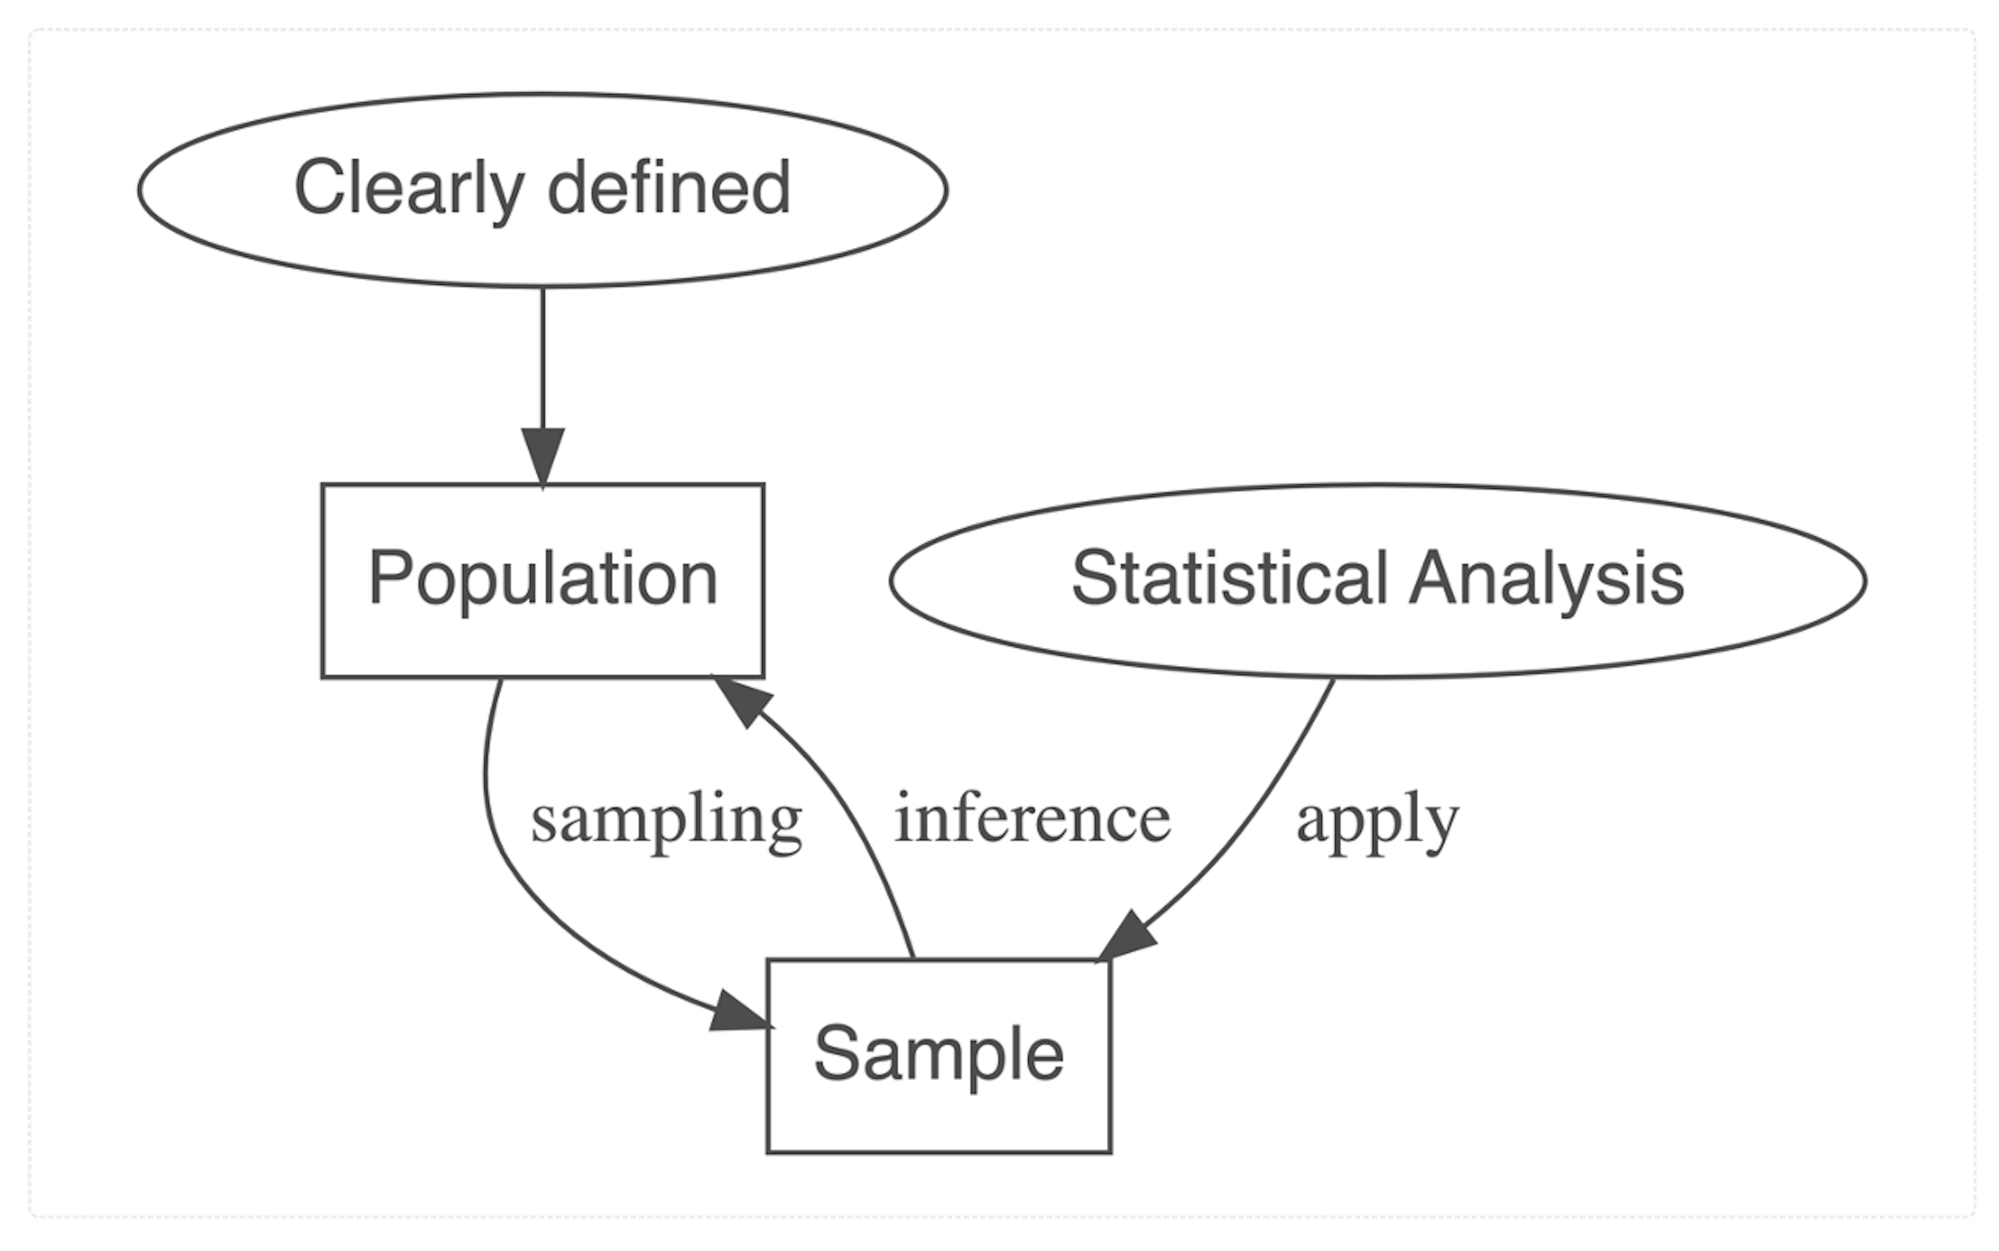
From A Random Sample To Making An Inference About A Population

Slide 5
Null and Alternative Hypothesis
Null hypothesis is statement about status quo represented by a symbol H0.
The opposite of the null hypothesis is known as the alternative hypothesis represented by a symbol H1or HA. The alternative hypothesis is actually a statement that we really want to know. Unfortunately, we never really test it.
If we reject the null hypothesis, we are in favour of the alternative hypothesis - this does not mean we are directly testing it.

Slide 6
Examples of Null Hypotheses
There is no difference between male vs. female students’ satisfaction toward their university
There is no relationship between perceived quality of housing accommodation and satisfaction toward university.
There is no effect of providing a lengthy feedback of students’ course evaluation.
There is no association between satisfaction and performance.

Slide 7

Intuitive Explanation
You found out that 30 out of 100 students passed the exam.
P(pass|H0 is true) = 0.03, which reads *“The probability of passing the exam given that H0 is true is equal to 0.3”.
You might be tempted to say that passing the exam without studying is very likely (only 30 out 100 students passed it). Because the chance of passing the exam without preparation is quite large (30%), and the fact that Bob passed the exam, you might believe that Bob was honest - Bob might have not studied before the exam.

Slide 8
Intuitive Explanation
You found out that 2 out of 100 students passed the exam.
P(pass|H0 is true) = 0.02, which reads *“The probability of passing the exam given that H0 is true is equal to 0.02”.
The new information indicates that the chance of passing the exam if one had not studied is only 2%, which is very small - the exam was hard. In light with this information, you would incline to say that Bob was dishonest – he might have studied before the exam and concealed this fact.

Slide 9
Intuitive Explanation
he probability of passing the exam given H0 is true is called the probability value. It has more than one name – significance value abbreviated as sig.value, and p-value. We use the p-value to make a decision as to whether H0 is rejected or retain. The p-value from the first scenario is 30%, which is quite large and from the second one is 2%, which is quite small that warrant us to reject H0. The question is how small the p-value must be that would protect us from making a wrong decision?

Slide 10
Intuitive Explanation
To decide whether to reject H0, we need to compare p-value to the what so-called “significance level” abbreviated as “alpha (α)”. α is our tolerance level. Researchers’ consensus is to use α=0.05, which means we can only afford to make a wrong decision 1 out of 20.
If p-value > 5%, retain H0
If p-value < 5%, reject H0
SPSS reports the p-value associated with a statistical test

Slide 11

Test Statistic
Software like SPSS does not only report p-value but also output a test statistic, hereafter abbreviated as T−statistic.
We reject the null hypothesis in favor of the alternative hypothesis if a T−statistic is more extreme that would be expected if H0 were true (i.e., more extreme than tcrit). That is, in the Bob’s situation we reject H0 if
Thus, you have two ways to make an inference, either use a T−statistic or a p-value. Either way, your conclusion would be the same.

Slide 12
Limitations Of P-Value
It is often interpreted as the evidence of a meaningful result, where in fact, the results might not be practical (e.g., the effect size is very small).
The use of p-value would lead to a dichotomous decision: significant vs. not significant due to a certain threshold (e.g., 5% significant level). It is very problematic when the p-value is close to the threshold.
p-value associated with a study depends on a sample size. Large sample tends to lead to a significant result (p < 0.05) although the result is not practically relevant.
Many findings that are not significant – as a result of using the cut-off value of 5% significance level, never get published in scientific journals. This leads to a publication bias.

Slide 13
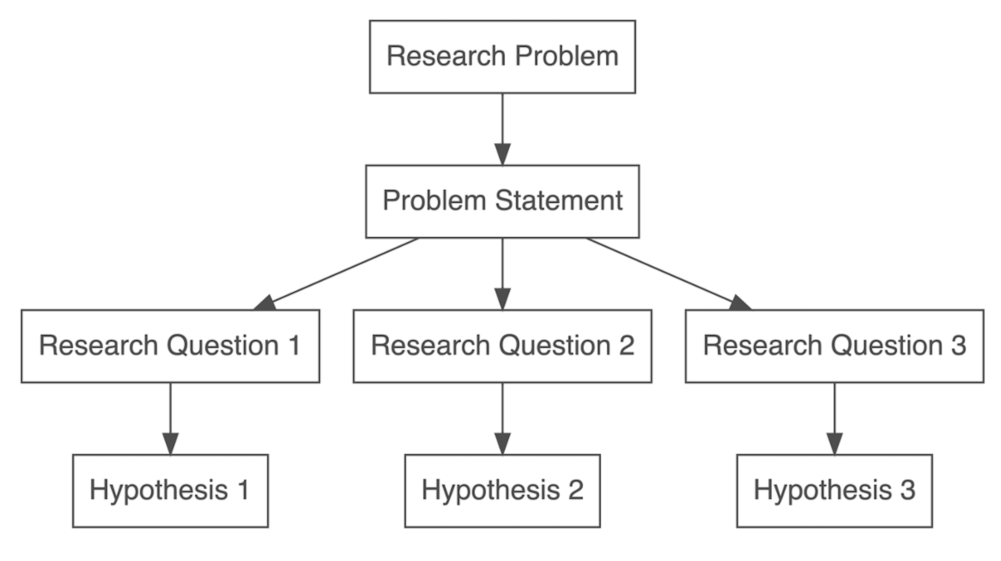
Formulating a Research Problem and Hypotheses
Research problem is usually formulated into a problem statement or research objective, which in turn, produces one or multiple research question. The approach I adopt is that one research question translates to one research hypothesis.

Slide 14
Non-Directional and Directional Hypothesis
Non-directional
When you hypothesize that there is a difference between male and female on their intentions to buy a product, your hypothesis is non-directional.
Non-directional hypothesis is uninteresting and may not be useful as it did not give you a specific detail of what you really want to know.
In a non-directional hypothesis, the direction of the effect or relationship you are investigated is not specified.
Associated with a two-sided test.
Directional hypothesis
E.g., male rather than female is more like to buy a product.
The direction of the effect or relationship is specified.
More useful.
Associated with a one-sided test.

Slide 15
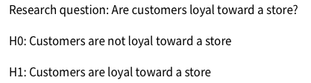
From Hypothesis to Questionnaire
How would you define and measure customer loyalty?
Using self-reported measure:
“I like the store more than other convenience stores”.
1_strongly disagree
2_disagree
3_neutral
4_agree
5_strongly agree

Slide 16


Managerial vs. Statistical Formulation

Slide 17
Type-1 Error, Type-2 Error and Power
Type-1 error occurs when you reject a null hypothesis when in fact it is true in the reality.
Type-2 error occurs when you do not reject a null hypothesis when in fact it is false in the reality.

