Slide 1
Chapter 16: Moderation
Textbook: Ahmad Daryanto, Introduction to Quantitative Research Methods for Marketing With SPSS and R: Tools and Techniques, Routledge. 2024

Slide 2
Learning Objectives
Understand the concept of moderation.
Know how to use hierarchical regression to test moderation effect.
Understand moderation plots.
Understand the concept of bootstrapping.
Know how to use Process Macro to test moderation.

Slide 3
What is Moderation?
It is just an interaction effect.
Moderation explains how a relationship between two variables is affected by another variable.
A variable that moderates a relationship is called as a moderator variable.
For example, the relationship between monetary incentives differ across male vs. female. Gender is a moderator of the relationship.

Slide 4
Sales performance
Moderation exists as b_{male} > b_{female}
Female
b_{female}
b_{male}
Male
Monetary incentives

Slide 5
Sales performance
Moderation does not exist as b_{male} = b_{female}
b_{female}
Female
b_{male}
Male
Monetary incentives

Slide 6
Another Example
Task Motivation
Very easy
Easy
Neutral
Difficult
Very difficult
Monetary incentives

Slide 7
Sales performance
Moderation does not exist as b_{male} = b_{female}
b_{female}
Female
b_{male}
Male
Monetary incentives

Slide 8
Representing Moderation with a Diagram
Z
X
Y

Slide 9
Z
X
Y

Slide 10
Representing Moderation with a Diagram
Gender
Monetary Incentives
Sales Performance

Slide 11
Representing Moderation with a Diagram
Perceived Task Difficulty
Monetary Incentives
Task Motivation

Slide 12

Capturing Moderation
A moderation model is just a regression model.
Moderation is captured by an interaction term X*Z
Such model is known as a moderated regression model
In a moderated regression model, both components of the interaction terms (X and Z) should exist as main terms in the model.

Slide 13
Diagram
X
Y
Z
error
X*Z

Slide 14



The Meaning of $β_{1}$
Alternative form:
The coefficient associated with X is clearly a function of the coefficient associated with Z
The effect of X on Y at a particular value of Z is given by:

Slide 15
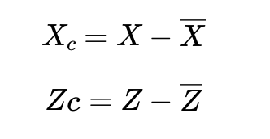
Mean-centering
Many researchers transformed X and Z by mean-centering X and Z (i.e., subtracting mean of a variable for all observations on that variable) before testing moderation.
Mean centering makes the interpretation more meaningful.
e.g., the coefficient estimated associated with X represents the effect of X at the mean of Z and mean of Z always exists.

Slide 16
Testing Moderation Hypothesis
A common strategy to test the main effects and a moderation effect hypotheses is to conduct a hierarchical regression analysis via two stages.
Stage 1. Testing main effects: Use the additive model and examine the coefficients associated with X and Z.
Stage 2. Testing moderation effect: Enter the interaction term XZ, and examine the coefficient associated with the interaction term.

Slide 17
Illustration
Attractiveness
Authenticity
Attachment

Slide 18
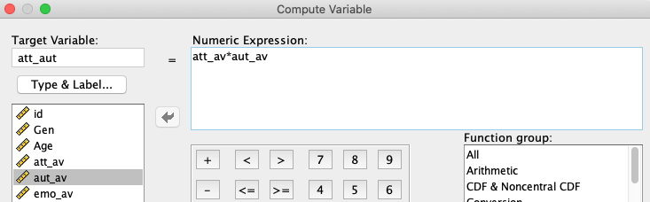

Slide 19
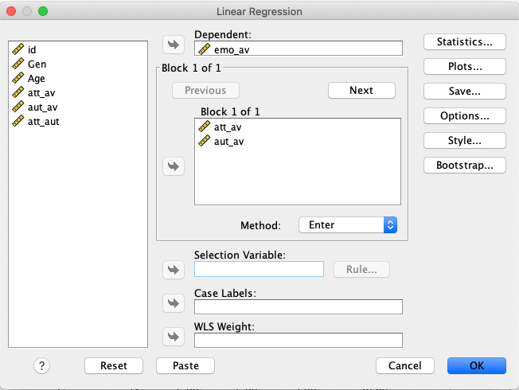
After Inserting The Main Terms, Click ‘Next’
Insert The Main Terms, Then Click ‘Next’

Slide 20
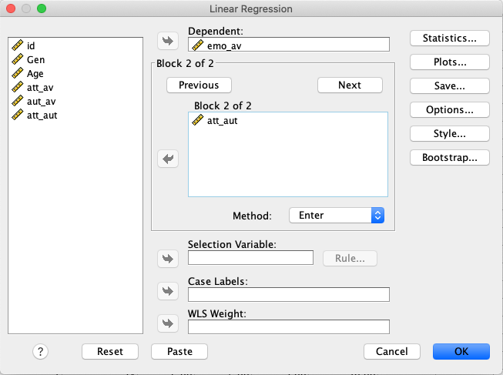
Insert The Interaction Term

Slide 21
SPSS Syntax
*Testing moderation.
* Create an interaction term.
COMPUTE att_aut=att_av*aut_av.
* Hierarchical regression.
REGRESSION
/MISSING LISTWISE
/STATISTICS COEFF OUTS R ANOVA
/CRITERIA=PIN(.05) POUT(.10)
/NOORIGIN
/DEPENDENT emo_av
/METHOD=ENTER att_av aut_av
/METHOD=ENTER att_aut.

Slide 22
P-value Of The Main Effects
P-value Of The Interaction Effect

Slide 23
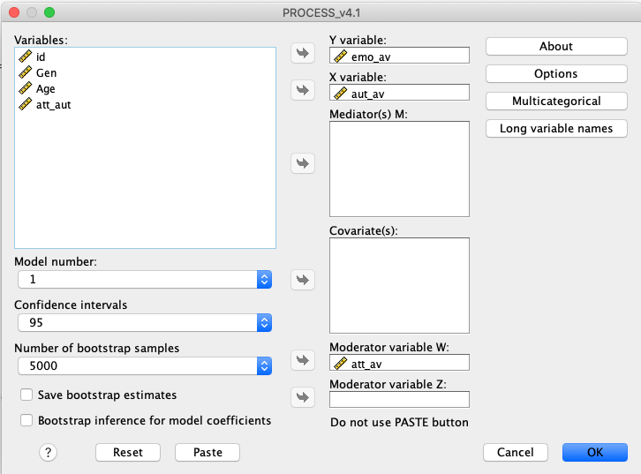
Moderation With Hayes’s PROCESS Macro

Slide 24
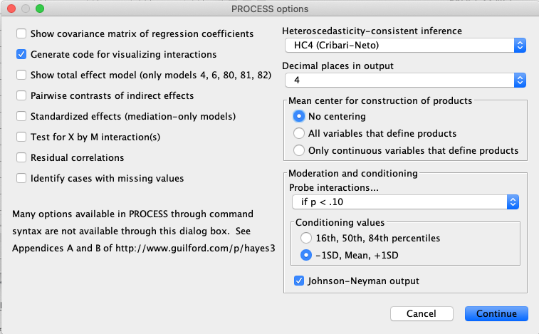

Slide 25
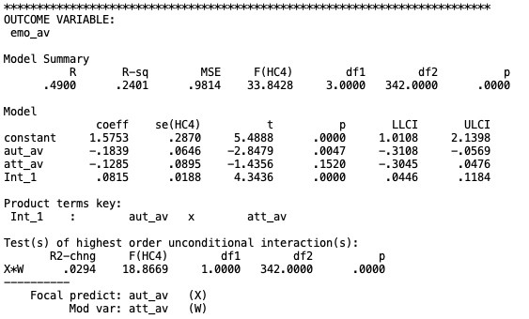
Interaction Term Is Significant

Slide 26


Conditional Effect
At att_av=2.686 (-1SD below the mean), the effect of authenticity of on attachments is not significant
The p-values of these thresholds are 0.05 (see next the output)

Slide 27
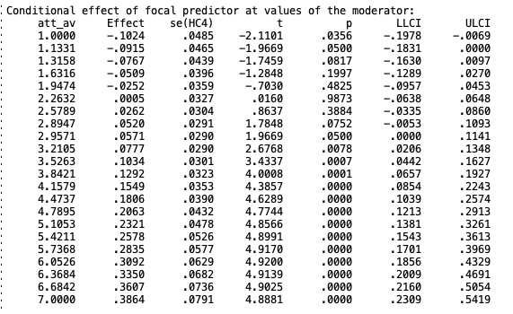
Johnson-Neyman Outputs
Moderator Values Defining the JN-Significance

Slide 28
Johnson-Neyman Outputs

Slide 29
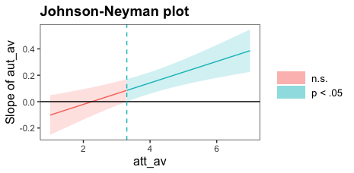
Output from the R code provided in Lin (2020)
Lin, H. (2020). Probing two-way moderation effects: A review of software to easily plot johnson-neyman figures. Structural Equation Modeling: A Multidisciplinary Journal, 27(3), 494–502.

Slide 30
Spurious Moderation
Spurious = fake
A moderation effect is spurious when it is detected as a significant but it is actually not
What causes a spurious moderation?
When a nonlinear effect (e.g., the relationship between $X$ and $Y$ resembles U-shape) exist in a population, and
X and Z is correlated
Unfortunately, researchers rarely address this issue in empirical studies (Daryanto, 2019; Daryanto & Lukas, 2022). Daryanto & Lukas (2022) found that ‘only 21 reported attempts to control for spurious moderation in marketing studies hypothesizing moderation published over the past 40 years’ (p. 180). This is a very small number.

Slide 31
How to Avoid Spuriousness?
Inspect the correlation coefficient and scatter plot of the relationship between either X, Z, and Y. If the correlation is nonzero and patterns suggest nonlinear relationship, this may create the spuriousness issue.
A simple solution is by inserting quadratic terms of the predictors into the moderated regression model, resulting in:

