Slide 1
Chapter 8: Sampling Distribution
Textbook: Ahmad Daryanto, Introduction to Quantitative Research Methods for Marketing With SPSS and R: Tools and Techniques, Routledge. 2024

Slide 2
Learning Objectives
Understand what a sampling distribution is.
Understand the importance of the central limit theorem and its implication to practice.
Know the normal approximation to the binomial distribution.
Understand how to calculate the standard error of the mean.

Slide 3
The Lady Tasting Tea
It was taken from the title of the first chapter of a book written by Salsburg (2001).
Illustrate sampling distribution of proportions.

Slide 4
Sampling distribution
Sampling distribution is the distribution of a statistic over a very large collection of samples (e.g., thousands, millions), each of which is randomly selected from a single population.
A statistic is a value calculated from sample, which varies from sample to sample
Fisher named such variable as a variate (Fisher, 1934), but today a random variable is the convention.
Population is a large pool of values, which can be infinitely large.

Slide 5
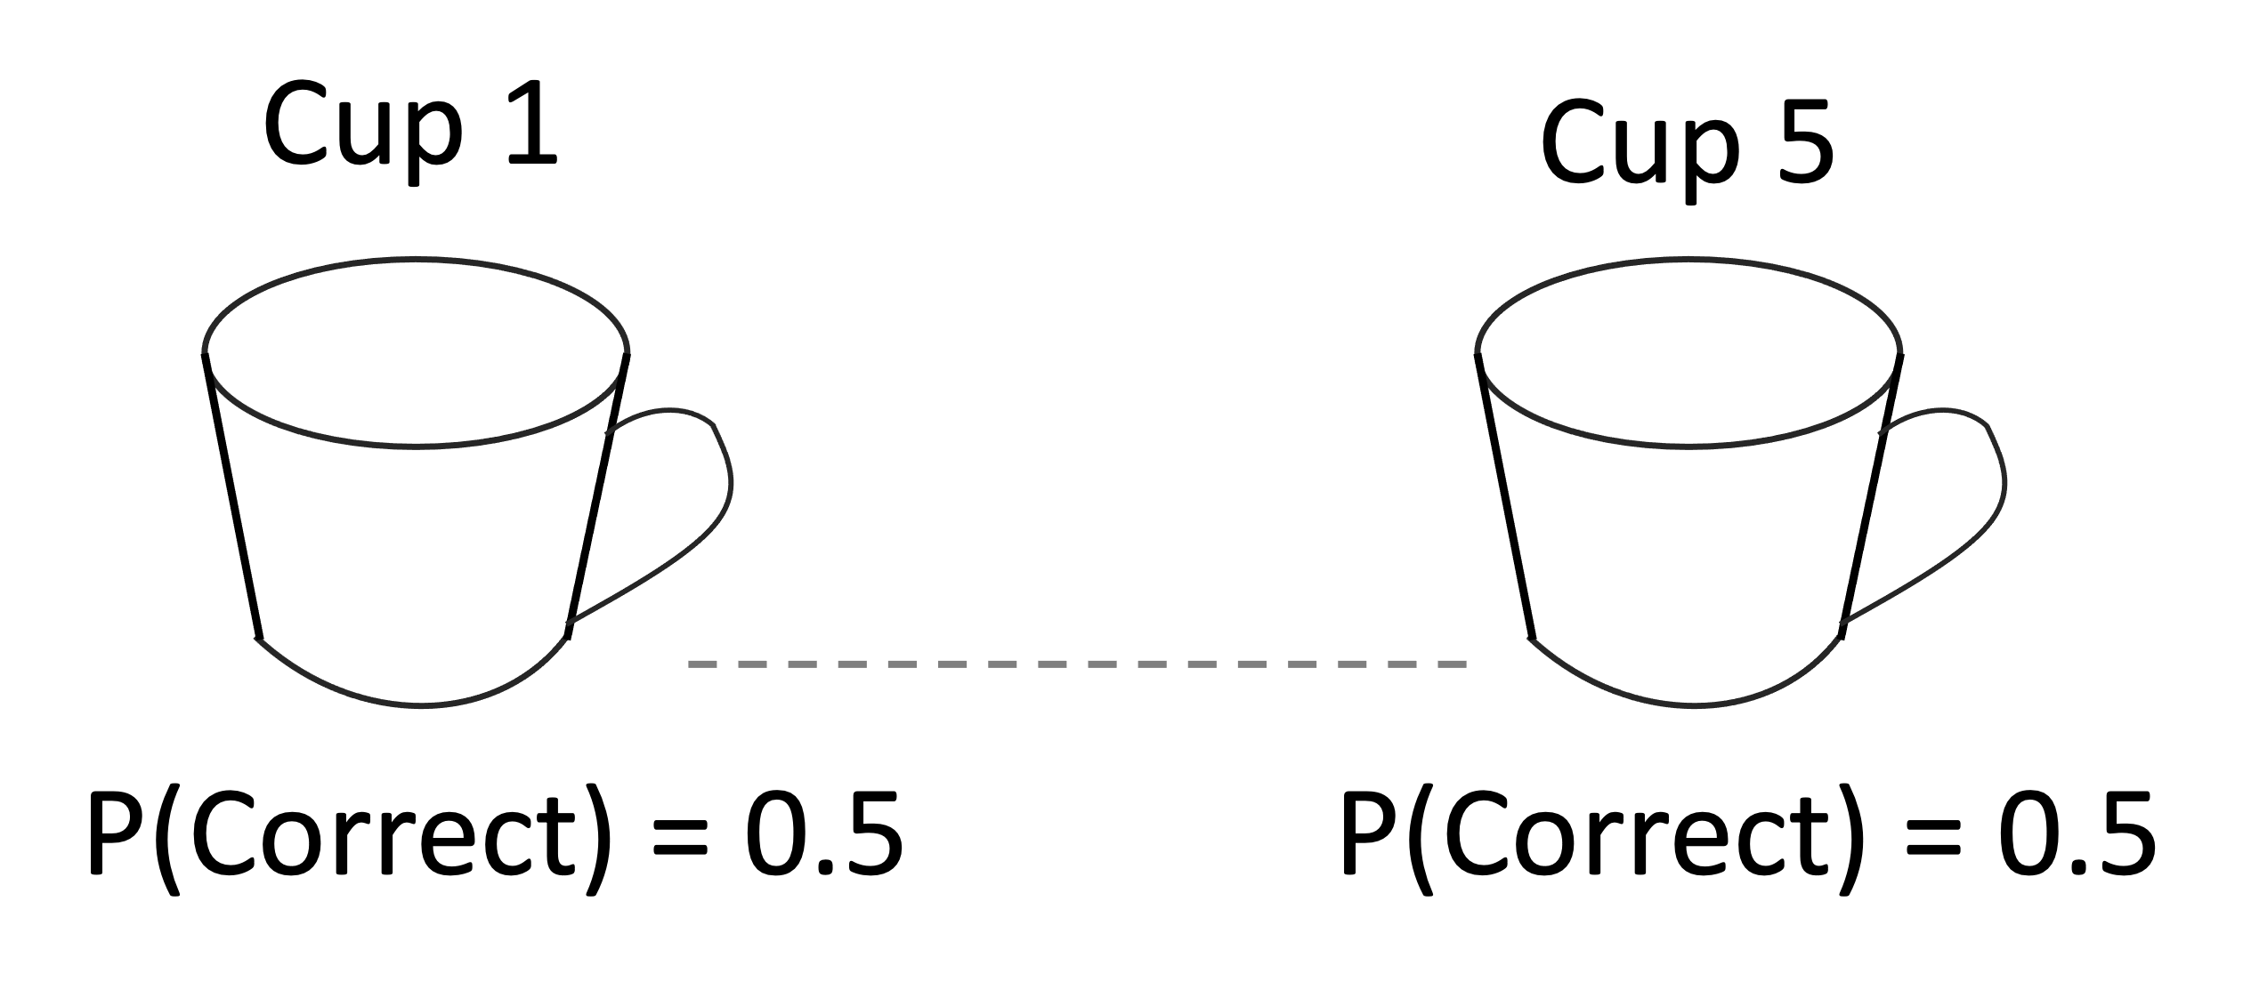
Lady Tasting Tea Experiment
If we presented the lady with 5 cups, then the values obtained from the 5 cup trials constitutes as a sample. One sample will consist of 5 values of which can be coded as either 0 for wrong guess or 1 for correct guess. If we believe that the lady has no magical ability and just makes a random guess, then her chance of making a correct answer in a cup is half.

Slide 6
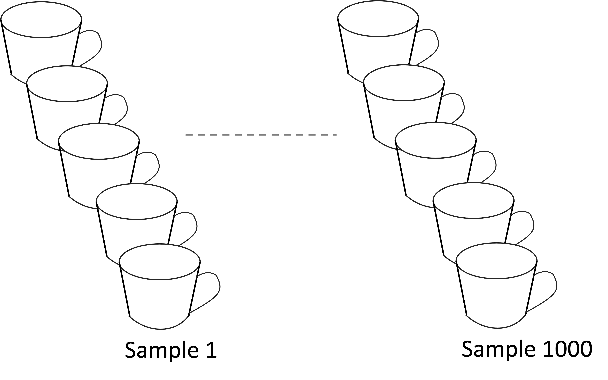
Now, let us image that we could repeat the experiment again and again by presenting her with 1000 sets of 5 cups (i.e., 1000 samples) (see Figure 2.2). In each sample, we calculate the number of correct guesses. Therefore, when the whole experiments are finished, we would obtain 1000 values of correct guesses.

Slide 7
At this point, the definition of the sampling distribution can be expressed as:
“The sampling distribution of the number of correct guess under a random guess is the distribution of the correct guess that would be obtained if the lady is making a random guess over a large number of experiments.”

Slide 8
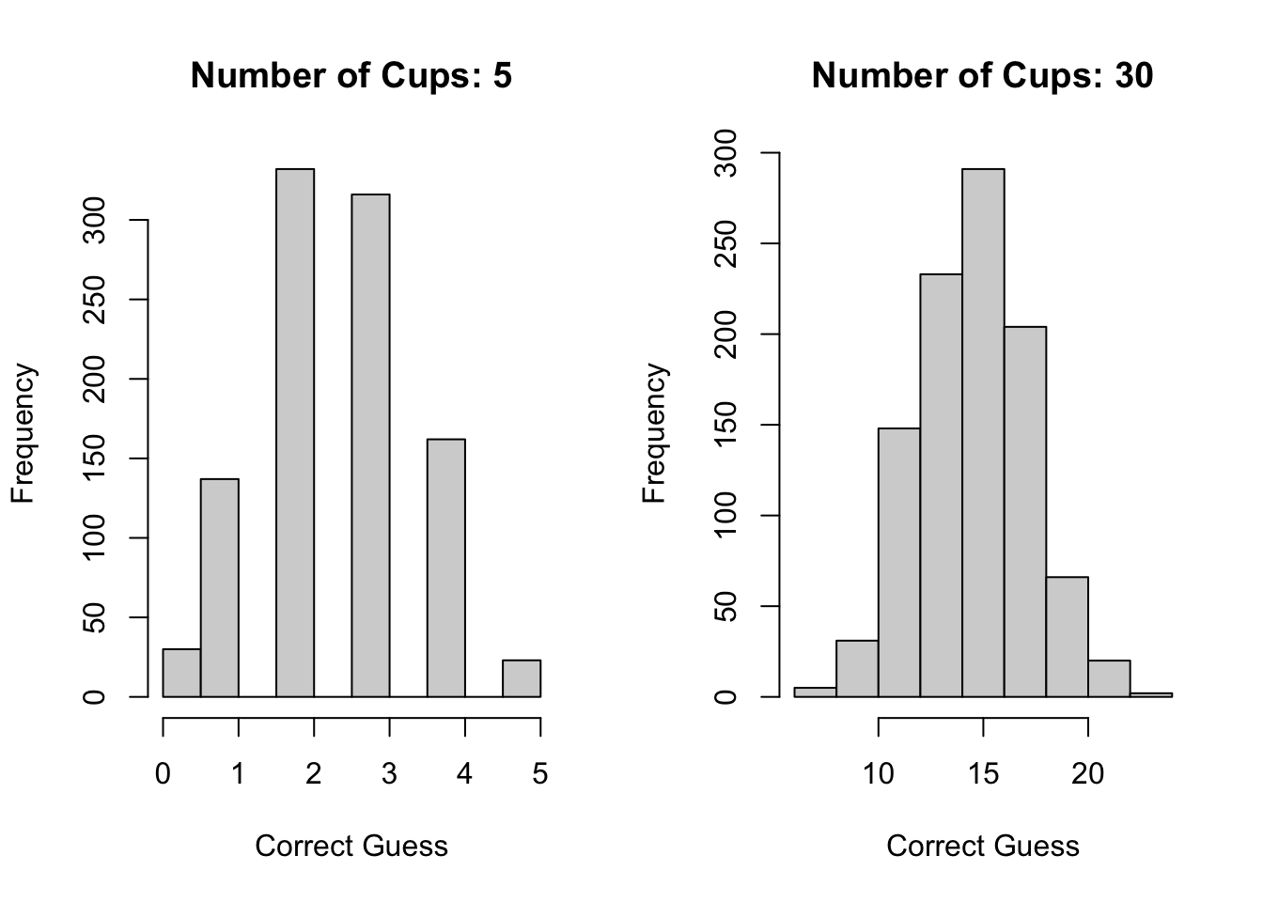
Central Limit Theorem
If a sample size is equal or greater than 30, the sampling distribution of a value will be normal regardless of the distribution of the value in a population.

Slide 9
Sampling Distribution of Sample Means
Sample mean is just the average score of something.
E.g., average spending of a number of customers.
Applying CLT, the distribution of the average spending will be normal provided that the sample size is larger than 30, even if the distribution of the average spending in the population is not normal.

Slide 10
R code
rm(list = ls(all=TRUE)) # make a fresh start
library(mnonr)
set.seed(16) # to make this illustration reproducible
# create population distribution that is not normally distributed.
pop_size = 10000 # population size
dat <- mnonr(n=10000,p=1,ms=7,mk=15,Sigma=matrix(c(1),1,1),initial=NULL)
# ms = a value for skewness.
# For a normal distribution, ms = 0.
# mk = value for kurtosis.
# For a standard normal distribution, mk = 0.
hist(dat)

Slide 11
R code
# Resampling from a population
nsamples <- 500 # set the number of samples
sample_size <- 30 # set the number cases in a sample
# prepare an R object to store the sample means
sample_means = rep(NA, nsamples)
for(i in 1:nsamples){
mysample <- sample(dat, sample_size, replace = TRUE)
sample_means[i] = mean(mysample)
}
hist(sample_means)

Slide 12
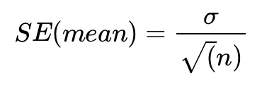
Standard Error of the Mean
SE (mean) = The standard deviation of the sampling mean distribution given is called the standard error of the mean. I use the abbreviation.
where σ is the standard deviation of the population distribution and n is a sample size. In practice, you will never knew the value for σ, which can be replaced with the sample standard deviation.

