Slide 1
Chapter 13: Multiple Linear Regression
Textbook: Ahmad Daryanto, Introduction to Quantitative Research Methods for Marketing With SPSS and R: Tools and Techniques, Routledge. 2024

Slide 2
Learning Objectives
Understand that a multiple regression model is an extension of a simple linear regression model.
Understand the role of control variables.
Understand the meaning of regression coefficients in a multiple regression model.
Know how to conduct an hierarchical regression.
Know how to build a path model from series of hypotheses.
Know steps in building a multiple regression model

Slide 3

What Is a Multiple Regression?
Multiple regression model is a generalization of a simple linear regression model by having multiple independent variables to explain a dependent variable.

Slide 4
Roles of Variables
Predictor
Mediator
Moderator
Control

Slide 5
Control Variables
In a multiple regression model, researchers frequently refer to a control variable also known as a covariate. A control variable is an independent variable that influences a dependent variable but is not of a particular interest to the researchers. From a statistical perspective, the inclusion of a control variable in a multiple regression model helps eliminate the variation in the dependent variable associated with it. This, in turn, allows us to attribute the remaining variation in the dependent vairable to the independent variables that are the primary focus of the research..

Slide 6
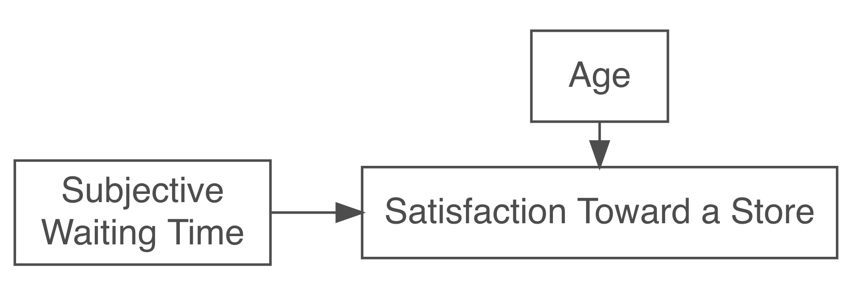
Control Variable
Age as a control variable.

Slide 7
To Include or Not To Include
The methodological challenge that researchers often face when dealing with control variables is whether it is really necessary to include them. The recommendation is that the inclusion of control variables into a multiple regression model should be justified by a theory or thoughtful consideration. In fact, when in doubt, it is advisable to leave the control variables out (Becker et al., 2016; Carlson & Wu, 2012; Spector & Brannick, 2011). It is also advisable to run analyses with and without the control variables and compare the results (Becker et al., 2016). If the results are essentially the same, we can report the analysis without the control variables and include a statement indicating that their inclusion did not affect the initial results.

Slide 8

The Meaning of the Regression Coefficients
As there are more than one variable in the model, a regression coefficient associated with an independent variable in a multiple regression model is an estimate of the effect of the independent variable on the dependent variable when *ceteris paribus* holding other variables in the model constant.
The coefficient estimate associated with WT or the partial regression coefficient is -0.86, which means that the effect of one point increase in the subjective waiting time will decrease the satisfaction score by 0.86 point, while holding Age constant. Similarly, if Age is increased by one point, score on SatStore would go down by 0.01 point, while holding other WT in the model constant.
The partial regression coefficient for WT is -0.86. The coefficient can be found by partialing out the influence of Age on WT and use the remaining part as the predictor of satisfaction.

Slide 9
Partial Regression Coefficient
REGRESSION
/MISSING LISTWISE
/STATISTICS COEFF OUTS R ANOVA
/CRITERIA=PIN(.05) POUT(.10)
/NOORIGIN
/DEPENDENT wt
/METHOD=ENTER age
/SAVE RESID.
Execute.
REGRESSION
/MISSING LISTWISE
/STATISTICS COEFF OUTS R ANOVA
/CRITERIA=PIN(.05) POUT(.10)
/NOORIGIN
/DEPENDENT satstore
/METHOD=ENTER RES_1.

Slide 10
Assumptions in Multiple Regression
The assumption in a simple regression model also applies to a multiple regression model. That is the expected form should be described by Equation 2.1, homoskedasticity, no autocorrelation, and no endogeneity. In addition to these, there is one more assumption in multiple regression that a simple regression model does not have, which is no multicollinearity.

Slide 11
Hierarchical Regression
When a regression model contains control variables, the common strategy to analyze the impact of an independent variable on a dependent variable via multiple regression is by performing a hierarchical regression analysis.
Conducting a hierarchical regression of the above model, two regression models are required. In the first regression, Store Satisfaction is regression on Age. As there is only one independent variable, this is a simple linear regression model. In the second regression, Store Satisfaction is regressed on Age and Subjective Waiting Time.

Slide 12
SPSS Action
Data: store.sav
REGRESSION
/MISSING LISTWISE
/STATISTICS COEFF OUTS R ANOVA CHANGE
/CRITERIA=PIN(.05) POUT(.10)
/NOORIGIN
/DEPENDENT satstore
/METHOD=ENTER age
/METHOD=ENTER wt.

Slide 13
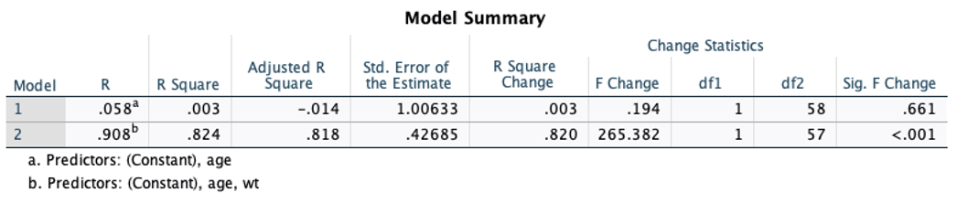
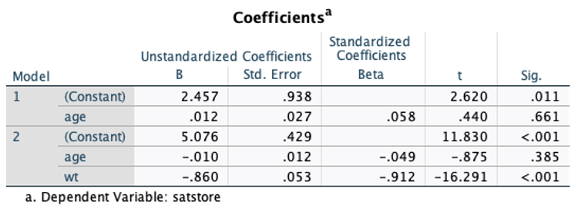
From the outputs displayed in Figure 2.2, RModel12=0.003, RModel22=0.824, and R-square change =ΔR²=0.820. This ΔR2 is associated with ΔF(1,57)=265.382, corresponding to a very small p-value (p < 0.0001), which means that adding wt in the second model provides a significant improvement over the first model. Looking at results displayed in Figure 2.3, variable age was not significant in explaining store satisfaction (p = 0.385), whereas wt has a negative influence on store satisfaction ($b = -0.860).

Slide 14
R Action
library(haven)
library(stargazer)
dat <- read_spss("/Users/ahmaddaryanto/Documents/Data1/store.sav")
lm1 <- lm(satstore ~ age, data = dat)
lm2 <- lm(satstore ~ age + wt, data = dat)
stargazer(lm1, lm2, type = "text", single.row=TRUE)
anova(lm1, lm2)

Slide 15
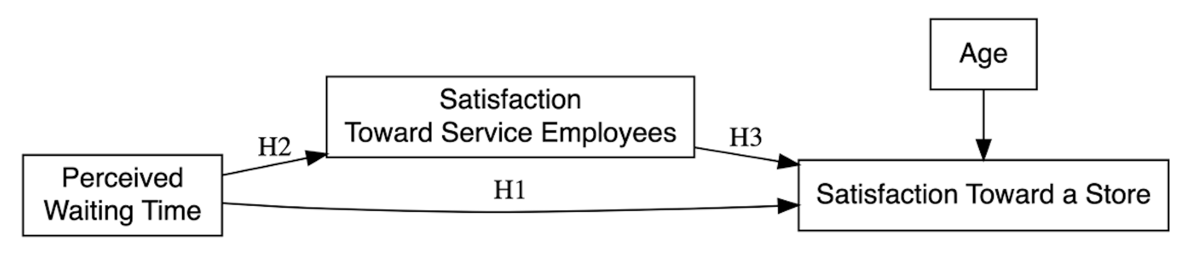
Path Model
Multiple regression analysis can be used to test series of hypotheses represented by a path model.

Slide 16
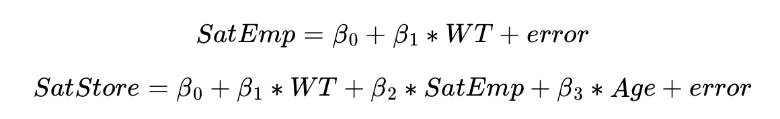
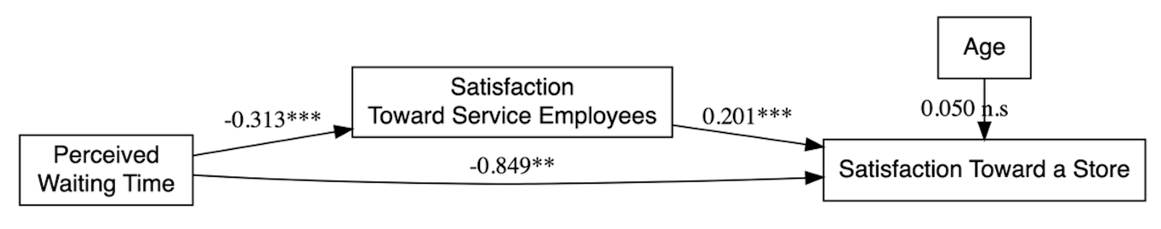
The hypotheses in the path model are tested using two regression models:
Path Model With Coefficient Estimates Obtained From Two Regressions.

Slide 17
Steps in Building a Model
Define your research objectives and identify key constructs.
Formulate your hypotheses.
Collect data.
Prepare your data.
Specify your regression model.
Check model assumptions.
Conduct hypothesis tests.
Communicate your findings.
Draw conclusions.

