Slide 1
Chapter 19: Experiment
Textbook: Ahmad Daryanto, Introduction to Quantitative Research Methods for Marketing With SPSS and R: Tools and Techniques, Routledge. 2024

Slide 2
Learning Objectives
Understand what an experiment is.
Understand the concept of confounding effect.
Be able to recognize threats to internal and external validity.
Familiar with the term of a main effect and an interaction effect.

Slide 3
Why Experiment?
Designing a procedure or task by manipulating a variable in order to test a theory or prediction.
It is the most appropriate research method to test a hypothesis about cause-and-effect relationship.
Cause
Effect

Slide 4
Key Feature
The key feature of an experiment is that it involves manipulating a variable of interest (e.g., price discount: 50% discount vs. no discount) that may affect the outcomes of the experiment.
Random Assignment: Participants are randomly assigned to different experimental conditions.
Price discount
Purchase intention

Slide 5
Terminology
Randomized Two-Group Design: participants are randomly assigned two experimental conditions e.g., treatment vs. control
Treatment condition: A group of participants to whom an experimental treatment is administered (e.g., receiving 5% price discount).
Control condition: A group of participants to whom no experimental treatment is administered.

Slide 6
Randomized Two-Group Design
Treatment
Outcomes
Random sample
Randomly assigned
Population
Control
Outcomes
Notation:
X₁
O₁
R
X₂
O₂

Slide 7
Creating Experimental Condition
Manipulating one variable with several levels
Manipulating more than one variable

Slide 8
Several Experimental Levels
Another way of manipulating an experimental variable is by creating several treatment levels (e.g., low vs. medium vs. high treatment).
Condition
Operationalization
Outcome
Low
1 display
Weekly sales
Medium
3 displays
Weekly sales
High
6 displays
Weekly sales

Slide 9
Manipulating More Than One Variable
Experiment | Technical training | Non-technical training
Morning | Randomly-allocated Participants | Randomly-allocated Participants
Evening | Randomly-allocated Participants | Randomly-allocated Participants

Slide 10
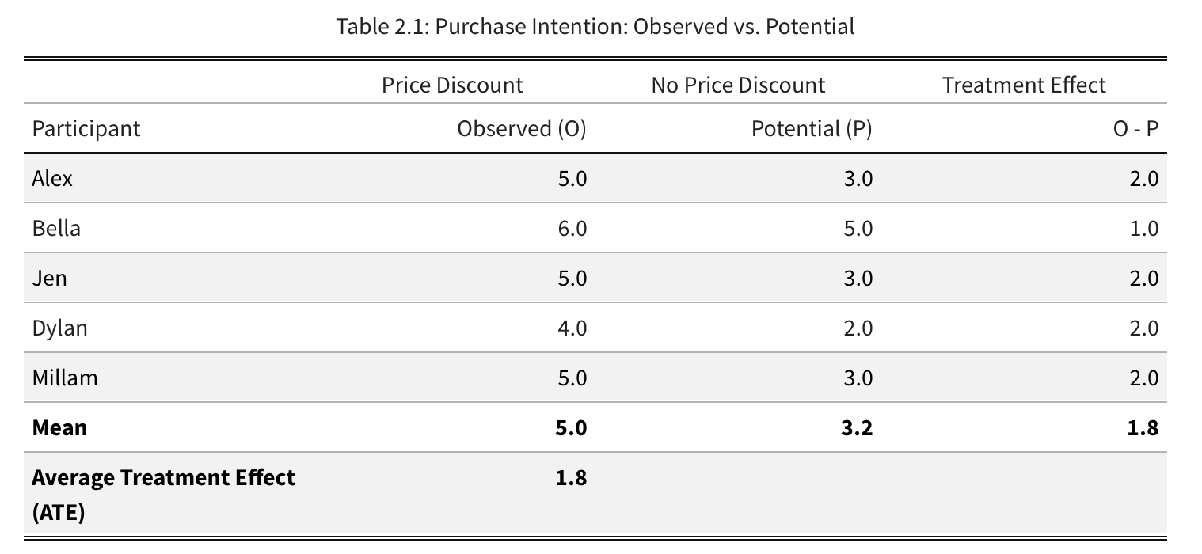
What Random Assignment Does
Random assignment removes selection bias that may arise due to existing differences among participants. In general, this holds: Treatment effect - control = Treatment effect + selection Bias

Slide 11
Key Factors in Designing an Experiment
Unit of analysis or test unit. In the price discount illustration above, our test unit is consumer.
What independent variables or treatments are to be manipulated. In the pricing illustration, the independent variable is the pricing discount manipulated into two types: 5% discount (treatment) vs. no discount (control)
What outcome variables (just another name for dependent variables) are to be measured.

Slide 12
Broad Types Of Outcome Measures
Self-reported attitudinal measures
Self-reported behaviours
Real-behaviours

Slide 13
Analyzing Experimental Data
Comparing group means with ANOVA
Regression analysis

Slide 14

Comparing two groups (e.g., Treatment vs. control)
X is (0,1) variable,
= 1 if an individual is assigned to a treatment group or
0 otherwise, and A1 and A2 are covariates.

Slide 15
Analysing 2 x 2 Experimental Design with Regression
Data: mother nature experiment.sav
We are interested in the effect of how nature is communicated (i.e., either in terms of mother or father) would influence consumers' pro-environmental behaviours (PEB)
Participants were asked to read an article about nature. In the article, nature was either framed as a mother-nature or a father-nature. Participants were randomly assigned to read one of these two types of article.
Gender is considered as a covariate

Slide 16
Model
Framing: 1 = mother-nature, 0 = father-nature
Gender: 1 = Female, 0 = Male
PEB: average scores of pro-environmental behaviour items each measured using a 7-point Likert scale (1 = strongly disagree, 7 = strongly agree)
Inter : is an interaction term created by multiplying Framing with Gender (Framing x Gender).
Age (in years) is treated as a covariate (control variable).
PEB = F(Age, Framing, Gender, Inter)
Notes:
In the next slides we will learn how to describe experimental design using notation

Slide 17
GLM Procedure
The 2 x 2 between-subject design can be analyzed by using the GLM procedure in SPSS.

Slide 18
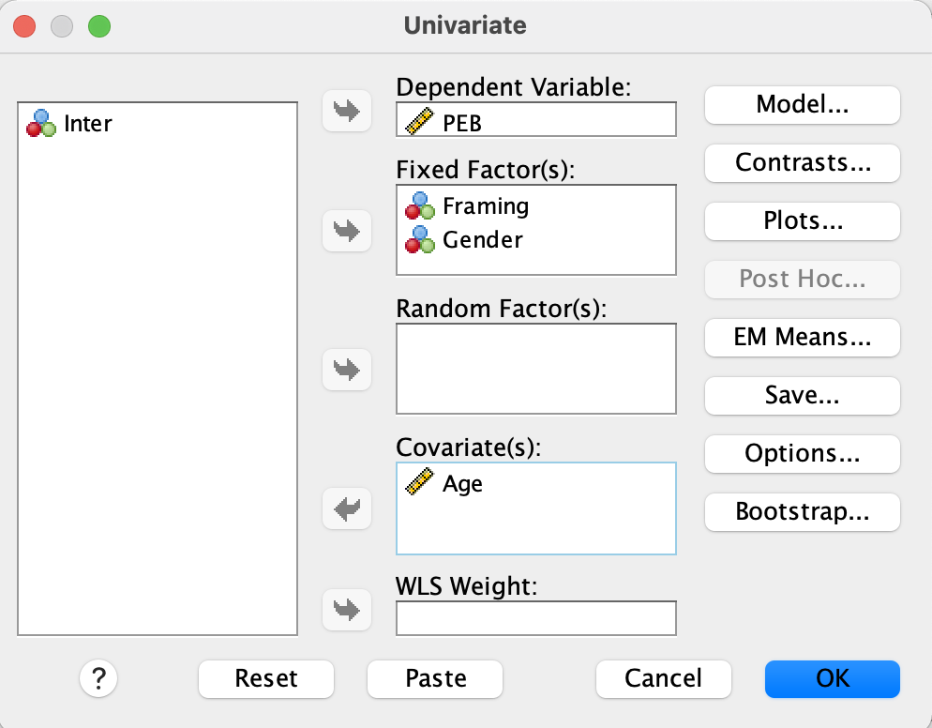
GLM

Slide 19
GLM syntax
UNIANOVA PEB BY Framing Gender WITH Age
/METHOD=SSTYPE(3)
/INTERCEPT=INCLUDE
/PLOT=PROFILE(Framing*Gender) TYPE=BAR
ERRORBAR=CI MEANREFERENCE=NO
/PRINT ETASQ DESCRIPTIVE
/CRITERIA=ALPHA(.05)
/DESIGN=Age Framing Gender Framing*Gender.

Slide 20
Allocation of participants. There are 70 participant in each condition
35 males assigning to the Father-nature condition. Mean score of PEB = 4.039, SD = 0.208

Slide 21
Main Result
Framing is significant,
p < 0.05
Gender is significant, p < 0.001
Framing x Gender is significant,
p < 0.001

Slide 22
Plotting Means

