Slide 1
Chapter 2: Getting Started With SPSS
Textbook: Ahmad Daryanto, Introduction to Quantitative Research Methods for Marketing With SPSS and R: Tools and Techniques, Routledge. 2024

Slide 2
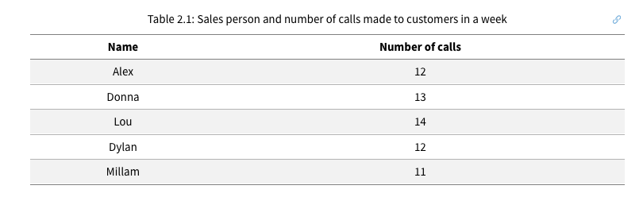
A Simple Data

Slide 3
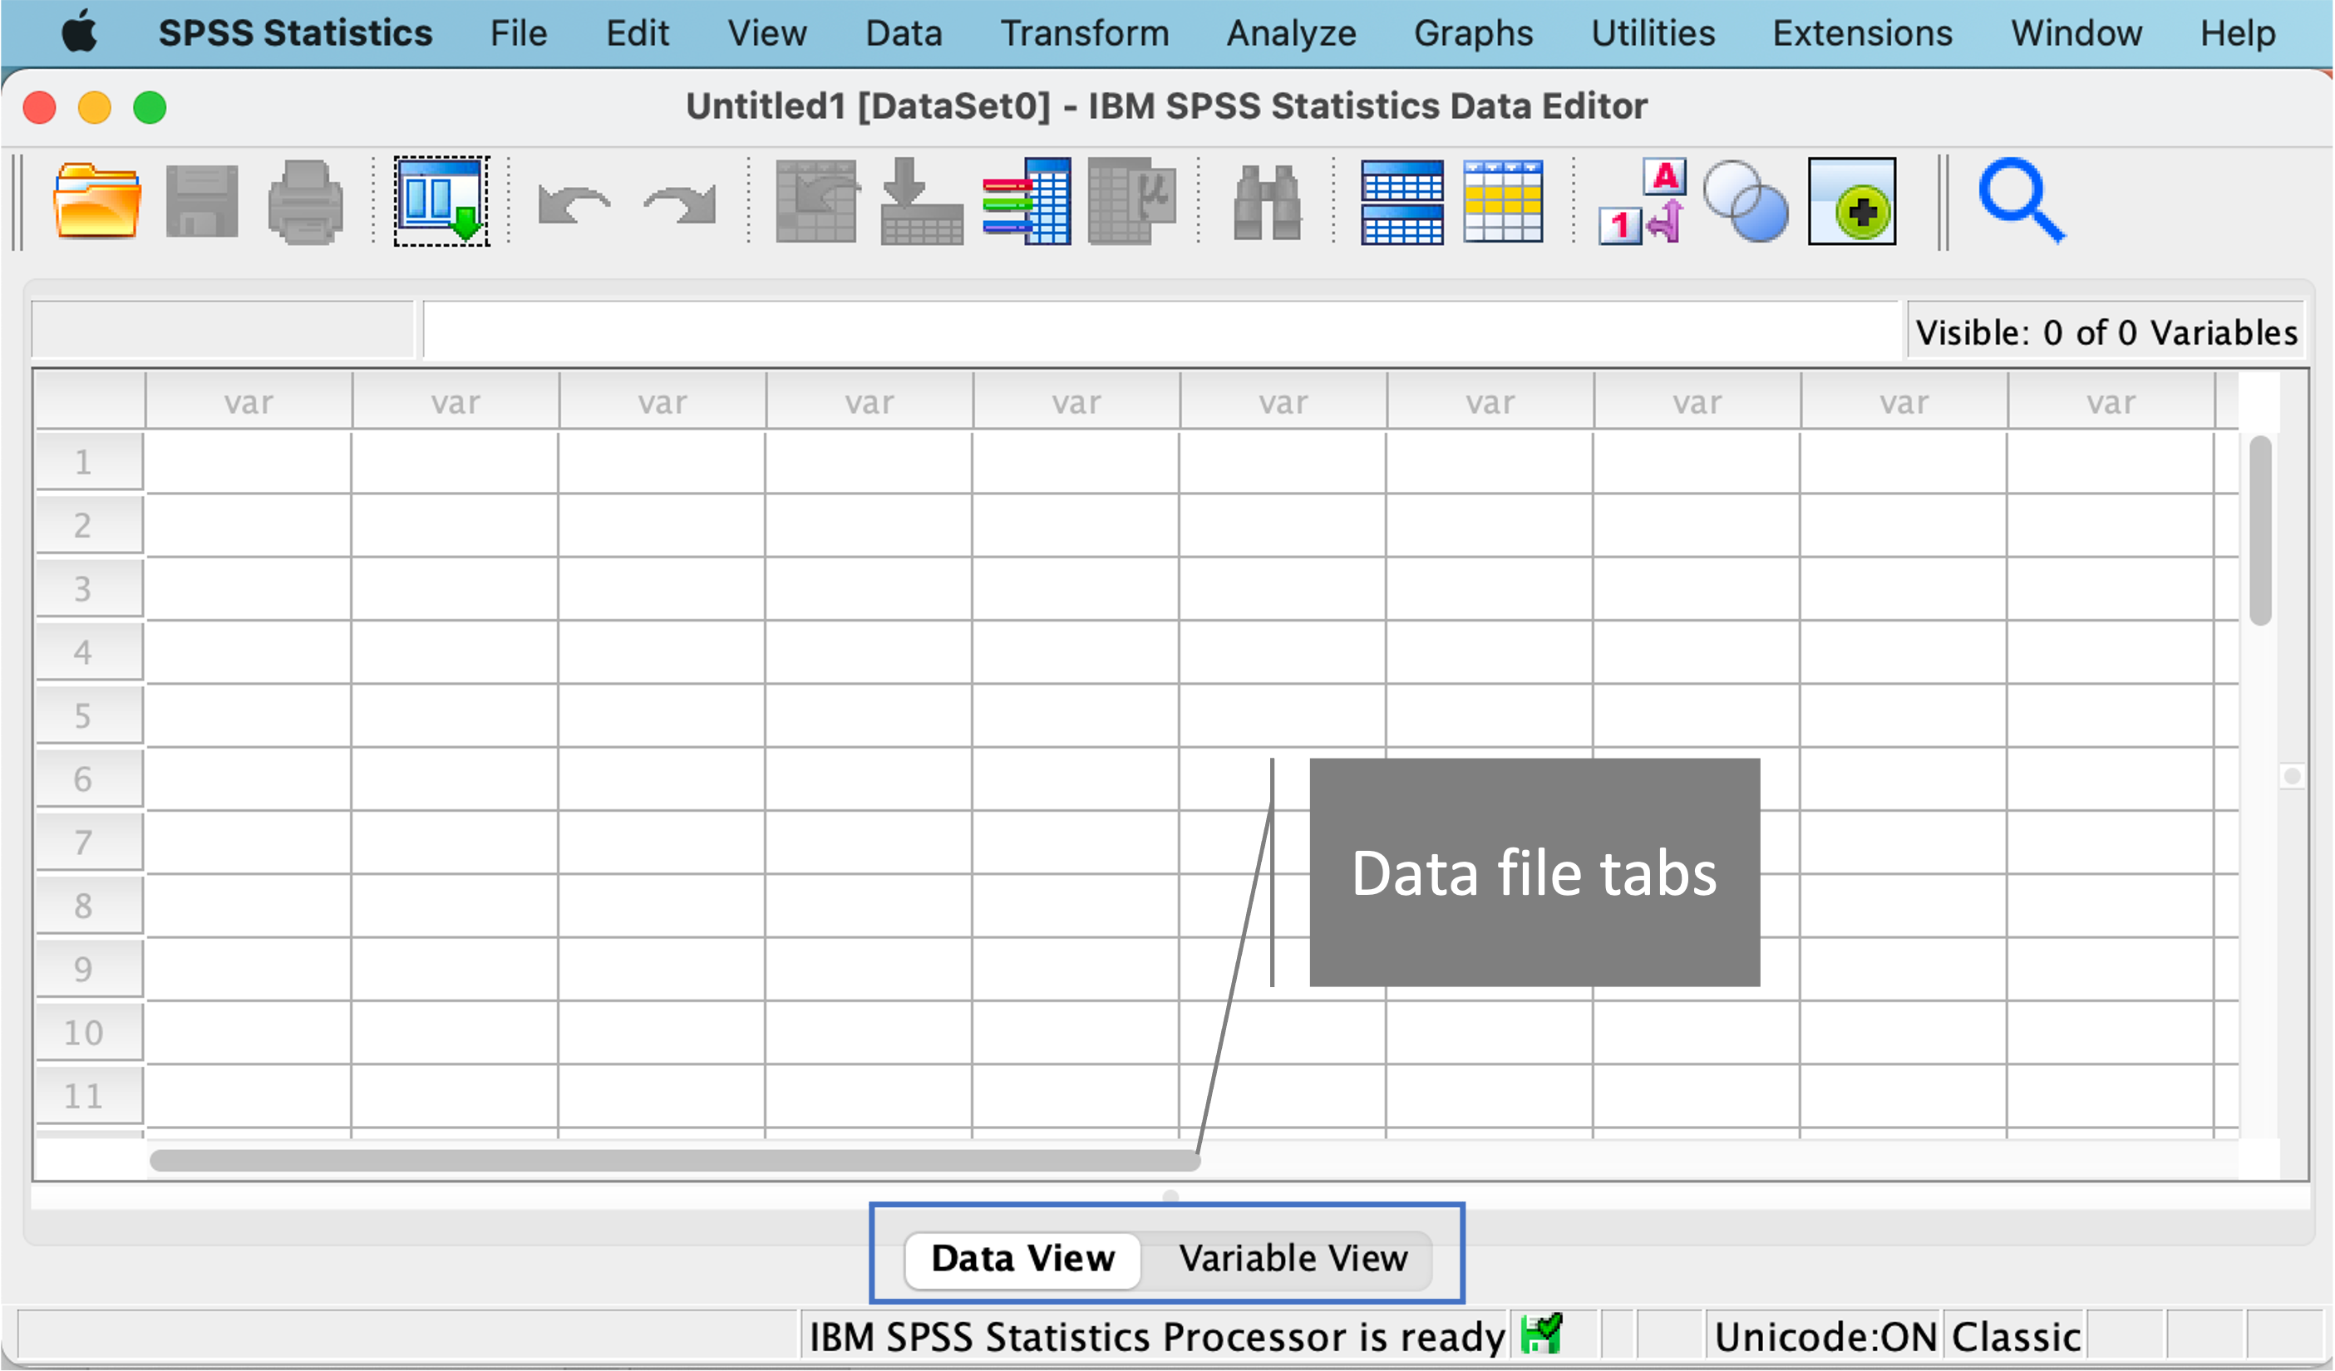
An Empty SPSS Data

Slide 4
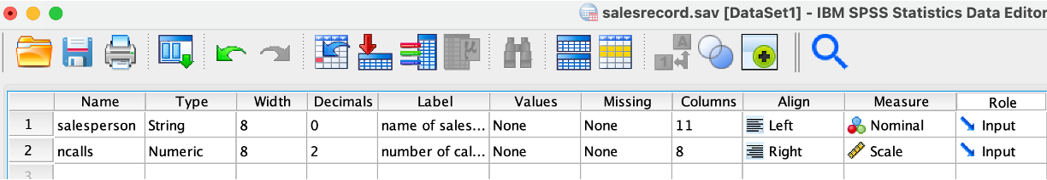
Variable View Window

Slide 5
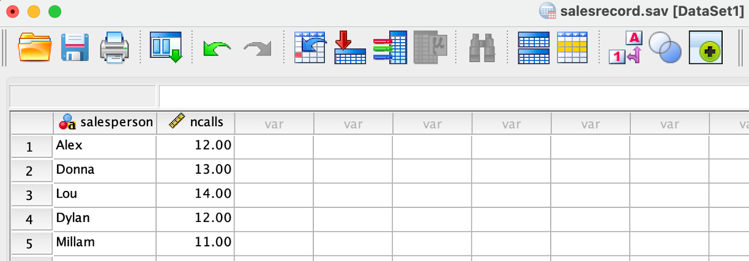
Data View Window

Slide 6
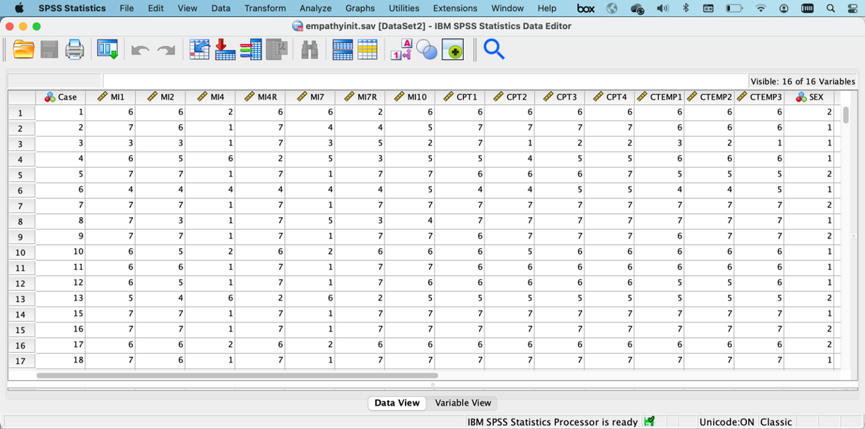
Data View Window

Slide 7
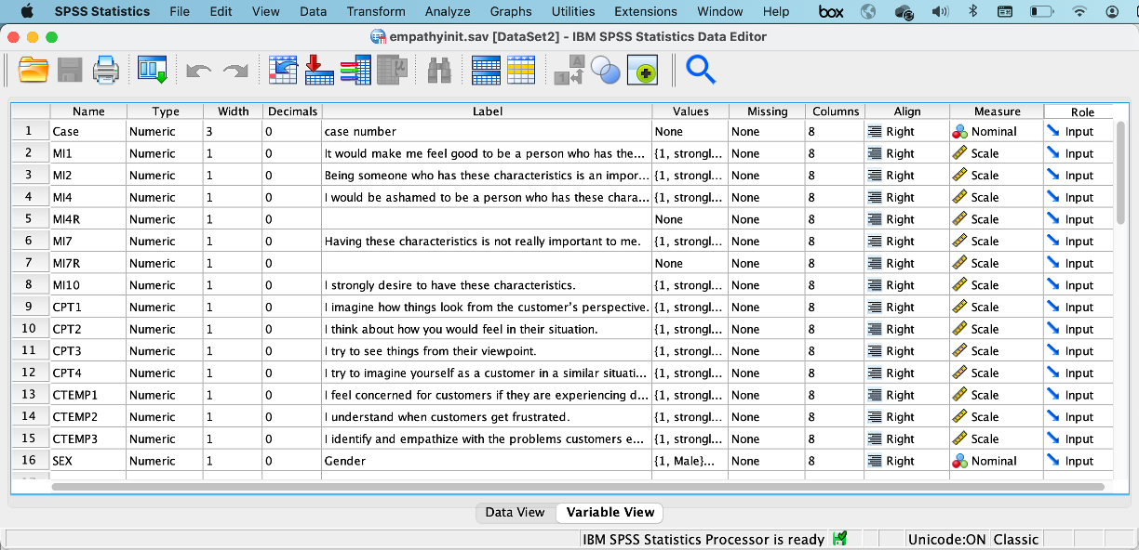
Variable View Window

Slide 8
Opening a Data File
Data file in SPSS has an extension .sav.
Exercise data: empathyinit.sav
Open data
File→Open→Data
On the Variable View, on the second row, you can see variable MI1. On the Label column, you can see the full details of what has been measured: “It would make me feel good to be a person who has these characteristics”, and the Values represent what the imputed numbers represented in the questionnaire, e.g., 1 = strongly disagree, 7 = strongly agree.

Slide 9
SPSS Syntax
To allow SPSS to execute a procedure given in the pull-down menu, SPSS provides two options: clicking OK or Paste.
If you click OK, SPSS executes the procedure and produce outputs in an output window. If you click Paste, SPSS open a syntax editor, which contains scripts or commands to run the SPSS procedure.

Slide 10
For a demonstration, let us run a frequency analysis for ncalls variable. From the SPSS pull down menu, click:
Analyze→Descriptive Statistics→Frequencies
Insert ncalls to Variable(s) box
Click Paste
SPSS produces a syntax as you can see below:
DATASET ACTIVATE DataSet1.
FREQUENCIES VARIABLES=ncalls
/ORDER=ANALYSIS.
The first command tells you the data file that is active: DataSet1. SPSS assigns a different name for a data set. You can see data set name inside a bracket term next to filename . The same data file can be assigned a different dataset name depending on the order the data is opened.

Slide 11
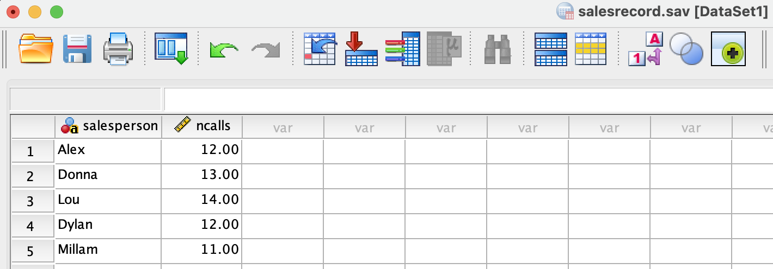
Filename
Dataset’s name

Slide 12
SPSS Macros
SPSS macro is a special SPSS scripts that contains commands to perform a specific statistical procedure that can be installed on SPSS/
It is not necessarily available under the SPSS menu when you install SPSS for the first time.
It can be developed by end users.
For example, I developed EndoS macro that will be discussed in the endogeneity chapter.
To use SPSS macros, they needs to be installed on SPSS.

Slide 13
Installing an SPSS Macro
To install the spd file onto SPSS, you can double click the spd file provided that you have an admin right on your machine. If do not have an admin right, you will be prompted by an error message - that’s how you find out that you do not have an admin right. Alternatively, you can install the macro by clicking: Extensions→Utilities→Install Custom Dialog.

