Slide 1
Chapter 3: Getting Started with R
Textbook: Ahmad Daryanto, Introduction to Quantitative Research Methods for Marketing With SPSS and R: Tools and Techniques, Routledge. 2024

Slide 2
Learning Objectives
Know how to install RStudi (Posit), R, and R packages.
Understand the notion of R objects.
Know several basic functions in R.
Know how to read and export an SPSS data.
Know how to use the pipe operator.
Able to install and call tidyverse packages.
Know how ggplot package works.
Know how to create graphs with ggplot and ggpubr.

Slide 3
RStudio (Posit)
R is easily run using RStudio, which is also free – it is now called Posit
RStudio is an IDE, which stands for Integrated Development Environment, which is essentially a software applications that can be used to write and execute programming code.
install RStudio by visiting this website https://posit.co/downloads/.

Slide 4
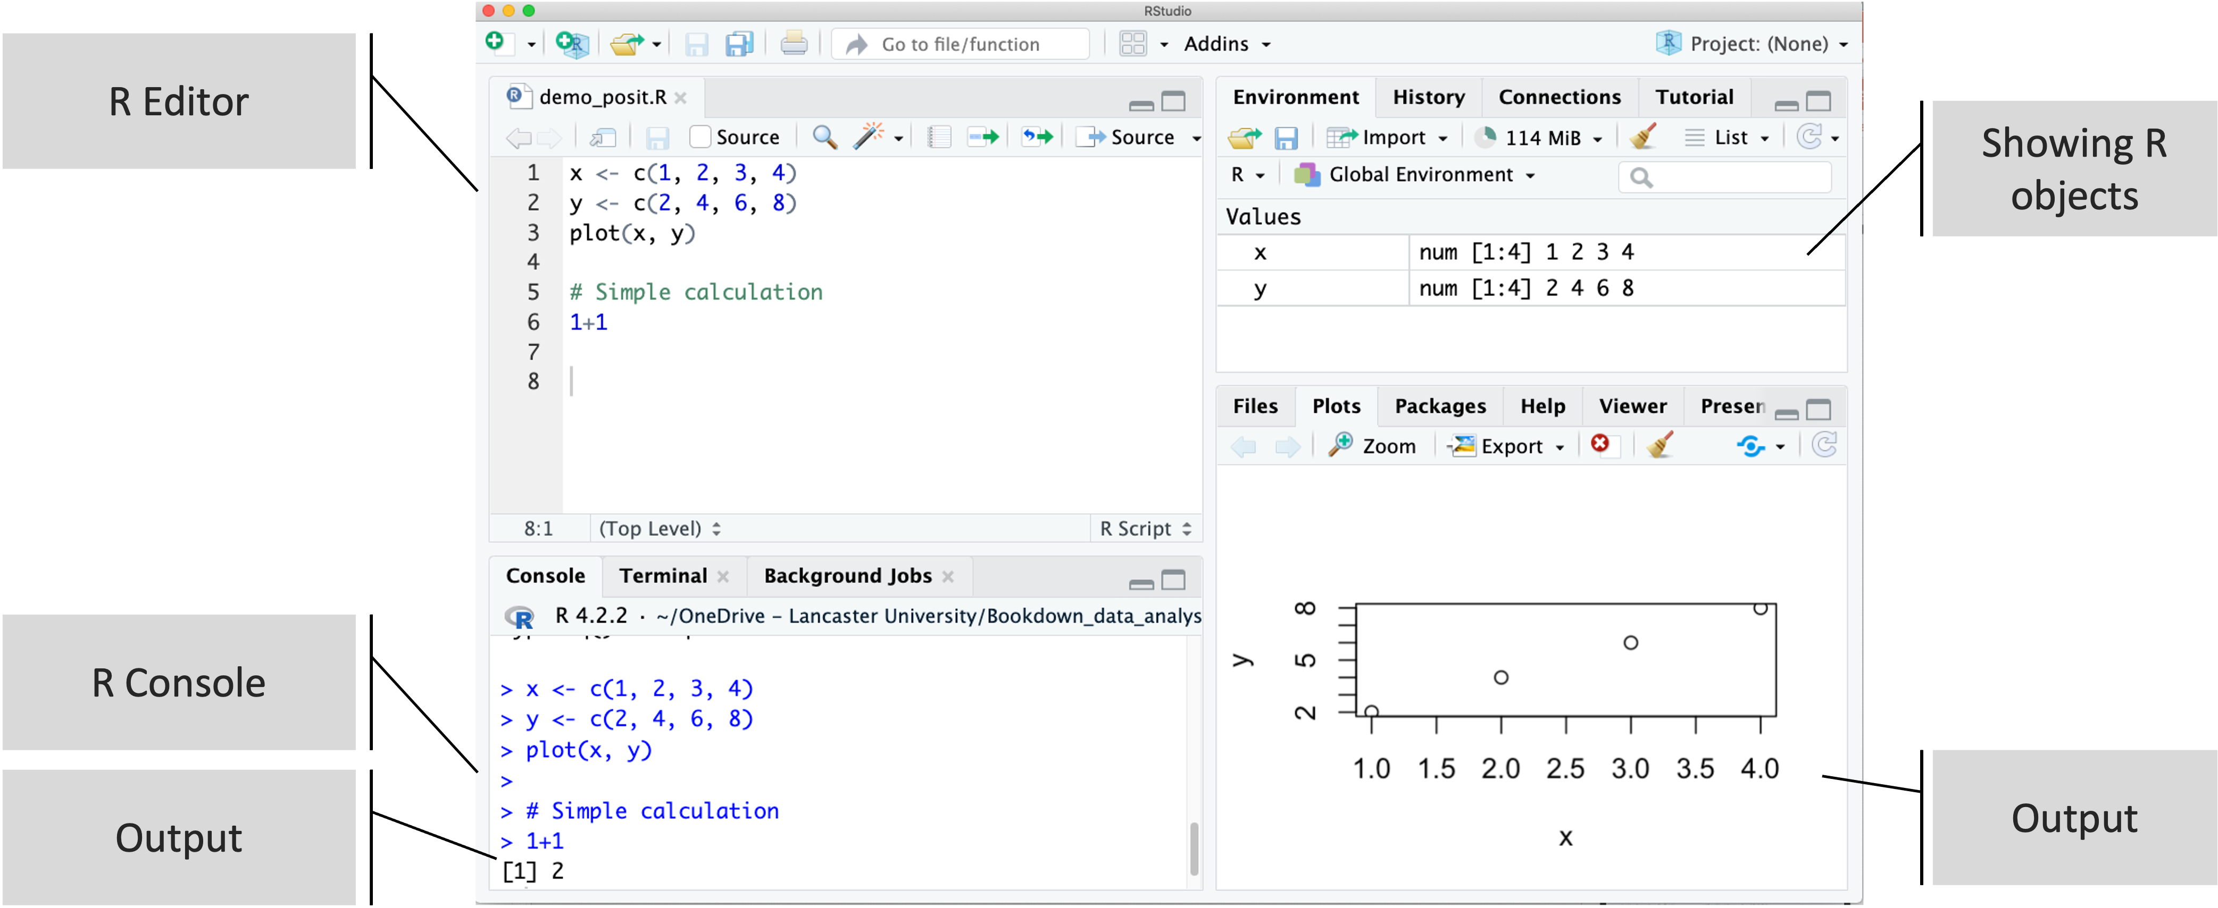
RStudio (Posit) Screenshot On My Screen

Slide 5
Key Elements In the Previous Screenshot
R editor pane allows you to write R code usually typically called R script if you saved it in a file. R script will have an extension file.r. You can create an R script using RStudio by clicking: File→New File→R script.
R console pane can also be used to write your code. On the console, you have to press enter to run it. The output is also printed on the pane – the result of running 1+1 is printed as [1] 2. Any code that you write in the R editor will be printed on the console along with the outputs.

Slide 6
In the Output on the right of the image, you see a graph displayed as a result of running plot(x,y).
In the Global Environment pane, RStudio list R objects that are active in your R session. R is a programming language that is object-oriented, which means that everything you created in R is an object.
As you can see on the pane, there are two R objects: x, and y. These two objects were created as a result of running x <- c(1, 2, 3, 4) and y <- c(2, 4, 6, 8).
These two R objects are ‘alive’ in your computer (i.e, R workspace)) during R session. As they are alive, they consume energy that are taken from your computer RAM. If you close your R session, the objects are killed - and I don’t mean to sound evil.

Slide 7
ls() # see the results in your R console or global environment pane.
rm(list=ls()) # remove all objects, start with the clean slate.

Slide 8
Executing Code in R editor
To run a particular line, select the line with your cursor and click the Run toolbar button.
To run multiple lines, select the entire lines, and click the Run toolbar button.
To run the entire code in your script, click the Source toolbar button.

Slide 9
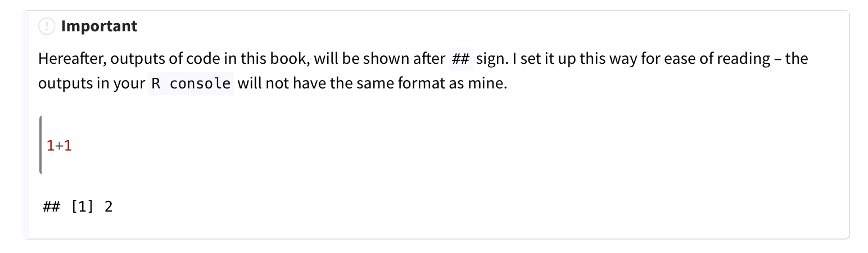

Slide 10
R Package
R package is a collection of functions.
A function is programming code that acts as a tool that you use to make things work.
ggplot2 is an R package that contains various functions to create graphs.
to see the complete lists of function in the stats package.
library(help = "stats")

Slide 11
Install and Load A Package
install.packages(“package1”) will install a package called package1. Just for your info, there is no package called `package1`, so do not try to install it. You can install multiple packages at once by running install.packages("package1", "package2", "package3")
library(package1) which loads package1. To load a package means making it available during your R session, so that it can be searched by R. R is automatically loaded with R standard packages that comes with it when you start R. This means, you can use any functions in that belong to R standard packages straightaway.

Slide 12
Loading Data
An R package typically comes with data sets. Run the following to see list of data in your R.
data() # list of all data
data(package="MASS") # load data in MASS package
data(Boston) # reload the data Boston that belongs to the MASS package.
head(Boston) # view the first few rows of Boston

Slide 13
Read an SPSS Data
Use haven package and read_sav("file.sav") function to read data from SPSS.
library(haven) # load the package
Reading an SPSS data from my Mac
dat_empathy <- read_sav("/Users/ahmaddaryanto/Documents/Data1/empathy.sav")
check Global Environment pane, dat_empathy appears as an R object.

Slide 14
Exporting Data To An SPSS Format
library(haven)
write_sav(dat_sales,"/Users/ahmaddaryanto/Documents/Temp/dat_sales_temp.sav")
# dat_sales was exported to Temp directory of my computer with a new name: dat_sales_temp.sav.

Slide 15
Viewing Data
library(haven) # to read SPSS data
library(tibble) # to use view(dat)
view(dat_sales) # a new window is created in RStudio showing data contents.
You can check the structure of our data with glimpse() function from the dplyr package.
library(dplyr)
glimpse(dat_sales)

Slide 16
Pipe Operator
The %>% and >| symbols are called pipe operators, which belongs to the magrittr package and loaded automatically if you used the dplyr package.
Both operators are quite identical and for the tasks you are doing in this book, you can use either one of them. The operator %>% is the predecessor of the >| operator where the latter is from R base package (R version 4.1 above)

Slide 17
Some Useful Functions For Data Manipulation
mutate()
relocate()
Select()
add_row()
rowMeans()

Slide 18
All-In-One Package: tidyverse
install.packages("tidyverse")
library(tidyverse)
https://www.tidyverse.org
a collection of packages useful for data science.

Slide 19
ggplot
Elegant way of creating graphs
library(ggplot2)
p <- ggplot(data = dat_sales2,
mapping = aes(x = ncalls, y = norders)) +
geom_point() +
labs(x = "Number of Calls",
y = "Number of Orders",
title = "My first plot using ggplot")

Slide 20
ggpubr
A wrapper function of ggplot
library(ggpubr)
# first part
p2 <- ggscatter(data = dat_sales2,
x = "ncalls", y = "norders",
shape = "gender",
size = 5,
xlab = "Number of Calls",
ylab = "Number of Orders",
title = "My first Plot",
ggtheme = theme_gray())
# second part: modifying legend
p2 <- p2 + scale_shape_discrete(name="Gender", labels=c("Female", "Male"))
p2

Slide 21
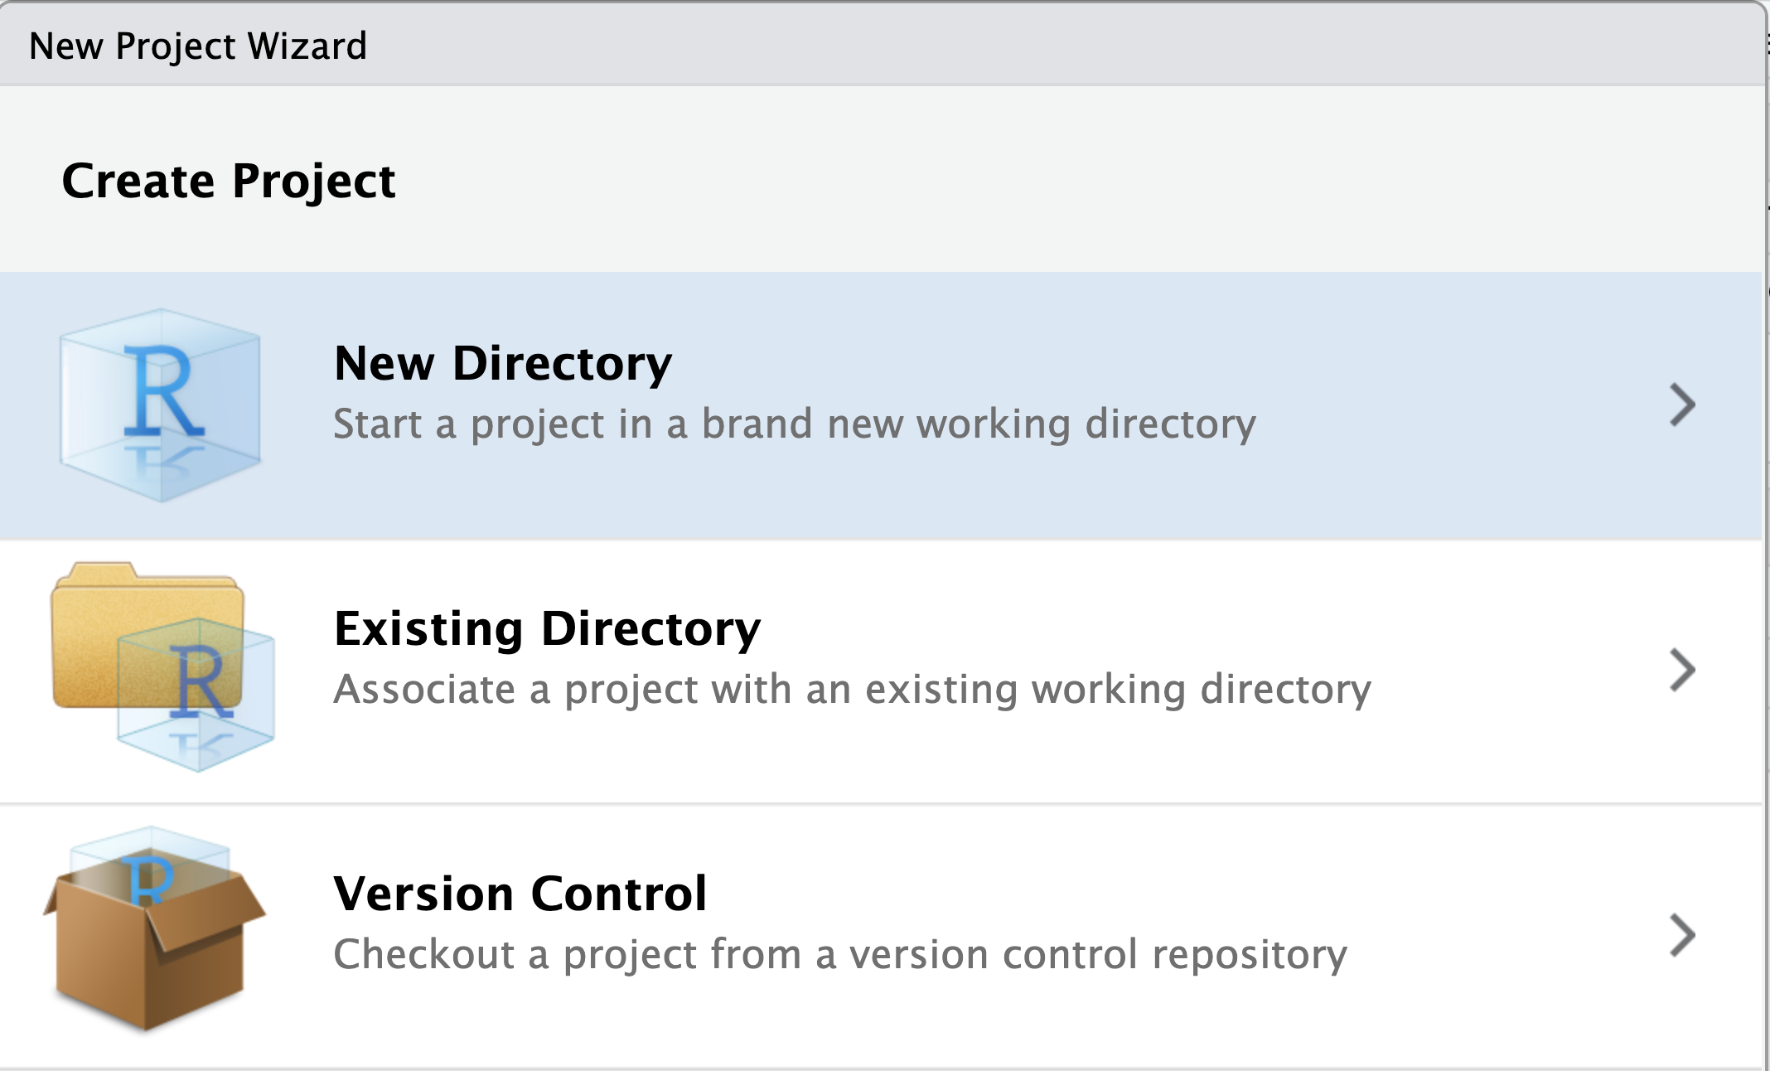
Working On A Project

Slide 22
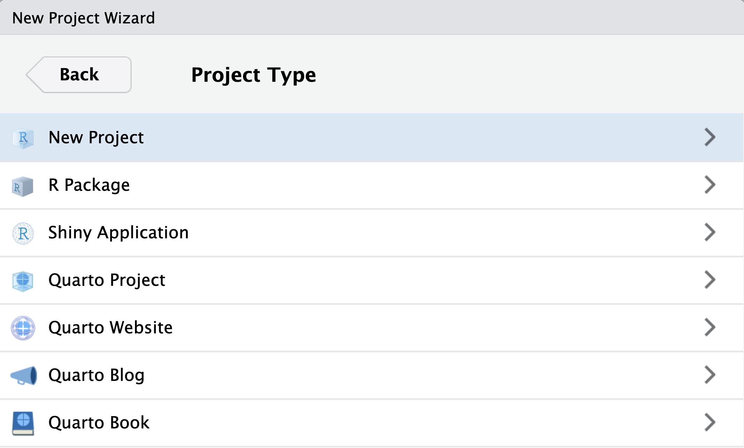
Choose A New Directory

Slide 23
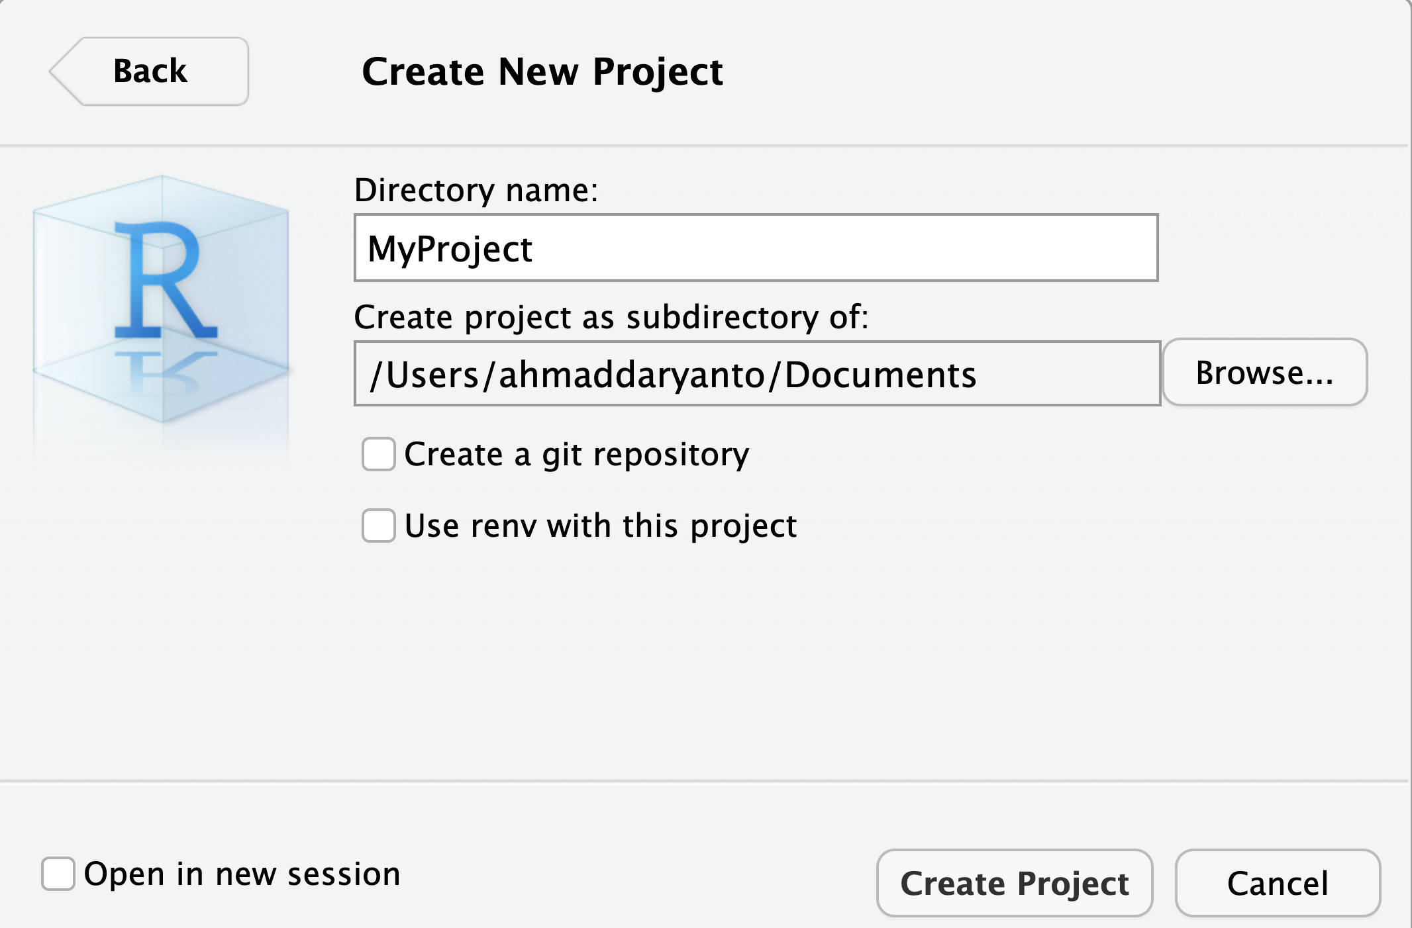

Slide 24
