Slide 1
Chapter 15: Mediation
Textbook: Ahmad Daryanto, Introduction to Quantitative Research Methods for Marketing With SPSS and R: Tools and Techniques, Routledge. 2024

Slide 2
Learning objectives:
Understand the concept of mediation.
Know how to conduct mediation test with SPSS and R.
Understand the concept of bootstrapping.
Know how to use Hayes’s Process Macro to test mediation.

Slide 3
What Is Mediation?
Addressing how X affects Y
Can M explain the relationship between X and Y?
The famous example of the search for a mediator variable took place in the 18th century (Pearl & Mackenzie, 2018). Many sailors expediting to arctic suffered from scurvy (the pirate disease). At that time, people discovered that citrus fruit prevented scurvy but the reason was unknown until Albert Szent-Gyorgyi discovered the existence of vitamin C in fruits in 1930– he won a nobel prize for his invention. Thanks to the nobel prize winner, nowadays, we understand that the correct path is citrus fruits → vitamin C → scurvy.Vitamin C is the mediator of the effect of citrus fruits on scurvy. That is, vitamin C explains why citrus fruits prevents scurvy.

Slide 4
Hypotheses
Mediation is represented by this diagram:
X
M
Y
Researchers typically present three hypotheses from the above model
H1. X is positively related to M
H2. M is positively related to Y
H3. M mediates X on Y

Slide 5
Hypotheses
Mediation is represented by this diagram:
H1
H2
X
M
Y
H3
Researchers typically present three hypotheses from the above model
H1. X is positively related to M
H2. M is positively related to Y
H3. M mediates X on Y

Slide 6
c
X
Y
a
M
b
X
Y
c‘
c captures the total effect of X on Y.
c’ represents a direct effect
ab captures a mediation effect/indirect effect

Slide 7
Terminology: Full Mediation
M
✓
✓
a
b
c‘
X
Y
n.s

Slide 8
Terminology: Partial Mediation
M
✓
✓
a
b
c‘
X
Y
✓

Slide 9
Methods of Analysis
Regression using Baron and Kenny’s Approach
Regression with bootstrapping
Structural Equation Modelling (SEM)

Slide 10
Baron and Kenny’s (BK) approach
Published in 1986
Obsolete
But a good start to learn mediation
Involves three steps
Step 1: Test path c (i.e., X → Y) by regressing Y on X using a simple linear regression)
Step 2: Test path a (X → M) using a simple linear regression

Slide 11
Example
Data set: empathyV2.sav
Store employee’s CPT
Store employee’s moral identity
Store employee’s empathy

Slide 12
Measures
Responses were measured using a Likert scale (1=strongly disagree, 7=strongly agree)
Moral Identity (Aquino and Reed, 2002)
It would make me feel good to be a person who has these characteristics.
Being someone who has these characteristics is an important part of who I am.
I would be ashamed to be a person who has these characteristics. (R)
Having these characteristics is not really important to me. (R)
I strongly desire to have these characteristics.
Customer-oriented perspective taking (Axtell et al. (2007)
I imagine how things look from the customer’s perspective
I think about how you would feel in their situation
I try to see things from their viewpoint
I try to imagine yourself as a customer in a similar situation
Empathy towards customers (Parker and Axtell (2001)
I feel concerned for customers if they are experiencing difficulties
I understand when customers get frustrated
I identify and empathize with the problems customers experience

Slide 13
Presenting the results on a diagram
Use standardized scores,
Write down the coefficient and
flag if the estimates are significant, e.g., * if p<0.01, ** if p<0.05, *** if p < 0.001
Moral identity
b= 0.504***
Empathy
Customer-oriented perspective taking
b= 0.662***
b = 0.547***
Moral identity
Empathy
b= 0.142***
*** p < 0.001

Slide 14
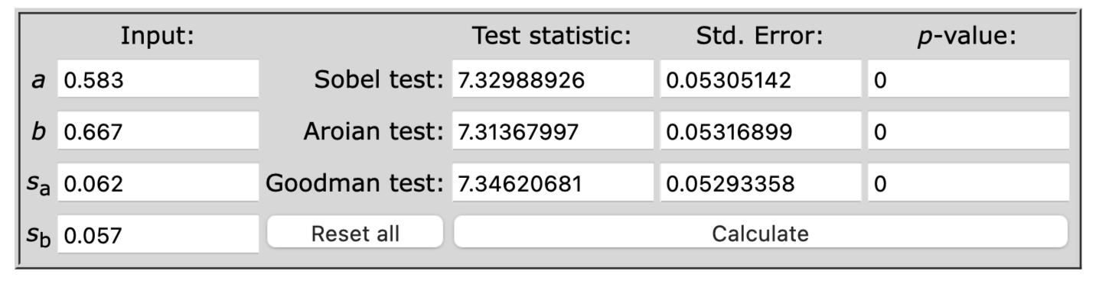
Sobel’s test
To test whether the product a x b is significant, Sobel (1982) introduced a formula that gives us the standard error for ab.
The calculation is facilitated by this applet: http://quantpsy.org/sobel/sobel.htm
Limitation: require a large sample size; assume a, b normal.

Slide 15
Bootstrapping
Bootstrapping is a resampling procedure
Taking a sample repeatedly from your ‘sample’ – yes, the data from which the sample is drawn is regarded as a ‘population.
A sample drawn from the ’population’ is called a bootstrap sample
Say, you have 1000 values for ab gathered from the 1000 bootstrap samples. From these 1000 values, you can calculate the 95% confidence interval by arranging the values in an ascending order.
Included in the Process Macro.

Slide 16
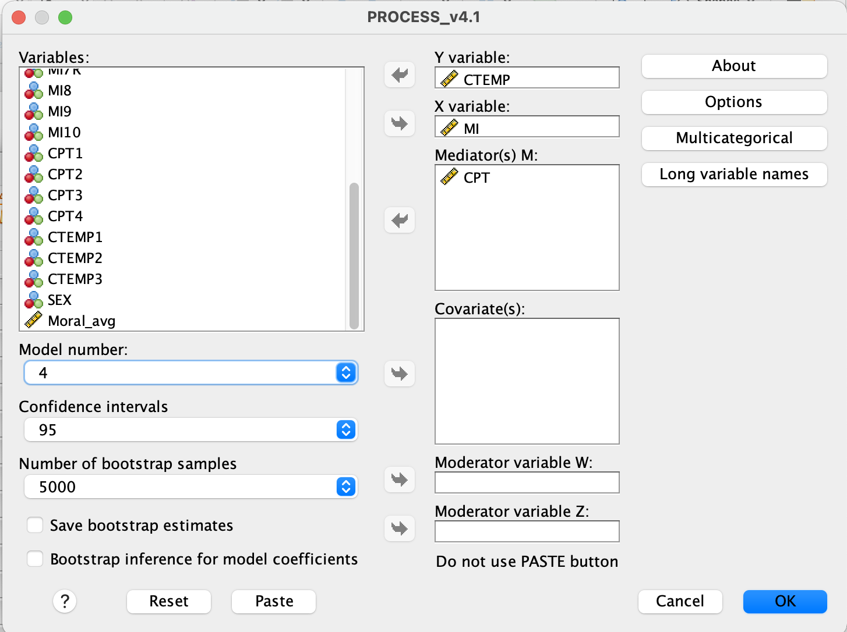
Process Macro
The, X, M, and Y variable
Change Model number to 4
95% Confidence interval
Leave the default number as it is

Slide 17
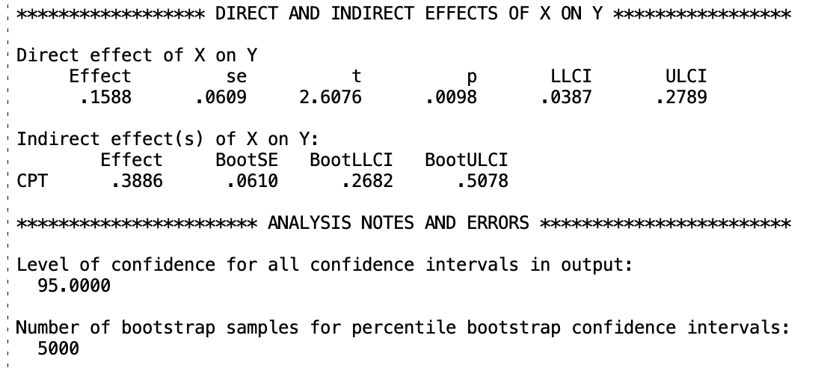
Indirect effect = mediation effect.
Size of mediation effect = 0.3886
The bootstrap confidence interval does not include zero, therefore the mediation effect is significant

