Slide 1
Chapter 4: Construct And Measurement
Textbook: Ahmad Daryanto, Introduction to Quantitative Research Methods for Marketing With SPSS and R: Tools and Techniques, Routledge. 2024

Slide 2
Learning Objectives
Understand what constitute a (latent) construct and its operationalization.
Understand the objective of using a scale to measure a construct.
Understand the difference between reflective and formative latent construct
Understand the four levels of measurement.
Understand the notion of reliability and validity.
Able to conduct reliability analysis using SPSS and R.

Slide 3
Identifying A Construct
Let us look at the following research objectives.
To determine the effect of perceive ease of use on customer intention to revisit a website
To determine the effect of compulsive buying on satisfaction toward a product and likelihood to return the product
To determine the effect of gender on the attitude toward a print ad.
The underlined words in the above research objectives are called construct, latent constructs or latent psychological constructs since they are not easily observable
How to measure these latent constructs and make sure we are really measuring them?

Slide 4
Definition
Construct is an abstract representation of a concept measured with single or multiple statements or questions.
Construct can stem from trait, attitude, motivation, perception and preferences.
E.g., intelligence, attitude toward a brand brand preference

Slide 5
Operational definition
A construct can be measured in different ways.
To measure consumer loyalty toward a store.
For example:
You can present consumers with set of questions that tap their loyalty toward a store with a Likert-scale ranging from strongly disagree to strongly agree: " I am satisfied with this store".
Alternatively, ask consumers to indicate their frequency of visit toward a store.
The procedures or ways of measuring a construct is called construct operationalization or operational definition of a construct.

Slide 6
Variable(s)
Variables are sometimes treated as synonyms for constructs.
If a construct is measured with multiple questions or items, each item is considered as a variable.
I speak about a variable instead of a construct when I have gathered data from my survey and use variables to represent constructs in my worksheet or data file.
Examples:
Gender is a construct. ’GEND’ used as a variable in my worksheet to denote gender.
If satisfaction is measured with three items, I could use ’SAT1’ ’SAT2’, ’SAT3’ to represent each of the items in my SPSS data file.

Slide 7
Scale
Is a collection of variables to measure a construct,
For instance, to measure consumers’ impulsiveness, you can use a scale developed by Rook and Fisher (1995), which consists of 9 items. Two sample items of the impulsiveness scale are: (1) "I often buy things spontaneously", (2) "I often buy things without thinking". These statements require you to indicate your opinion with a 7-Likert scale ranging from 1 = strongly disagree to 7 = strongly agree.
Developing a scale involves a lengthy and complex scientific procedure, which is beyond the scope of our module.

Slide 8
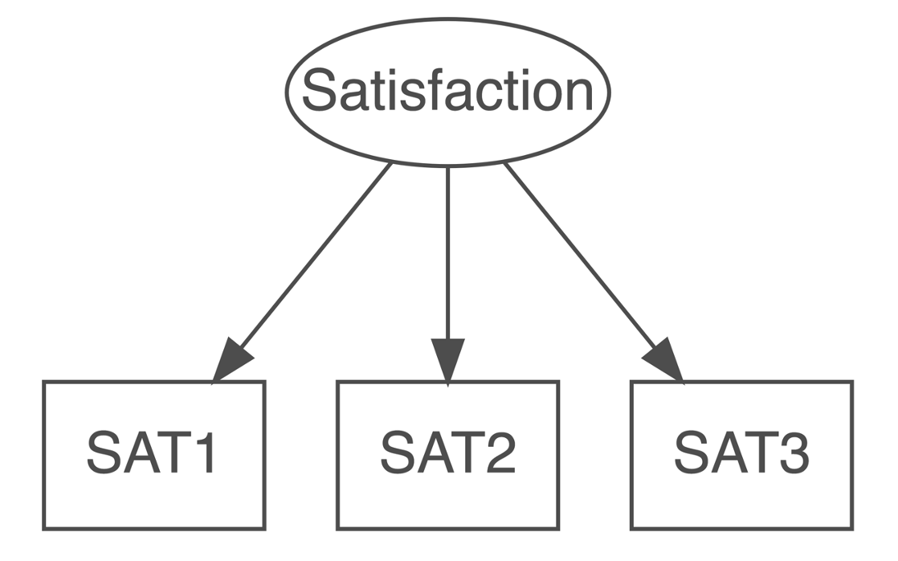
Reflective construct
The direction of the arrow infers that the latent construct influence the measurement items. That is, changes in the measurement items are due to changes in the latent construct.

Slide 9
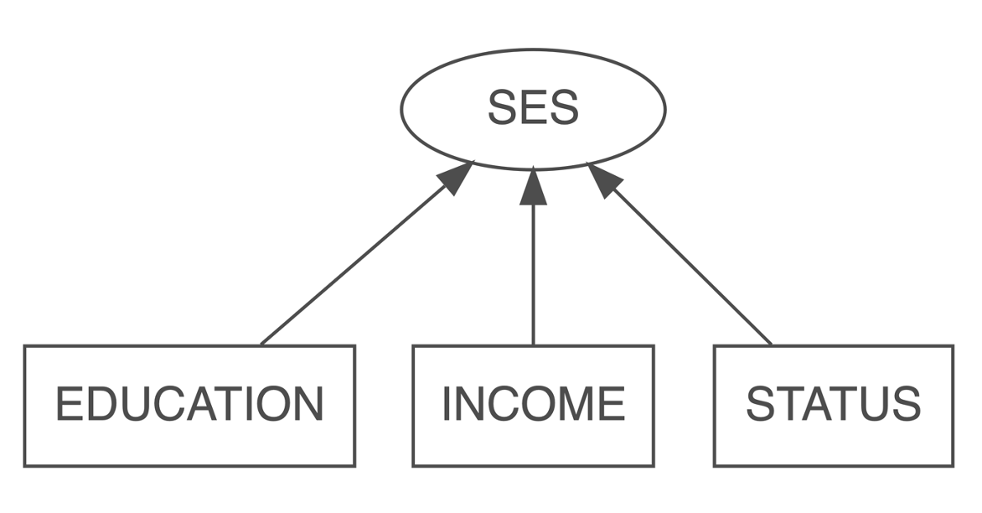
Formative construct
The direction of the arrow implies that a latent construct exist because it is formed by the items. In other words, the items cause the construct.

Slide 10
Tips
Use an existing scale. Do not invent yourself unless the scale does not exist.
There are many scales that have been developed, there is a higher chance that you can adapt existing scales to suit your research context.

Slide 11
Using the Scale
Imagine that you have collected data on consumer satisfaction. Your consumer satisfaction scale consists of three items, each measured with a seven-point semantic scale with 1= very dissatisfied, and 7 = very satisfied. You assigned SAT1, SAT2 and SAT3 as variables in your spreadsheet or SPSS to represent these items.
How would you determine the level of consumer satisfaction, suppose one consumer provides SAT1 = 4, SAT2 = 5, and SAT = 6?

Slide 12
Using the Scale
Summated score
adding together the response to each item
SAT1 + SAT2 + SAT3 = 4 + 5 + 6 = 15
15 is not meaningful
Average sore
(4 + 5 + 6)/3 = 15/3 = 5
5 is meaningful, i.e., somewhat satisfied.
Widely used in research and the approach we adopt in this course

Slide 13
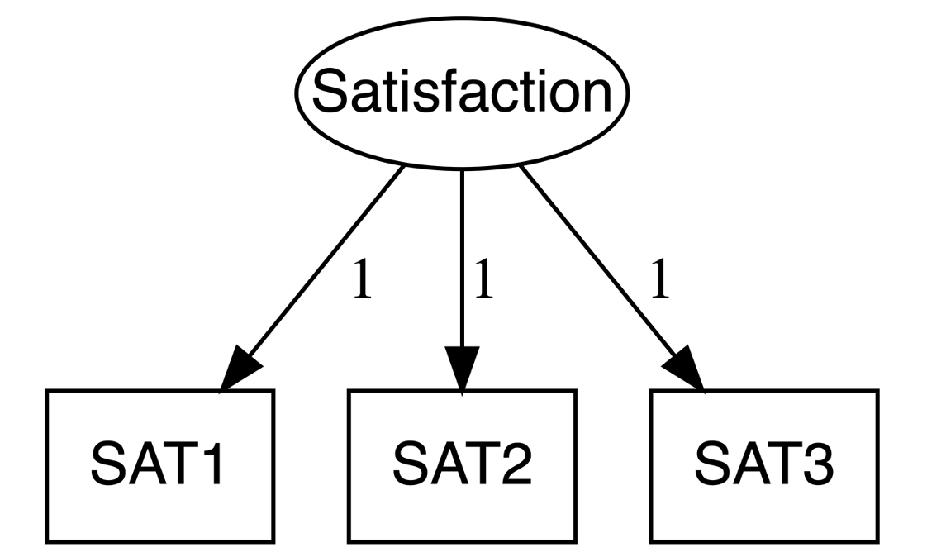

Limitation of Mean Score
By taking the average, we implicitly assume that respondents react to the three satisfaction items in the same way. In the calculation of mean score, this implies that each items contributes equally to the formation of mean score.
SAT1 = 4, SAT2 = 5, and SAT = 6
Mean score:

Slide 14
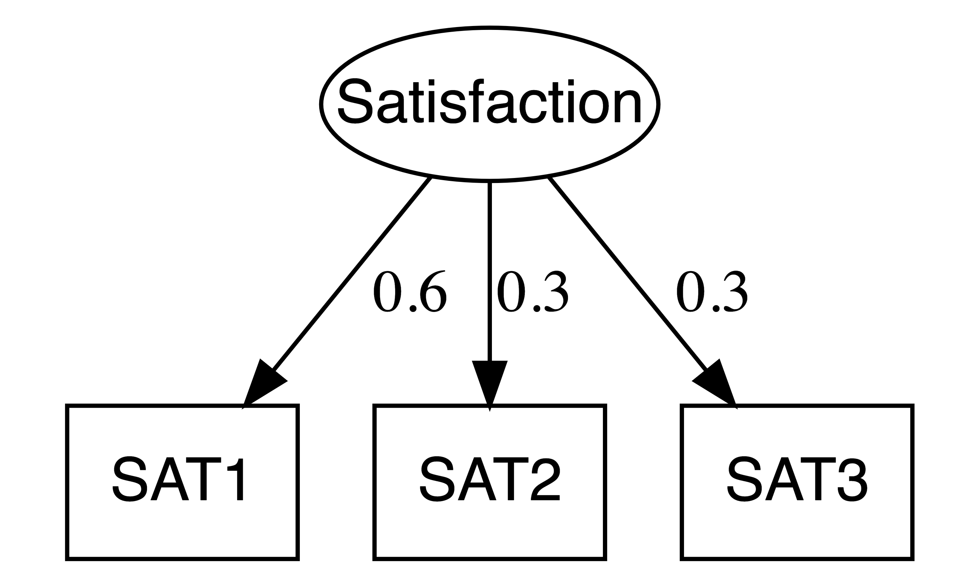
Your turn
if the weight applied to SAT1 is 60%, and those applied to SAT2 and SAT3 are only 30%
SAT1 = 4, SAT2 = 5, and SAT = 6
Mean score = ?

Slide 15
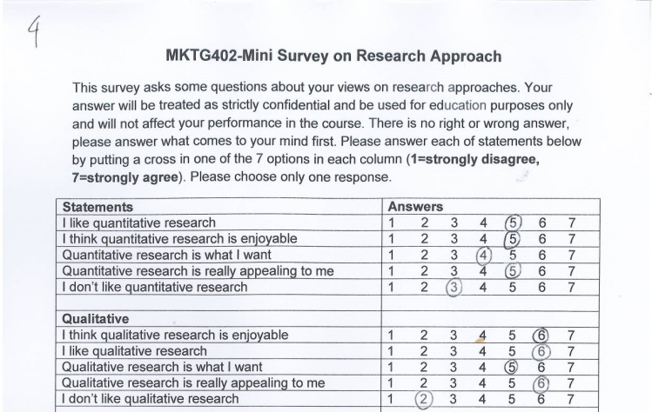
Combining scales
Sometimes, we use two scales
to represent a construct
Negatively worded!
Reverse code first!
AQ=Attitude toward Quant=(5+5+4+5+(8-3)/5=4.8
If AQ>AL : Quant-oriented
AL=Attitude toward Qual=(6+6+5+6+(8-2)/5=5.8
If AQ<AL : Qual-oriented
Method Orientation=AQ-AL=4.8-5.8=-1.0 → Qual oriented

Slide 16
Scale evaluation
How would you ensure that a scale to measure a construct is good, i.e., reliable and valid? Two terms are associated with scale evaluation: reliability and validity.
Reliability: An indicator of a scale consistency
Are the questions really measuring the same thing?
Validity: Is the accuracy of a scale or the extent to which a score truly represents a construct

Slide 17
Reliability
is an indicator of a scale consistency, which measures the extent to which a scale is free from random error.
It also means consistency or stability.
If you administer a scale to the same respondents at two separate points in time and if the results of both measurements are the same, provided the condition between the first and second measurement are the same, then the scale is reliable.

Slide 18
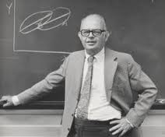
Reliability Coefficient
Coefficient alpha (α)=Cronbach’s alpha
The most commonly applied estimate of a scale’s reliability.
Invented by Cronbach (1951)
It assess to what extent items in a scale get together in measuring a construct.
Cronbach’s alpha is a coefficient that ranges from 0 to 1, with 0 meaning totally unreliable and 1 meaning perfectly reliable
Cronbach’s alpha of 0.7 is regarded as satisfactory.

Slide 19
Validity
is a measure the extent to which scale items really measuring the intended construct.
There are three types of validity:
Face validity
Convergent Validity
Discriminant Validity

Slide 20
Face Validity
Do items read as reflecting the name of the construct?
A simple way to inspect whether a scale achieves face validity or not is simply by reading each questions or statements in the scale.

Slide 21
Face Validity
Imagine, if variable LOY1 reads as: " I like the brand", while LOY2 and LOY3 read as: "I would recommend this brand to my family and friends", and " I buy this brand whenever I can", respectively.
While you intend to use these three items to measure brand loyalty, the the scale is not valid because LOY1 measures brand liking instead of brand loyalty.
If you believe that brand liking and brand loyalty are two distinct constructs, therefore you can not use LOY1 as an item to measure brand loyalty.

Slide 22
Convergent Validity
Defined as the extent to which a scale is positively correlated with other measures that are supposed to be positively correlated.
For example, if you have good items measuring brand liking, the items should be positively correlated to items measuring brand loyalty.

Slide 23
Discriminant Validity
Defined as the extent to which a scale is negatively correlated or uncorrelated to other measures from which it is supposed to differ.
For example, if you have good items measuring brand liking, the items should be negatively correlated with items measuring brand hate.

Slide 24
Reliability vs. Validity
A reliable measure does not necessarily to be valid.
If you step on a scale measuring your weight and it repeatedly shows 180, you probably raise your eyebrow because you know your weight is around 60 kg.
The scale is reliable because it shows consistent results every time you step on it,
The scale is not valid because it is not showing the true value.
However, for a scale to be valid, it should be reliable. Therefore, in research, a good scale is the one that is both reliable and valid.

Slide 25
Scaled-response formats
Majority of research in marketing used a scaled-response formats.
Utilized a continuum (e.g., 5 or 7-point scale) chosen by the researcher to measure respondent’s attitude, feelings, judgment, and perception.
Permits the measurement of the intensity of a respondent’s answer
The response options are identified in the questionnaire
Labeled: all options/positions are identified with some descriptive word phrase.
Typically used for a higher-level statistical analysis
E.g., Likert-scale (1=strongly disagree to 7=strongly agree)

Slide 26
Ratio
Quantitative
Interval
Categorical
Ordinal
Qualitative
Nominal

Slide 27
Different Ways of Measuring the Same Construct
A construct can be measured in different ways using different types of level of measurements. For example, satisfaction can be measured using either a nominal, interval, or ratio scale as illustrated by the example below.
Nominal
Are you satisfied with our mobile app?
___ Yes ___ No
Ordinal
Compared to other mobile app you have used, how is your satisfaction with our mobile app?
___ Lower ___ About the same ___ Higher
Interval
Please indicate your level of satisfaction with our mobile app
___ Very unsatisfied ___ Unsatisfied ___ Satisfied ___ Very satisfied

Slide 28
Reliability Analysis
If a scale consists of multiple items, you can conduct a reliability analysis. The aim of the analysis is to inspect whether items used for measuring a construct have good internal consistency – whether the multiple items belong together.
What you want to know is whether the Cronbach’s alpha of the scale is about or greater than the recommended value of 0.7.

Slide 29
SPSS Action
RELIABILITY
/VARIABLES=BT1 BT2 BT3 BT4
/SCALE('ALL VARIABLES') ALL
/MODEL=ALPHA
/SUMMARY=TOTAL.

Slide 30
R Action
install.package("pysch")
library(tidyverse)
library(haven)
library(psych)
dat2 <- dat <- read_spss("/Users/ahmaddaryanto/Documents/Data1/retailerbrand.sav") %>%
select(BT1, BT2, BT3, BT4)
res <- alpha(dat2)
res

