Slide 1
Chapter 23: Binary Logistic Regression
Textbook: Ahmad Daryanto, Introduction to Quantitative Research Methods for Marketing With SPSS and R: Tools and Techniques, Routledge. 2024

Slide 2
Learning Objectives
Understand the principle of a logistic regression.
Understand why a linear regression model with a continuous dependent.
Understand the method used to estimate coefficients in a logistic regression.
Know how to interpret key outputs of a logistic regression from SPSS binary logistic procedure and the glm R function.

Slide 3
Building a Model
Imagine that we select a group of acoustic guitar owners in random from the population of acoustic guitar owners. Then, we asked them to indicate whether they owned an electric guitar and how many years they have been playing an acoustic guitar (in years)
Can the number of years playing an acoustic guitar explain whether someone owns an electric guitar?

Slide 4

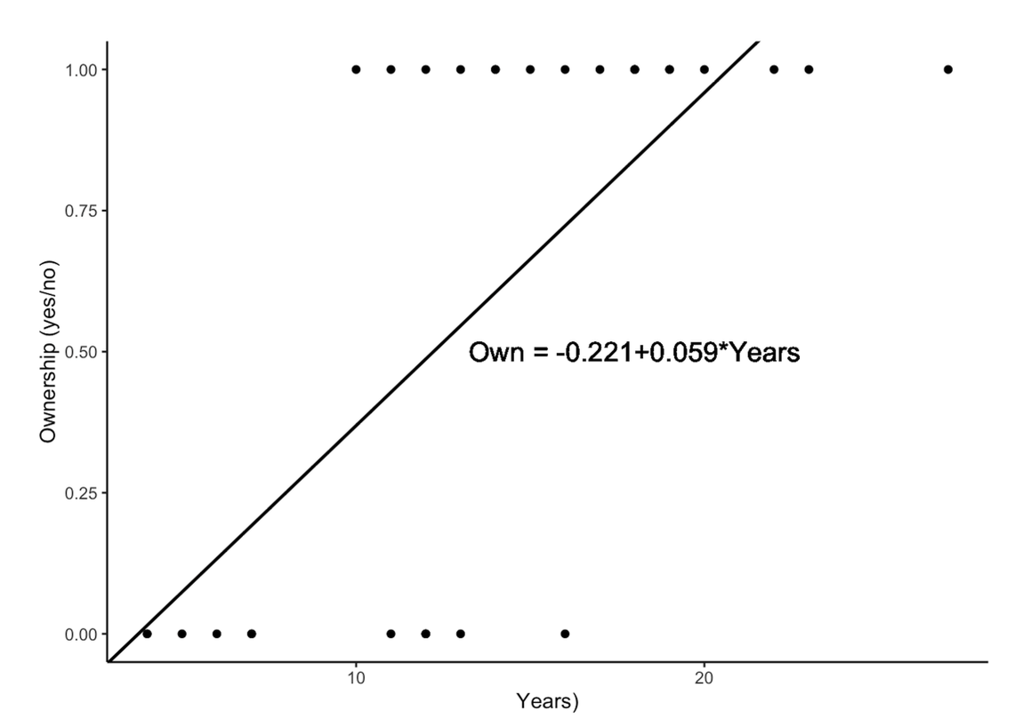
An OLS regression is not appropriate for modelling the probability of owning an electric guitar as the dependent variable can take a value of either 0 or 1.

Slide 5
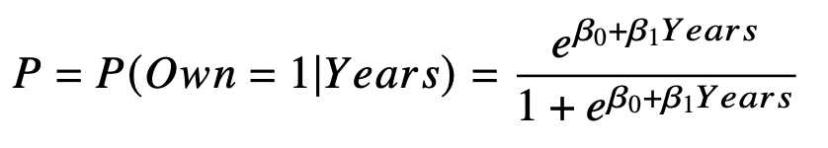
Logistic Regression Model
𝑃 = the probability of owning an electric guitar at a certain value of 𝑌𝑒𝑎𝑟𝑠.
𝑌𝑒𝑎𝑟𝑠 = number of years playing an acoustic guitar.
𝑒 = Euler’s number = 2.718

Slide 6
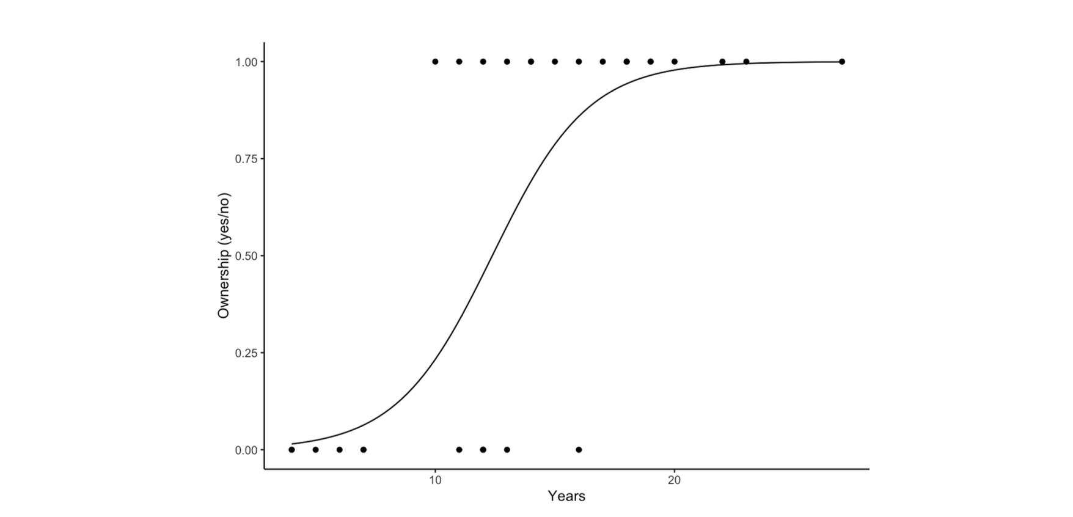
S-shaped Curve
An S-shaped logistic curve showing the probability of owning an electric guitar given Years

Slide 7
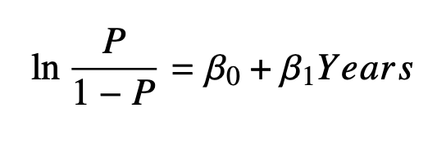


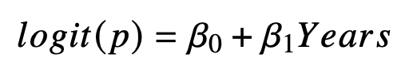
Alternative Form
= odds ratio
= ratio of the probability that a
customer owns an electric guitar to the probability that he or
she does not own an electric guitar.
is often referred to as 𝑙𝑜𝑔𝑖𝑡 giving us the binary logit model

Slide 8
SPSS Action
LOGISTIC REGRESSION VARIABLES Own /METHOD=BSTEP(LR) Years /SAVE=PRED PGROUP /CLASSPLOT /PRINT=GOODFIT /CRITERIA=PIN(0.05) POUT(0.10) ITERATE(20) CUT(0.5).

Slide 9
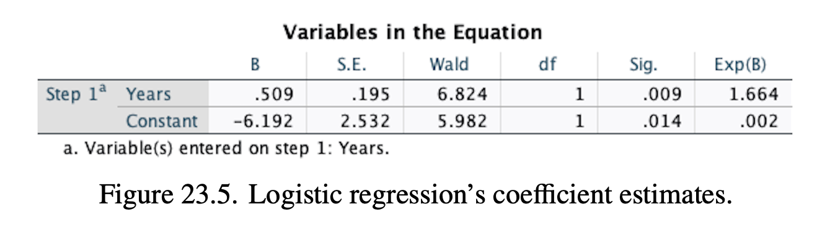

Variables In The Equation
For an additional one year of playing an acoustic guitar, the logit is expected to be increased by 0.509.

Slide 10
Odd Ratio
SPSS also produces odds ratios, which are often reported by researchers in their academic papers. In the SPSS outputs, the odds ratio is given by the entry of the last column, 𝐸𝑥𝑝(𝐵), where 𝐵 is the entry of the first column. The odds ratio associated with the coefficient of 𝑌𝑒𝑎𝑟𝑠 is 1.664. As the heading of the column suggests this value is obtained by this simple calculation 𝑒0.509 = 1.644, in reverse, 𝑙𝑛(1.644) = 0.509

Slide 11
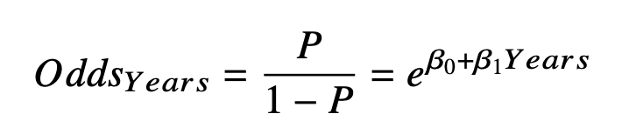
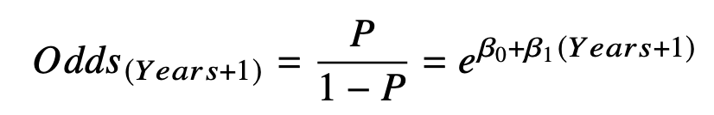
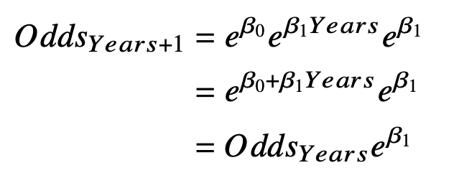

The odds ratio of an additional year will be:
That is, the odds of another year of playing is the odds of the current year multiplied by the odds ratio

Slide 12
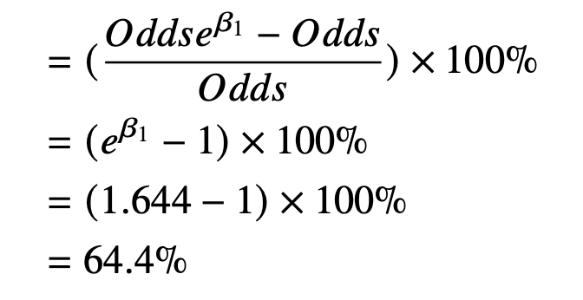
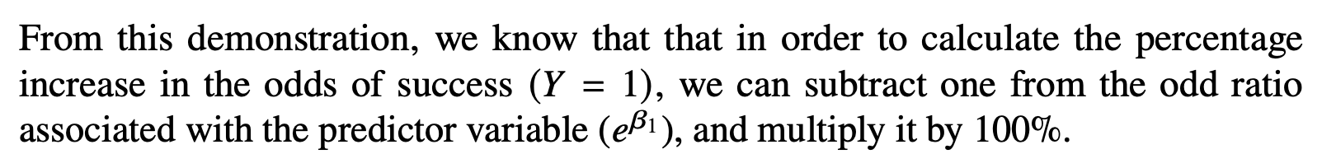
Based on our results, the odds of owning an electric guitar from an additional year of playing an acoustic guitar increase by 64.4%, as calculated below:

Slide 13
Likelihood Ratio Test
The likelihood ratio test compares an intercept-only model (no predictor) with our specified model (i.e., model with 𝑌𝑒𝑎𝑟𝑠). The null hypothesis is that the model with the predictor is no better than the intercept-only model. Therefore, in this test, we want to reject the null hypothesis (i.e., obtaining a small p-value). The outputs relevant to likelihood ratio test can be produced by changing the Method to Backward: LR.
If we are using the syntax, it can be requested by using /METHOD=BSTEP(LR) (see SPSS syntax).

Slide 14
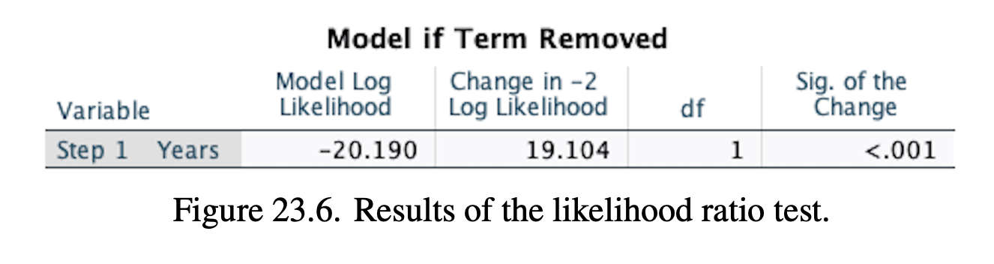
As can be seen from the table, the p-value of the test is very small, therefore, we reject the null hypothesis and conclude that our model with predictor 𝑌𝑒𝑎𝑟𝑠 is better than the intercept-only model.

Slide 15
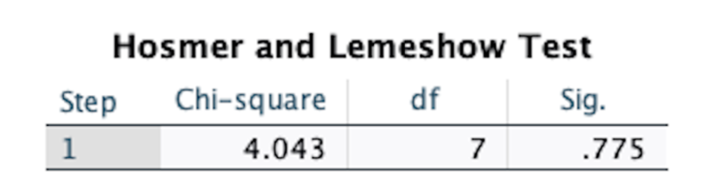
Hosmer And Lemeshow Test
Hosmer and Lemeshow test is a goodness of fit test based on a chi-square statistic that provides an indication of how accurate is the prediction from the model. This test requires large number of cases (at least 50) (Hair, Black, Babin, Anderson, & Tatham, 2009; Hosmer Jr, Lemeshow, & Sturdivant, 2013).
The null hypothesis is that the observed and the expected proportions are the same. In this test, we want to retain the null hypothesis, which means that our specified model is acceptable
There is no significant differences between the observed proportions and those predicted by the model (p> 0.05). Thus, the use of our model to predict ownership is statistically justified.

Slide 16
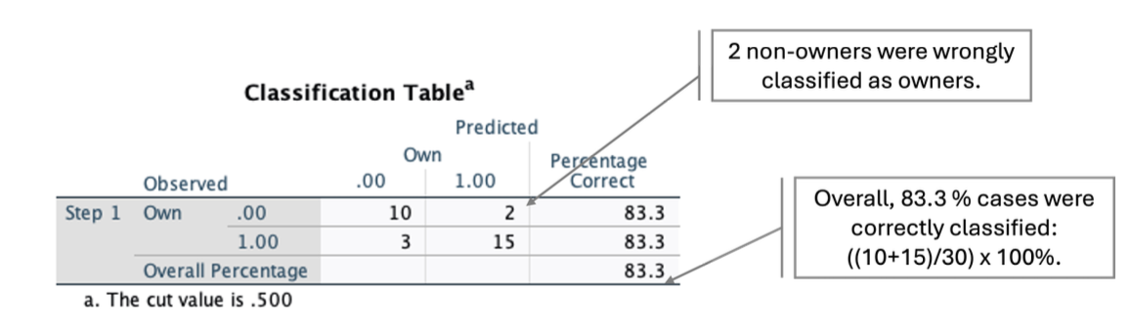
Classification Table
One way of measuring how accurate the prediction of our logit model is by assessing the classification table, which is a cross tabulation of the observed and the predicted values for the probabilities.

Slide 17
R Action
library(ahdar) mylogit <- glm(formula = Own~Years, family = binomial(link = "logit"), data = guitar) summary(mylogit)
mylogit$deviance
mylogit$null.deviance # likelihood ratio test
LR_test<-mylogit$null.deviance-mylogit$deviance
# Compute the p-value
df <- 1
LR_pvalue<-1-pchisq(LR_test,df) LR_pvalue

Slide 18
# Hosmer-Lemeshow Test
library(glmtoolbox) hltest(mylogit)
# Classification table
library(tidyverse) guitar <- guitar %>% mutate(predprob=round(fitted(mylogit),2)) guitar <- guitar %>% mutate(predgrp=ifelse(predprob >= 0.5, 1,0)) head(guitar)

Slide 19
Probit Model
An alternative to logit is the probit model. In the probit model,
the probability of owning an electric guitar is calculated by using
the cumulative standard normal distribution.
To run the probit regression using our data, we can
use the glm function by setting family = binomial(link = "probit").
library(ahdar)
myprobit <- glm(formula = Own~Years, family = binomial(link = "probit"), data = guitar) summary(myprobit)
In practice, the difference between logit and probit is minimal. Despite their similarity, logit model is easy to be communicated because it has a closed form.

Slide 20
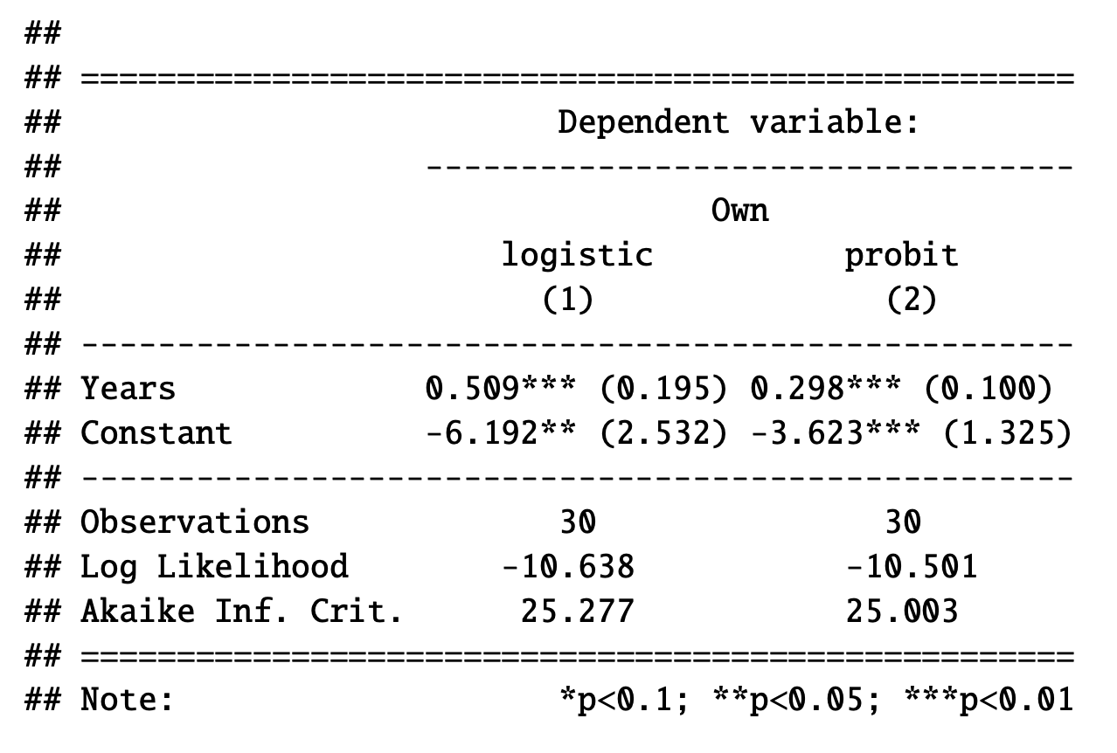
# Printing the results of logit and probit library(stargazer) stargazer(mylogit, myprobit, type = "text", single.row=TRUE)

Slide 21
The code below calculates the predicted probability of owning an electric guitar using logit and probit at four different values of 𝑌𝑒𝑎𝑟𝑠: 0, 5, 10, and 20 years.
library(ahdar)
Yrs <- c(0, 5, 10, 20)
mylogit <- glm(formula = Own~Years, family = binomial(link = "logit"), data = guitar)
myprobit <- glm(formula = Own~Years, family = binomial(link = "probit"), data = guitar)
p_logit <- predict(mylogit, list(Years = Yrs), type = "response")
p_probit <- predict(myprobit, list(Years = Yrs), type = "response")
res <- data.frame(Yrs, p_logit, p_probit) round(res,3)

Slide 22
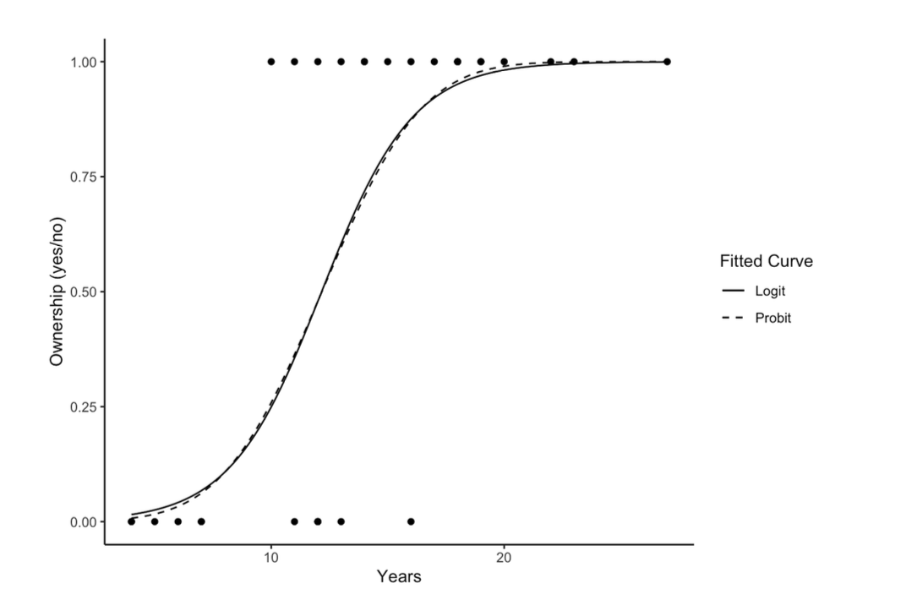
The estimated logit and probit curves coincide to each other, showing no substantial difference between the logit and probit models.
This minimal difference occurs most of the time in practice.

Slide 23
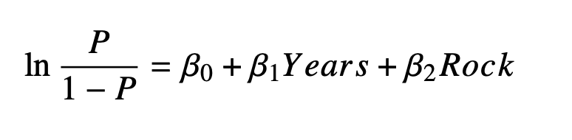
Multiple Predictors
How can we interpret the coefficients of the model?

Slide 24
We can interpret the sign of Years in a similar way we interpret the sign of the coefficient in a regression model. For example, if 𝑌𝑒𝑎𝑟𝑠 has a positive sign, this means that 𝑌𝑒𝑎𝑟𝑠 is positively related to probability of owning an electric guitar. In other words, the more experience an individual has with an acoustic guitar, the higher the chance that he or she owns an electric guitar.
We can calculate the partial effect for every observations, and take the average of the partial effects. Using R, this can be easily done by using the logitmfx (Fernihough, Henningsen, & Fernihough, 2019).
Instead of calculating the average partial effect, we can compute the effect of change in 𝑌𝑒𝑎𝑟𝑠 at a specific Years on the predicted probabilities, holding 𝑅𝑜𝑐𝑘 constant.

Slide 25
The Multinomial Logit Model
The multinomial logit model is the extension of the binary logit model. Similarly, the multinomial probit model is the extension of the binary probit model. In these models, the dependent variable has more than two categories (e.g., Brand A vs. Brand Brand B vs. Brand C).
We can use a multinomial logit to explain the choice of three types of guitar: electric, acoustic, and electro-acoustic.

Slide 26
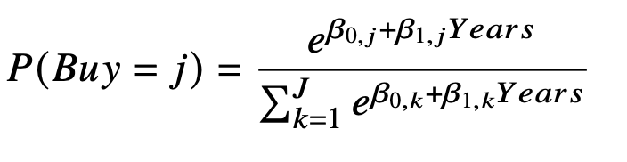
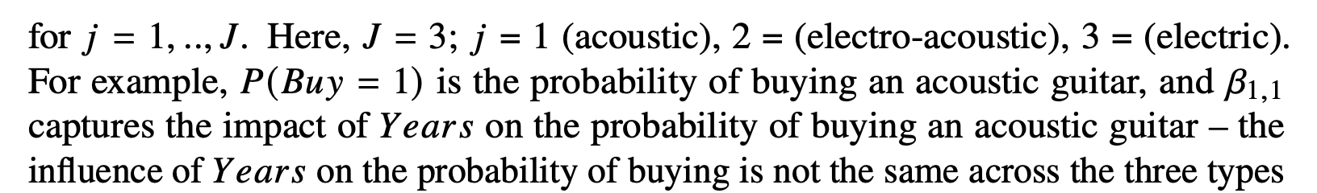
of guitar.

Slide 27
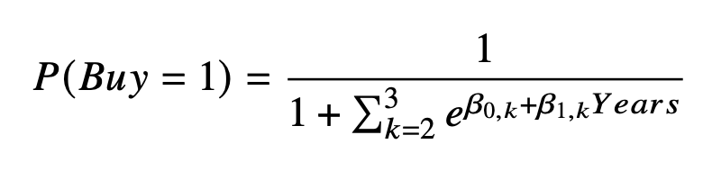
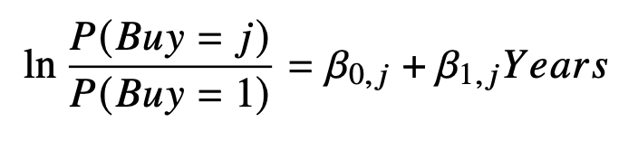
Having a base category, each possible choice is compared to it. The logit (i.e., the log of the odds ratio) is given by:

Slide 28
Choosing the Base Category
In a multinomial logit model, from a mathematical point of view, choosing the base category is arbitrary.
There is no a clear guideline in the literature about choosing the base category. However, in general, our research objectives dictate the choice of the base: choose a category that can answer our research questions.
If we want to investigate the effect of price discount on buying, ’no purchase’ can be selected as the base.

Slide 29
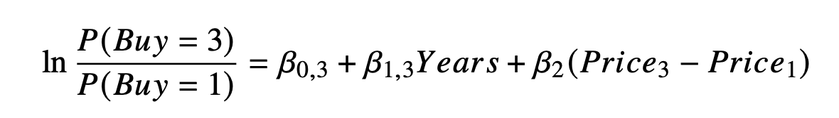
Independence from the Irrelevant Alternatives Property
Using acoustic as the baseline category: , the logit associated with buying an
electric guitar given 𝑌𝑒𝑎𝑟𝑠 is :
The odds ratio does not consider the price of the electro-acoustic. That is, the decision of buying either an acoustic or electric guitar does not depend on the price of the electro-acoustic that is also under consideration. This is known as the independence from the irrelevant alternative (IIA) property.
The multinomial probit model does not need the IIA property but specifying the model is more complex that that of the multinomial logit model, hence, it is not very popular in practice.

Slide 30
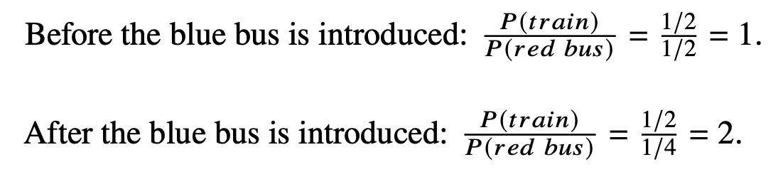
The classic example of the violation of the IIA property is the blue bus and red bus paradox. Imagine that the mode of transportation that you can choose is: a train, a bus painted in red (red bus). Suppose that your probabilities of choosing each transportation mode are: 1/2 and 1/2. A new bus has just been introduced. This bus is painted in blue (blue bus). Because colour will not affect the length of your journey, you should not be indifferent between the two bus. Therefore, your probability of choosing either bus is 1/4. Now, the choice probabilities with respect to train, red bus, and blue bus are 1/2, 1/4, 1/4. These probabilities will be inconsistent with the IIA property. Why?

Slide 31
The Origins of the IIA Property
The IIA property is also known in the literature as the Luce’s axiom introduced by the prominent mathematical psychologist, R Duncan Luce (Luce 1959). According to Luce (1959): "It is a natural probabilistic formulation on K. J. Arrow’s famed principle of the independence of irrelevant alternatives, and as such it is a possible underpinning for rational, probabilistic theories of social behavior" (Luce 1977, p.229).

