Slide 1
Dance Dance Evolution 2
Amy Davies, Emil Maric, Kieren Wou, Jeff Seo
L2A-03
EECE381

Slide 2
Introduction
A dance dance revolution (DDR) game implemented on the DE2
Problem is to incorporate the NIOS 2 Processor to implement all necessary functionality of a regular DDR game
Target market: Younger demographic (ages 5-18) and music enthusiasts

Slide 3
Development Process: Market constraints
Simple interface to navigate and play
Developed for a younger demographic
The game should be inexpensive
Songs that appeal to large range of people

Slide 4
Development Process: Project Requirements
Sound output to match with the song playing
Graphical output to show notes playing in the song
Well defined difficulty levels for play mode
Different genre of music on SD card
Responsive gameplay; no delay
Scoring system to allow user to track improvement over time

Slide 5
Work Accomplished Features:
Full audio streaming using interrupts and buffers (Challenging)
Hardware Accelerated Dual Buffer Graphics (Challenging)
PlayStation Controller/Mat integration
Multi core processing: 1 – audio, 1 - graphics
Bitmap integration for backgrounds
Real time system processing
SD Card integration

Slide 6
Design - Audio
We decided to take on the challenge of playing the full length of songs using FIFO interrupts.
This proved to be a tricky and time consuming task but worth the effort
In addition we put the audio processing on a different core to speed up the game, which we will talk about in a later slide
Audio files are stored and read from the SD Card. This allows different songs to be added to the game in the future

Slide 7
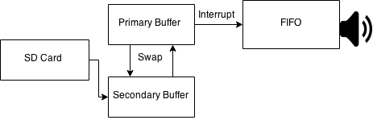
Design - Audio
Utilized the FIFO and SD Card
First read from the SD Card and fill up a primary buffer
Use the primary buffer and fill the FIFO and output the byte samples (sound)
While the primary buffer is outputting, fill up a secondary buffer with bytes read from the SD Card
Once the FIFO is less than 25% full, the interrupt is triggered and we fill up the FIFO again from the primary buffer.
If the primary buffer is empty then you swap the primary buffer with the secondary buffer and the secondary buffer now becomes the primary buffer.

Slide 8
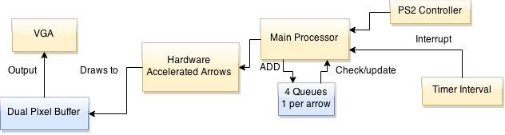
Design - Graphics
Implemented through the use of Hardware Accelerators
Used bit-mapping to display images for background

Slide 9
Design - Hardware Accelerated Graphics
Each arrow is in a 25x25 array block.
Internal registers to hold:
x,y coordinate
colour
arrow direction
arrow type - outline or fill
pixel buffer - start and back buffer

Slide 10
Design - Gameplay
We’re using 4 queues to track where the arrows are.
Each time an interrupt is triggered we go through the queues and update the position of the arrows.
We are using a combination data structure of a linked list and a queue to iterate through all the queues efficiently

Slide 11
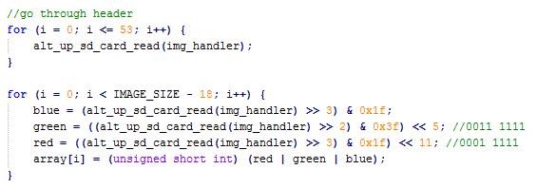
Design - Graphics
Image files stored in BMP format are in 24bit
We convert them into the 16bit 5-6-5 RGB format used by the NIOS2 processor.
We read the file from SD Card, convert it through bit shifting
Store it into an array of size 320x240 which is then drawn onto the screen by the pixel buffer.

Slide 12
Design - Controller
Communicate with PS2 Controller/Mat through serial port interface by using GPIO pins on the DE2 board
Read a stream of bytes sent by the controller where each set of bits indicate which button has been pressed
Implemented interrupts to detect when a button is pressed for responsive behaviour; essentially, when button pressed, if no arrow is within the fixed boundary to score, we deduct a point. Else we increment the score.

Slide 13
Design – Dual Cores
The two main processes, Audio and Video, together were very resource intensive which resulted in a slow process with multiple glitches.
Decided to split audio and video into two separate cores to speed up the processes
Used hardware FIFO to communicate between audio and video cores for synchronization between states

Slide 14
Results (Solution Assessment)
Audio playback exceeds initial goals with having entire songs running from SD Card
Graphical interface displays everything required with little to no lag
Implemented a user interface with simple gameplay
Implemented scoring system

Slide 15
Conclusions
Developed a simple DDR-based game with the use of DE2 and embedded systems such as the NIOS2 processor
The main components include the audio, graphics, and control interfaces
Overall, the project meets the requirements set in beginning of the course

Slide 16
Suggested Future Work
Multiplayer
Different game interfaces i.e. rock band style where there can be different interface such as microphone, drums, guitars, etc.
Ability to create personal music score
Ability to add personal music

