Slide 1
Åpningstider / Opening hours
Mandag til fredag: 08:00 – 22:00
Lørdag og søndag: 10:00 – 18:00
Monday - Friday: 08:00 – 22:00
Saturday - Sunday: 10:00 – 18:00

Slide 2


Hvordan realisere kunnskapssamfunnet?
Debattmøte mandag 24. februar kl. 16:00
Vilhelm Bjerknes` hus
Blablablablablabla denne sliden blir lagret som en egen slide i arkivet.
Paneldeltakere:
Sivert Bjørnstad (Frp) Michael Tetzschner (H) Ola Elvestuen (V) Elisabeth Løland (Krf) Rasmus Hansson (MDG) Marianne Marthinsen (AP) Heikki Holmås (SV).
Kommentarer: rektor Ole Petter Ottersen ved UiO og rektor Kari Toverud Jensen ved HiOA

Slide 3
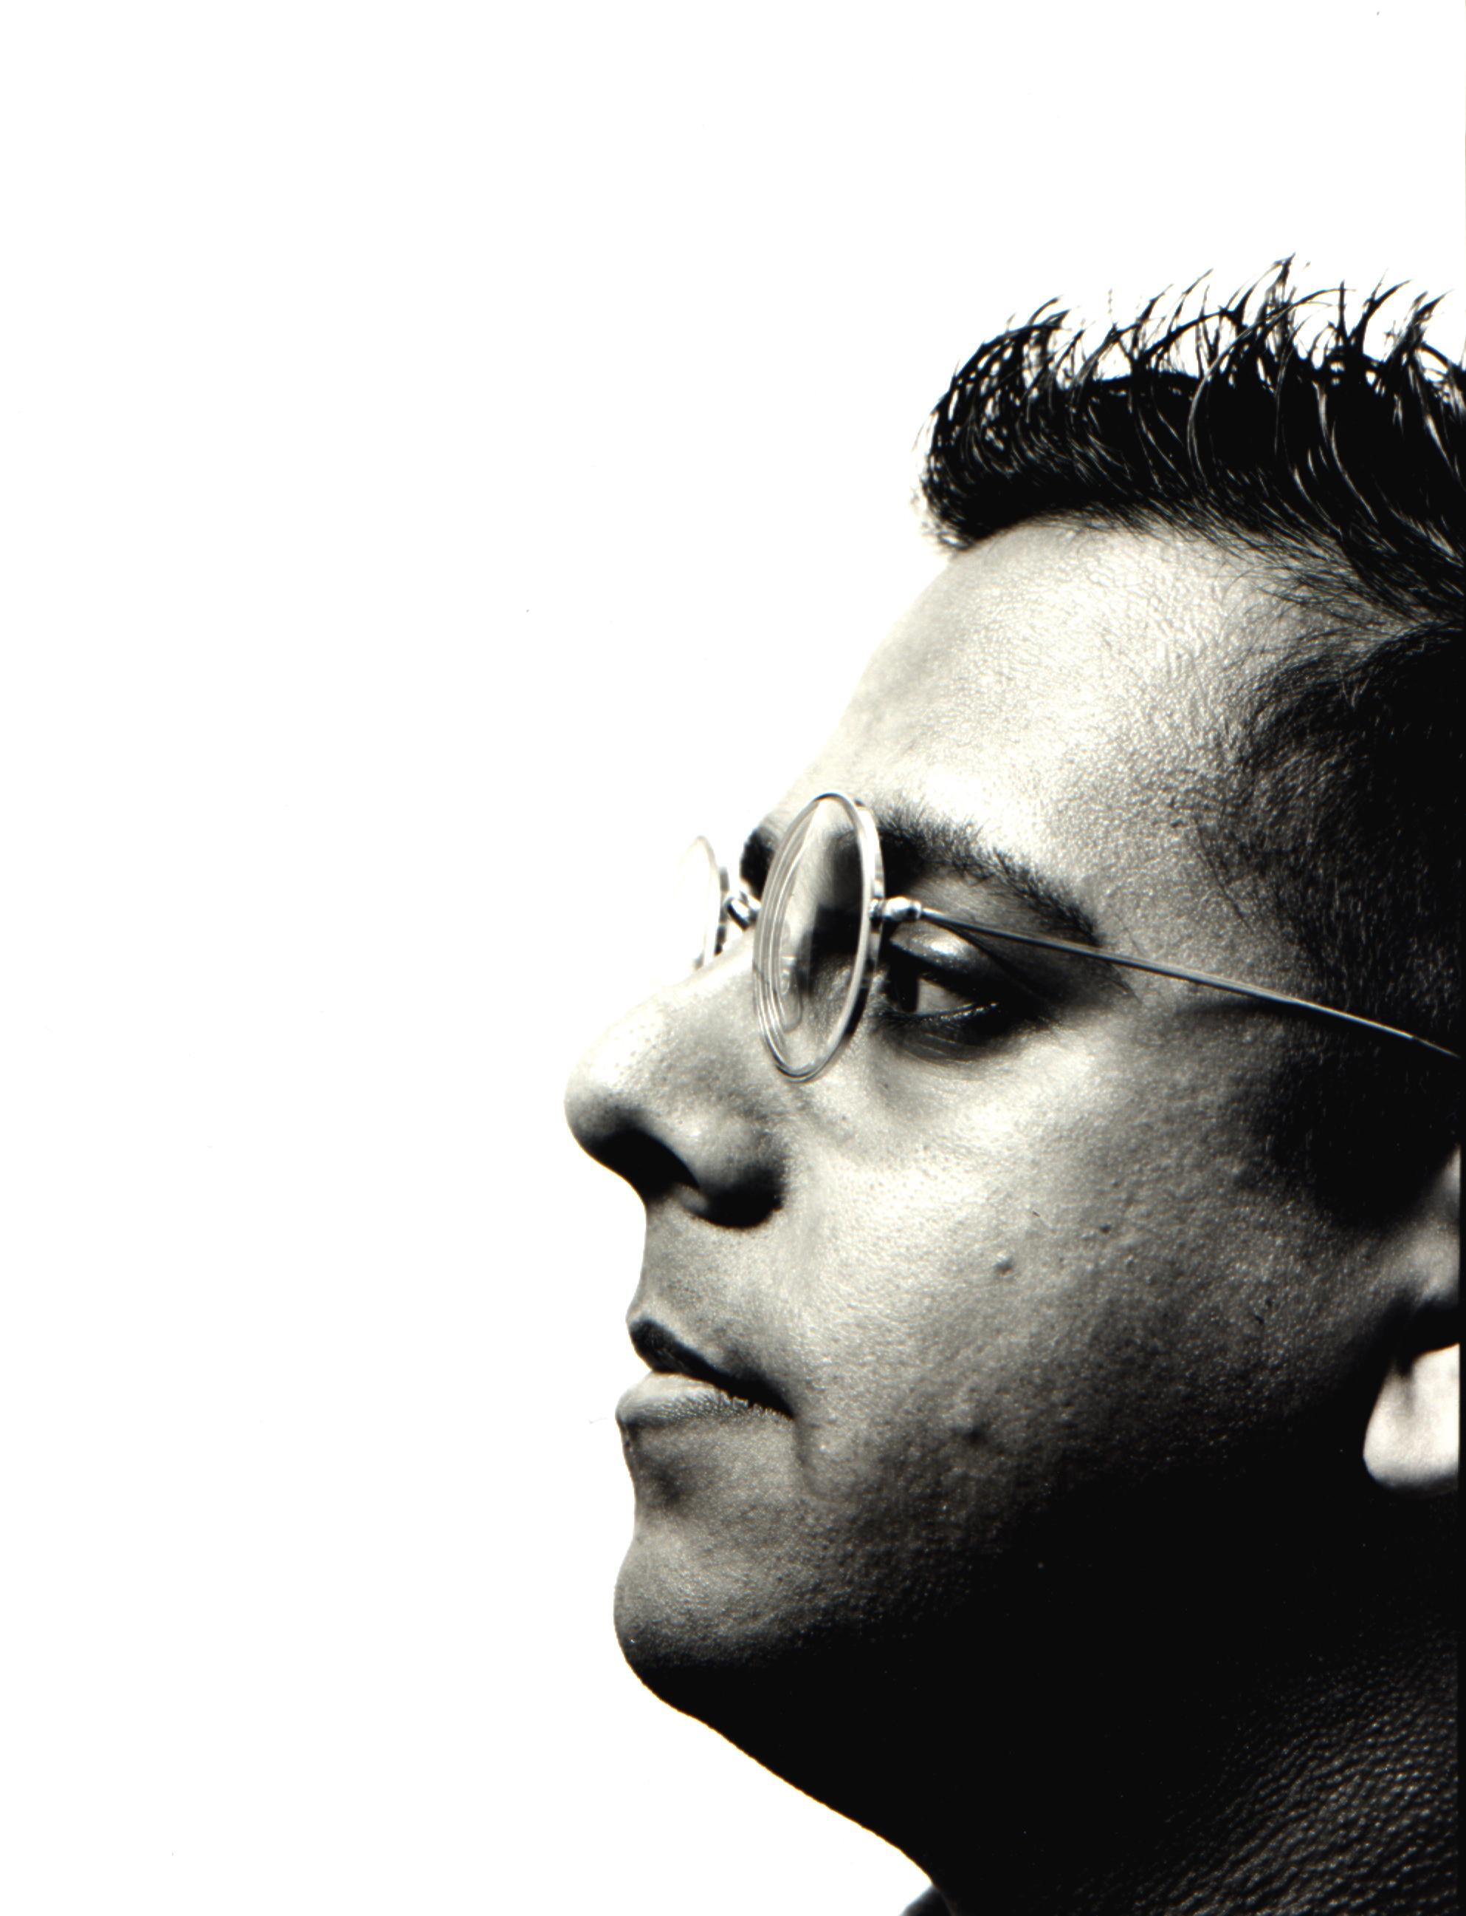
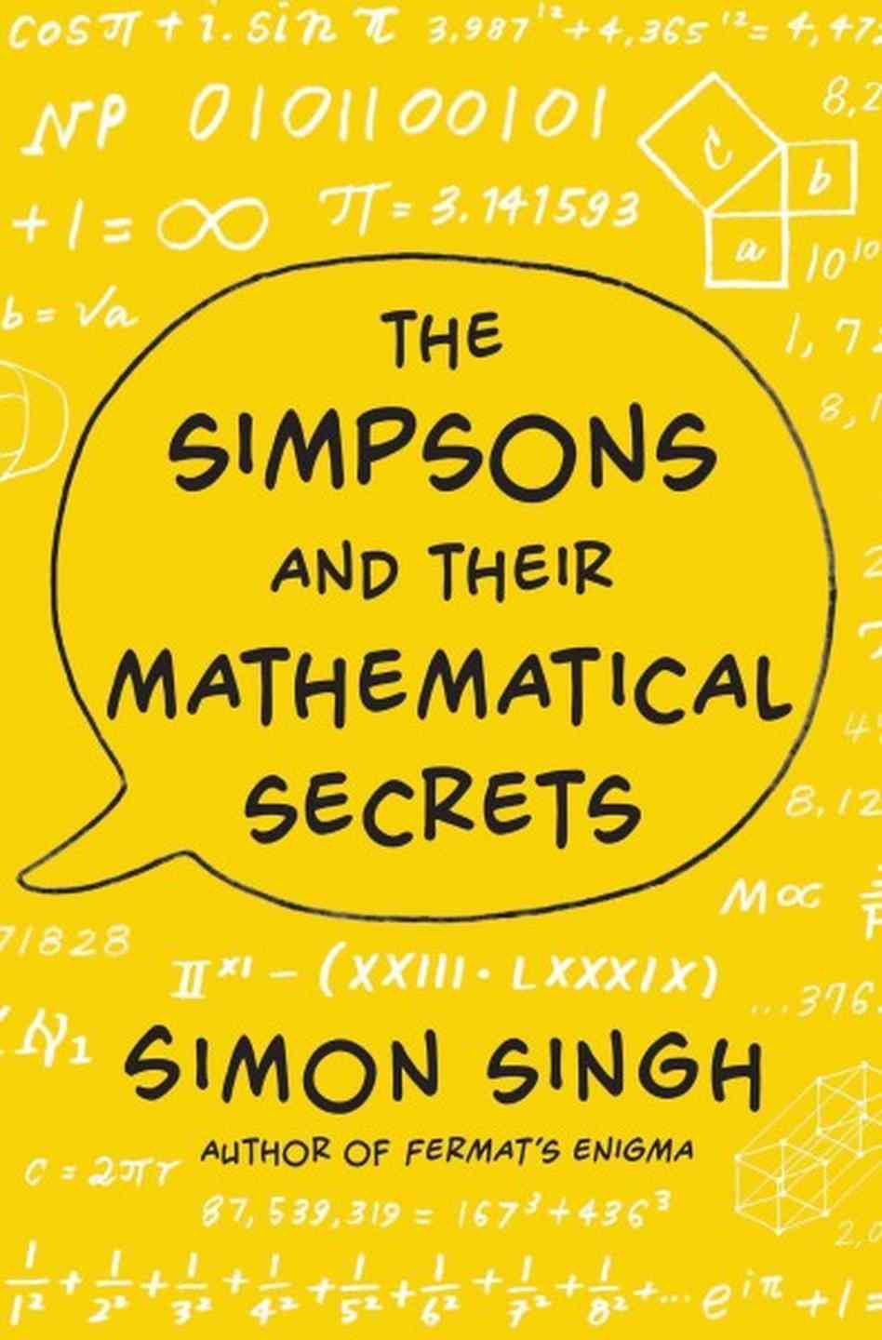

Sophus Lie’s Auditorium
Friday 14. March at 18:15
Simon Singh
The Simpsons and
their Mathematical Secrets
Foto: Nigel Spalding
The Simpsons and their Mathematical Secrets
The brainy new book by the bestselling author of Fermat’s Last Theorem. A must for anyone interested in mathematics, as well as for the millions of Simpsons fans worldwide.
You may have watched hundreds of episodes of The Simpsons (and its sister show, Futurama) without ever realizing that cleverly embedded in many plots are subtle references to mathematics, ranging from well-known equations to cutting-edge theorems and conjectures. That they exist, Simon Singh reveals, underscores the brilliance of the shows’ writers, many of whom have advanced degrees in mathematics in addition to their unparalleled senses of humour.

