Slide 1

SMART PARENTING TECHNOLOGY
Baby Monitor
Project
Intelligent monitoring for peace of mind
Team Name | Course / Institution | 2026

Slide 2
TEAM MEMBERS
Ahd Mohsen
Sara Saria
Reem Mahmoud
Sana Mahmoud
Layan Mohamed
231001691
231010910
231001389
231000371
231002952
Bachelor of Electrical & Computer Engineering
Baby Monitor Project • 2026
2

Slide 3
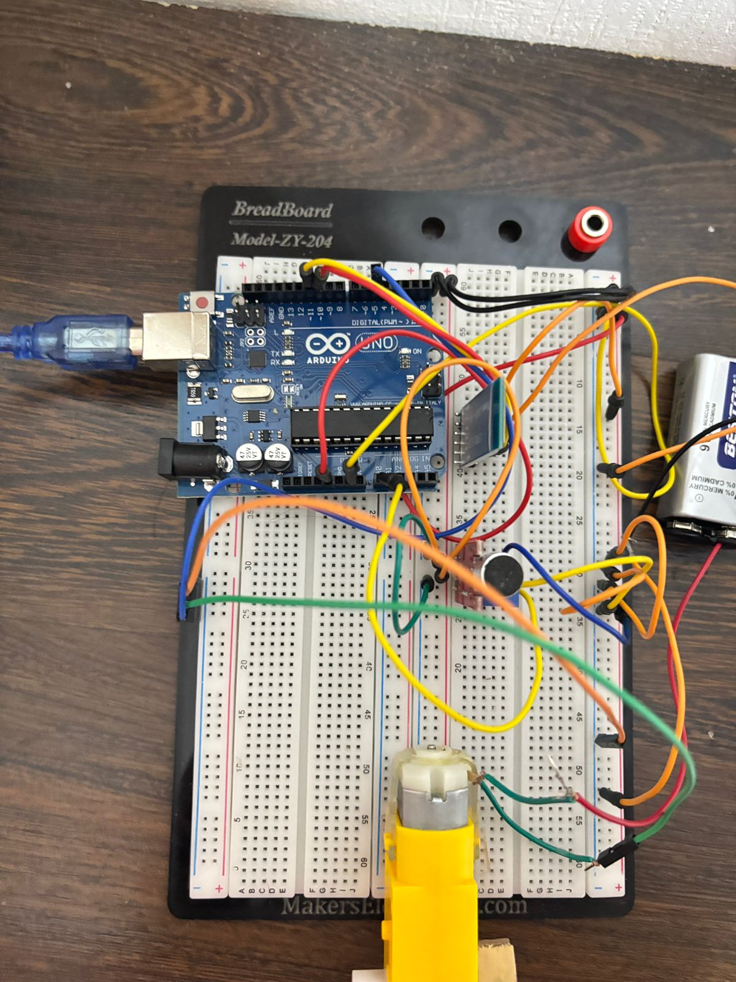
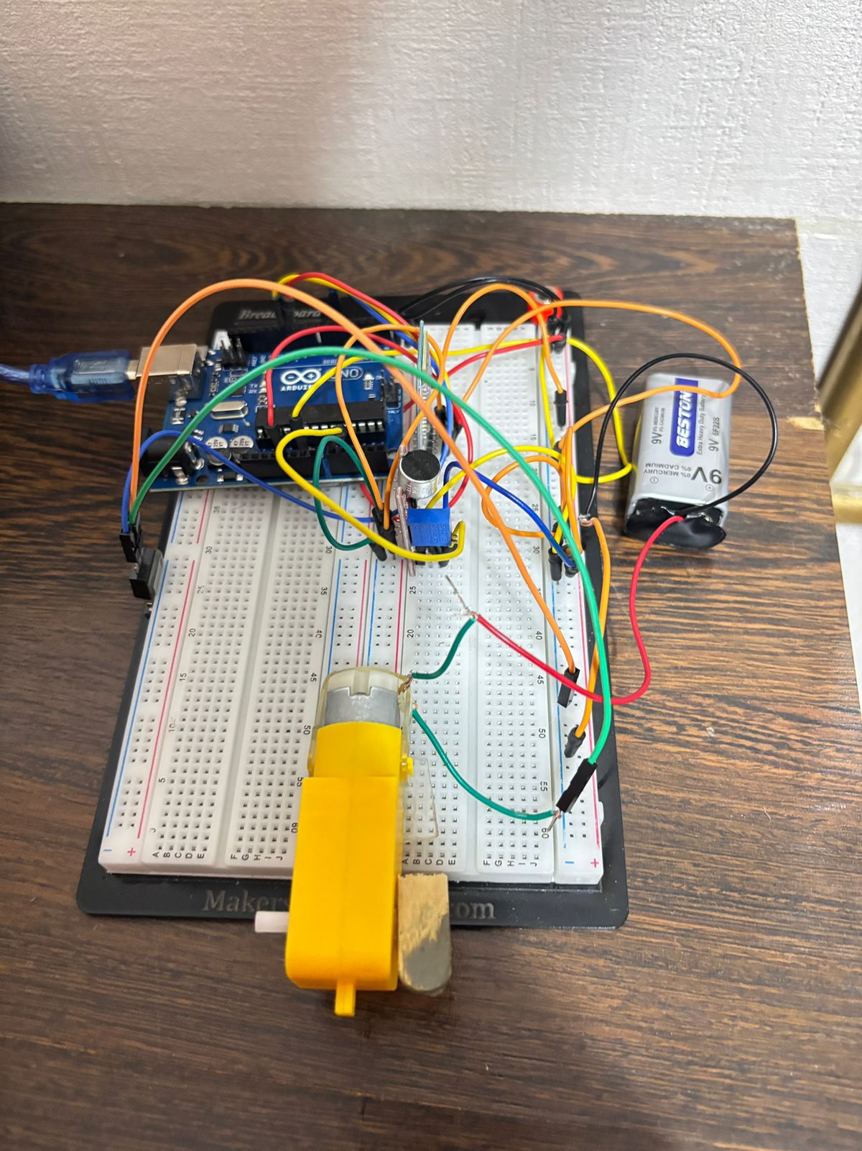

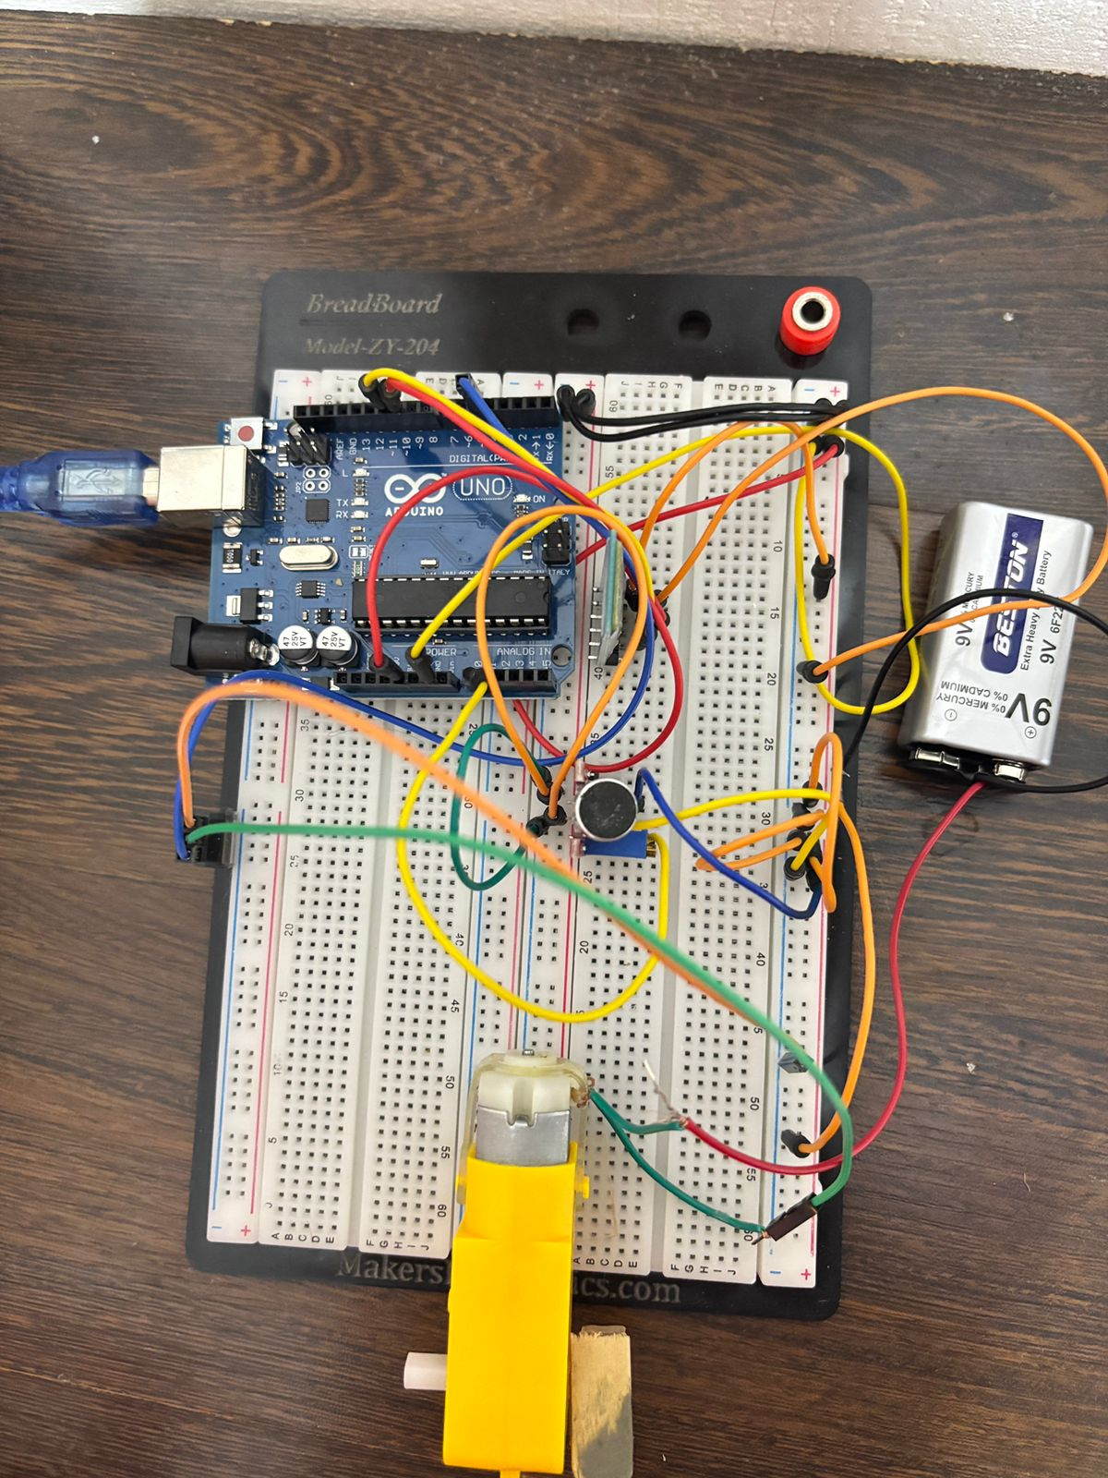
PROJECT PHOTOS
Circuit – Top View
Circuit – Side View
Baby Doll (Test Subject)
Circuit – Clean Build
3

Slide 4
COMPONENTS USED
Arduino Uno
MOSFET IRF Z44N
(N-Channel)
Gear Motor (Yellow)
Sound Sensor
Main microcontroller. Runs the logic, reads sensors, and controls outputs.
Acts as a high-current switch. Gate connected to PWM pin 5 (~5V) to control motor speed. Drain → motor, Source → GND.
High-torque, low-speed DC motor. Opens/closes the baby bed cover based on sound detection.
Analog microphone module. Reads crying/noise via A0. VCC → 5V, GND → GND.
Bluetooth HC-05
9V Battery
Baby Doll & Bed
Jumper Wires
Wireless link to parent's phone. VCC → 5V, GND → GND, TXD → Pin 11, RXD → Pin 10.
Powers the gear motor independently. (+) → motor, (−) → common GND.
Physical demo setup. The doll simulates a baby; the bed has a motorised cover controlled by the circuit.
Connect all components on the breadboard. Colour-coded for clarity.
4

Slide 5
CIRCUIT WIRING & CONNECTIONS
Arduino (Controller)
Sound Sensor (Input)
Bluetooth HC-05
5V → Breadboard positive rail
GND → Breadboard negative rail
A0 → Arduino Analog Pin A0 (reads analog cry signal)
VCC → 5V | GND → GND
VCC → 5V | GND → GND
TXD → Arduino Pin 11 (receives data)
RXD → Arduino Pin 10 (sends data)
MOSFET IRF Z44N
Gear Motor
9V Battery
Gate → PWM Pin 5 (~5V) — controls motor speed
Drain → Gear Motor terminal
Source → GND
Controlled by MOSFET drain
Opens/closes bed cover on cry detection
High torque ensures reliable actuation
(+) → Gear Motor positive terminal
(−) → Common GND
Separate from Arduino 5V rail for motor current
5

Slide 6
SYSTEM ARCHITECTURE
Hardware Unit
Signal Flow
Mobile / Output
Arduino Uno (MCU)
Sound Sensor (A0)
MOSFET IRF Z44N
Gear Motor (DC)
9V Battery
Sound → Analog signal
Arduino processes input
PWM signal to MOSFET
MOSFET switches motor
Bluetooth sends alert
HC-05 Bluetooth
Parent's smartphone
Real-time notifications
Motor opens bed cover
Sound threshold control
6

Slide 7
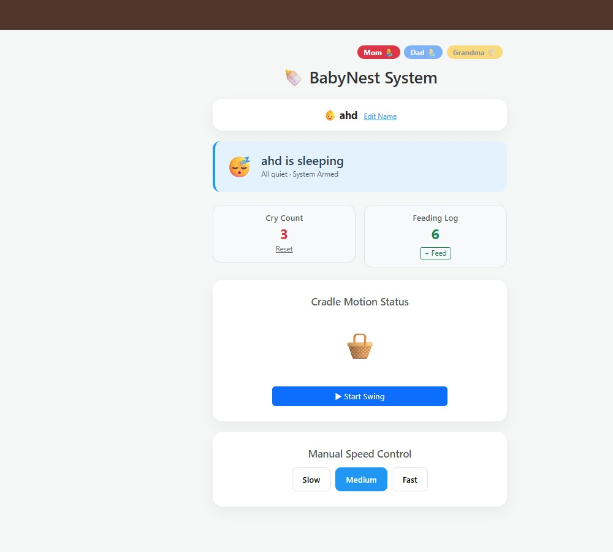

BLYNK PHOTOS
Circuit – Top View
Blynk uses virtual pins as an IoT interface to communicate between the app and the device. The connection is established using an authentication code, similar to a password, which must be known by both the device and Blynk.
Blynk.write() is used to send data from the app to the Arduino, while Blynk.virtualWrite() sends data from the Arduino to the app. The Blynk.run() function keeps the Blynk connection active and allows continuous communication between the device and the app.
Circuit – Side View
3

Slide 8
Thank You
Questions & Discussion Welcome
Ahd • Sara • Reem • Sana • Layan

