Slide 1
The Detection and Classification of Universal Emotions
Austin Dase and Justine Caylor
COSC 602
Team Project 2

Slide 2
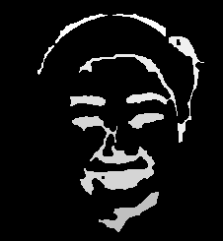
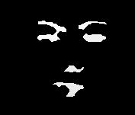
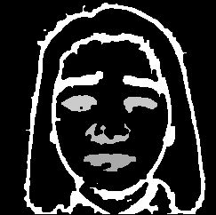
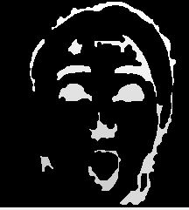
Can you identify the emotion?

Slide 3
HAPPY
ANGRY
SADNESS
SURPRISE

Slide 4
Introduction
There are six universal emotions: happiness, sadness, anger, surprise, disgust, and fear.
Humans have the ability to express emotion in verbal and visual ques.
Because all humans are different, detecting emotion based on static visual images can be difficult.
For our project, our goal is to detect and analyze the most important facial features, and use those features for emotion classification.

Slide 5
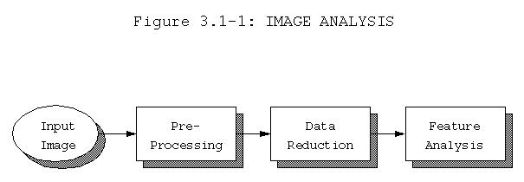
System Flow
Grayscale Images obtained from The Japanese Female Facial Expression (JAFFE) Database[1].
Used images that expressed one of the six universal emotions and omitted ‘neutral’ emotion images.
Removed noise from the images.
Only focused on detecting the expressive parts of the face: eyes, eyebrows, and mouth.
[1] Michael J. Lyons, Shigeru Akemastu, Miyuki Kamachi, Jiro Gyoba.
Coding Facial Expressions with Gabor Wavelets, 3rd IEEE International Conference on Automatic Face and Gesture Recognition, pp. 200-205 (1998).

Slide 6
Feature Extraction Process Flow
Greyscale
( If needed)
Sobel
Dilation (x2)
Erosion
Found 2 Eyes and Mouth or 4 Iterations ?
Mark 8
Chain 8
Area Based Thresholding
Yes
No
Dilation (x1)
Erosion
Final Result

Slide 7
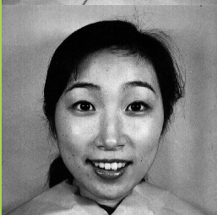
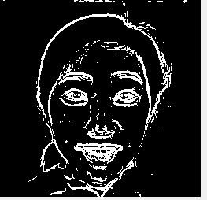
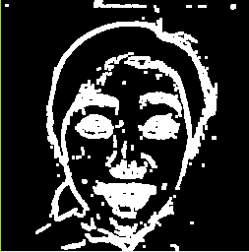

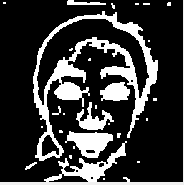
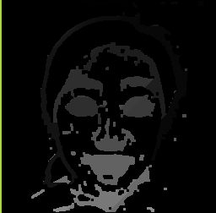
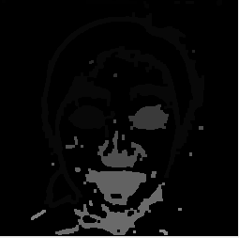
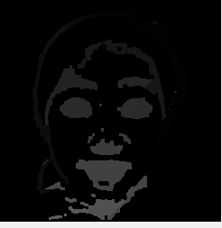


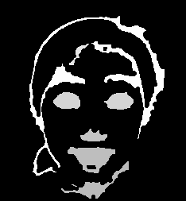
Image Processing Algorithms Used
Tool: Microsoft Visual Studio in C/C++
Original
Sobel Operator
Thresholding
Dilation (x2)
Erosion(x1)
Setting edges to zero for object detection
Mark8 and Chain8
Calculations: Area, Circularity, Perimeter, Diameter, Centroid
Sobel
Dilation
Dilation
Erosion
Mark8
Mark8
Mark8
Mark8
Erosion

Slide 8
Classification Algorithms Used
Tool: MATLAB
Classifiers: happiness, sadness, anger, surprise, disgust, and fear.
Features: Eye 1 Area, Eye 2 Area, Eye 1 Circularity, Eye 2 Circularity, Mouth Area, Distance between Eye 1 and Eyebrow 1, Distance between Eye 2 and Eyebrow 2
Supervised Learning Algorithms: Decision Tree, SVM, kNN, and Linear Discriminant
Dataset was split 70% for training and 30% for testing
10 cross-fold validation method to estimate the performance of the trained model and avoid overfitting

Slide 9
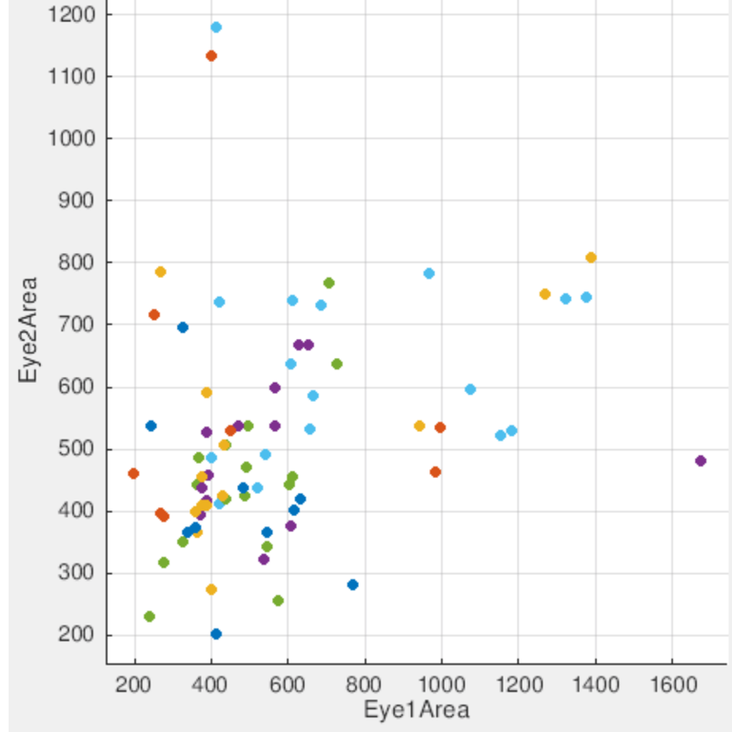
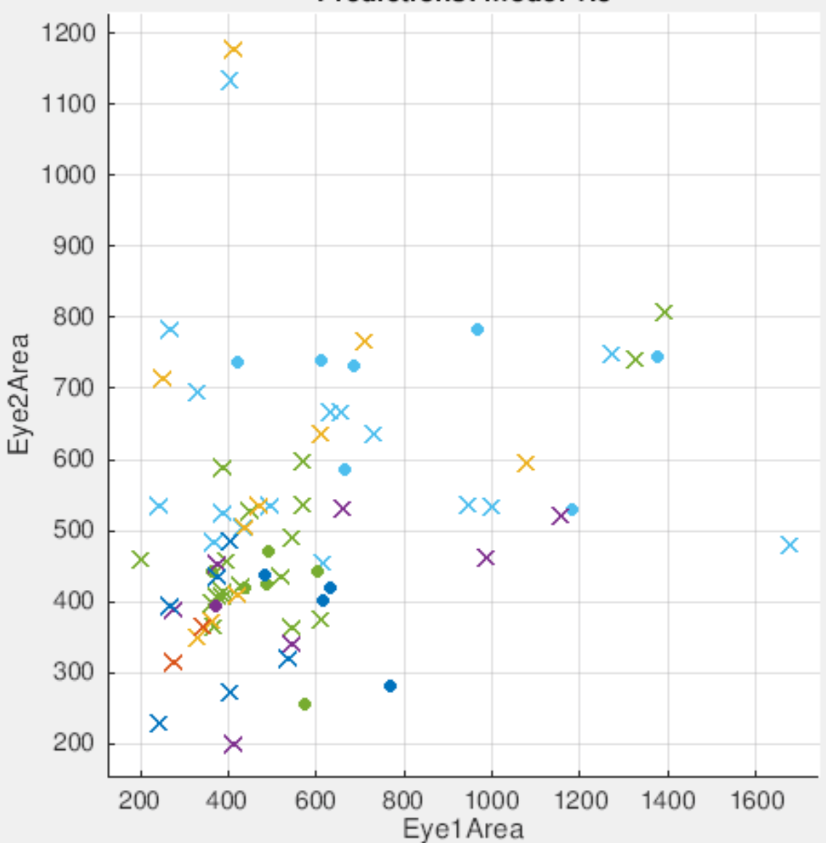
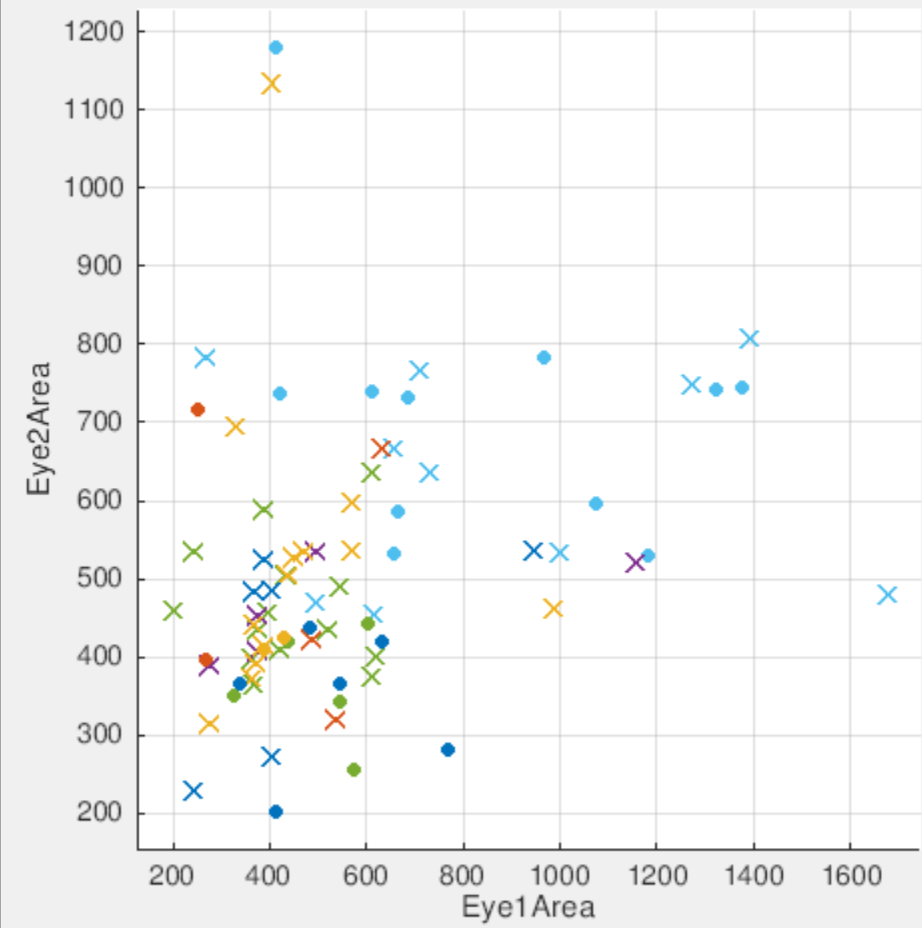
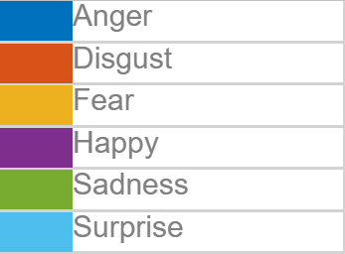
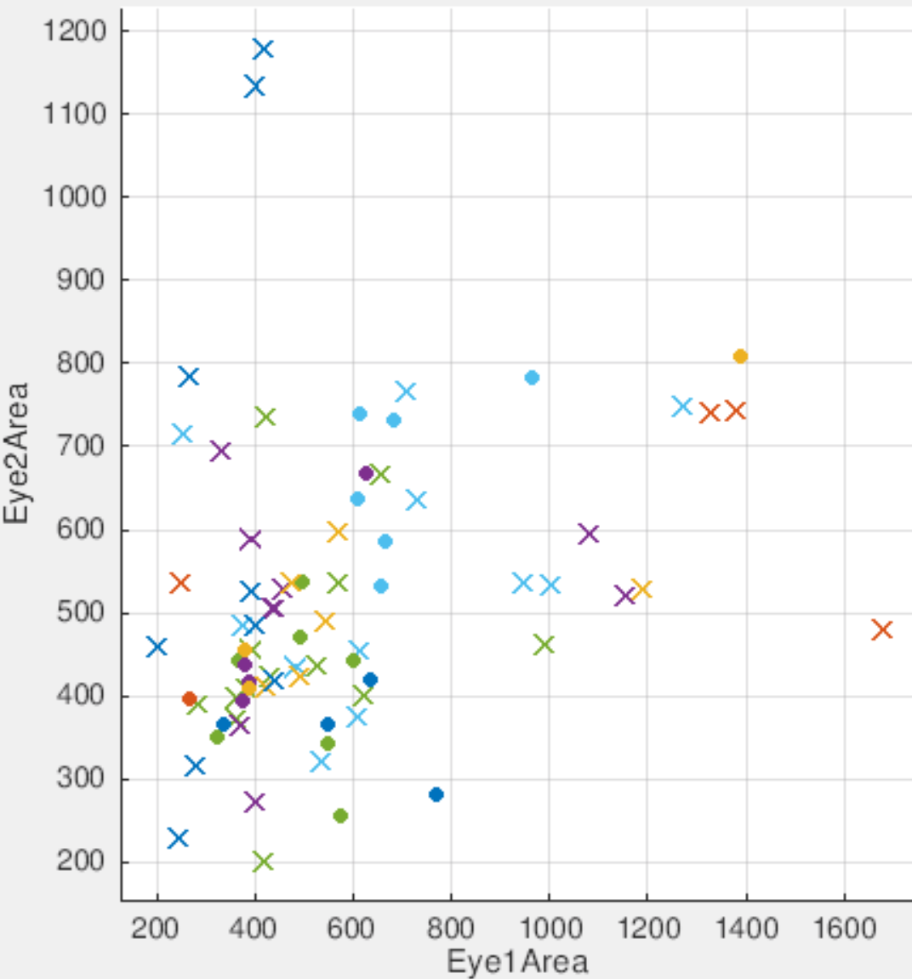
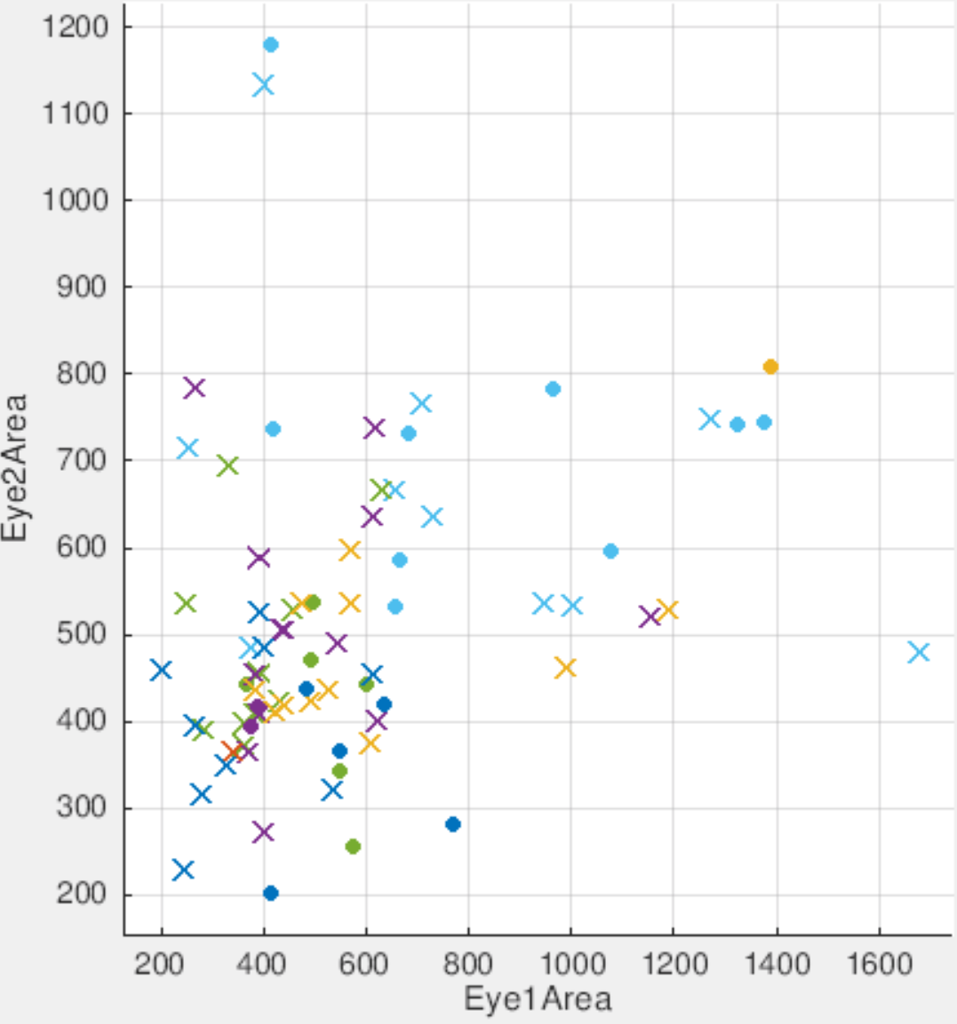
Decision Tree
Linear Discriminant
SVM
KNN

Slide 10
Concluding Remarks
Created a foundation for image processing research in regard to facial feature detection and emotion classification
Have become more familiar with the image processing and classification algorithms and tools
Future works:
Noise reduction filter after applying edge detection
Exploration of other edge detection techniques
Additional logic for feature extraction and calculation

Slide 11
References
[1] Design, S. (n.d.). The Ekmans' Atlas of Emotion. Retrieved from http://atlasofemotions.org/#introduction/
[2] Ekman, P., & Keltner, D. (1970). Universal facial expressions of emotion. California mental health research digest, 8(4), 151-158.
[3] Berdahl, J. L., & Martorana, P. (2006). Effects of power on emotion and expression during a controversial group discussion. European journal of social psychology, 36(4), 497-509.
[4] Chen, L. S., Huang, T. S., Miyasato, T., & Nakatsu, R. (1998, April). Multimodal human emotion/expression recognition. In Automatic Face and Gesture Recognition, 1998. Proceedings. Third IEEE International Conference on (pp. 366-371). IEEE.
[5] Halder, R., Sengupta, S., Pal, A., Ghosh, S., & Kundu, D. (2016). Real Time Facial Emotion Recognition based on Image Processing and Machine Learning. International Journal of Computer Applications, 139(11).
[6] Chow, G., & Li, X. (1993). Towards a system for automatic facial feature detection. Pattern Recognition, 26(12), 1739-1755.
[7] Lyons, M. J., Budynek, J., & Akamatsu, S. (1999). Automatic classification of single facial images. IEEE transactions on pattern analysis and machine intelligence, 21(12), 1357-1362.
[8] Pal, P., Iyer, A. N., & Yantorno, R. E. (2006, May). Emotion detection from infant facial expressions and cries. In Acoustics, Speech and Signal Processing, 2006. ICASSP 2006 Proceedings. 2006 IEEE International Conference on (Vol. 2, pp. II-II). IEEE.
[9] http://www.kasrl.org/jaffe.html
[10] S. Ioannou, G. Caridakis, K. Karpouzis, and S. Kollias, “Robust feature detection for facial expression recognition,” Eurasip J. Image Video Process., vol. 2007, no. May 2014, 2007.
[11]Scott E Umbaugh, Digital image processing and analysis: human and computer vision applications with CVIPtools. CRC press, 2010.

