Slide 1
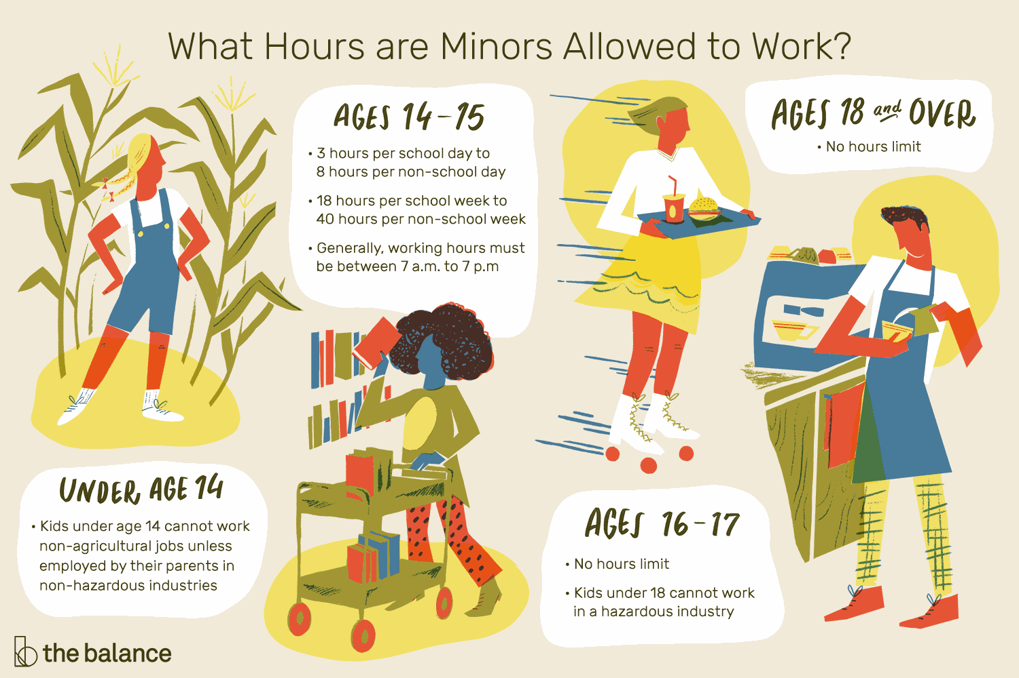
by: Ahmed Omar Zein
Why people work in young ages
Why people work in young ages
People may work in young ages because they want to learn more about earning money, communication skills. Also they can learn management skills, getting idea about there future career, what do they like and don’t like to do. They can build self confidence they can feel responsibility and develop new skills, but there is a law that say people under 18 should not work.

Slide 2
By: Ahmed Omar Zein
Bad reasons for people working in young ages
Some people may work in young ages because that there mom and dad can’t get enough money to live and this is a bad thing but this is the curse . Because any one under age of 18 should not work to earn money but he can work for fun and learning skills. But in developing countries work for earning money to help there family.

