Slide 1

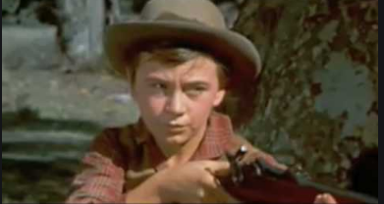
One difference between Travis and Peak
Travis and Peak have lots of different character treats between each other even the similar treats are less than the different ones. One character treat in Travis is that he is reasonable and so responsible and, that is shown in all of the story Travis was responsible of his home and farm. However Peak character treats is that he is risky and impulsive and, that is shown when peak was arrested he said that he ‘’climbed six sky scrapers and he planed for nine!’’.
Ahmed Omar Zein 6f 84words slide 4

