Slide 1



Building Generative AI With .NET & C#
Ahmed HEDFI
.NET Technical Architect – TESSAN GROUP

Slide 2
AI TYPES
AI
Machine Learning
Deep Learning
Generative AI

Slide 3
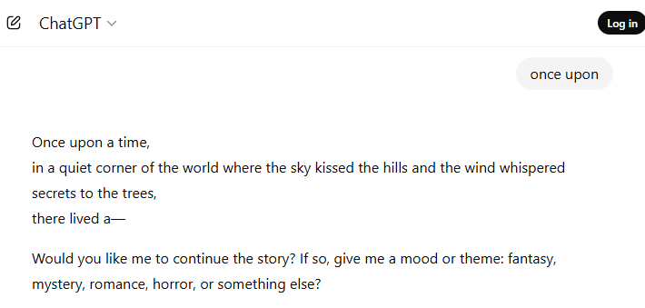



HOW LLMs WORK
LLM

Slide 4

Online Models

Slide 5


Offline Models

Slide 6
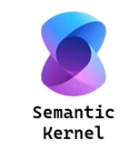
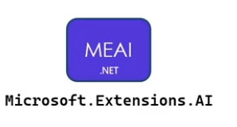
C# AI FRAMEWORKS

Slide 7

CHAT COMPLETION
Request
LLM
Response
Prompt Engineering
Temperature / Reasoning Effort
Structured Output

Slide 8
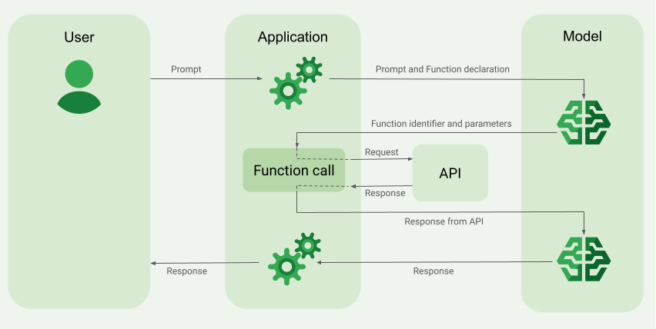
FUNCTION CALLING

Slide 9
MODEL CONTEXT PROTOCOL (MCP)
MCP Client
MCP SERVER
Tool 1
Protocol
Tool 2
LLM
Tool n

Slide 10

SCAN ME

