Slide 1
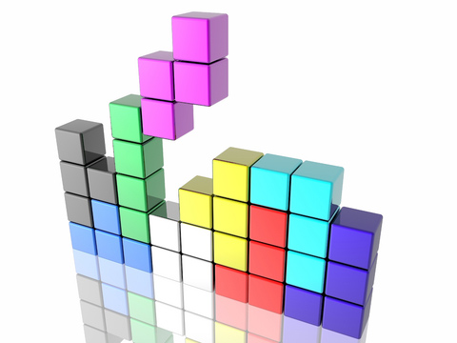
TETRIS 3D
Creation of a 3D Tetris Game

Slide 2
Context
Mr Loudni wants a Tetris game, but with 3D fonctions
Must be realized using Java end Jmonkey Engine
Might be used on Android platforms

Slide 3

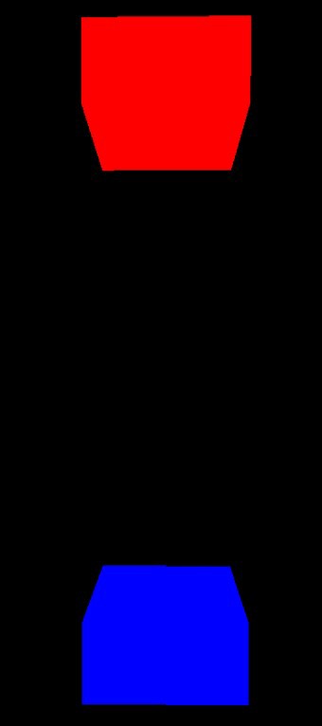
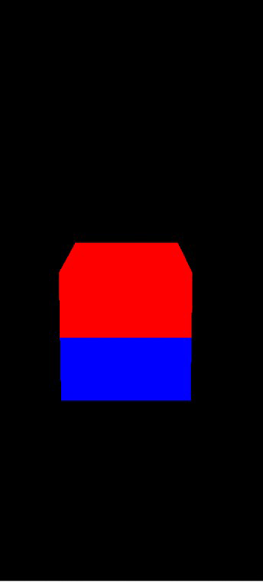
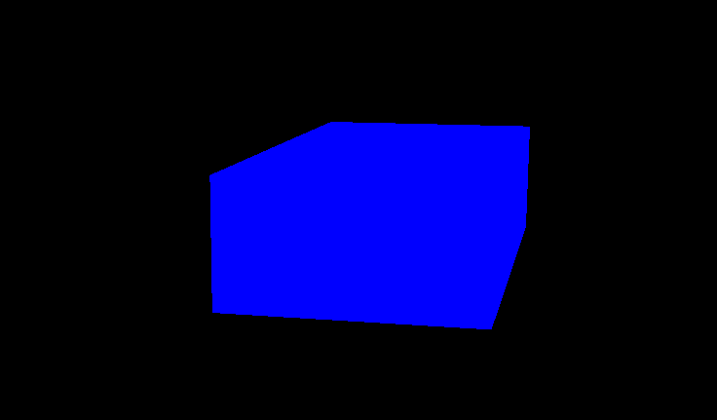
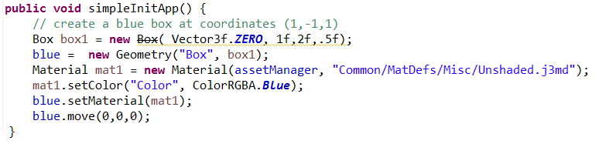

Slide 4
Enjeux
Master Jmonkey Engine and Blender to conceive, integrate and manipulate Tetris Game’pieces in the game environment.
Build a game engine able to handle the best a Tetris game’progress.

Slide 5
Objectives
Build a software that permit to play Tetris, and to add a new game possibility by implementing 3D gameplay
Be sure that the player can see all the game space by conceiving a moving camera with changing point of view

