Slide 1
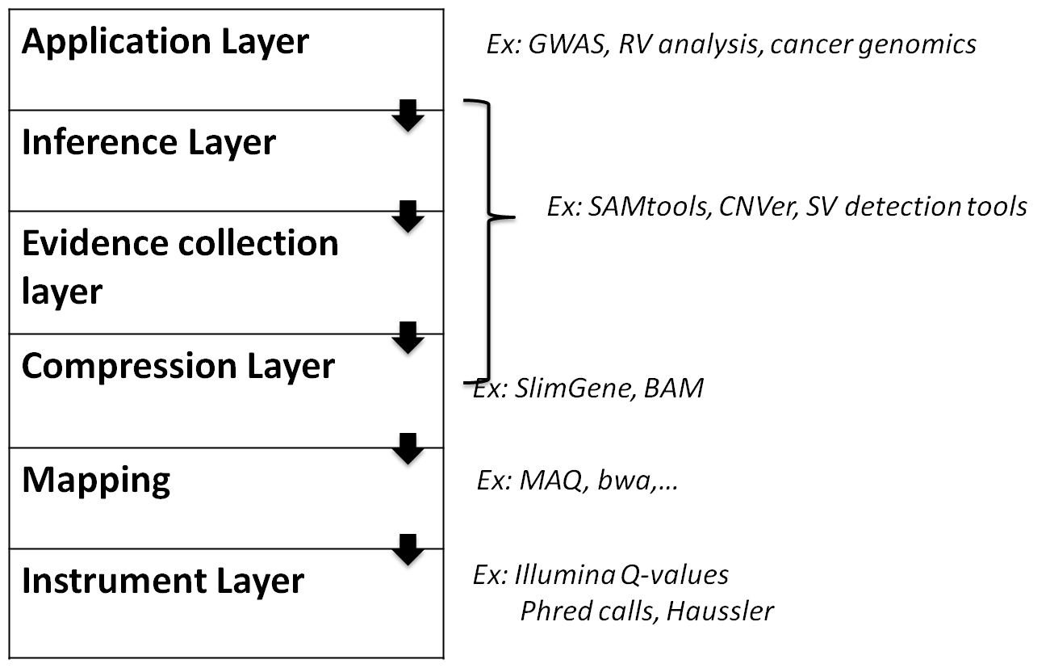
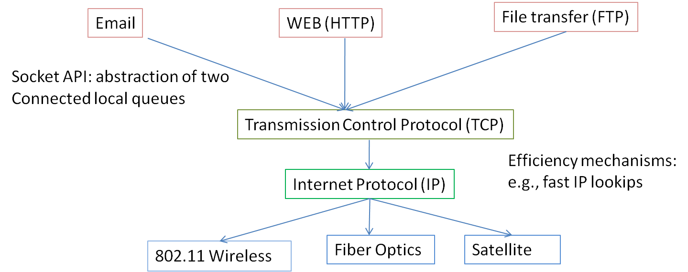
Genomic Databases
Christos Kozanitis (student) Vineet Bafna(PI) George Varghese(PI)
Computer Science and Engineering
Logo
Logo
Background
Biological Processing
The Current State of the Art
Implementation of MapTo
With dropping sequencing costs, in the future every person will have their full DNA as part of their medical record
At around 250 Gbytes per person, this repository will be a vast genomic database that can be exploited to allow personalized health care.
Sample clinical query: For gene X that is linked to cancer, is it likely that the patient has some portion of its gene (region of DNA) either changed, inserted, or deleted?
We argue that standard relational databases do not meet this need.
Instead, we present our initial ideas for the abstractions that are required for a genomic database
With dropping sequencing costs, storing and processing are new bottlenecks (time & cost)
Storage in cloud or cluster (250 Gb per seq)
Compressed Genomes using our new proposal SlimGene
Latency for ad hoc programming (months?)
New Datbase APIs to reduce programming to scripting?
CPU Costs (more than sequencing?)
Efficient indices in Databse Layer to reduce CPU cycles
Currently, layering is not explicit.
Software blocks encompass multiple layers.
There is some movement toward layering
Ex: Haussler’s proposal seeks to separate mapping and instrumentation layers
Mapping algorithms would work on fragments with a single, instrument independent error model.
SAMtools separate mapping from higher layers
Our proposal: separate inference layer from evidence collection layer.
Create an index
Upon a query move disks accordingly
Results
Input: A sorted file of size 5.6GB
Time elapsed to fetch a range towards the end of the file: 84 sec
Time that MapTo uses: 0.2 sec
Lessons from Complex Systems
Our Layering
Why not relational databases?
A good way to build complex software is to do so in layers.
Each layer should provide a higher level abstraction to layer above (good APIs)
Attention must be paid to efficiency mechanism or folks will work around layers
What should the layering for genomic processing be? The APIs? The Mechanisms?
Most work in inference from gene sequencing requires probabilistic inference not well supported by databases
Biological abstractions are more closely modeled by intervals on a reference line than by tables
There are unique biological features (e.g., haplotyping) that seem to require different data structures than what are common in databases
Biological databases have to deal with errors (e.q, sequencung errors and mappiing errors)
Proposed API
An analogy: Networking
Partner
Given a sub-read or a read as input, identify all of the sub reads that come from the same read
BestMap
The input is a collection of reads and sub-reads. The output is the location of the optimal mapping of the sub-reads , along with an encoding of the alignment
AllMaps
The input is a collection of reads and sub-reads. The output is the set of multiple locations where the sub-reads match up, along with an encoding of the alignments.
MapsTo
The input is a collection of intervals I. The output is a collection of all reads that whose bestmap alignments intersect with I.
Coverage
The input is a collection of intervals I. The output is the number of reads in MapsTo (Derived from MapsTo).
HaploGraph
The input is a collection of locations S corresponding to known SNVs. The output is a graph G(S,ES), where each edge (u, v) ∈ ES is labeled with reads whose sub-reads span both u and v. An edge exists only of the corresponding set of reads is non-empty.

