Slide 1
Source
Build
Test
Deploy
Measure
git push
compile
smoke
staging
monitor
docker build
unit
alarm
QA
integration
production
PRODUCTION FEEDBACK

Slide 2
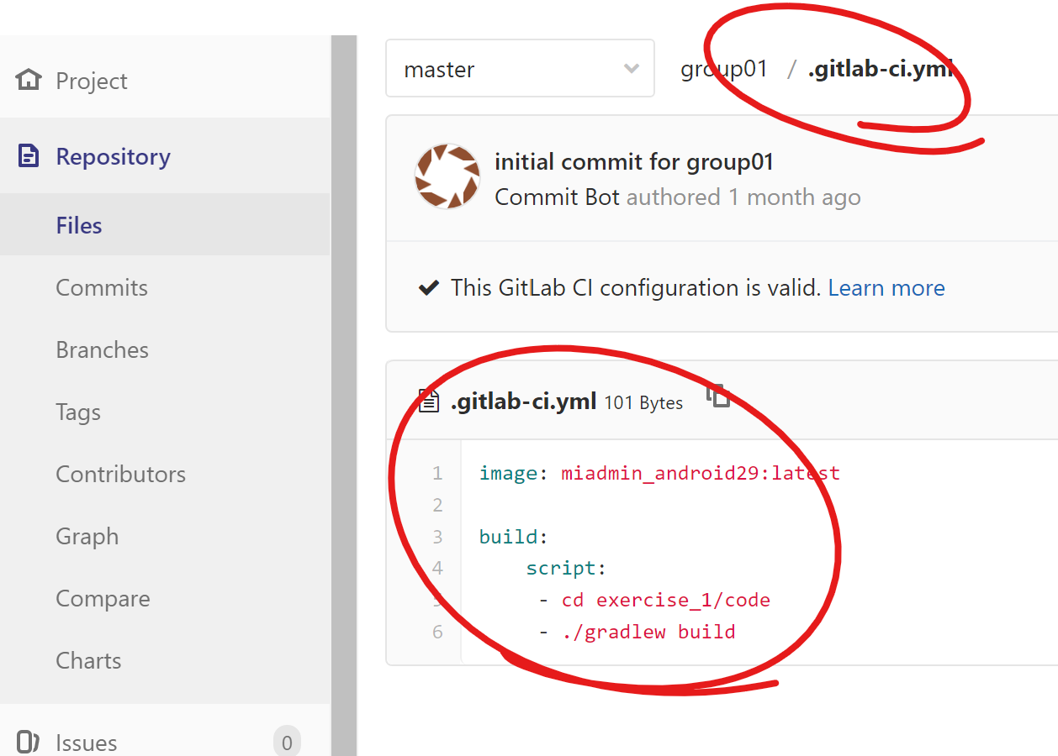

Slide 3
Continuous Integration
Build
Unittest
Codeanalyse
Artifactory
Webpage
Buildumgebung
5
Binär
Repository
1
Versions
Kontrolle
CI
Server
Subversion
Git
4
Statische
Codeanayse
Metrics
findBugs
Checkstyle
Sonar
NDepend
2
3
Junit
Emma
JaJCoCo
NUnit
Maven
Gradle
MSBuild
Build
Tool
UT
Testrunner

Slide 4

Buildumgebung
Continuous Integration
Build
Unittest
Codeanalyse
Automatisches Deployment
Testumgebung
Continuous Delivery
Build
Unittest
Codeanalyse
UI-Test
Systemtest
Operation
Manuelles Deployment
Continuous Deployment
Build
Unittest
Codeanalyse
UI-Test
Systemtest
Operation
Produktivumgebung

