Slide 1
Recommendations
Websites collect data about you all the time.
Many websites use this data to make recommendations for you
  Google ads focused on your email contents
  Facebooks ads focused on your claimed likes/dislikes
  Amazon suggestions based on other people’s past purchases
  Netflix suggestions based on your movie ratings and other people who watched similar movies

Slide 2
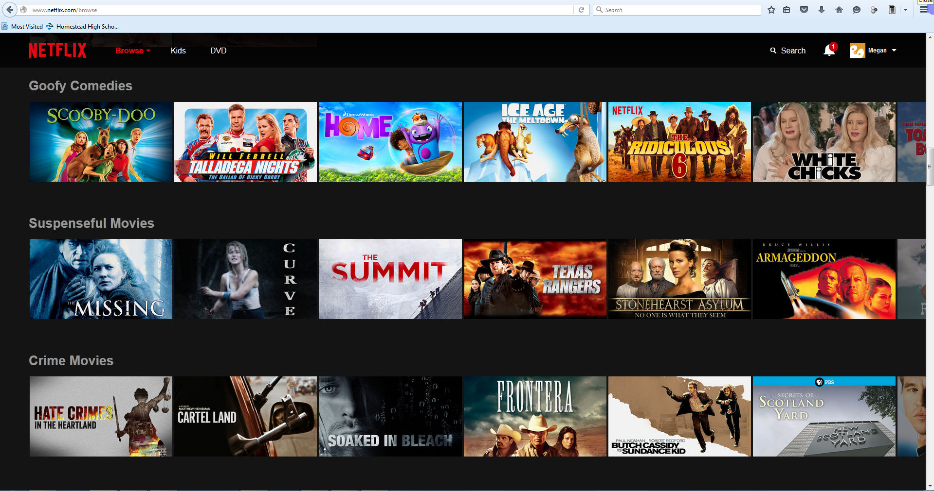

Slide 3
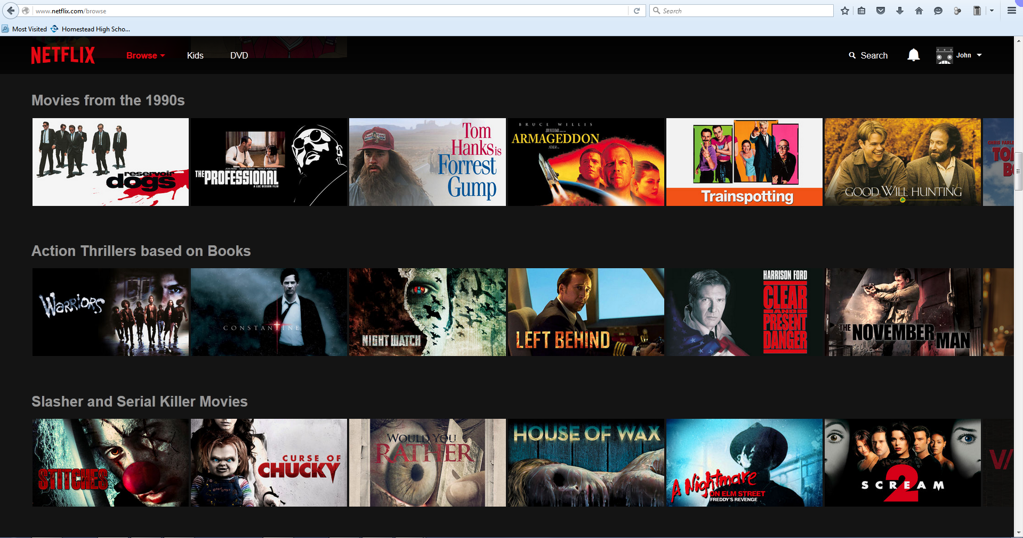

Slide 4
Lab: NetflixPrize
You will be given a large dataset – the MovieLens Recommendation set. This is a set of files containing 100,000 movie ratings from 1,000 different users of movielens.org
Your goal:
Predict a user’s rating of a movie that they have not seen yet.

Slide 5
Reading Complex Data
The first step of this process is just to read in the data so that it can be used by your program. To do this, you will need to design some classes representing things in this problem set.
To do:
  Create a new Eclipse project.
  Add at least 3 classes to this project. These should be real world things that exist in the data.
  Give your classes fields representing available and applicable data.

Slide 6
Reading Complex Data
Now, let's just make sure we're able to read from the file.
To do:
  Steal FileIO code from Squeeze.
  Create a main method to test reading lines from the file.
  Print out all of the lines on the command line.

Slide 7
Reading Complex Data
Once a class structure is in place, and we can read lines from the file, we are ready to translate from one format into the other.
To do:
  Create a new class. The job of this class is to translate Strings into database objects.
  Pass each of the lines from the file into this class, then add database objects to an ArrayList.
  Test by reading in, then printing data for just one user.

Slide 8
Lab: NetflixPrize
Predict a user’s rating of a movie that they have not seen yet.
Requirements:
  getRating and guessRating methods that fit the given javadoc comments
  Runtime for a length 10,000 test file is less than 2 minutes
  Average difference between your prediction and actual for test data is less than 1 star
  All code is authored by you (no outside libraries)
If you fit this, you are eligible for…
  The Contest
  The top 6 predictors will receive accolades and prizes.

Slide 9
Lab: NetflixPrize - Submitting
Please be sure that:
  You did not modify existing method headers in NetflixPredictor.java
  The NetflixPredictor class remains package-less
  You must be able to customize the ratings file that is loaded by passing a full path into the constructor
  (ratingsFile could be similar to “C:\temp\newu.data”)
Now, run NetflixTester with all 5 numbered u.base/u.test files. Copy/Paste the result of all tests into a text file. Save this file in the base folder of your project.
Finally, Submit on SchoolLoop!

