Slide 1
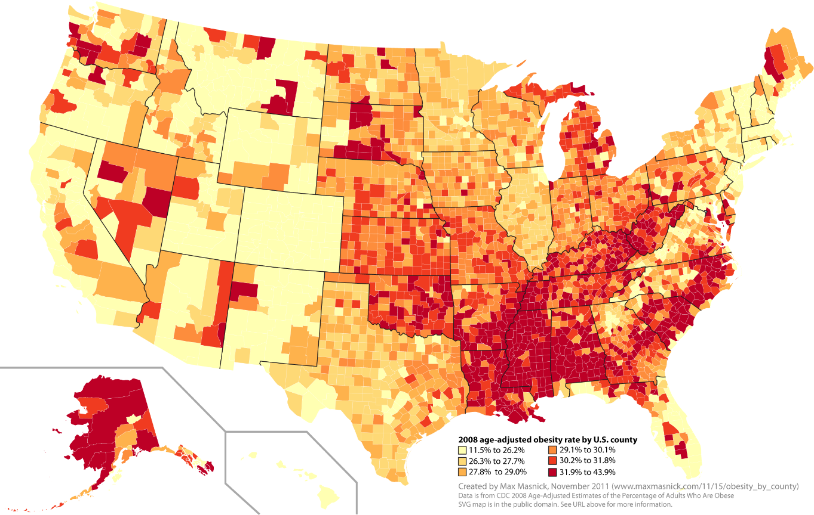
Predicting Obesity in the United States
Aaron Hellman
General Assembly
Data Science Fall 2015

Slide 2
Data Sets
Obesity Rates in the USA
Broken down by County
For the Years 2004 - 2012
Farmers Market Locations in the USA
Name, location (including County)
Current Results (Updated Dec 18 2015)
Food Security Factors in the USA
All data is for 2007 or 2012 or the change over the 5 year period.
Several food security factors including:
Grocery, supercenter, fast food Stores per 1000 people per county
Grocery Store Access
School Lunch Program participants
Food insecurity
Expenditures per capita on fast food
SNAP (food stamps) participation and applicants
Many more
Most Results are for 2007, 2010, 2012

Slide 3
Data Manipulation
Obesity Rates in the USA
Data is good, didn’t need much changes
Farmers Market Locations in the USA
Did not have the normal FID which is the County designation Key, so had to create a County/State Key to join on the Obesity Rates table
Food Security Factors in the USA
All data is mostly clean, but the variables are all stored on a separate sheet
Column headers are impossible to know without the key so had to reference that often to understand what data I was using

Slide 4
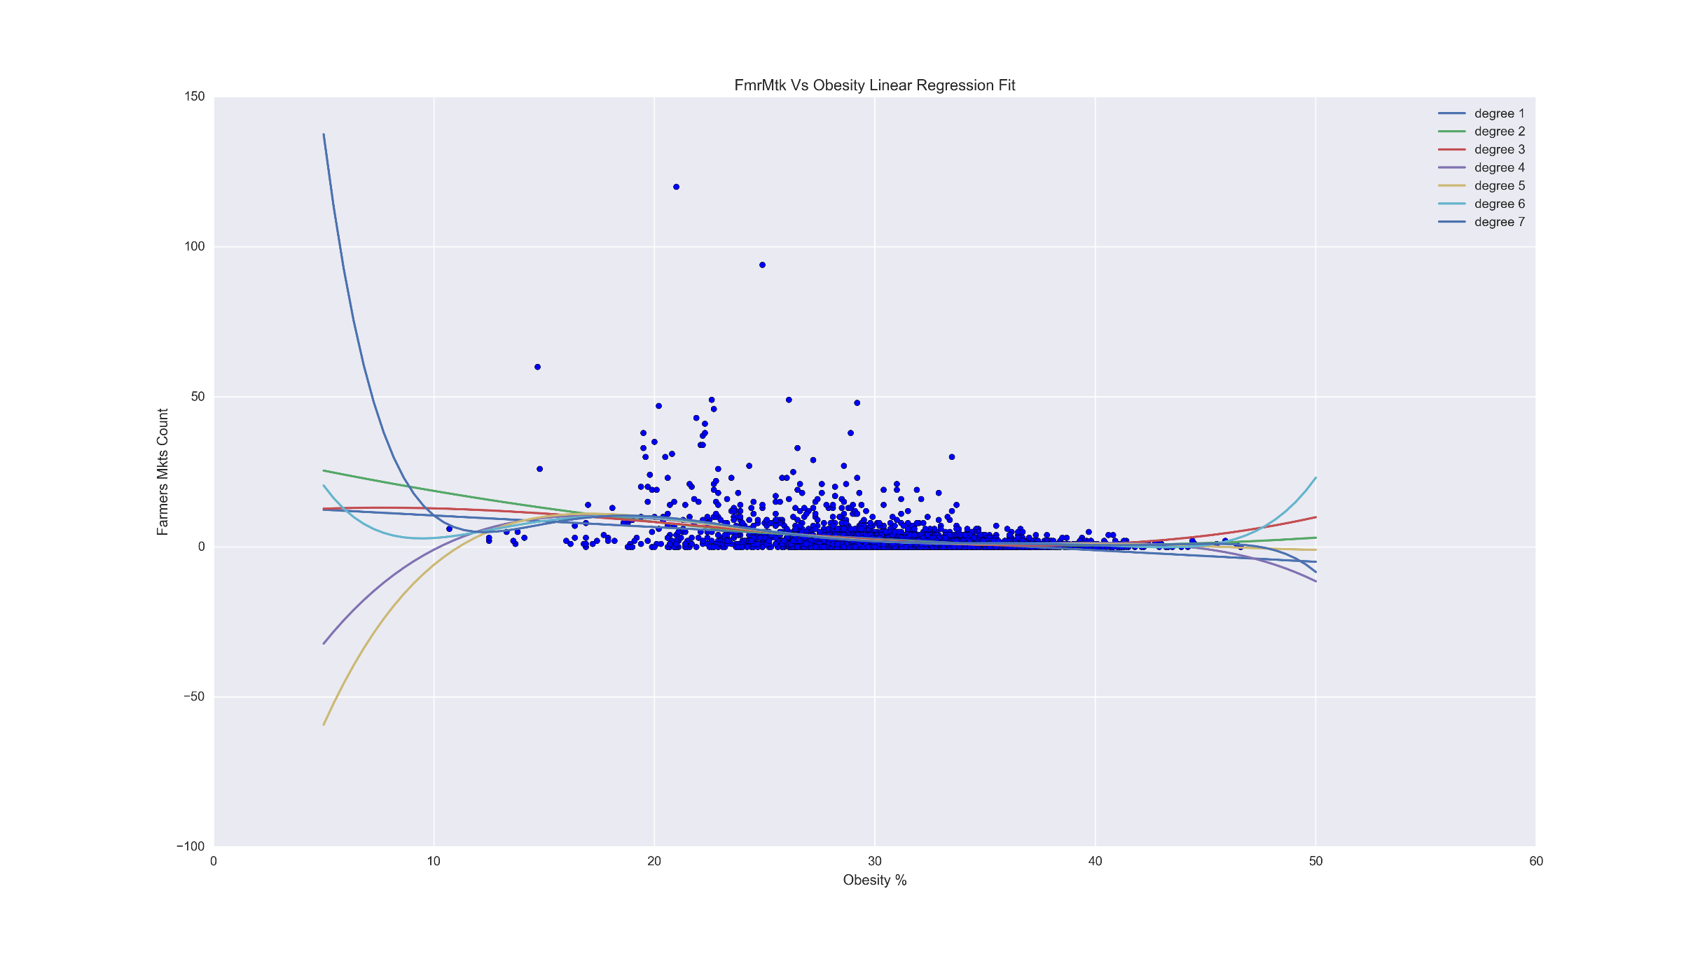
Farmers Markets Per County Vs Obesity Rate Linear Regression
Regression Score
Degree:
1: 0.10600412271158455
2: 0.12509365362261404
3: 0.12847462177258184
4: 0.13910968034817917
5: 0.14001867548716207
6: 0.14176995710180251
7: 0.14274707651026963
Conclusion: Not a very good predictor for Obesity Rates per county

Slide 5
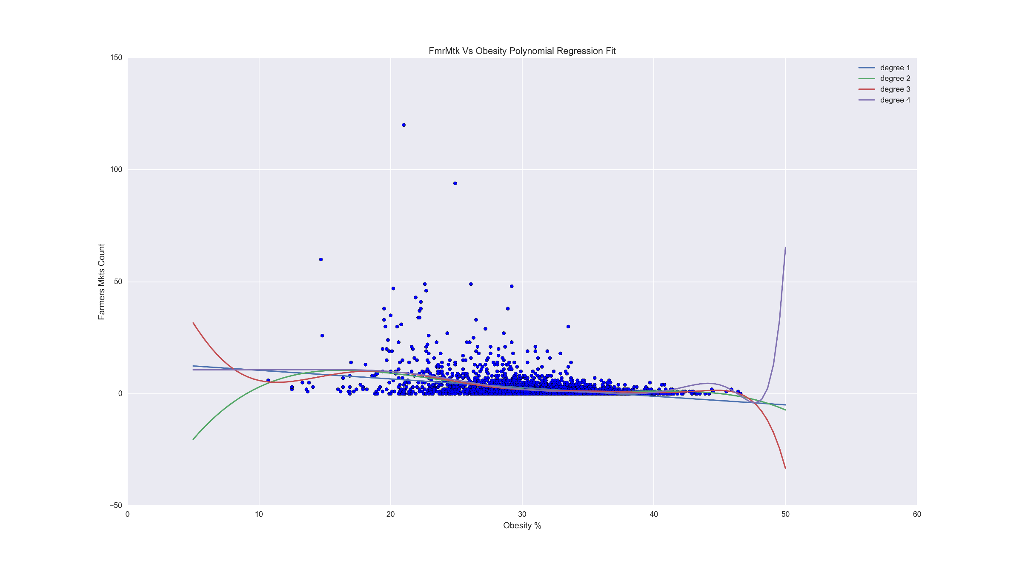
Farmers Markets Per County Vs Obesity Rate Polynomial Regression
Regression Score
Degree:
1: 0.10600412268453729
2: 0.13850319902920927
3: 0.14288862711952732
4: 0.13268373247497089
Conclusion: Not a very good predictor for Obesity Rates per county

Slide 6
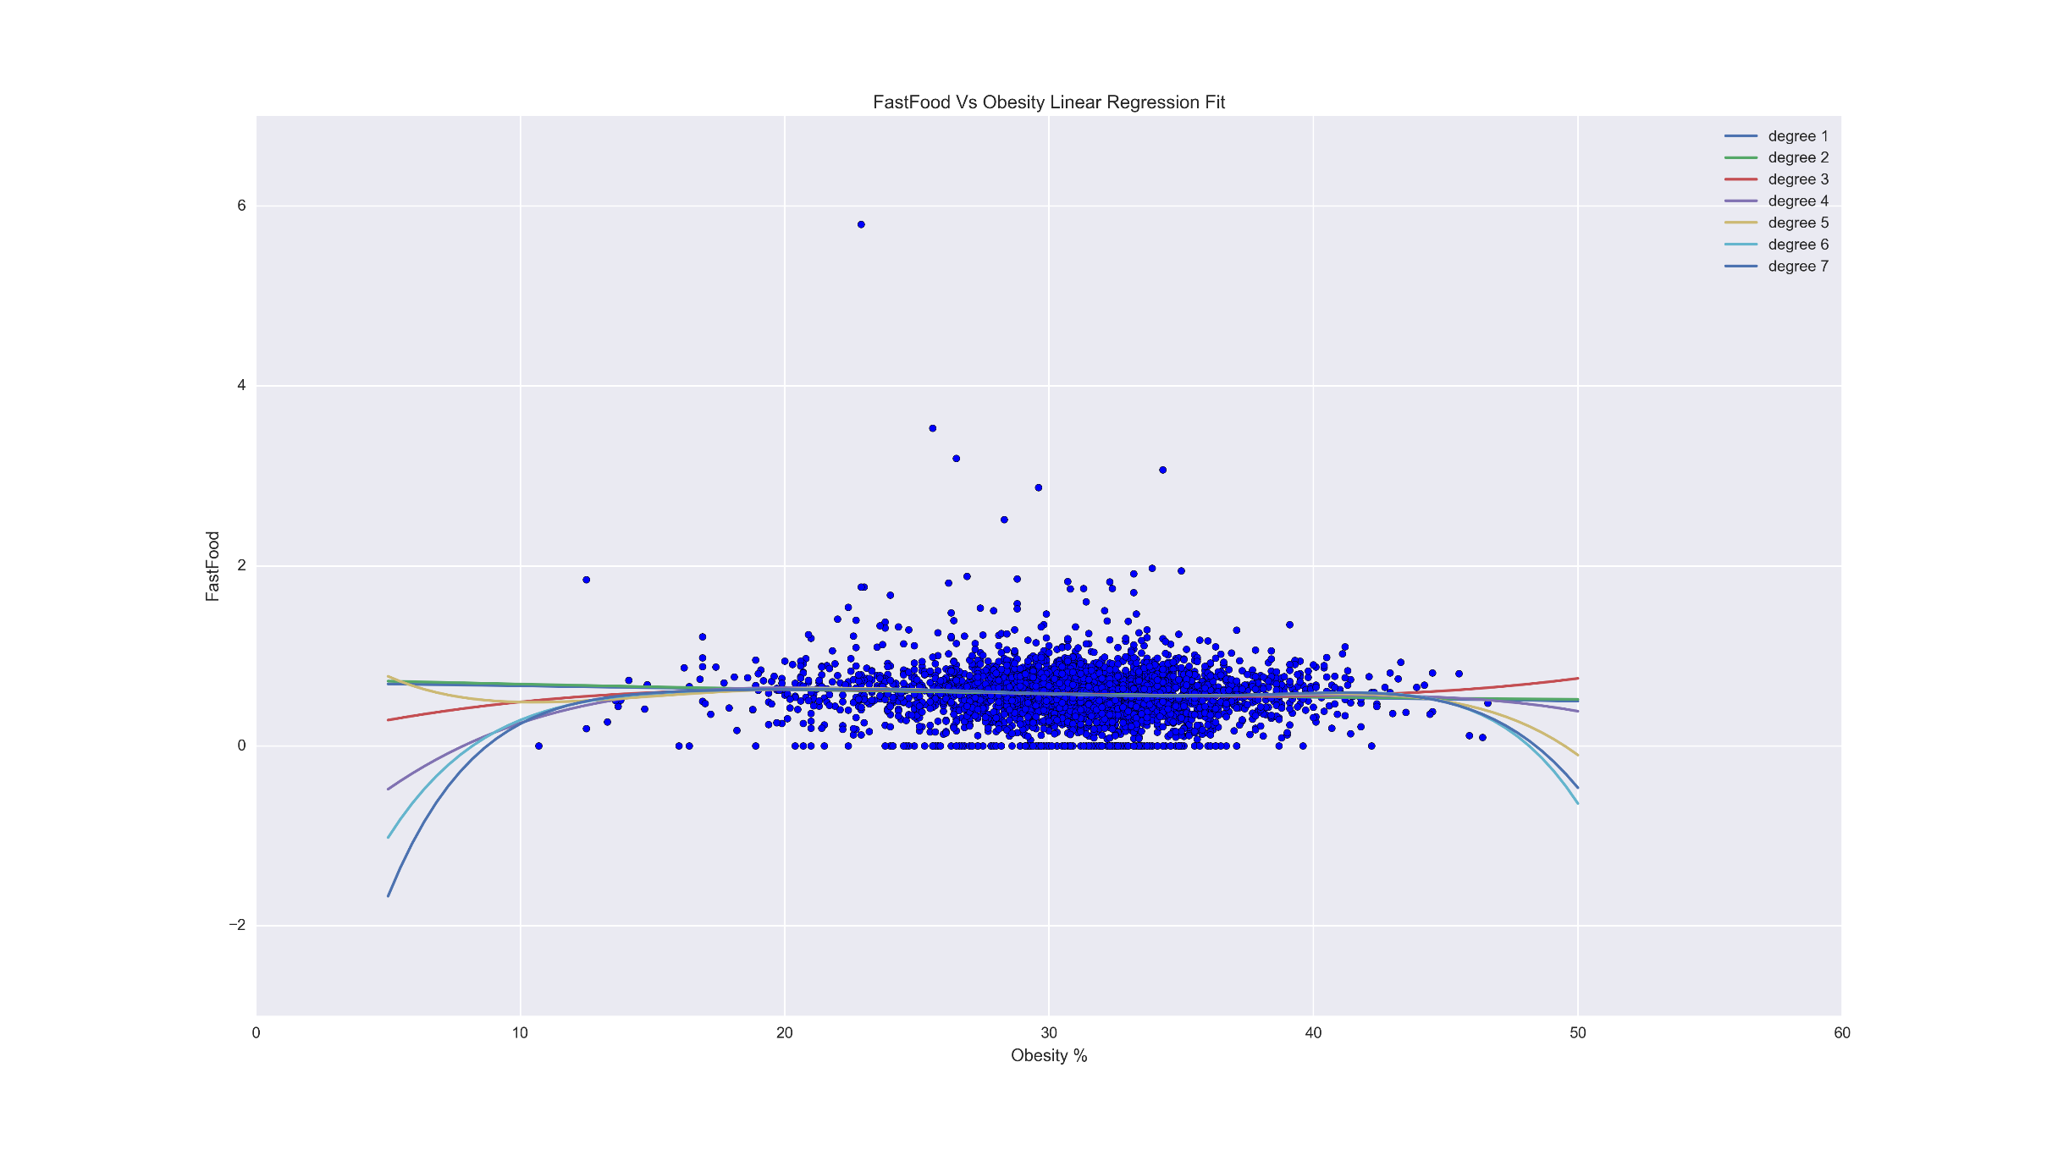
Fast Food per 1k Per County Vs Obesity Rate Linear Regression
Regression Score
Degree:
[0.0038420810119844662, 0.0038760939503880154, 0.0050730940595735685, 0.0060196352519259477, 0.0066158433715498566, 0.0068843340567162903, 0.0068935458589377552]
Conclusion: Very bad predictor for Obesity Rates per county

Slide 7
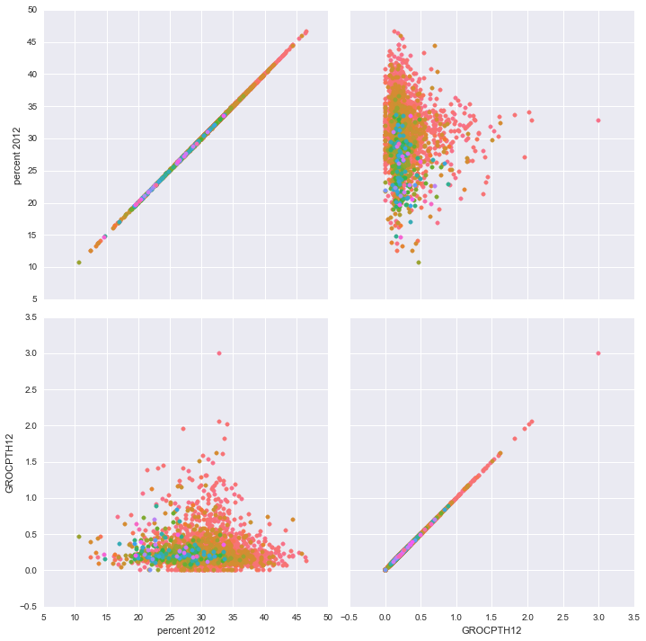
Obesity Vs Grocery Stores Per 1k with Farmers Markets Hue
Conclusion: Possible correlation between the number of Farmers markets and Grocery Stores and their effect on population obesity.
Will apply a KNN and Random Forest to see if we can create a prediction model

Slide 8
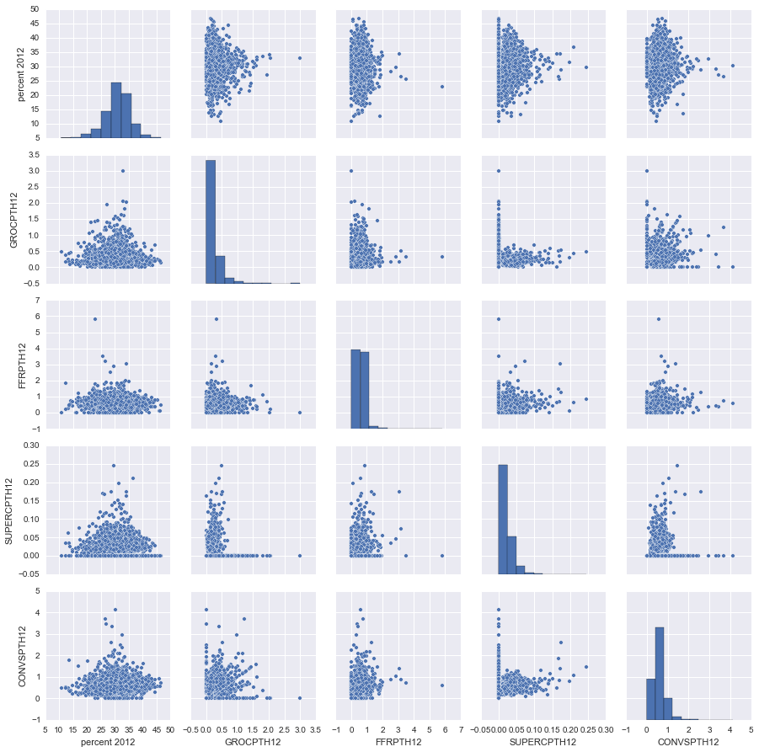
Food Stores vs Obesity Pairplot
Takeaway: No obvious linear correlation between Food Store availability per 1000 people and obesity rates.
Next Step: Decision tree analysis

Slide 9
Insights
It has been difficult to find any obvious correlation between the obesity rates in the US and the food factors
Will try to add in a few more that I have available in the Food Security sheet and will see if race and health factors have any influence on the data
Still need to utilize the other regression formulas on the current and future data sets
Will try to find more data sets to see if I can find any other clear influences on Obesity Rates

