Slide 1
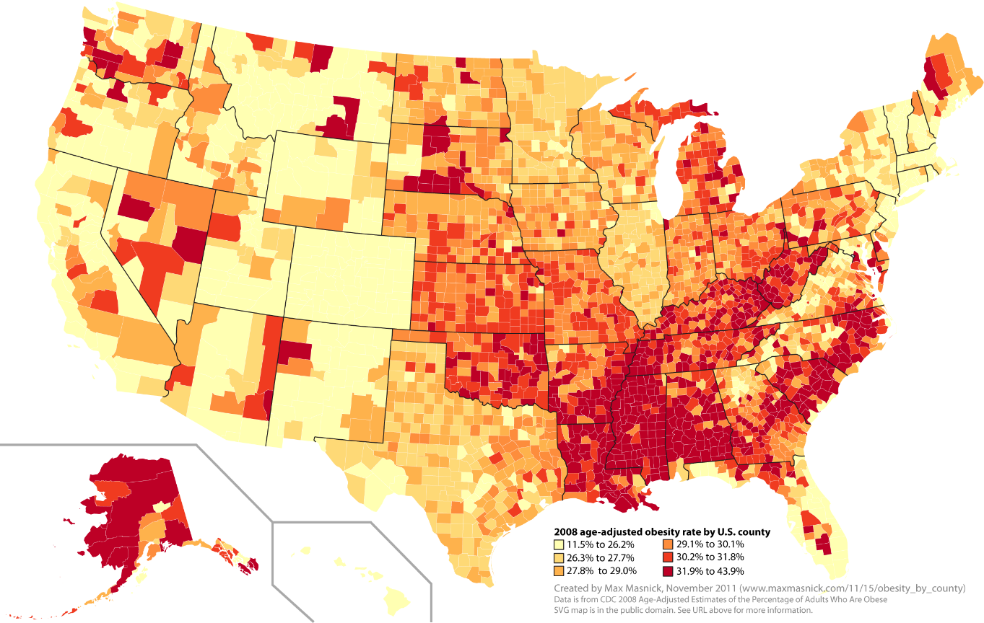
Predicting Obesity in the United States
Aaron Hellman
General Assembly
Data Science Fall 2015

Slide 2
Data Sets
Obesity Rates in the USA
Broken down by County
For the Years 2004 - 2012
Farmers Market Locations in the USA
Name, location (including County)
Current Results (Updated Dec 18 2015)
Food Security Factors in the USA
All data is for 2007 or 2012 or the change over the 5 year period.
Several food security factors including:
Grocery, supercenter, fast food Stores per 1000 people per county
Grocery Store Access
School Lunch Program participants
Food insecurity
Expenditures per capita on fast food
SNAP (food stamps) participation and applicants
Many more
Most Results are for 2007, 2010, 2012

Slide 3
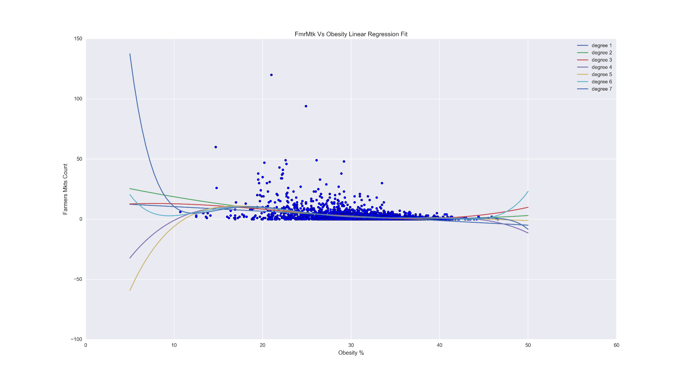
Farmers Markets Per County Vs Obesity Rate Linear Regression
Regression Score
Degree:
1: 0.10600412271158455
2: 0.12509365362261404
3: 0.12847462177258184
4: 0.13910968034817917
5: 0.14001867548716207
6: 0.14176995710180251
7: 0.14274707651026963
Conclusion: Not a very good predictor for Obesity Rates per county

Slide 4
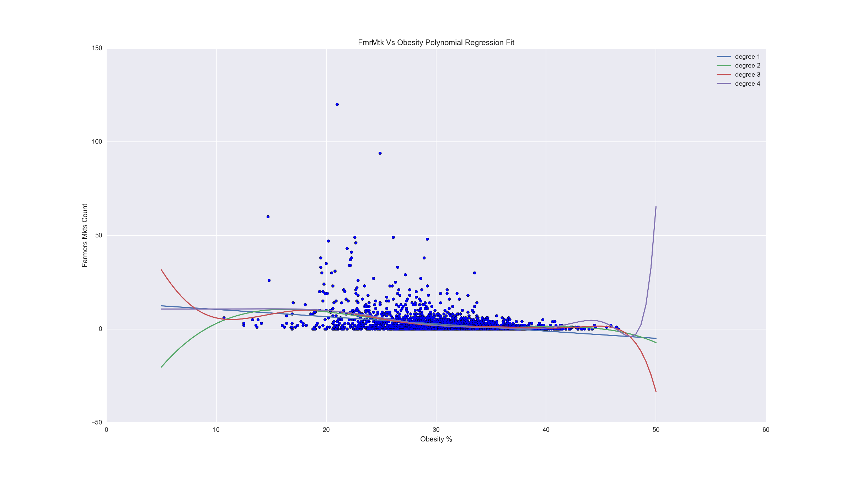
Farmers Markets Per County Vs Obesity Rate Polynomial Regression
Regression Score
Degree:
1: 0.10600412268453729
2: 0.13850319902920927
3: 0.14288862711952732
4: 0.13268373247497089
Conclusion: Not a very good predictor for Obesity Rates per county

Slide 5
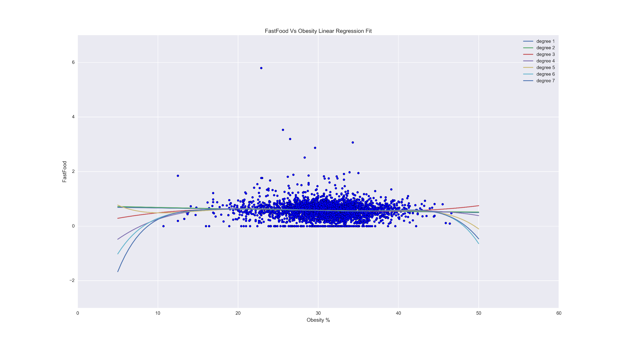
Fast Food per 1k Per County Vs Obesity Rate Linear Regression
Regression Score
Degree:
[0.0038420810119844662, 0.0038760939503880154, 0.0050730940595735685, 0.0060196352519259477, 0.0066158433715498566, 0.0068843340567162903, 0.0068935458589377552]
Conclusion: Very bad predictor for Obesity Rates per county

Slide 6
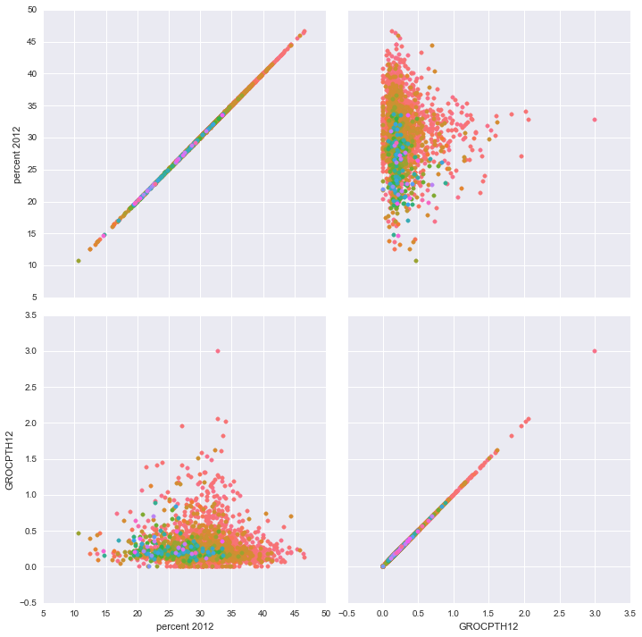
Obesity Vs Grocery Stores Per 1k with Farmers Markets Hue
Conclusion: Possible correlation between the number of Farmers markets and Grocery Stores and their effect on population obesity.
Will apply a KNN and Random Forest to see if we can create a prediction model

Slide 7
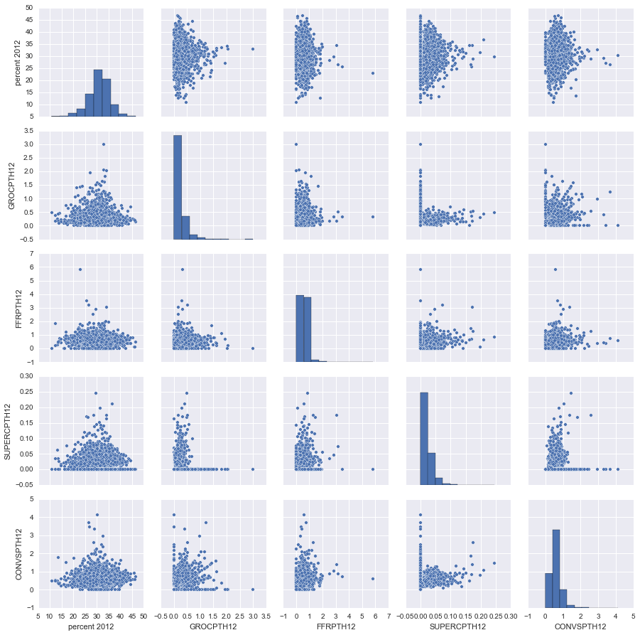
Food Stores vs Obesity Pairplot
Takeaway: No obvious linear correlation between Food Store availability per 1000 people and obesity rates.
Next Step: Decision tree analysis

Slide 8
Next Steps
Analyze the other data sets
Utilize the other regression formulas on the current and future data sets

