Slide 1
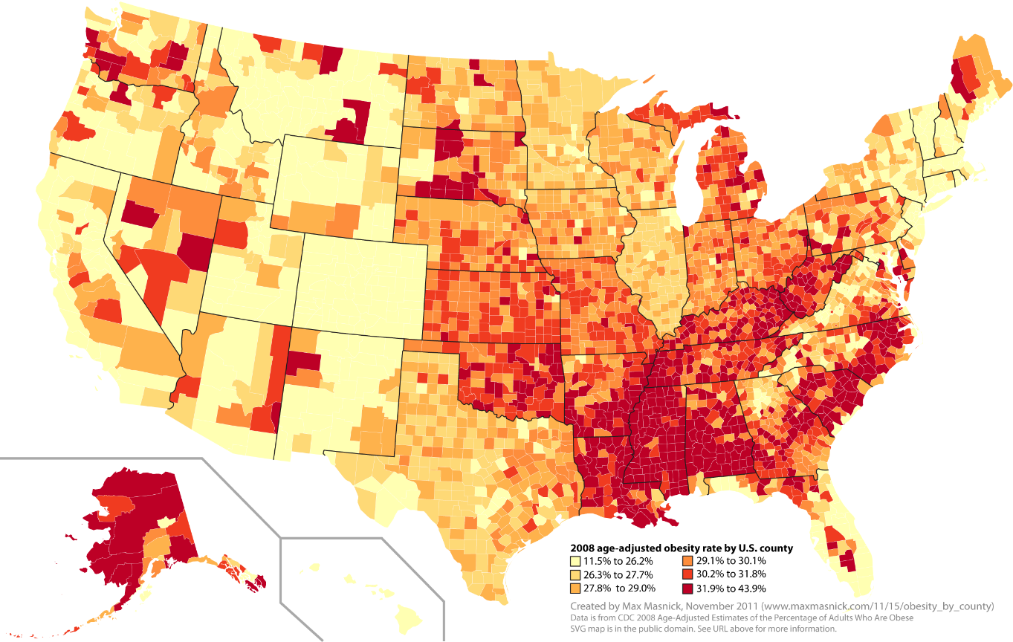
Predicting Obesity Rate in the United States
Aaron Hellman
General Assembly
Data Science Fall 2015

Slide 2
Investigation and Question:
Can we predict the Obesity rate using the FDA Food Factors Data and more importantly:
Are there certain Food Sales, Socioeconomic and Food Access Factors that influence the data more heavily so we can better combat rising Obesity rates in the United States?

Slide 3
Data Sets
Obesity Rates in the USA
Gathered and published by the CDC annually
Broken down by County for all 50 states and DC
For the Years 2004 - 2012
Farmers Market Locations in the USA
Name, location (including County)
Current Results (Updated Dec 18 2015)
Food Security Factors in the USA
All data is for 2007, 2010 or 2012 or the change over the 5 year period
Several food security factors including:
Grocery, supercenter, fast food Stores per 1000 people per county
Grocery Store Access and Access to Low income households
School Lunch Program participants
Food insecurity
Expenditures per capita on fast food and restaurants
SNAP (food stamps) participation and applicants
Many more

Slide 4
Data Manipulation
All data was gathered from Data.gov
Obesity Rates in the USA
Data is good, didn’t need much changes
These will be our Y values
Farmers Market Locations in the USA
Did not have the normal FID which is the County designation Key, so had to create a County/State Key to join on the Obesity Rates table
Food Security Factors in the USA
All data is mostly clean, but the variables are all stored on a separate sheets
Column headers are impossible to know without the key so had to reference that often to understand what data was useful

Slide 5
Food Security Factors:
Column Name | Description
FarmersMkts Per County | Farmers Markets Per County
PCT_LACCESS_POP10 | Percent of the population who have access to grocery stores
PCT_LACCESS_LOWI10 | Low Income Percent of the popultion who have access to grocery stores
PCT_LACCESS_HHNV10 | Low Income Percent of the population who have access to grocery stores without a car
GROCPTH12 | Grocery stores per 1000 people
SUPERCPTH12 | Supercenters per 1000 people
CONVSPTH12 | Convenience Stores per 1000 people
SNAPSPTH12 | SNAP-authorized stores per 1,000 people
FFRPTH12 | Fast-food restaurants per 1,000 people
FSRPTH12 | Full-service restaurants per 1,000 people
PC_FFRSALES12 | Expenditures per capita, fast food
PC_FSRSALES12 | Expenditures per capita, full service restaurant
REDEMP_SNAPS12 | SNAP redemptions/SNAP-authorized stores
PCT_SNAP09 | SNAP participants (% pop)
PC_SNAPBEN10 | SNAP benefits per capita
SNAP_PART_RATE10 | SNAP participants (% eligible pop)
PCT_NSLP09 | National School Lunch Program participants (% pop)
PCT_FREE_LUNCH10 | Students eligible for free lunch (%)
PCT_REDUCED_LUNCH10 | Students eligible for reduced-price lunch (%)
PCT_SBP09 | School Breakfast Program participants (% pop)
FOODINSEC_10_12 | Household food insecurity (%, three-year average)
VLFOODSEC_10_12 | Household very low food security (%, three-year average)
Takeaway: There are 22 Food Security items
8 relate to Fast Food, Grocery Store and other food sales stores
11 relate to low income food insecurity metrics like SNAP and Free Lunch Participants
2 relate to total expenditures on prepared food

Slide 6
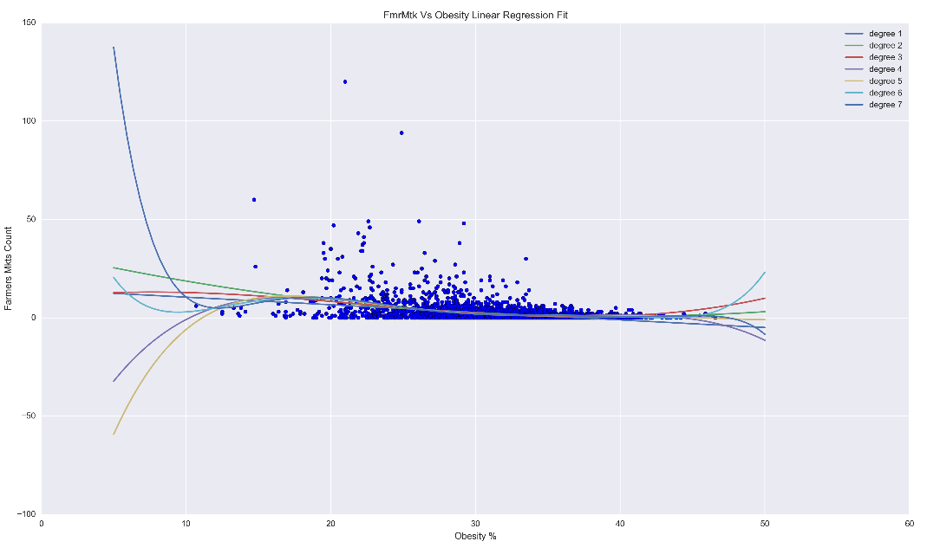
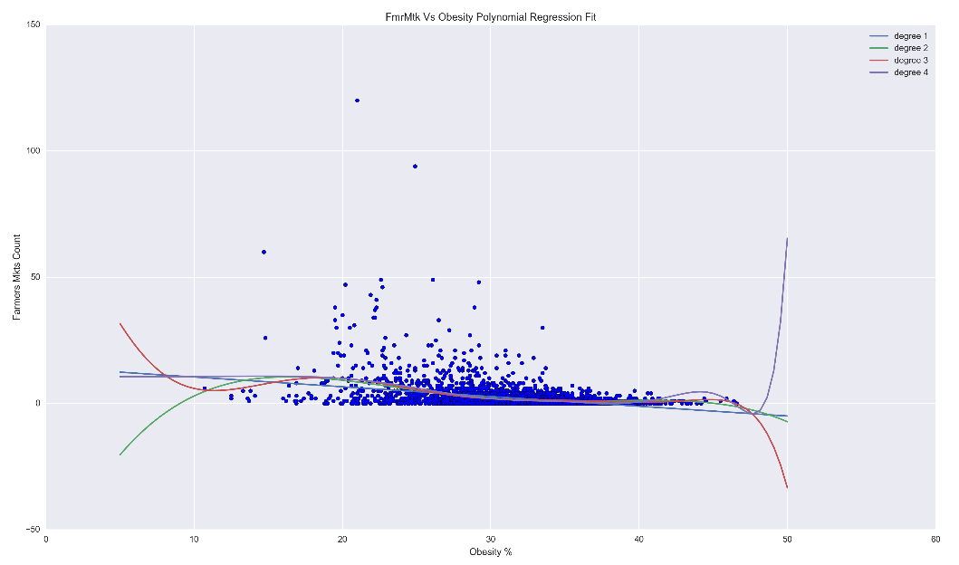
First Attempt: 2D Linear and Polynomial Regression of the Farmers Market Data
First idea was that a lack of farmers markets in a county would be a large influence on the obesity rates o f the area.
Analyzed Multi-degree Linear Regression:
Linear Regression Score
Degree:
1: 0.10600412271158455
2: 0.12509365362261404
3: 0.12847462177258184
4: 0.13910968034817917
5: 0.14001867548716207
6: 0.14176995710180251
7: 0.14274707651026963
Polynomial Regression Scores
Degree:
1: 0.10600412268453729
2: 0.13850319902920927
3: 0.14288862711952732
4: 0.13268373247497089
Conclusion: Neither a good predictor, at any degree

Slide 7
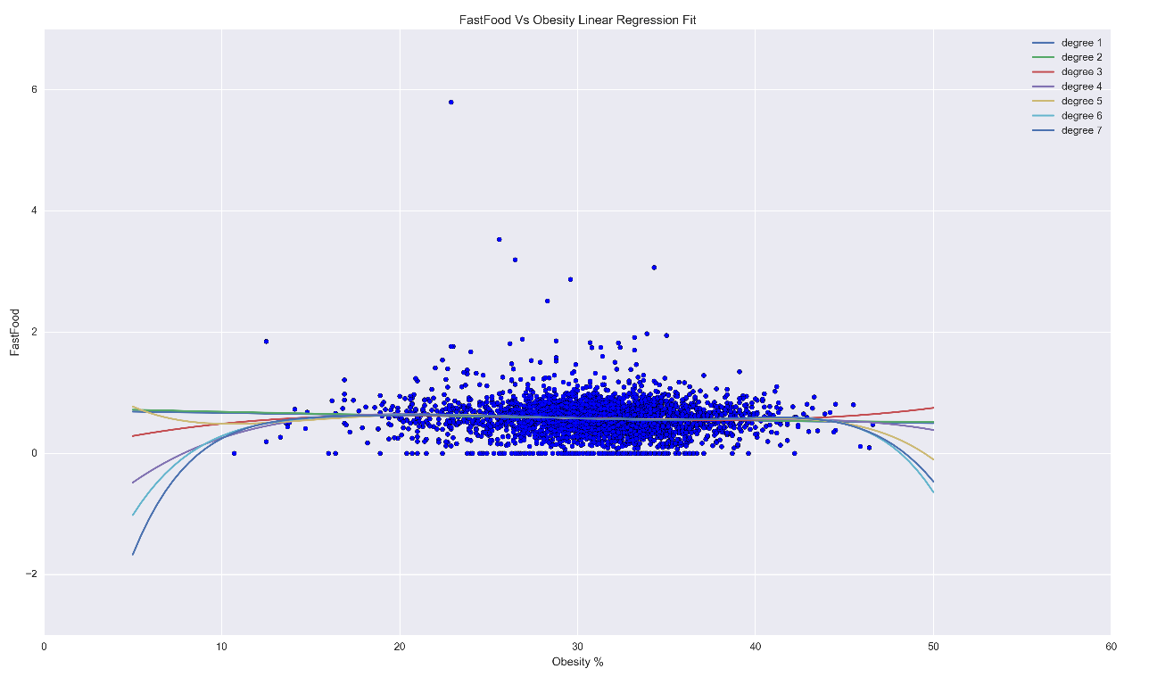
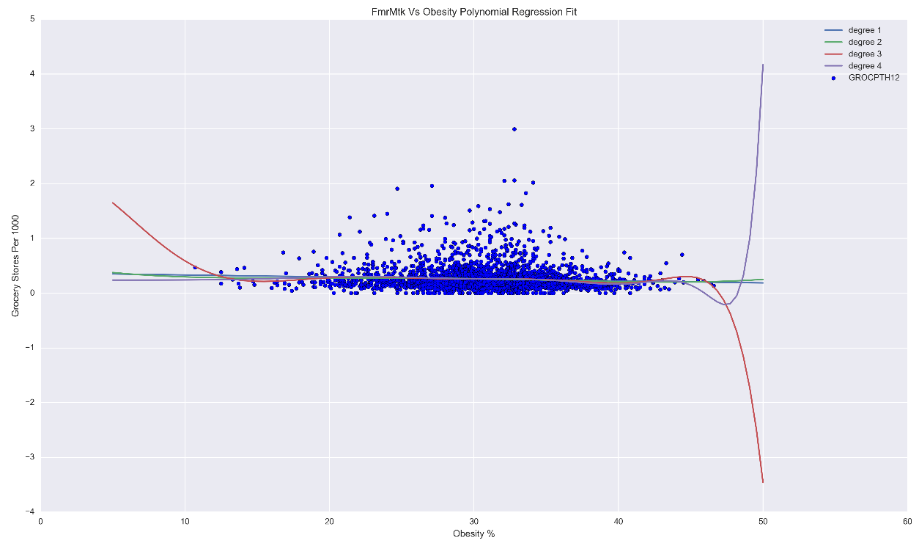
Fast Food and Grocery Stores Per 1k People Linear & Polynomial Regressions
Regression Scores
Degree:
[0.0038420810119844662, 0.0038760939503880154, 0.0050730940595735685, 0.0060196352519259477, 0.0066158433715498566, 0.0068843340567162903, 0.0068935458589377552]
Regression Scores
Degree:
[0.0055038499318978973, 0.0063996399612947785, 0.0094325969667015119, 0.0059002143372995919]
Conclusion: Even worse than the Farmers Market analysis

Slide 8
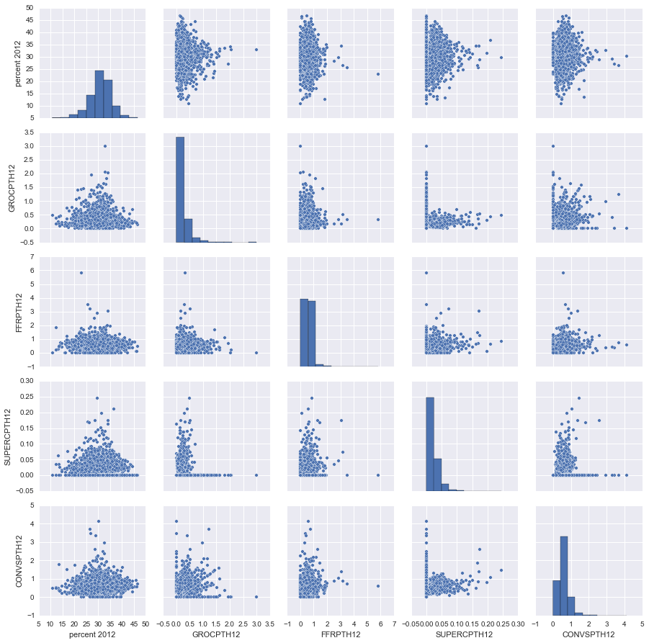
Food Stores vs Obesity Pairplot
Conclusion: Insignificant linear correlation between Food Store availability per 1000 people and obesity rates.
Since normal Linear Regression didn’t give any meangiful predictors, maybe the Log of the data will prove better results.

Slide 9
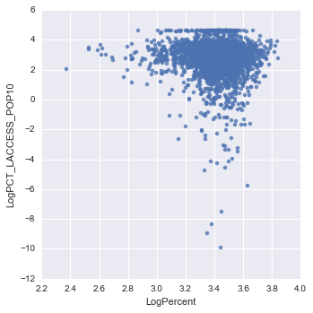
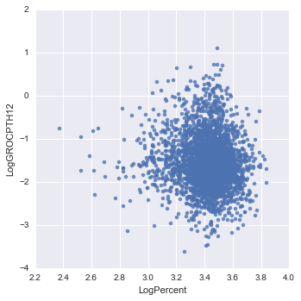
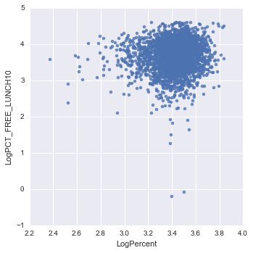
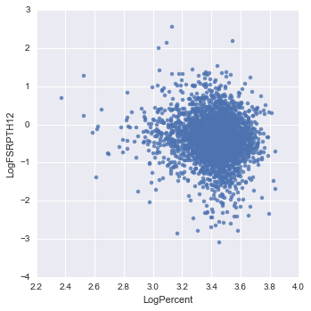
Logistic Linear 2D Regression:
Could not analyze all of the data together as there was too much variance for the Seaborn Pairplot
Made the data worse and more noisy - no matter what the food factor was
Conclusion: No possible prediction from the 2D Log Analysis
Next Steps: 2D linear regression analysis is insufficient so I need to move on to Multivariable Regression.

Slide 10
Multivariable Regression
This is the process of using many or all of the Food Factors data sets combined and building a model on their predictability of the obesity rate.
5 Groups of multivariable regression analysis:
All 22 Food Factors together
9 retail/wholesale related factors
11 Low-income food factors
5 SNAP food factors
2 Food Expenditure Factors

Slide 11
Multivariable Regression: Linear Regression
Using Linear Regression with Cross Validation having 10 folds:
All 22 Food Factors together
Mean Linear Val Score: 0.214
Test Set Linear Val Score: 0.234
9 retail/wholesale related factors
Mean Linear Val Score: 0.145
Test Linear Val Score: 0.127
11 Low-income food factors
Mean Linear Val Score: 0.121
Test Linear Val Score: 0.061
5 SNAP food factors
Mean Linear Val Score: 0.046
Test Linear Val Score: 0.059
2 Food Expenditure Factors
Mean Linear Val Score: 0.073
Test Linear Val Score: 0.149
Takeaway:
Combining all the food factors together did the best, but still was a very poor fit of the data. (For a perfect fit, we want a Mean Linear Val Score of 1)

Slide 12
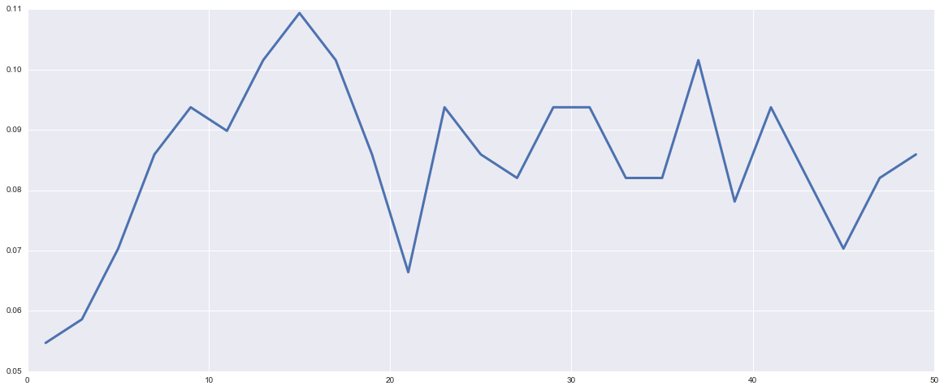
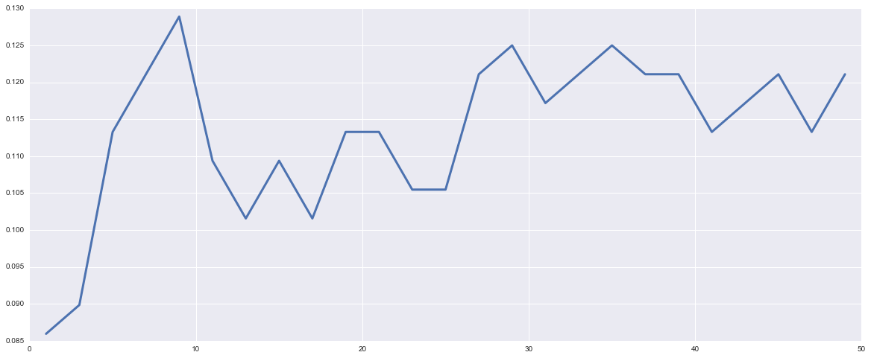
Multivariable Regression: KNN
With Cross Validation having 10 folds:
All 22 Food Factors together
Mean Linear Val Score: 0.101
9 retail/wholesale related factors
Mean Linear Val Score: 0.109
11 Low-income food factors
Mean Linear Val Score: 0.099
5 SNAP food factors
Mean Linear Val Score: 0.097
2 Food Expenditure Factors
Mean Linear Val Score: 0.120

Slide 13
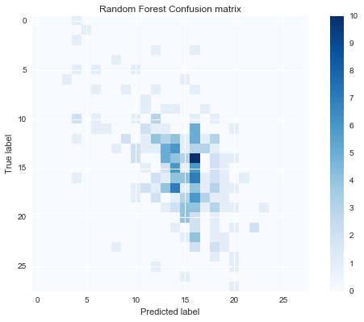
Multivariable Regression: Random Forests
With Cross Validation having 10 folds:
All 22 Food Factors together
Mean Linear Val Score: 0.121
9 retail/wholesale related factors
Mean Linear Val Score: 0.108
11 Low-income food factors
Mean Linear Val Score: 0.102
5 SNAP food factors
Mean Linear Val Score: 0.107
2 Food Expenditure Factors
Mean Linear Val Score: 0.108

Slide 14
Multivariable Logistic Regression
Next Steps: Logistic distribution of the data in 2 separate analyses
Logistic Modeling
Binary (0 or 1)
The Obesity rate is either above or below the median value
Quintiles (5 equal parts)
The Obesity Rate is in 1 of five even quintiles based on percentage
Regression Models of the data Applied:
Linear
Bagging with 250 base estimators
Boosting with 250 base estimators
Decision Tree with 1/2 of max nodes and max nodes
Random Forest with 1/3, 2/3 and max features

Slide 15
Multivariable Logistic Binary Regression
 | All Food Factors | Retail | Low Income | SNAP | Expenditures
Linear | 0.096 | 0.052 | 0.058 | 0.015 | 0.048
Bagging | 0.692 | 0.568 | 0.647 | 0.602 | 0.638
Boosting | 0.631 | 0.546 | 0.599 | 0.563 | 0.637
Decision 1/2 | 0.639 | 0.585 | 0.627 | 0.559 | 0.623
Decision Max | 0.627 | 0.542 | 0.586 | 0.564 | 0.639
Random Forest 1/3 | 0.701 | 0.583 | 0.651 | 0.595 | -
Random Forest 2/3 | 0.701 | 0.575 | 0.650 | 0.601 | -
Random Forest Max | 0.702 | 0.577 | 0.649 | 0.598 | 0.641

Slide 16
Multivariable Logistic Quintile Regression
 | All Food Factors | Retail | Low Income | SNAP | Expenditures
Linear | 0.158 | 0.114 | 0.077 | 0.026 | 0.076
Bagging | 0.607 | 0.517 | 0.566 | 0.548 | 0.594
Boosting | 0.518 | 0.456 | 0.490 | 0.490 | 0.550
Decision 1/2 | 0.549 | 0.513 | 0.583 | 0.530 | 0.557
Decision Max | 0.511 | 0.449 | 0.484 | 0.481 | 0.591
Random Forest 1/3 | 0.607 | 0.159 | 0.579 | 0.552 | -
Random Forest 2/3 | 0.607 | 0.517 | 0.569 | 0.555 | -
Random Forest Max | 0.606 | 0.520 | 0.566 | 0.546 | 0.593

Slide 17
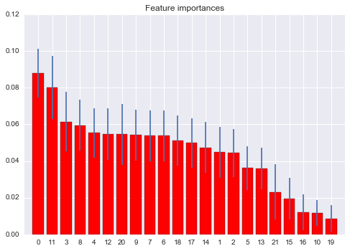
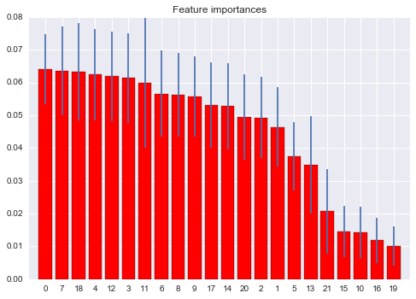
Multivariable Logistic Regression Forest Features
Binary Random Forest Max Feature Ranking:
Feature ranking:
1. feature FarmersMkts Per County (0.088)
2. feature PCT_LACCESS_POP10 (0.08)
3. feature PCT_LACCESS_LOWI10 (0.061)
4. feature PCT_LACCESS_HHNV10 (0.059)
5. feature GROCPTH12 (0.055)
6. feature SUPERCPTH12 (0.055)
7. feature CONVSPTH12 (0.054)
8. feature SNAPSPTH12 (0.054)
9. feature FFRPTH12 (0.054)
10. feature FSRPTH12 (0.054)
11. feature PC_FFRSALES12 (0.051)
12. feature PC_FSRSALES12 (0.05)
13. feature REDEMP_SNAPS12 (0.047)
14. feature PCT_SNAP09 (0.045)
15. feature PC_SNAPBEN10 (0.044)
16. feature SNAP_PART_RATE10 (0.036)
17. feature PCT_NSLP09 (0.036)
18. feature PCT_FREE_LUNCH10 (0.023)
19. feature PCT_REDUCED_LUNCH10 (0.019)
20. feature PCT_SBP09 (0.012)
21. feature FOODINSEC_10_12 (0.012)
22. feature VLFOODSEC_10_12 (0.009)
Quintile Random Forest Max Feature Ranking:
Feature ranking:
1. feature FarmersMkts Per County (0.064)
2. feature PCT_LACCESS_POP10 (0.064)
3. feature PCT_LACCESS_LOWI10 (0.063)
4. feature PCT_LACCESS_HHNV10 (0.062)
5. feature GROCPTH12 (0.062)
6. feature SUPERCPTH12 (0.061)
7. feature CONVSPTH12 (0.06)
8. feature SNAPSPTH12 (0.057)
9. feature FFRPTH12 (0.056)
10. feature FSRPTH12 (0.056)
11. feature PC_FFRSALES12 (0.053)
12. feature PC_FSRSALES12 (0.053)
13. feature REDEMP_SNAPS12 (0.049)
14. feature PCT_SNAP09 (0.049)
15. feature PC_SNAPBEN10 (0.046)
16. feature SNAP_PART_RATE10 (0.037)
17. feature PCT_NSLP09 (0.035)
18. feature PCT_FREE_LUNCH10 (0.021)
19. feature PCT_REDUCED_LUNCH10 (0.015)
20. feature PCT_SBP09 (0.014)
21. feature FOODINSEC_10_12 (0.012)
22. feature VLFOODSEC_10_12 (0.01)

Slide 18
Conclusions
No good conclusion
Aligned with expectations as this is a complex issue
Not planning on writing the CDC

