Slide 1
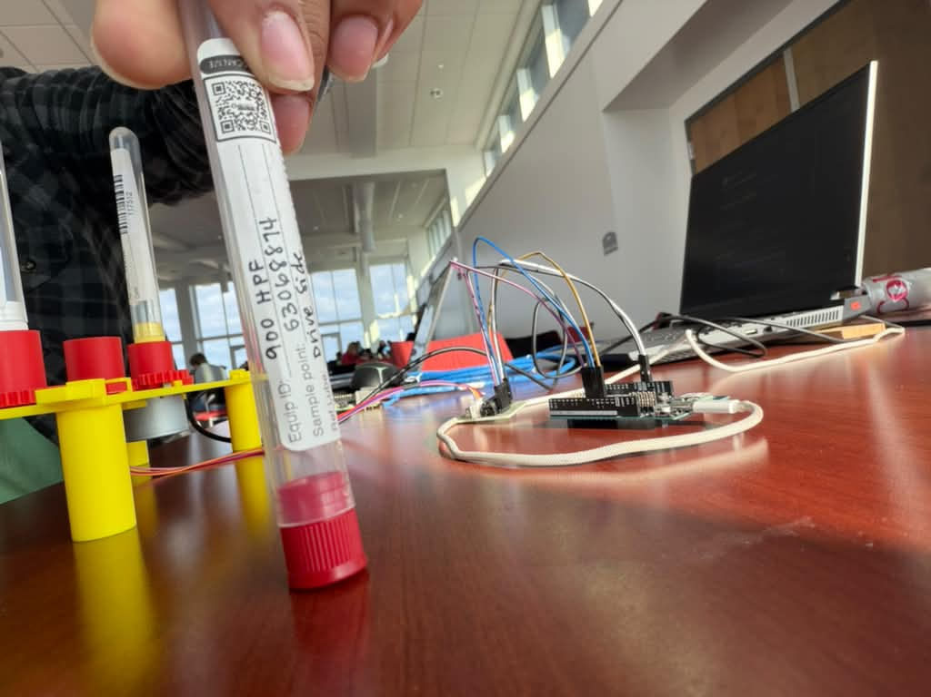
LRS-3
Label Reading System
Three tubes. One scan.
Clear sample records.
Built for the
MRG Laboratories challenge
Notes:
Introduce LRS-3. This is our actual prototype photo supplied by the team. We address sample-label transcription for the MRG Laboratories challenge. The companion demo begins with team-supplied footage of the rig and the phone scan in progress, then shows real application processing in dark mode.

Slide 2
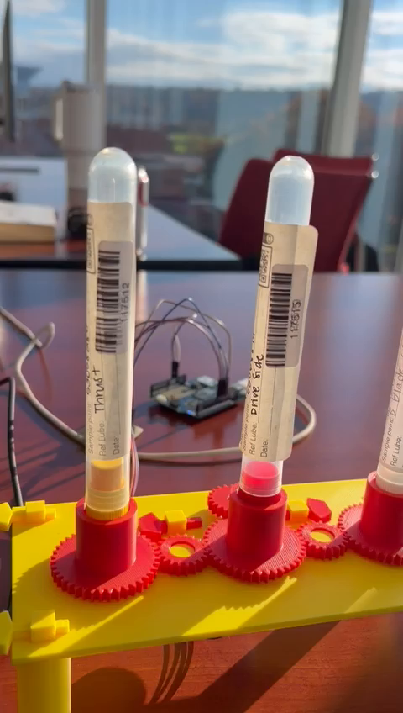
How we built it
150+ photos from 40+ samples
Manual photography for training and development
Printed gears + Arduino UNO Q
Eight views per tube, grouped into three samples
Local OCR, human review and CSV export
Notes:
The 150+ photos and 40+ samples are team-reported collection totals. They differ from the documented smudge experiment with 44 training fields and 9 development fields. Twenty epochs improved clean exact development fields from 5/9 to 6/9 and synthetic-smudge variants from 13/27 to 18/27; this small reused development set is not independent accuracy. Sources: tube-training/SMUDGE_TRAINING.md and user-supplied collection figures. The video frame shows our actual rig. OpenSCAD/Bambu prints include separate gears and washers. UNO Q drives a 28BYJ-48 through ULN2003. Seven movements separate eight nominal views. The camera splits frames into three sample groups. FastAPI, OpenCV, ZXing, RapidOCR, local recognizers and SQLite support processing. Explain the failed small T keys and wider replacement, plus lighting and phone certificate challenges.

Slide 3
Results and challenge entries
20.8 s / tube
MRG Laboratories
Earlier Pi processing benchmark.
Excludes capture, upload and review.
MLH / xAI
Grok helps review difficult readings.
90% accuracy target
Unseen-sample validation comes next.
GoDaddy Domain
Notes:
The 20.8 seconds is an earlier Pi benchmark of ten tubes twice each, not full scan duration. The 90% accuracy figure is a goal, not a measured result. An earlier integrated version passed 71 Python tests and JavaScript capture checks; physical motor movement was confirmed. Grok optionally explains warnings and reads a selected crop with explicit consent. Suggestions stay unconfirmed until operator review. No live Grok call is included in the demo. Challenge labels are team-supplied; a registered domain name was not provided. Next: evaluate unseen tubes, improve lighting/mobile usability, and verify a full capture-to-export run. Source: README.md and ASSISTANT.md.

