Slide 1
AI-Powered Comparison of IT Programs Across Ontario Colleges
Interim Presentation
Capstone Project | Group 3 | March 8, 2026
Amit Sharma · Ahemadashraf Pathan · Sahil Varudi · Sahil Jajadiya · Deepesh Dixit

Slide 2
Agenda
01 Problem Statement
05 Challenges & Solutions
02 Project Objectives
06 Remaining Work & Timeline
03 Dataset Overview
07 Individual Contributions
04 Exploratory Data Analysis (EDA)
08 Conclusion & Next Steps

Slide 3
Problem Statement
Fragmented Information
No Side-by-Side Comparison
Advisor Difficulty
Each Ontario college has its own website with no unified view of IT programs.
Students must manually open dozens of tabs to compare Credential type, duration, delivery format and skills.
Academic advisors lack a structured view of how programs cluster by skill area.
Recruiter Gap
Policy Blind Spot
No public resource maps which colleges produce graduates with specific tech skills.
Regional distribution of IT program supply is not compiled or visualised anywhere.

Slide 4
Project Objectives
Unified Dataset
Smart Recommendations
1
2
3,273 records, 26 colleges, 14 fields — credential type, duration, delivery, description.
ML-powered engine that matches a student profile to ranked programs.
Advisor Cluster View
College Benchmarking
3
4
Programs grouped by skill area so advisors instantly see all related offerings.
Side-by-side comparison of program count, credentials, and skill coverage.
Recruiter Search
Policy Analytics
5
6
Keyword → colleges ranked by how many matching programs they offer.
Regional map of IT program supply — where the programs are vs. where the demand is.
Full Web Platform
7
Browser-based app, FastAPI backend, all six views accessible without installation.

Slide 5
Dataset Overview
2039
26
8
14
Total Programs
Colleges Covered
Credential Types
Fields per Record
14 Key Fields Collected:
college_name
campus_name
program_name
credential_type
credential_group
duration_months
duration_years
program_category
delivery_format
source_url
details_url
program_level
program_length
program_description
Source: Ontario Colleges portal + individual college websites | Dedup key: college + campus + program + code + intake + start date

Slide 6
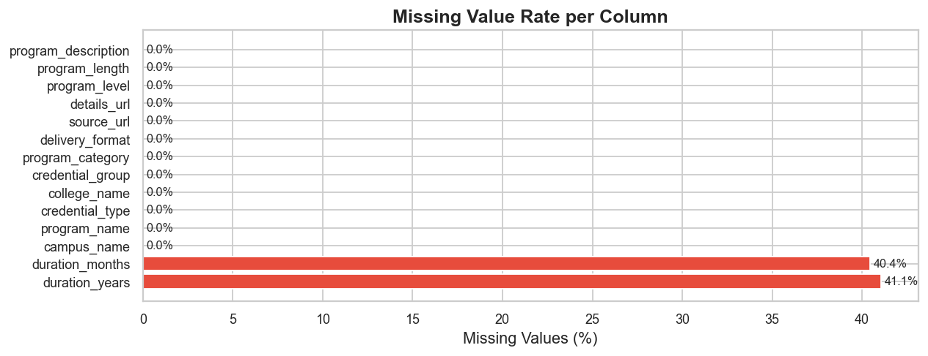
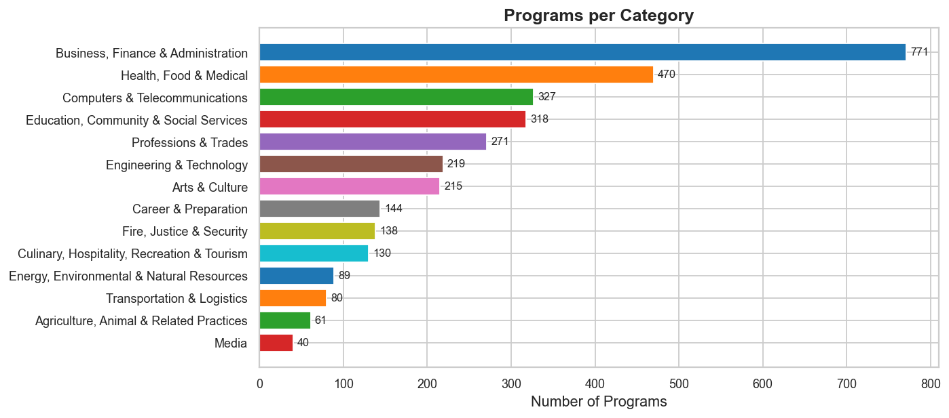
EDA — Data Quality & Program Categories
Data Quality Insights
Program Category Insights
• duration_months & duration_years have ~40% missing values — converted to NaN, NOT dropped • Missing durations assigned a neutral score so programs still surface if skills & goals match • program_description is 100% complete — the primary input for future NLP skill extraction
• Computer Science / IT is the single dominant category — expected and confirms correct data scope • Business Technology & Information Systems form meaningful secondary clusters • No large off-topic categories visible — the 17-term IT keyword filter worked correctly

Slide 7
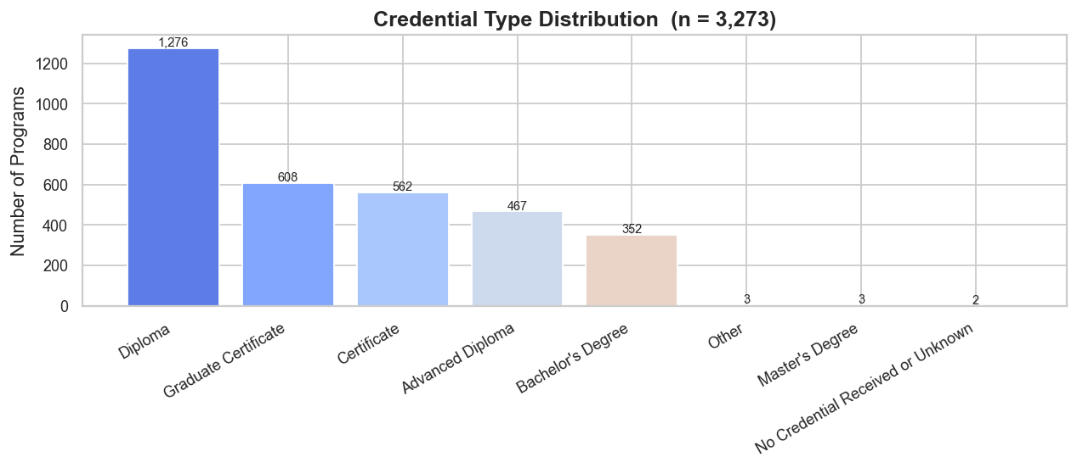
EDA — Credential Types & Delivery Formats
What This Chart Tells Us
• Ontario Diploma is the most common credential — the primary IT pathway for school leavers entering a 2-year program • Ontario Graduate Certificate (Post-grad) is the second largest — significant for degree holders or career changers upskilling • Bachelor's degrees and Ontario Advanced Diplomas exist but are a small fraction — only select colleges offer degree-level IT • Short Certificates are least common; colleges clearly favour multi-semester comprehensive programs over micro-credentials

Slide 8
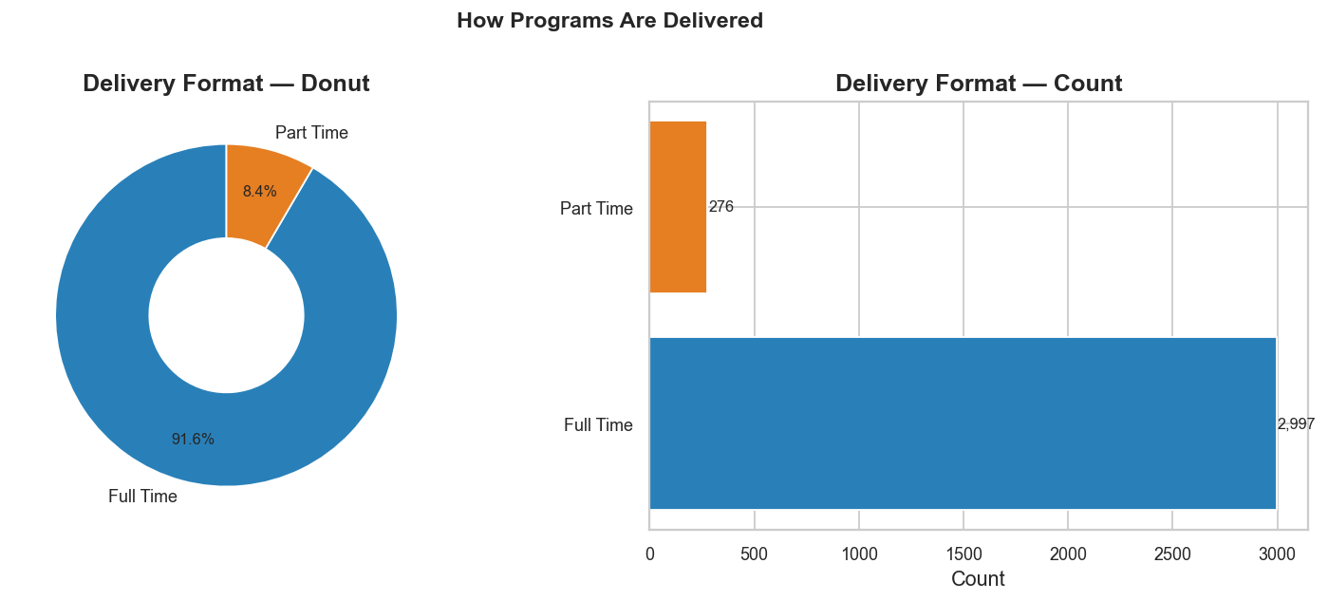
EDA — How Programs Are Delivered
What This Chart Tells Us
• Full-Time in-person is dominant — over 60% of programs require physical attendance at a campus • Online and Hybrid programs are more prevalent than expected, reflecting post-pandemic adaptation by Ontario colleges • Part-time offerings are limited but important for working professionals seeking to upskill without leaving employment • Delivery format is captured as a first-class filter in the recommendation engine — students explicitly specify their preference

Slide 9
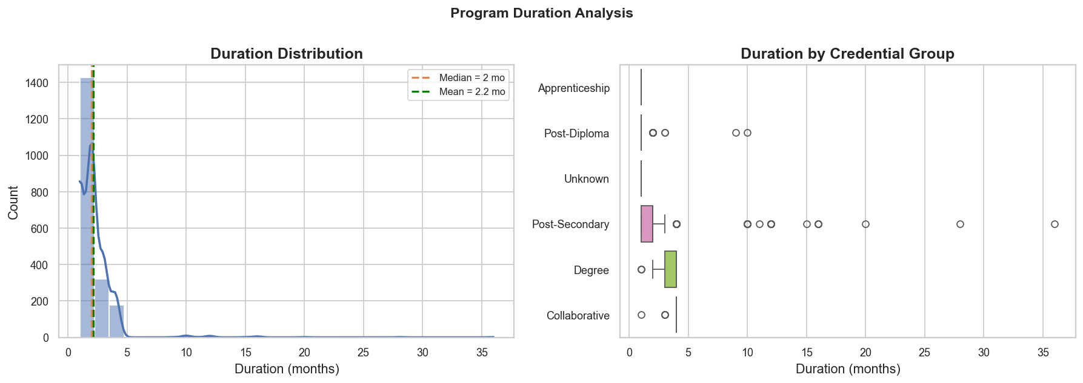
EDA — Program Duration Analysis
What This Chart Tells Us
• Median program duration is ~24 months — consistent with the 2-year Ontario College Diploma standard • Distribution is bimodal: a cluster at 12 months (Graduate Certificates, short certs) and another at 24 months (diplomas) • Bachelor’s degree programs form a long right tail extending to 36–48 months • Box plot confirms Graduate Certificates are shortest; Ontario Advanced Diplomas and Bachelor’s are longest — useful for student filtering

Slide 10
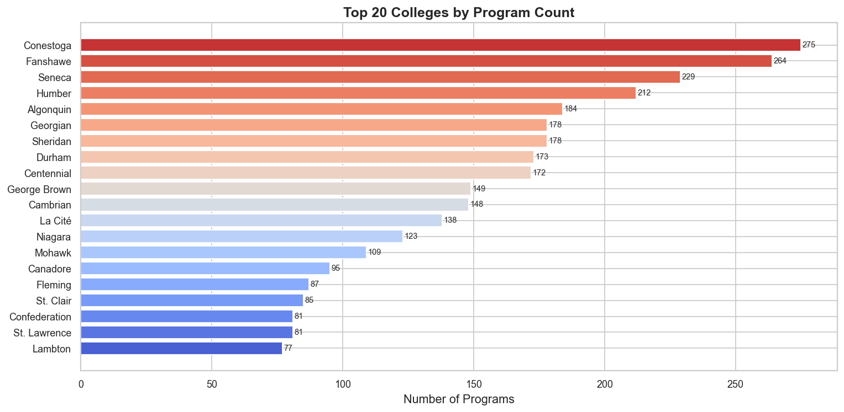
EDA — Program Distribution Across Colleges
What This Chart Tells Us
• GTA colleges (Seneca, George Brown, Centennial, Humber) dominate — together ~35% of all IT programs in the dataset • Sharp drop-off after the top 5; smaller colleges in Northern and Eastern Ontario offer far fewer programs • Geographic concentration is a policy concern: students outside the GTA have significantly fewer local options • Our recommendation engine includes preferred region as a scoring factor to surface relevant programs near the student

Slide 11
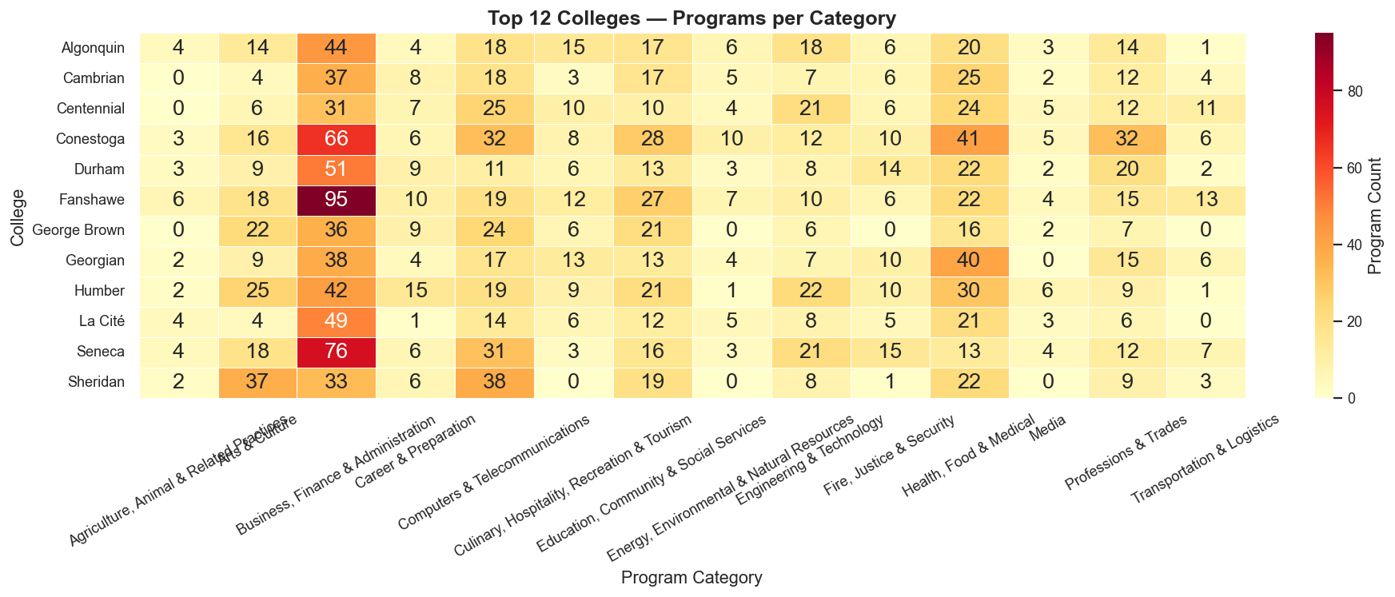
EDA — College × Program Category Heatmap
What This Chart Tells Us
• Darker cells = higher program count; broad-spectrum colleges (Seneca, George Brown) show uniformly dark rows • Some colleges have concentrated hot-spots in specific categories (e.g. strong in Networking or Cybersecurity) • Lighter rows reveal narrow-focus colleges — fewer categories and fewer programs per category • This heatmap directly informs the College Benchmarking view on the web platform — advisors use it to see specialisation patterns

Slide 12
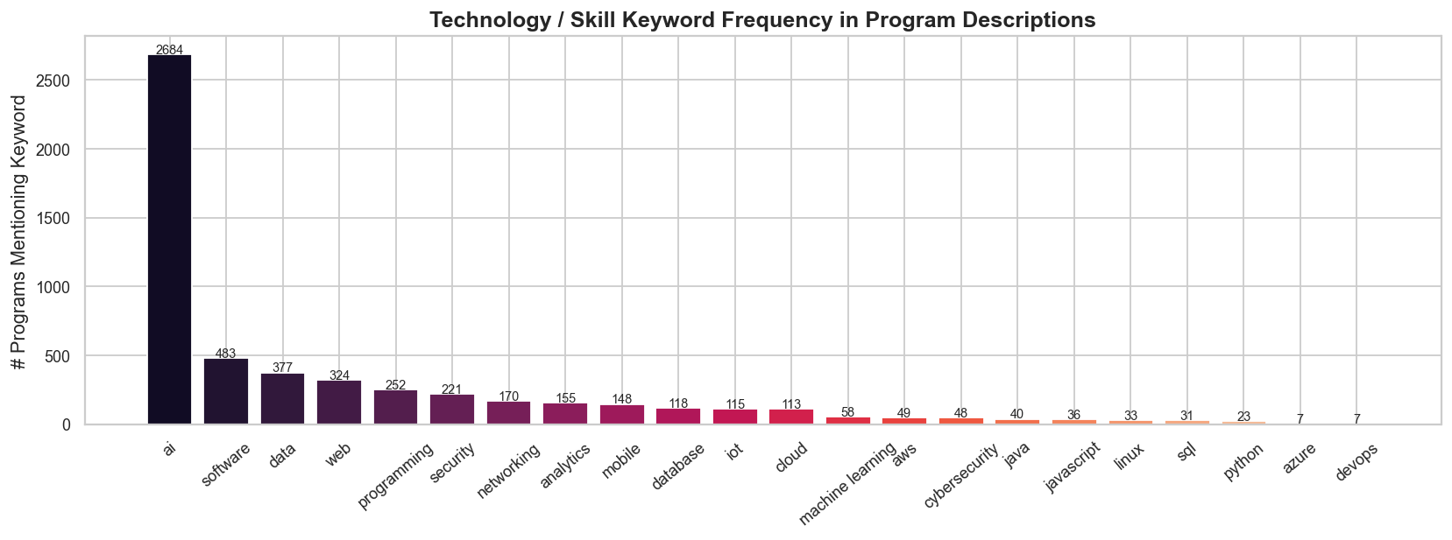
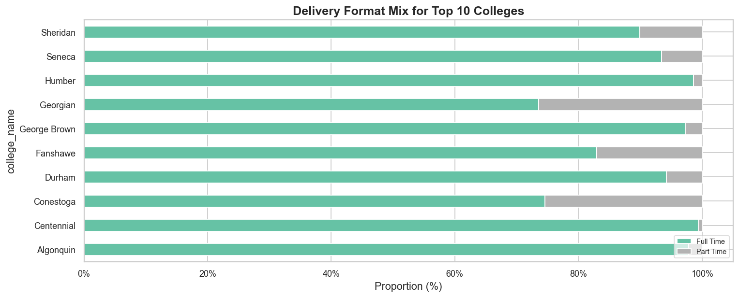
EDA — Skill Keywords & Delivery Mix by College
Skill Keyword Insights
Delivery Mix by College Insights
• 'data', 'security' and 'software' appear in the most descriptions — core Ontario IT curriculum pillars • Modern keywords like 'cloud', 'devops', 'ai' and 'analytics' signal curriculum modernisation • 'blockchain' and 'iot' are underrepresented — niche and not yet mainstream in Ontario college syllabi • Keyword frequencies seed the NLP skill extraction pipeline for the next sprint
• Delivery mix varies substantially — some colleges are near 100% in-person; others offer 30%+ online • Online-heavy colleges tend to serve a broader geography, reaching students outside the GTA • This variability justifies delivery format as a first-class recommendation filter — not just a nice-to-have • Colleges with strong hybrid presence are better positioned for the growing demand for flexible learning

Slide 13
Challenges & How We Addressed Them
Inconsistent Vocabulary
Solution: Normalization function: lowercase + strip punctuation + collapse whitespace before any comparison.
Challenge: Every college used different strings for the same value (e.g. 'Full Time' vs 'FT').
Duration Nulls (~40%)
Solution: Programs with null duration receive a neutral score on the duration component; still surface if skills match.
Challenge: Large share of rows had 'Not Available' for duration — couldn't drop or fabricate.
Defining 'IT'
Solution: 17-term keyword filter validated by manual sampling; consistent if not perfect.
Challenge: Raw data included all faculties: health, hospitality, business. 'IT' is fuzzy at the edges.
Growing app.js
Solution: Split into sections with comment headers; each section follows the same fetch → render pattern.
Challenge: Without a framework, the JS file grew large as features were added.
Team Coordination
Solution: Explicit Jira task ownership + API-change communication rule before any merge.
Challenge: API changes silently broke the frontend; 5 people across 4 components needed clearer ownership.

Slide 14
Work Remaining
Machine Learning
NLP Skill Extraction
• KMeans clustering on feature vectors (replace hand-coded skill groups)
• spaCy pipeline to extract structured skills from program descriptions
• Random Forest / XGBoost classifier for student–program fit scoring
• Replace keyword overlap with real skill-to-skill comparison
• Sentence-BERT semantic similarity (stretch goal)
Model Evaluation
Testing
• Clustering: silhouette score + manual cluster review
• Unit tests per API endpoint
• Classifier: accuracy / precision / recall / F1 / AUC
• End-to-end recommendation flow tests
• Recommendations: NDCG and hit-rate @ K on gold-standard profiles
• Edge cases: empty input / unknown region / extreme duration
Final Documentation
• Swagger schema descriptions
• Updated architecture diagram
• User guide per persona + final report

Slide 15
Timeline & Milestones
Milestone
Status
Milestone 1 — Proposal
Completed
Milestone 2 — Technical Planning
Completed
Data Collection & Cleaning
Completed
EDA
Completed
Backend API (rule-based)
Completed
Frontend Web App
Completed
ML Model Development
In Progress
NLP Skill Extraction
Not Started
Model Evaluation
Not Started
Testing
Not Started
Final Report & Presentation
Not Started

Slide 16
Conclusion & Next Steps
We're ahead of where we expected to be at this point. The platform is functional end-to-end: a clean 3,273-record dataset, a working FastAPI backend with eight endpoints, a full frontend with seven views including visualisations and an AI chatbot, and a comprehensive EDA. The rule-based recommendation engine gives reasonable results and served its purpose as a v1 scaffold. The next phase — replacing it with trained ML models and adding NLP-based skill extraction — is the harder lift, but the groundwork is in place.
Next Steps:
Sprint 1 (next)
Sprint 1 (next)
Train KMeans clustering model on program feature vectors
Implement spaCy NLP pipeline for structured skill extraction
Sprint 2
Sprint 2
Train Random Forest / XGBoost classifier for fit scoring
Build model evaluation framework (silhouette, F1, NDCG)
Sprint 3
Sprint 4 (final)
Write unit tests + end-to-end tests for all API endpoints
Final report, Swagger documentation, user guide, presentation
Thank You — Questions Welcome

