Slide 1

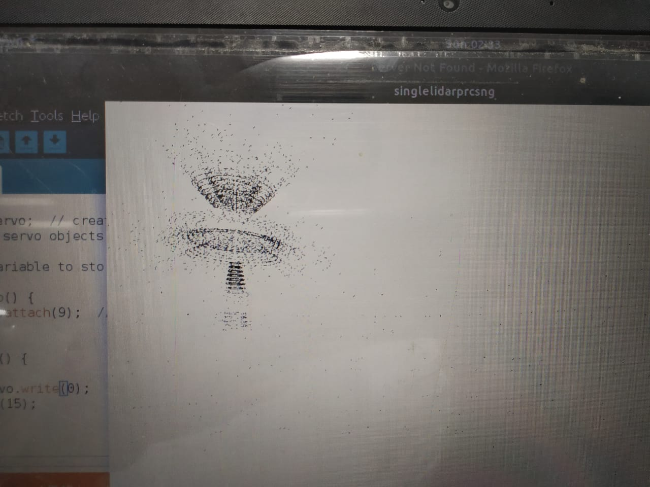
Robotics
Club, IITG
3D LIDAR
Ahemad Khan, Yashwanth, Hardik Singh, Ayushi Rai,
Divyam, Drigesh, Aakash Meena , Aniraj Choudhury
Abstract/Introduction
AIM The aim of this project is to draw a three dimensional image of the object with the help of processing IDE and Arduino IDE. The ultrasonic sensors are used for the purpose of mapping of object with respect to the lidar. DIFFERENTIATING OBJECTS Through this model, different objects could be identified for the particular range of distance. And lines are generated by 3d mapping.
Results
Now we can map the surrounding and get a 3D view of the objects present in it. Ultimately we would be able to identify the 3D view of the objects by taking multiple readings OUTPUT
Methodology
The Project consists of two major parts: 1) Mechanical Structure 2) Algorithm Mechanical structure We have used two servos, connected to each other such that the second servo is fixed on the axis of first servo. The first servo will rotate 180 degree in the horizontal plane(X-Z) and so the second servo will rotate in vertical plane(X-Y). On the axis of second servo one Ultrasonic sensor is fixe. Algorithm Each Ultrasonic sensor will give the distance of the object in front of it, now suppose there is a object of some height placed in front of our model then it gives distance of the point in front of the sensor , now we will rotate the second servo by some angle and then it will give the distance of point just next to last point so by continuing this thing we can map the height of the object. For the width of the object we will rotate the first servo by some small angles up to 180 degrees. By processing we can then map the whole object.
Conclusion
With the help of our model we can map objects. This is a very low cost model, which can map the surrounding.
Surrounding Walls
LiDAR
References
https://www.instructables.com/id/Ultrasonic-3D-Maps-With-Python-and-Arduino/?fbclid=IwAR3X30IH4CKg0J78q79tOyG-yGHk0z01ARv2aGSr-yj08I7tU7TYw_Y6Qag https://github.com/PranaliDesai/Multiple-Ultrasonic-Sensor-?files=1 https://github.com/nuguri3/3dReconstructionUsingUltrasonic?files=1

