Slide 1
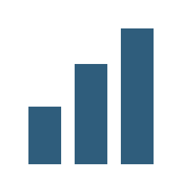
Icons
Innovation
Risk and compliance
Team
Growth
Data and analytics

