Slide 1

Reducing Audio Bandwidth with an FFT-based Low-Pass Filter
Andy Henshaw, Trent Geissler, Lauren Staples
MATH 7900 Final Project

Slide 3
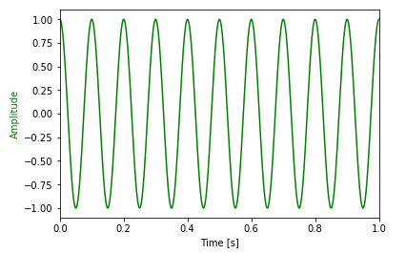

Example Audio Signal

Slide 4
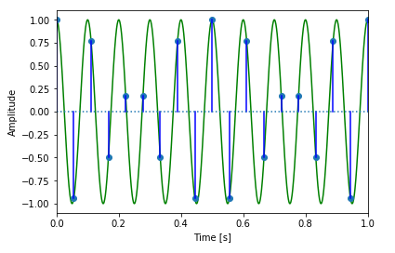

Under-sample at 18 Hz:
Notes:
N being an index of samples, starting at 0. We arrive here by plugging in n/18 for t.

Slide 5
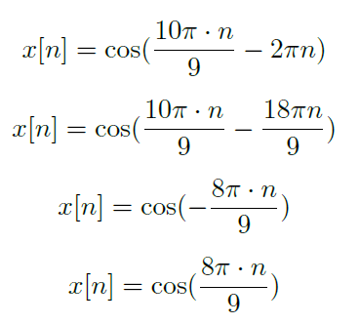
Under-sample at 18 Hz, continued:
Notes:
Because the cosine function is periodic, adding or subtracting a full period of 2pi inside the function does not change the function. The alias is caused by whatever is leftover after subtracting a full period. Cosine functions are also even functions, so negative terms become even. 8pi*n/9 is the alias created by our undersampling.

Slide 6
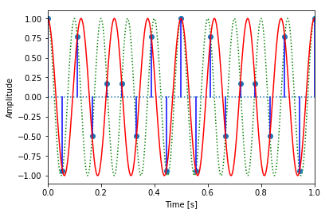

Under-sample at 18 Hz:
Notes:
There are multiple curves that intersect with our sampling points. The red curve is the curve reconstructed from the alias term caused by our undersampling.

