Slide 1

SPECTRAL-UGX
Fourier-Based Counterfeit Banknote
Detection for Uganda
MBARARA UNIVERSITY OF
SCIENCE AND TECHNOLOGY
SPECTRAL _UGX WIZARDS
DEPARTMENT OF COMPUTER SCIENCE
AHEREZA NOBERT
2025/BCS/014/PS
KISEMBO STEPHEN
2025/BCS/100/PS

Slide 2
PROJECT IDEA
THE PROBLEM STATEMENT
VALUE PROPOSITION
› Rampant circulation of Counterfeit Ugandan banknotes are a growing threat to the economy.
› Low cost counterfeit detection that is accessible to small scale traders like mobile money agents, market vendors and small businesses.
› Small scale trader vulnerabilities(shortage of funds to purchase the expensive UV counterfeit detectors).
› Available on smart phones that can easily be accessed by most parties

Slide 3
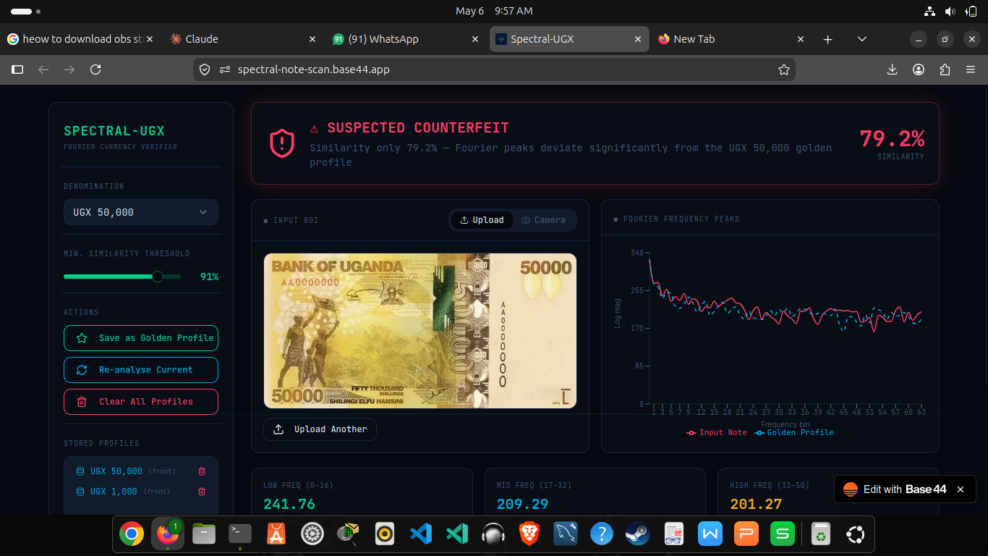
LIVE DEMO
THE PIPELINE: IMAGE → DECISION
STEP 1 — CAPTURE
A UGX banknote is photographed or uploaded. The system crops the Region of Interest (ROI) and converts it to grayscale.
STEP 2 — 2D FFT
2D Fast Fourier Transform decomposes the image:
Converts pixel intensities into frequency components.
STEP 3 — RADIAL PSD
① ROI: note cropped
& greyscaled
② 64-bin Fourier
frequency peaks plotted
Radial Power Spectral Density (PSD) is compared against stored denomination profiles
STEP 4 — PEARSON MATCH
③ Low/Mid/High freq
band averages computed
④ 79.2% similarity
→ FLAGGED COUNTERFEIT
Bin profile compared to golden profile:
r ≥ 0.90 → GENUINE ✓
r < 0.90 → COUNTERFEIT ✗
Key insight: genuine notes share nearly identical Fourier spectra — counterfeits deviate in frequency amplitude, revealing themselves mathematically.

Slide 4
ALIGNMENT WITH SUSTAINABLE DEVELOPMENT GOALS (SDGs)
01
IMAGE → FREQUENCY DOMAIN
02
03
PEARSON CORRELATION MATCH
SDG 8: DECENT WORK AND ECONOMIC GROWTH Counterfeit money harms businesses and local economies, our system supports:
Secure commerce,
Business confidence
Reduced fraud losses
SDG 1: NO POVERTY
Counterfeit money is a regressive tax on the poor. Wealthy institutions have
insurance and advanced scanners while the poor do not.
SDG 9: INDUSTRY, INNOVATION AND INFRASTRUCTURE
The project promotes:
Technological innovation
Local research and development
Frequency spectrum comparison: Input Note (red) vs. Golden Profile (blue) — 64 radial bins, log-magnitude scale

Slide 5
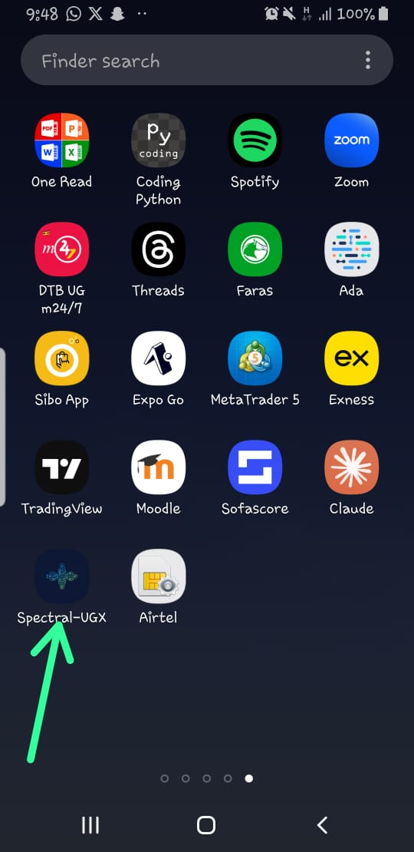
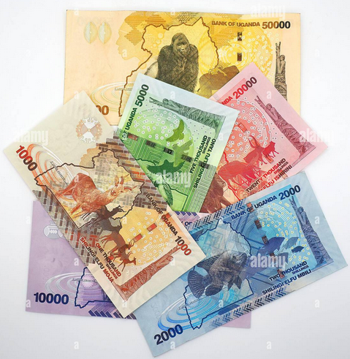
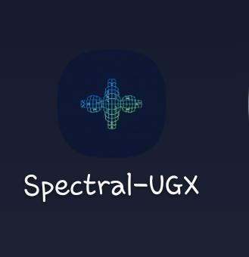
CONCLUSION
WHAT WE ACHIEVED
Link to the website: https://spectral-note-scan.base44.app
✓ Built a working web app (SPECTRAL-UGX) for UGX banknote verification.
✓ Pearson correlation threshold (≥ 90%) successfully flags suspicious notes.
✓ Supports UGX 1K,2K,5K,10K,20K and 50k denominations with stored profiles.
Presented by: SPECTRAL_UGX WIZARDS

