Slide 1

ASOW conditions for an SIP
A. Herrero Parareda, I. Vitebskiy, J. Scheuer and F. Capolino
Department of Electrical Engineering and Computer Science

Slide 2

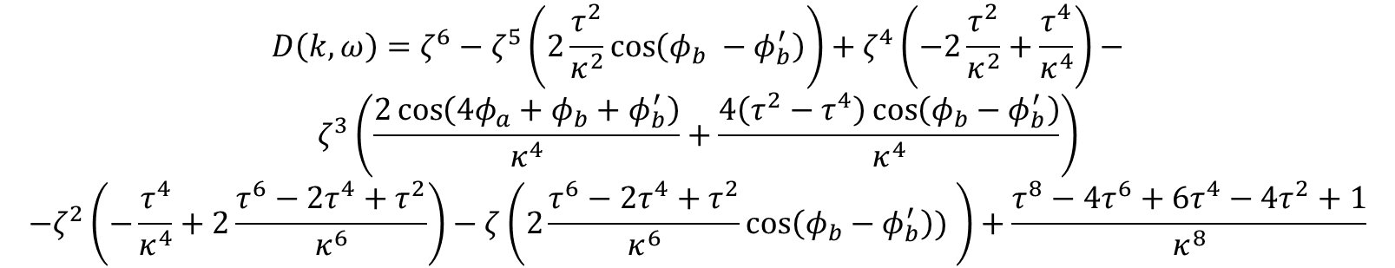


Characteristic polynomial
The eigenvalue solutions are found from the characteristic equation
$$D\left(k,ω\right)=\det\left(T_{u}−ζI\right)=0$$
where
$$ζ=e^{−jkd}$$
The full characteristic polynomial is:
$$D\left(k,ω\right)=ζ^{6}−ζ^{5}\left(2\frac{τ^{2}}{κ^{2}}\cos\left(φ_{b} −φ_{b}^{′}\right)\right)+ζ^{4}\left(−2\frac{τ^{2}}{κ^{2}}+\frac{τ^{4}}{κ^{4}}\right)−$$
$$ζ^{3}\left(\frac{2\cos\left(4φ_{a}+φ_{b}+φ_{b}^{′}\right)}{κ^{4}}+\frac{4\left(τ^{2}−τ^{4}\right)\cos\left(φ_{b}−φ_{b}^{′}\right)}{κ^{4}}\right)$$
$$−ζ^{2}\left(−\frac{τ^{4}}{κ^{4}}+2\frac{τ^{6}−2τ^{4}+τ^{2}}{κ^{6}}\right)−ζ\left(2\frac{τ^{6}−2τ^{4}+τ^{2}}{κ^{6}}\cos\left(φ_{b}−φ_{b}^{′}\right)) \right)+\frac{τ^{8}−4τ^{6}+6τ^{4}−4τ^{2}+1}{κ^{8}}$$
Evaluated at the SIP frequency, $ω_{s}$, the characteristic equation must have the form
$$D\left(k,ω_{s}\right)={\left(ζ−ζ_{s}\right)}^{3}{\left(ζ−ζ_{s}^{−1}\right)}^{3}=0$$

Slide 3
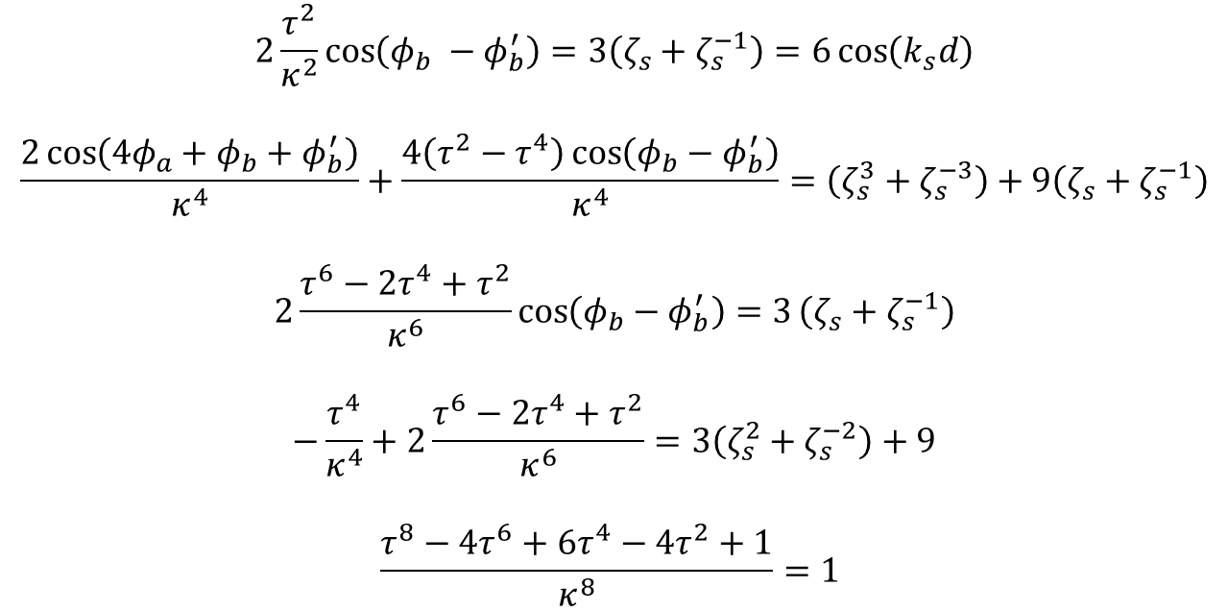
Necessary but not sufficient conditions
Equating the coefficients of both polynomials, we obtain the following five necessary conditions
$$2\frac{τ^{2}}{κ^{2}}\cos\left(φ_{b} −φ_{b}^{′}\right)=3\left(ζ_{s}+ζ_{s}^{−1}\right)=6\cos\left(k_{s}d\right)$$
$$\frac{2\cos\left(4φ_{a}+φ_{b}+φ_{b}^{′}\right)}{κ^{4}}+\frac{4\left(τ^{2}−τ^{4}\right)\cos\left(φ_{b}−φ_{b}^{′}\right)}{κ^{4}}=\left(ζ_{s}^{3}+ζ_{s}^{−3}\right)+9\left(ζ_{s}+ζ_{s}^{−1}\right)$$
$$2\frac{τ^{6}−2τ^{4}+τ^{2}}{κ^{6}}\cos\left(φ_{b}−φ_{b}^{′}\right)=3\left(ζ_{s}+ζ_{s}^{−1}\right)$$
$$−\frac{τ^{4}}{κ^{4}}+2\frac{τ^{6}−2τ^{4}+τ^{2}}{κ^{6}}=3\left(ζ_{s}^{2}+ζ_{s}^{−2}\right)+9$$
$$\frac{τ^{8}−4τ^{6}+6τ^{4}−4τ^{2}+1}{κ^{8}}=1$$

Slide 4

SIP solutions
Solving the system of equations, we find that, for a given $\backslash kappa$:
$$τ=\sqrt{1−κ^{2}}$$
$$k_{s}d=\frac{1}{2}\operatorname{acos}\left(\frac{1}{6}\left(−\frac{τ^{4}}{κ^{4}}2\frac{τ^{6}−2τ^{4}+τ^{2}}{κ^{6}}−9\right)\right)$$
$$β=α−α^{′}=\frac{1}{2Rnk_{0}}\operatorname{acos}\left(\frac{κ^{2}}{τ^{2}}3\cos\left(k_{s}d\right)\right)=\frac{1}{2Rnk_{0}}\operatorname{acos}\left(B\right)$$
$$γ=α+α^{′}=−π+ \frac{1}{2Rnk_{0}}\operatorname{acos}\left(k^{4}\left(\cos\left(3k_{s}d\right)+9\cos\left(k_{s}d\right)\right)−2\left(τ^{2}−τ^{4}\right)\frac{κ^{2}}{τ^{2}}3\cos\left(k_{s}d\right)\right)$$
$$α=\frac{γ+β}{2} \\ α^{′}=\frac{γ−β}{2}$$

Slide 5
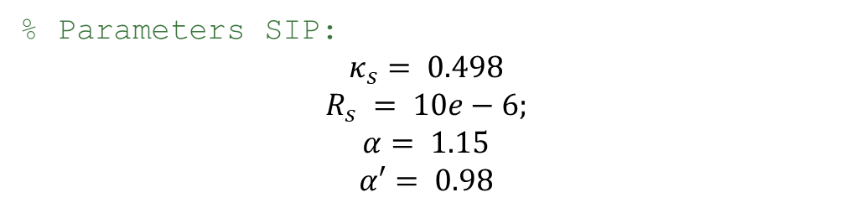
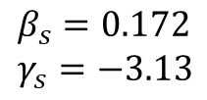
For the coupling coefficient of our SIP, we have:
% Parameters SIP:
$$κ_{s}= 0.498$$
$$R_{s} = 10e−6;$$
$$α= 1.15$$
$$α′= 0.98$$
$$β_{s}=0.172 \\ γ_{s}=−3.13$$
$$κ=0.498 →τ=0.867 →\frac{k_{s}d}{π}=0.469 →β=0.0077 →γ=−3.13→α=−1.56, α^{′}=−1.57$$
Using the same radius and coupling coefficient, we get different $β, α, α^{′}$. We still get an SIP.

Slide 6
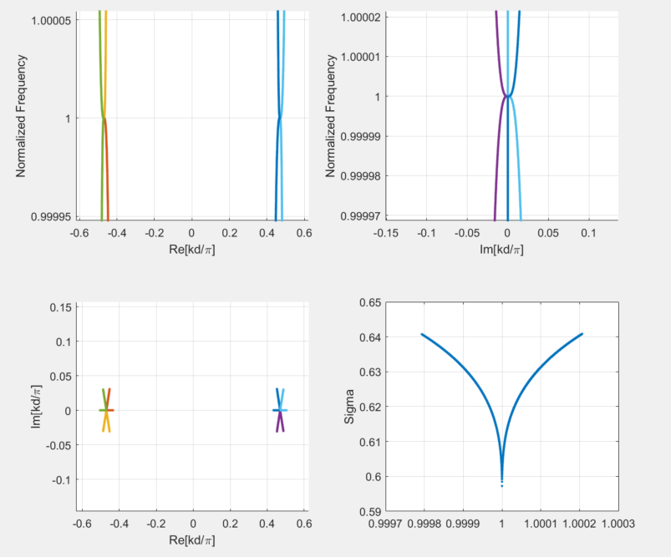
Dispersion Diagram
% Parameters SIP:
Freq_Center = 193.54;
CouplCoeff_k1 = 0.498;
Radius = 10e-6;
Alpha = -1.56;
Alpha_2 = -1.57;
The SIP we find is not the same as the one in the paper.
The angles are negative. Changing them to positive does not have an SIP.

Slide 7
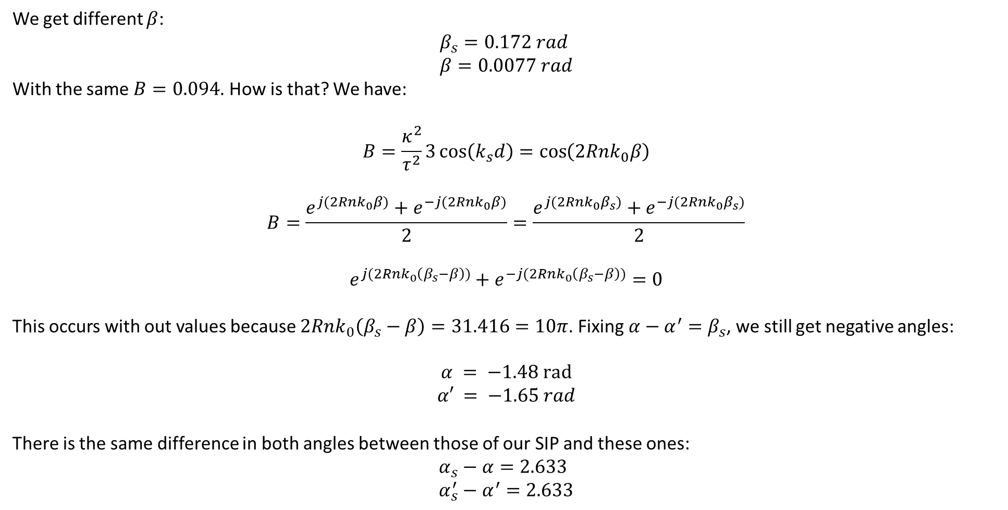
Negative angles and different SIP:
We get different $β$:
$$β_{s}=0.172 rad \\ β=0.0077 rad$$
With the same $B=0.094$. How is that? We have:
$$B=\frac{κ^{2}}{τ^{2}}3\cos\left(k_{s}d\right)=\cos\left(2Rnk_{0}β\right)$$
$$B=\frac{e^{j(2Rnk_{0}β)}+e^{−j(2Rnk_{0}β)}}{2}=\frac{e^{j(2Rnk_{0}β_{s})}+e^{−j(2Rnk_{0}β_{s})}}{2}$$
$$e^{j(2Rnk_{0}\left(β_{s}−β\right))}+e^{−j(2Rnk_{0}\left(β_{s}−β\right))}=0$$
This occurs with out values because $2Rnk_{0}\left(β_{s}−β\right)=31.416=10π$. Fixing $α−α^{′}=β_{s}$, we still get negative angles:
$$α = −1.48 rad$$
$$α′ = −1.65 rad$$
There is the same difference in both angles between those of our SIP and these ones:
$$α_{s}−α=2.633 \\ α_{s}^{′}−α^{′}=2.633$$

Slide 8
Angles and SIP
After adding these difference, we recover the SIP of the paper.
Adding other numbers: $1, 3, …$ does not excite an SIP. Why?

