Slide 1

ASOW conditions for an SIP
A. Herrero Parareda, I. Vitebskiy, J. Scheuer and F. Capolino
Department of Electrical Engineering and Computer Science

Slide 2
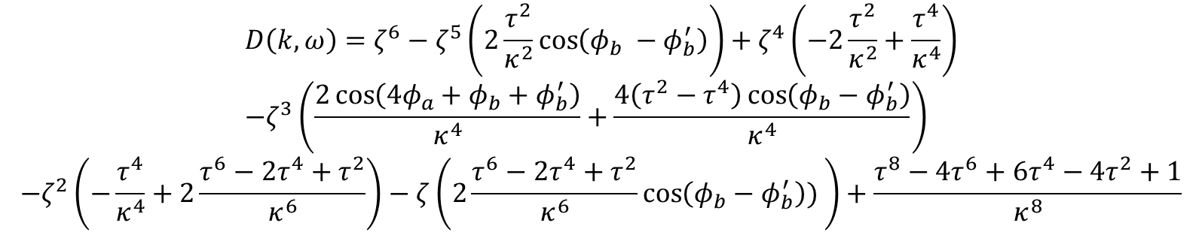


Characteristic polynomial
The eigenvalue solutions are found from the characteristic equation
$$D\left(k,ω\right)=\det\left(T_{u}−ζI\right)=0$$
where
$$ζ=e^{−jkd}$$
The full characteristic polynomial is:
$$D\left(k,ω\right)=ζ^{6}−ζ^{5}\left(2\frac{τ^{2}}{κ^{2}}\cos\left(φ_{b} −φ_{b}^{′}\right)\right)+ζ^{4}\left(−2\frac{τ^{2}}{κ^{2}}+\frac{τ^{4}}{κ^{4}}\right) \\ −ζ^{3}\left(\frac{2\cos\left(4φ_{a}+φ_{b}+φ_{b}^{′}\right)}{κ^{4}}+\frac{4\left(τ^{2}−τ^{4}\right)\cos\left(φ_{b}−φ_{b}^{′}\right)}{κ^{4}}\right)$$
$$−ζ^{2}\left(−\frac{τ^{4}}{κ^{4}}+2\frac{τ^{6}−2τ^{4}+τ^{2}}{κ^{6}}\right)−ζ\left(2\frac{τ^{6}−2τ^{4}+τ^{2}}{κ^{6}}\cos\left(φ_{b}−φ_{b}^{′}\right)) \right)+\frac{τ^{8}−4τ^{6}+6τ^{4}−4τ^{2}+1}{κ^{8}}$$

Slide 3
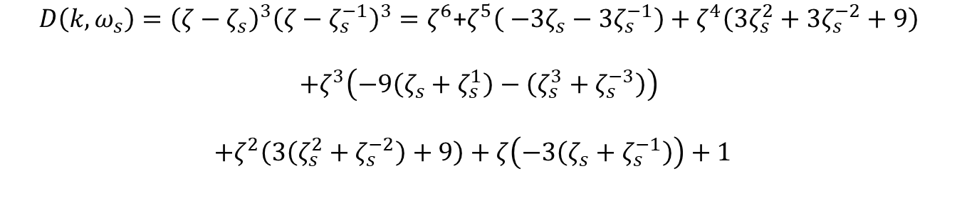

Dispersion relation in the vicinity of the SIP
Evaluated at the SIP frequency, $ω_{s}$, the characteristic equation must have the form
$$D\left(k,ω_{s}\right)={\left(ζ−ζ_{s}\right)}^{3}{\left(ζ−ζ_{s}^{−1}\right)}^{3}=ζ^{6}\text{+}ζ^{5}\left( −3ζ_{s}−3ζ_{s}^{−1}\right)+ζ^{4}\left(3ζ_{s}^{2}+3ζ_{s}^{−2}+9\right)$$ $$+ζ^{3}\left(−9\left(ζ_{s}+ζ_{s}^{1}\right)−\left(ζ_{s}^{3}+ζ_{s}^{−3}\right)\right)$$
$$+ζ^{2}\left(3\left(ζ_{s}^{2}+ζ_{s}^{−2}\right)+9\right)+ζ\left(−3\left(ζ_{s}+ζ_{s}^{−1}\right)\right)+1$$
where we have that
$$ζ_{s}+ζ_{s}^{−1}=2cos\left(k_{s}d\right) \\ ζ_{s}^{2}+ζ_{s}^{−2}=2cos\left(2k_{s}d\right) \\ ζ_{s}^{3}+ζ_{s}^{−3}=2cos\left(3k_{s}d\right)$$

Slide 4
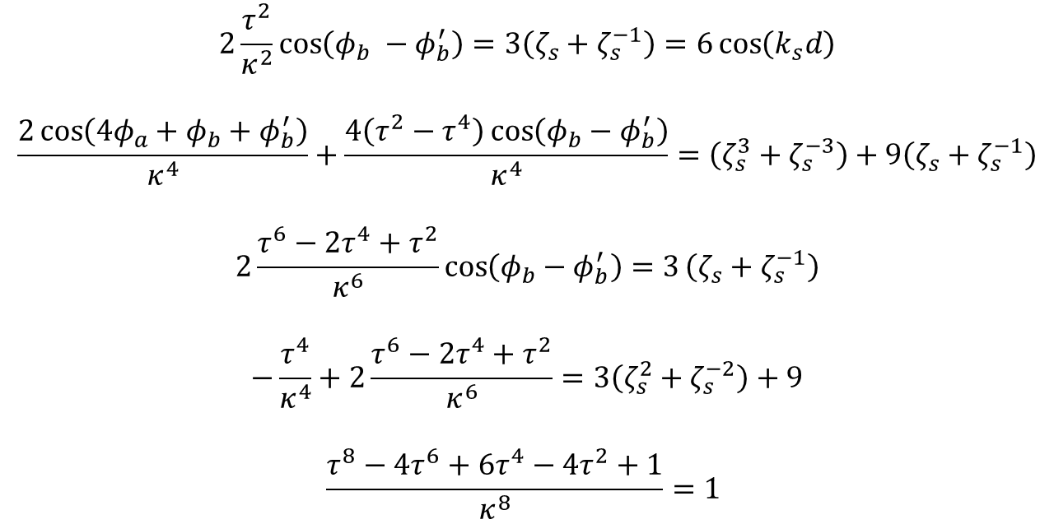
Necessary but not sufficient conditions
Equating the coefficients of both polynomials when evaluated at $ω_{s}$, we obtain the following five necessary conditions
$$2\frac{τ^{2}}{κ^{2}}\cos\left(φ_{b} −φ_{b}^{′}\right)=3\left(ζ_{s}+ζ_{s}^{−1}\right)=6\cos\left(k_{s}d\right)$$
$$\frac{2\cos\left(4φ_{a}+φ_{b}+φ_{b}^{′}\right)}{κ^{4}}+\frac{4\left(τ^{2}−τ^{4}\right)\cos\left(φ_{b}−φ_{b}^{′}\right)}{κ^{4}}=\left(ζ_{s}^{3}+ζ_{s}^{−3}\right)+9\left(ζ_{s}+ζ_{s}^{−1}\right)$$
$$2\frac{τ^{6}−2τ^{4}+τ^{2}}{κ^{6}}\cos\left(φ_{b}−φ_{b}^{′}\right)=3\left(ζ_{s}+ζ_{s}^{−1}\right)$$
$$−\frac{τ^{4}}{κ^{4}}+2\frac{τ^{6}−2τ^{4}+τ^{2}}{κ^{6}}=3\left(ζ_{s}^{2}+ζ_{s}^{−2}\right)+9$$
$$\frac{τ^{8}−4τ^{6}+6τ^{4}−4τ^{2}+1}{κ^{8}}=1$$
Using the lossless condition $τ^{2}+κ^{2}=1$, we find that the left hand side first and third are equivalent. The fifth one is equivalent to the lossless condition and the fourth one determines $k_{s}d$ from the coupling coefficient $κ$.

Slide 5

SIP solutions
Solving the system of equations, we find that, for a given $κ$:
$$k_{s}d=\frac{1}{2}\operatorname{acos}\left(\frac{1}{6}\left(−\frac{τ^{4}}{κ^{4}}+2\frac{τ^{6}−2τ^{4}+τ^{2}}{κ^{6}}−9\right)\right)$$
$$β=α−α^{′}=\frac{1}{2Rnk_{0}}\operatorname{acos}\left(\frac{κ^{2}}{τ^{2}}3\cos\left(k_{s}d\right)\right)=\frac{1}{2Rnk_{0}}\operatorname{acos}\left(B\right)$$
$$γ=α+α^{′}=−π+ \frac{1}{2Rnk_{0}}\operatorname{acos}\left(κ^{4}\left(\cos\left(3k_{s}d\right)+9\cos\left(k_{s}d\right)\right)−2\left(τ^{2}−τ^{4}\right)\frac{κ^{2}}{τ^{2}}3\cos\left(k_{s}d\right)\right)$$
$$α=\frac{γ+β}{2} \\ α^{′}=\frac{γ−β}{2}$$

Slide 6
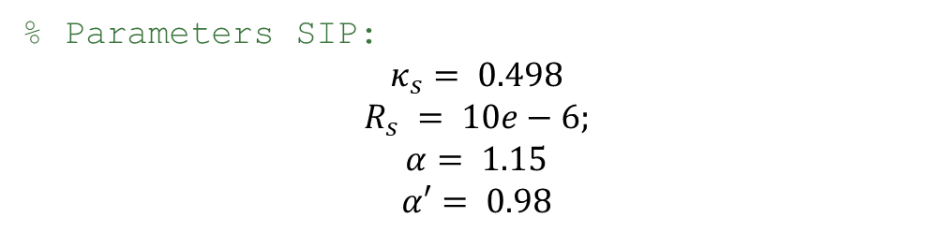
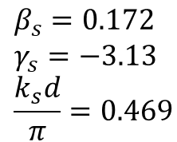
For the coupling coefficient of the SIP of the paper, we have:
% Parameters SIP:
$$κ_{s}= 0.498$$
$$R_{s} = 10e−6;$$
$$α= 1.15$$
$$α′= 0.98$$
$$β_{s}=0.172 \\ γ_{s}=−3.13 \\ \frac{k_{s}d}{π}=0.469$$
$$κ=0.498 →τ=0.867 →\frac{k_{s}d}{π}=0.469 →β=0.0077 →γ=−3.13→α=−1.56, α^{′}=−1.57$$
Using the same radius and coupling coefficient, we get different $β, α, α^{′}$. We still get an SIP.

Slide 7
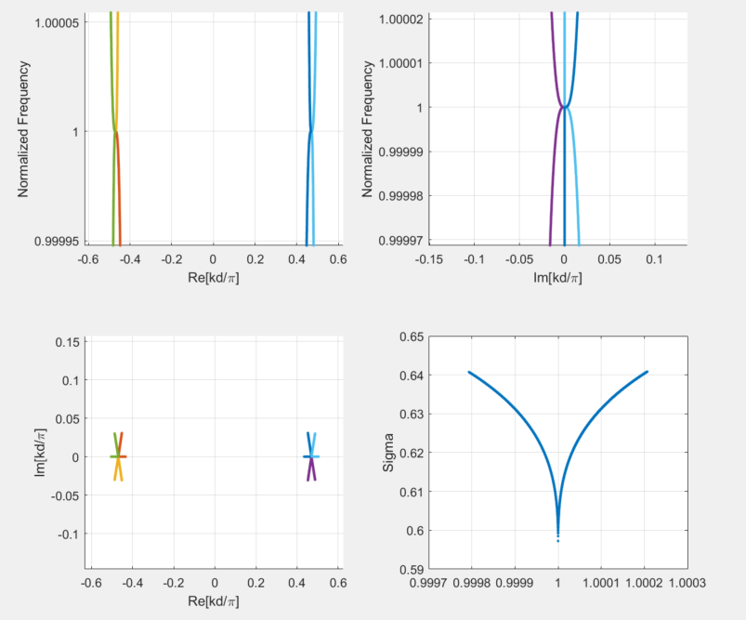
Dispersion Diagram of the SIP found analytically
% Parameters SIP:
Freq_Center = 193.54;
CouplCoeff_k1 = 0.498;
Radius = 10e-6;
Alpha = -1.56;
Alpha_2 = -1.57;
The SIP we find is not the same as the one in the paper.
The angles are negative. Changing them to positive does not show an SIP.

Slide 8
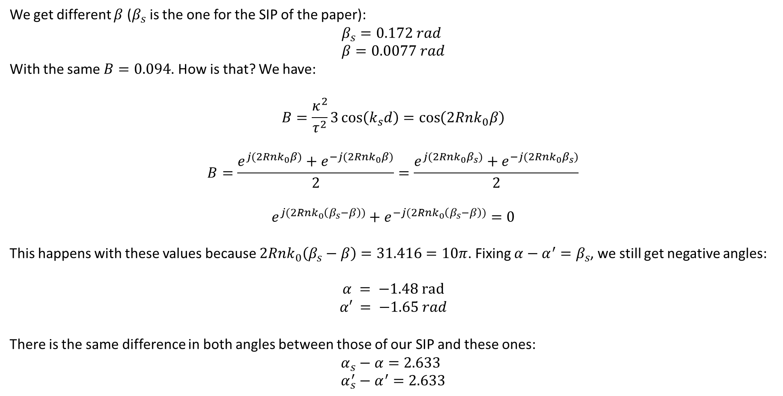
Negative angles and different SIP:
We get different $β$ ($β_{s}$ is the one for the SIP of the paper):
$$β_{s}=0.172 rad \\ β=0.0077 rad$$
With the same $B=0.094$. How is that? We have:
$$B=\frac{κ^{2}}{τ^{2}}3\cos\left(k_{s}d\right)=\cos\left(2Rnk_{0}β\right)$$
$$B=\frac{e^{j(2Rnk_{0}β)}+e^{−j(2Rnk_{0}β)}}{2}=\frac{e^{j(2Rnk_{0}β_{s})}+e^{−j(2Rnk_{0}β_{s})}}{2}$$
$$e^{j(2Rnk_{0}\left(β_{s}−β\right))}+e^{−j(2Rnk_{0}\left(β_{s}−β\right))}=0$$
This happens with these values because $2Rnk_{0}\left(β_{s}−β\right)=31.416=10π$. Fixing $α−α^{′}=β_{s}$, we still get negative angles:
$$α = −1.48 rad$$
$$α′ = −1.65 rad$$
There is the same difference in both angles between those of our SIP and these ones:
$$α_{s}−α=2.633 \\ α_{s}^{′}−α^{′}=2.633$$

Slide 9
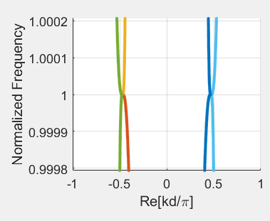
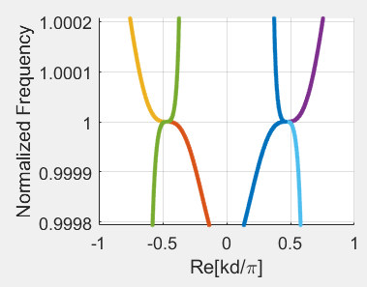
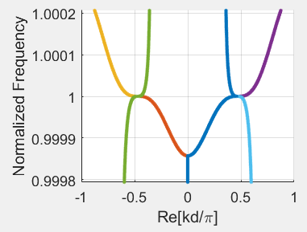
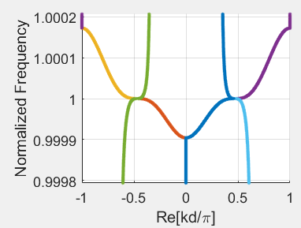


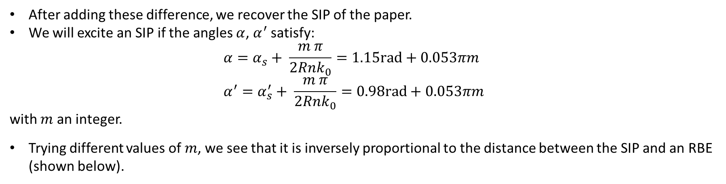


Angles and SIP
After adding these difference, we recover the SIP of the paper.
We will excite an SIP if the angles $α$, $α^{′}$ satisfy: $α=α_{s}+ \frac{m π}{2Rnk_{0}}=1.15rad+0.053πm$ $α^{′}=α_{s}^{′}+ \frac{m π}{2Rnk_{0}}=0.98rad+0.053πm$
with $m$ an integer.
Trying different values of $m$, we see that it is inversely proportional to the distance between the SIP and an RBE (shown below).
$$m=1$$
$$m=100$$
$$m=200$$
$$m=300$$

Slide 10
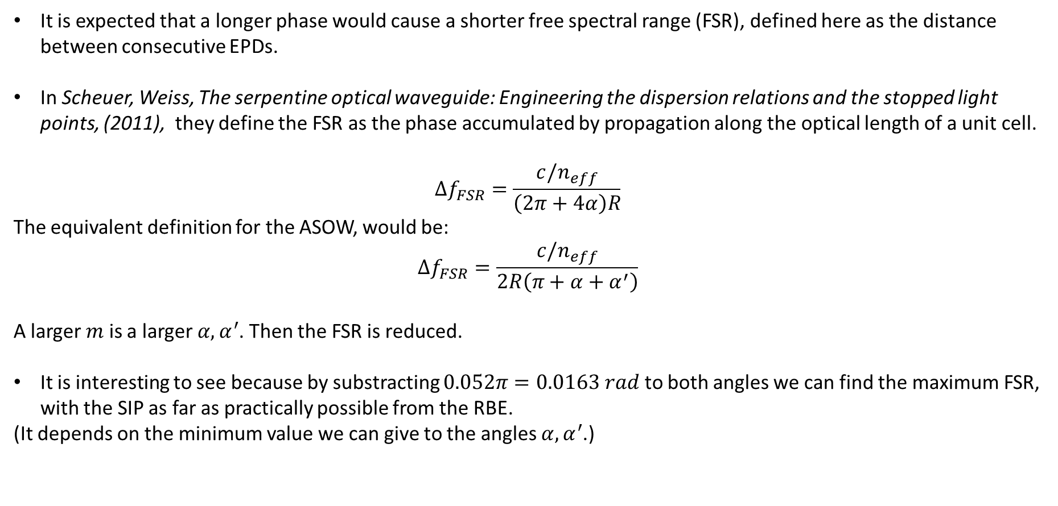
Impact
It is expected that a longer phase would cause a shorter free spectral range (FSR), defined here as the distance between consecutive EPDs.
In Scheuer, Weiss, The serpentine optical waveguide: Engineering the dispersion relations and the stopped light points, (2011), they define the FSR as the phase accumulated by propagation along the optical length of a unit cell.
$$Δf_{FSR}=\frac{c/n_{eff}}{\left(2π+4α\right)R}$$
The equivalent definition for the ASOW, would be:
$$Δf_{FSR}=\frac{c/n_{eff}}{2R\left(π+α+α^{′}\right)}$$
A larger $m$ is a larger $α,α^{′}$. Then the FSR is reduced.
It is interesting to see because by substracting $0.052π=0.0163 rad$ to both angles we can find the maximum FSR, with the SIP as far as practically possible from the RBE.
(It depends on the minimum value we can give to the angles $α,α^{′}$.)

Slide 11
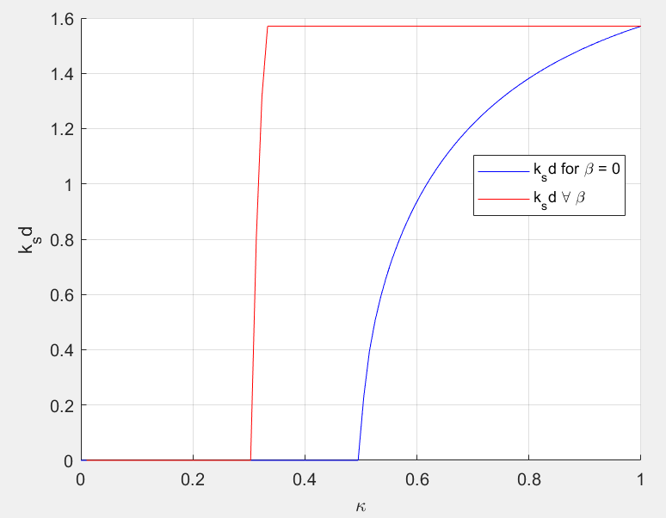
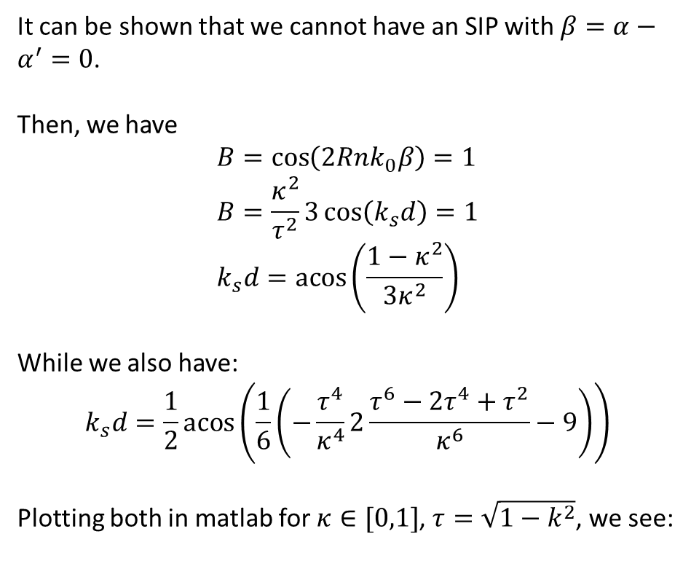
No SIP on SOW
It can be shown that we cannot have an SIP with $β=α−α^{′}=0$.
Then, we have
$$B=\cos\left(2Rnk_{0}β\right)=1 \\ B=\frac{κ^{2}}{τ^{2}}3\cos\left(k_{s}d\right)=1 \\ k_{s}d=\operatorname{acos}\left(\frac{1−κ^{2}}{3κ^{2}}\right)$$
While we also have:
$$k_{s}d=\frac{1}{2}\operatorname{acos}\left(\frac{1}{6}\left(−\frac{τ^{4}}{κ^{4}}2\frac{τ^{6}−2τ^{4}+τ^{2}}{κ^{6}}−9\right)\right)$$
Plotting both in matlab for $κ∈[0,1]$, $τ=\sqrt{1−k^{2}}$, we see:
It can be shown formally if you want to go further into it.

