Slide 1

ASOW with a complex refractive index
A. Herrero Parareda, I. Vitebskiy, J. Scheuer and F. Capolino
Department of Electrical Engineering and Computer Science

Slide 2
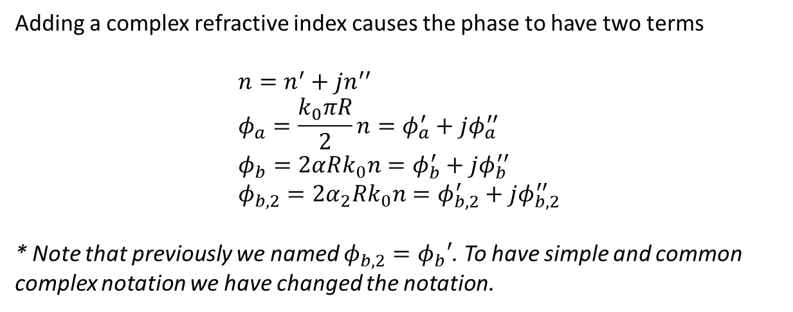
Phases
Adding a complex refractive index causes the phase to have two terms
$$n=n^{′}+jn^{′′} \\ φ_{a}=\frac{k_{0}πR}{2}n=φ_{a}^{′}+jφ_{a}^{′′} \\ φ_{b}=2αRk_{0}n=φ_{b}^{′}+jφ_{b}^{′′} \\ φ_{b,2}=2α_{2}Rk_{0}n=φ_{b,2}^{′}+jφ_{b,2}^{′′}$$
* Note that previously we named $φ_{b,2}=φ_{b}′$. To have simple and common complex notation we have changed the notation.

Slide 3
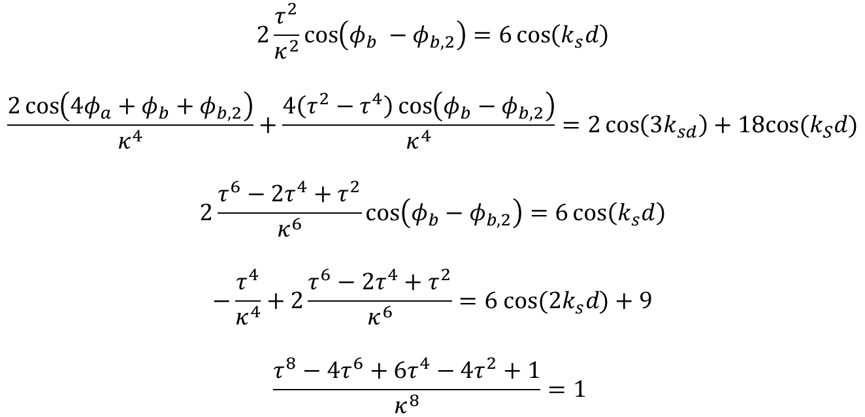
Necessary equations to obtain an SIP in ASOW
$$2\frac{τ^{2}}{κ^{2}}\cos\left(φ_{b} −φ_{b,2}\right)=6\cos\left(k_{s}d\right)$$
$$\frac{2\cos\left(4φ_{a}+φ_{b}+φ_{b,2}\right)}{κ^{4}}+\frac{4\left(τ^{2}−τ^{4}\right)\cos\left(φ_{b}−φ_{b,2}\right)}{κ^{4}}=2\cos\left(3k_{sd}\right)+18cos⁡(k_{S}d)$$
$$2\frac{τ^{6}−2τ^{4}+τ^{2}}{κ^{6}}\cos\left(φ_{b}−φ_{b,2}\right)=6\cos\left(k_{s}d\right)$$
$$−\frac{τ^{4}}{κ^{4}}+2\frac{τ^{6}−2τ^{4}+τ^{2}}{κ^{6}}=6 cos⁡(2k_{s}d)+9$$
$$\frac{τ^{8}−4τ^{6}+6τ^{4}−4τ^{2}+1}{κ^{8}}=1$$
But now $φ_{a}, φ_{b}, φ_{b,2}, k_{s}=k_{s}^{′}+jk_{s}^{′′}$ are complex.

Slide 4
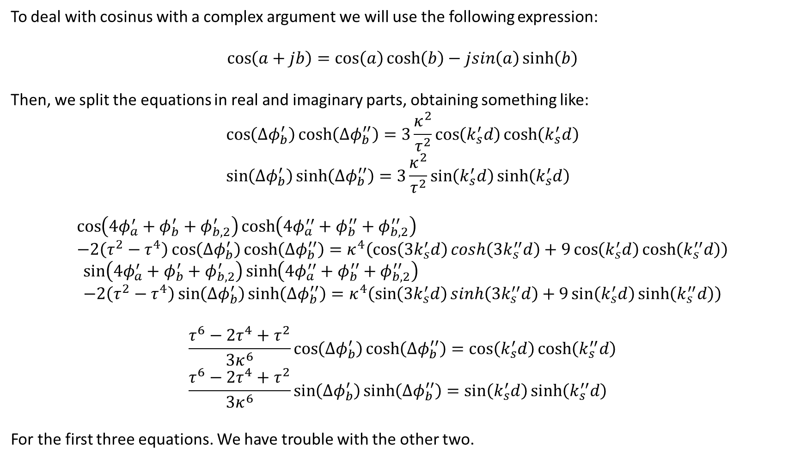
Complex cosinus
To deal with cosinus with a complex argument we will use the following expression:
$$\cos\left(a+jb\right)=\cos\left(a\right)\cosh\left(b\right)−jsin\left(a\right)\sinh\left(b\right)$$
Then, we split the equations in real and imaginary parts, obtaining something like:
$$\cos\left(Δφ_{b}^{′}\right)\cosh\left(Δφ_{b}^{′′}\right)=3\frac{κ^{2}}{τ^{2}}\cos\left(k_{s}^{′}d\right)\cosh\left(k_{s}^{′}d\right) \\ \sin\left(Δφ_{b}^{′}\right)\sinh\left(Δφ_{b}^{′′}\right)=3\frac{κ^{2}}{τ^{2}}\sin\left(k_{s}^{′}d\right)\sinh\left(k_{s}^{′}d\right)$$
$$\cos\left(4φ_{a}^{′}+φ_{b}^{′}+φ_{b,2}^{′}\right)\cosh\left(4φ_{a}^{′′}+φ_{b}^{′′}+φ_{b,2}^{′′}\right) \\ −2\left(τ^{2}−τ^{4}\right)\cos\left(Δφ_{b}^{′}\right)\cosh\left(Δφ_{b}^{′′}\right)=κ^{4}\left(\cos\left(3k_{s}^{′}d\right)cosh\left({3k}_{s}^{′′}d\right)+9\cos\left(k_{s}^{′}d\right)\cosh\left(k_{s}^{′′}d\right)\right)$$
$$\sin\left(4φ_{a}^{′}+φ_{b}^{′}+φ_{b,2}^{′}\right)\sinh\left(4φ_{a}^{′′}+φ_{b}^{′′}+φ_{b,2}^{′′}\right) \\ −2\left(τ^{2}−τ^{4}\right)\sin\left(Δφ_{b}^{′}\right)\sinh\left(Δφ_{b}^{′′}\right)=κ^{4}\left(\sin\left(3k_{s}^{′}d\right)sinh\left({3k}_{s}^{′′}d\right)+9\sin\left(k_{s}^{′}d\right)\sinh\left(k_{s}^{′′}d\right)\right)$$
$$\frac{τ^{6}−2τ^{4}+τ^{2}}{3κ^{6}}\cos\left(Δφ_{b}^{′}\right)\cosh\left(Δφ_{b}^{′′}\right)=\cos\left(k_{s}^{′}d\right)\cosh\left(k_{s}^{′′}d\right) \\ \frac{τ^{6}−2τ^{4}+τ^{2}}{3κ^{6}}\sin\left(Δφ_{b}^{′}\right)\sinh\left(Δφ_{b}^{′′}\right)=\sin\left(k_{s}^{′}d\right)\sinh\left(k_{s}^{′′}d\right)$$
For the first three equations. We have trouble with the other two.

Slide 5
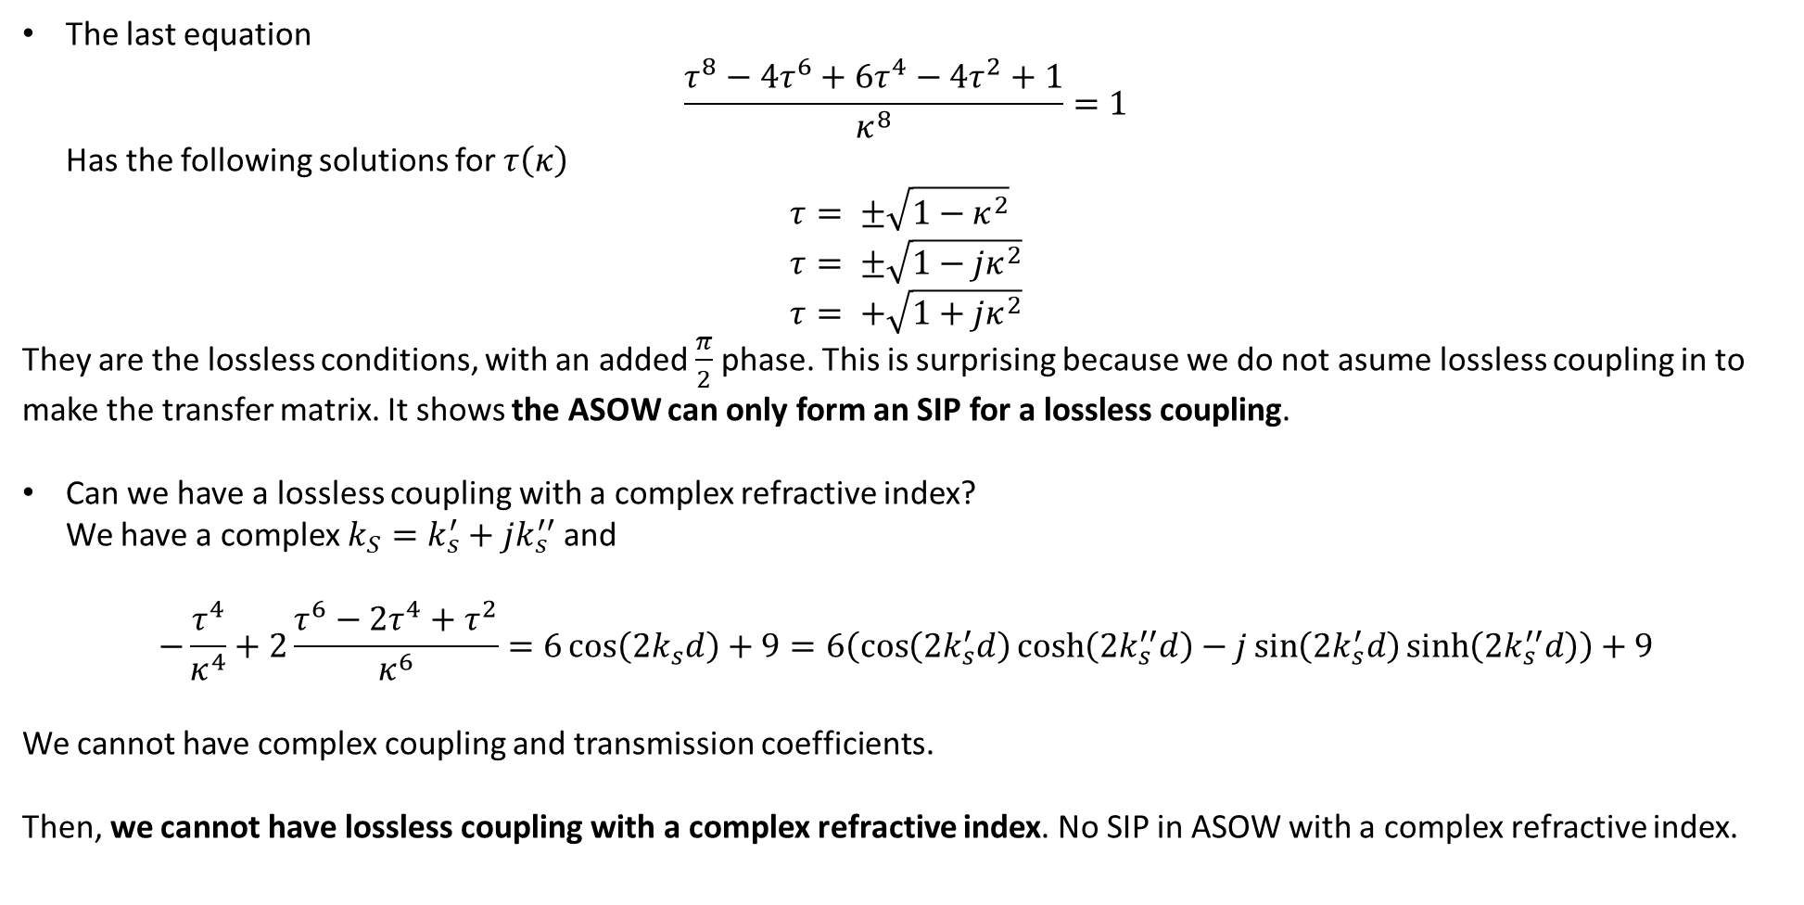
Issues
The last equation $\frac{τ^{8}−4τ^{6}+6τ^{4}−4τ^{2}+1}{κ^{8}}=1$ Has the following solutions for $τ\left(κ\right)$
$$τ= ±\sqrt{1−κ^{2}} \\ τ= ±\sqrt{1−jκ^{2}} \\ τ= +\sqrt{1+jκ^{2}}$$
They are the lossless conditions, with an added $\frac{π}{2}$ phase. This is surprising because we do not asume lossless coupling in to make the transfer matrix. It shows the ASOW can only form an SIP for a lossless coupling.
Can we have a lossless coupling with a complex refractive index? We have a complex $k_{S}=k_{s}^{′}+jk_{s}^{′′}$ and
$$−\frac{τ^{4}}{κ^{4}}+2\frac{τ^{6}−2τ^{4}+τ^{2}}{κ^{6}}=6\cos\left(2k_{s}d\right)+9=6\left(\cos\left(2k_{s}^{′}d\right)\cosh\left({2k}_{s}^{′′}d\right)−j\sin\left({2k}_{s}^{′}d\right)\sinh\left(2k_{s}^{′′}d\right)\right)+9$$
We cannot have complex coupling and transmission coefficients.
Then, we cannot have lossless coupling with a complex refractive index. No SIP in ASOW with a complex refractive index.

Slide 6
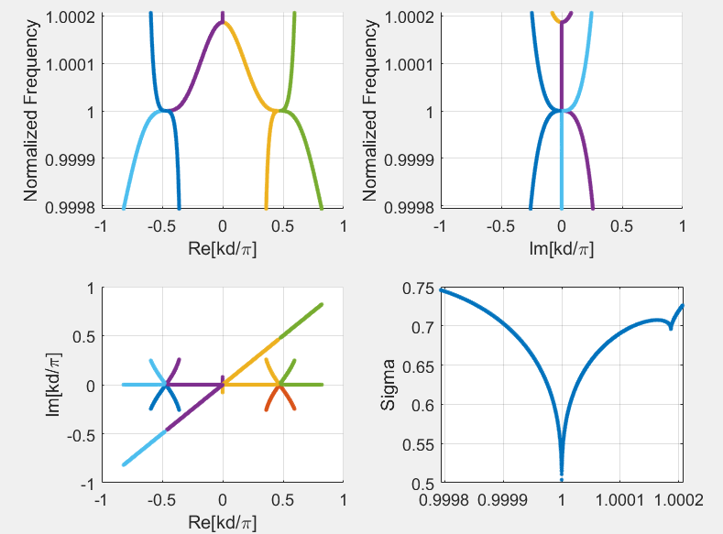
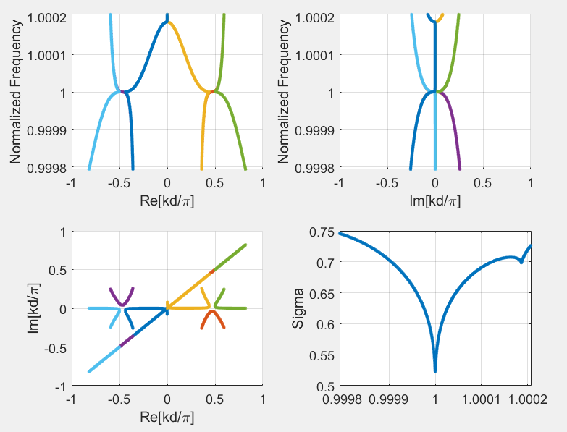
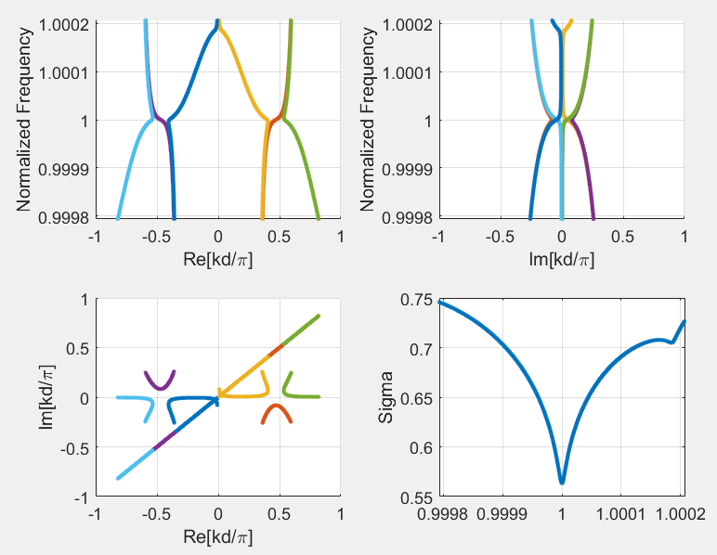



Small n’’: Dispersion diagram
$$n=2.362$$
$$n=2.362−j{10}^{−6}$$
$$n=2.362−j{10}^{−5}$$

Slide 7
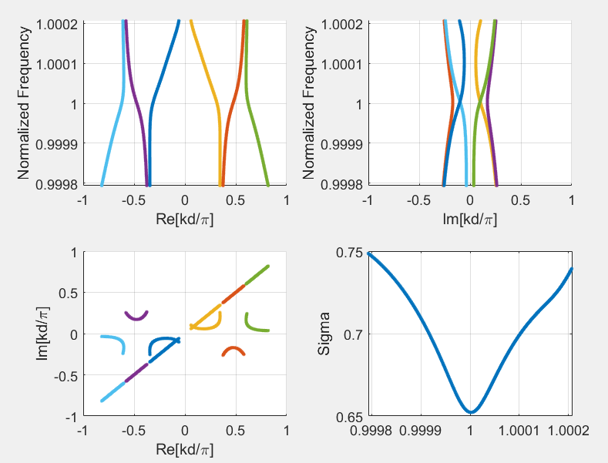


Small n’’: Dispersion diagram
$$n=2.362$$
$$n=2.362−j{10}^{−5}$$
$$n=2.362−j{10}^{−4}$$
The quality of the SIP disappears very fast when a complex refractive index is added.

Slide 8
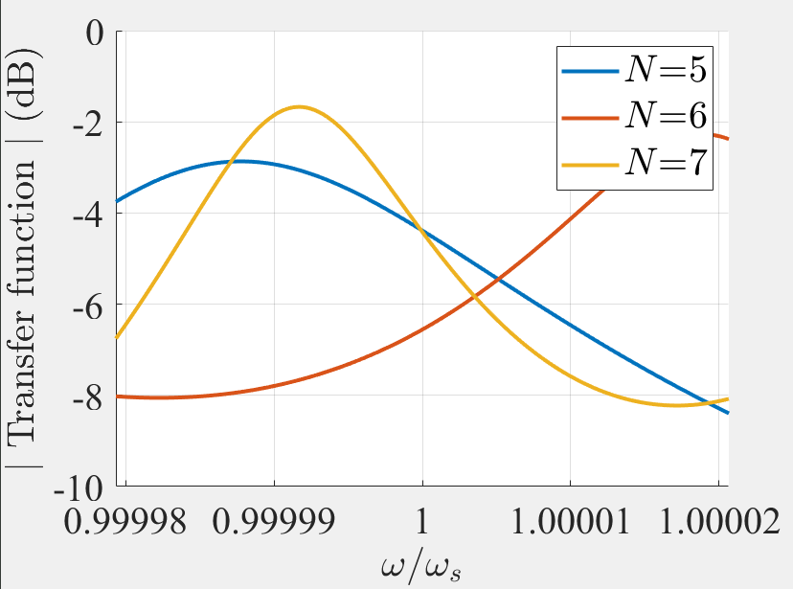
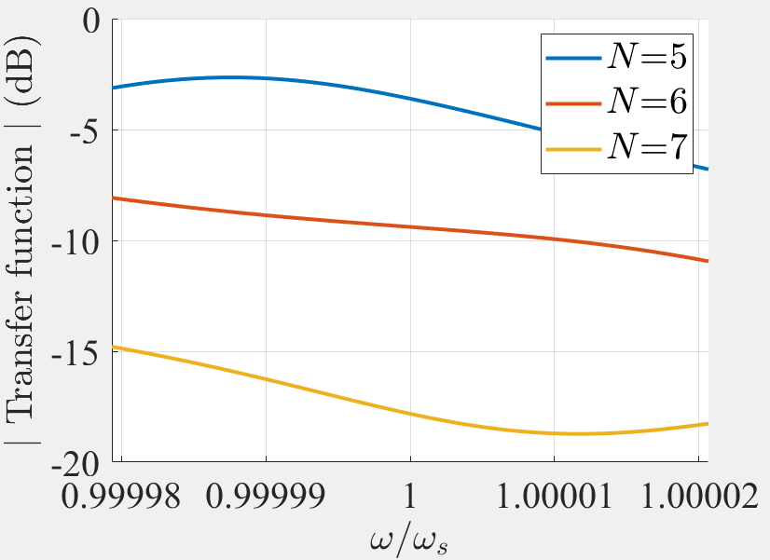


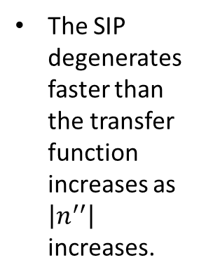
Small n’’: Dispersion diagram and transfer function
The SIP degenerates faster than the transfer function increases as $\left|n^{′′}\right|$ increases.
$$n=2.362$$
$$n=2.362−j{10}^{−4}$$

Slide 9
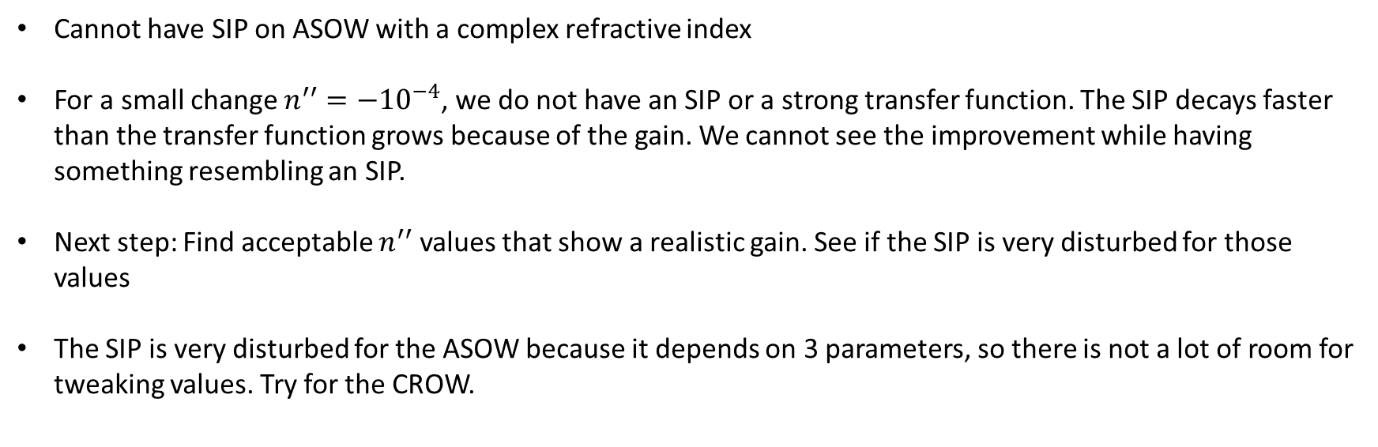
Discussion
Cannot have SIP on ASOW with a complex refractive index
For a small change $n^{′′}=−{10}^{−4}$, we do not have an SIP or a strong transfer function. The SIP decays faster than the transfer function grows because of the gain. We cannot see the improvement while having something resembling an SIP.
Next step: Find acceptable $n^{′′}$ values that show a realistic gain. See if the SIP is very disturbed for those values
The SIP is very disturbed for the ASOW because it depends on 3 parameters, so there is not a lot of room for tweaking values. Try for the CROW.

