Slide 1

$Q$ for large $N$ in 6DBE-ASOW
A. Herrero and F. Capolino
Department of Electrical Engineering and Computer Science

Slide 2
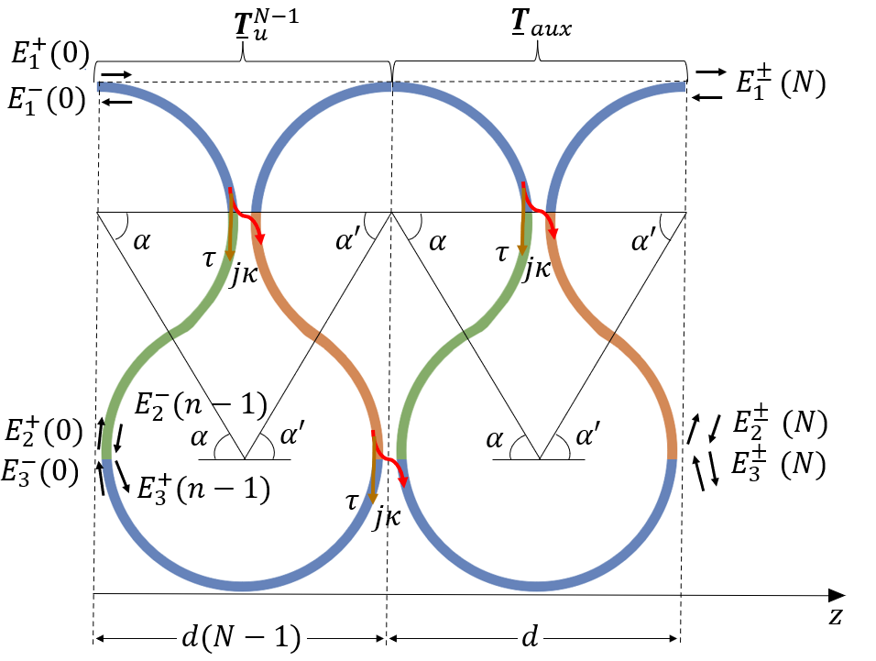
Quality factor for large N
To find $Q$, we find first the transfer function, $T_{f}$. To do that we have a $12×12$matrix $A$, which has the transfer matrix for the finite-length structure & the boundary conditions (BC) in it. The numerical errors originate when solving the system $Ax=b$ near the 6DBE frequency.
$$Ax=b$$
$$A= \left(\begin{matrix}T_{aux}T_{u}^{N−1} & −I_{d} \\ BC & BC\end{matrix}\right)$$
$$b= \left(BC\right)$$
Solve for $x$:
$$x=\left(\begin{matrix}E^{±}(0) \\ E^{±}\left(L\right)\end{matrix}\right)$$
$$T_{f}=\frac{E_{out}}{E_{inc}}=\frac{E_{1}^{+}(L)}{E_{1}^{+}(0)} \\ τ_{g}=−\frac{∂∠T_{f}}{∂ω} \\ Q=\frac{τ_{g}ω_{res}}{2}$$
We must find a way to increase $N$ without increasing numerical errors substantially

Slide 3
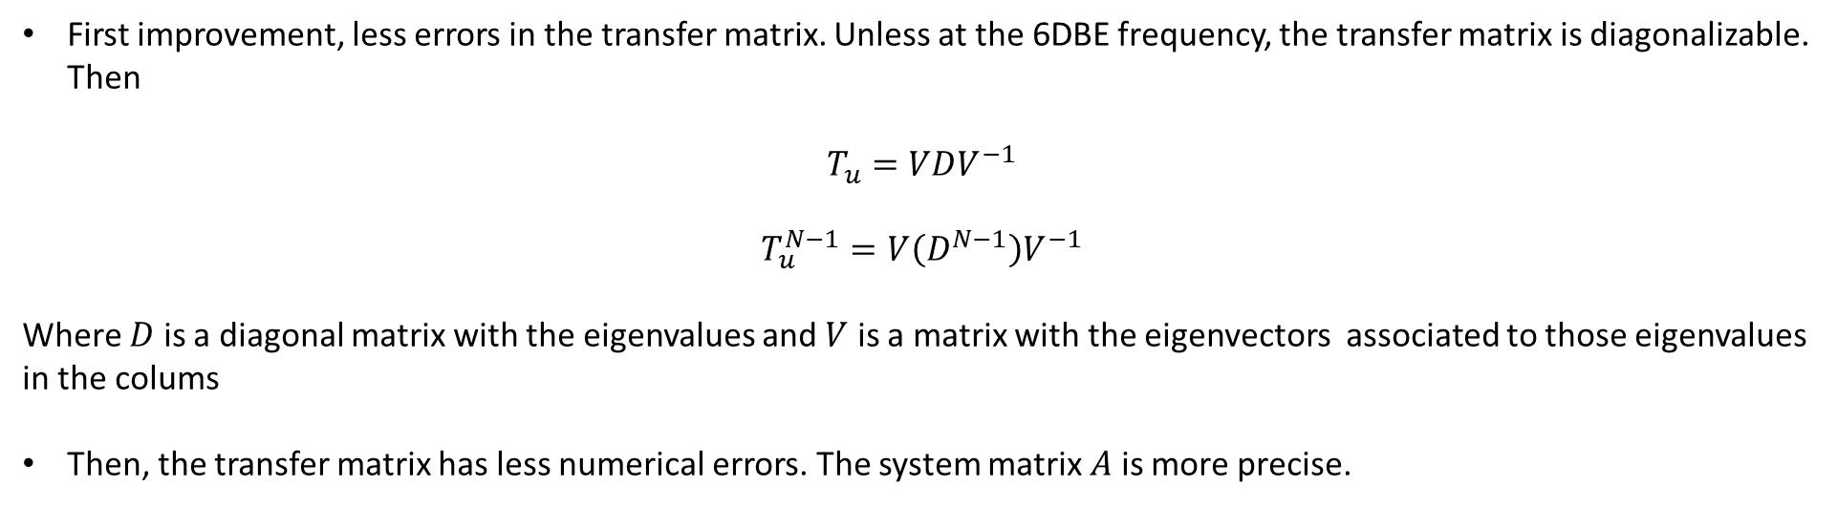
Quality factor for large N
First improvement, less errors in the transfer matrix. Unless at the 6DBE frequency, the transfer matrix is diagonalizable. Then
$$T_{u}=VDV^{−1}$$
$$T_{u}^{N−1}=V\left(D^{N−1}\right)V^{−1}$$
Where $D$ is a diagonal matrix with the eigenvalues and $V$ is a matrix with the eigenvectors associated to those eigenvalues in the colums
Then, the transfer matrix has less numerical errors. The system matrix $A$ is more precise.

Slide 4
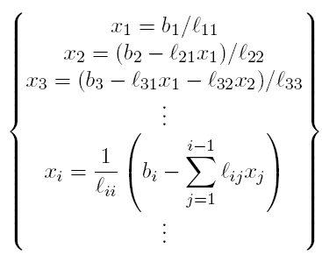
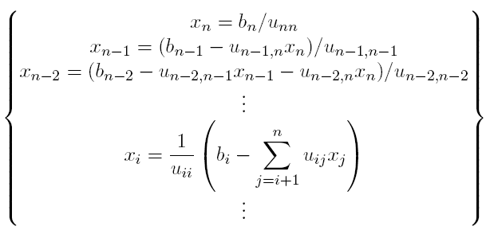
Quality factor for large N
We want to increase the number of unit cells $N$ without have more numerical errors.
Option 1: $x = A\backslash b$. This returns a least-squares solution to the system
Option 2: $PA = LU$, in which $L, U$are lower & upper triangular matrices. Then, $LUx=Pb, Ux = z, Lz = Pb$. Both have an algebraic solution. Calculate $z$, then $x$
Option 3: $x = linsolve(A,b),$a MATLAB function that does $LU$-decomposition, $A = LU$, without partial pivoting (the $P$ is a permutation matrix, which helps avoid error propagation)
Triangular matrix algorithms:
$$Lx=b$$
Forward substitution algorightm
$$Ux=b$$
Backward substitution algorithm
There are algorithms to improve the numerical solution of $Ax = b$

Slide 5
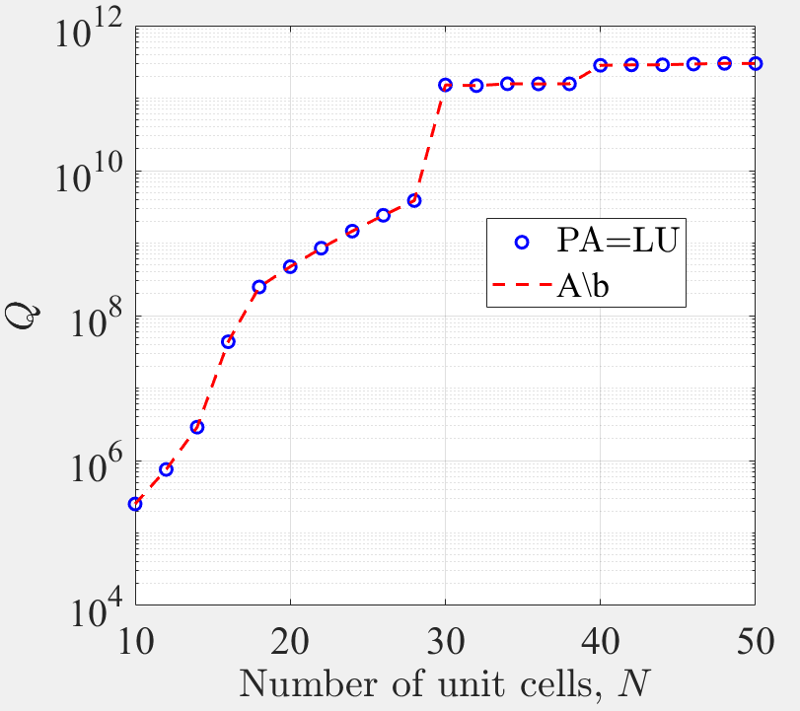
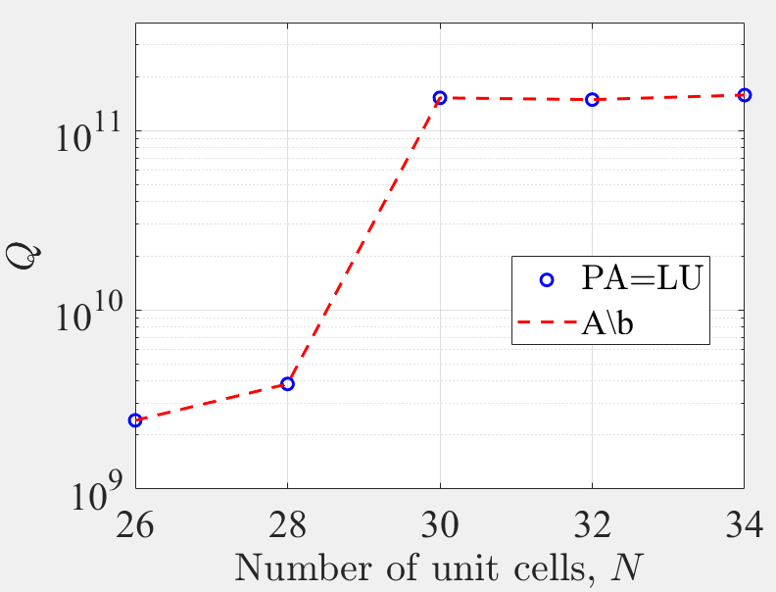
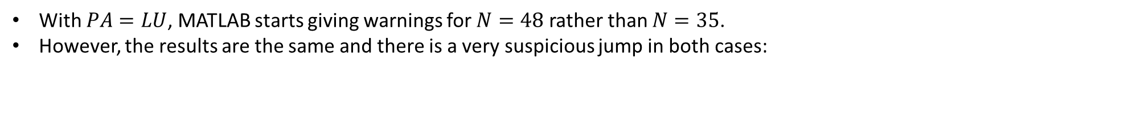
Quality factor for large N
With $PA=LU$, MATLAB starts giving warnings for $N=48$ rather than $N=35$.
However, the results are the same and there is a very suspicious jump in both cases:
There is a big change for $N = 30$. Hard to fit.

