Slide 1

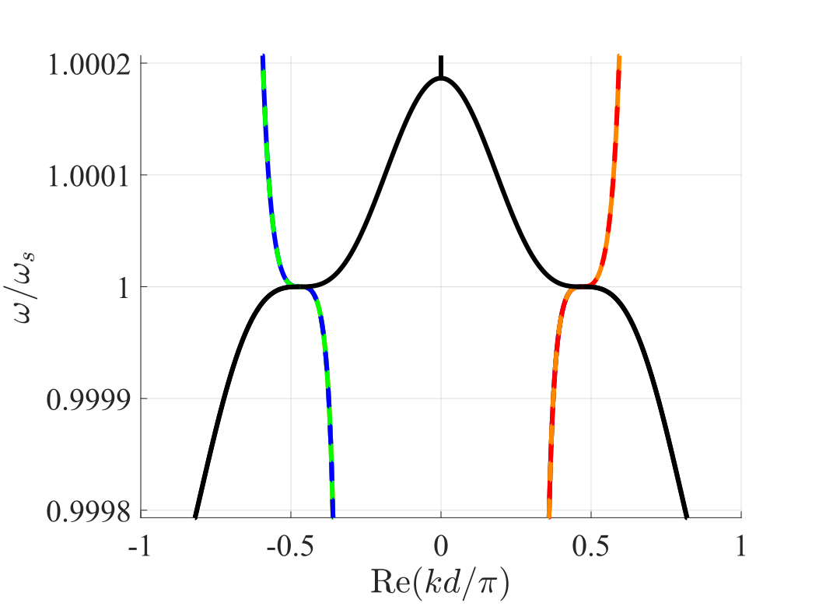
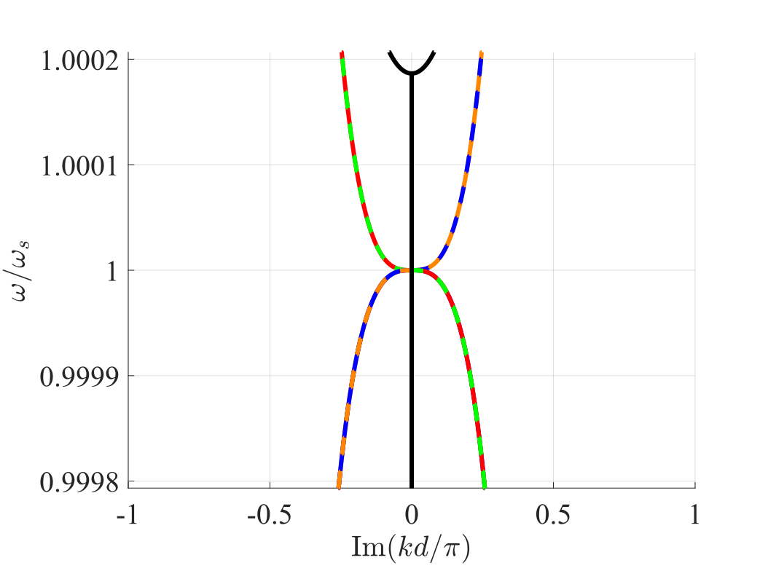
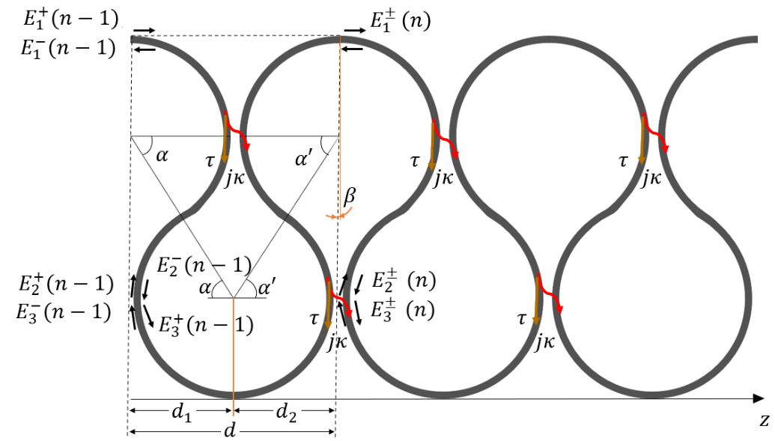
Frozen mode in an asymmetric serpentine optical waveguide
A. Herrero Parareda, I. Vitebskiy, J. Scheuer and F. Capolino
Department of Electrical Engineering and Computer Science

Slide 2

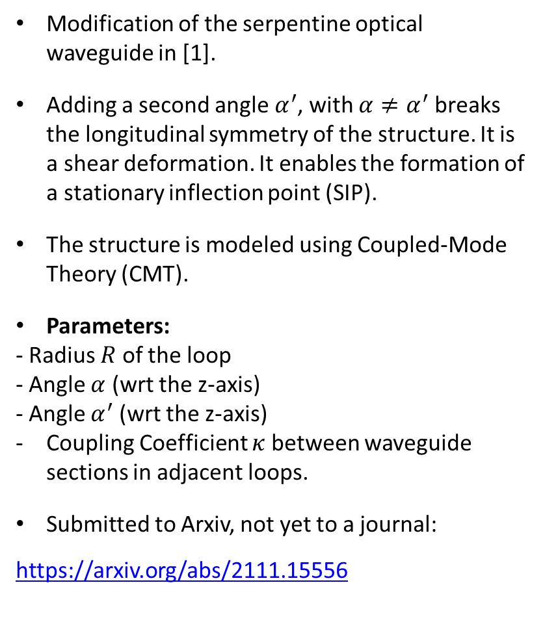
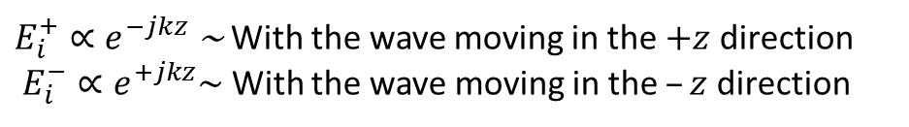
Asymmetric serpentine optical waveguide (ASOW)
Modification of the serpentine optical waveguide in [1].
Adding a second angle $α^{′}$, with $α≠α^{′}$ breaks the longitudinal symmetry of the structure. It is a shear deformation. It enables the formation of a stationary inflection point (SIP).
The structure is modeled using Coupled-Mode Theory (CMT).
Parameters:
- Radius $R$ of the loop
- Angle $α$ (wrt the z-axis)
- Angle $α^{′}$ (wrt the z-axis)
Coupling Coefficient $κ$ between waveguide sections in adjacent loops.
Submitted to Arxiv, not yet to a journal:
https://arxiv.org/abs/2111.15556
$E_{i}^{+}∝e^{−jkz}$~ With the wave moving in the $+z$ direction
$E_{i}^{−}∝e^{+jkz}\sim$ With the wave moving in the $–z$ direction
[1] Scheuer, Weiss, “The Serpentine Optical Waveguide: engineering the dispersion relations and the stopped light points”, Opt. Express 19, 11517, 2011

Slide 3
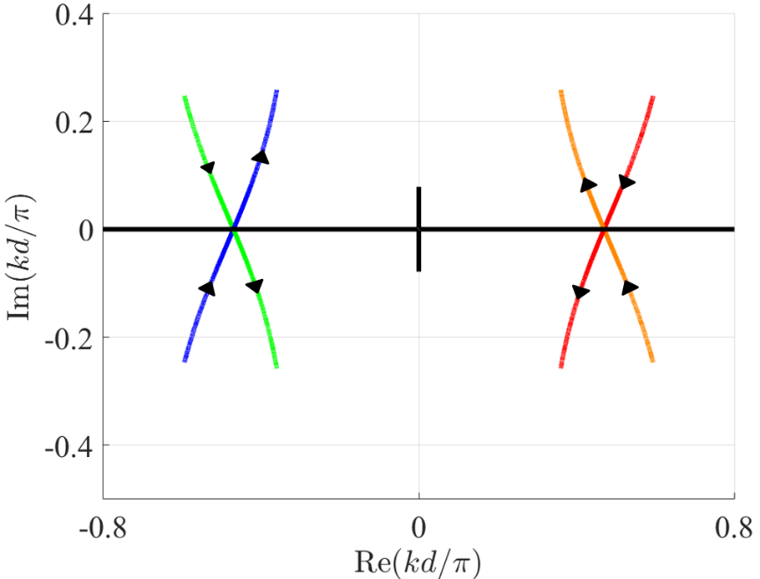
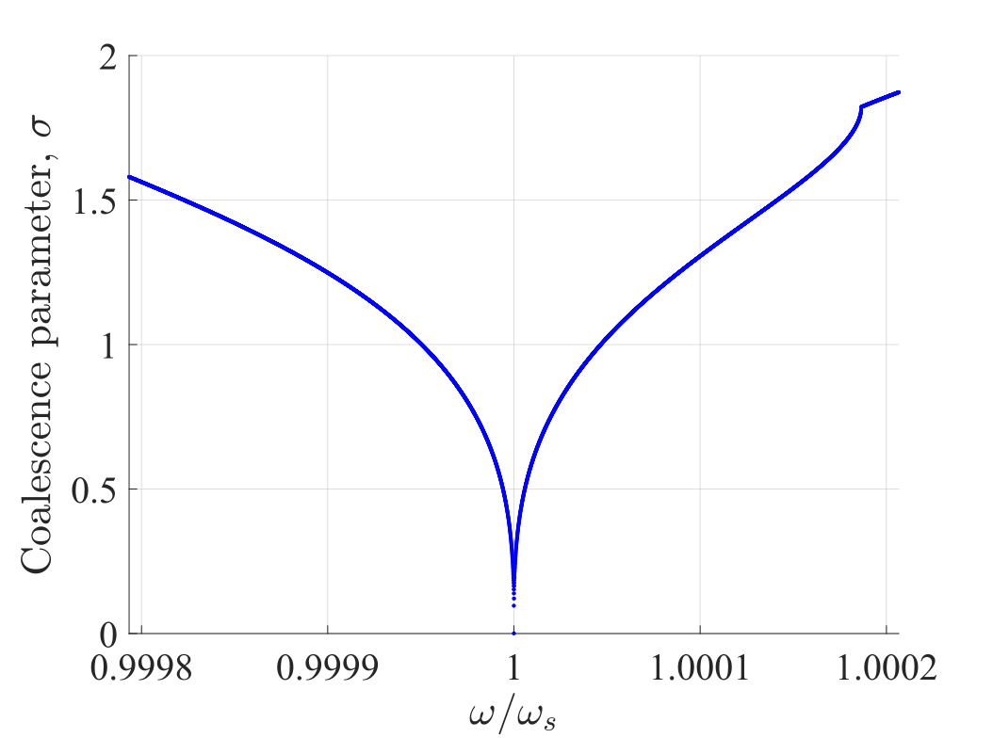
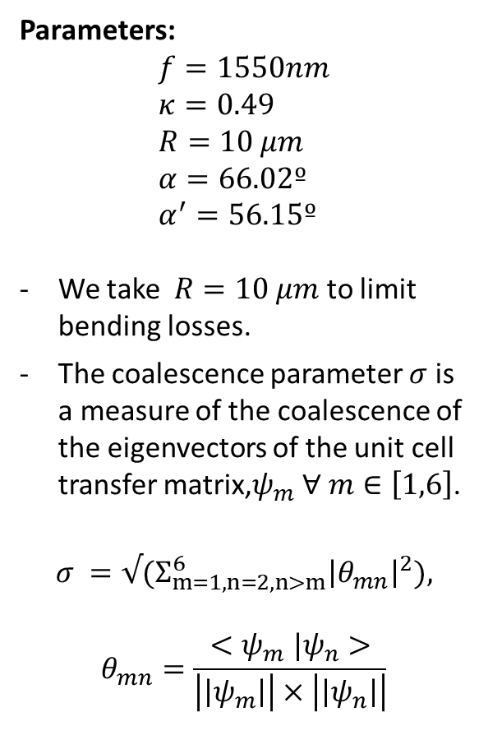
Dispersion diagram for a unit cell at the SIP
Parameters:
$$f=1550nm \\ κ=0.49 \\ R=10 μm \\ α=66.02º \\ α^{′}=56.15º$$
We take $R=10 μm$ to limit bending losses.
The coalescence parameter $σ$ is a measure of the coalescence of the eigenvectors of the unit cell transfer matrix,$ψ_{m} ∀ m∈\left[1,6\right]$.
$$σ =√{(Σ}_{m=1, n=2, n>m}^{6}{\left|θ_{mn}\right|}^{2}),$$ $$θ_{mn}=\frac{{<ψ}_{m}|ψ_{n}>}{\left|\left|ψ_{m}\right|\right|×\left|\left|ψ_{n}\right|\right|}$$

Slide 4
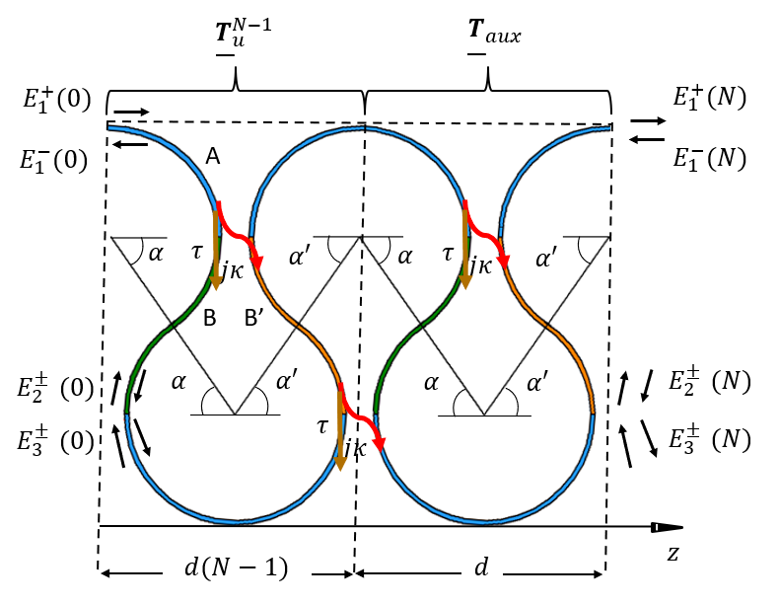
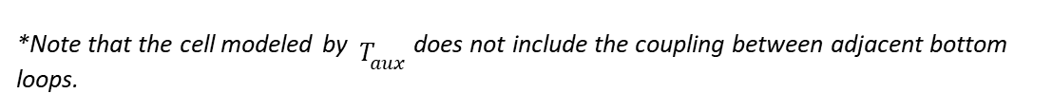

Finite-length SIP-ASOW
By connecting the two bottom ports of each side with a waveguide section, we transform the 6-port device into a 2-port.
$$[E^{±}\left(N\right)]=T_{aux}·{\left(T_{u}\right)}^{N}·[E^{±}\left(0\right)]$$
${ T}_{u} \sim$ Transfer matrix of the unit cell
$T_{aux}$~ Transfer matrix without the second coupling point
$l=d×N \sim$ Length of the finite length structure
$N \sim$ Number of unit cells
The boundary conditions are:
$E_{1}^{+}(0)= E_{inc}$ $E_{1}^{−}(N)=0$ $E_{2}^{+}(0)=E_{3}^{−}(0)$ $E_{3}^{+}\left(0\right)=E_{2}^{−}\left(0\right)$ $E_{2}^{−}(N)=E_{3}^{+}(N)$ $E_{3}^{−}(N)=E_{2}^{+}(N)$
_{*Note that the cell modeled} _{by} $T_{aux}$ does not include the coupling between adjacent bottom loops.

Slide 5
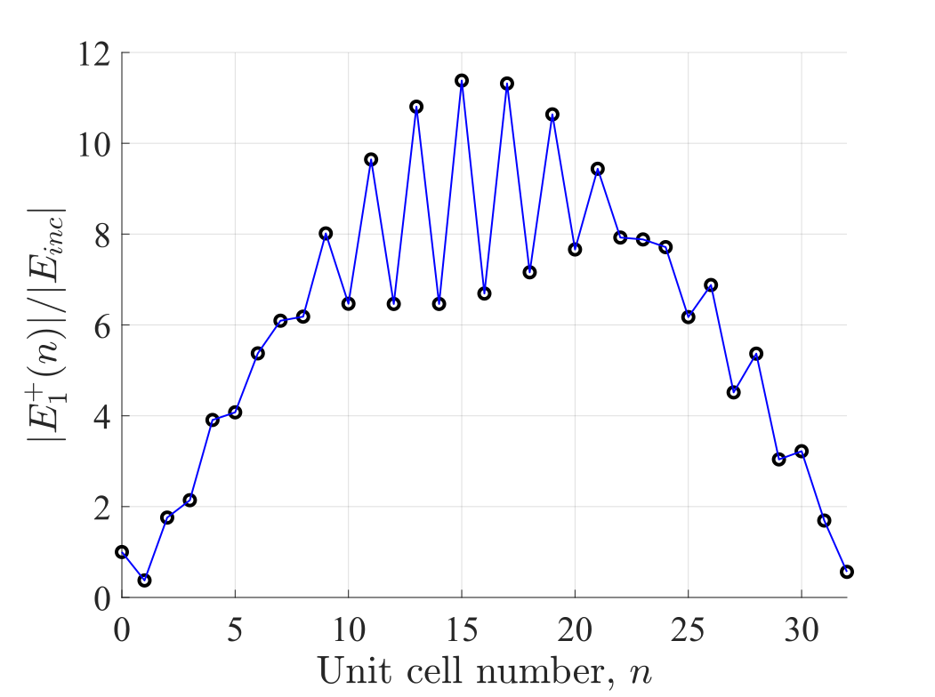
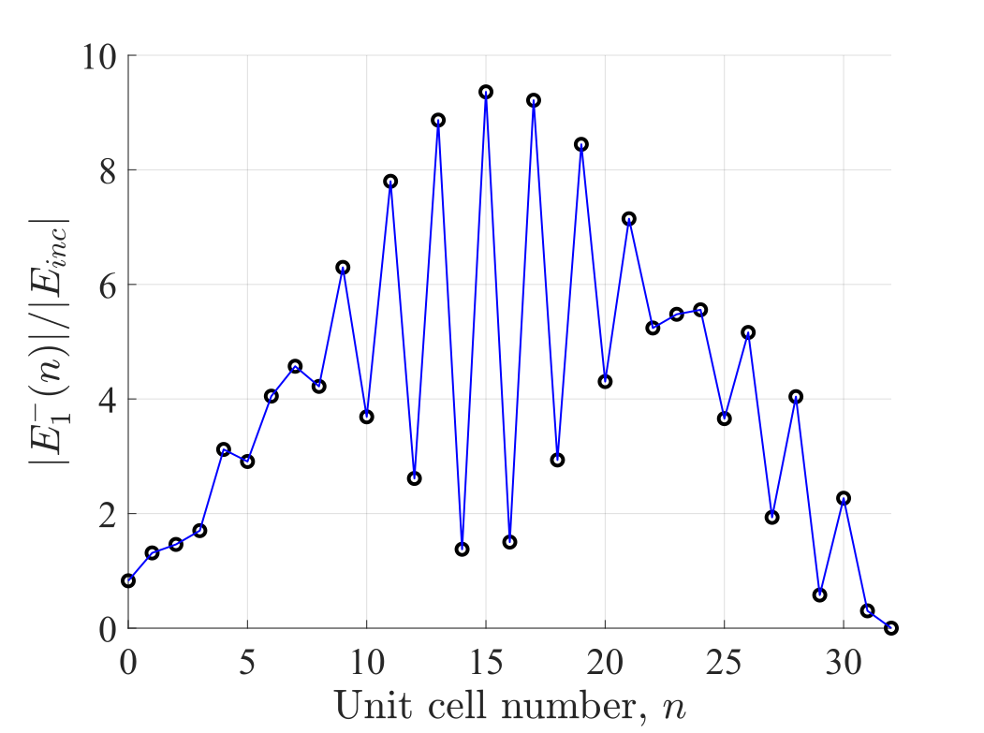
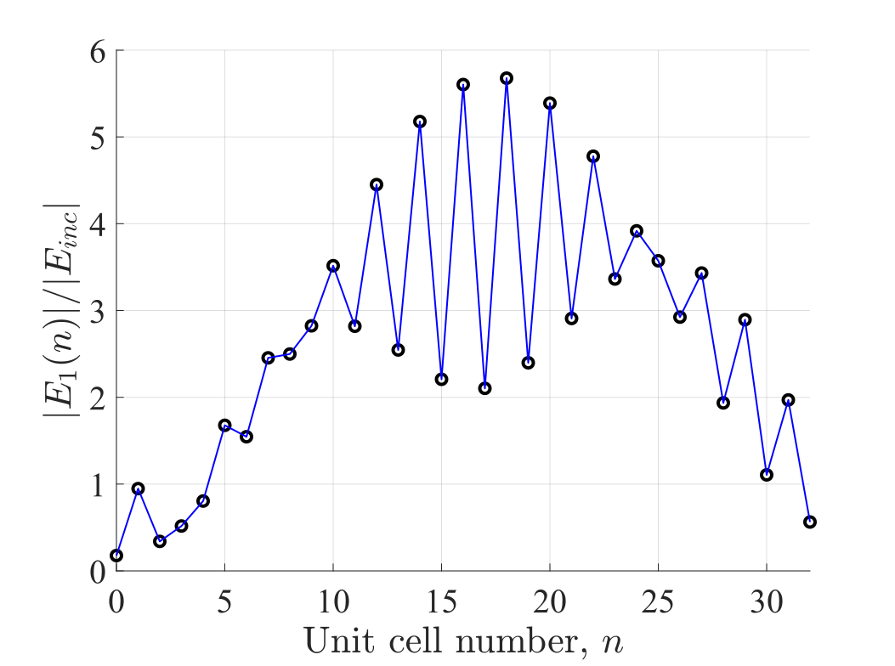
Field amplitudes inside the finite-length SIP-ASOW
The field amplitudes satisfy the boundary conditions at the edges of the SIP-ASOW.
The dramatic field amplitude increase characteristic of the SIP-related frozen mode is in full display.

Slide 6
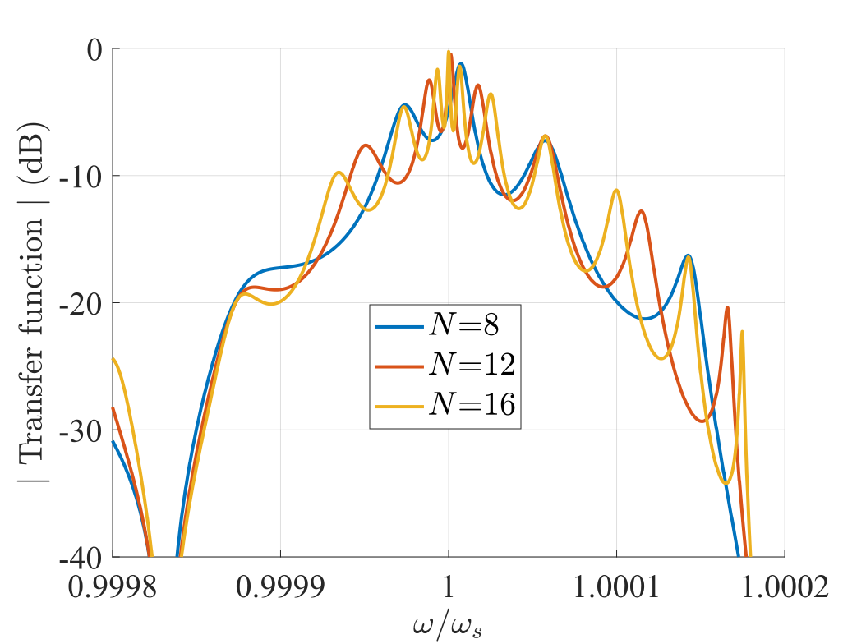
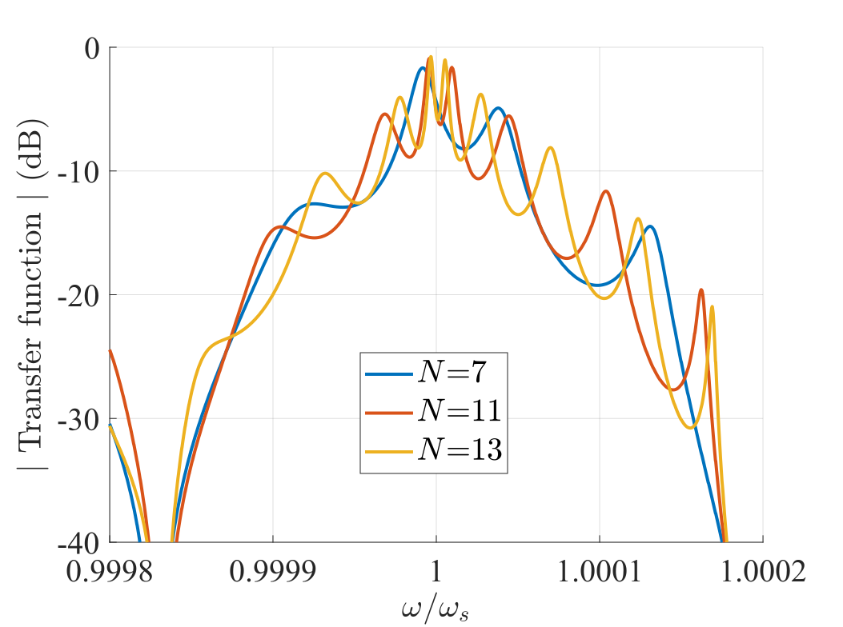
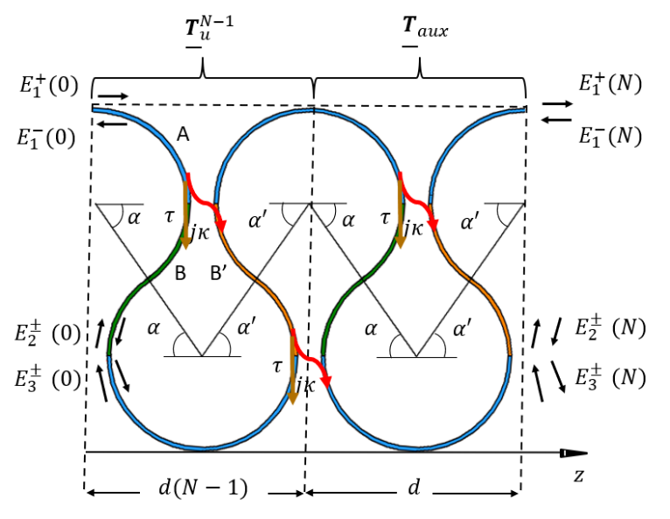
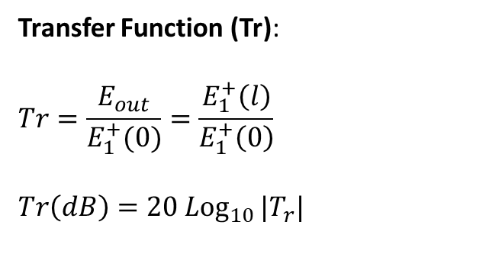
Transfer function for a finite-length SIP-ASOW
Transfer Function (Tr):
$$Tr=\frac{E_{out}}{E_{1}^{+}(0)}=\frac{E_{1}^{+}\left(l\right)}{E_{1}^{+}\left(0\right)}$$
$$Tr\left(dB\right)=20{ Log}_{10 }|T_{r}|$$
There is complete transmission near the SIP frequency.
There is a strong decay on the right side. At that frequency there is a regular band edge (RBE).
The strong decay on the left side is caused by a small band gap in the dispersion diagram of the full structure (not shown here).

Slide 7
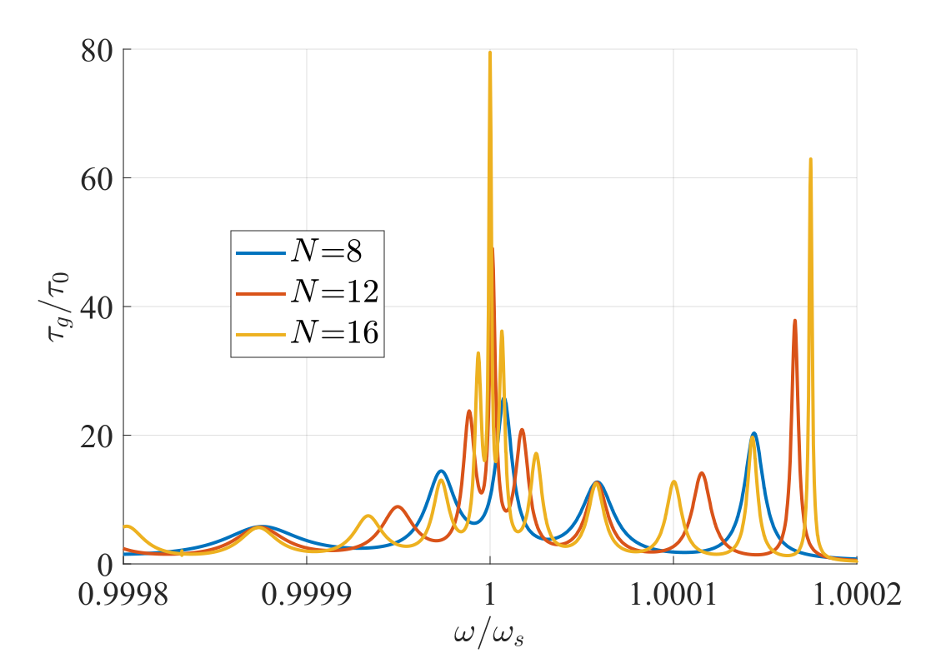
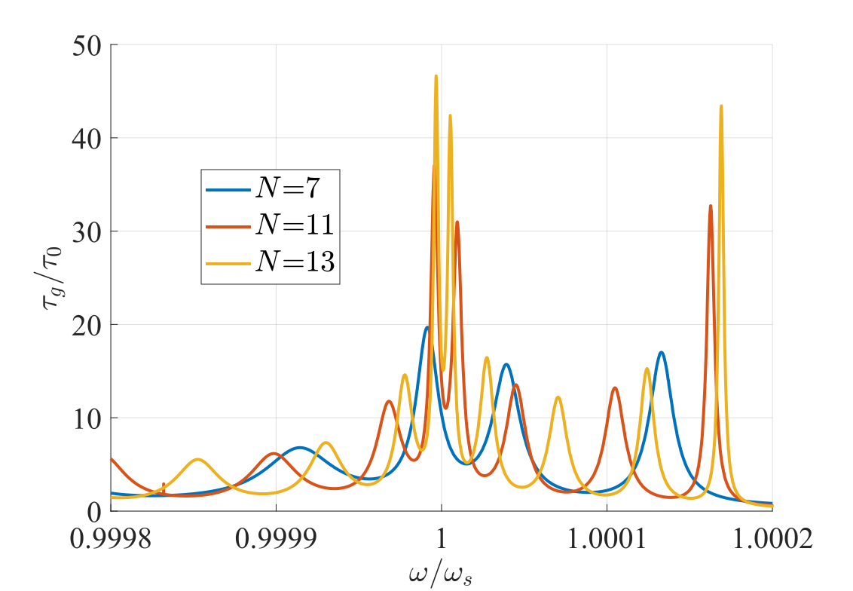
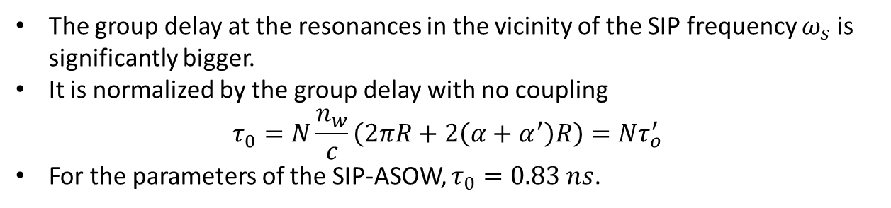
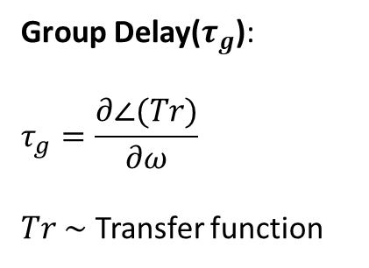
Group Delay for a finite-length SIP-ASOW
Group Delay($τ_{g}$):
$$τ_{g}=\frac{∂∠(Tr)}{∂ω}$$
$Tr \sim$ Transfer function
The group delay at the resonances in the vicinity of the SIP frequency $ω_{s}$ is significantly bigger.
It is normalized by the group delay with no coupling
$$τ_{0}=N\frac{n_{w}}{c}\left(2πR+2\left(α+α^{′}\right)R\right)=Nτ_{o}^{′}$$
For the parameters of the SIP-ASOW, $τ_{0}=0.83 ns$.

Slide 8
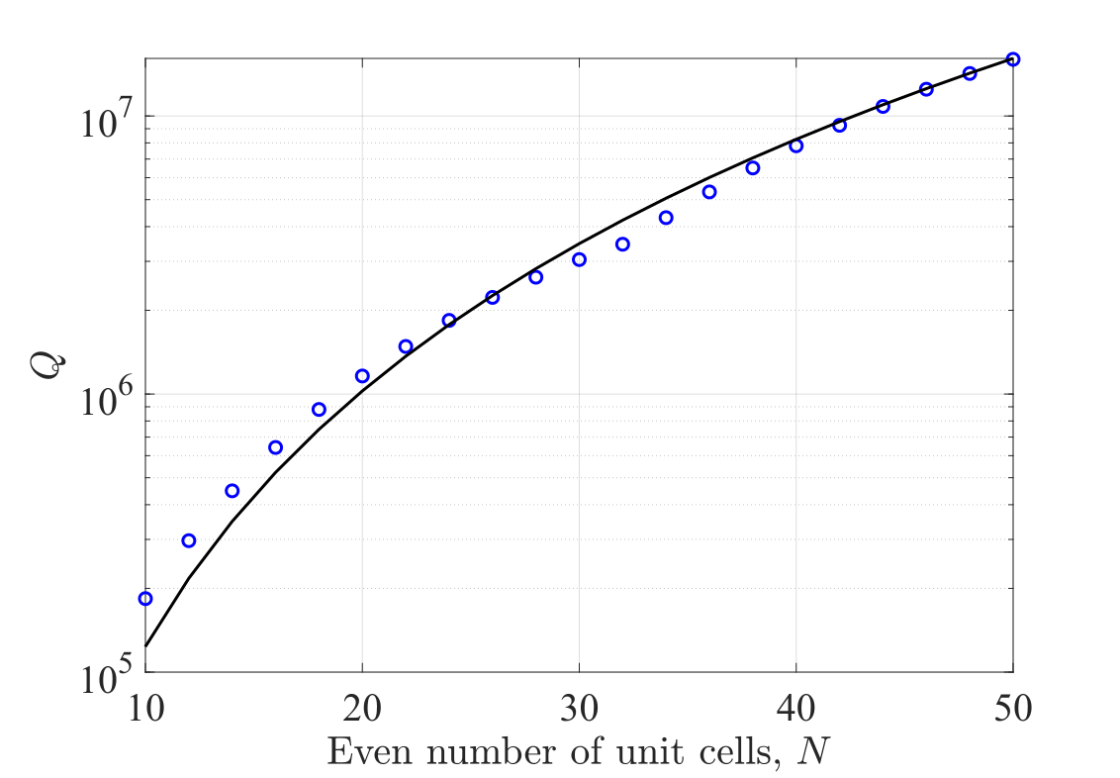
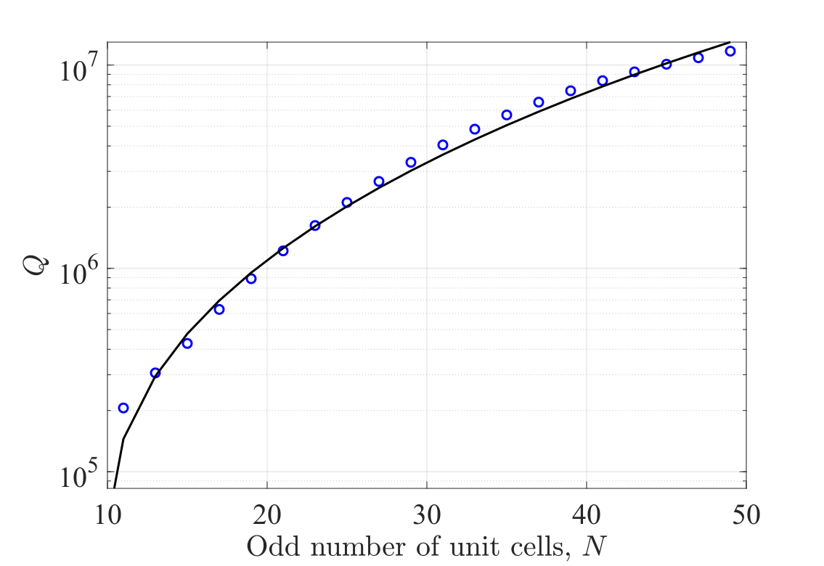
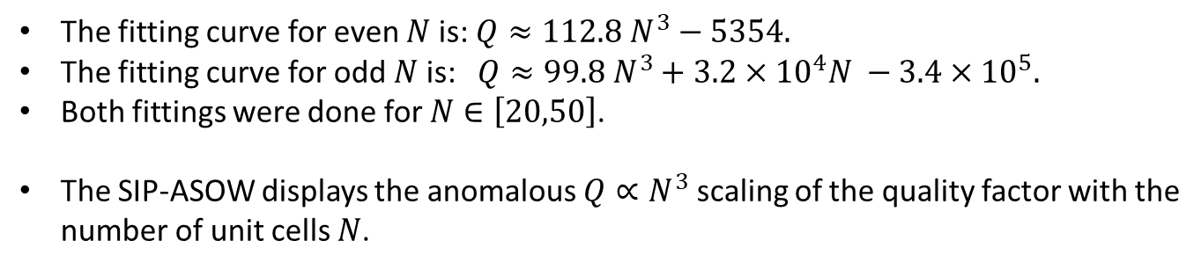
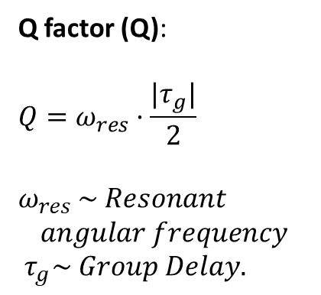
Group Delay for a finite-length SIP-ASOW
Q factor (Q):
$$Q=ω_{res}·\frac{{|τ}_{g}|}{2}$$
$ω_{res}$ $\sim Resonant$ $$angular frequency$$ $τ_{g}\sim Group Delay.$
The fitting curve for even $N$is: $Q≈112.8 N^{3}−5354.$
The fitting curve for odd $N$ is: $Q≈99.8 N^{3}+3.2×{10}^{4}N −3.4×{10}^{5}.$
Both fittings were done for $N∈\left[20,50\right]$.
The SIP-ASOW displays the anomalous $Q∝N^{3}$ scaling of the quality factor with the number of unit cells $N$.

